Slide 1
YUVA YODHA ENERGY TECH HACKATHON 2026 • CHALLENGE: SMART BUILDINGS
PROTOTYPE PITCH DECK
ECOSENSE AI
Intelligent Building Energy Optimizer
AI-Powered Energy Efficiency
Comfort-Aware Optimization
Peak-Demand Management
BUILDING
Commercial Spaces &
Active Thermal Zones
SENSORS / DATA
Occupancy, Temperature,
IAQ & Power Telemetry
AI ENGINE
Random Forest 24h Ahead
Demand Forecasting
OPTIMIZED CONTROL
Peak Shaving, Comfort Guard
& Dynamic Setbacks
➔
➔
➔
TEAM NOVA • Yuva Yodha Energy Tech Hackathon 2026
Team Lead: Dharshine V | vdharshine19@gmail.com
CURRENT STATUS
Functional software simulation and energy decision-support prototype
EcoSense AI • Intelligent Building Energy Optimizer | Yuva Yodha Energy Tech Hackathon 2026 (Smart Buildings) Slide 1 of 10

Slide 2
THE COMMERCIAL BUILDING CHALLENGE
PROBLEM STATEMENT
THE PROBLEM
BUILDINGS OFTEN RUN ON FIXED SCHEDULES — BUT BUILDING CONDITIONS KEEP CHANGING.
FIXED SCHEDULE
➔
VACANT / PARTIAL SPACES
➔
UNNECESSARY HVAC + LIGHTING
➔
ENERGY WASTE + PEAK SPIKES
01 | ENERGY WASTE
Unnecessary HVAC & lighting operation
• HVAC and lighting run full blast regardless of real headcount
• Meeting rooms and empty zones conditioned on rigid timers
• Avoidable baseload drives significant continuous energy loss
02 | PEAK DEMAND
Simultaneous loads create demand spikes
• Midday outdoor heat combined with occupancy spikes grid draw
• Commercial utilities levy steep Maximum Demand charges
• Unmanaged coincidence creates expensive electrical spikes
03 | COMFORT MISMATCH
Static settings fail to adapt to occupancy
• Thermostats hold a flat setpoint regardless of zone density
• Leads to simultaneous overcooling in empty rooms & stuffiness
• Occupant dissatisfaction leads to manual setpoint tampering
"Building managers need smarter, data-driven operating decisions."
EcoSense AI • Intelligent Building Energy Optimizer | Yuva Yodha Energy Tech Hackathon 2026 (Smart Buildings) Slide 2 of 10

Slide 3
INTELLIGENT ENERGY PLATFORM
SOLUTION OVERVIEW
OUR SOLUTION
ECOSENSE AI TURNS BUILDING DATA INTO ACTIONABLE ENERGY DECISIONS.
STEP 1
SENSE
Occupancy + environmental + energy data
• Zone occupancy (headcount)
• Indoor temp (°C) & humidity
• HVAC, lighting, & plug power
STEP 2
PREDICT
24-hour demand forecast
• Random Forest regression
• Diurnal pattern modeling
• Empirical prediction bands
STEP 3
OPTIMIZE
Energy + comfort + peak demand
• Simultaneous 3-way balance
• Strict 22°C–26°C comfort target
• Peak limit clipping (≤175 kW)
STEP 4
RECOMMEND
Actionable operating suggestions
• Dynamic occupancy setbacks
• Daylight harvesting dimming
• Thermal pre-cooling triggers
STEP 5
MEASURE
Baseline vs optimized performance
• Transparent savings analytics
• Real-time kWh & ₹ tracking
• Continuous comfort logging
CURRENT PROTOTYPE: Software simulation + decision support
EcoSense AI • Intelligent Building Energy Optimizer | Yuva Yodha Energy Tech Hackathon 2026 (Smart Buildings) Slide 3 of 10

Slide 4
SYSTEM ARCHITECTURE & PIPELINE
4-LAYER STACK
HOW ECOSENSE AI WORKS
From raw telemetry → prediction → optimized decision
LAYER 1: BUILDING DATA
Occupancy • Temperature • Humidity • IAQ • HVAC • Lighting • Plug Loads
Collects multi-zone telemetry across 5 building zones (~2,300 m²) with real-time signal validation.
▼
LAYER 2: AI FORECAST
Random Forest Regressor • 24-Hour Energy Demand Prediction
Predicts whole-building power draw (kW) with R² ≈ 0.942 and empirical prediction bands (±1.645 × MAE).
▼
LAYER 3: OPTIMIZATION ENGINE
Energy + Comfort + Peak Demand Multi-Objective Balance
Calculates setpoint offsets, shifts loads before peak hours, and enforces 22°C–26°C comfort boundaries.
▼
LAYER 4: DECISION COCKPIT
Interactive Dashboard • Zone Analytics • Scenario Lab • Recommendations
Delivers explainable operating recommendations to facility managers with quantified kWh and ₹ impact.
EcoSense AI • Intelligent Building Energy Optimizer | Yuva Yodha Energy Tech Hackathon 2026 (Smart Buildings) Slide 4 of 10

Slide 5
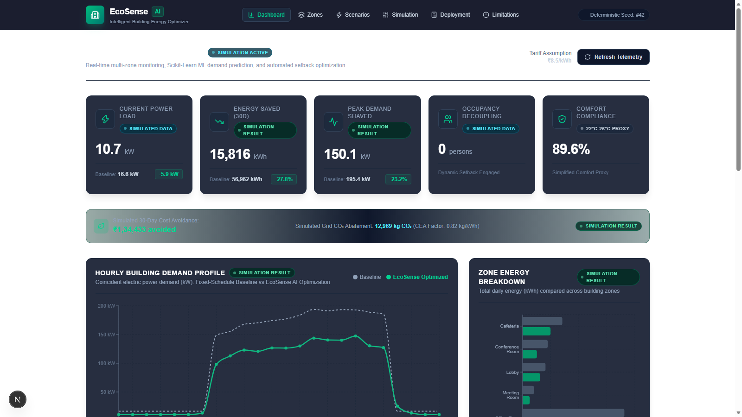
WORKING SOFTWARE PROTOTYPE
LIVE DEMO READY
WHAT WE ACTUALLY BUILT
A fully functional software simulation prototype & analytics decision support platform.
DASHBOARD
Monitor simulated building performance
Live 24h demand timeseries, current zone telemetry, and active optimization status.
ZONE ANALYTICS
Inspect 5 building zones
Granular occupancy, dry-bulb temp, relative humidity, and power breakdown per zone.
SCENARIO LAB
Compare optimization strategies
Test Comfort-First, Aggressive Energy, and Peak-Shaving operational trade-offs.
SIMULATION
Baseline vs EcoSense evaluation
Side-by-side verification of fixed schedule vs intelligent optimized control.
Technology Stack: Next.js (React) • FastAPI • Python • scikit-learn
EcoSense AI • Intelligent Building Energy Optimizer | Yuva Yodha Energy Tech Hackathon 2026 (Smart Buildings) Slide 5 of 10

Slide 6
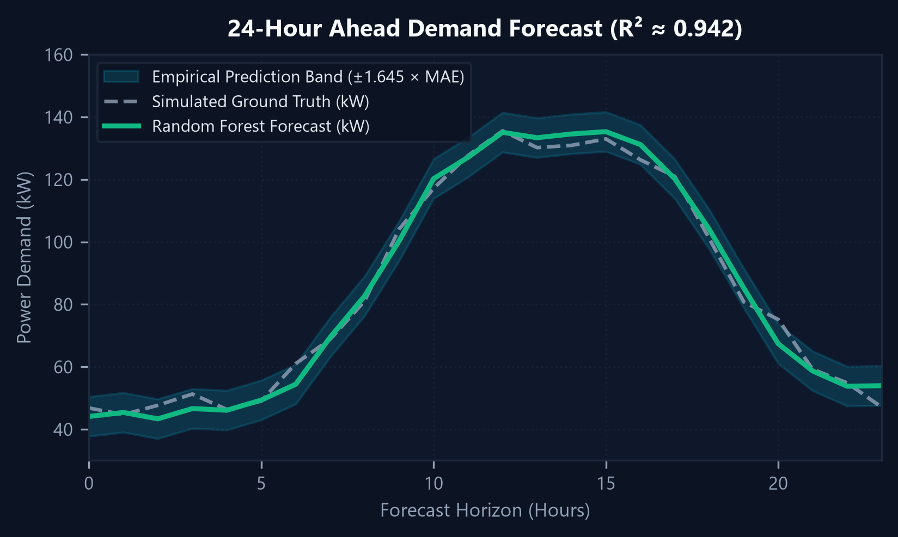
PREDICTIVE MODELING & MULTI-OBJECTIVE TARGETS
RANDOM FOREST REGRESSOR
THE AI ENGINE
SIMULATED DATA ➔ FEATURE ENGINEERING ➔ RANDOM FOREST ➔ 24-HR FORECAST ➔ OPTIMIZATION
MODEL ACCURACY METRICS
R² ≈ 0.942 (94.2% Variance Explained)
MAE ≈ 3.85 kW (Mean Absolute Error)
RMSE ≈ 5.21 kW (Root Mean Squared Error)
Chronological 80/20 train-test split on 30-day simulated telemetry.
OPTIMIZATION TARGETS
• Energy: Minimize active power consumption across all zones
• Comfort: Maintain 22°C – 26°C occupied indoor temperature
• Peak Demand: Keep whole-building draw ≤ 175 kW threshold
Approximate empirical prediction band defined as forecast ± 1.645 × MAE.
EcoSense AI • Intelligent Building Energy Optimizer | Yuva Yodha Energy Tech Hackathon 2026 (Smart Buildings) Slide 6 of 10

Slide 7
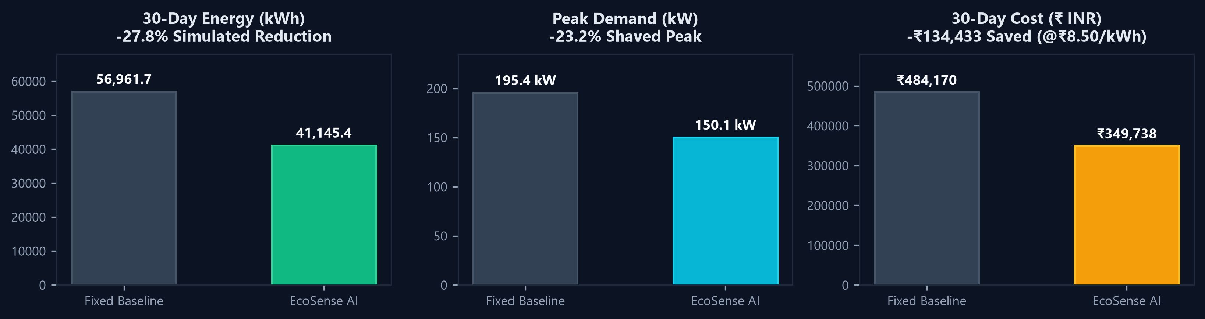
SIMULATION RESULTS & PERFORMANCE EVALUATION
SIMULATION RESULT
WHAT DID THE PROTOTYPE SHOW?
27.8%
SIMULATED ENERGY REDUCTION
Baseline: 56,961.7 kWh ➔ EcoSense: 41,145.4 kWh
Saved: 15,816.3 kWh across 30 days
23.2%
SIMULATED PEAK SHAVED
Baseline: 195.4 kW ➔ EcoSense: 150.1 kW
Shaved: 45.3 kW (Kept ≤ 175 kW threshold)
₹134,433
SIMULATED 30-DAY COST DIFFERENCE
Baseline: ₹484,170 ➔ EcoSense: ₹349,738
Calculated at commercial tariff ₹8.50/kWh
SIMULATION RESULT — NOT MEASURED REAL-WORLD BUILDING DATA | Compared with defined fixed-schedule baseline across 5 simulated zones (~2,300 m²)
EcoSense AI • Intelligent Building Energy Optimizer | Yuva Yodha Energy Tech Hackathon 2026 (Smart Buildings) Slide 7 of 10

Slide 8
COMPETITIVE DIFFERENTIATION & CORE VALUE
WHY WE WIN
WHY ECOSENSE AI?
01 | ENERGY + COMFORT + PEAK
Optimizes all three instead of energy alone.
• Traditional systems often cut energy by sacrificing occupant comfort.
• EcoSense AI strictly guards the 22°C–26°C comfort boundary.
• Simultaneously manages peak demand charges (≤ 175 kW threshold).
02 | PREDICTIVE DEMAND FORECASTING
Forecasts demand before peak periods arrive.
• Proactively anticipates afternoon thermal and occupancy surges.
• Enables smart pre-cooling during low-tariff, low-demand morning hours.
• Prevents reactive throttling when peak demand penalties kick in.
03 | ZONE-AWARE INTELLIGENCE
Different zones receive different recommendations.
• Evaluates conference rooms, cafeteria, and open offices individually.
• Applies dynamic setbacks only to vacant or partially occupied zones.
• Eliminates clumsy whole-building blanket setpoint adjustments.
04 | ACTIONABLE & EXPLAINABLE
Turns predictions into clear operating recommendations.
• Delivers quantified kWh and cost savings for every proposed action.
• Provides transparent rationale for facility manager verification.
• Keeps humans in the loop for safe, accountable supervisory control.
"Not just a dashboard. A decision-support layer for smarter buildings."
EcoSense AI • Intelligent Building Energy Optimizer | Yuva Yodha Energy Tech Hackathon 2026 (Smart Buildings) Slide 8 of 10

Slide 9
IMPLEMENTATION ROADMAP & VALUE REALIZATION
4-PHASE ROADMAP
FROM PROTOTYPE TO REAL BUILDINGS
NOW
SOFTWARE PROTOTYPE
Simulation + ML + optimization + dashboard
• 30-day multi-zone simulation
• Random Forest demand forecasting
• Multi-objective optimization cockpit
NEXT
SENSOR PILOT
Occupancy + temperature + IAQ + energy meters
• IoT sensor deployment in 1 zone
• Validate ground-truth thermal inertia
• Refine empirical prediction models
THEN
BMS INTEGRATION
HVAC + lighting supervisory control
• BACnet / Modbus protocol bridge
• Automated setpoint recommendations
• Supervised closed-loop control
SCALE
MULTI-BUILDING FLEET
Continuous learning + portfolio management
• Cross-building knowledge transfer
• Enterprise portfolio dashboard
• Grid interactive demand response
EXPECTED OPERATIONAL VALUE
• ENERGY: Reduce unnecessary consumption during low/zero occupancy hours.
• PEAK DEMAND: Reduce avoidable afternoon demand spikes to curb maximum demand charges.
• COMFORT: Strictly maintain 22°C–26°C target across all occupied spaces.
• OPERATIONS: Equip facility managers with actionable, explainable operational guidance.
Roadmap represents planned progression. Future phases require physical hardware pilots and BMS integration.
EcoSense AI • Intelligent Building Energy Optimizer | Yuva Yodha Energy Tech Hackathon 2026 (Smart Buildings) Slide 9 of 10

Slide 10
YUVA YODHA ENERGY TECH HACKATHON 2026
CONCLUSION & VISION
BUILDING SMARTER, NOT JUST USING LESS
ECOSENSE AI
Intelligent Building Energy Optimizer
"Turning building data into smarter energy decisions."
27.8%
Simulated Energy Reduction
23.2%
Simulated Peak Shaved
22°C–26°C
Strict Comfort Target Guard
TEAM NOVA • Yuva Yodha Energy Tech Hackathon 2026
Team Lead: Dharshine V | vdharshine19@gmail.com
Challenge: Smart Buildings
CURRENT STATUS
Functional software simulation and decision-support prototype.
Evaluated on 5 commercial zones with 30-day deterministic telemetry.
EcoSense AI • Intelligent Building Energy Optimizer | Yuva Yodha Energy Tech Hackathon 2026 (Smart Buildings) Slide 10 of 10

