Slide 1
Data Literacy with Tableau
Data Literacy with Tableau

Slide 2
KONGU COLLEGE OF ARTS AND SCIENCE, KARUR.

Slide 3
India’s Agricultural Crop Production Analysis (1997-2021)

Slide 4
LEADER: P.Dharani TEAM MEMBERS: T. Gayathri D. Jeya Priya K. Pothiyazhagan K. Renuka R. Tharshini FACULTY MEMBER: Mrs. D. Nathiya M.sc.,B.Ed.,PGDCA

Slide 5
INTRODUCTION: The Captivating realm of India’s agricultural cultivation, providing a comprehensive visual exploration of the key aspects and trends in the agricultural sector. The visual representations, readers can gain valuable insights into crop production, seasonal variations, regional distribution and over all production trends. This visualizations enable intuitive analysis, allowing stakeholders to uncover patterns, indentify areas of growth or concern and make data driven decisions.

Slide 6
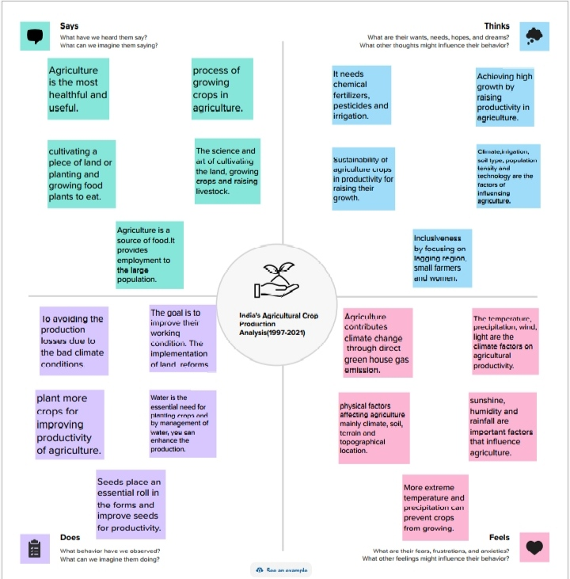
EMPATHY MAP

Slide 7
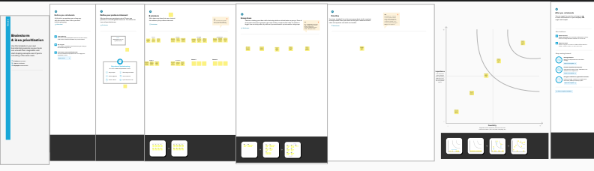
BRAINSTROMING MAP

Slide 8
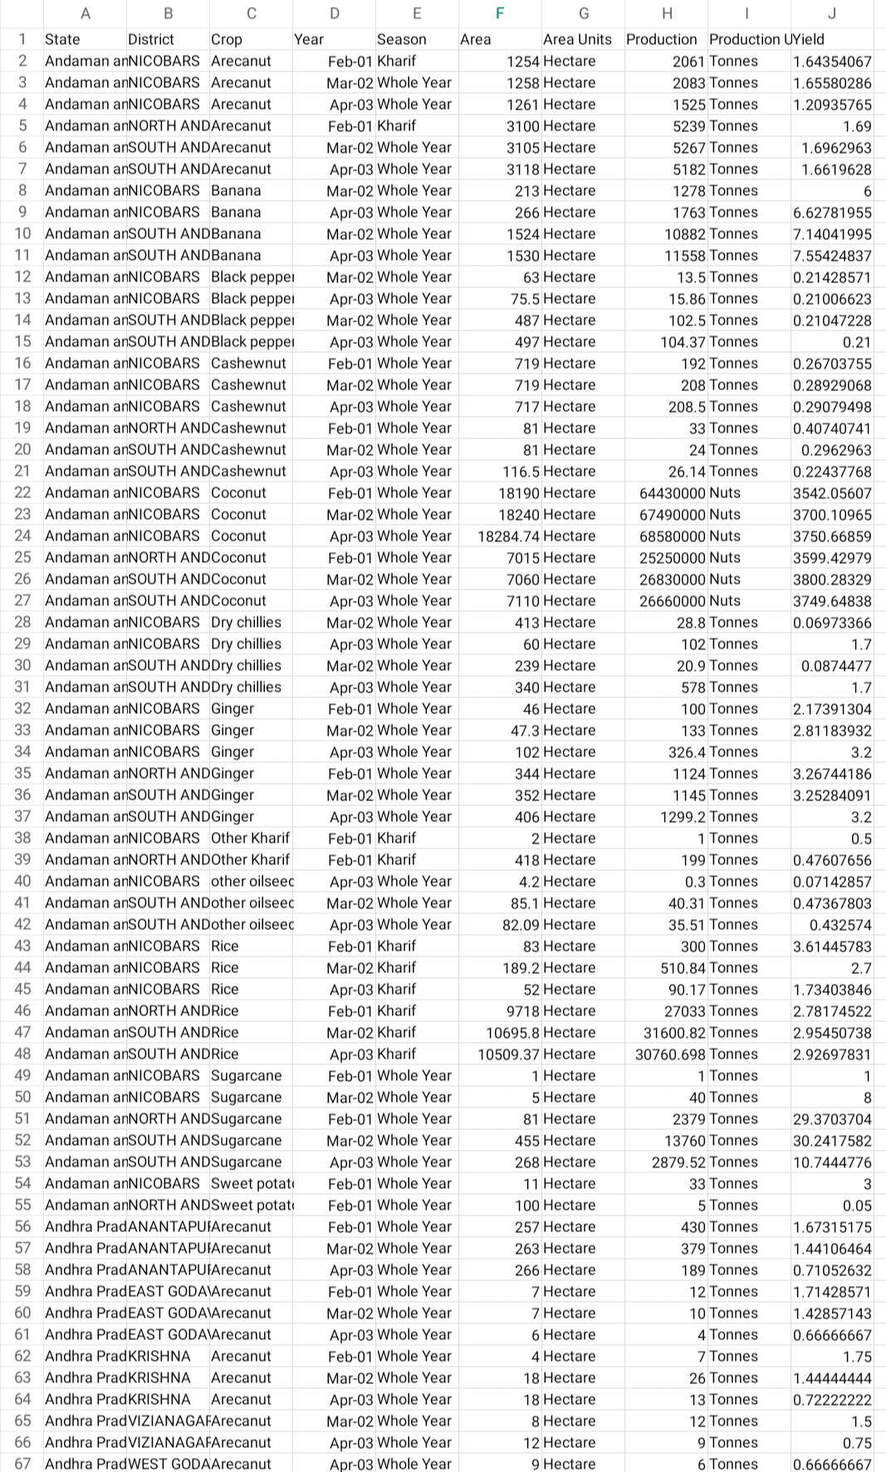
DATA SET

Slide 9
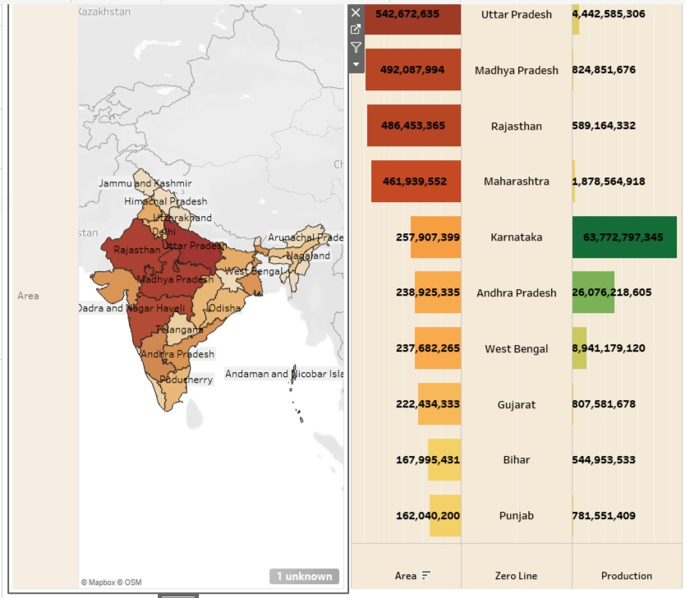
ACTIVITY 01 DASHBOARD 01

Slide 10
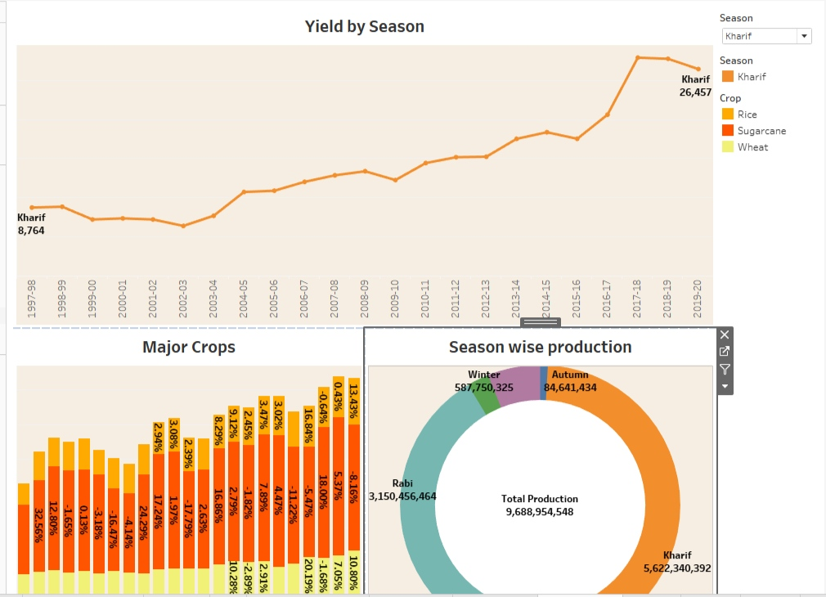
ACTIVITY 02 DASHBOARD 02

Slide 11
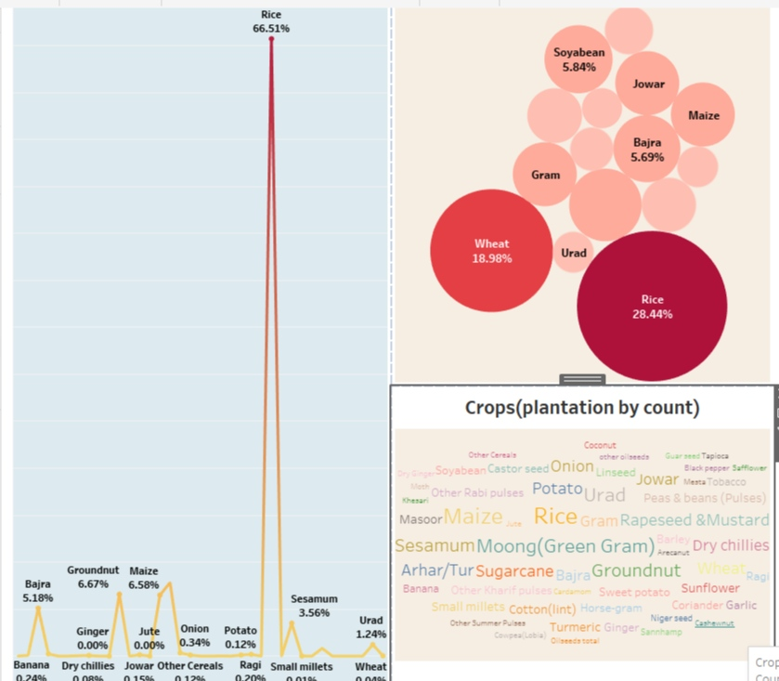
ACTIVITY 03 DASHBOARD 03

Slide 12
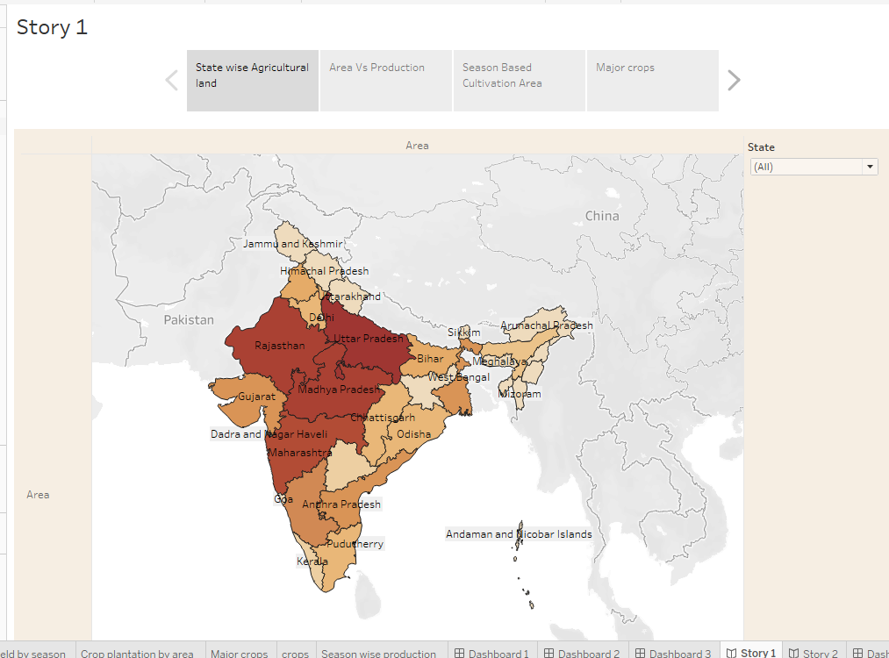
ACTIVITY 04 STORY 01

Slide 13
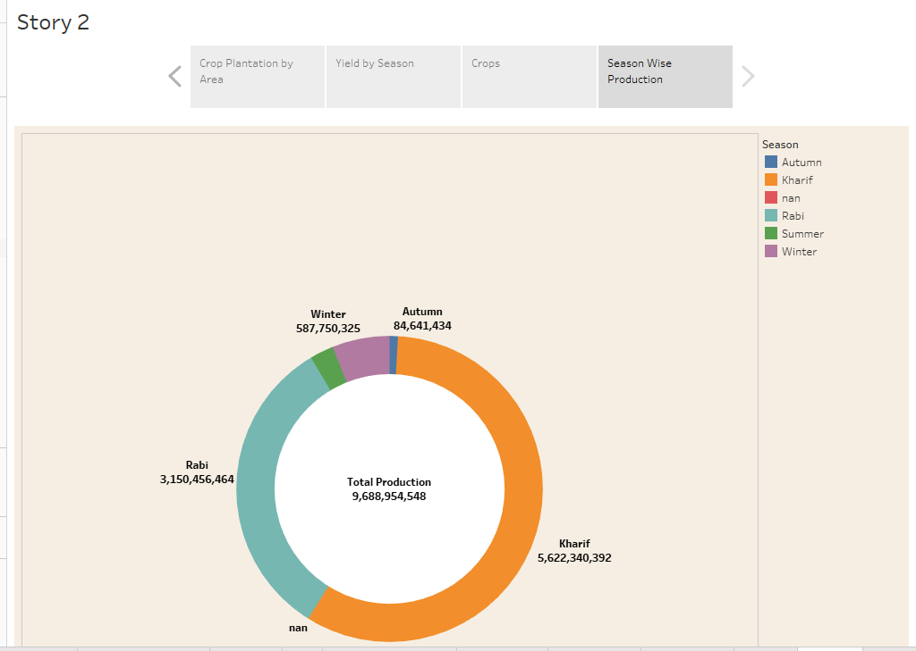
ACTIVITY 05 STORY 02

Slide 14
ADVANTAGES: Agriculture supplies raw material to various agro-based industries like suger, jute, cotton textile and vanaspati industries. Food processing industries are similarly dependent on agriculture. The development of these industries entirely is dependent on agriculture. Agriculture is the backbone of the indian economy and it plays a crucial role in the ensuring food security for the population.

Slide 15
DISADVANTAGES: The type of farming is conducted on a large scale, it can lead a several environmental issues such as deforestation, soil degradation, water pollution and bio diversity loss. Food safety concerns. Agriculture can lead to the depletion of natural resources such as water and soil. It can lead to land degradation and desertification. Possibility of poor quality food production. It is risk to human health.

Slide 16
CONCLUSION
The Agriculture sector is of vital importance for the region. Agriculture has given so much to society but it has its own pros and cons that we can’t over look.
It is under going a process of transition to a market economy , with substantial changes in the social, legal, structural, productive and supply set-ups, as in the case with all other sector of the economy.
India’s Agriculture sector is still very important to the indian economy, although its share of the economy has decreased over the past 50 years.

Slide 17
THANK YOU

