Slide 1
Modern Web Development
Mit Ruby on Rails

Slide 2
Modern Web Development
Ruby
Rack
Sinatra
Rails
Aufbau (MVC)
Model
Routing
Controller
View
Data Access
Active Record Pattern
Associations / Migrations
TDD
Rspec, Minitest, Cucumber
TDD und DHH
Frontend Development
Assets (CSS, JS, Images)
Turbolinks & Websockets
Singlepage Applications
Rails Advanced
Features
Und Gems
Sonstiges
Advanced Ruby
REST-API
Deployment
Klausur

Slide 3
Was sind fixtures?
Einstellungen für die Tests
Datenbankeinträge für die Tests
Ein Mock (Attrappe/Ersatz) für die Datenbank
Eine veraltete Test-Lib
Notes:
B

Slide 4
Welche Tests gibt es bei Rails nicht?
ActionView::Test
ActionController::Test
ActiveSupport::TestCase
ActionDispatch ::IntegrationTest
Notes:
A gibt’s nicht

Slide 5
Wie testet man eine Controller-Umleitung?
get :index assert_redirect_to root_path
post :create assert_response :redirect
get :index assert_redirect_to :index
get_via_redirect :show assert_response :redirect
Notes:
2 Richtige! (A und B)

Slide 6
CSS Präprozessor
SASS – CSS with superpowers
Compass – Compass is a Sass-based Stylesheet Framework that streamlines the creation and maintenance of CSS.
Bourbon - Bourbon is a library of pure Sass mixins that are designed to be simple and easy to use
Less
Less Hat – A kick-ass LESS Mixin Library for Everyone
Stylus
Nib – Mixins for Stylus

Slide 7
Features
SASS
LESS
Stylus
Variables
✓
✓
✓
Nesting
✓
✓
✓
Mixins
✓
✓
✓
Inheritance
✓
~
✓
Import
✓
✓
✓
Color Functions
✓
✓
✓
Operations
✓
✓
✓

Slide 8
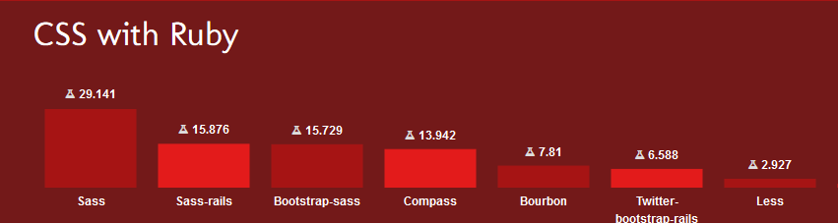
Welchen soll ich nehmen?
Kurze Antwort: Sass
Etwas länger: Sass ist aus verschiedenen Gründen besser, aber wenn du schon zufrieden mit LESS/Stylus bist, dann bleib dabei. Immerhin verwendest du einen Präprozessor.
Lange Antwort: https://css-tricks.com/sass-vs-less/

Slide 9
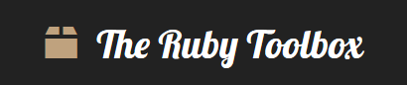
Ruby-Toolbox-Score
100% = jeder Verwendet es
Github Repository: rails/rails
29.713 watchers
12.055 forks
Rubygem: rake
93.593.135 Downloads
Jedes Projekt verwendet rails und rake
relative Popularität 30%
1/3 der Projekte verwenden es
http://awesome-ruby.com/

Slide 10
CSS-Frameworks
Konsistenter Look-And-Feel
Cross-Browser
Cross-Plattform
Responsive
Features
Navigation, Menu
Formulare
Message-Box
Modal-Dialoge
Tabellen
Uvm.

Slide 11
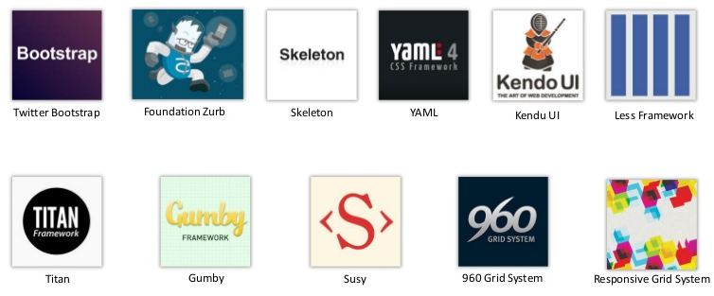
CSS-Frameworks
http://usablica.github.io/front-end-frameworks/compare.html

Slide 12
Grid-System
span 1 | span 1 | span 1 | span 1 | span 1 | span 1 | span 1 | span 1 | span 1 | span 1 | span 1 | span 1
span 4 |  |  |  | span 4 |  |  |  | span 4
span 4 |  |  |  | span 8
span 6 |  |  |  |  |  | span 6
span 12
.container oder .container-fluid
Vertikale Unterteilung durch .row
Geräte column container
xs < 768px ~ auto auto
sm < 992px ~ 62px 750px
md < 1200px ~ 81px 970px
lg >= 1200px ~ 97px 1170px
Verfügbare Klassen (bootstrap):
.col-sm-4, .col-md-7, .col-lg-1

Slide 13

JS-Präprozessoren Transpiler
Ruby/Python/Erlang/Perl/Java/Lisp/Pascal/… to JS
CoffeeScript
Family (10)
Friends (24)
JavaScript – Extensions
Security Enforcing (8)
Static Typing (16)
Dart
Typescript
asm.js
Synchronous to Asynchronous JavaScript Compilers (11)
JavaScript Language Extensions (13)
Tierless languages (client & server) (6)
https://github.com/jashkenas/coffeescript/wiki/List-of-languages-that-compile-to-JS
Notes:
Über 83
Not-Invented Here? Oder JS-Object-Model?

Slide 14

“It had to be done in ten days or something worse than JS would have happened.”
– Brendan Eich
http://wtfjs.com/
http://bonsaiden.github.com/JavaScript-Garden/
http://www.amazon.de/Das-Beste-JavaScript-Douglas-Crockford/dp/3897218763/

Slide 15
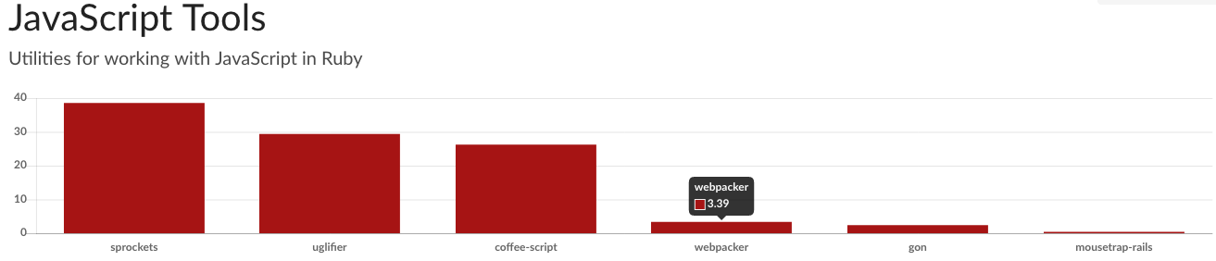
Java Script
ES6 oder Typescript
Klassen
Closure (Syntax und This)
DER JS Standard
JS in Rails:
https://github.com/lukehoban/es6features

Slide 16
Standard Ablauf
DOM
head
Rails App
GET
body
Layout
Partial
Partial
DOM
head
body
Layout
Partial
Partial

Slide 17
Turbolinks
DOM
head
Rails App
GET
body
Layout
Partial
Partial
Vorteile
CSS/JS nicht neu Parsen
Weniger Datenvolumen
Nachteile
Inkompatibel zu einige JQuery-Libs
body
Layout
Partial
Partial

Slide 18
AJAX in Rails
DOM
head
Rails App
GET
body
Layout
Partial
Partial
Body
Layout
Vorteile
Alles ist möglich
Nachteile
Komplexität?
Partial
Partial
JSON
JavaScript

Slide 19
ActionCable
DOM
DOM
DOM
head
Rails App
DOM
GET
head
head
body
head
body
body
body
Layout
Layout
Layout
Partial
Layout
Partial
Partial
Body
Partial
Partial
Partial
Partial
Layout
Partial
Partial
Partial
JSON
JavaScript
Vorteile
Alles ist möglich
Kein HTTP-Overhead
An viele/alle Browser
Nachteile
Komplexität?
Browser/Proxy Support

Slide 20
Ajax - The Rails Way
Form is submitted via a XMLHttpRequest-powered form.
= form_for @message, remote: true do |f|
Server creates or updates a model object
@message = Message.create(message_params) head :created
Server generates a JavaScript response that includes the updated HTML template for the model
$('#messages').prepend('<%=j render @message %>'); $('#<%= dom_id @message %>').highlight();
Client evaluates the JavaScript returned by the server, which then updates the DOM.
https://signalvnoise.com/posts/3697-server-generated-javascript-responses

Slide 21
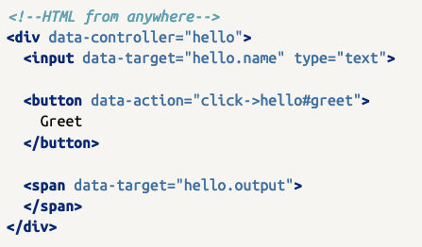
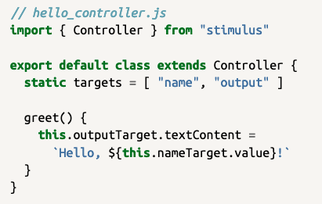
Stimulus JS
Just HTML
Javascript
https://stimulusjs.org/

Slide 22
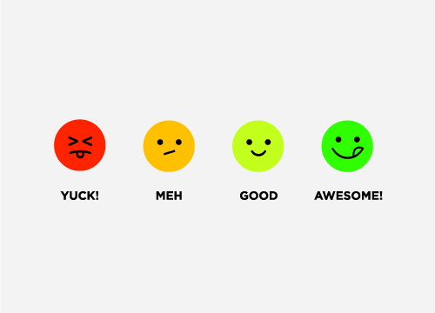
Single Page Applications?
Vorteile
Nachteile
User experience
Server Load
Code-Separation
SEO
Caching
Performance
Write Code Twice

Slide 23
JS Frameworks MVC
Pure JS
Compile To JS
Backbone.js
AngularJS
Ember.js
KnockoutJS
Dojo
React
Vue
JQuery
Vanilla JS
Spine
Dart
GWT
Batman.js
Closure
Elm
AngularDart
Serenade.js
Inesita
http://todomvc.com/
Notes:
64 Applications

Slide 24
REST-APIs in Rails
Rails 5 (API Only)
Rails::API
Optimiert die Rack-Middleware für API-Zugriffe
Keine Serialisierung
ActiveModel::Serializers
JSON
Grape
XML, JSON, und TXT
Eigenes Microframework
Roar
JSON, JSON-HAL, JSON-API and XML
Rabl
JSON, XML, MessagePack, PList, BSON
Jbuilder
Langsam, Nur Json

