Slide 1
Ruby on Rails
Modern Web Development
Notes:
~1h

Slide 2

Wer?
Michael Sprauer
Michael@Sprauer.net
Softwareentwickler seit 2004
C++/Qt
Java
Ruby
DHBW-Absolvent
Familienvater

Slide 3
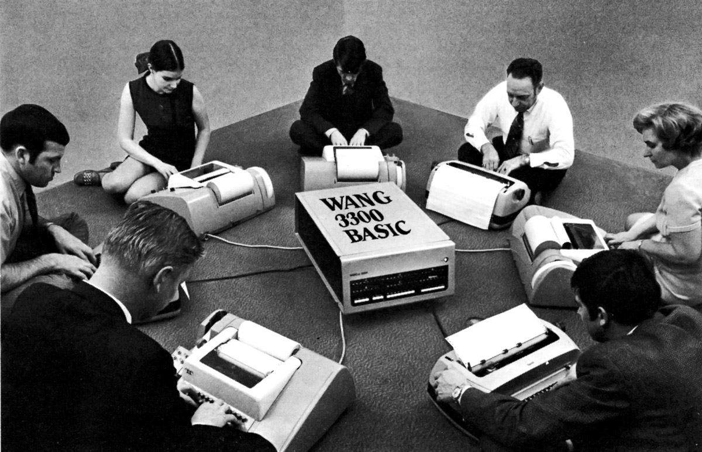
Modern Web Development
Mit Ruby
on Rails

Slide 4
Ruby on Rails
Ruby
Rack
Sinatra
Rails
Aufbau (MVC)
Model
Routing
Controller
View
Data Access
Active Record Pattern
Associations / Migrations
TDD
Rspec, Minitest, Cucumber
TDD und DHH
Frontend Development
Assets (CSS, JS, Images)
Turbolinks & Websockets
Singlepage Applications
Rails Advanced
Features
Und Gems
Sonstiges
Advanced Ruby
REST-API
Deployment
Klausur

Slide 5

Ruby
Bring the fun back to development

Slide 6

Wer?
Yukihiro "Matz" Matsumoto
Chief Architect of Ruby at Heroku in San Francisco
Erster Entwurf aus dem Jahr 1993
“Some may say Ruby is a bad rip-off of Lisp or Smalltalk, and I admit that. But it is nicer to ordinary people. “

Slide 7
Warum?
“My language is perfect. It can do everything.”
Assembler, Kann auch alles!
“language that make me productive while being fun to use”
“Instead of emphasizing the what, I want to emphasize the how part: how we feel while programming”

Slide 8

Historie
24.02.1993 – Erste Erwähnung
21.12.1995 – Erste öffentliche Version V0.95
25.12.1996 – Ruby 1.0
1997 Matz arbeitet Vollzeit an Ruby
Dezember 1998 – Ruby 1.2
August 1999 – Ruby 1.4
September 2000 – Ruby 1.6
2004 – DHH veröffentlicht “Ruby on Rails”
Aktuell: 2.7.0
Notes:
Wie siehts jetzt mit der Relevanz von Ruby aus?

Slide 9
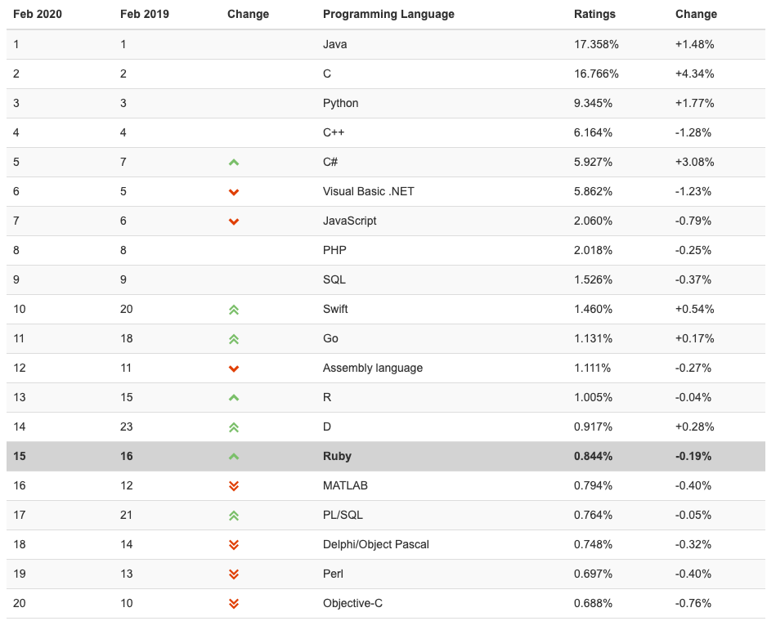
Notes:
http://www.tiobe.com/tiobe-index/

Slide 10
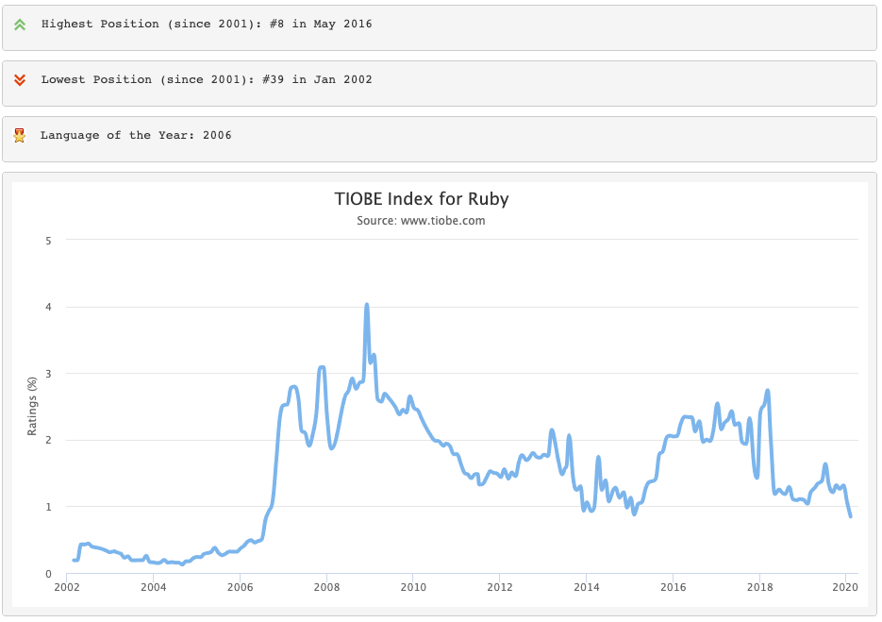
Notes:
http://www.tiobe.com/tiobe-index/ruby/

Slide 11
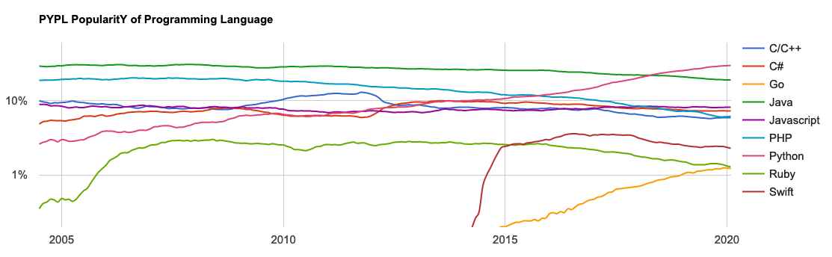
Popularity Index (Pypl)
http://pypl.github.io/PYPL.html CC Attribution 3.0 Unported
Notes:
http://pypl.github.io/PYPL.html

Slide 12
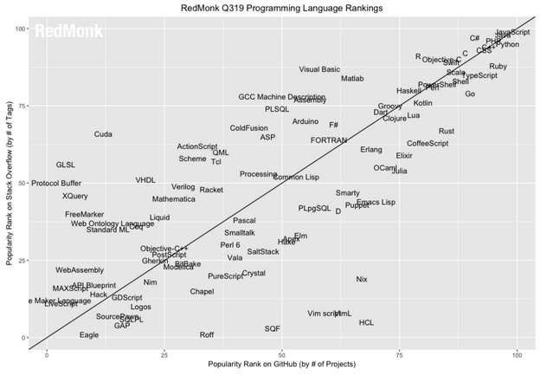
StackOverflow vs. Github
Notes:
Redmonk Index
http://sogrady-media.redmonk.com/sogrady/files/2016/07/lang.rank_.Q316.plot-WM.png

Slide 13
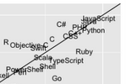
StackOverflow vs. Github

Slide 14












Startup -> Enterprise ready
Airbnb
Crunchbase
Ask.fm
Soundcloud
Bloomberg
Github
Helpling
Zendesk
Groupon
Twitch
Kickstarter
Notes:
https://www.netguru.com/blog/top-34-web-apps-built-with-ruby-on-rails

Slide 15
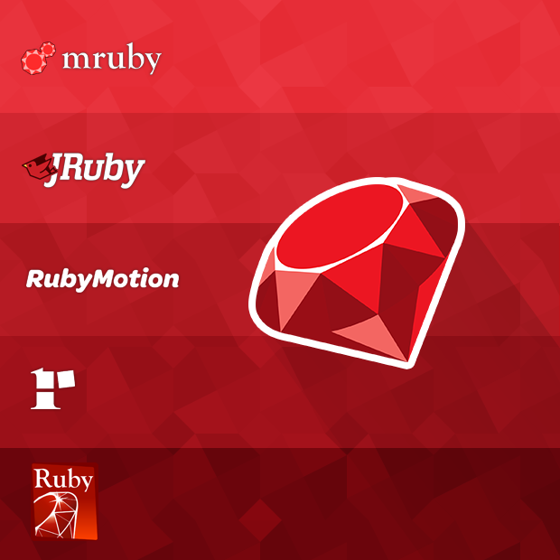
Implementations
MRI
JRuby
Rubinius
mruby
Opal
RubyMotion

Slide 16
Eigenschaften
Menschlich
Technisch
Konsistent
natürlich (Menschlich)
Erweiterbar
General Purpose
Langsam
dynamisch Typisiert
Objekt Orientiert
Funktionale Anteile
Duck-Typing
Interpretiert
Mixins
Open Classes
Closures
Introspection/Reflection/Meta Programming
“Actually, I'm trying to make Ruby natural, not simple.” (Matz, 2000)

Slide 17
Ruby und seine Prinzipien
Principle of:
Least Surprise – geringste Überraschung
Conciseness – Prägnanz
Concistency – Konsistenz
Flexiblility – Flexibilität
TIMTOWTDI – There is more than one way
EIAO – Everything is a Object
Ruby soll den Mensch verstehen, nicht anders herum

Slide 18
Principle of Least Suprise
This is often misunderstood
It‘s not „principle of no surprise“
„surprise“ means „the one in designers‘s eye“
There are good surprises and bad surprises
„least surprise“ means „least bad surprise“
Matz (http://www.rubyist.net/~matz/slides/oscon2003)
Notes:
Actually, I didn't make the claim that Ruby follows the principle of least surprise. Someone felt the design of Ruby follows that philosophy, so they started saying that. I didn't bring that up, actually.

Slide 19
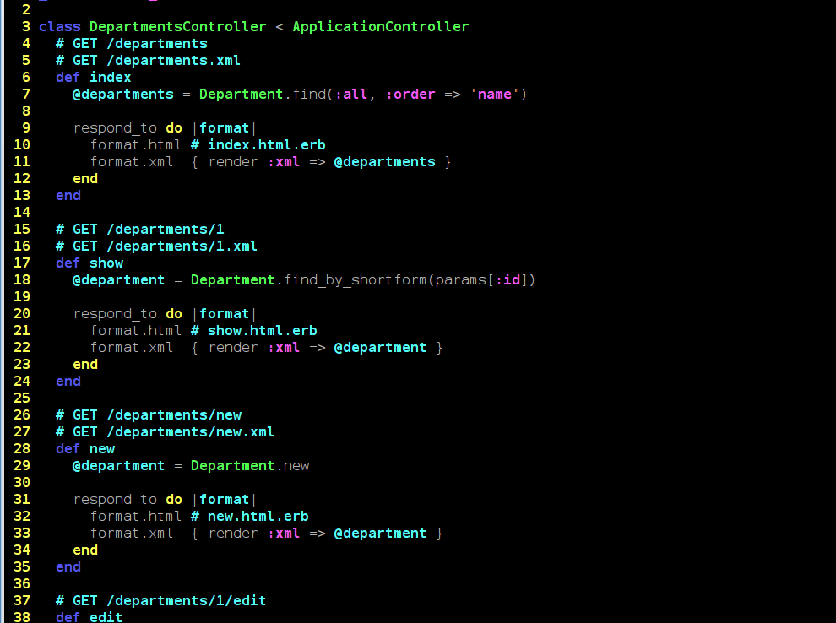
Ruby Syntax

Slide 20
Unterschiede zu anderen Sprachen (C++, Java, PHP, …)
Klammern sind optional (meistens)
Semikolons sind optional (meistens)
Methoden dürfen !, = oder ? enthalten
Train-Wreck-Lines included (Law Of Demeter)
"c,b,b,a".upcase.split(",").uniq.sort
Notes:
Law of Demeter – Don‘t play with your toy‘s toys

Slide 21
Namenskonvention
KONSTANTE
variablen
Klassen und Module
variable_mit_leerzeichen (snake case)
KlasseOderModulMitLeerzeichen (camel case)

Slide 22
Variablen und ihr Scope
var # Lokal
@var # Instanz
@@var # Klasse
$var # Global
Memoization Pattern
variable ||= "Value"
class Klasse
@@klassen_variable = rand(10)
def methode
@@klassen_variable
end
end
a = Klasse.new
b = Klasse.new
a.methode #=> 8
a.methode #=> 8
b.methode #=> 8
class Klasse
def methode
@instanz_variable ||= rand(10)
end
end
a = Klasse.new
b = Klasse.new
a.methode #=> 5
a.methode #=> 5
b.methode #=> 3
class Klasse
def methode
lokale_variable
end
end

Slide 23
Klassen in Ruby
attr_accessor generiert
Getter (attr_reader :name)
Setter (attr_writer :name)
class Person
attr_accessor :name, :age
end
def name
@name
end
def name=(name)
@name = name
end

Slide 24
Klassen in Ruby
me = Person.new
me.name = "Michael"
me.age = 36
fred = Person.new
fred.name = "Fred"
fred.age = 51
fred.age + me.age #=> 87
class Person
attr_accessor :name, :age
def initialize
@name = ""
end
end

Slide 25
Klassen in Ruby
class Song
def initialize(lyrics)
@lyrics = lyrics
end
def sing_me_a_song()
@lyrics.each {|line| puts line }
end
end
happy_bday = Song.new(["Happy birthday to you",
"I don't want to get sued",
"So I'll stop right there"])
happy_bday.sing_me_a_song()

Slide 26
Alles ist eine Klasse
"Ruby ist Cool".include? "ruby" #=> false
"Ruby ist Cool".downcase.include? "ruby" #=> true
5.upto(8).to_a #=> [5, 6, 7, 8]
5.times do |i|
puts i
end
3.downto(1) {|i| puts i}
0.step(10,2) {|i| puts i}
5.times.map {|i| i*2} #=> [0, 2, 4, 6, 8]

Slide 27
Methoden
Keine Unterscheidung zwischen Variable und Methode
Impliziter Rückgabewert (return)
class Klasse
def name
"Matz"
end
def to_s
age = 45
name + " " + age
end
end

Slide 28
Symbol und String
"ruby".object_id
"ruby".object_id
:ruby.object_id
:ruby.object_id
# Conversion
:ruby.to_s
"ruby".to_sym

Slide 29
Hash und Array
Key-Value Store
Array
hash = {key: "value", key2: "value2"}
hash[:key]
hash["key"] = hash[:key2]
hash[:integer] = 23
array = ["String", 42, {hash: 23}, 1337]
array.class
array[1]
array[1] = 42**42

Slide 30
Meta-Magic
module FancyString
def sanitize
self.gsub /[^a-z0-9]+/, ''
end
end
String.include FancyString
s = "Ruby is so *%%&/$* awesome!".sanitize
###############################
s.define_method :nerd do
self.sub "Ruby", "Me"
end
s.nerd
"me?".nerd

Slide 31
Mixins
module Person
def name
"Matz"
end
end
class Student
include Person
end
p = Student.new
p.name

Slide 32
I/O
STDIO
puts oder $stdout.puts
gets
$stderr.puts
Sockets
require 'socket'
s = TCPSocket.new 'bofh.jeffballard.us', 666
puts s.readlines.join "\n"
s.close
Notes:
DEOM

Slide 33
Ruby Block Syntax
A
B
Definition
def foo a=1 yield a
10.times.map{|i| yield i+a} end
Verwendung
foo(2){|i| puts i }
Definition
def foo(a, &block) block.call a 10.times.map{|i| yield i+a} end
Verwendung
foo(1) do |i| puts i end

Slide 34
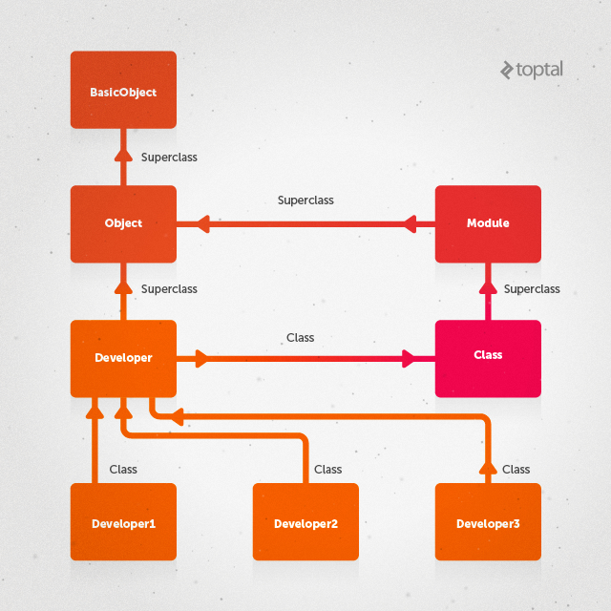

Slide 35
Klassen und Module
 | Klasse | Modul
Instanziierung? | Ja | Nein
Zweck | Erzeugen von Objekten | Mixins, Namespace
Superclass | Module | Object
Besteht aus | Methoden, Konstanten, Variablen und Klassen | Methoden, Konstanten, Variablen und Klassen
Vererbung | Kann erben und vererben | Keine Vererbung
Inlude | Kann nicht includiert werden | Inkludiert Methoden als Instanzmethoden
Extend | Nur über Vererbung | Singletonmethoden
Class.superclass.superclass etc.
Class -> Module -> Object -> BasicObject -> nil

Slide 36
Dynamische Eigenschaften
BasicObject#instance_eval
BasicObject#method_missing
Object#class
Object#clone
Object#define_singleton_methodObject#inspect
Object#instance_variable_get/set/defined?
Object#instance_variables
Object#instance_of? w/o ancestor chain
Object#is_a?(Class) same as #kind_of?
Object#nil?

Slide 37
Dynamische Eigenschaften
Object#respond_to?
Object#send
Module#attr_reader/_writer/_accessor
Module#autoload
Module#class_eval
Module#include (class methods) Module#included
Module#class_variable_get/set/defined?
Module#class_variables
Module#define_method
Module#name

Slide 38
Core und STD-Lib
Array
BasicObject
Object
Class
Module
NilClass
Numeric
String
File, Dir
Enumerator
Exception
ENV
Process/Thread
BigDecimal
Logger
Json
Fiddle (c-extension)
OpenSSL
Net
HTTP/FTP/IMAP/POP/SMTP/TELNET
Open3
SecureRandom
Socket
WIN32OLE
Yml
zlib

Slide 39

Was Ruby sonst noch kann…

Slide 40


https://www.ruby-toolbox.com/
Active Record Plugins
Background Processing
Code Quality
Libraries
Tools
Frameworks
https://awesome-ruby.com/

Slide 41
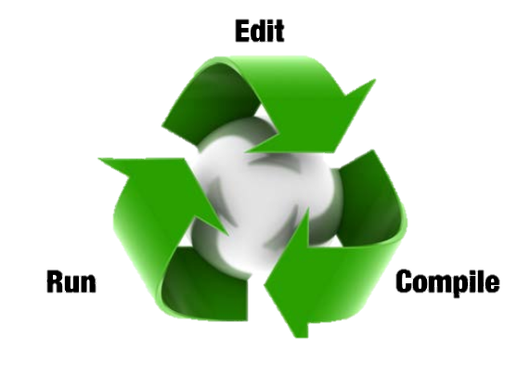
IDE
RubyMine
LightTable
Eclipse/Aptana
Sublime
Netbeans
Emacs
Vi
TextMate

Slide 42


Installation
Native
Virtuell
Unix/Linux/Mac
Rbenv http://rbenv.org/
rvm http://rvm.io/
Windows
WSL2 (google „ruby wsl2“)
http://rubyinstaller.org/
Browser
http://repl.it/languages/Ruby
http://tryruby.org
Docker
Vagrant
docker run --rm -it -v $(pwd):/workdir -p 3000:3000 ruby /bin/bash
git clone https://github.com/DHBW-KA/ruby_on_rails.git
cd ruby_on_rails && vagrant up
gem install pry && pry
Rbenv vs rvm: http://jonathan-jackson.net/rvm-and-rbenv
Notes:
WSL2: https://www.hanselman.com/blog/RubyOnRailsOnWindowsIsNotJustPossibleItsFabulousUsingWSL2AndVSCode.aspx

Slide 43
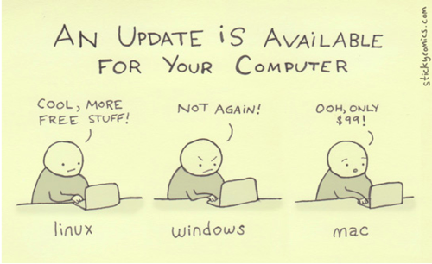
Installation

Slide 44
Übungen
Übung -1
Installiere Vagrant starte ruby:
ruby –version
(sudo) gem install pry
Pry
Übung 0
puts "hello world“
Weitere Übungen
https://github.com/DHBW-KA/rails_01-ruby
http://www.ruby-doc.org/core-2.7.0/
http://www.ruby-doc.org/stdlib-2.7.0/

Slide 45
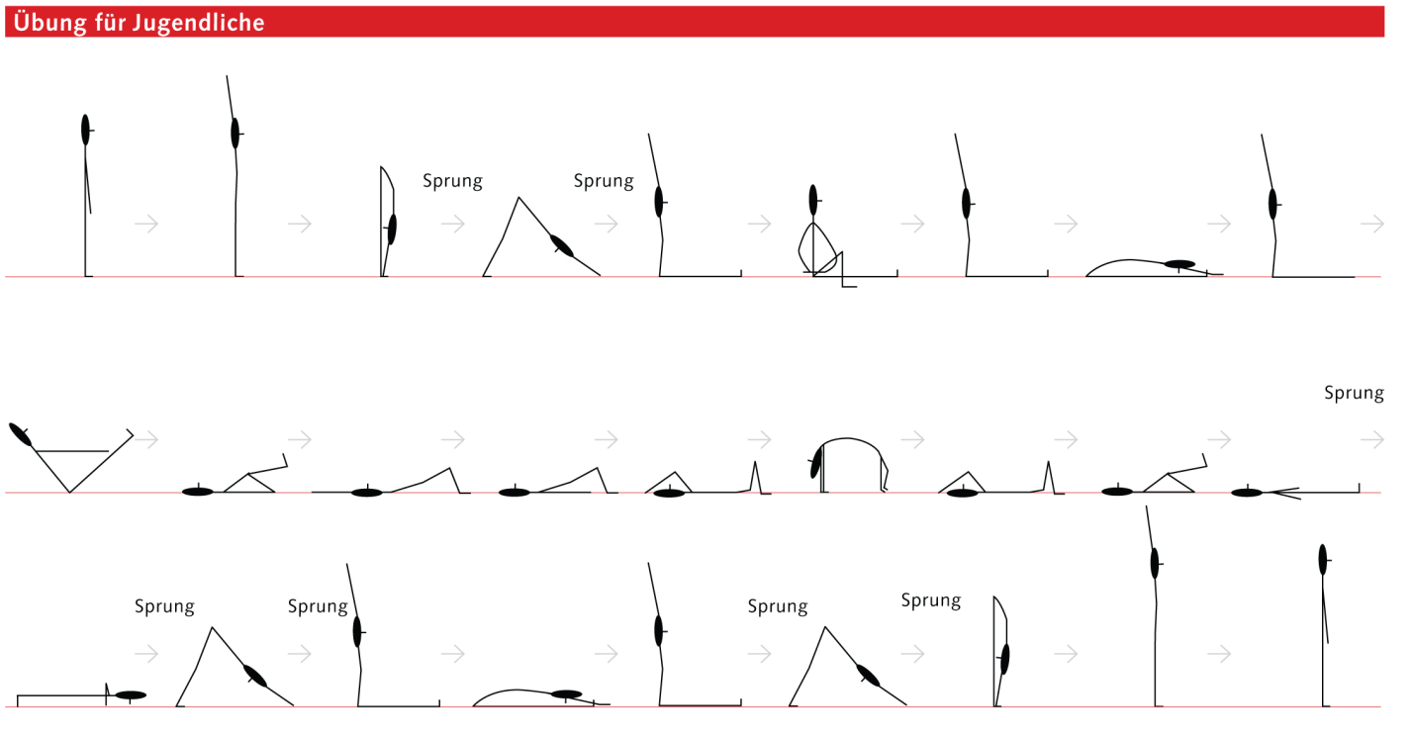
Übungen
Weitere Übungen
http://www.codeeval.com

Slide 46
Vagrant
sudo apt install vagrant git virtualbox
vagrant plugin install vagrant-vbguest
git clone https://github.com/DHBW-KA/ruby_on_rails.git
vagrant up
vagrant ssh

