Slide 1
Modern Web Development
Mit Ruby on Rails
Notes:
50min

Slide 2
Ruby on Rails
Ruby
Rack
Sinatra
Rails
Aufbau (MVC)
Model
Routing
Controller
View
Data Access
Active Record Pattern
Associations / Migrations
TDD
Rspec, Minitest, Cucumber
TDD und DHH
Frontend Development
Assets (CSS, JS, Images)
Turbolinks & Websockets
Singlepage Applications
Rails Advanced
Features
Und Gems
Sonstiges
Engines, Generators, REST-API
DSL, TDD(Mocking)
Deployment
Klausur

Slide 3
Welche Variante ist die schnellste / langsamste?
GET
ActionCable
Ajax
Turbolinks

Slide 4
Wie macht man eine Form zu einer Ajax-Form?
form_for @message, send: :remote
form_for @message, ajax: true
form_for @message, remote: true
form_for @message, send: :ajax
Notes:
C

Slide 5
Welche Formate kann Rails nicht zurückgeben
HTML
Slim
JS
JSON

Slide 6
Generator
Scaffold
Model
Migration, Model, Model-Test und Fixtures
Controller
Route, Controller, View, Assets, Helper und Controller-Test
Mailer
Job
Helper
Minitest
Scaffold
Model
Controller
Feature
Mailer
Nicht vertippen!
Notes:
Nicht vertippen!

Slide 7
Scaffolding
rails generate scaffold Message body:string
Notes:
Nicht vertippen!

Slide 8
Rails Startup
config.rb
config/environment.rb
config/application.rb
config/boot.rb
Setup Gems - Loadpath
Rails laden
Gems aus dem Gemfile laden
Rails configurieren
Rails.application.initialize!
config/initializers/*.rb
run Rails.application

Slide 9
I18n
Translate
I18n.t
Textübersetzung
Localize
I18n.l
Datum und Uhrzeit im Lokalen Format
config/application.rb
config.i18n.default_locale = :de
class ApplicationController
before_action {I18n.locale = current_user.language.isocode}
config/locales
<topic>.en.yml
en: hello: "Hello world"

Slide 10
ActionMailer
rails generate mailer UserMailer
app/views/user_mailer/welcome_email.html.erb
app/views/user_mailer/welcome_email.text.erb
UserMailer.welcome_email(@user).deliver_later
class UserMailer < ApplicationMailer default from: 'notifications@example.com' def welcome_email(user) @user = user mail(to: @user.email, subject: 'Welcome to My Awesome Site') end end

Slide 11
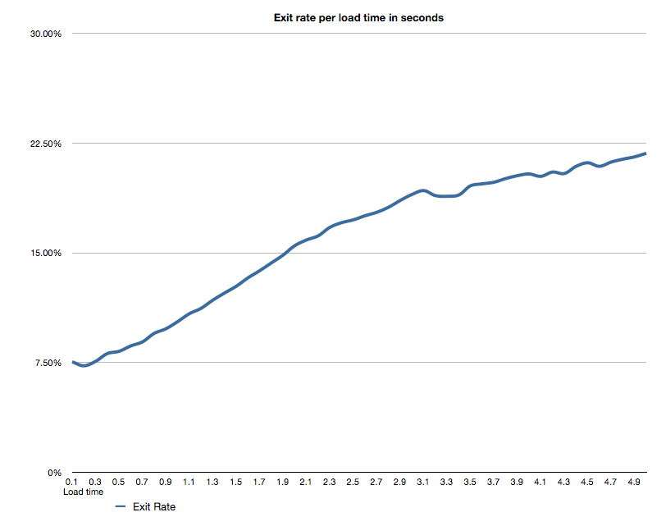
Slow site == bad
Source: wikia

Slide 12
Caching
Page
Action
Fragment
SQL
Assets
Reverse-Proxy
Aus Rails Core 4.0 entfernt actionpack-page_caching
actionpack-action_caching
Muss für die Entsprechende Umgebung eingeschaltet sein:
config/environment/*.rb
Notes:
Page-cache wird von nginx ausgeliefert (Authentication?)
Action-Cache nach den before_action Filters (User-Content?)

Slide 13
Conditional Get
@product = Product.find(params[:id]) if stale? @product render @product end
Client Header | Server Header | Rails
IF_NONE_MATCH | ETAG | cache_key
IF_MODIFIED_SINCE | LAST_MODIFIED | updated_at
Notes:
Vorteil: Browsercache oder Seite gar nicht erst ändern

Slide 14
Fragment Caching
-cache @projects do -each @project.each do |project| h1 = project.name + projekt.version
@projects.cache_key #:class/:id-:updated_at
Version ändern wenn HTML geändert wird
-cache [@projects, 'v1'] do

Slide 15
Custom Caching
def index @values = Rails.cache.fetch "cache_key", expires_in: 10.minutes do Some::Expensive::Api.call end render 'index' end

Slide 16
Cache Stores
config.cache_store =
:memory_store, { size: 64.megabytes }
:file_store, "/path/to/cache/directory„
:mem_cache_store, "cache-1.example.com", "cache-2.example.com"
:null_store

Slide 17
Query Caching
Automatisch
Nur innerhalb eines Requests
Category Load (0.5ms) SELECT "categories".* FROM "categories"
Project Load (0.5ms) SELECT "projects".* FROM "projects" INNER JOIN […]
CACHE (0.0ms) SELECT "projects".* FROM "projects" INNER JOIN […]

Slide 18
Asset Caching
Fingerprinting
Hash des Dateiinhalts im Name
Anderer Inhalt = Anderer Name
CDN-Kompatibel
rake assets:precompile
Statische Auslieferung durch NginX
Kann sogar vorher Komprimiert (gz) werden

Slide 19
Asset Pipeline
Static Assets
config.serve_static_files = true
Compression
config.assets.js_compressor = :uglifier config.assets.css_compressor = :sass
class Application < Rails::Application config.middleware.use Rack::Deflater end
Fingerprinting
config.assets.digest = : true
Notes:
Nicht alles reinwerfen ohne Verstand.
Messen!
Middleware anschauen. Da gibt es noch mehr

Slide 20
Asset Caching - NginX
location ~ ^/(assets|images|javascripts|stylesheets)/ {
expires 1y;
add_header Cache-Control public;
access_log off;
# Look for precompressed .gz files
gzip_static on;
# Some browsers still send conditional-GET requests if there's a
# Last-Modified header or an ETag header even if they haven't
# reached the expiry date sent in the Expires header.
add_header Last-Modified "";
add_header ETag "";
break;
}

Slide 21
Cache Levels
NginX
Rails
Controller
Database
View
CDN
Assets-Caching
Reverse-Proxy
Page-Caching
Action-Caching
SQL-Caching
Conditional Get
Fragment-Caching

Slide 22
ActiveJob
class HardWorkJob < ActiveJob::Base def perform sleep 10.minutes end end
HardWorkJob.set(wait: 1.week).perform_later @user
Backends
Backburner
Delayed Job
Qu
Que
queue_classic
Resque 1.x
Sidekiq
Sneakers
Sucker Punch

Slide 23
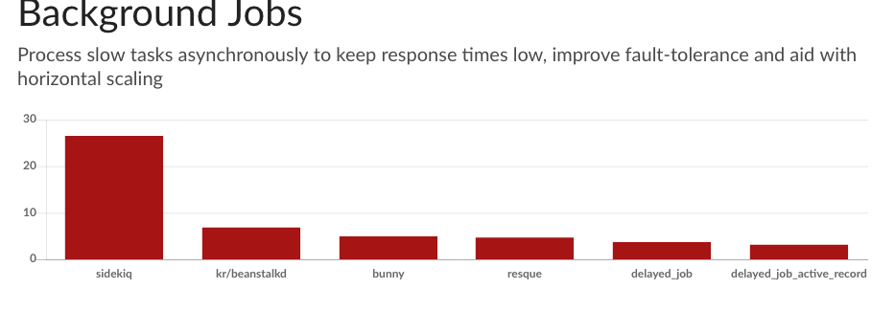
ActiveJob
https://www.ruby-toolbox.com/categories/Background_Jobs

Slide 24
Engines
Getestete Module
Abstraktion
Mit und ohne eigenen Namespace
Routen
Modelle
Controller
Templates
Viele Gems sind Engines
Devise
Spree
RefineryCMS

Slide 25
Engines
rails plugin new admin --mountable
lib/admin/engine.rb
module Admin class Engine < ::Rails::Engine isolate_namespace Admin end end
app/(controllers|models|views|assets)/**
Rails.application.routes.draw do
mount Admin::Engine => "/admin"
end

Slide 26
rubygems
<NAME>.gemspec
require '<name>/version' Gem::Specification.new do |s| s.name = '<NAME>' s.version = MyGemName::VERSION s.date = '2015-03-27' s.summary = "My fancy gem!" s.description = "A simple hello world gem" s.authors = ["Your Name"] s.email = 'your@name.com' s.homepage = 'http://rubygems.org/gems/<name>' s.license = 'MIT' s.files = Dir['{app,config,db,lib}/**/*', 'MIT-LICENSE', 'Rakefile', 'README.md'] s.test_files = Dir['test/**/*'] s.add_dependency 'rails', '~> 4' s.add_development_dependency 'sqlite3', '~> 1' end
lib/<NAME>.rb # Basis Datei
lib/<NAME>/version.rb
module MyGemName VERSION = '0.1.2' end
gem build <NAME>.gemspec
gem push <NAME>-0.1.2.gem # Account erforderlich

Slide 27
Authentication
Devise - A flexible authentication solution for Rails.
warden - General Rack Authentication Framework.
Sorcery - Magical Authentication for Rails 3 and 4.
OAuth2 - A Ruby wrapper for OAuth 2.0
Doorkeeper - An OAuth2 provider for Rails.
api-auth - HMAC-SHA1 wie Amazon Web Services.
https://www.ruby-toolbox.com
https://github.com/markets/awesome-ruby

Slide 28
Authorization
CanCanCan - Continuation of CanCan, an authorization Gem for Ruby on Rails.
Pundit - Minimal authorization through OO design and pure Ruby classes.
Rolify - Role management library with resource scoping
https://www.ruby-toolbox.com
https://github.com/markets/awesome-ruby

Slide 29
ORM/ODM Extensions
Paranoia - ActiveRecord plugin allowing you to hide and restore records without actually deleting them.
Apartment - Multi-tenancy for Rails and ActiveRecord.
Acts As Commentable - Provides a single Comment model that can be attached to any model(s) within your app.
ActsAsTaggableOn - A tagging plugin for ActiveRecord that allows for custom tagging along dynamic contexts.
Awesome Nested Set - Awesome Nested Set is an implementation of the nested set pattern for ActiveRecord models.
https://www.ruby-toolbox.com
https://github.com/markets/awesome-ruby

Slide 30
Verschiedenes
Kaminari - A Scope & Engine based, clean, powerful, customizable and sophisticated paginator
bullet - Help to kill N+1 queries and unused eager loading.
rack-mini-profiler - Profiler for your development and production Ruby rack apps.
Sunspot - A Ruby library for expressive, powerful interaction with the Solr search engine.
Discourse - A platform for community discussion. Free, open, simple.
https://www.ruby-toolbox.com
https://github.com/markets/awesome-ruby

Slide 31
Verschiedenes
Chartkick - Create beautiful Javascript charts with one line of Ruby.
Spree - Spree is a complete open source e-commerce solution for Ruby on Rails.
Sentry - The open source, self-hosted error catcher.
PaperClip - Easy file attachment management for ActiveRecord.
https://www.ruby-toolbox.com
https://github.com/markets/awesome-ruby

