Slide 1
Modern Web Development
Mit Ruby on Rails

Slide 2
Modern Web Development
Ruby
Rack
Sinatra
Rails
Aufbau (MVC)
Model
Routing
Controller
View
Data Access
Active Record Pattern
Associations / Migrations
TDD
Rspec, Minitest, Cucumber
TDD und DHH
Frontend Development
Assets (CSS, JS, Images)
Turbolinks & Websockets
Singlepage Applications
Rails Advanced
Features
Und Gems
Sonstiges
Advanced Ruby
REST-API
Deployment
Klausur

Slide 3
Welcher Schritt ist nicht notwendig?
Schema in db/schema.rb anpassen
Model im app/models Ordner anlegen
rake db:migrate
Migration in db/migrations erzeugen
Notes:
A

Slide 4
has_many <-> has_and_belongs_to_many
HABTM hat keine Join Tabelle
Beide haben eine anonyme Jointabelle
has_many hat eine anonyme Jointabelle
Nur has_many kann zusätzliche Attribute haben
Notes:
D

Slide 5
Welche Vorteile bietet ORMs *NICHT*
Abstraktion
Caching
SQL-Injections vermeiden
DB-Konsistenz
Notes:
C

Slide 6
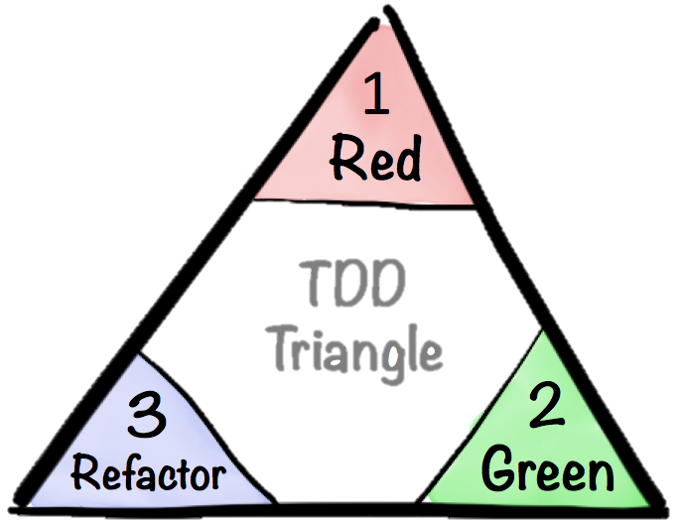

Slide 7
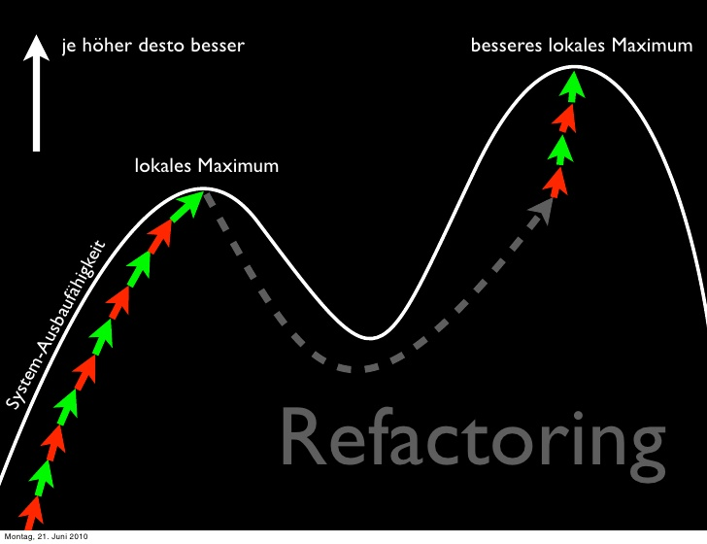

Slide 8
Was muss ein Test-Framework können?
Einfaches Erstellen und Verwalten von Tests
Tests (in zufälliger Reihenfolge) laufen lassen
Nicht noch eine weitere Sprache lernen um Tests zu schreiben
Schnell

Slide 9
Tests in Rails
Minitest
Rails Standard
Unit Testing + Acceptance Test
Programmer Readable
RSpec
Behaviour Driven Development für Ruby
Unit Testing + Acceptance Test
Programmer Readable
Cucumber
Human Readable
Only Acceptance Test

Slide 10
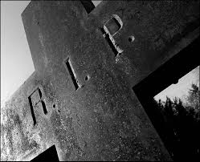
Test::Unit
Ruby 1.9 Built-In
Letztes Ruby 1.9.3
End of Life
February 23 2015

Slide 11
Minitest
require 'minitest/autorun' class TruthTest < Minitest::Test def test_truth assert true end end
rspec is a testing DSL. minitest is ruby. -- Adam Hawkins

Slide 12
RSpec
require 'rspec' describe "Truth" do it 'should be true' do true.should == true end end
rspec is a testing DSL. minitest is ruby. -- Adam Hawkins

Slide 13
Testing Style
Should (Rspec alt)
foo.should eq(bar)
Expect (Rspec neu)
expect(foo).to_eq(bar)
Assert (Minitest)
assert_equal foo, bar
http://betterspecs.org/#expect

Slide 14
Cucumber
Feature: Truth In order to demonstrate cucumber I want to test for truthiness Scenario: Test the truth Given I have a true-value Then It should be true
Feature
Step Definition
Given(/^I have a true\-value$/) do @value = true end Then(/^It should be true$/) do @value.should == true end

Slide 15
Cucumber
Eine weitere Syntax lernen um Tests zu schreiben
Auch von nicht-Programmierern lesbar
Muss aber nicht zwangsläufig das tun was da steht
Schlechte Verwaltung umfangreicher Tests
Wenige Fälle in denen es sinnvoll ist
Kunde will die Tests lesen
Langsamer
Mehr Text zu lesen / zu warten

Slide 16
Is It Fast?
58 Minuten
https://github.com/MichaelSp/rspec_vs_minitest_vs_cucumber
http://brandonhilkert.com/blog/7-reasons-why-im-sticking-with-minitest-and-fixtures-in-rails/

Slide 17
Ein einzelner Testlauf
MRI (Vagrant Linux)
~ 5 Sec
MRI (Windows)
~17 Sec
JRuby (windows)
18-21 Sec
JRuby (Vagrant Linux)
4-14 Min!

Slide 18
Tests In Rails
Test::Unit
Wurde früher in Rails verwendet
Noch aktiv
RSpec
BDD
Etwas Langsamer
Minitest
Rails Built-In
Durch Module erweiterbar; Weniger Magic
http://cheat.errtheblog.com/s/minitest
Cucumber
Noch langsamer
„Natürliche“ Sprache, dadurch etwas aufwändiger
Vergleich:
https://github.com/RubyoffRails/Episode12
“Cucumber makes no sense to me unless you have clients reading the tests. Why would you build a test-specific parser for English?” @dhh

Slide 19
Minitest
<Model>Test < ActiveSupport::TestCase
assert_equal
assert_difference
assert_present
<Controller>Test < ActionControll::TestCase
get :index, delete :destroy, post :create, patch :update
request, response, session, flash
assert_response
assert_redirect_to
assert_template
assert_select
<Integration>Test < ActionDispatch::IntegrationTest
get root_path

Slide 20
Minitest - Model
require "test_helper" class UserTest < ActiveSupport::TestCase def user @user ||= User.new end def test_valid assert user.valid? end end

Slide 21
Minitest - Controller
require "test_helper" class UsersControllerTest < ActionController::TestCase def user @user ||= users :one end def test_index get :index assert_response :success assert_not_nil assigns(:users) end def test_new get :new assert_response :success end end

Slide 22
Fixtures
Pfad: test/fixtures/<model-plural>.yml
manager: name: Big Boss hans: name: Hans Hacker supervisor: manager email: hans@local.host password_digest: <%= BCrypt::Password.create 'admin', cost: 4 %>
Vor dem Test
Direkt in die DB
Keine Validierung
Referenzen durch die Namen
Transaktionen
Schneller als FactoryGirl

Slide 23
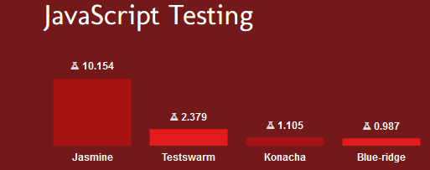
Frontend (JS) Tests
Headless
In Browser
Capybara
Rack_test / Selenium / WebKit
Poltergeist
Teaspoon
QUnit
Mocha.js
Jasmine
Karma
Protractor
Testswarm
https://www.ruby-toolbox.com/categories/javascript_testing

Slide 24

Capybara
Gemfile
gem 'capybara'
gem 'capybara_minitest_spec' # optional
Test_helper.rb
require 'capybara/rails' class ActionDispatch::IntegrationTest include Capybara::DSL end
Capybara.default_driver = :rack_test # default, no JS Capybara.default_driver = :selenium # slower, with JS Capybara.default_driver = :webkit # headless, with JS
test 'can login' do visit login_path fill_in 'Name', with: 'admin' fill_in 'Password', with: 'admin' click_on 'Submit' page.has_content? 'Login Successful' click_on 'Logout' page.has_content? 'Logged out' end

Slide 25
Capybara Cheat-Sheet
visit('/projects')
visit(post_comments_path(post))
Clicking Links and Buttons
click_link('id-of-link')
click_link('Link Text')
click_button('Save')
click('Link Text') # Click either a link or a button
click('Button Value')
Interacting with Forms
fill_in('First Name', :with => 'John')
fill_in('Password', :with => 'Seekrit')
fill_in('Description', :with => 'Really Long Text…')
choose('A Radio Button')
check('A Checkbox')
uncheck('A Checkbox')
attach_file('Image', '/path/to/image.jpg')
select('Option', :from => 'Select Box')
Scoping
within("//li[@id='employee']") do
fill_in 'Name', :with => 'Jimmy'
end
within(:css, "li#employee") do
fill_in 'Name', :with => 'Jimmy'
end
within_fieldset('Employee') do
fill_in 'Name', :with => 'Jimmy'
end
within_table('Employee') do
fill_in 'Name', :with => 'Jimmy'
end
Querying
page.has_xpath?('//table/tr')
page.has_css?('table tr.foo')
page.has_content?('foo')
page.should have_xpath('//table/tr')
page.should have_css('table tr.foo')
page.should have_content('foo')
page.should have_no_content('foo')
find_field('First Name').value
find_link('Hello').visible?
find_button('Send').click
find('//table/tr').click
locate("//*[@id='overlay'").find("//h1").click
all('a').each { |a| a[:href] }
Scripting/Debugging
result = page.evaluate_script('4 + 4');
save_and_open_page
Asynchronous JavaScript
click_link('foo')
click_link('bar')
page.should have_content('baz')
page.should_not have_xpath('//a')
page.should have_no_xpath('//a')
XPath and CSS
within(:css, 'ul li') { ... }
find(:css, 'ul li').text
locate(:css, 'input#name').value
Capybara.default_selector = :css
within('ul li') { ... }
find('ul li').text
locate('input#name').value

Slide 26
Demo Sourcen
https://github.com/DHBW-KA/rails_tdd

Slide 27
Übung
https://github.com/DHBW-KA/Rails-Klausur-2016

Slide 28

Is TDD Dead?
RailsConf 2014 – Keynote
TDD is Dead
Long Live Testing
TDD and Confidence
Code Confidence is good
TDD doesn‘t work allways
Test-induced design damage
TDD may lead to bad SW-design
But design is a decision
Feedback and QA
Trade-offs to TDD
Costs of Testing
Can you do too much testing?
Value tests more than functional code?
Answering Questions
Martin Fowler
Kent Beck
David Heinemeier Hanson
http://martinfowler.com/articles/is-tdd-dead/
Notes:
DHH: „TDD is Dead“ - https://www.youtube.com/watch?v=9LfmrkyP81M
Gist: https://gist.github.com/dhh/4849a20d2ba89b34b201

