Slide 1
Decoding speech comprehension in ESL learners using Temporal Response Function (TRF)

Slide 2
Aim & Introduction
Several linguistic features affecting speech comprehension (e.g., phonemes, semantics, word order, sentence structure)
Neural activities induced from discrete stimuli were commonly used in the experiments (Di Liberto et al., 2015).
Word onset, speech envelope, and those linguistic features had an effective influence when using Temporal response function (TRF) to decode EEG data (Brodbeck et al., 2022)
Aim: To use TRF to decode speech comprehension in Mandarin native speakers who are ESL learners

Slide 3
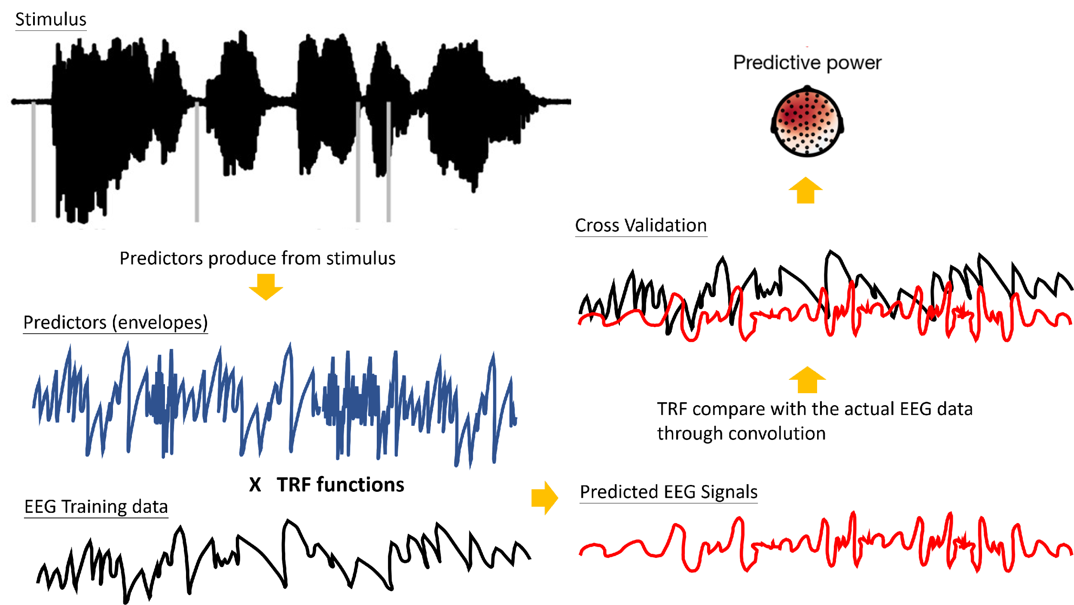
Temporal Response Function (TRF)
Ting-hsin Yen, and Chun-hsien Hsu. ‘Methods of exploring the relationship of using computational model to decode speech comprehension mechanism.’ Poster presented at 2023 Annual Meeting of Taiwan Society of Cognitive Neuroscience. Taoyuan, Taiwan

Slide 4
Stimuli & Procedure
Stimuli:
Audiobook: Alice’s Adventures in Wonderland Chapter one
2,129 words, 12 tapes, lasted 12.4 minutes
Procedure (for Natives & ESLs)
Repeat 12 times
Listen to Alice Chapter.1 tape
Answer a comprehension question
Brodbeck et al., 2022 & Bhattasali et al., 2020

Slide 5
Participants (EEG)
Natives
EEG recordings: Open Alice EEG dataset (Bhattasali et al., 2020)
N = 33 native English speaker (Mage= 20.30 yrs)
Sampling rate: 100 Hz (down sample from 500Hz)
EEG Cap: 61 channels
Filter: 5 ~ 20 Hz
ESLs
EEG was recorded from NCU, Taiwan
N = 26 native Mandarin speaker adults (Mage= 22.25 yrs)
Sampling rate: 100 Hz (down sample from 1000Hz)
EEG Cap: 64 channels
Filter: 5 ~ 20 Hz

Slide 6
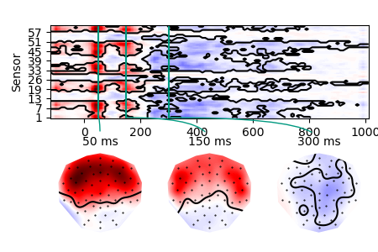
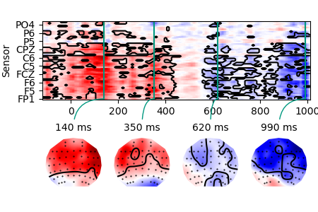
Envelope (one sample t-test)
Natives: α = 0.05, 33 clusters, p < .001
n-sensors tstart tstop duration v p sig
44 -0.12 0.28 0.4 2475.7 0.0001 ***
55 0.19 1.02 0.83 -5495.3 0 ***
ESLs:
α = 0.05, 32 clusters, p < .001
n-sensors tstart tstop duration v p sig
51 -0.12 0.45 0.57 3995.8 0 ***
36 0.56 0.82 0.26 -612.63 0.0176 *
40 0.81 1.02 0.21 -968.33 0.0063 **
Ting-hsin Yen, and Chun-hsien Hsu. ‘Methods of exploring the relationship of using computational model to decode speech comprehension mechanism.’ Poster presented at 2023 Annual Meeting of Taiwan Society of Cognitive Neuroscience. Taoyuan, Taiwan

Slide 7
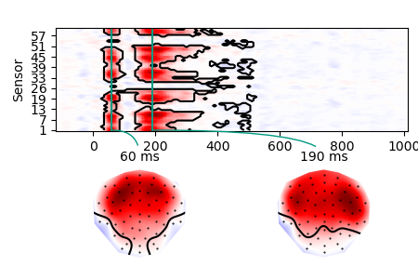
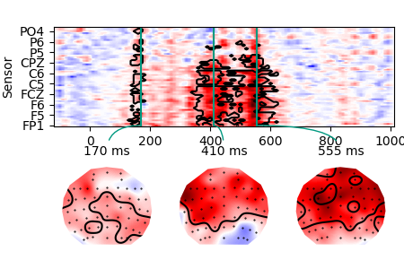
Word onset (one sample t-test)
Natives: α = 0.05, 74 clusters, p < .001
n-sensors tstart tstop duration v p sig
54 0.03 0.42 0.39 3156.8 0 ***
36 0.37 0.53 0.16 -374.92 0.042 *
ESLs: α = 0.05, 49 clusters, p < .001
n-sensors tstart tstop duration v p sig
41 0.13 0.19 0.06 227.91 0.0185 *
46 0.34 0.63 0.29 1810.7 0 ***
Ting-hsin Yen, and Chun-hsien Hsu. ‘Methods of exploring the relationship of using computational model to decode speech comprehension mechanism.’ Poster presented at 2023 Annual Meeting of Taiwan Society of Cognitive Neuroscience. Taoyuan, Taiwan

Slide 8
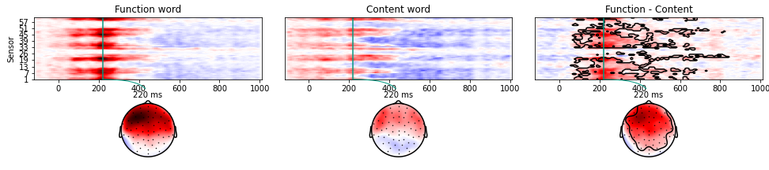
Lexicality (Natives, paired t-test)
Natives:
n = 33, α = 0.05, 55 clusters, p < .001
n-sensors tstart tstop duration v p sig
57 0.06 0.56 0.5 3443.3 0 ***
37 0.55 0.85 0.3 506.42 0.0124 *

Slide 9
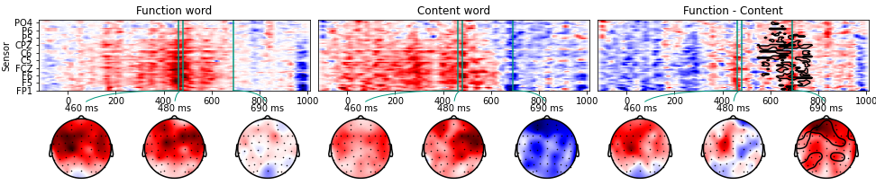
Lexicality (ESLs, paired t-test)
ESLs: n = 26, α = 0.1*, 93 clusters, p = .009
n-sensors tstart tstop duration v p sig
49 0.55 0.78 0.23 606.72 0.0089 **

Slide 10
Conclusion
The TRF results of the ESLs showed a different pattern with the natives
Envelope: ESLs showed a longer and slower response (frontal area)
Onset: ESLs presented a more significant longer response
Lexicality (non-lexical - lexical): ESLs presented a delayed and shorter response
Summary: TRFs shown by ESLs indicated that comprehending speeches in the second language might require more effort to parse linguistic information.

