Slide 1
Multi-Scale Transformer-CNN Network for Brain Tumor Segmentation and Survival Prediction
Under the guidance of Dr. Geeta S
DHEERAJ REDDY 22BCE1257
VARA ANJAN 22BCE1750
JAYA MADHAV 22BCE1754

Slide 2
Introduction:
Why is Brain Tumor Segmentation & Survival Prediction Important?
Brain tumors, especially gliomas, require accurate segmentation for diagnosis and treatment.
Manual MRI segmentation is time-consuming and subjective, leading to inconsistent results.
Predicting patient survival time helps doctors personalize treatment plans.
Challenges in Brain Tumor Segmentation
Tumor Variability: Differences in size, shape, and location make segmentation difficult.
CNN Limitations: Struggles to capture global context.
Transformer Limitations: Cannot effectively extract local features.
Existing U-Net Variants: Lack multi-scale feature integration for better segmentation.
How Does This Paper Solve These Problems?
Incorporates Multi-Scale Transformer Convolution (MTC) blocks in skip connections to combine local & global features.
Uses Swin Transformer blocks to improve long-range dependency capture.
Outperforms state-of-the-art segmentation & survival prediction methods.

Slide 3
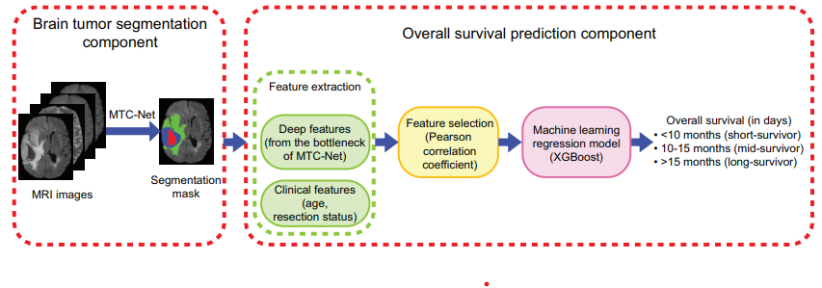
Figure 1: Overview of TCSS comprising a brain tumor segmentation
component followed by an overall survival prediction component.

Slide 4
Related Work:
Traditional Methods:
Handcrafted radiomic features for survival prediction.
Classical ML models (Random Forest, Linear Regression) lack deep feature extraction.
Deep Learning-Based Approaches:
CNNs (U-Net, nnU-Net) capture local details but miss global context.
Transformers (Swin-Unet, TransBTS) capture global dependencies but lack fine detail.
Hybrid models exist but lack multi-scale feature integration.
MTC-Net solves these issues by combining CNN & Transformer features effectively.
Key Differences in This Work
First to incorporate Multi-Scale Transformer Convolution (MTC) blocks into skip connections.
Combines CNN's local feature extraction with Transformer's global feature learning.
Uses deep features instead of handcrafted radiomic features for survival prediction.

Slide 5
Proposed Method – Overview:
How MTC-Net Works?
Step 1: Extracts multi-scale local features from the MRI scan using a CNN-based encoder.
Step 2: Uses Multi-Scale Transformer Convolution (MTC) blocks to:
Enhance feature representation by integrating local & global features.
Capture tumor size, shape, and location variations effectively.
Step 3: Uses Swin Transformer blocks to model long-range dependencies, improving segmentation accuracy.

Slide 6
Multi-Scale Transformer Convolution (MTC)
Why Do We Need MTC?
Problem: Training data contains annotation errors due to complex image manipulations.
Example: A subtle tampering region might be mislabeled, confusing the model.
Impact: Traditional models blindly trust incorrect labels, leading to poor learning.
Solution: Instead of relying on fixed labels, MTC adjusts uncertainty dynamically.
Divisional Structure
Detects and corrects mislabeled regions dynamically.
Prevents the model from overfitting to incorrect annotations.
Enhances reliability by refining predictions iteratively.

Slide 7
Multi-Scale Transformer Convolution (MTC)
How MTC Improves Model Learning
Detects & Fixes Noisy Labels: Assigns low confidence to incorrectly labeled pixels.
Prevents Overconfidence in Wrong Predictions: Stops the model from making high-confidence incorrect decisions.
Learns from the Most Reliable Data: Prioritizes correct labels, reducing false positives.
Key Benefits of MTC
More Robust to Noisy Labels.
Fewer False Positives & Negatives.
Improves Generalization to Real Data.
Compatible with Any IMD Model.

Slide 8
MTC-Guided Prediction Refinement (MTC-PR).
Problem: Common Errors in IMD
Over-Segmentation: The model detects too much manipulation, including real areas.
Under-Segmentation: The model misses manipulated regions, reducing accuracy.
Phantom-Segmentation: The model creates false positives, labeling untouched areas as tampered.
How MTC-PR Refines Predictions
Corrects Over-Segmentation: Reduces detection of false tampered regions.
Fixes Under-Segmentation: Ensures smaller manipulated regions are correctly detected.
Removes Phantom-Segmentation: Eliminates false positives in real areas.

Slide 9
MTC-Guided Prediction Refinement (MTC-PR).
How MTC-PR Improves Segmentation
Uses uncertainty maps to detect and correct misclassified regions.
High-uncertainty areas are re-evaluated and refined for better accuracy.
Correctly classified areas remain unchanged, preventing unnecessary adjustments.
Key Benefits of MTC-PR
More accurate and reliable segmentation.
Reduces false positives and false negatives.
Improves generalization to unseen manipulations.
Works seamlessly with different IMD architectures.

Slide 10
Key Novel Contributions
Advancements in Brain Tumor Segmentation & Survival Prediction:
Traditional segmentation models struggle with capturing both local and global tumor features, leading to errors. This work introduces three key innovations that significantly improve segmentation accuracy & survival prediction.
Modeling Both Local & Global Features
Local Features (CNNs): Captures fine tumor details.
Global Features (Transformers): Captures long-range dependencies.
Better segmentation & survival prediction.

Slide 11
Key Novel Contributions
Multi-Scale Transformer Convolution (MTC) for Smarter Learning
Dynamically integrates multi-scale CNN & Transformer features.
Adapts to tumor shape, size, and anatomical variations.
Improves model generalization across datasets.
MTC-Guided Prediction Refinement (MTC-PR) for Better Segmentation
Corrects Over-Segmentation: Reduces false positives.
Fixes Under-Segmentation: Ensures small tumor regions are detected.
Removes Phantom-Segmentation: Eliminates misclassified areas.
Uses multi-scale feature refinement for accurate segmentation.

Slide 12

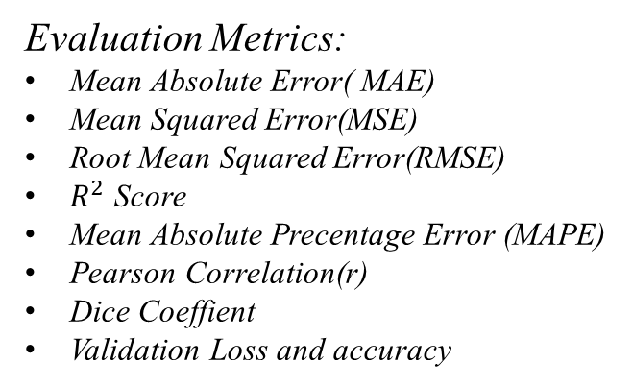
Experimental results
Datasets Used:
BraTS 2020 MRI datasets.
Includes 369 patients (BraTS 2020).
Evaluation Metrics:
Mean Absolute Error( MAE)
Mean Squared Error(MSE)
Root Mean Squared Error(RMSE)
$R^{2}$ Score
Mean Absolute Precentage Error (MAPE)
Pearson Correlation(r)
Dice Coeffient
Validation Loss and accuracy
Results:
MTC-Net outperforms CNN- & Transformer-based models in segmentation accuracy.
TCSS model improves survival prediction, achieving higher accuracy & lower MSE.
Fig: The Dice Coefficient Of The Brain Tumour Segmentaton
Fig :Showing The Evaluation Metrics Of The Brain Tumour Segmentation

Slide 13
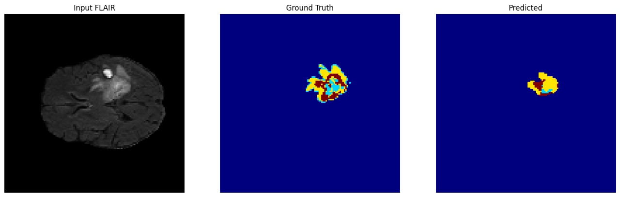
results
Sample Output 1: Original Segmentation Vs Predicted Segmentation

Slide 14
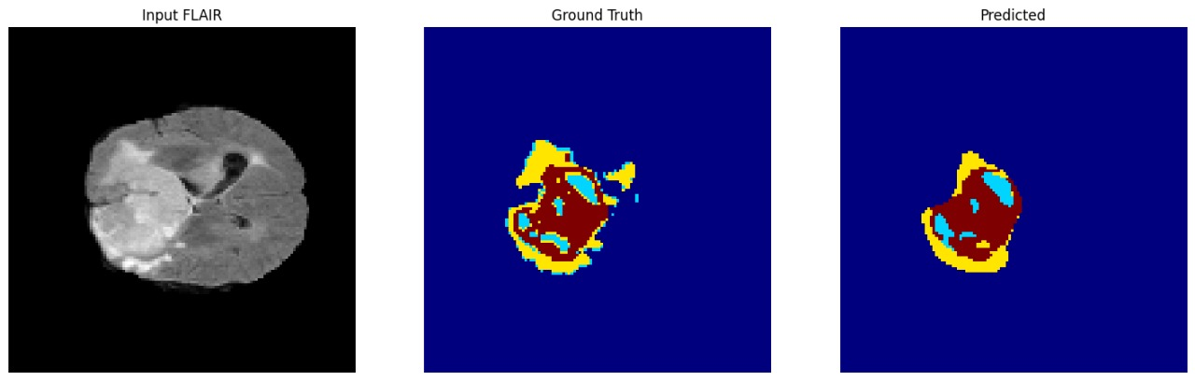
results
Sample Output 2: Original Segmentation Vs Predicted Segmentation

Slide 15
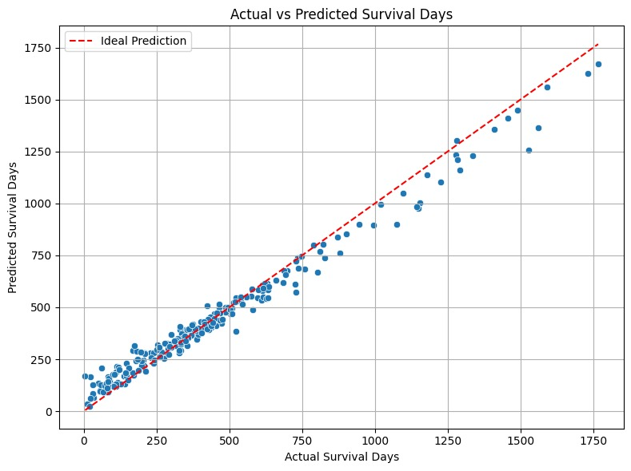

results
This scatter plot compares actual vs. predicted survival days. Each dot represents a patient, and the red dashed line shows ideal predictions. The close clustering around the line indicates high model accuracy in forecasting survival outcomes.
Fig: scatter plot comparing actual vs. Predicted survival days

Slide 16
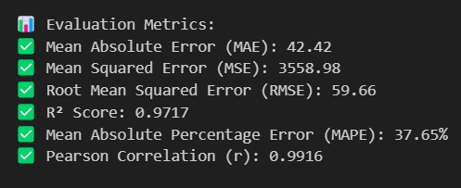
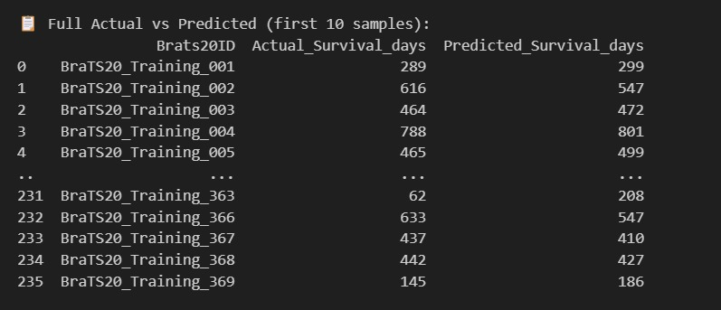
results
Fig: Evaluation metrics of the survival prediction
The model demonstrates strong performance with a low MAE of 42.42 and RMSE of 59.66, indicating accurate survival day predictions. A high R² score of 0.9717 and a Pearson correlation of 0.9916 reflect a strong linear relationship between actual and predicted values, confirming the model's reliability.
Fig: sample of actual versus predicted survival days for patients in the BraTS20 dataset.
The close match between the predicted and actual values across various cases highlights the model’s ability to generalize well and produce consistent survival time estimations.

Slide 17
CONCLUSION & future work:
Conclusion:
MTC-Net improves brain tumor segmentation by combining CNNs & Transformers for multi-scale feature extraction.
TCSS Model enhances survival prediction using deep features instead of handcrafted radiomic features.
Outperforms state-of-the-art segmentation & survival prediction models.
Future Work:
Apply MTC-Net to other medical imaging tasks.
Improve survival prediction by incorporating more clinical data.

Slide 18
CONCLUSION & future work:
Summary of Contributions
Introduced Multi-Scale Transformer Convolution (MTC) blocks for better feature extraction.
Hybrid CNN-Transformer Model: Achieves superior tumor segmentation accuracy.
Deep Learning-Based Survival Prediction: Uses deep features instead of handcrafted ones for improved accuracy.
Outperformed existing models on BraTS 2020 datasets.

Slide 19
CONCLUSION & future work:
Real-World Impact & Applications
Medical Imaging: Improves MRI-based tumor diagnosis & treatment planning.
AI in Healthcare: Enhances automated medical image segmentation for various diseases.
Cancer Research: Helps develop personalized treatment strategies for glioma patients.
Future Research Directions
Expanding MTC-Net for segmentation in other medical domains.
Enhancing Survival Prediction by incorporating genetic & clinical biomarkers.
Integrating Generative AI & Uncertainty Estimation for more robust tumor analysis.

Slide 20
THANK YOU

