Slide 1


PRESENTED BY DHEERAJ P
DATASCIENCE WITH PYTHON INTERN
TOPIC : AI VIRTUAL MOUSE

Slide 2
CONTENTS
1. Abstract
2. Problem Statement
3. Solution
4. software requirement
5. Library used in python
6. System working
7. Advantage
8. Conclusion

Slide 3
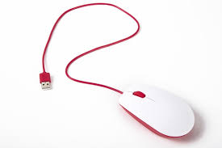
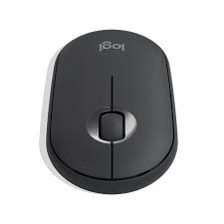
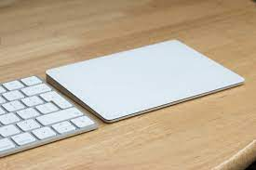
1. ABSTRACT
This project promotes an approach for the Human Computer Interaction (HCI) where cursor movement can be controlled using a real-time camera
it is an alternative to the current methods including manual input of buttons or changing the positions of a physical computer mouse.
Instead, it utilizes a webcam and computer vision technology to control various mouse events and is capable of performing every task that the physical computer mouse can

Slide 4
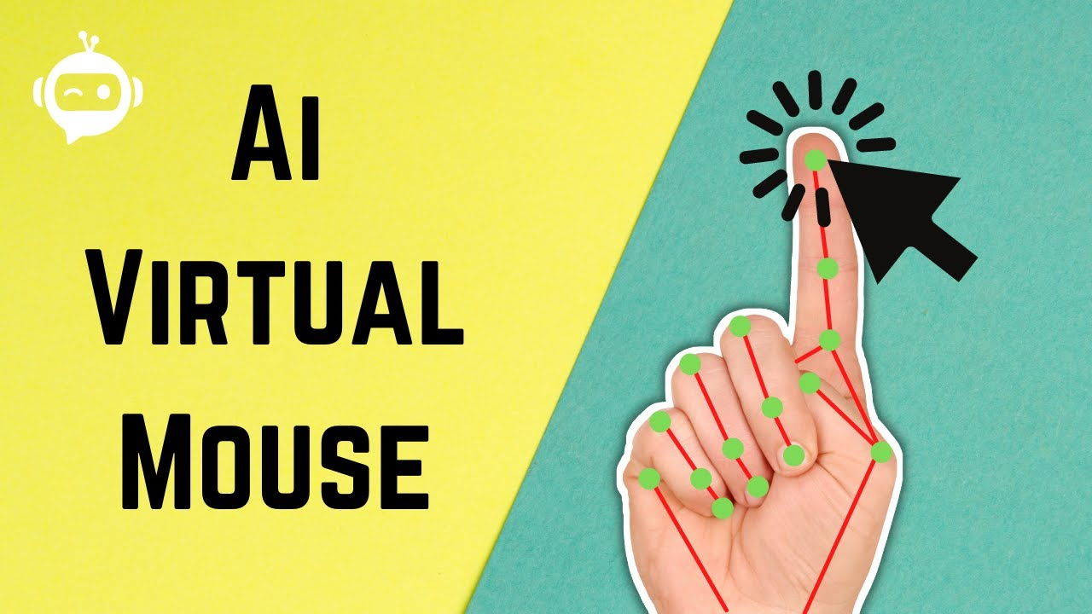
2. Problem Statement
To design virtual mouse which detects hand gestures patterns instead of physical mouse.
Basically we use colored tips for detection which are captured by webcam.
Here, the colored fingertip acts as an object which the web cam senses.
The camera is positioned such that it recognizes the moment of finger tips and performs the operations of mouse.
The utilization of virtual mouse appears in space saving situations or in movement situation.

Slide 5
3. Solution
Finding center and the size of the hand
Locate the center of the hand, we compute the radius of the palm region to get hand size.
Draw a circle increasing the radius of the circle from the center coordinate until the circle meets the first black pixel
When the algorithm finds the first black pixel then it returns to the current radius value.
The convex hull algorithm is used to solve the problem of finding the biggest polygon including all vertices
We used this algorithm to recognize if a finger is folded or not.
Next, we move the mouse cursor if the gap between the two finger images (current and previous frame) is far then the mouse cursor moves fast or, if the gap is close then the cursor moves slow such as( Left clicking, Right clicking, Double clicking, Scrolling)

Slide 6
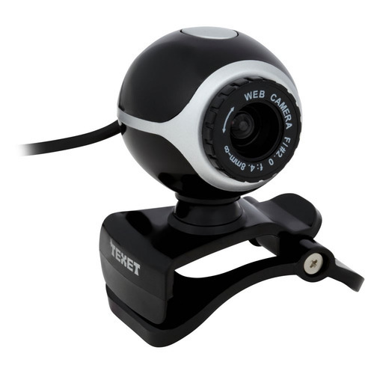


4. Software requirement
Python( is one of the programming languages designed for the Common Language Infrastructure)
OpenCV (Open Source Computer Vision Library) is a library of programming functions mainly aimed at real-time computer vision, developed by Intel.
OpenCV (Open Source Computer Vision Library) is a library of programming functions mainly aimed at real-time computer vision, developed by Intel.

Slide 7
5. Library used in python
OpenCV is a cross-platform library using which we can develop real-time computer vision applications. It mainly focuses on image processing, video capture and analysis including features like face detection and object detection..
AutoPy is a simple, cross-platform GUI automation library for Python. It includes functions for controlling the keyboard and mouse, finding colors and bitmaps on-screen, and displaying alerts.
Python time() function retrieves the current time
Hand tracking module It Used Computer Vision to Tracking Of Hand Landmarks inside the Frame.
Numpy library for the python programming language adding support for large multi-dimensional array for matrices along with a large collection of high-level mathematical function to operate on these

Slide 8
6. SYSTEM WORKING
Following are the steps in working of our project:
Capturing real time video using Web-Camera.
Processing the individual image frame.
Flipping of each image frame.
Conversion of each frame to a grey scale image
Color detection and extraction of the different colors (RGB) from flipped gray scale image.
Conversion of the detected image into a binary image.
Finding the region of the image and calculating its centroid.
Tracking the mouse pointer using the coordinates obtained from the centroid.
Simulating the left click and the right click events of the mouse by assigning different color pointers.

Slide 9
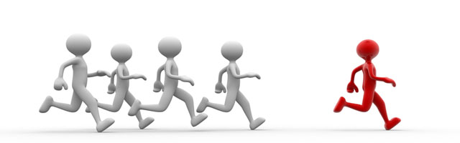
7. Advantage
The main advantage of using hand gestures is to interact with computer as a non-contact human computer input modality
Reduce hardware cost by eliminating use of mouse.
Convenient for users not comfortable with touchpad.
The framework may be useful for controlling different types of games and other applications dependent on the controlled through user defined gestures.

Slide 10


