Slide 1


Module 1: Introduction
Developing Business Applications with
Notes:
Welcome
Duration of this module: 1½ hours
(short break after 45 minutes)

Slide 2
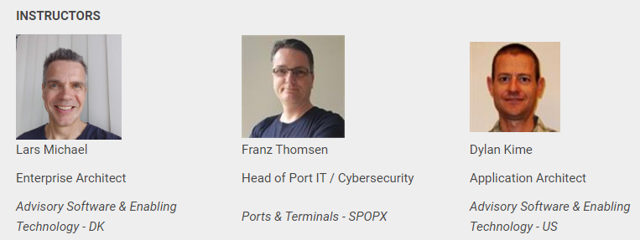
Notes:
I am the original creator of DS
Franz is the creator of the WF-part of DS. He built the Seaport OPX NCOS Online service in Australia using DS + WF.
Dylan is one of the most experienced users of DS+WF components. Built several business applications using this tech stack.

Slide 3
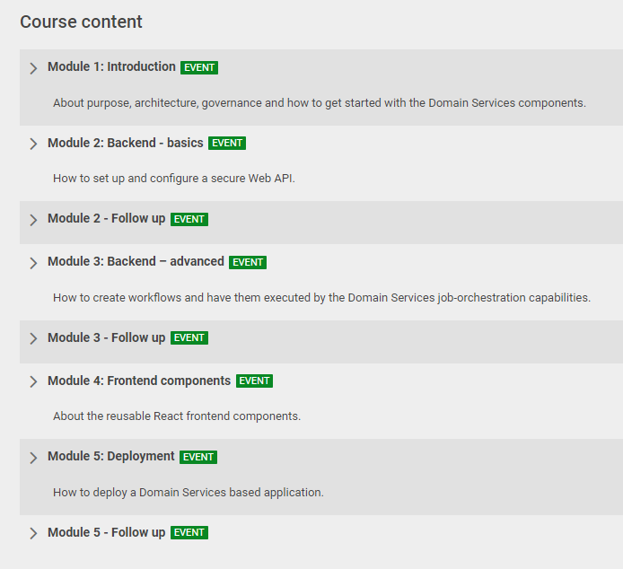



Notes:
We will split the modules between us like this. (Actually, I expect to learn a lot my self from attending module 3, 4 & 5…)
Each module will consist of a live session and a bit of ”homework” in the form of tests and possibly small coding assignments.
Tests and assignments is something you do in between the modules. Probably less than 1 hour.
We will complete 1 module each week.
The ”Follow Up” events will be used to follow up on these assignments (feedback, Q&A etc.)

Slide 4
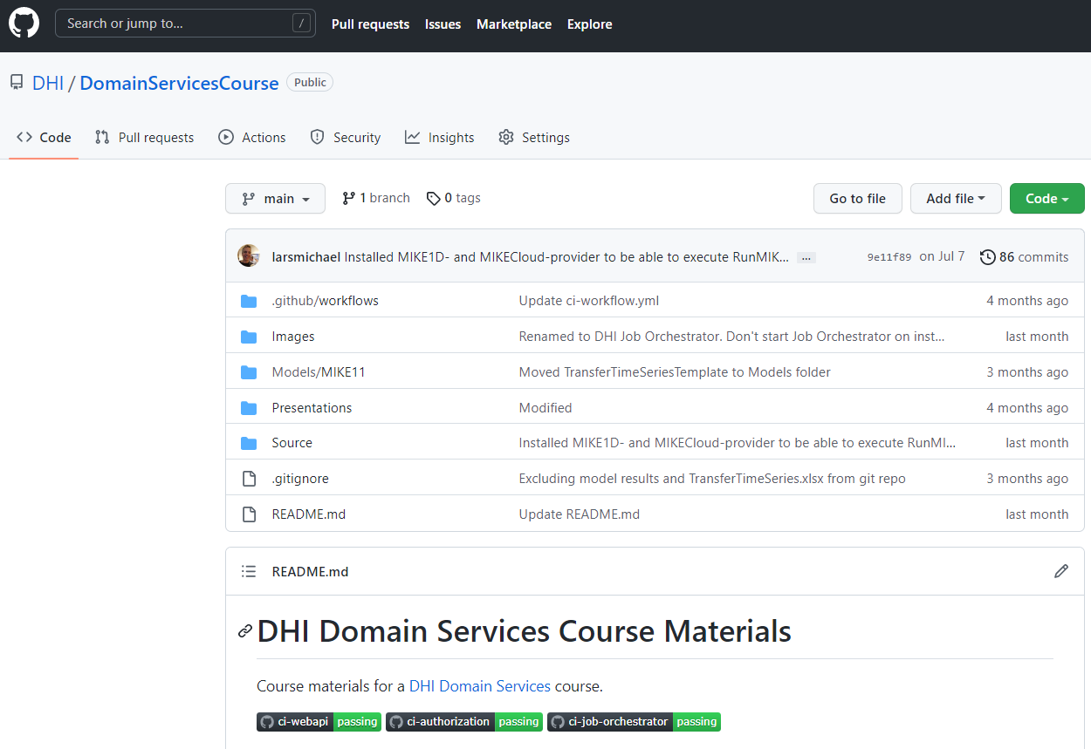
Notes:
We have gathered the course materials in a GitHub Repository:
PP Presentations
Source code for a sample application which will be used as a reference throughout the course.

Slide 5




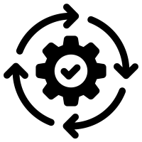



Browser
Client
WebSocket
Application Services
HTTP
HTTP
Authorization
Server
Web
Server
Job
Orchestrator
Job
Host(s)
Job
Host(s)
HTTP
Job
Host(s)
HTTP
TCP/IP
TCP/IP
HTTP
HTTP
Infrastructure Services
Azure
PostgreSQL
MIKE Cloud
Services
Notes:
A bit more about this sample application.
The sample application is a relatively simple – yet realistic application.
The application orchestrates a MIKE 11 model execution workflow and displays the simulation results in a web application. In that sense, it mimics the functionality of a typical DHI business application.
It also has a very typical architecture for a DS/WF-based application
4 application services
Auth server: (web server). Security aspects (user accounts and their privileges). Issues access tokens to the client for accessing the actual web server.
Web server. Backend for the application. Start jobs, request status, view results (time series or maps etc.). REST API, but also some real-time messaging (SignalR/WebSocket) for example for real-time update of job progress.
Job Orchestrator: Orchestrate job execution (incl. load balancing). Typical job: Model execution.
One or more job hosts: Actual execution of jobs.
All 4 application services can run on a single machine, which is good for rapid prototyping and debugging, but in production. It will typically be distributed to individual resources for robustness and scalability.
Application services communicate with infrastructure-services.
PostgreSQL databases (user accounts, job status etc.).
MIKE Cloud services (time series data storage)
Client (browser) running the frontend (JavaScript) code.
May seem overwhelming at first glance. We will gradually work our way into it during the course.

Slide 6
Module 4: Frontend (React)
Module 5: Deployment
Browser
Module 2: Backend – basics (Web API and security)
Module 3: Backend – advanced (jobs & workflows)
Client
WebSocket
Application Services
HTTP
HTTP
Authorization
Server
Web
Server
Job
Orchestrator
Job
Host(s)
Job
Host(s)
HTTP
Job
Host(s)
HTTP
TCP/IP
TCP/IP
HTTP
HTTP
Infrastructure Services
Azure
PostgreSQL
MIKE Cloud
Services
Notes:
We will gradually work our way into this architecture during the 5 modules

Slide 7

Notes:
Before digging into the matter; I have created a small poll. To have a bit of live interaction and make sure we are all awake.

Slide 8
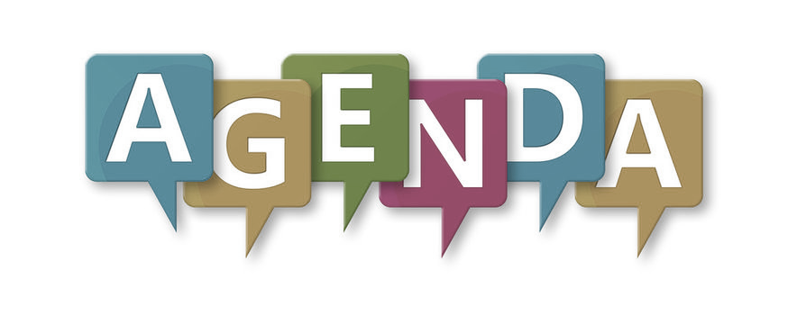
Purpose
Design & Architecture
Governance
How to Get Started?
Demo…
Notes:
This first module of the course will be a bit theoretic. But please be patient, I promise that in the end and in the following modules, we will dive much more into the practical details.
Purpose: Why was it made. What does it solve?
Overall design principles and architectural pattens that have guided the development process
Organization and processes around DS
How to get started using the NuGet package manager and the visual studio project templates.
Demo. So at least in the end of this presentation, you will see a bit of live coding

Slide 9
Purpose
Notes:
Why did we make DS? Which problems does it solve?

Slide 10

Cloud
Technology alignment
Community driven
Multi-user
Data abstraction
Web & mobile
Agility
Notes:
DS is the result of a strategic initiative initiated around 8 years ago (pre CloudBridge and the current DHI+ strategies.).
Requirements:
Technology alignment (MIKE Zero, MIKE Workbench, MIKE+)
Agile development (not year-long release periods)
Supporting distributed, service-oriented (web/mobile) applications (Online Services, DSS). What we normally refer to as Business applications.
Data integration with heterogenous data sources (data abstraction)
Community-driven. Transcending geographic and organizational boundaries. (Slogan: “Think Group First!”)

Slide 11
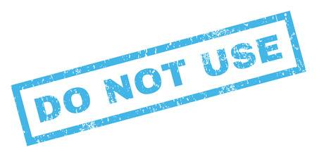
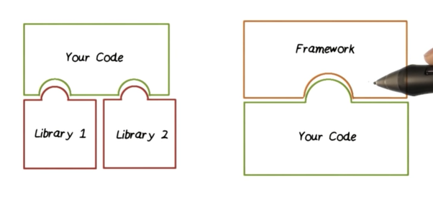
Libraries vs. Frameworks
Notes:
Libraries instead of “yet another framework” (MIKE Operations, DIMS.Core, MIKEZero
What is the difference?
In short:
Library: your code call library code
Framework: Framework calls your code (Inversion of Control).
NOTE: "You" is persona of an application developer.
Library : You (as an application developer) are in control
Framework: Framework takes control. They are opinionated. Dictates stuff. Your application code needs to be crammed into the boundaries of the framework.
Not inherently evil, though. Keep at an arms length. Find the right balance. Robert Martin: "you can date frameworks, but don't marry them"

Slide 12
A collection of reusable libraries for developing service-oriented business applications
Notes:
So, described in a single sentence, this is what Domain Services is:
A collection of reusable libraries for developing service-oriented applications
NOTE: I use the terms ”library” and ”component” interchangeable.

Slide 13
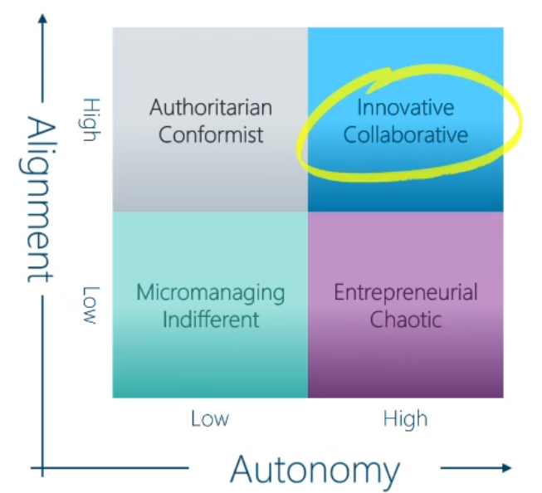
Notes:
Luckily, now 8 years later, this still fits perfectly with the current DHI strategy.
Examples: at the latest Town Hall meeting, our CEO presented this diagram illustrating how the new DHI+ strategy aims to establish an innovative and collaborative culture based on a high degree of autonomy as well as a high degree of alignment. Domain Services perfectly sustain this strategy.
The fact that these libraries are shared across all DHI, leads to a high degree of alignment.
At the same time, for a software developer, libraries provide a high degree of autonomy, as you can cherry-pick whatever you need in a particular context.
Furthermore, DS is maintained using the open-source model, which provide for a high degree of community-led collaboration.
In that sense, DS perfectly sustains even the newest DHI strategy (DHI+)

Slide 14
Design & Architecture

Slide 15
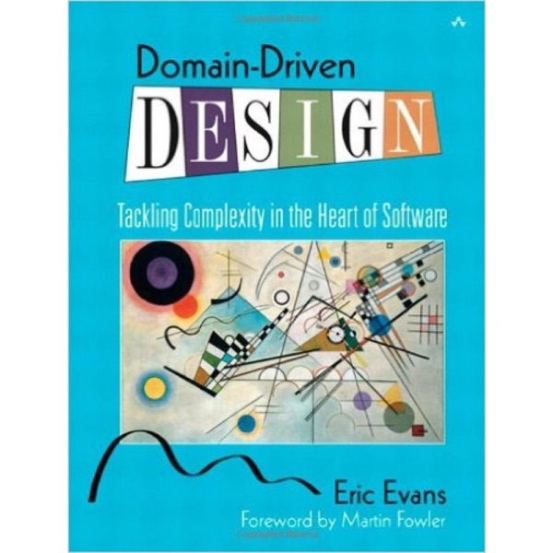
Notes:
Domain Driven Design (or DDD).
These are the design principles from where Domain Services has its name.
DDD is about modeling real-world concepts into the software. Revolves around an object-oriented model of the domain – the domain model. An object model that comprise data as well as behavior.
DDD Defines terms such as entities, repositories and services which you will see heavily represented in the Domain Services code.

Slide 16
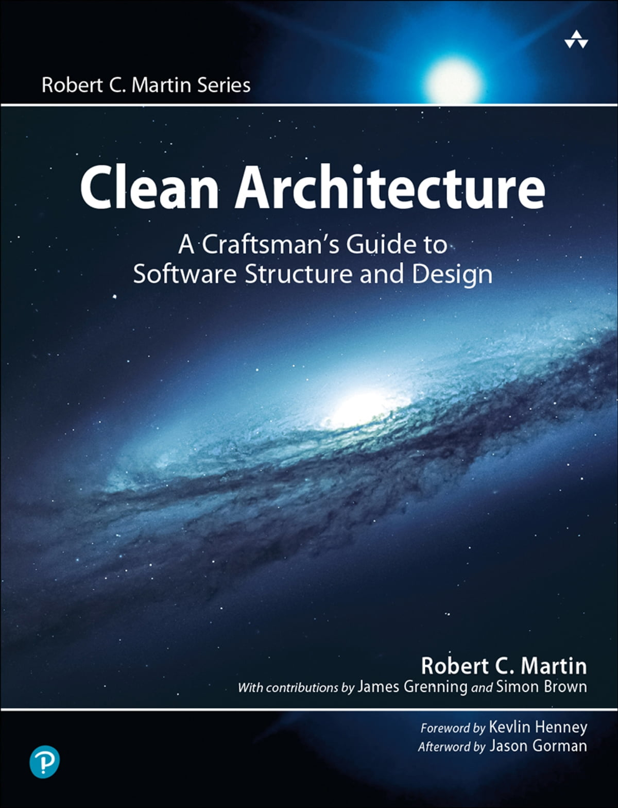
Independence on UI- and storage technologies
Loose coupling and high testability
No framework constraints
Notes:
When it comes to the architecture, DSS is guide by an architectural pattern called “Clean Architectural”.
The term "Clean Architecture" was originally coined by Robert. C. Martin – one of the fathers of the Agile Manifesto for software development.
3 key characteristics:
Clear separation between essentials and details. E.g. UI and storage technologies are considered Implementation details
Maintainability
No need to Cram your application into the constraints of a framework. Cherry pick.

Slide 17
UI technologies?
Storage technologies?
“A good architecture allows major decisions to be deferred”
Robert C. Martin
Logging?
Hosting?
Security?
Notes:
Quote about Clean Architecture – and DS
What are those “major decisions” (details)
UI technologies (Polymer, React, WinForms, WPF)
Storage technologies (Postgres db, MO db, MIKE dfs files, MIKE Cloud Platform)
Logging (files, database)
Security (built-in or 3rd party services)
hosting (on prem/Azure/Amazon).
Maximizes the decisions that are NOT made in advance. Allows you to defer and revert decisions as long as possible.
Requirements ALWAYS change.
Obviously, Eventually decided by the application developers themselves.
Compose and Configure their application from prebuild components (and possibly custom extensions)
Such an architecture is Powerful but highly flexible => Appreciated by BUs.

Slide 18
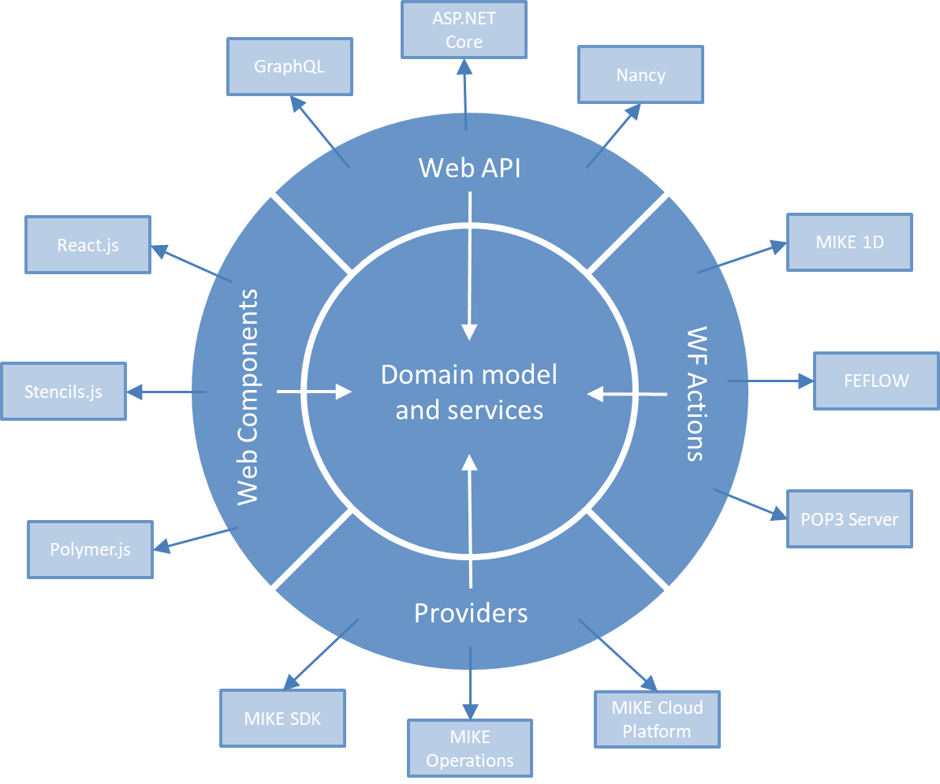

Onion Architecture
Notes:
Another name for Clean Architecture
Because: Depicted as a number of concentric layers
Center: Domain Model & services. Aka. "Business Layer"
Outer layer (Infrastructure). Dependencies on 3rd party technologies (ASP.NET Core, React)
Light blue: 3rd party. Dark blue: DS components
NOTE: No outward dependencies from domain model and services to infrastructure layer (arrows) -> BL independent on any infrastructure!
4 categories of infrastructure components.
75% library (consumes – call methods), 25% framework (implements).
5 categories in all: go through them One-by-one.
(*) BTW, Should be clear by now, where the inspiration for the DS logo came from ☺

Slide 19
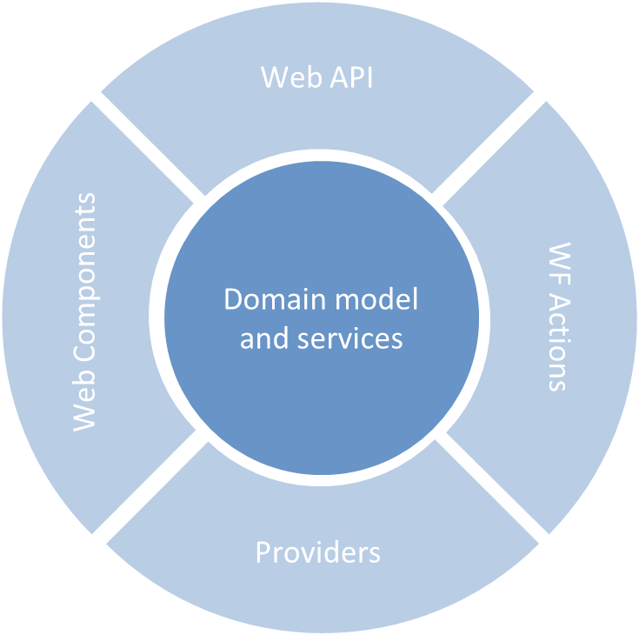
Job Execution
DDD
IWorker
IEntity
ICloudInstanceHandler
IRepository
ILoadBalancer
IService
DHI.Services.TimeSeries
DHI.Services
Logging
DHI.Services.Jobs
Security
ILogWriter
IOtpAuthenticator
ILogReader
IAuthenticationProvider
Notes:
Interface definitions and abstract base classes (abstractions)-> Extensibility points. 80+
<---Examples--->
Fundamental abstractions in assembly DHI.Services – job execution in DHI.Services.Jobs
Same assemblies: Stateless services => ideal for web services (web APIs) – more later
In general: Pure .NET components (aka. POCOs). No outward dependencies. Result of using DIP - more later.

Slide 20
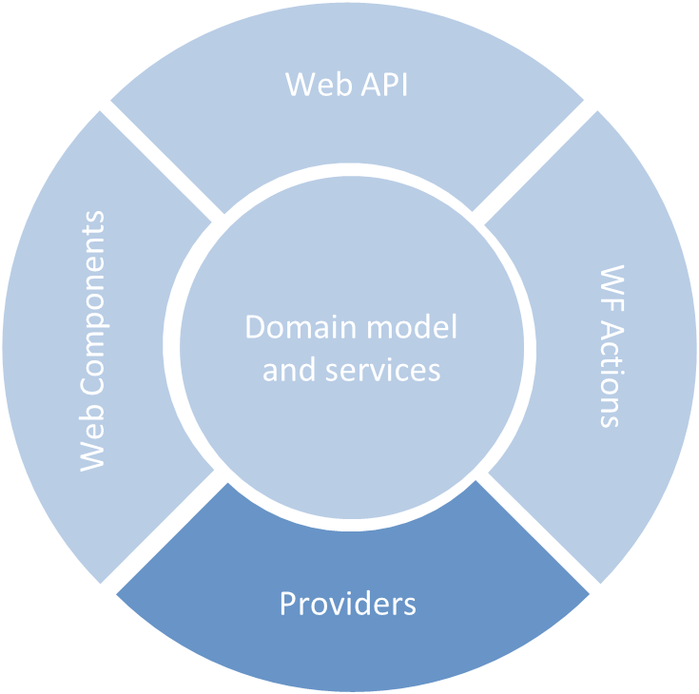
DHI.Services.Provider.MIKECore
DHI.Services.Provider.MIKECloud
DHI.Services.Provider.PostgreSQL
Notes:
Contains Concrete technology-specific implementations of abstractions.
Also known as "plugins"
A typically plugin is an implementation of a Repository-interface.
Plugins are grouped in assemblies called providers. Each provider component has a dependency on one-and-only-one specific technology - e.g. PostgreSQL.

Slide 21
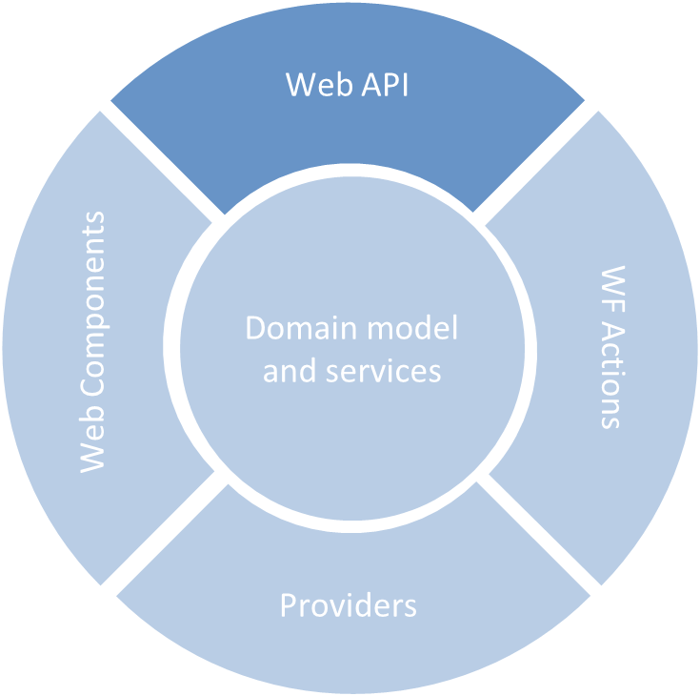
DHI.Services.Jobs.WebApi
DHI.Services.TimeSeries.WebApi
DHI.Services.Security.WebApi
Notes:
Exposes the .NET services (center) as http-based Web API components (REST).
HTTP is a stateless protocol -> the stateless .NET services are perfectly suited to form the basis.
Lean. Merely Thin wrappers around the .NET services.
ASP.NET Core

Slide 22
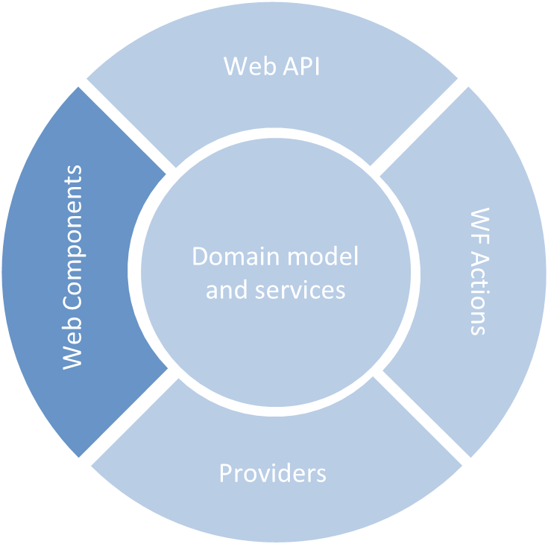
LeafletAnimation
ScenariosTable
JobsList
Notes:
Reusable JaveScript components.
First Google Polymer - Now React components.
So, both Web API and Web UI components have been refactored.
Demonstrates the decoupled nature.
Infrastructure components easily replaceable.

Slide 23
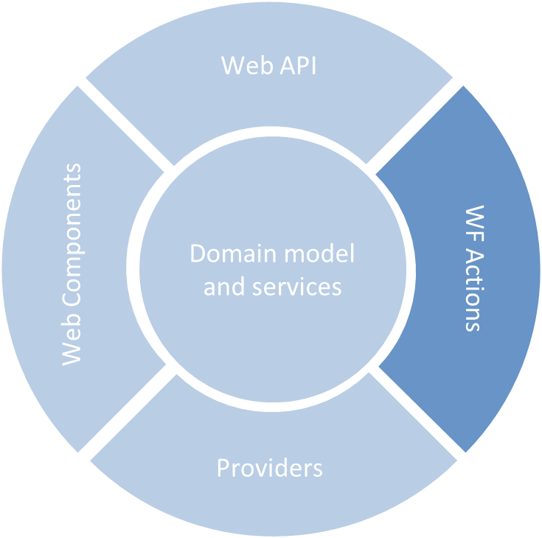
DHI.Workflow.Actions.Core
DHI.Workflow.Actions.Jobs
DHI.Workflow.Actions.TimeSeries
Notes:
Workflow actions are small blocks of functionality that can be combined to form workflow sequences
Preferably, thin wrappers of business functionality in DS BL – or other pure .NET libraries
Previously Implemented using Windows Workflow Foundation (part or the .NET Framework)
Executed using the Jobs-functionality of DS.
The powerhouse for extending DS with reusable business functionality.

Slide 24
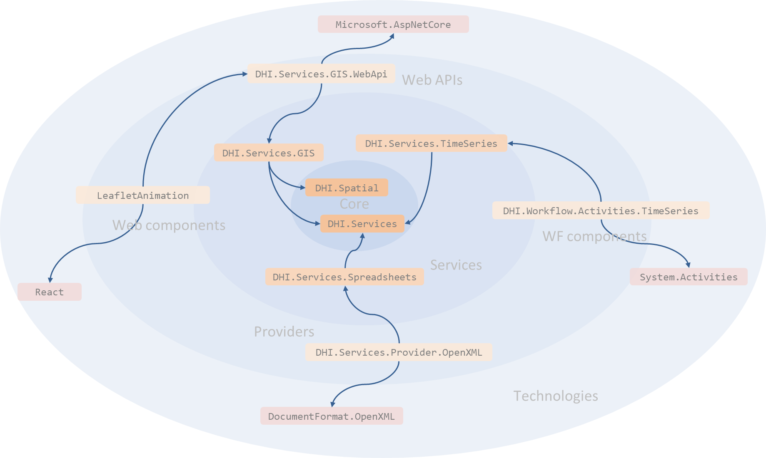
Notes:
The same onion rings exploded a bit more. Allows more details.
In the very core:
the most stable domain models for geometry, physical quantities and units etc.
The most basic abstractions of entities, repositories, services etc.
GIS + leaflet
WF
No outward dependencies from the BL

Slide 25
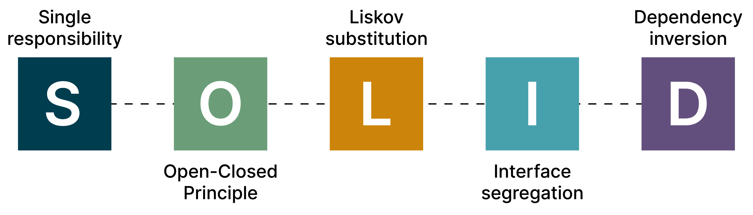
Notes:
DS is implemented using the SOLID design principles
SOLID is an acronym for five object-oriented design principles
I will not go into details with all of them, but just emphasize a single one, which is very important for the DS design.
This is the last one “Dependency Inversion” (represented by the “D” in SOLID)

Slide 26
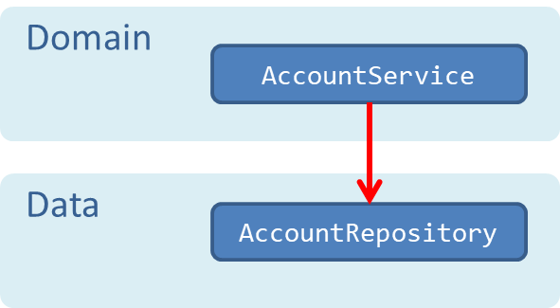
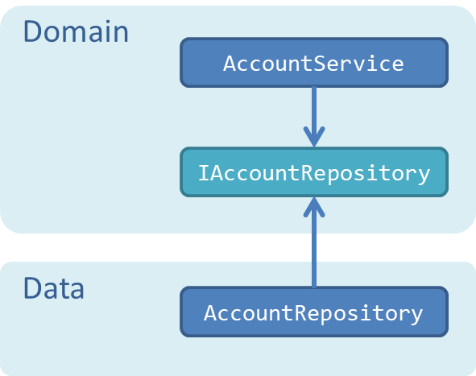
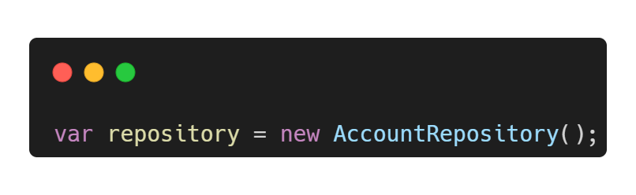
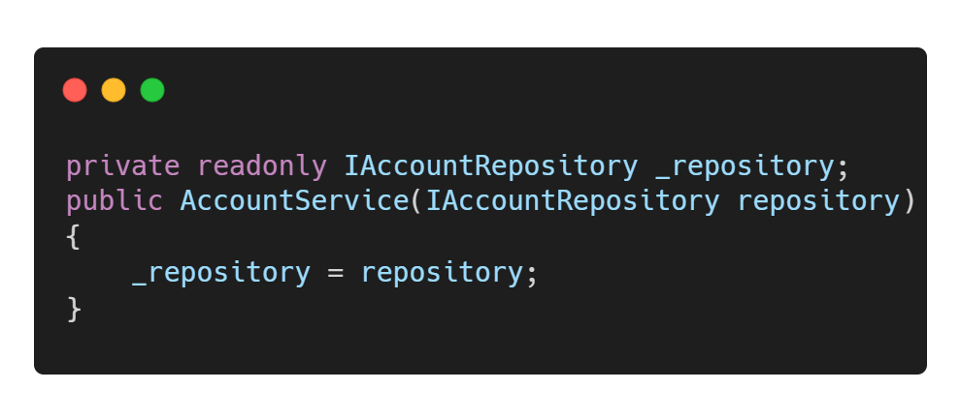
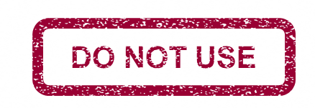
Dependency Inversion Principle "High-level modules should not depend on low-level modules. Both should depend on abstractions"
Notes:
DIP states that “High-level modules should not depend on low-level modules. Both should depend on abstractions”
Best illustrated by a simple example.
<---elaborate--->
Advantages:
Decoupling (Domain functionality is decoupled from infrastructure – for example storage technologies)
Testability increases dramatically (mock/fake objects – ex. in-memory repository)
Sustains agile development. Perfect for distributed teams and Internal OSS as we practice it.
In other words: the magic principle. It is the one principle that makes most of the difference.
DIP -> Storage agnostic functionality, high testability and high maintainability.

Slide 27
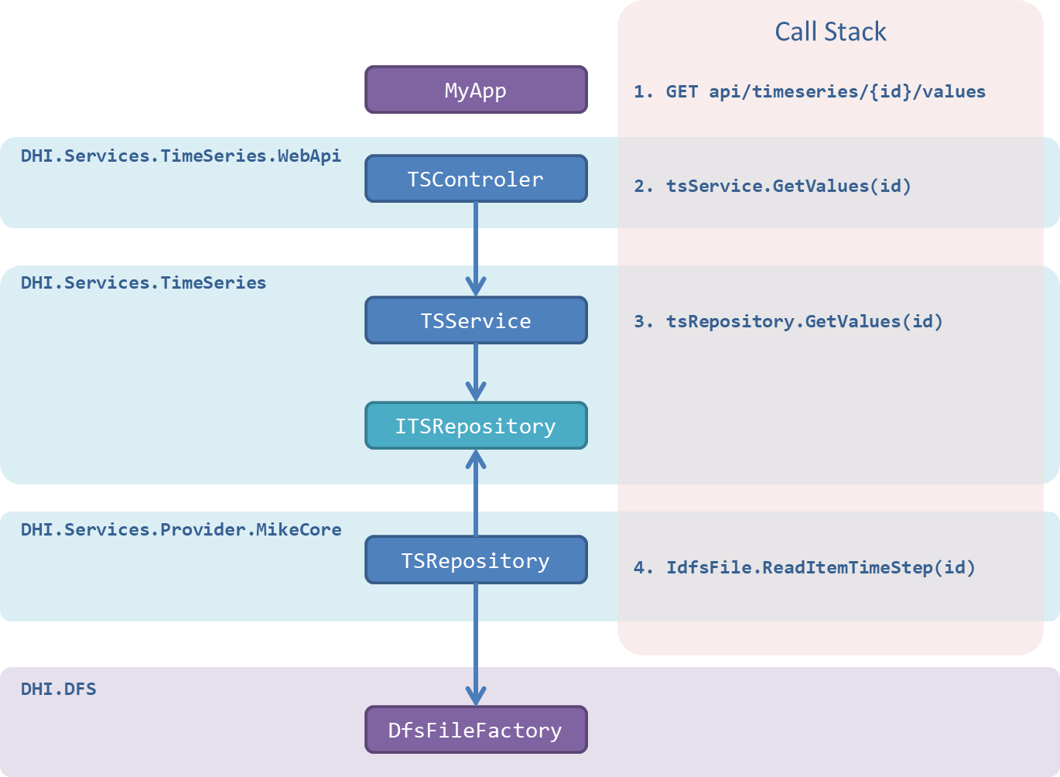
Notes:
Same story – but Conventional vertical view
Light blue is DS assemblies – purple is 3rd party library.
One BL component and two infrastructure components
Object dependency graph involved in a single HTTP request for some time series values
The components (from center)
The call stack.

Slide 28
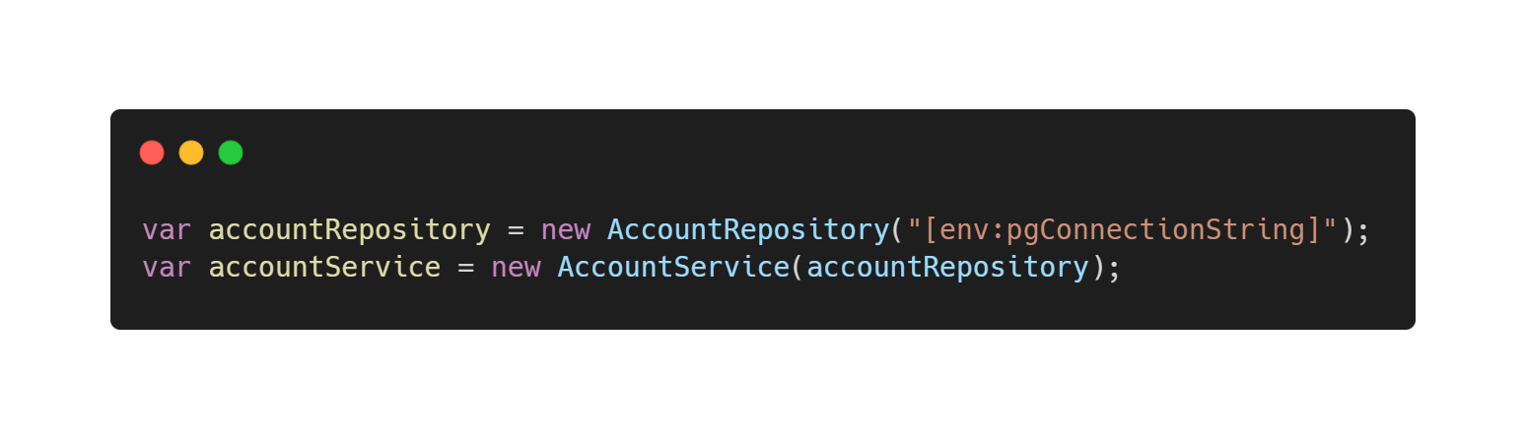
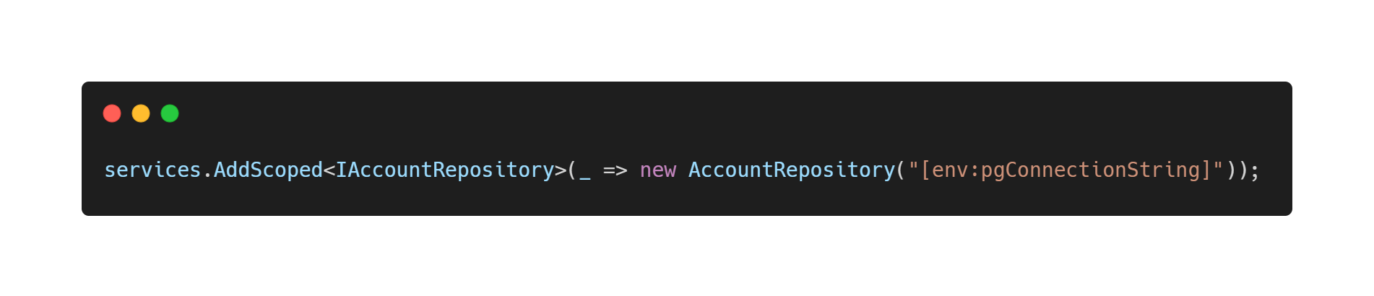
Object Composition
Using DI Container (ASP.NET Core):
Notes:
DS uses dependency injection ->
DI Container (ASP.NET Core built-in DI container). Register concrete types for abstractions
DIY (Pure DI). Build object graph conventionally using constructors (the new keyword)
More about this in module 2.

Slide 29

Notes:
5 minutes

Slide 30
Governance
Notes:
Organization and processes around DS

Slide 31

Consume
Contribute
Internal
Flexibility
Control
Notes:
The Domain Services components are governed using what we call an internal (#) Open-Source process – a process that is similar to that of Open-Source Software – only practiced within the boundaries of DHI.
In practice this means that every software developer within DHI can easily consume (#) as well as contribute (#) to the Domain Services components. As a software developer this gives you a high degree of flexibility (#) and control (#). With this model, bug-fixes and new features can be processed and released within a few days – or even hours.

Slide 32
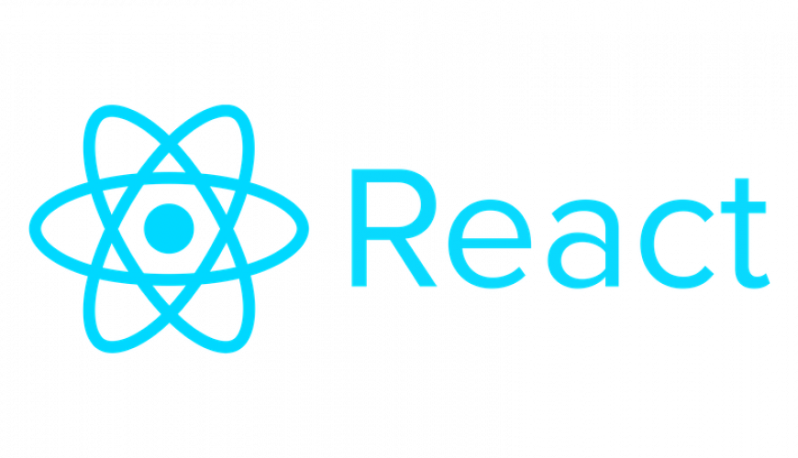
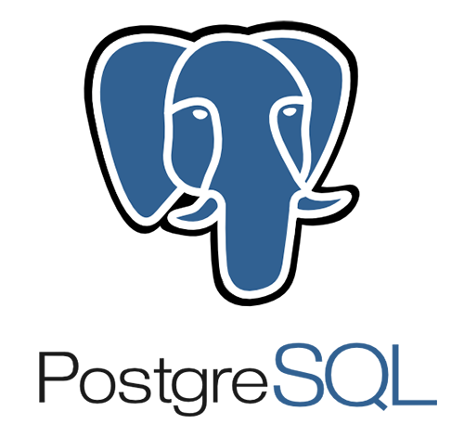

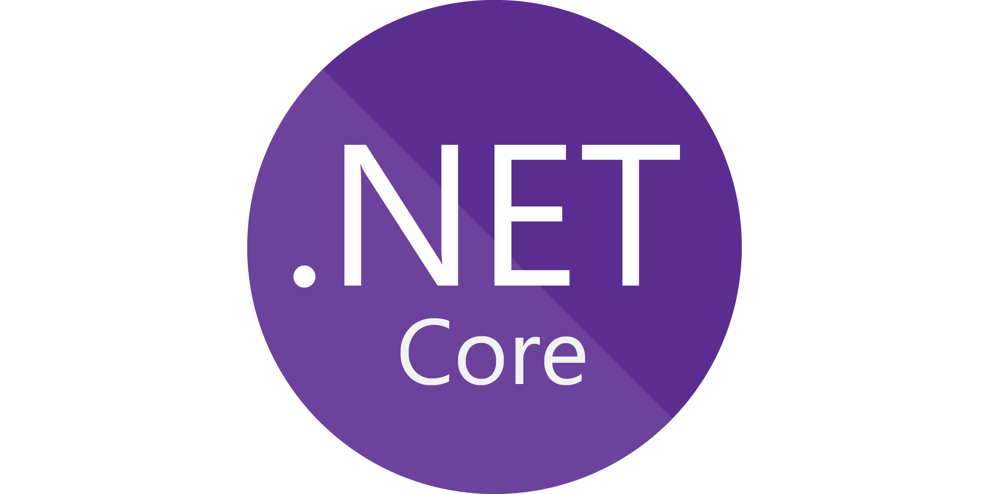
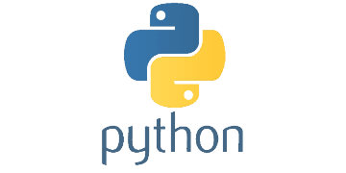
Notes:
Thousands of well-known software projects are governed using the open-source software model. These are just a few of the open-source projects that we - at DHI - frequently use in our own software projects.
Several large companies actively support open-source – for example Facebook with the React JavaScript library and Microsoft with the .NET programming platform. Likewise – only within the boundaries of DHI – we govern DS using the same principles.

Slide 33


Notes:
Almost all open-source projects use GitHub as their platform – So does DS. However, for now the Domain Services code repositories are private – not public. Only GitHub users affiliated with the DHI Organization can view and contribute to the source code.
The Domain Services components (libraries) are released as individually versioned software packages on NuGet. Each package is its own little product. NuGet is the package manager for the Microsoft .NET ecosystem. This way, NuGet becomes a repository of components that can be easily shared across all software development projects at DHI.

Slide 34



Roles
Maintainers
Contributors
Users
Notes:
On a high level, DS is governed as any other productized software asset within DHI – there is a Product Owner and a Product Manager. They are responsible for matters such as overall strategy, budgets, roadmaps and backlogs.
At a lower level, the practical day-to-day governance follow that of open-source projects. In this model there are 3 different roles: maintainers, contributors and users.
The maintainers are the curators of the source code. While balancing the needs among users and contributors, the maintainers have the overall responsibility of the quality of the source code. The practical work involves moderation of issues, code review and release management.
Contributors are more loosely affiliated. Contributors are developers who have commit privileges to the source code repository and have made one or more contributions to the code. Maybe they have fixed a bug that they found themselves, or they have extended the functionality to meet the needs of some project that they worked on.
Users are consumers of the released components – the NuGet packages. The typical user is a software developer in a business unit working on a business application. Some users take a more active role than just consumers – by spreading the word, educating and supporting other consumers, reporting issues etc.
One person can easily take many roles. Typically, a maintainer is also a contributor. And contributors are almost always also users.
The actual persons holding these roles are scattered across the organizational and geographical boundaries within the DHI group – thus mimicking open-source projects in the outside world.

Slide 35






GitHub flow
8
Fetch package
1
File issue
2
Create branch
foobar issue
3
Create pull request
foobar 4.7.4
foobar-fix
foobar 4.7.3
foobar-fix pull request
6
Delete branch
4
Review pull request
5
Merge pull request
7
Build and deploy package
Notes:
The code is maintained using the GitHub flow. Let’s see an examples of this:
A user discovers a bug in the foobar nuget package and files an issue in the GitHub issue tracker
A contributor picks up the issue and creates a dedicated branch for fixing the issue
Once the fix is ready, and properly covered by unit tests, the contributor creates a so-called pull-request. This is a signal to the maintainer that the code is ready for review
The maintainer reviews and approves the pull request
Then he merges the development branch into the trunk. This operation automatically closes the pull request. The issue is also closed – either automatically or manually.
Now he can delete the development branch.
Then the maintainer builds and deploys a package with a new version number to nuget
From here it can be fetched and consumed by the users

Slide 36
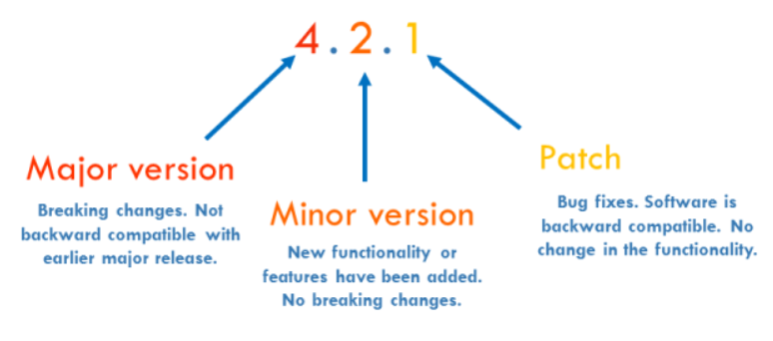
Notes:
Versioning scheme (semantic versioning).
3 digits.

Slide 37
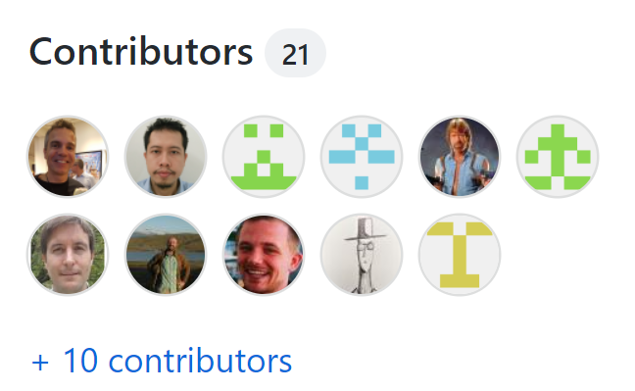
Notes:
To finalize this section: This is an image of the list of contributors to the core GitHub repository (21)
You can see that quite a few employees have contributed to this code repository through the years.

Slide 38
How to get started?

Slide 39
Application 1
Ver 2.11
Ver 1.1
Ver 1.4
Application 2
Ver 4.0
Ver 2.1
Notes:
Technically, Domain Services is a number of software components – also know as libraries – that are released as individually versioned packages on NuGet.
The software libraries can be compared to LEGO blocks (#). You can compose your application from the individual libraries just as you would compose a house from a collection of LEGO blocks (#-#-#). This way (#), NuGet becomes a repository of components that can be shared across all business applications at DHI (#-#).

Slide 40
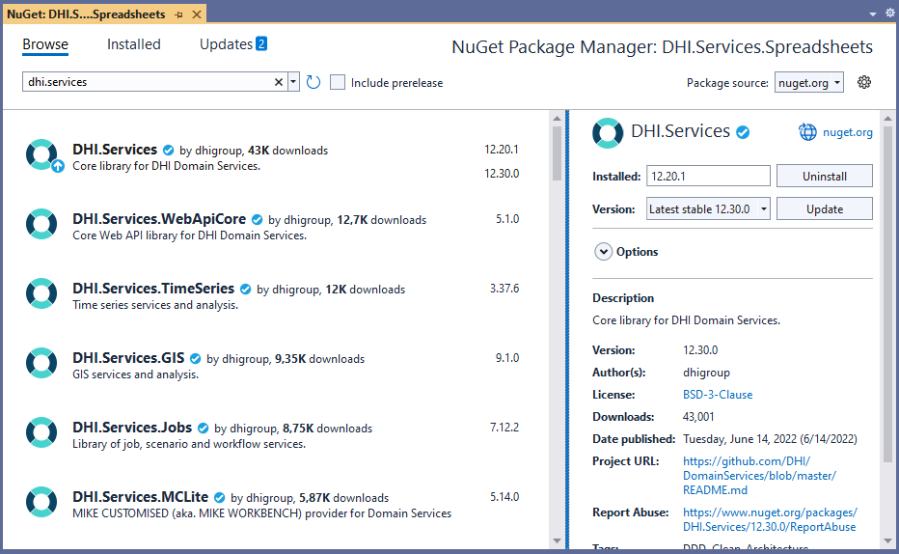
NuGet as a Platform
Notes:
Deployed as versioned packages at internal nuget feeds
Currently, around 50 packages in total
Easily accessible for any developer at DHI using the NuGet package Manager within Visual Studio

Slide 41
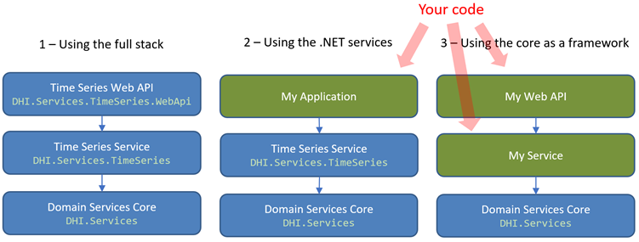
How to leverage the Domain Services components
Notes:
Blue boxes represent existing components which can be fetched as NuGet packages
Green boxes represent code that you write yourself
Range from writing no (or very little) code yourself (all out-of-the-box) to writing more code yourself

Slide 42
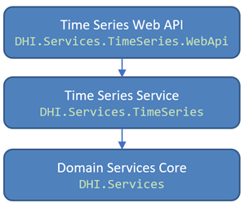
1 - Using the full stack
Notes:
Full vertical slice within a specific domain – including a Web API and even React UI
Starting point: VS project templates

Slide 43
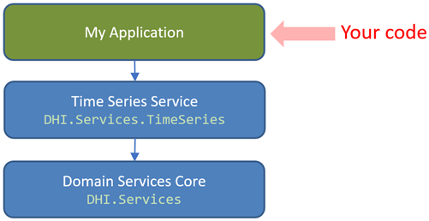
2- Using the .NET services
Notes:
The Web API are merely details – They are thin wrappers around pure .NET services
Isolated in their own components
This is where the actual business logic resides
Can be used directly from for example a classic .NET desktop application (MPC)

Slide 44
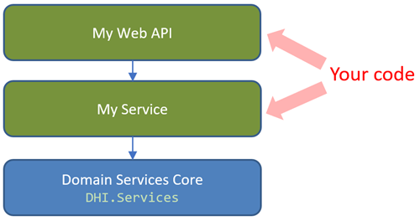
3 - Using the core as a framework
Notes:
Core contains generic interfaces and base classes for DDD types (entities, services & repositories)
Can be used to create your own service-oriented types
Simply install DHI.Services and get going.

Slide 45
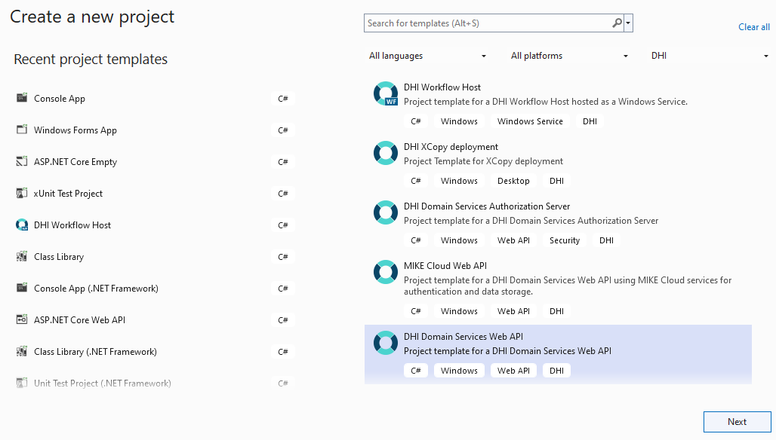
Visual Studio Project Templates
Notes:
Install as VS extension from the Software Center or Visual Studio Market Place
Plug into the UI side-by-side the official project templates

Slide 46
Demo…
Notes:
Use case no. 2 (Using the .NET services directly)

Slide 47
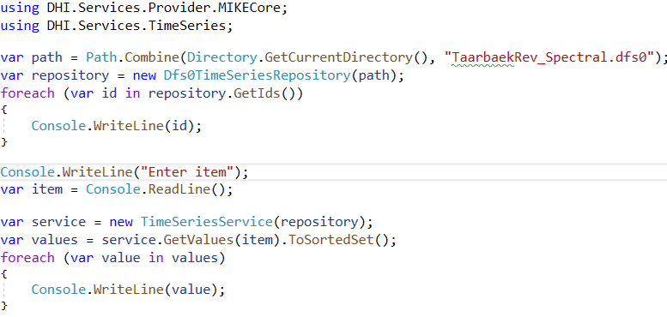

Slide 48
Wrap Up
Notes:
Wrap Up. Before next live session (a week from now)
Go to the Campus site. Under module 1 you will find:
A test (as many times as you want – until you get it right…)
An assignment (Do what I just did in the demo.)
Provide feedback

