Slide 1


Module 4: Frontend Components
Developing Business Applications with

Slide 2

Aims and context
Introduction to DHI react components
Applying the DHI react components
Guide to running the example
Take home exercises/ideas
Notes:
<use this slide for agenda>

Slide 3
Aims and context

Slide 4








Module 4: Frontend (React)
Browser
Client
WebSocket
Application Services
HTTP
HTTP
Authorization
Server
Web
Server
Job
Orchestrator
Job
Host(s)
Job
Host(s)
HTTP
Job
Host(s)
HTTP
TCP/IP
TCP/IP
HTTP
HTTP
Infrastructure Services
Azure
PostgreSQL
MIKE Cloud
Services
Notes:
Up until now you have spent time learning about and building components from the application services layer.
We now move on to the client layer, and there are multiple client types that can be used including:
Console (command line) applications
System service applications
Desktop applications
Desktop plugins
Web browser applications
Web browser applications have become more and more popular in the world and DHI due to:
Easy (no) installation for the user
Centralized updates and management
Interactive web mapping and charting have become much easier to deliver
There are challenges with delivering web applications for DHI:
Lack of developers
Lack of unified approaches
Maintenance in a very fast changing technology landscape

Slide 5

Notes:
Before digging into the matter; I have created a small poll. To have a bit of live interaction and make sure we are all awake.

Slide 6
Introduction to DHI react components

Slide 7
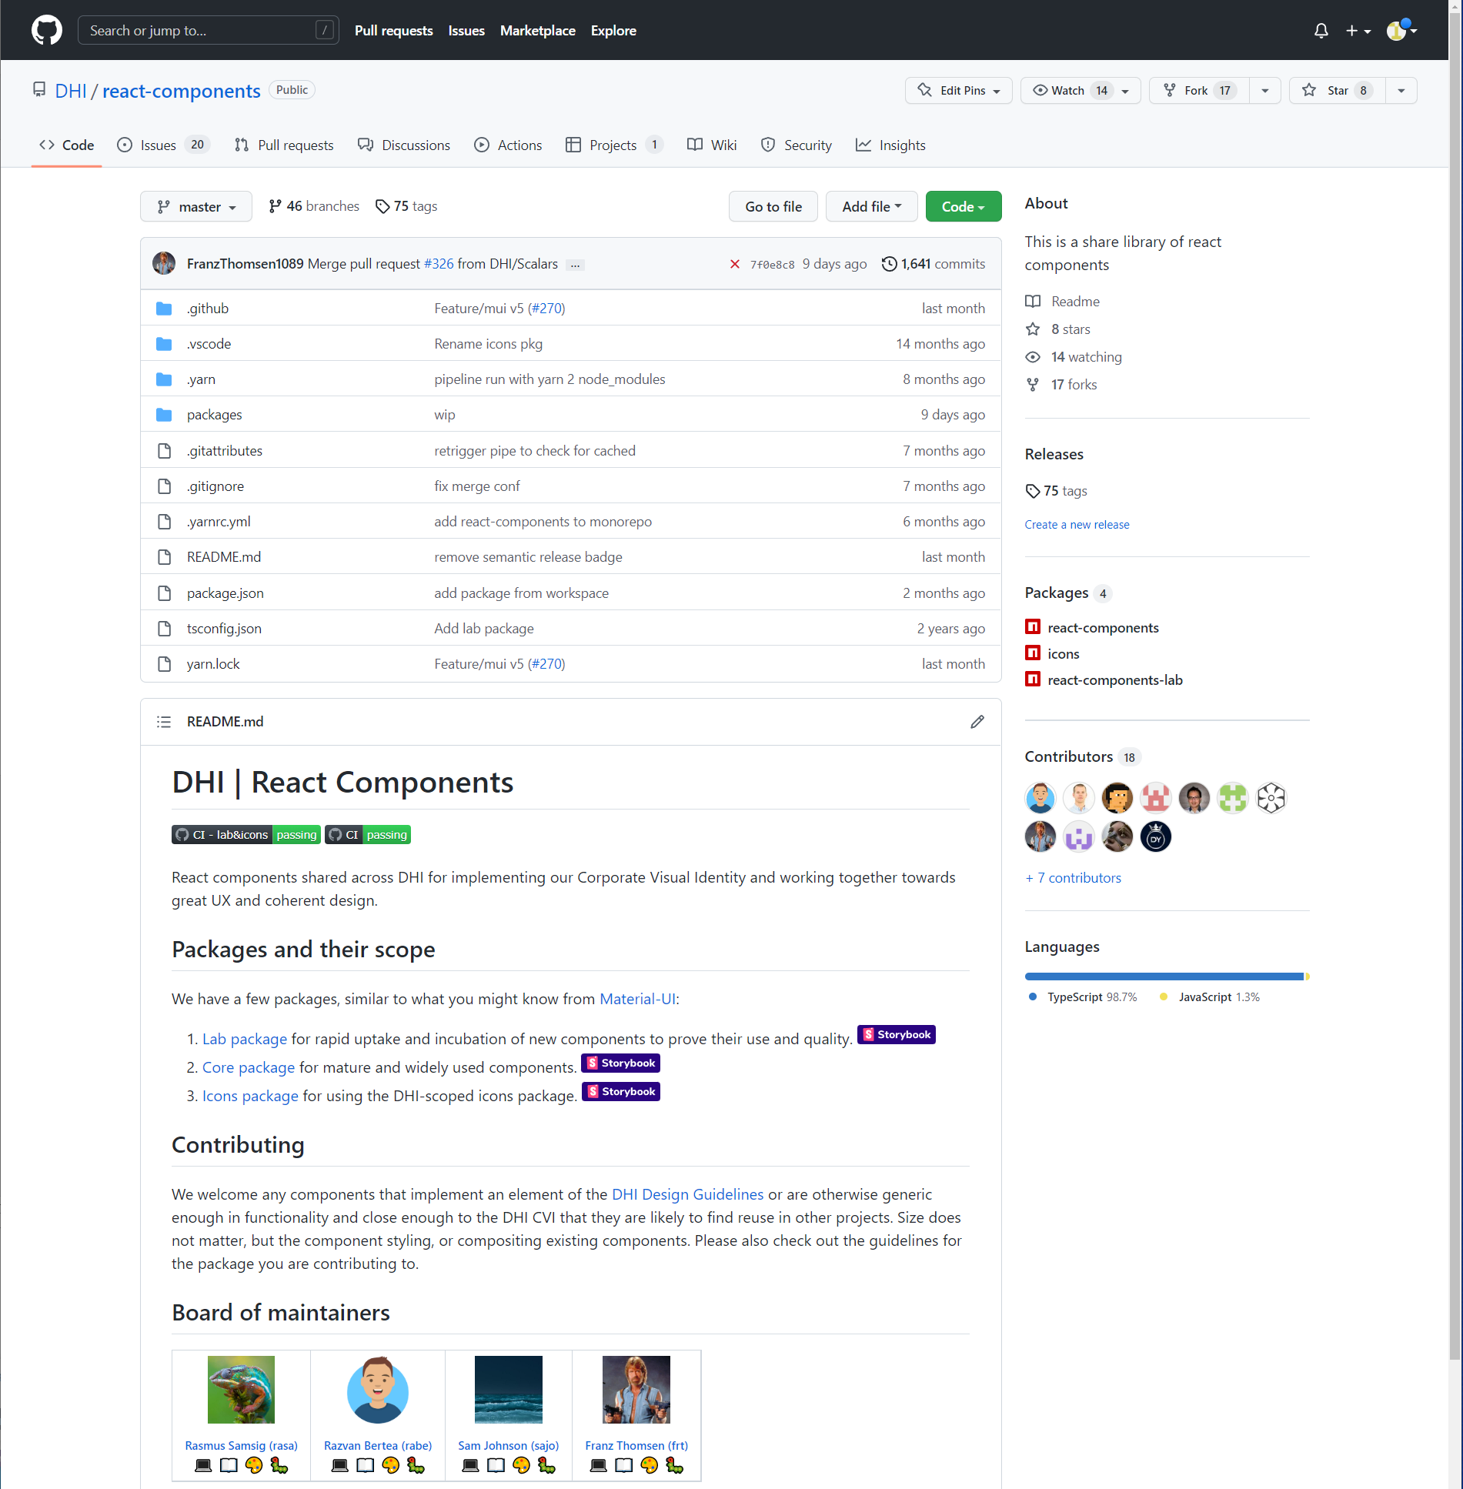
https://github.com/DHI/react-components
Notes:
DHI’s web development history:
ASP.NET web forms 2008-2013
Polymer 2013-2018
React 2018-now
React components (RC) collects and publishes a set of commonly used components that can be installed and used in your projects.
Examples include:
Authentication
Account management
Charting
Job management
Scenarios
API queries
…many more

Slide 8
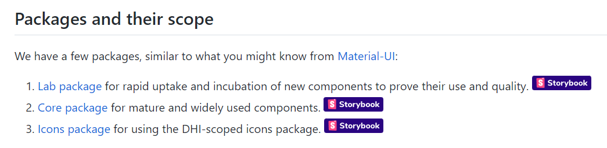
https://github.com/DHI/react-components
Notes:
Within RC, packages are divided up into lab, core, and icons

Slide 9
Use the storybook link to launch an interactive component explorer/tester
https://github.com/DHI/react-components
Notes:
Within RC, packages are divided up into lab, core, and icons

Slide 10
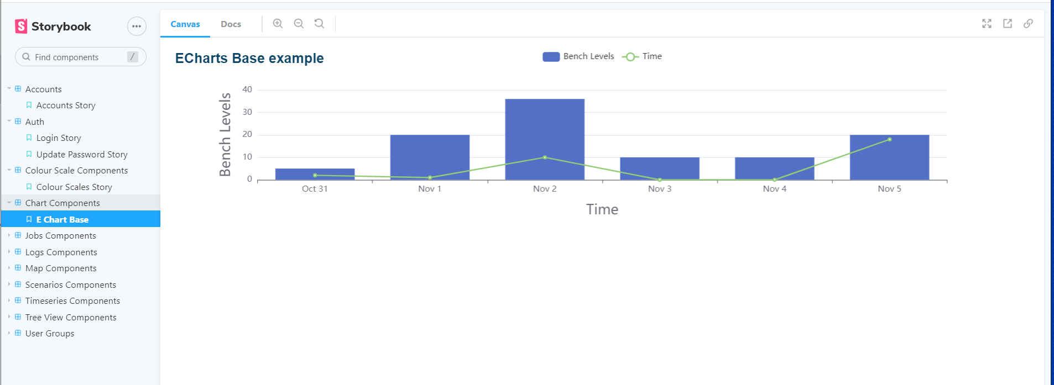
https://domainservices.dhigroup.com/?path=/story/chart-components--e-chart-base

Slide 11
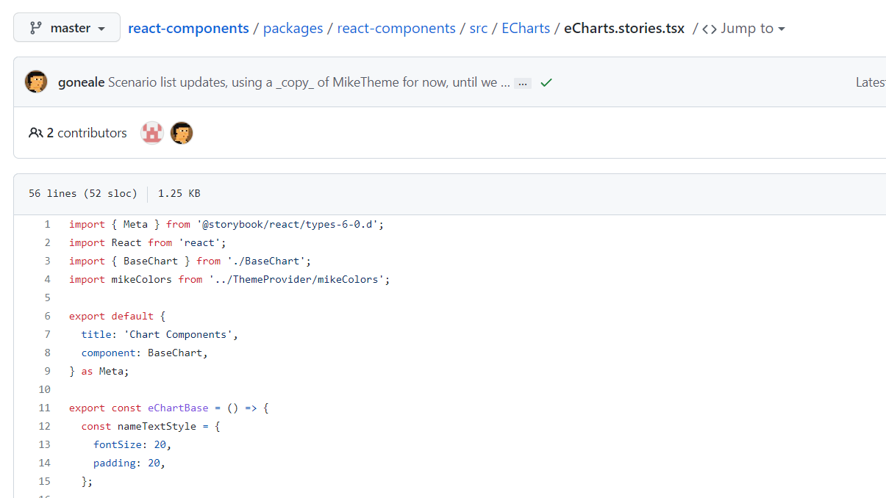
You can find the code for each story in the github repository
https://domainservices.dhigroup.com/?path=/story/chart-components--e-chart-base
https://github.com/DHI/react-components/blob/master/packages/react-components/src/ECharts/eCharts.stories.tsx
Notes:
Once you have found a component to work with, copying code from the story to your example can be helpful

Slide 12
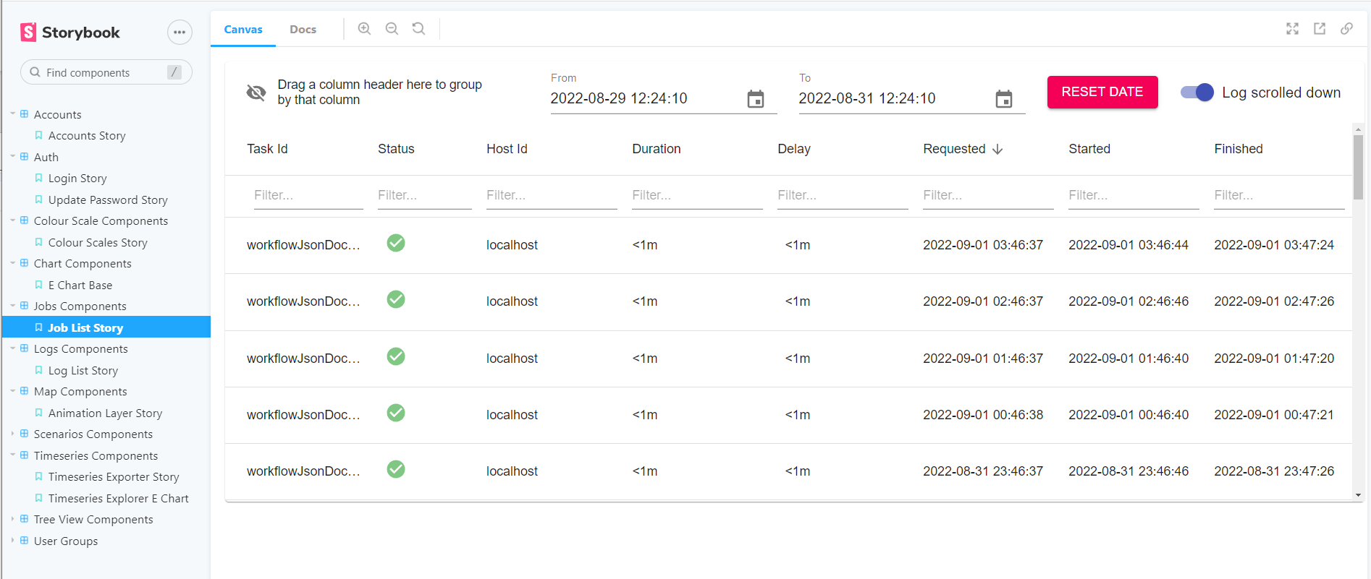
https://domainservices.dhigroup.com/?path=/story/jobs-components--job-list-story
Notes:
Some of the stories require authentication
Some of the stories are difficult to run or layout standalone

Slide 13
Applying the DHI react components

Slide 14
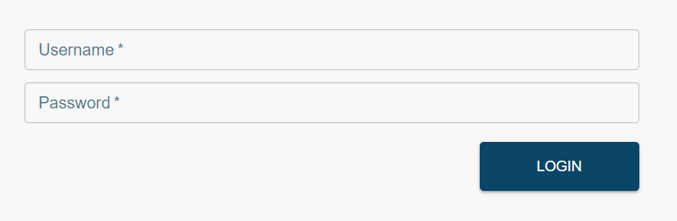
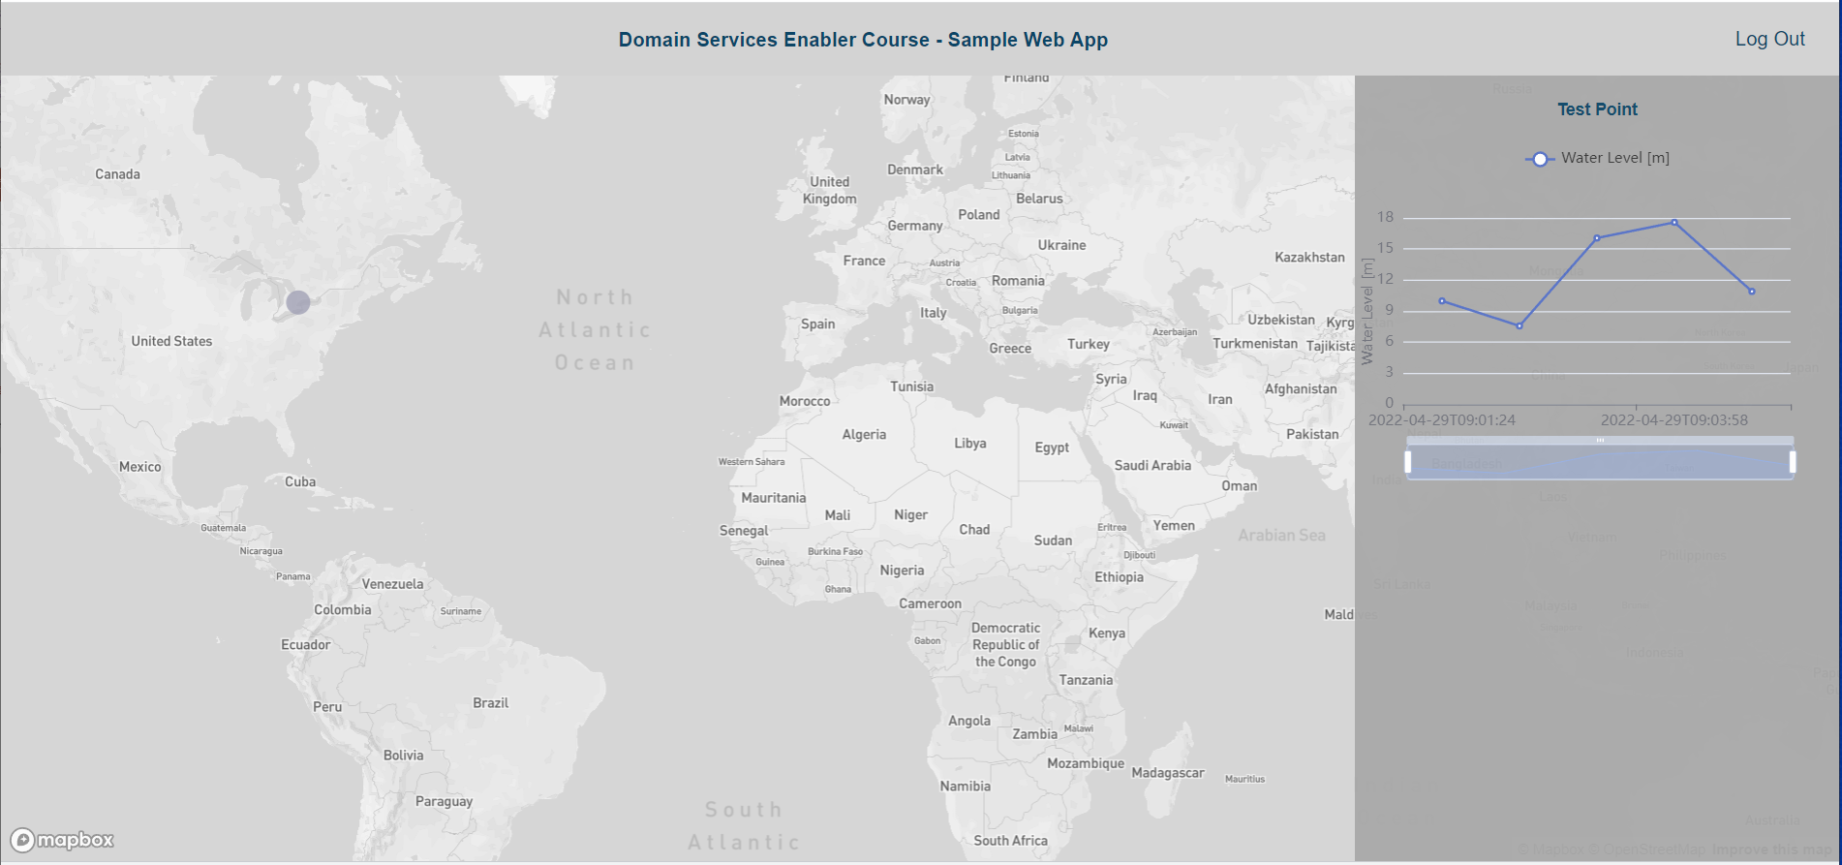
ThemeProvider
Login, User
Datasource
fetchtimeSeriesValues
BaseChart
Notes:
ThemeProvider: makes DHI default colors available eg: blue font colors
Login: presents the login form, posts credentials to the authentication API
User: typescript interface to read user response from the API
DataSource: typescript interface used for querying timeseries data from the API
fetchtimeSeriesValues: function to query data from the API
BaseChart: presents timeseries data in a basic line chart

Slide 15
Guide to running the example

Slide 16
Install:
Visual Studio Code
Node.js (I’m using 18.8.0)
Yarn (I’m using 1.22.19)

Slide 17
Register:
Github token https://github.com/DHI/react-components/blob/master/packages/react-components/README.md
Mapbox token https://account.mapbox.com/access-tokens/
Notes:
Github token for installing DHI/react-components, goes into .npmrc file
Mapbox token for using both react-map-gl component and showing vector tiles, goes into .env file

Slide 18
Launch:
In VS Code, open the DomainServicesCourse folder
In the terminal
Cd Source/Frontend
yarn
yarn start

Slide 19
Take home exercises/ideas

Slide 20
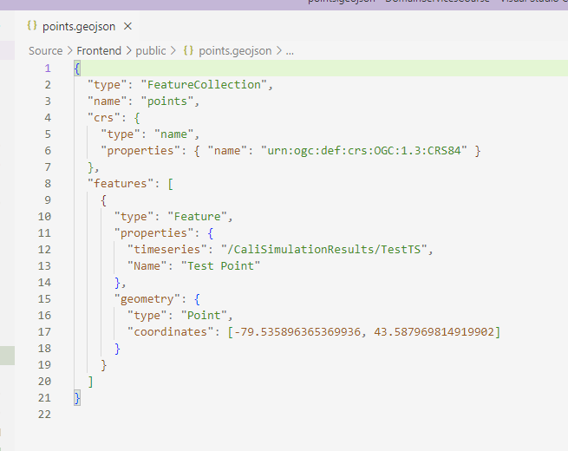
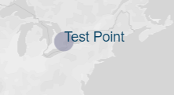
Additional points on the map linked to timeseries
Notes:
Additional points can be added simply by updating the points.geojson file

Slide 21
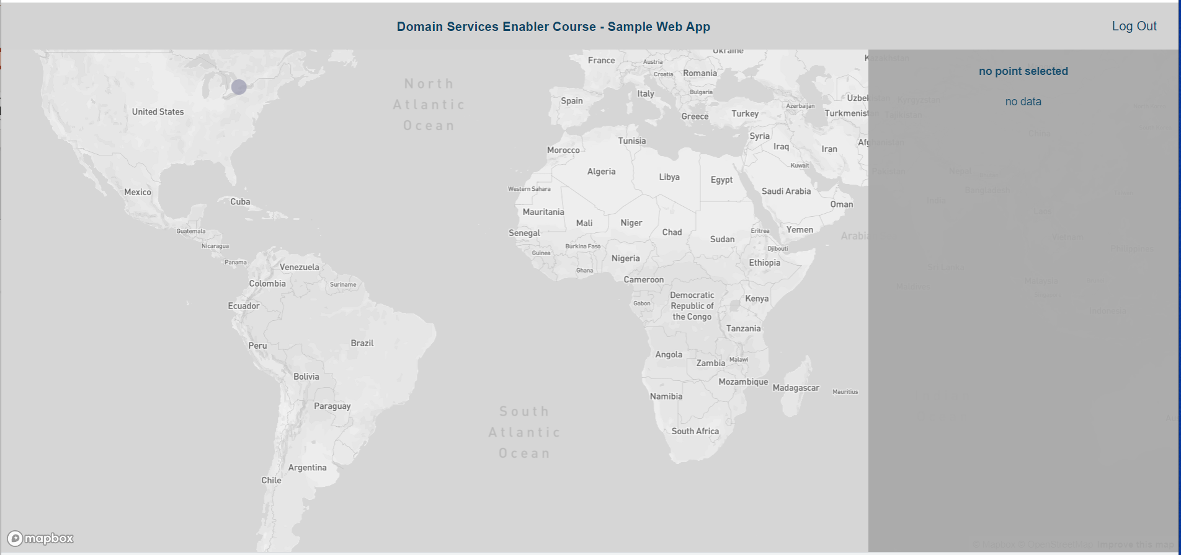
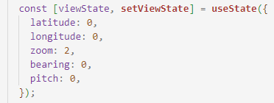
Initialise the map to a more useful bounding box
Notes:
You can set the initial bounding box when initializing the viewState variable. Other approaches could include calculating the bounding box of all points once they are received (you would also need to change how the points.geojson file is fetched in order to do this)

Slide 22
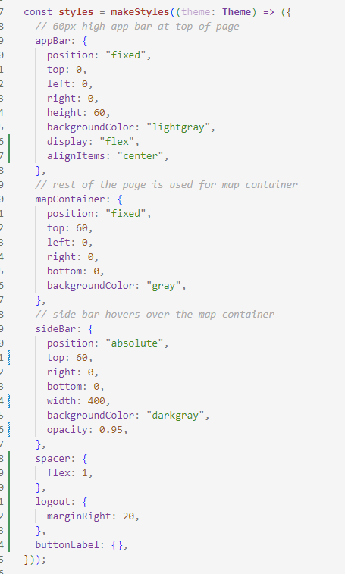
Change the side bar into a bottom bar where the timeseries chart has more room
Notes:
The layout/position of the Data page components are controlled by JSS. Update the JSS so that the sidebar becomes a bottom bar.

Slide 23
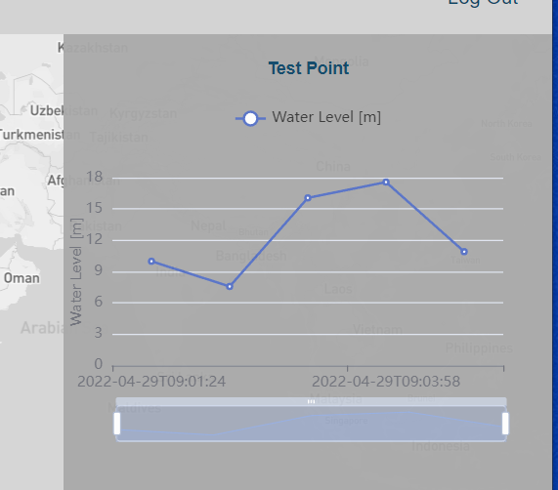
Add a ‘clear selected point’ or ‘X’ button to clear the selected point app state
Notes:
Find the code for the ‘Log Out’ button in this app, and use that as a basis for a new button in the sidebar, that clears the selected point app state.

Slide 24
Wrap Up
Notes:
Wrap Up. Before next live session (a week from now)
Go to the Campus site. Under module 5 you will find:
Provide feedback

Slide 25

Notes:
<use this slide for breaks>

