Slide 1


Module 2: Backend - basics
Developing Business Applications with
Notes:
Welcome
1½ hours (short break after 45 minutes)

Slide 2








Browser
Module 2: Backend – basics (Web API and security)
Client
WebSocket
Application Services
HTTP
HTTP
Authorization
Server
Web
Server
Job
Orchestrator
Job
Host(s)
Job
Host(s)
HTTP
Job
Host(s)
HTTP
TCP/IP
TCP/IP
HTTP
HTTP
Infrastructure Services
Azure
PostgreSQL
MIKE Cloud
Services
Notes:
Auth server: (web server). Security aspects (user accounts and their privileges). Issues access tokens to the client for accessing the actual web server.
Web server. Backend for the application. Start jobs, request status, view results (time series or maps etc.). REST API, but also some real-time messaging (SignalR/WebSocket) for example for real-time update of job progress.

Slide 3

Service Types
Plugins & Providers
Service Configuration
Securing the Application
Demo…

Slide 4
Service Types

Slide 5
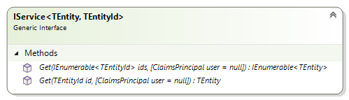
Services
TEntity: The type of the entity
TEntityId: The type of the entity identifier
Notes:
The services are the types that expose most of the functionality of DS. They are the ones you interact with as a consumer of DS – they constitute the API of DS. There are many kind of services for time series, GIS, spreadsheets, jobs etc. But they all based on the same generic abstractions/interfaces.
They are all centered around one specific type of entity – represented by the generic TEntity type parameter. An entity is always represented by a unique identifier of type TEntitiyId
The IService interface is the most basic service interface. All services share this interface.

Slide 6
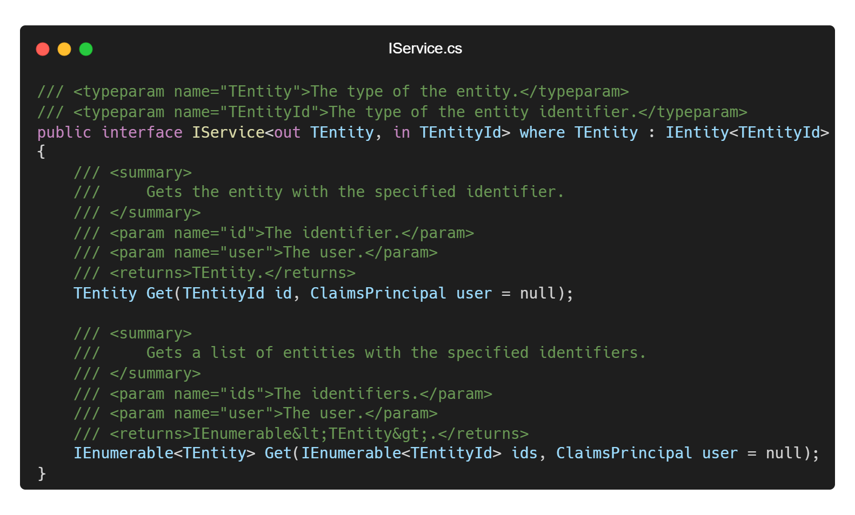
Notes:
This is how IService interface looks in actual C# code

Slide 7
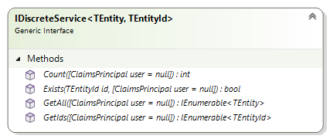
Discrete services
Can handle a finite (countable) number of entities
Notes:
Interface segregation principle (SOLID)
Not one big service interface, but rather a number of smaller interfaces that can be combined.
“Clients should not be forced to depend upon interfaces that they do not use”

Slide 8
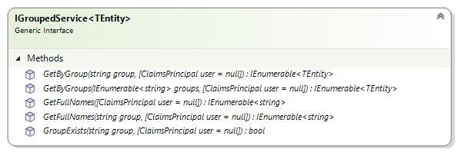
Grouped services
Can handle entities organized in hierarchical groups (e.g. trees)

Slide 9
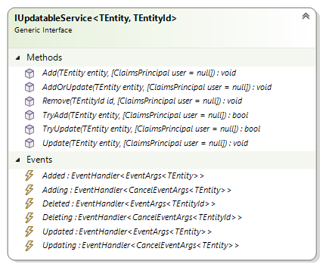
Updatable services
Can handle add, remove and update of entities
Notes:
Many, relatively fine-grained interfaces: Interface Segregation Principle (ISP) – one of the SOLID principles.

Slide 10
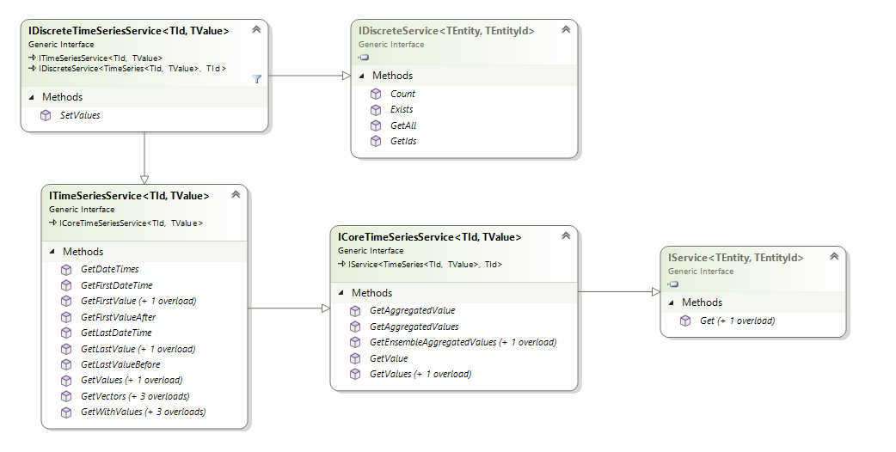
Time series services
Notes:
In a combination of composition and inheritance, the actual service types are defined. Here is a diagram of the interfaces defining a discrete time series service.

Slide 11
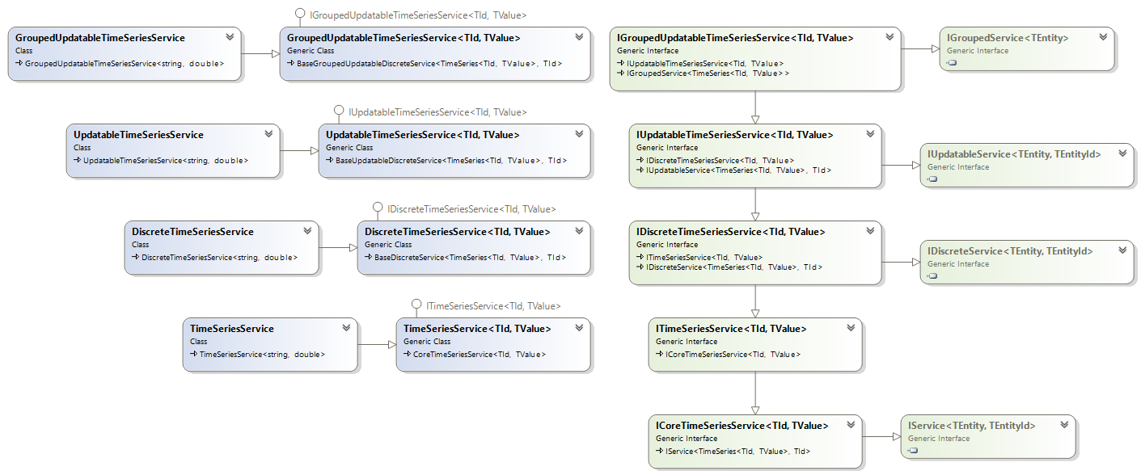
Time series services
Increasing functionality
Notes:
In a combination of composition and inheritance, the actual service types are defined. Here is a class diagram of all the time series services.
To the right We recognize the just mentioned generic interfaces. Then we have some time series-specific extensions of interfaces.
A hierarchy of TS interfaces: IGroupedUpdatableTSS is an extension of IUpdatableTSS which again is an extension of IDiscreteTSS
The concrete service implementations. Each service is an extension of the one below it (it has the same functionality + something more). The service at the bottom has less functionality and then you have increasingly more functionality as you move up the stack.
Non-generic versions of generic services. Decisions have been made about the types of identifier and values (string and double respectively)
Why do we need this granularity? Because there is a large variety in what the different time series data sources support. E.g. MO supports grouped time series – but a dfs-file doesn’t.

Slide 12
Plugins & Providers

Slide 13
Extensibility Points
IWorker
JobService
WorkflowWorker
IMapSource
MapService
DfsuMapSource
Dfs2TimeSeriesRepository
ITimeSeriesRepository
TimeSeriesService
Dfs0TimeSeriesRepository
Notes:
DS types expose a number of interfaces that serve as extensibility points.
For example, the JobService is depending on an object implementing the IWorker interface.
Indicated with the socket notation
Likewise, the MapService requires an IMapSource-object and the TimeSeriesService an ITimeSeriesRepository-object.
At runtime, these services will need a concrete implementation of these interfaces – but will work with any implementation (#) - as shown for the TimeSeriesService
These extensibility points act as seams between the pure and stable BL and more volatile details.

Slide 14
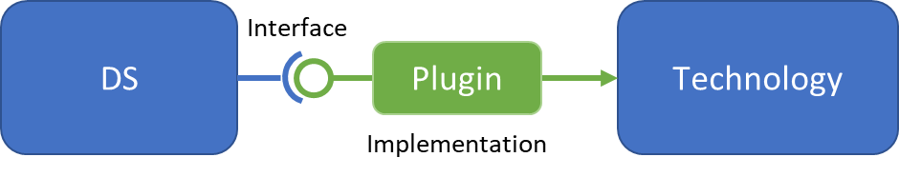
Plugins
Notes:
The concrete implementations of these interfaces are called ”plugins”.
The typical plugin is technology-specific – i.e. depending on a specific technology.
So, the plugins very often act as adapters between DS and specific technologies.

Slide 15
Providers
DHI.Services.Provider.{Technology}
DHI.Services.Provider.Foo
DHI.Services.Provider.Bar
Plugin a
Plugin d
Technology Foo
Technology Bar
Plugin b
Plugin e
Plugin c
Plugin f
Notes:
All technology-specific plugins are gathered in their own component (their own assembly/DLL).
Such a component is called a provider.
Namespace convention: DHI.Services.Provider.{Technology}
All plugins for a technology “Foo” is gathered in a component called DHI.Services.Provider.Foo
Likewise for technology Bar

Slide 16
MIKE Core Provider
DHI.Services.Provider.MIKECore
Dfs0TimeSeriesRepository
ITimeSeriesRepository
TimeSeriesService
Dfs2TimeSeriesRepository
MIKE Core
DfsuTimeSeriesRepository
IGisRepository
GisService
DfsuFeatureRepository
IMapSource
MapService
DfsuMapSource
Notes:
Just a few of some of the plugins from the MIKE Core provider:
Various time series repositories for different dfs-files
A feature repository serving vector graphics (features) from a dfsu-file for the GIS service
A map source serving bitmap images from a dfsu files for the Map service

Slide 17
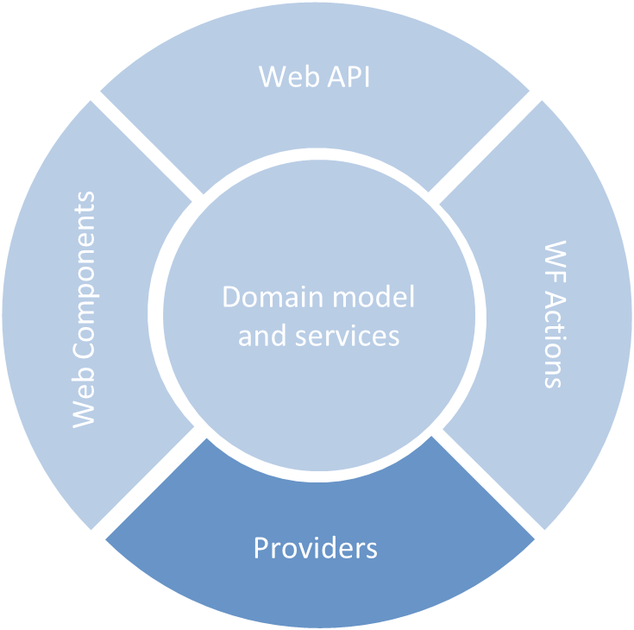
DHI.Services.Provider.MIKECore
DHI.Services.Provider.MIKECloud
DHI.Services.Provider.PostgreSQL
Notes:
As you may remember from module 1, providers belong to the infrastructure-layer of the onion architecture (module 1)

Slide 18
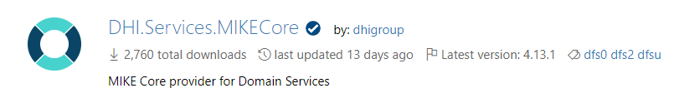
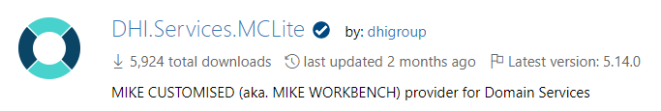
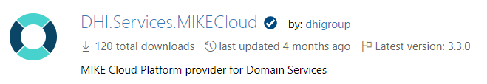
Providers - NuGet Packages
DHI.Services.<Technology>
Notes:
Like other DS-components, also providers are published as NuGet packages
NOTE:
Generally, the naming convention for NuGet packages is that the NuGet package ID is equivalent to the root-namespace of the contained assembly/DLL
However, there is a subtle exception for providers, where the “Provider”-part of the namespace is excluded
DHI.Services.Provider.MIKECore => DHI.Services.MIKECore
I could try to argument why, but the most important is that you know. And at least it is consistent!

Slide 19
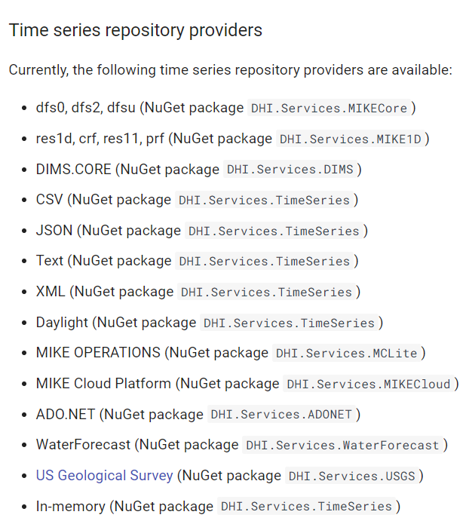

Slide 20
Service Configuration

Slide 21
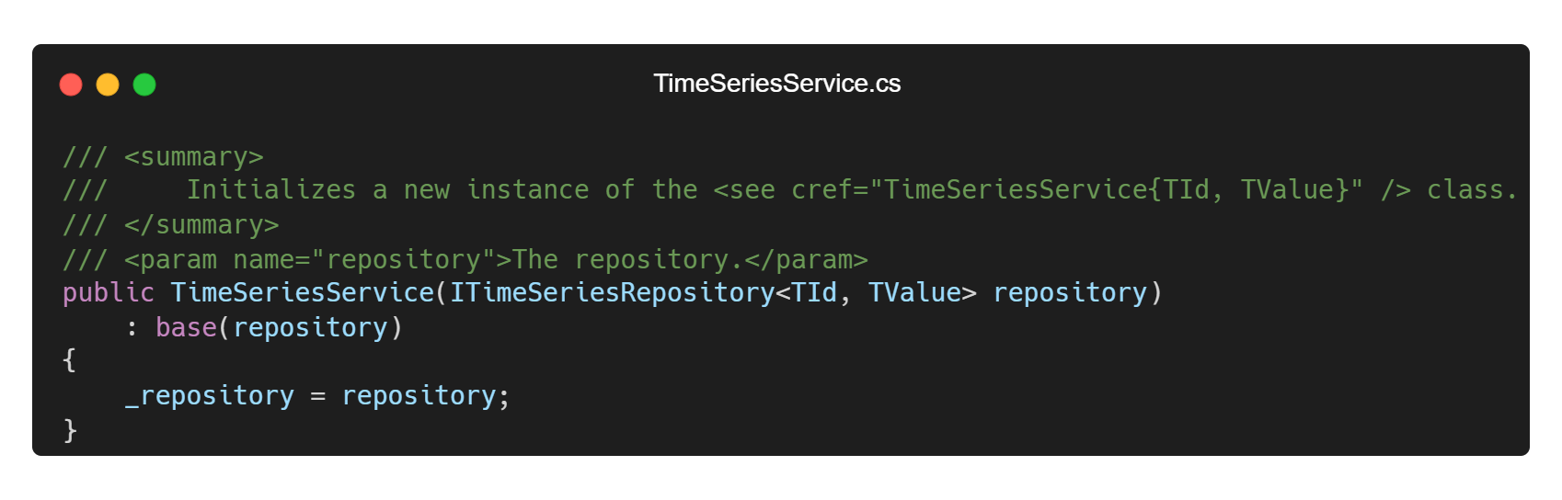
Dependency Injection
Notes:
Almost all services depend on a repository. The repository is responsible for the actual reading and writing to the underlying data source. This repository object is injected into the service through the constructor during service object creation. So, all service constructors look conceptually like this. This is a technique called dependency injection
As mentioned in Module 1, this is a very powerful design, as it:
Decouples the service functionality from the storage technologies . Persistence becomes a detail that is abstracted away.
Dramatically increases the testability of services – for example using fake in-memory repositories.

Slide 22

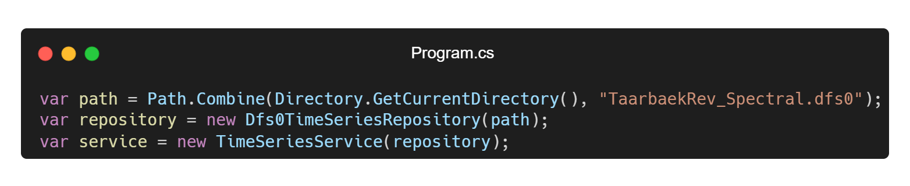
Service Composition
YOUR CODE
Notes:
Saw this in the module 1 assignment.
Create repository object – in this case a Dfs0TimeSeriesRepository
Inject it into a compatible service
Keep an eye on the “YOUR CODE” stamp in the following slides. It will appear on slides with code that you will write when configuring your application – typically in the composition root of your app - Program.cs (or possibly Startup.cs file of an ASP.NET Core project)

Slide 23
Connections
Notes:
A connection is an alias/identifier for a particular service.
These connection IDs are used directly in the URLs (endpoints) of the Domain Services Web API components.
This way you can register multiple instances of for example a TimeSeriesService using different storage repositories. And then at runtime – when making requests to the Web API endpoints - you can decide which connection to use.

Slide 24
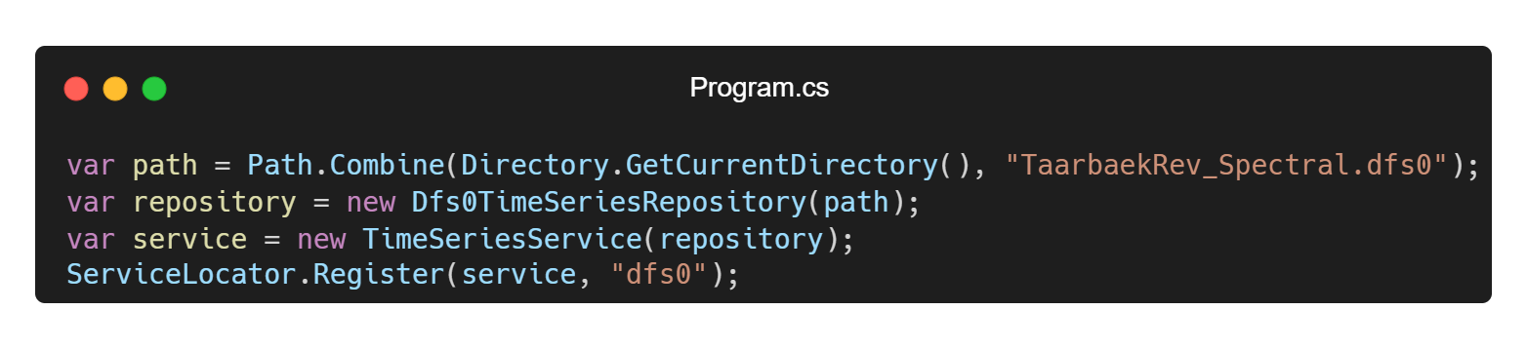
Registering Connections
YOUR CODE
Notes:
Registration of connections for a Web API is done using the Register() method on the static ServiceLocator class. This is done in the Program.cs (or Startup.cs) file which is the “composition root” of any ASP.NET project.
Here you can see how you can register the TimeSeriesService that we created previously as a connection with id “dfs0”

Slide 25
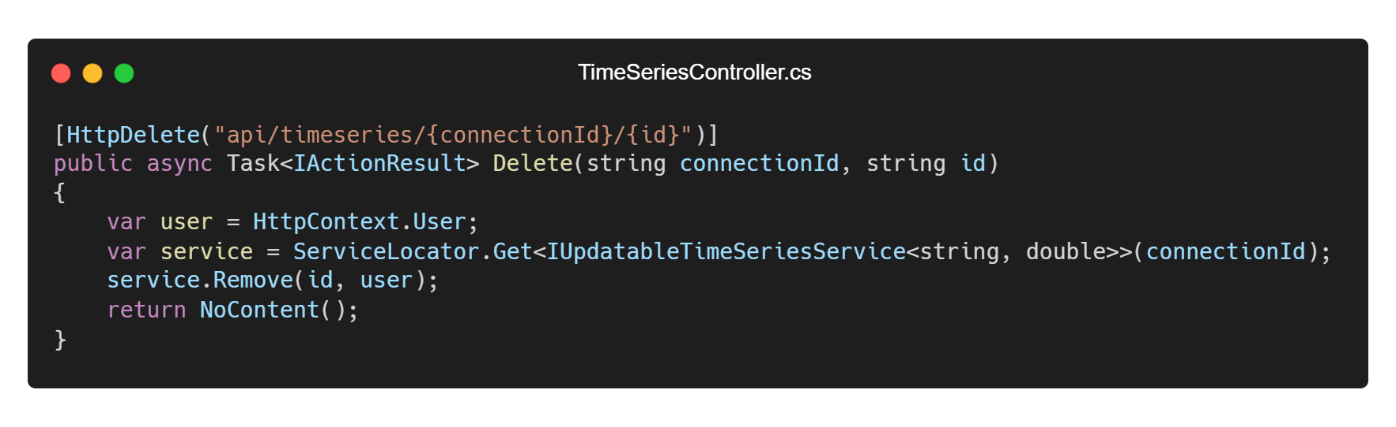
Using Connections in a Controller
Notes:
Here you can see how the service locator is used in an ASP.NET controller action (this is from the time series Web API) - to retrieve a connection with a particular connection ID at runtime.
No “YOUR CODE” stamp! Unless you write custom controllers (which indeed you can!), you don’t have to write code like this

Slide 26
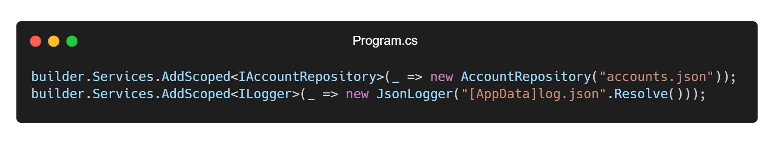
YOUR CODE
Registering other services
Notes:
Not all services need to be resolved runtime from the connection ID. Some services – let’s call them system services – are configured using the standard ASP.NET Dependency Injection mechanism.
Here is an example of registration of a user account repository, which is required in the Authorization Server and a logger.
This is done in the so-called service collection of the WebApplicationBuilder object.
It also takes place in the Program.cs (or Startup.cs) file which is the “composition root” of any ASP.NET project. It is all standard ASP.NET.

Slide 27
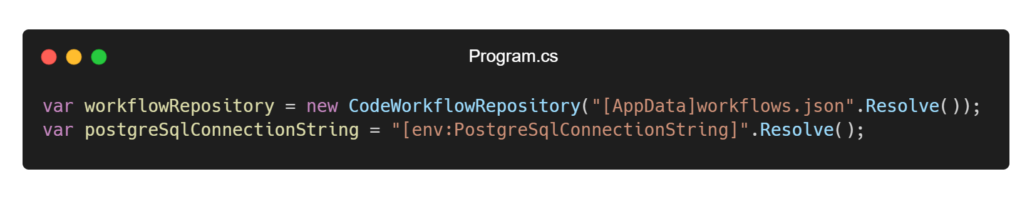
Configuration String Placeholders
YOUR CODE
Notes:
There are 2 types of configuration string placeholders, you can use in you configuration of an application.
By convention, data files are often placed in the ASP.NET App_Data folder or sub folders to this. In this case, instead of giving the full path to the App_Data folder when defining the connection string, then the [AppData]-placeholder can be used. Then the [AppData]-placeholder will be resolved to the full folder path at runtime.
The other type of placeholder is for looking up the value of an environment variable at runtime. The syntax is as shown here. This placeholder will be replaced by the actual value of the PostgreSqlConnectionString environment variable.
To trigger the actual runtime conversion, you must call the Resolve() extension method.

Slide 28

Notes:
5 minutes

Slide 29
Securing the Application

Slide 30

Security Aspects
Authentication
Authorization
Brute-force attacks
SQL injection
Cross Site Scripting (XSS)
Cross Site Request Forgery (CSRF)
Denial-of-service attacks
…
Notes:
Securing your application is hard! There is indeed a lot to be worried about
Here are just a few of the security aspects to consider.
Focusing on the first couple of them alone (#)
Other security aspects might be covered to a certain degree in Module 5 (Deployment)

Slide 31



Authorization Flow
Browser
Client
Application Services
Authorization
Server
Web
Server
Notes:
DS supports the OAuth authorization flow called: "Resource Owner Password Credentials Grant".
Nice separation of concerns:
Different Web servers (whether they represent applications or individual microservices within an application) can share the same instance of an authorization server
The Authorization server can be replaced with 3rd party Authorization servers (e.g. Auth0 or MIKE Cloud authentication)

Slide 32
Authentication Features
Two-factor authentication (OTP using Microsoft- or Google Authenticator)
IP-whitelisting
Password Policy
Secure Account Registration (B2C)
Secure Password Reset
Breached Password Protection (Have I Been Pwned?)
Brute-force Attack Protection (Progressive delay)
Notes:
Show

Slide 33
Demo…
Notes:
Show templates in Visual Studio Marketplace

Slide 34
Wrap Up
Notes:
Wrap Up. Before next live session (a week from now)
Test
Assignment (Do what I just did in the demo)
Evaluation (module 1)

Slide 35



