Slide 1


Module 1: Introduction
Developing Business Applications with
Notes:
<RECORD!>
Welcome
Thanks for signing up
Duration of this session: 1½ hours
(short break halfway)

Slide 2
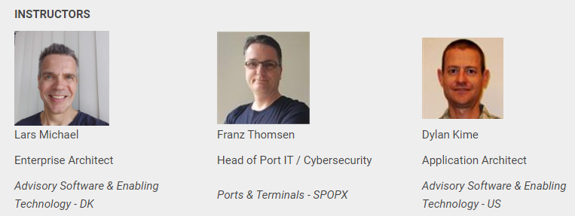
Notes:
<RECORD!>
Instructors you will meet
I am the original creator of DS
Franz is the creator of the WF-part of DS. He built our flagship business application - NCOS Online - using DS + WF.
Dylan is one of the most experienced users of DS+WF components. Built several business applications using this tech stack.

Slide 3
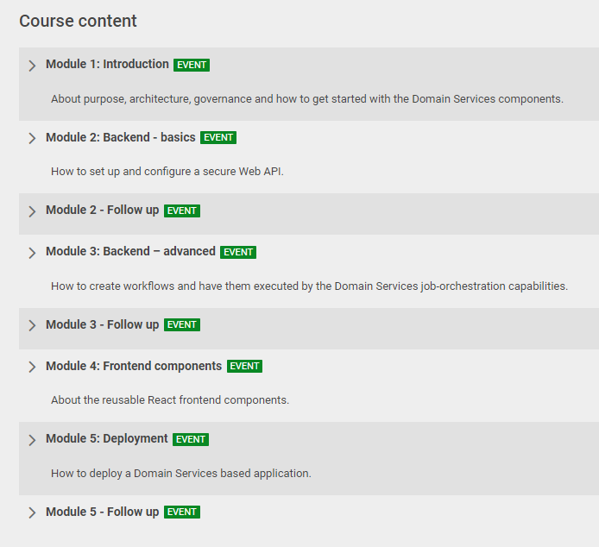



Notes:
We will split the modules between us like this.
Each module will consist of a live session and a bit of ”homework” in the form of tests and possibly small coding assignments.
Tests and assignments is something you do in between the live sessions. Probably less than 1 hour.
We will complete 1 module each week.
The ”Follow Up” events will be used to follow up on these test & assignments (feedback, Q&A etc.)

Slide 4
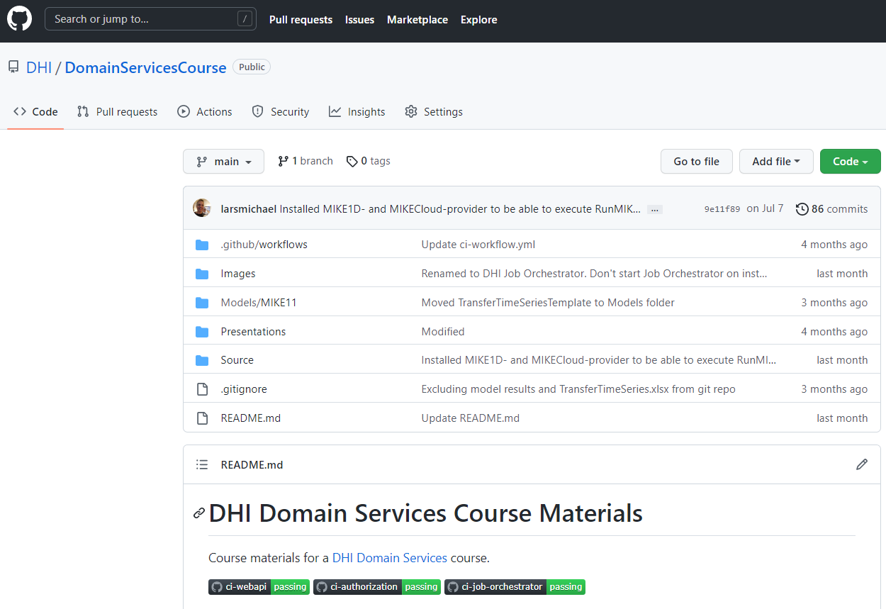
Notes:
We have gathered the course materials in a GitHub Repository:
PP Presentations
Source code for a sample application which will be used as a reference throughout the course.

Slide 5




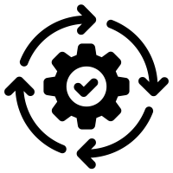



Frontend
Client
WebSocket
Application Services
HTTP
HTTP
Authorization
Server
Web
API
Job
Orchestrator
Job
Host(s)
Job
Host(s)
HTTP
Job
Host(s)
HTTP
TCP/IP
TCP/IP
HTTP
HTTP
Infrastructure Services
Azure
PostgreSQL
MIKE Cloud
Services
Notes:
A bit more about this sample application.
The sample application is a relatively simple – yet realistic application.
The application orchestrates a MIKE 11 model-execution and displays the simulation results in a web application. In that sense, it mimics the functionality of a typical DHI business application.
4 application services (communication via internet protocols)
Auth server: (web server). Security aspects (user accounts and their privileges). Issues access tokens to the client for accessing the actual web server.
Web server. Backend for the application. REST API, but also some real-time messaging (SignalR/WebSocket) for example for real-time update of job progress.
Job Orchestrator: Orchestrate job execution (incl. load balancing).
One or more job hosts: Actual execution of jobs.
All 4 application services can run on a single machine, which is good for rapid prototyping and debugging. In production, they will typically be distributed to individual resources for robustness and scalability.
Application services communicate with infrastructure-services.
May seem overwhelming at first glance. But we will gradually work our way into it during the course.

Slide 6
Module 4: Frontend (React)
Module 5: Deployment
Frontend
Module 2: Backend – basics (Web API and security)
Module 3: Backend – advanced (jobs & workflows)
Client
WebSocket
Application Services
HTTP
HTTP
Authorization
Server
Web
API
Job
Orchestrator
Job
Host(s)
Job
Host(s)
HTTP
Job
Host(s)
HTTP
TCP/IP
TCP/IP
HTTP
HTTP
Infrastructure Services
Azure
PostgreSQL
MIKE Cloud
Services

Slide 7

Notes:
Before digging into the matter; I have created a small poll. To have a bit of interaction and make sure we are all awake.

Slide 8

Purpose
Design & Architecture
Governance
How to Get Started?
Demo…
Notes:
This first module of the course will be a bit theoretic. But please be patient, I promise that in the end and in the following modules, we will gradually dive much more into the practical details. After this disclaimer:
Purpose: Why was it made. What does it solve?
Overall design principles and architectural pattens that have guided the development process
Organization and processes around DS
How to get started using the DS components.
Demo. So at least in the end of this presentation, you will see a bit of live coding

Slide 9
Purpose
Notes:
Why did we make DS? Which problems does it solve?

Slide 10

Cloud
Technology alignment
Community driven
Multi-user
Data abstraction
Web
Agility
Notes:
DS is the result of a strategic initiative initiated around 8 years ago (pre CloudBridge and the current DHI+ strategies.).
What were the challenges, we wanted to solve?
Technology alignment (already then, several dev. framework MZ, MW, MIKE+)
Data abstraction => easily integrate with data from heterogenous data sources
More agile development (at that time release every 18 months)
Most importantly: Support of Business application development (web applications. Not much experience)
Community-driven. All of DHI – despite geographical and organizational affiliation. (Slogan: “Think Group First!”)

Slide 11
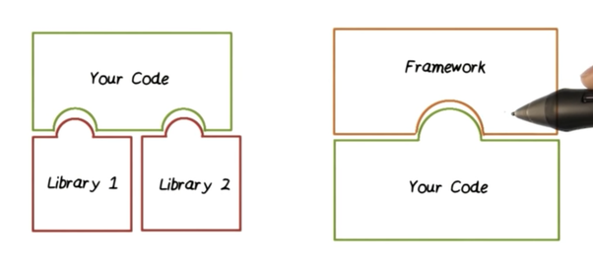
Libraries vs. Frameworks
Notes:
Long story short! After a long process (workshops, design-documents)
Instead of “yet another framework” (in addition to MZ, MW, MIKE+) – let’s build some autonomous libraries that can be used across different frameworks and applications.
What is the difference?
Consuming libraries: your code calls the library code
Using a framework: The framework calls your code.
When using libraries, your code - & you (as an application developer) - are in control. You can cherry-pick whatever libraries you need.
On the contrary, Frameworks take control. Your application code needs fit into the framework. Frameworks are opinionated and dictate stuff.

Slide 12
A collection of reusable libraries for developing service-oriented business applications
Notes:
Anyway, described in a single sentence, this is what Domain Services is:
A collection of reusable libraries for developing service-oriented applications
BTW, in the following, I will probably use the word “component” rather than “library”. But in my world, they mean the same.

Slide 13
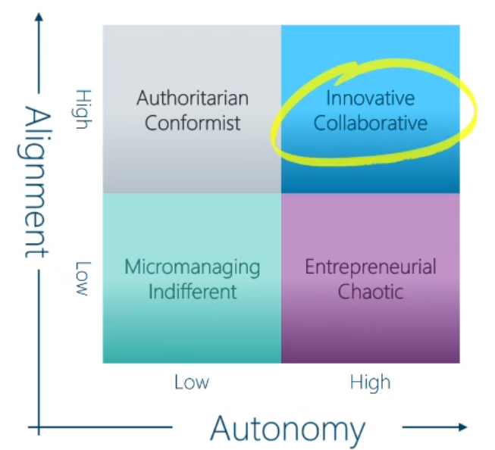
Notes:
Luckily, now 8 years down the road, this approach still fits perfectly with the current DHI strategy.
Latest Town Hall meeting, our CEO presented this diagram illustrating how the new DHI+ strategy aims to establish an innovative and collaborative culture based on a high degree of autonomy as well as a high degree of alignment. DS perfectly sustain this strategy. (#)
Shared across all DHI => high degree of alignment.
cherry-pick whatever you need in a particular context =>high degree of autonomy
open-source model => a high degree of community-led collaboration.
In that sense, DS perfectly sustains even the newest DHI strategy (DHI+)

Slide 14
Design & Architecture
Notes:
A bit about the overall design principles and architectural pattens that have guided the development process

Slide 15
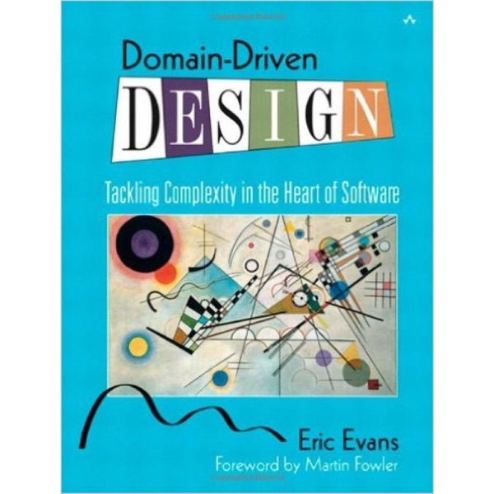
Notes:
Well-known book by Eric Evans: Domain Driven Design (or DDD).
These are the design principles from where Domain Services has its name.
In short, DDD is about modeling real-world concepts into the software.
It Revolves around an object-oriented model of the domain – aka. the domain model
DDD Defines terms such as entities, repositories and services, which you will see heavily represented in the Domain Services code.

Slide 16

Notes:
When it comes to the architecture, DS is guide by an architectural pattern called “Clean Architecture”.
The term "Clean Architecture" was originally coined by Robert. C. Martin – one of the fathers of the Agile Manifesto for software development.

Slide 17
UI technologies?
Storage technologies?
“A good architecture allows major decisions to be deferred”
Robert C. Martin
Logging?
Hosting?
Security?
Notes:
Quote from the author about Clean Architecture
What does he mean. What are those “major decisions” that can be deferred (or postponed)?
Decisions about UI technologies (Polymer, React, WinForms, WPF)
Storage technologies (Postgres db, MO db, MIKE dfs files, MIKE Cloud Platform)
Logging (files, database)
Security (DIY or 3rd party services)
Hosting (on prem/Azure/Amazon).
Clean Architecture maximizes the decisions that are NOT made in advance. Allows you to delay decisions as long as possible – and even revert them later on.
Good because Requirements will ALWAYS change

Slide 18
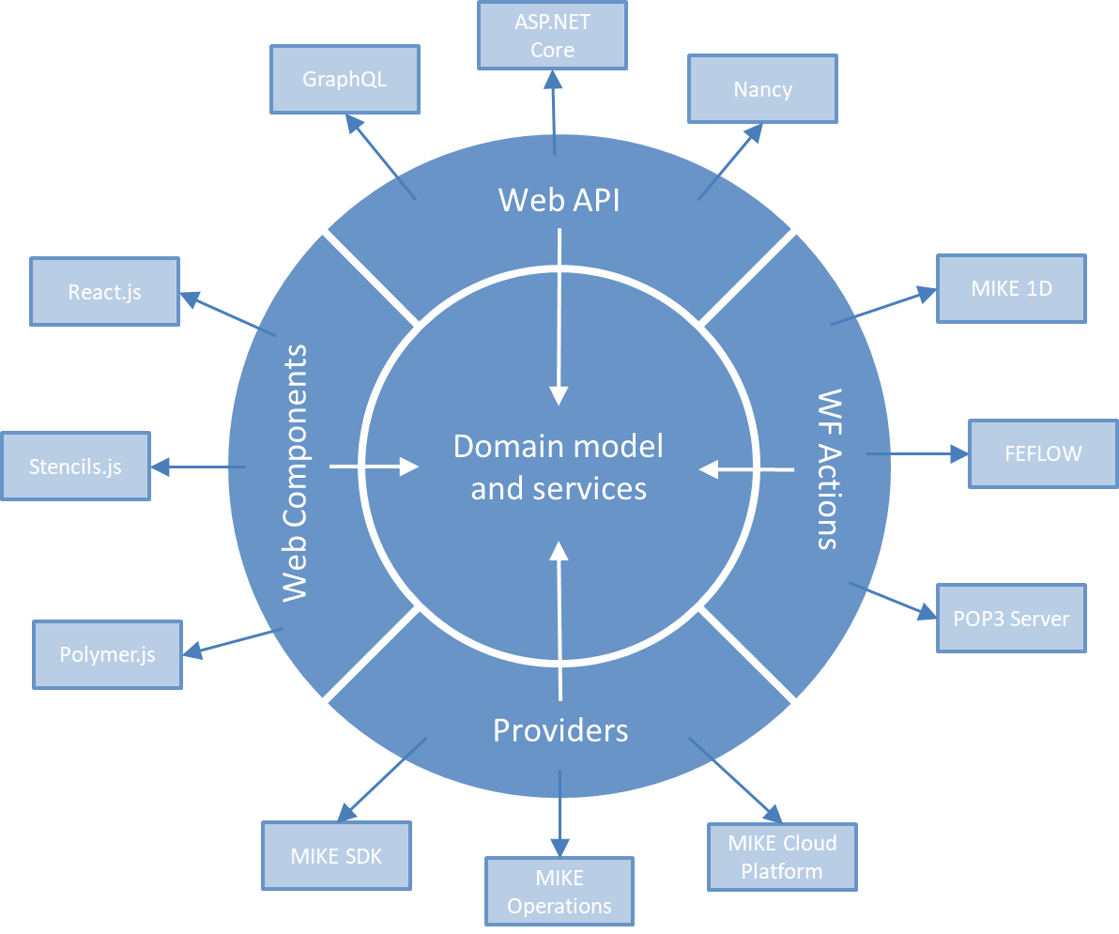
Onion Architecture
Notes:
Another name for Clean Architecture (can be depicted as a number of concentric layers)
Center: Domain Model & services. Aka. "Business Layer"
Outer layer (Infrastructure layer). Dependencies on 3rd party technologies (ASP.NET Core, React)
Light blue: 3rd party. Dark blue: DS components
NOTE: All dependencies points towards the BL => BL independent on any infrastructure!
4 categories of infrastructure components.
5 categories in all: go through them One-by-one.

Slide 19
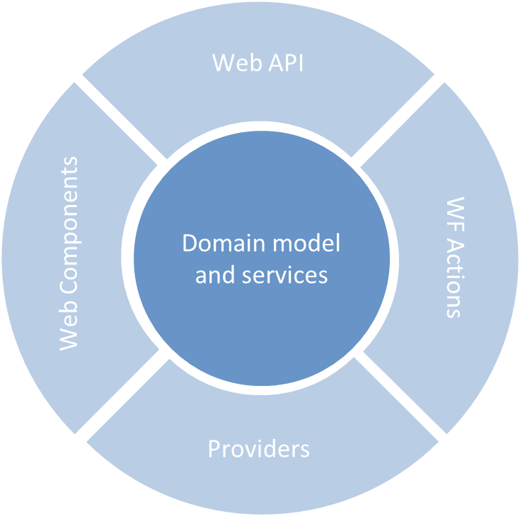
DHI.Services.TimeSeries
DHI.Services.GIS
DHI.Services.Jobs
Notes:
The domain layer contains a number of domain-specific services (e.g. time series , jobs and GIS) (#)
All services expose basic CRUD-functionality
But also, additional business logic. E.g. the time series service provides functionality such as re-sampling, gap-filling, moving average etc.
In general: Pure vanilla .NET components (aka. POCOs).
No hard-wired dependencies on storage technologies or other infrastructure aspects

Slide 20
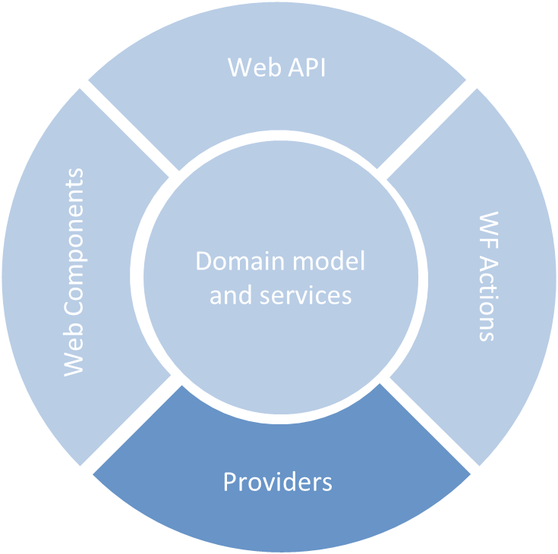
DHI.Services.Provider.MIKECore
DHI.Services.Provider.MIKECloud
DHI.Services.Provider.PostgreSQL
Notes:
Providers are components containing so-called “plugins” to the domain model and services
A typical plugin is a repository, which is an abstraction of data persistence (#)
For example, the MIKECloud provider contains a repository for persistence of TS in the MIKE Cloud TS storage.
More details in module 2.

Slide 21
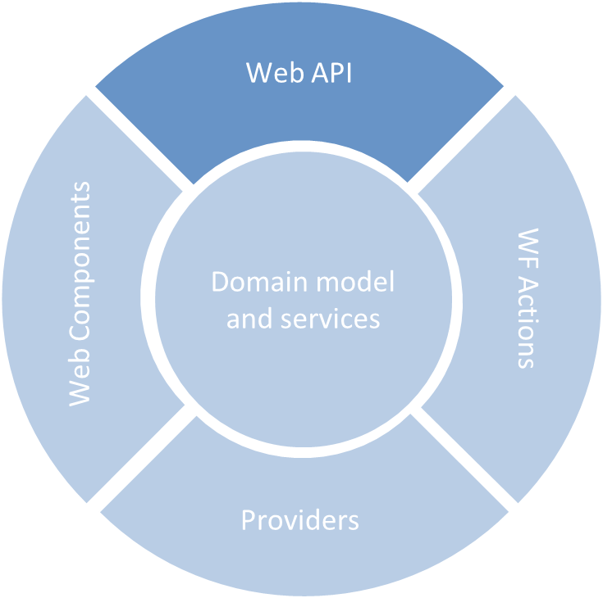
DHI.Services.Jobs.WebApi
DHI.Services.TimeSeries.WebApi
DHI.Services.Security.WebApi
Notes:
The Web API components expose the BL services as http-based Web APIs (aka. REST APIs).
All service components in the BL has an equivalent Web API component. (#)
E.g. TimeSeries and Jobs
Lean. Merely thin wrappers around the BL services. All business functionality is encapsulated in the BL services.
All Web API components are implemented using the ASP.NET Core web framework.
Must be used from an ASP.NET Core project.

Slide 22
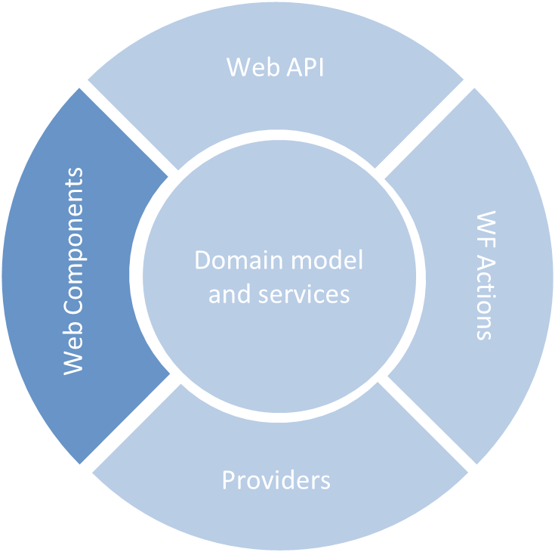
LeafletAnimation
ScenariosTable
JobsList
Notes:
Web UI components
Reusable JaveScript components. (#)
First generation: Google Polymer - Now React components.
Based on functionality in the BL – exposed via the Web API components
E.g. the LeafletAnimation displaying maps with data-overlays retrieved from the MapService

Slide 23
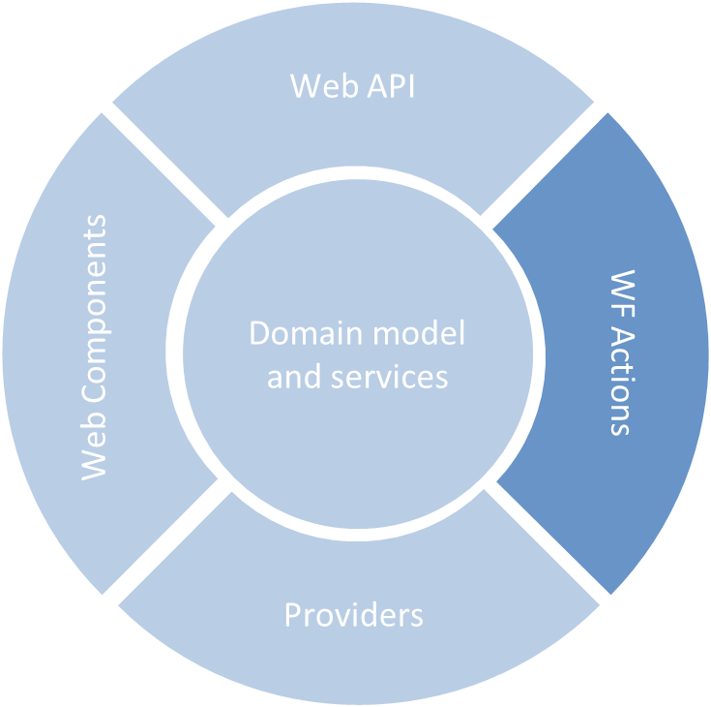

DHI.Workflow.Actions.Core
DHI.Workflow.Actions.Jobs
DHI.Workflow.Actions.TimeSeries
Notes:
Workflow actions are small blocks of functionality that can be combined to form workflow sequences
Namespace used for these components is DHI.Workflow.Actions
Franz, Module 3: How to build and execute workflows.
(#) BTW, You have probably guessed by now, where the inspiration for the DS logo came from ☺

Slide 24
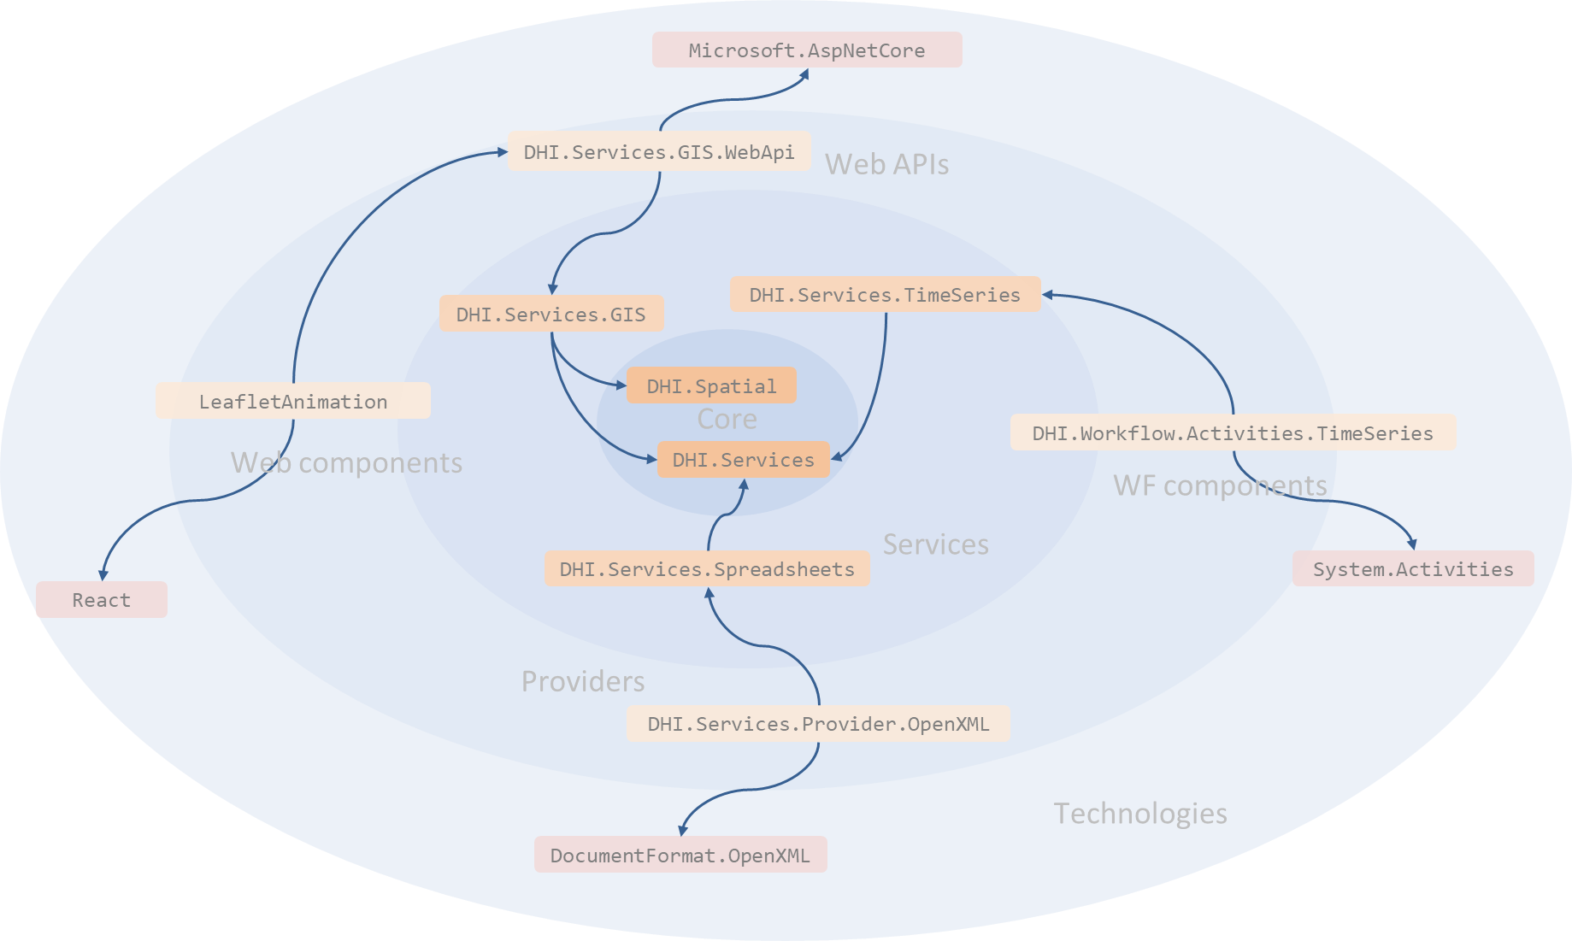
Notes:
The same onion rings exploded a bit more. Allows more details (still only a subset).
In the very core:
the most fundamental domain models – e.g. for geometry (DHI.Spatial) - but also, domain models for physical quantities and units etc.
DHI.Servies: generic abstractions of entities, repositories, services etc.
DHI.Services is the core component of DS
Then we have the service layer.
All services depend on DHI.Services.
DHI.Services.GIS also depends on the spatial geometry in DHI.Spatial.
< --- Follow: GIS + leaflet --- >
It is in the infrastructure layer that the dependencies switch direction from pointing towards the center to pointing towards various 3rd-party technologies.

Slide 25
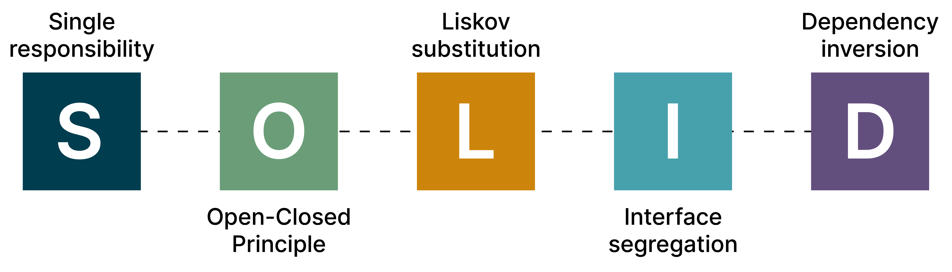
Notes:
DS is implemented using the SOLID design principles
SOLID is an acronym for five object-oriented design principles
I will not go into details with all of them, but just emphasize a single one, which is very important for the DS design.
This is the last one “Dependency Inversion”

Slide 26
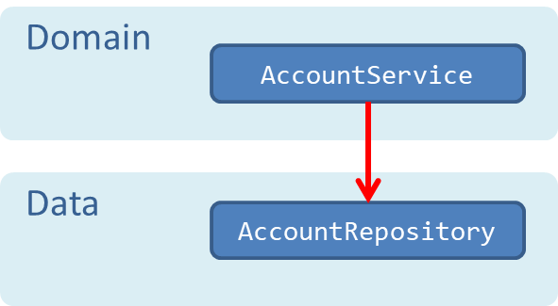
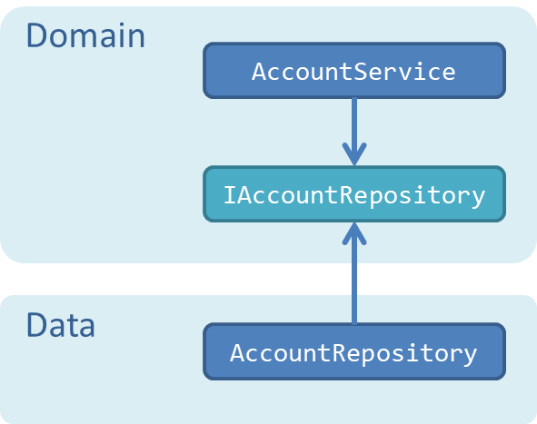
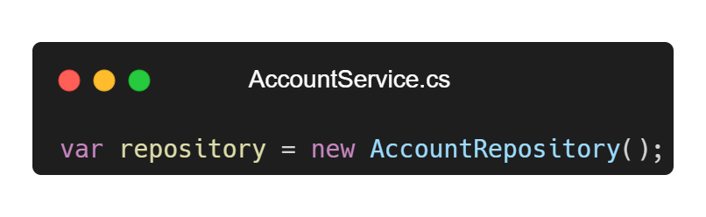
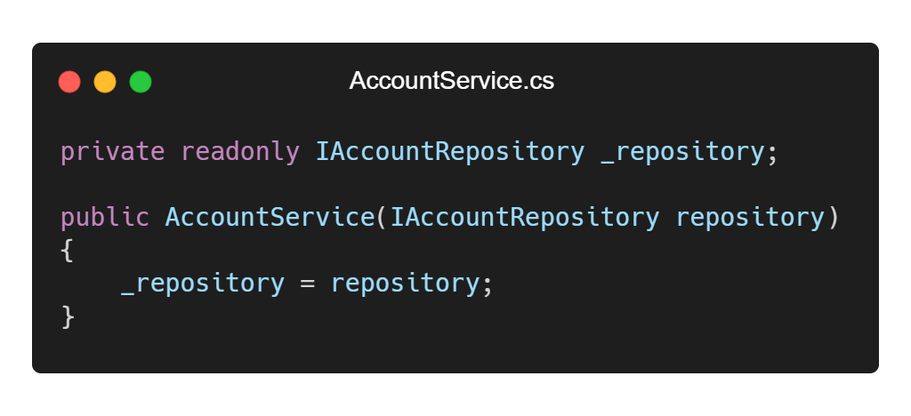

Dependency Inversion Principle "High-level modules should not depend on low-level modules. Both should depend on abstractions"
Notes:
DIP states that “< --- read loud --- >”
Best illustrated by a simple example:
Left: Apparently well-structured. Split in layers. Deceptively decoupled. Hard-wired dependency domain->data. Tightly coupled. Create instance using the new operator. (#)
Right: Introduce abstraction. Service requires. Repository implements. Instead of “newing” up instance, inject through constructor.
Result: Dependency is turned around.
Advantages (compared to left):
Decoupling (Domain functionality is decoupled from infrastructure – for example storage technologies) => reuse, replace infrastructure.
Testability increases dramatically (mock/fake objects – ex. in-memory repository)
This particular usage of the DIP – defining an abstraction of data persistence - is aka the repository pattern.

Slide 27

Notes:
To spell it out:
Generally, new is glue!
Any time you use the new keyword, you are gluing your code to a particular implementation.

Slide 28
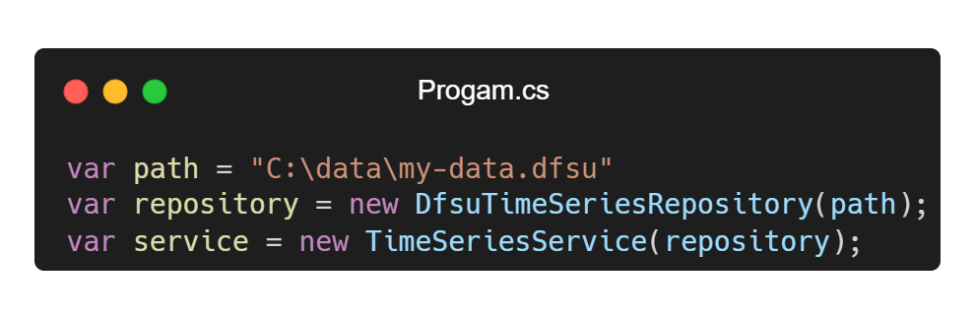
Composing Objects - Dependency Injection
Notes:
However, at one point in time, you have to glue the individual bits and pieces together.
You have to compose the service objects for your application. You have to decide which concrete types to use.
You do this in the so-called composition-root of your application – typically Program.cs or possibly Startup.cs in ASP.NET Core.
Technique: dependency injection.
Create the repository object – in this case a DfsuTimeSeriesRepository (#)
Inject that repository into a compatible service (#)
More about this in module 2.

Slide 29
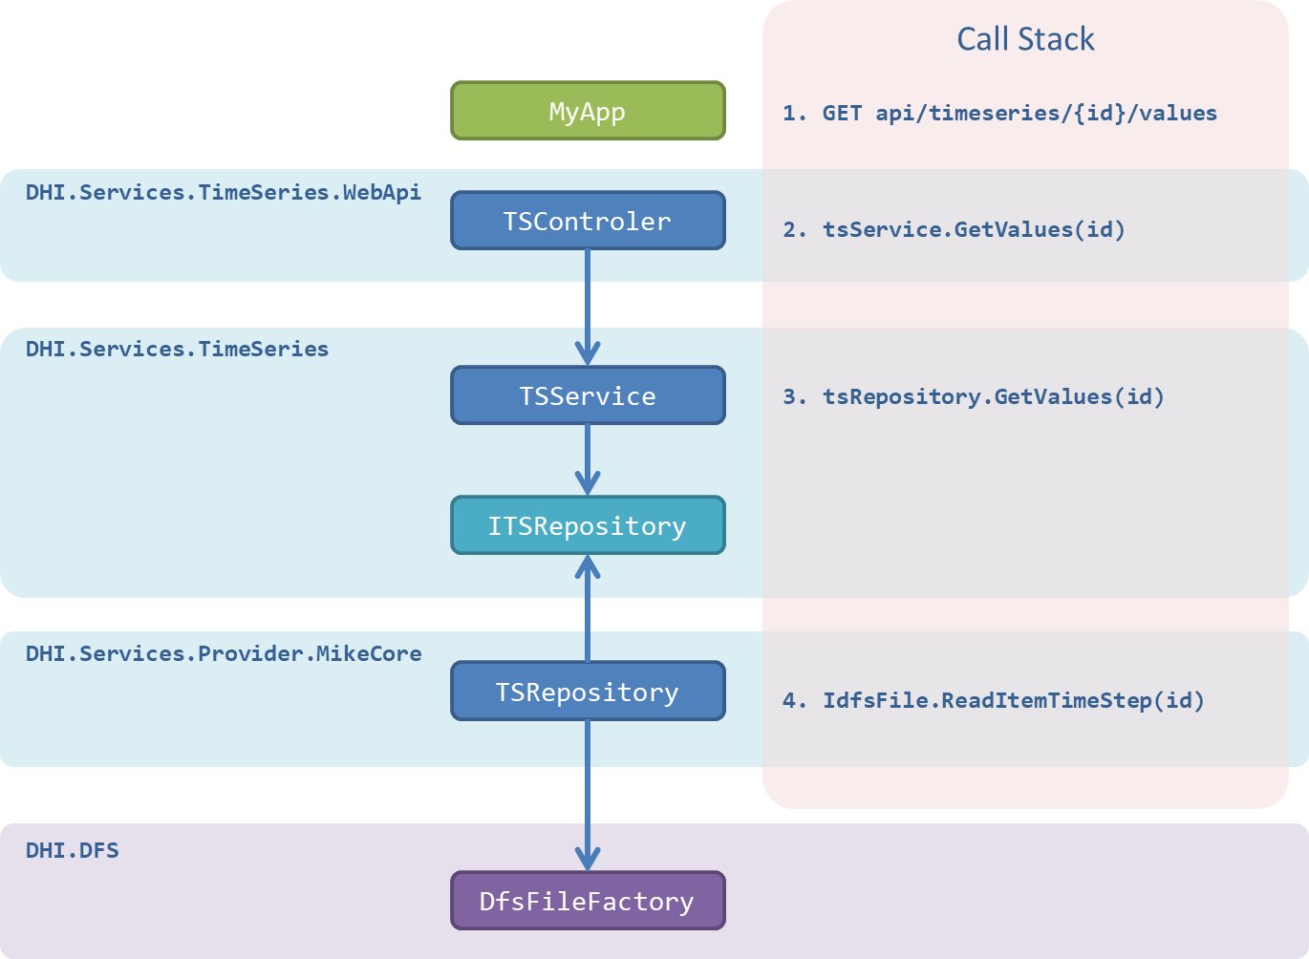
Notes:
Here is an example of how things might look at runtime
Entire object dependency graph involved in a single HTTP request for some time series values in a dfs-file
< --- Go through the call stack (from top) --->

Slide 30
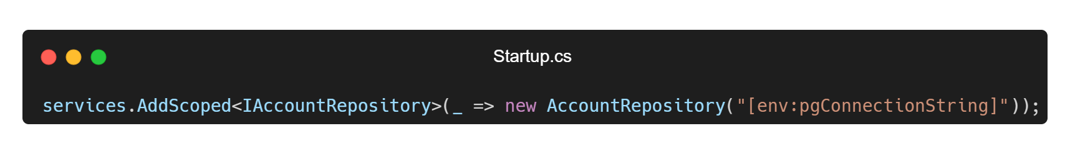
Composing Objects - DI Container
Notes:
Sometimes you delegate the responsibility for building the objects to a so-called Dependency Injection (DI) container.
Example: ASP.NET Core built-in DI container. Register concrete types for abstractions
Composition of the service objects will be resolved automatically by the DI container.

Slide 31

Notes:
5 minutes break

Slide 32
Governance
Notes:
Organization and processes around DS

Slide 33

Consume
Contribute
Internal
Flexibility
Control
Notes:
DS components are governed using what we call an internal (#) Open-Source process – a process that is similar to that of Open-Source Software – only practiced within the boundaries of DHI.
This means that every software developer within DHI can easily consume (#) as well as contribute (#) to the DS components.
As a software developer this gives you a high degree of flexibility (#) and control (#).
With this model, bug-fixes and new features can be processed and released within a few days – or even hours.

Slide 34





Notes:
Almost all open-source projects use GitHub as their platform – So does DS.
Code repositories are private, though – not public. Only GitHub users affiliated with the DHI GitHub Organization have access.
Backend (.NET) components are published on Nuget.org.
Frontend (JavaScript) components are published to the NPM registry.

Slide 35

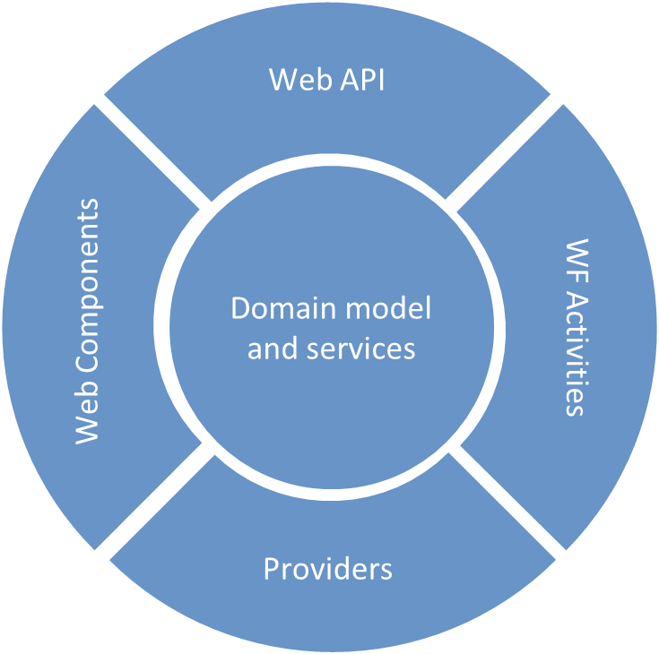
GitHub Repositories
DHI/DomainServices
DHI/DomainModels
DHI/react-components
DHI/Workflow
DHI/DomainServicesProviders
Notes:
Code is separated into 5 different GitHub repositories
DomainModels -> Spatial geometry (DHI.Spatial), physical quantities etc.
DomainServices -> BL services as well as their corresponding REST APIs

Slide 36



Open-Source Roles
Maintainers
Contributors
Users
Notes:
In the open-source model there are 3 different roles: maintainers, contributors and users.
Maintainers:
Overall responsibility of the quality of the source code.
Tasks: moderation of issues, code review and release management.
Contributors:
Developers who have commit privileges to the source code repository
Tasks: fixing bugs, adding functionality
Users
Consumers of the released components – the NuGet packages.
The typical user is a software developer in a business unit working on a business application.
One person can easily take many roles. Typically, a maintainer is also a contributor. And all contributors are most likely users.
This can be exemplified by the instructors (#)

Slide 37






GitHub flow
8
Fetch package
1
File issue
2
Create branch
foobar issue
3
Create pull request
foobar 4.7.4
foobar-fix
foobar 4.7.3
foobar-fix pull request
6
Delete branch
4
Review pull request
5
Merge pull request
7
Build and deploy package
Notes:
The code is maintained using the standard GitHub flow. Let’s see an examples of this:
A user discovers a bug in the foobar nuget package and files an issue in the GitHub issue tracker
A contributor picks up the issue and creates a dedicated branch for fixing the issue
Once the fix is ready, and properly covered by unit tests, the contributor creates a so-called pull-request. This is a signal to the maintainer that the code is ready for review
The maintainer reviews and approves the pull request
Then he merges the development branch into the trunk. This operation automatically closes the pull request. The issue is also closed – either automatically or manually.
Now he can delete the development branch.
Then the maintainer builds and deploys a package with a new version number to nuget
From here it can be fetched and consumed by the users

Slide 38
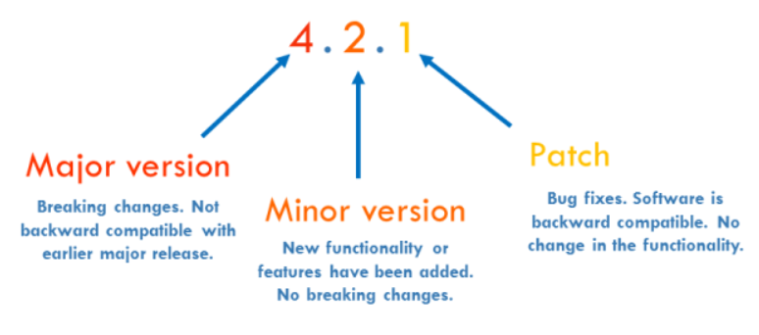
Semantic Versioning
Notes:
Versioning scheme.
3 digits
< --- from the back --- >

Slide 39
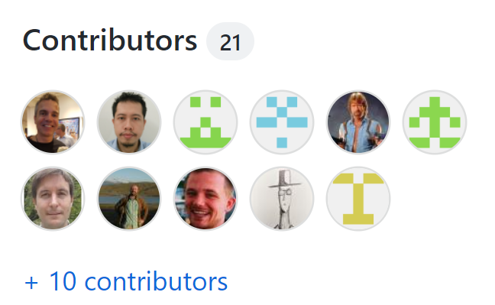
Notes:
To finalize this section about governance: This is an image of the list of contributors to the core DS GitHub repository (21)
You can see that quite a few employees have contributed to this code repository through the years.

Slide 40
How to get started?
Notes:
Now things get a bit more practical ☺

Slide 41
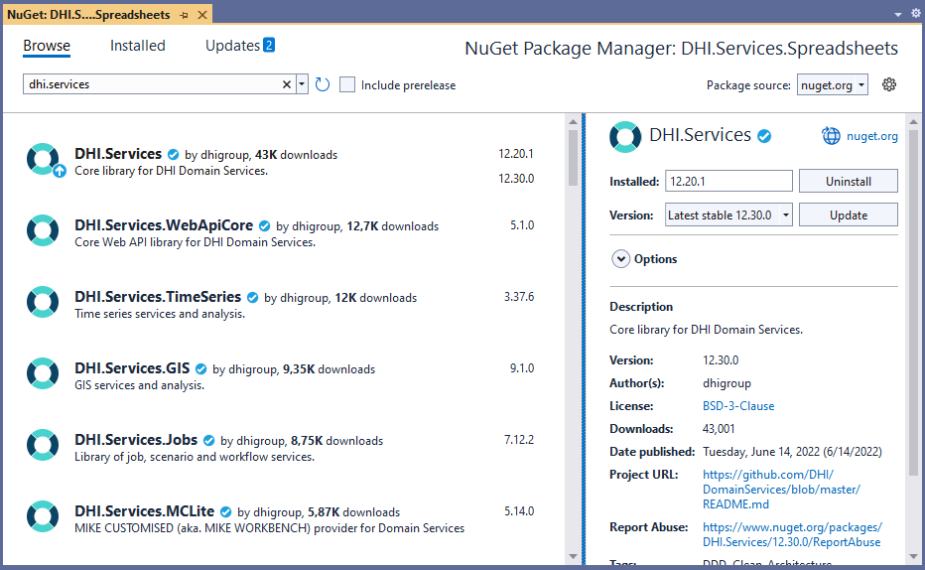
NuGet as a Platform
Notes:
DS components are deployed as packages on nuget.org.
Each package is versioned independently and thus treated as its own individual product => own release cycle => agility
Currently, around 60 packages in total
Easily accessible for any software developer using the NuGet package Manager within Visual Studio

Slide 42
NuGet Packages – Naming Convention
Category | Package Names | Example
Core | DHI.Services
Services | DHI.Services.{domain} | DHI.Services.Jobs
Web APIs | DHI.Services.{domain}.WebApi | DHI.Services.Jobs.WebApi
Providers | DHI.Services.{technology} | DHI.Services.MIKECloud
Workflow Actions | DHI.Workflow.Actions.{domain} | DHI.Worklow.Actions.Jobs
Notes:
Naming convention used for NuGet packages

Slide 43
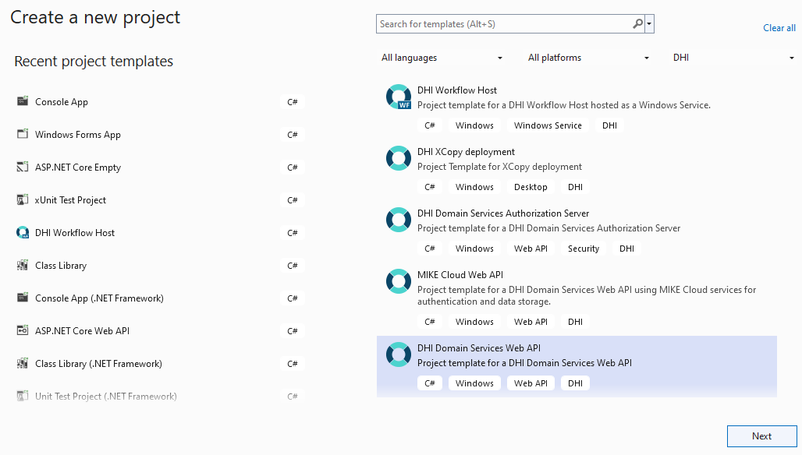
Visual Studio Project Templates
Notes:
DS Project templates for Visual Studio
Project templates for all of the 4 types of application services, you saw in the sample application diagram – for example, an auth server and a Web API
Install as VS extension from the DHI Software Center or the Visual Studio Market Place (show in module 2)
Once installed, they plug into the VS UI side-by-side the official project templates

Slide 44
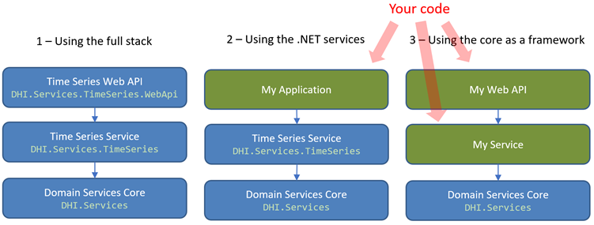
Use Cases
Notes:
Conceptually, there are 3 different ways to use the DS components
< --- mention 1,2,3 --->
Blue boxes represent existing components which can be fetched as NuGet packages
Green boxes represent code that you write yourself
Range from writing no (or very little) code yourself (all out-of-the-box) to writing more code yourself
Deeper dive into the 3 different use cases

Slide 45
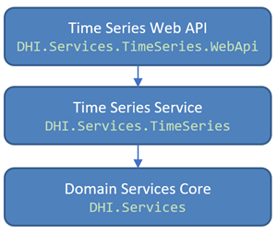
1 - Using the full stack
Notes:
Full vertical slice within a specific domain – including a Web API and possibly even a React UI component
Starting point: VS project templates, that I mentioned just before

Slide 46
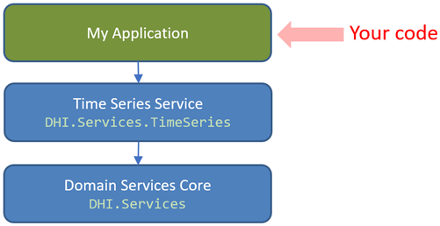
2- Using the .NET services
Notes:
Since all the business logic is isolated in the vanilla BL service component – for example as here the TS component
Such components can be referenced and used directly from for example a classic .NET desktop application
I will demo this use case in just a moment

Slide 47
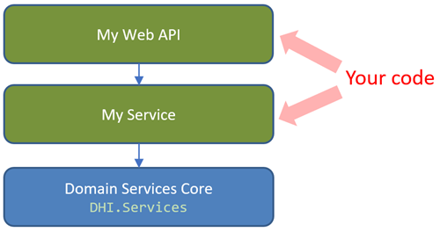
3 - Using the core as a framework
Notes:
Finally, you can use the core component (DHI.Services) as a framework
Core contains generic interfaces and base classes for DDD types (entities, services & repositories)
You can use this to create your own service-oriented types
Simply install the DHI.Services package and get going.

Slide 48
Demo…
Notes:
Use case no. 2: Using the BL services directly
Use a TS service to read some time series values from a dfs0-file (the file format for time series in our MIKE Software)
< --- Work on shared screen --- >

Slide 49
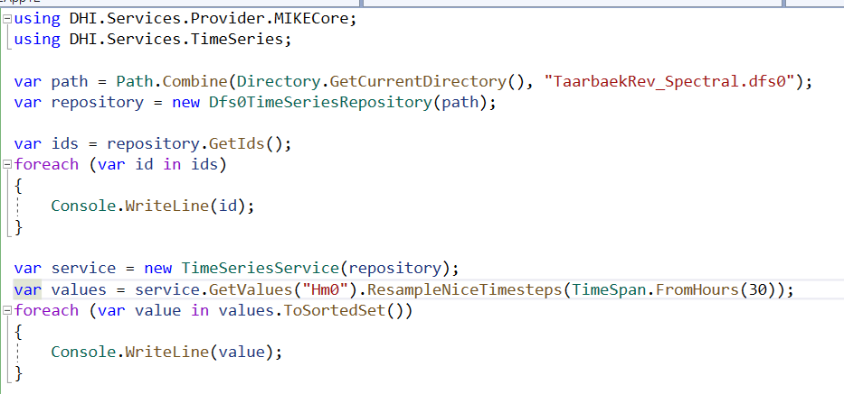

Slide 50
Wrap Up
Notes:
Time for questions?
Use:
Yammer
Up-coming follow-up sessions
Contact me directly

Slide 51
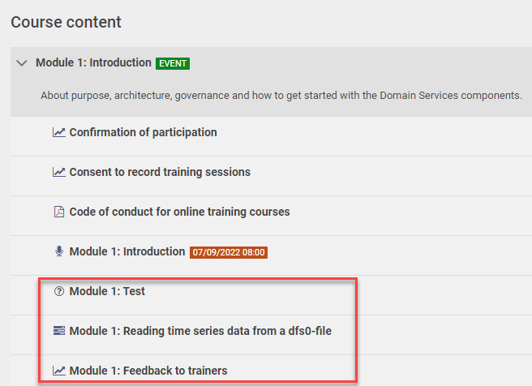
Notes:
Before next live session (a week from now)
Go to Campus course site. Under Course Content you will find:
A multiple-choice test (as many times as you want – until you get it right…)
An assignment (do what I just did in the demo.)
A chance to provide feedback
Please complete these during the week (before module 2)
Thanks for tuning in!
<STOP RECORDING!>

