Slide 1


Module 2: Backend - basics
Developing Business Applications with
Notes:
Welcome back everybody
To the Developing Business Applications with Domain Services course
Up-front, I want to acknowledge your discipline when it comes to solving the test and the assignment for module 1. Almost all of you finalized this during the week. Thanks.

Slide 2
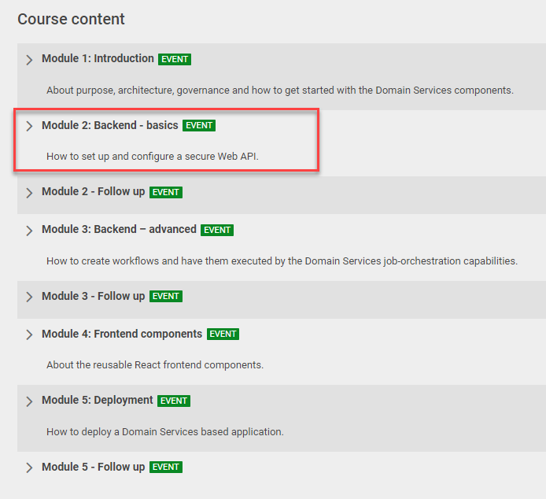



Notes:
We have now reached Module 2 – Backend Basics
With the sub-title “How to set up and configure a secure Web API”

Slide 3








Frontend
Module 2: Backend – basics (Web API and security)
Client
WebSocket
Application Services
HTTP
HTTP
Authorization
Server
Web
API
Job
Orchestrator
Job
Host(s)
Job
Host(s)
HTTP
Job
Host(s)
HTTP
TCP/IP
TCP/IP
HTTP
HTTP
Infrastructure Services
Azure
PostgreSQL
MIKE Cloud
Services
Notes:
You already saw this diagram of the sample application in the previous presentation.
This is the sample application that is used as a reference throughout the course
As you know, it can be found on GitHub in the DomainServicesCourse repository.
It consists of 4 application services + the frontend application itself
Down here in the bottom we have some existing cloud infrastructure services that the application services take advantage of:
Azure PostgreSQL databases for general persistence and the MIKE Cloud Time Series storage for storing time series
(#) Today, in the demo at the end of this presentation, I will create and configure these 2 application services from scratch:
Auth server: handle various security aspects
managing user accounts and their privileges.
Issues access tokens for the frontend to access the web API.
Web API: Exposing a REST API which serves as the backend for the frontend application.

Slide 4

Documentation & Other Resources
Service Registration (Web)
Securing the Application
Demo…
Notes:
But before coming to this demo, I will go through a few topics.
However: I listened to some feedback I got with regards to the module-1 presentation, which has led to some adjustments in this presentation.
Obviously, you all have different backgrounds and expectations for this course.
But a few of you found the first presentation a bit too theoretic (or academic if you will).
So, I have listened to this and tried to adjust this presentation towards being a bit more practical.
Instead of going too much into the theoretic stuff, I decided that I will start with browsing through the documentation and some other resources where you can then seek more detailed information yourself.
So that will be the first subject on the agenda
After that, I have some slides about service registration in web projects.
Both of the 2 services we will address today (the Authorization Server and the Web API) are web projects (built using ASP.NET – the web framework of the .NET ecosystem)
And finally, I will talk about various security aspects
We have 1½ hours.
Break halfway
I have shortened the presentation-part significantly, which should leave us with plenty of time for the demo and follow-up questions.

Slide 5
Documentation & Other Resources
Notes:
So, first something about the documentation and other resources, where you can seek information

Slide 6

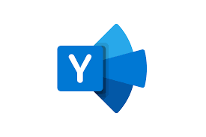

Documentation & Other Resources
Documentation
Yammer Community
Sample Code (requires membership of DHI GitHub organization)
Notes:
<remove laser pointer>
Besides the documentation, I will shortly look at the Yammer community and some sample code available in GitHub

Slide 7
Service Types
Notes:
We do need to

Slide 8
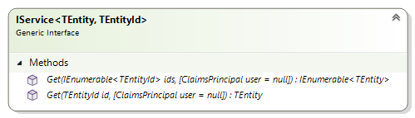
Services
TEntity: The type of the entity
TEntityId: The type of the entity identifier
Notes:
The services are the types that expose most of the functionality of DS. They are the ones you interact with as a consumer of DS – they constitute the API of DS. There are many kind of services for time series, GIS, spreadsheets, jobs etc. But they all based on the same generic abstractions/interfaces.
They are all centered around one specific type of entity – represented by the generic TEntity type parameter. An entity is always represented by a unique identifier of type TEntitiyId
The IService interface is the most basic service interface. All services share this interface.

Slide 9
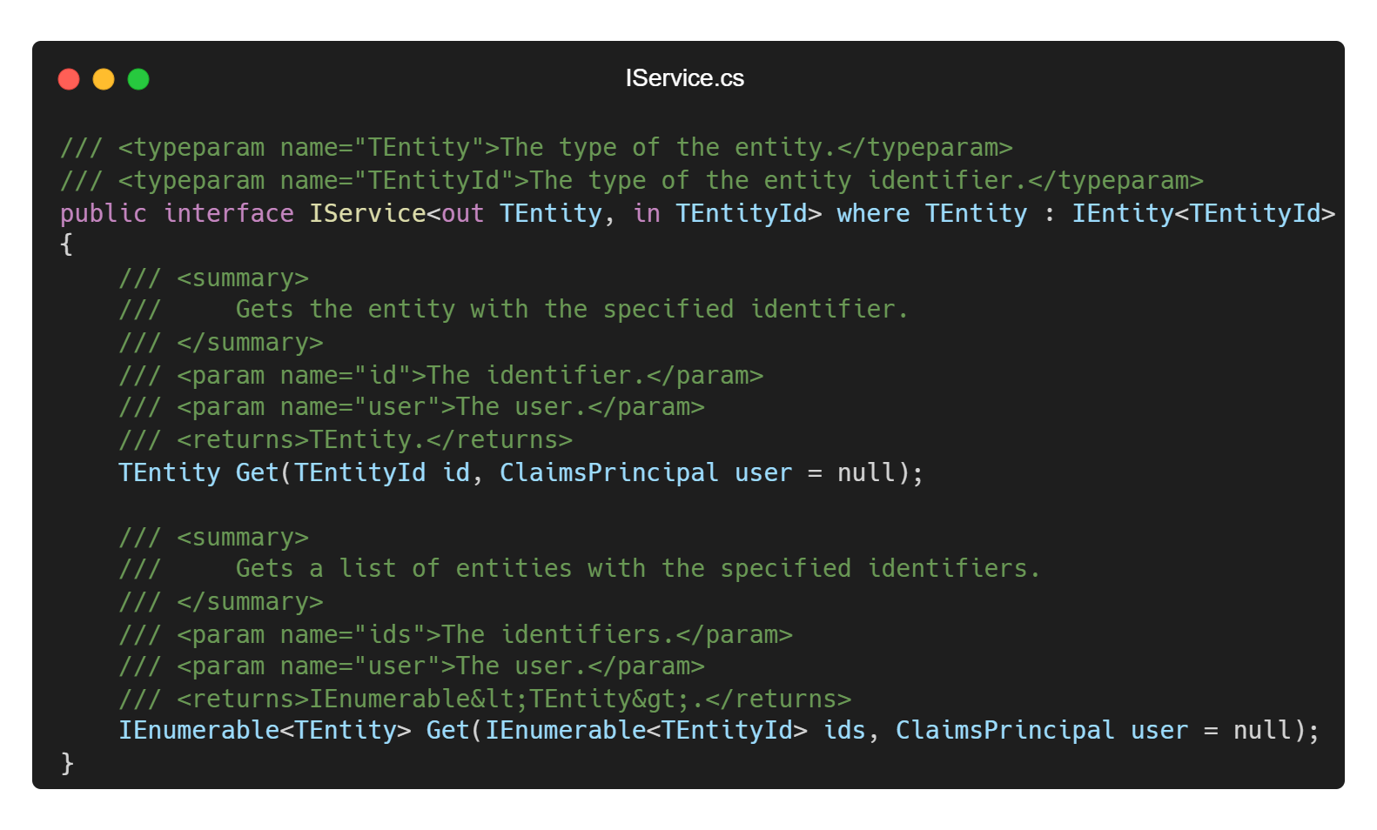
Notes:
This is how IService interface looks in actual C# code

Slide 10
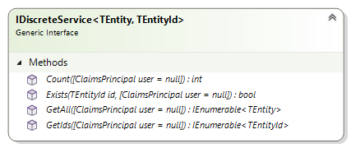
Discrete services
Can handle a finite (countable) number of entities
Notes:
Interface segregation principle (SOLID)
Not one big service interface, but rather a number of smaller interfaces that can be combined.
“Clients should not be forced to depend upon interfaces that they do not use”

Slide 11
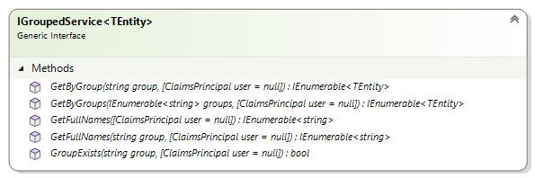
Grouped services
Can handle entities organized in hierarchical groups (e.g. trees)

Slide 12
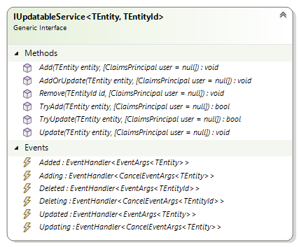
Updatable services
Can handle add, remove and update of entities
Notes:
Many, relatively fine-grained interfaces: Interface Segregation Principle (ISP) – one of the SOLID principles.

Slide 13
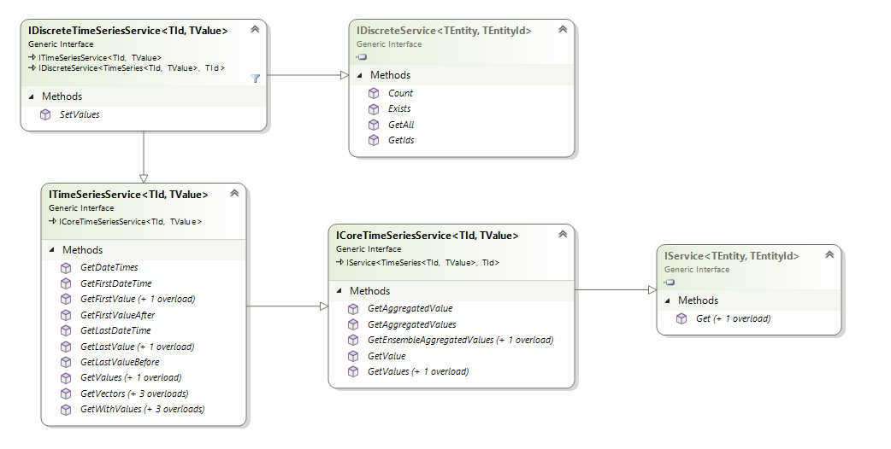
Time series services
Notes:
In a combination of composition and inheritance, the actual service types are defined. Here is a diagram of the interfaces defining a discrete time series service.

Slide 14
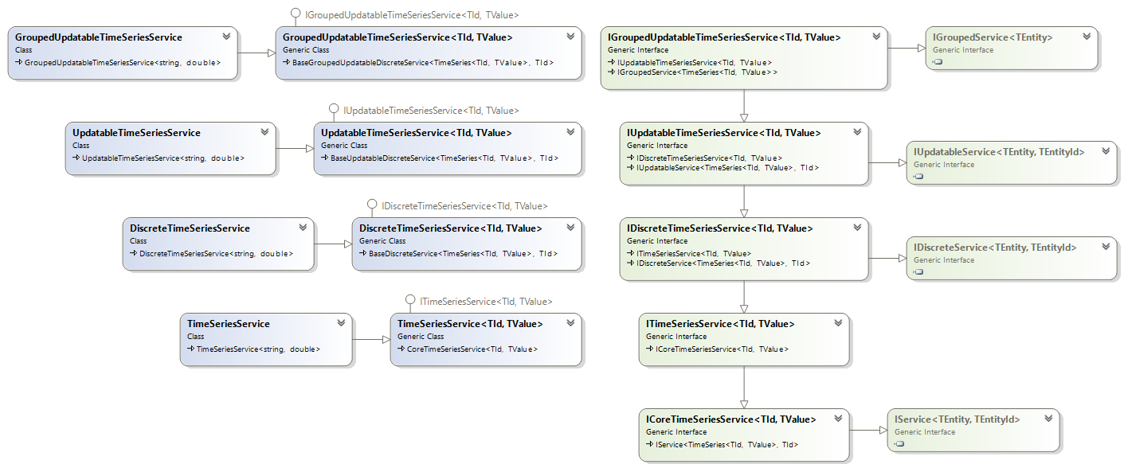
Time series services
Increasing functionality
Notes:
In a combination of composition and inheritance, the actual service types are defined. Here is a class diagram of all the time series services.
To the right We recognize the just mentioned generic interfaces. Then we have some time series-specific extensions of interfaces.
A hierarchy of TS interfaces: IGroupedUpdatableTSS is an extension of IUpdatableTSS which again is an extension of IDiscreteTSS
The concrete service implementations. Each service is an extension of the one below it (it has the same functionality + something more). The service at the bottom has less functionality and then you have increasingly more functionality as you move up the stack.
Non-generic versions of generic services. Decisions have been made about the types of identifier and values (string and double respectively)
Why do we need this granularity? Because there is a large variety in what the different time series data sources support. E.g. MO supports grouped time series – but a dfs-file doesn’t.

Slide 15
Plugins & Providers

Slide 16
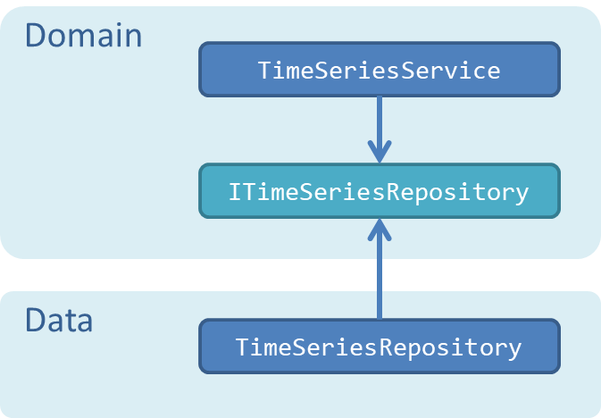

Slide 17
Service Abstractions
Dfs2TimeSeriesRepository
ITimeSeriesRepository
TimeSeriesService
Dfs0TimeSeriesRepository
IWorker
JobService
WorkflowWorker
IMapSource
MapService
DfsuMapSource
Notes:
DS types expose a number of interfaces that serve as extensibility points.
For example, the JobService is depending on an object implementing the IWorker interface.
Indicated with the socket notation
Likewise, the MapService requires an IMapSource-object and the TimeSeriesService an ITimeSeriesRepository-object.
At runtime, these services will need a concrete implementation of these interfaces – but will work with any implementation (#) - as shown for the TimeSeriesService
These extensibility points act as seams between the pure and stable BL and more volatile details.

Slide 18
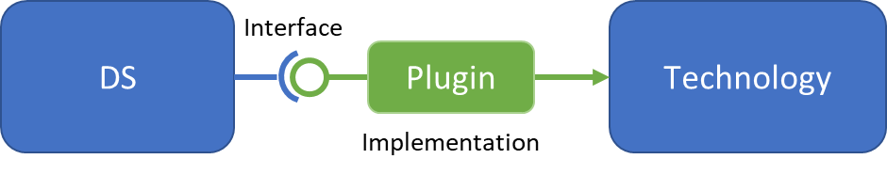
Plugins
Notes:
The concrete implementations of these interfaces are called ”plugins”.
The typical plugin is technology-specific – i.e. depending on a specific technology.
So, the plugins very often act as adapters between DS and specific technologies.

Slide 19
Providers
DHI.Services.Provider.{Technology}
DHI.Services.Provider.Foo
DHI.Services.Provider.Bar
Plugin a
Plugin d
Technology Foo
Technology Bar
Plugin b
Plugin e
Plugin c
Plugin f
Notes:
All technology-specific plugins are gathered in their own component (their own assembly/DLL).
Such a component is called a provider.
Namespace convention: DHI.Services.Provider.{Technology}
All plugins for a technology “Foo” is gathered in a component called DHI.Services.Provider.Foo
Likewise for technology Bar

Slide 20
MIKE Core Provider
DHI.Services.Provider.MIKECore
Dfs0TimeSeriesRepository
ITimeSeriesRepository
TimeSeriesService
Dfs2TimeSeriesRepository
MIKE Core
DfsuTimeSeriesRepository
IGisRepository
GisService
DfsuFeatureRepository
IMapSource
MapService
DfsuMapSource
Notes:
Just a few of some of the plugins from the MIKE Core provider:
Various time series repositories for different dfs-files
A feature repository serving vector graphics (features) from a dfsu-file for the GIS service
A map source serving bitmap images from a dfsu files for the Map service

Slide 21
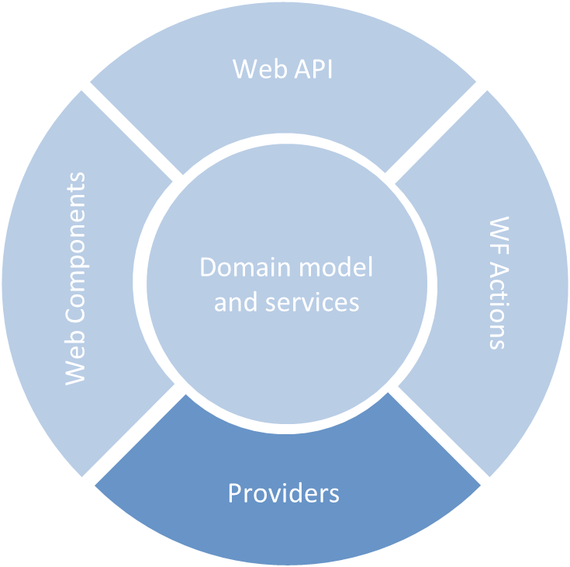
DHI.Services.Provider.MIKECore
DHI.Services.Provider.MIKECloud
DHI.Services.Provider.PostgreSQL
Notes:
As you may remember from module 1, providers belong to the infrastructure-layer of the onion architecture (module 1)

Slide 22
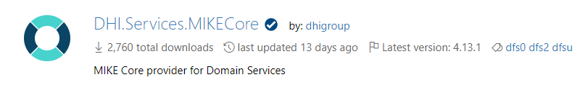
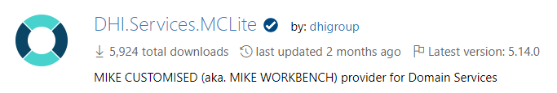
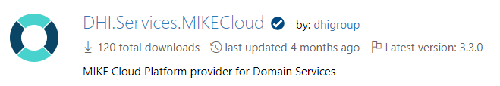
Providers - NuGet Packages
DHI.Services.<Technology>
Notes:
Like other DS-components, also providers are published as NuGet packages
NOTE:
Generally, the naming convention for NuGet packages is that the NuGet package ID is equivalent to the root-namespace of the contained assembly/DLL
However, there is a subtle exception for providers, where the “Provider”-part of the namespace is excluded
DHI.Services.Provider.MIKECore => DHI.Services.MIKECore
I could try to argument why, but the most important is that you know. And at least it is consistent!

Slide 23
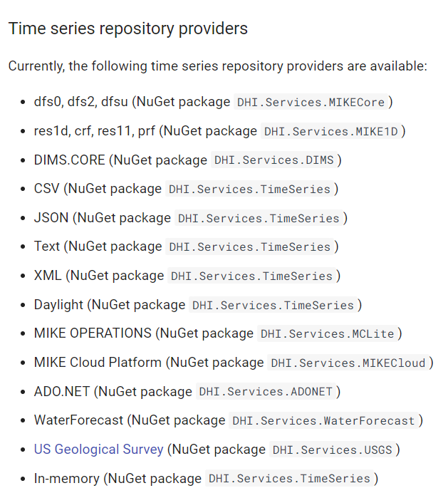

Slide 24
Service Registration (Web)
Notes:
Now, back to the agenda.
Both the services we are focusing on today (the Authorization Server and the Web API) are web projects (i.e. built using ASP.NET and the DS Web API components)
I will now show you how to create and register the necessary service objects in such projects.

Slide 25
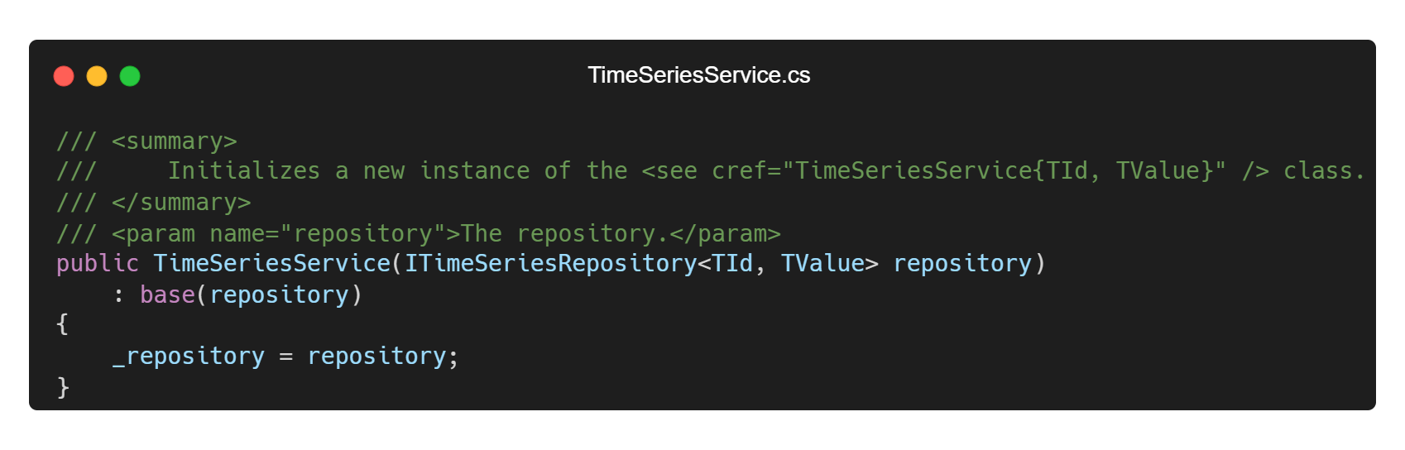
Dependency Injection
Notes:
Almost all services depend on a repository. The repository is responsible for the actual reading and writing to the underlying data source. This repository object is injected into the service through the constructor during service object creation. So, all service constructors look conceptually like this. This is a technique called dependency injection
As mentioned in Module 1, this is a very powerful design, as it:
Decouples the service functionality from the storage technologies . Persistence becomes a detail that is abstracted away.
Dramatically increases the testability of services – for example using fake in-memory repositories.

Slide 26
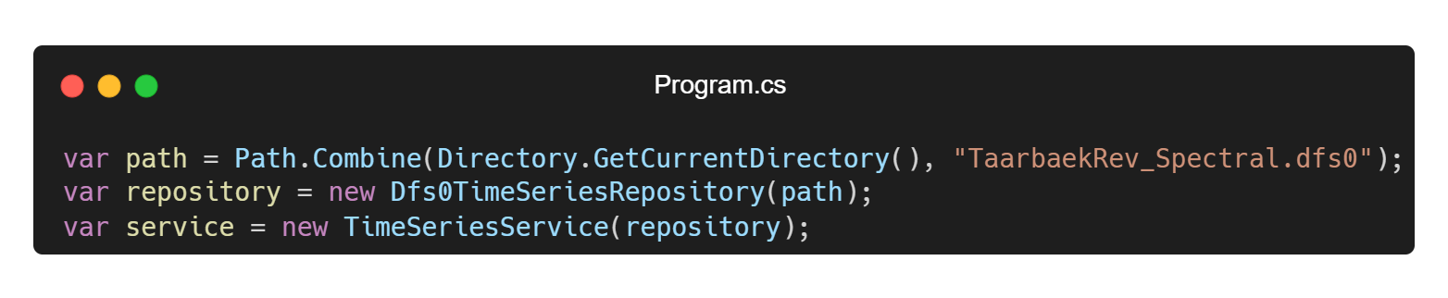
Composing Objects - Dependency Injection
Notes:
We already saw this code in module 1.
Here, I demonstrated how to create and compose service objects using the technique called Dependency Injection.
Create repository object – in this case a Dfs0TimeSeriesRepository (#)
Afterwards, you Inject it into a compatible service (#)
This is done in the Program.cs file which is the “composition root” of any .NET project.
So far, so good…

Slide 27
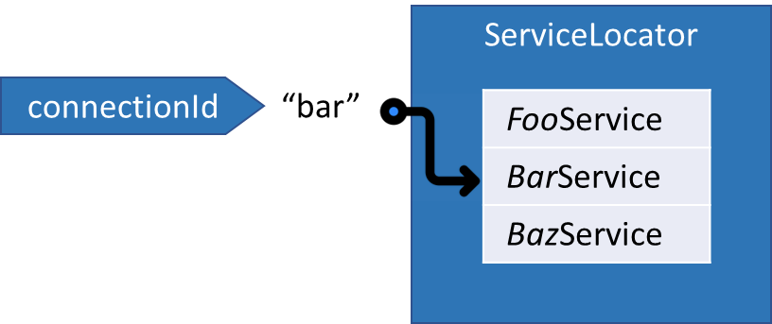
Connections
Notes:
However, In the Web API components, an extra concept is introduced:
The so-called connections.
You can think of connections as a dictionary of services.
You register the individual services in this dictionary (called the ServiceLocator)
The registration key is called the connectionID.

Slide 28
Connections
“dfs0”
“mikecloud”
dfs0 file
MIKE Cloud time series storage
dfs0 file
Notes:
As shown here, these connection IDs are used directly in the URLs of the REST API exposed by the DS Web API components. (#)
For example, the request shown here means something like: “Give me a list of time series from the connection with the given connection ID”
This way you can register e.g. multiple TimeSeries-services – each using different storage repositories – as connections.
And then, at runtime – when making requests to the Web API - you can decide which connection to use.
(#) For example, here you can switch between a dfs0-connection to a collection of dfs0-files.
And a mikecloud-connection to time series storage in MIKE Cloud.

Slide 29
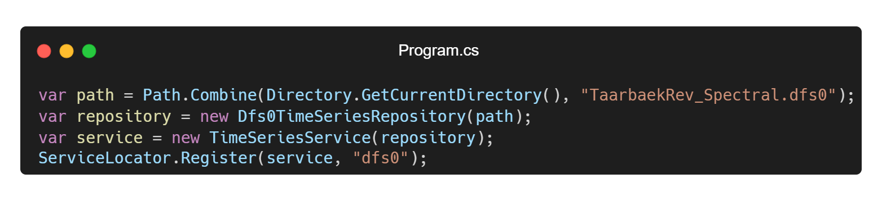
Registering Connections
Notes:
How does this look in code?
(#) Registration of connections for a Web API is done using the Register() method on the static ServiceLocator class.
Here you can see, how you can register the TimeSeriesService that we created previously as a connection with id “dfs0”

Slide 30
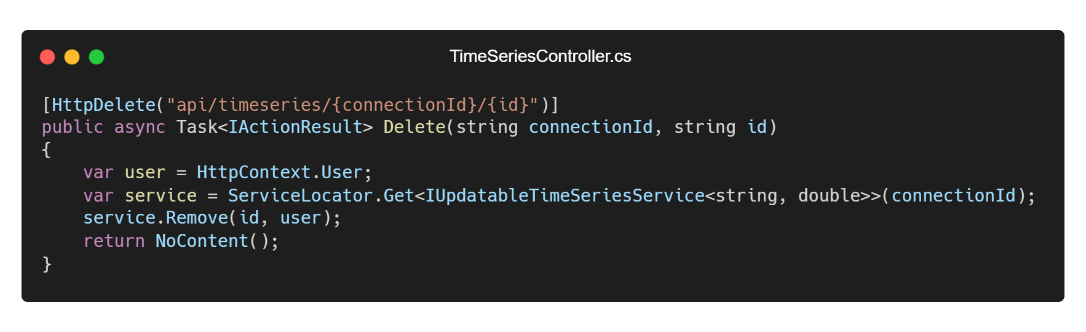
Using Connections in a Controller
Notes:
Connections are used in controller classes in the Web API components
Controllers are the classes in the ASP.NET web framework handling the incoming HTTP-requests
So, this is where we define our Web API endpoints (the URLs)
(#) Here you can see the declaration of an endpoint for deleting a timeseries with the given ID in the connection with the given connection-ID.
(#) and here you can see how the service locator is used in a controller action - to retrieve a connection with a particular connection ID at runtime.
This is code from the TimeSeriesController in the TimeSeries WebAPI-component that you get out-of-the-box.
So, this is code that you, under normal circumstances, do not need to write yourself as an application developer.
That is, unless you’ll write your own, custom controllers that use connections – which is of course doable.
But at least this demonstrates how the ServiceLocator is used at runtime

Slide 31
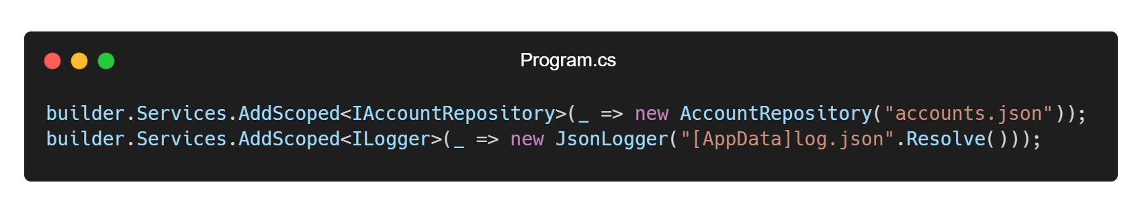
Registering other services
Notes:
Not all types of services need to be registered as connections. Some services – let’s call them system services – are registered using the standard ASP.NET Dependency Injection mechanism.
It is typically services for cross-cutting concerns such as security and logging.
(#) Here is an example of registration of a user account repository, which is required in the AccountController in the Authorization Server.
(#) and a logger used in various controllers.
This registration is done in the so-called service collection of the WebApplicationBuilder object (the builder variable).
This also takes place in the Program.cs
So, this is standard way to register services in ASP.NET

Slide 32
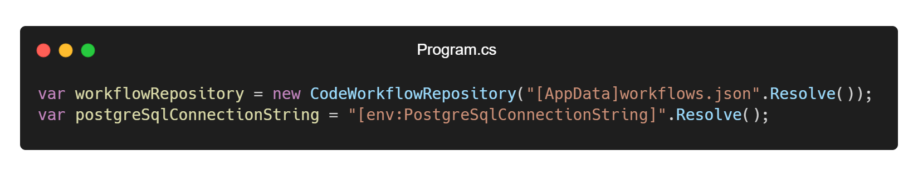
Configuration String Placeholders
[AppData]
[env:{EnvVar}]
Notes:
There is a small and convenient tool available for composing configuration strings – for example connection strings
In C# there is a well-known feature called string interpolation for composing strings at run-time.
This is an alternative to using string interpolation– a bit more explicit, though.
I called it Placeholders (in lack of better name..)
There are 2 types of configuration string placeholders, you can use when configuring your application.
By convention, data files in a web project are often placed in the ASP.NET App_Data folder (or sub folders to this).
In this case, instead of giving the full path to the App_Data folder when defining the connection string, then the [AppData]-placeholder can be used.
(#) The [AppData]-placeholder will be resolved to the full folder path at runtime.
This is an example of a connection string to a workflow-definitions file in the App_Data folder.
The other type of placeholder is for looking up the value of an environment variable at runtime.
An example is shown here. (#)
This placeholder will be replaced by the actual value of the Postgres-ConnectionString environment variable at runtime.
Security aspect
(#) To trigger the actual runtime conversion, you must call the Resolve() extension method.

Slide 33
Securing the Application
Notes:
Next on the agenda, something about security aspects

Slide 34

Security Aspects
Authentication
Authorization
Brute-force attacks
SQL injection
Cross Site Scripting (XSS)
Cross Site Request Forgery (CSRF)
Denial-of-service attacks
…
Notes:
Securing your application is hard! There is indeed a lot to be worried about
Here are just a few of the security aspects to consider < --- mention --- >.
The list is almost endless.
We could arrange a 10-hours course around security alone.
However, this is not the scope of this course, so in the following, I will focus only on the first 3 of them (#)
Other security aspects might be covered to a certain degree in Module 5 (Deployment)

Slide 35



Authorization Flow
Frontend
Client
Application Services
Authorization
Server
Web
API
Notes:
Well, at a minimum, you have to deal with controlled user access to your app – aka. authentication and authorization
In DS you get a complete solution for this out-of-the-box.
That’s the one used in the course sample application
I will now illustrate the authorization flow of this application.
(#) The user will enter his/her credentials (username and password) into an input form exposed by the Frontend.
(#) These credentials are passed on to the authorization server.
(#) If the credentials are successfully validated, the authorization server will issue and return a combination of an access- and a refresh token.
(#) The client will use the given access token to access the web API.
(#) Then, instead of having to ask the user to log in again and again, the refresh token can be used to request a new pair of an access- and a refresh token
(#) Again, the client will use the given access token to access the web API.
This architecture, with a dedicated authorization server, gives a nice separation of concerns:
Different Web APIs (even APIs for other applications) can share the same instance of an authorization server
Also, the Authorization server can be replaced with 3rd party authorization services (e.g. Auth0 or even MIKE Cloud authentication)

Slide 36
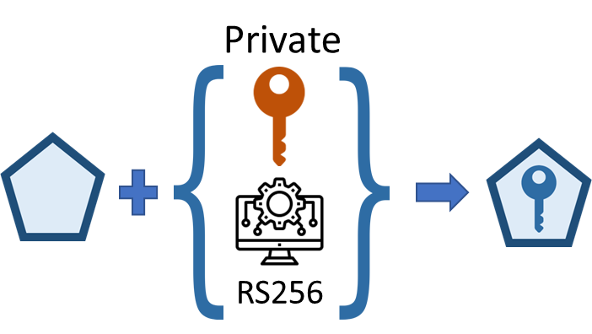
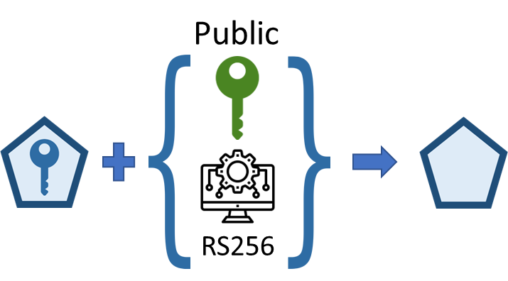
Asymmetric Signing – RS256
Frontend
Client
Application Services
Authorization
Server
Web
API
Notes:
For security reasons, the access tokens are signed with a digital signature.
Signing the tokens allows the recipients to
Validate that the content of the token wasn't changed since it was issued (avoid man-in-the-middle attacks)
Verify the original issuer of the token created the signature.
The RS256-algorithm used for signing is an a-symmetric algorithm that uses a pair of a private and a public key.
The signing works like this:
(#) Once the user credentials (or refresh token) has been received (#), the authorization server creates the access-token and uses the private key - and the RS256-algorithm - to sign the token
(#) The access-token is sent back to the client (together with the refresh token) and used to access the Web API (#)
(#) Finally, the Web API uses the public key – and the algorithm - to validate and decode the token.
The private and public keys are linked since they are generated as a pair (I showed you the documentation for how to create such a key-pair earlier)

Slide 37

Token lifespans
 | Type | Lifespan | Can be revoked?
 | Access | Short (< 1 hour) | No
 | Refresh | Longer (> 1 hour) | Yes
Notes:
The lifespan of the tokens are configurable, but since the access-token can be abused by malicious users to gain access, it must have a short lifespan (probably less than one hour)
These are sensitive tokens. Once issued, they can never be revoked
Refresh-tokens are less sensitive: If a refresh token becomes compromised, it can be revoked so it becomes invalid.
Also, for convenience, they should have relatively long lifespan – at least longer than the access tokens.

Slide 38
Authentication Features
Two-factor authentication (OTP using Microsoft- or Google Authenticator)
IP-whitelisting
Secure Account Registration (B2C)
Secure Password Reset
Password Policy
Breached Password Protection (Have I Been Pwned?)
Brute-force Attack Protection (Progressive delay)
Notes:
These are the out-of-the-box authentication features of Domain Services.
Two-factor authentication is supported using a one-time password for the Microsoft- or Google authenticator apps.
There is also support for IP-whitelisting – where only users from whitelisted IP-addresses are authenticated.
Both two-factor authentication and IP-whitelisting is used in NCOS Online (our flagship business application)
(#) However, they are both out of the scope for this course.
There is support for a flow for Secure account registration in a business-to-consumer scenario, where random users can register themselves.
And support for a secure password reset flow.
Both of these features are also out of scope for this course (#)
but you can find detailed descriptions of how to set this up in the documentation (as I showed you earlier).
Luckily, the last 3 features are all within the scope of this course ☺
In the demo, I will show how to configure a password policy and protection against breached passwords.
I will also demonstrate progressive delay, which is a protection against brute-force attacks

Slide 39

Notes:
5 minutes – Demo afterwards

Slide 40
Demo…
Notes:
In which I will build and configure an authorization server and a web API from scratch
Using the DS project templates for visual studio

Slide 41
Frontend
Module 2: Backend – basics (Web API and security)
Client
WebSocket
Application Services
HTTP
HTTP
Authorization
Server
Web
API
Job
Orchestrator
Job
Host(s)
Job
Host(s)
HTTP
Job
Host(s)
HTTP
TCP/IP
TCP/IP
HTTP
HTTP
Infrastructure Services
Azure
PostgreSQL
MIKE Cloud
Services
Notes:
Summarize (laser pointer)
I created these 2 application services from scratch (#)
Auth server:
Web API: Read time series from MIKE Cloud data storage
Could not connect to Azure Postgres databases, because I don’t know the connection-string and DYK is on vacation until next week.
Had to work with the local JSON-file based repositories.
However, in a subtle way this nicely demonstrates the decoupled and flexible structure of a DS-based application ☺

Slide 42
Questions?

Slide 43
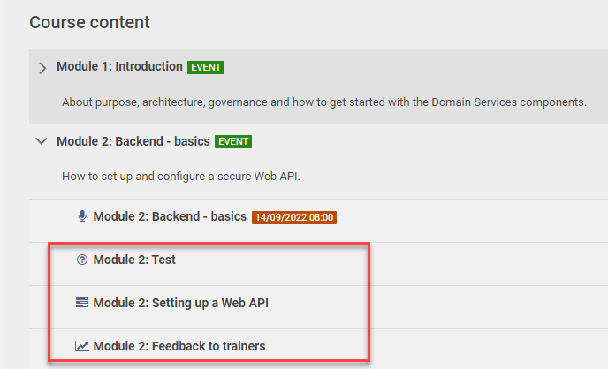
Notes:
Go to Campus course site. Under Course Content you will find:
A multiple-choice test (as many times as you want – if you think your score is too low…)
An assignment (Setting up a Web API) ---- WAIT?
A chance to provide feedback
Please complete these during the week (at least before the follow up session on Tuesday)
NOTE: Follow-up is a Teams-meeting – not Zoom
Thanks for tuning in!
<STOP RECORDING!>

Slide 44







YOUR CODE
ServiceLocator
connectionId
“bar”
FooService
BarService
BazService
Private
Public
RS256
RS256

