Slide 1


Module 4: Frontend Components
Developing Business Applications with

Slide 2








Module 4: Frontend (React)
Browser
Client
WebSocket
Application Services
HTTP
HTTP
Authorization
Server
Web
Server
Job
Orchestrator
Job
Host(s)
Job
Host(s)
HTTP
Job
Host(s)
HTTP
TCP/IP
TCP/IP
HTTP
HTTP
Infrastructure Services
Azure
PostgreSQL
MIKE Cloud
Services

Slide 3

…
Notes:
<use this slide for agenda>

Slide 4

Notes:
<use this slide for breaks>

Slide 5
Developing the front end

Slide 6
Init a react app
https://create-react-app.dev/docs/adding-typescript/

Slide 7
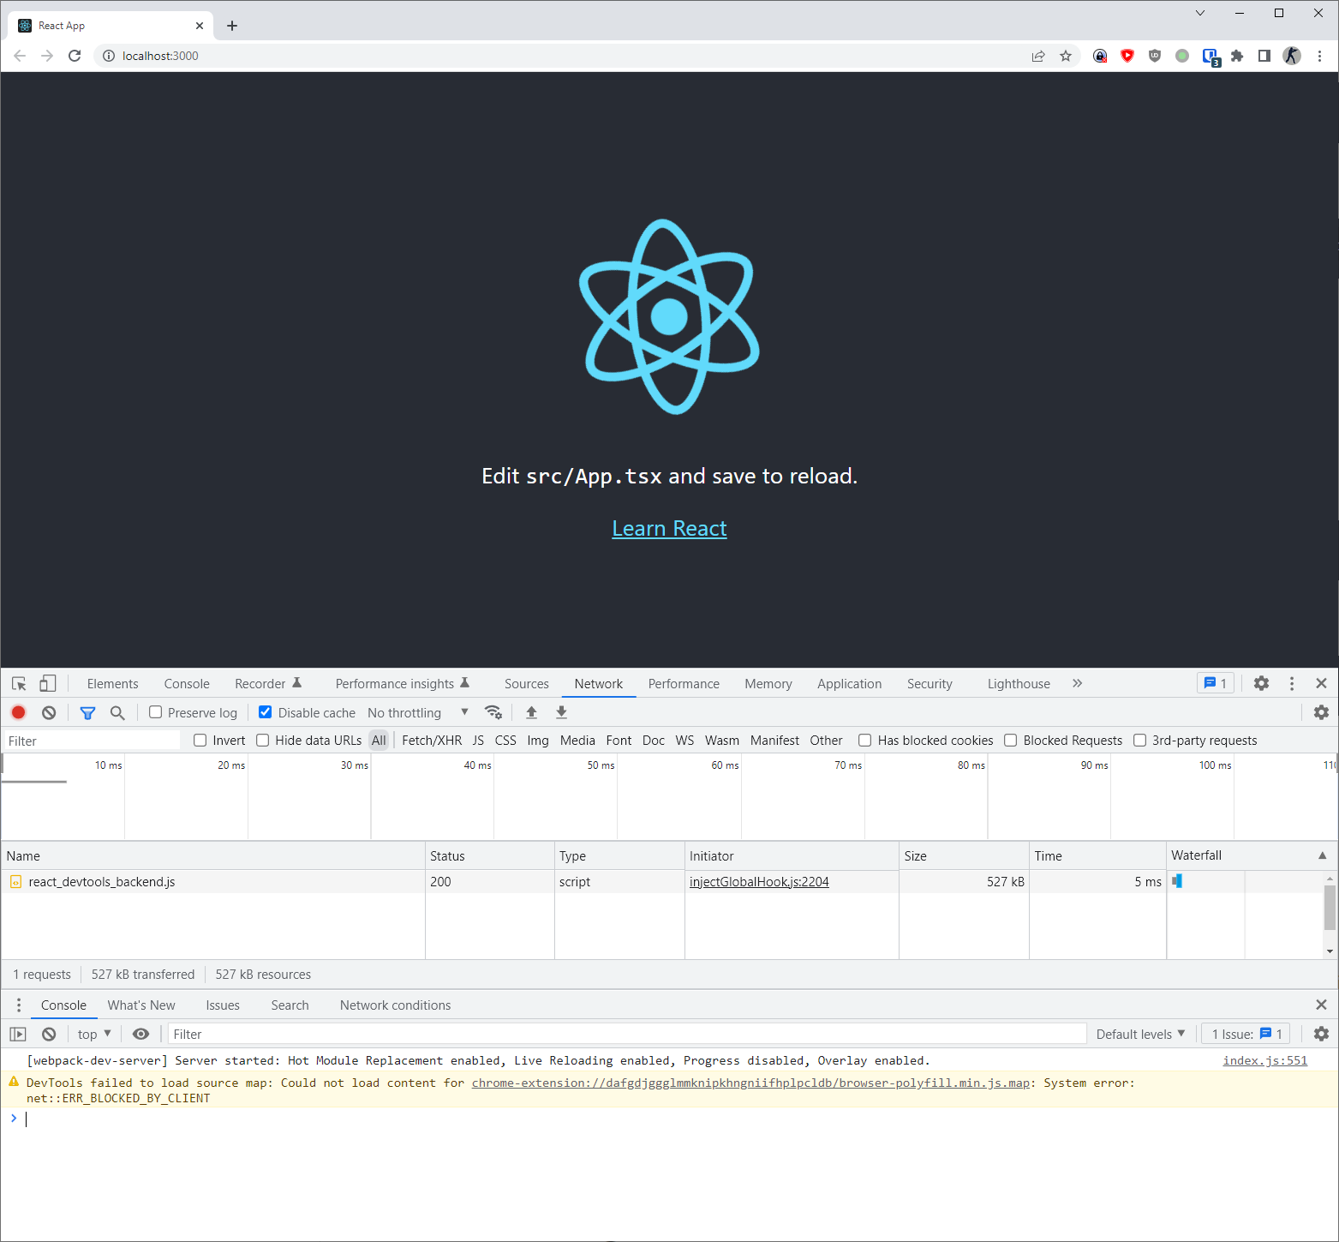
Test the empty app
yarn start

Slide 8
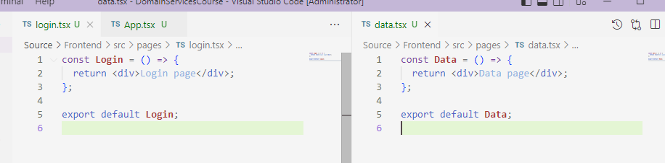
Add login and data pages

Slide 9
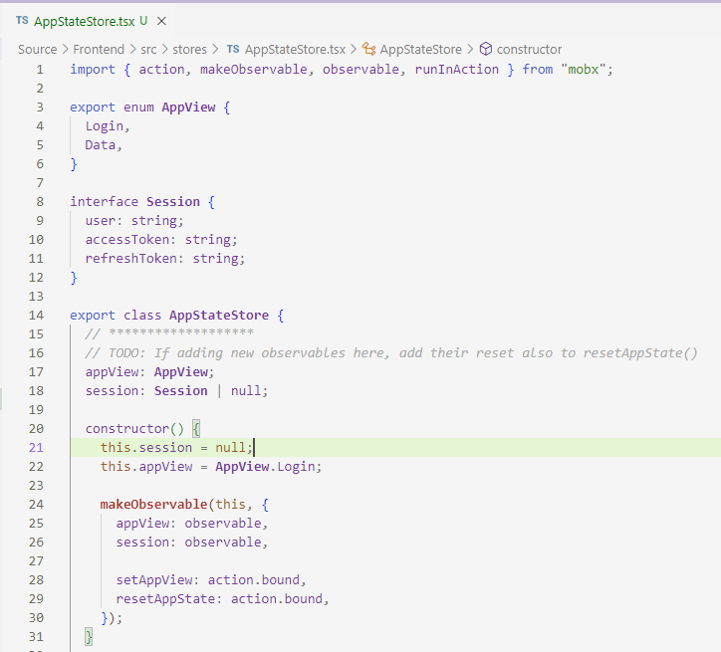
Add state storage
https://mobx.js.org/defining-data-stores.html

Slide 10
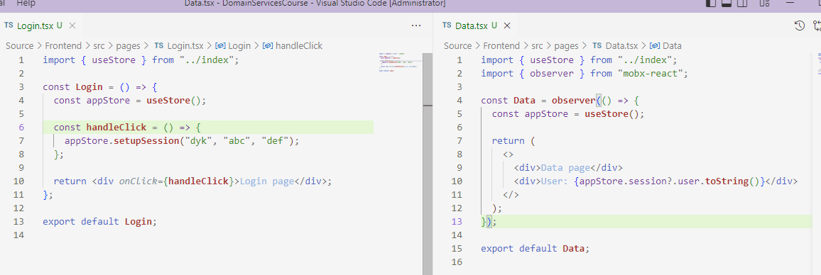
Test state storage
Add a click handler on the login page that updates the data page

Slide 11
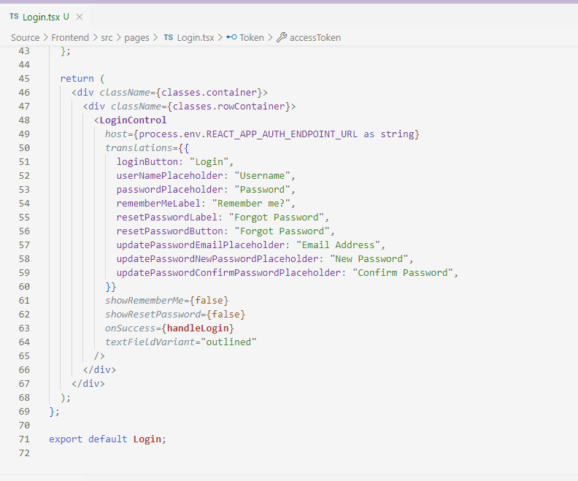
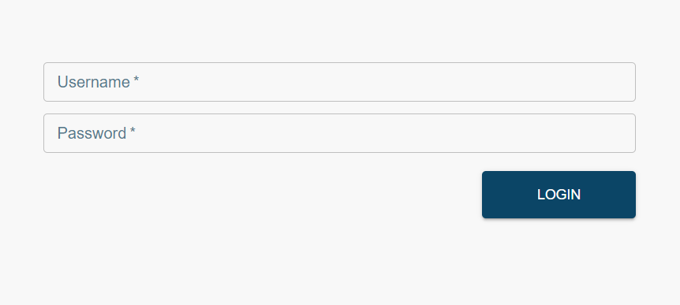
Login page layout
Install dhi/react-components to get material-ui and many other dependencies
https://github.com/DHI/react-components/tree/master/packages/react-components

Slide 12
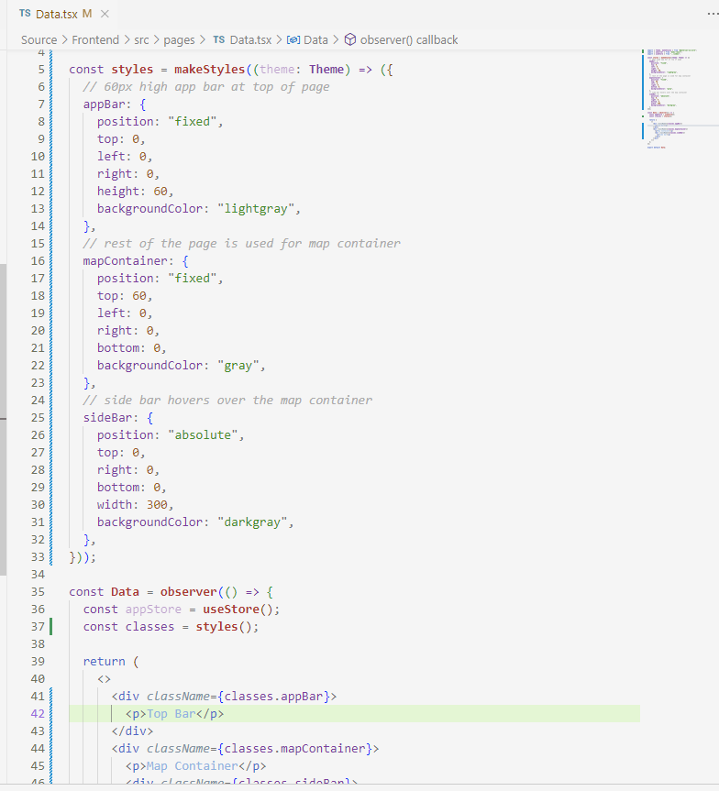
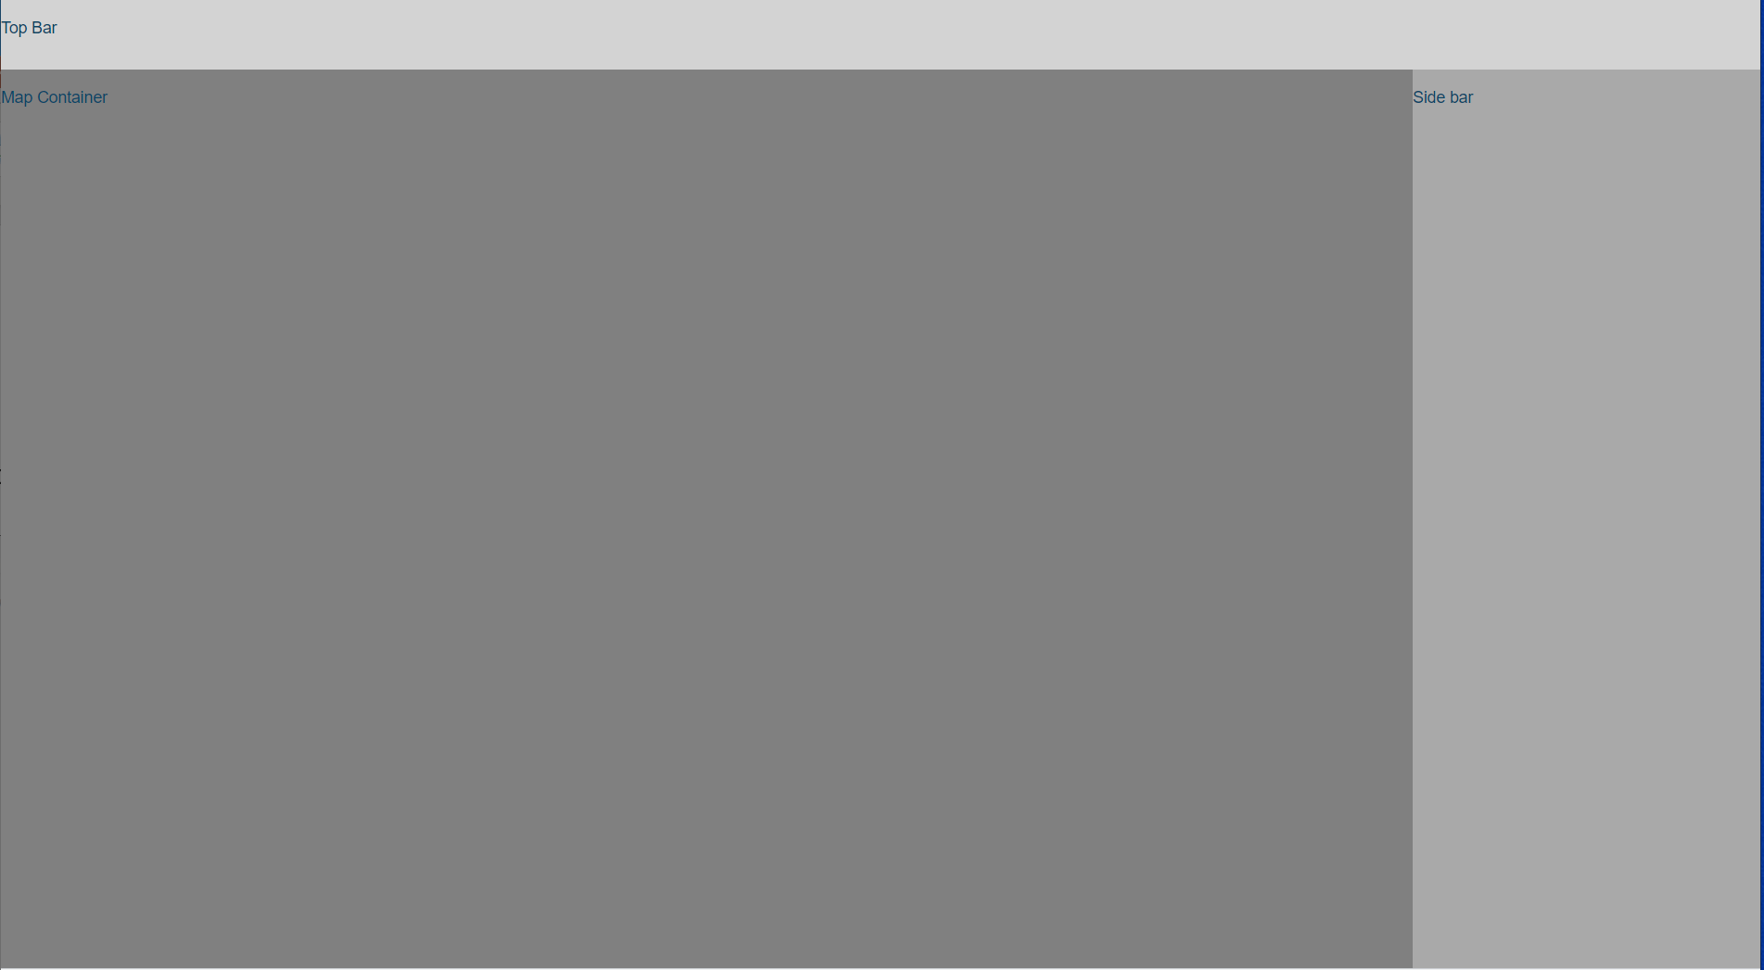
Data page layout
Top app bar, map container, side panel

Slide 13
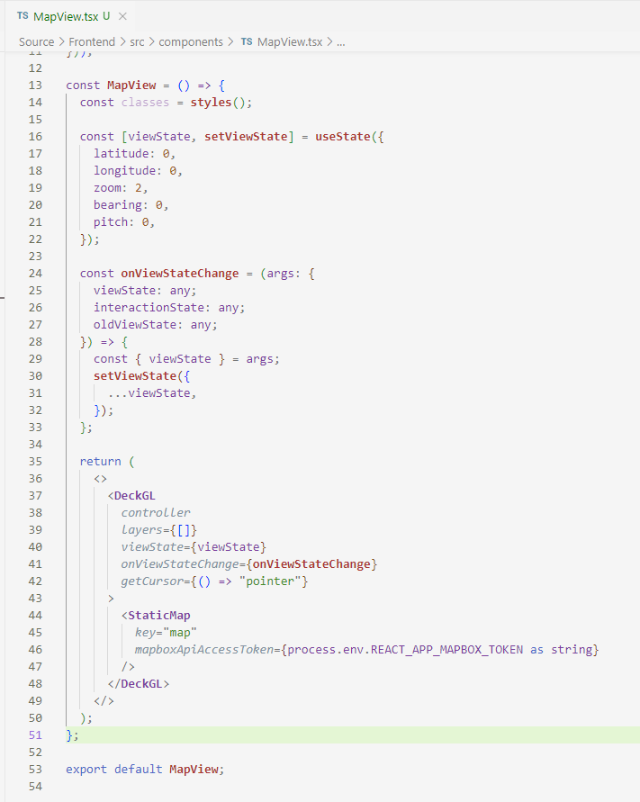
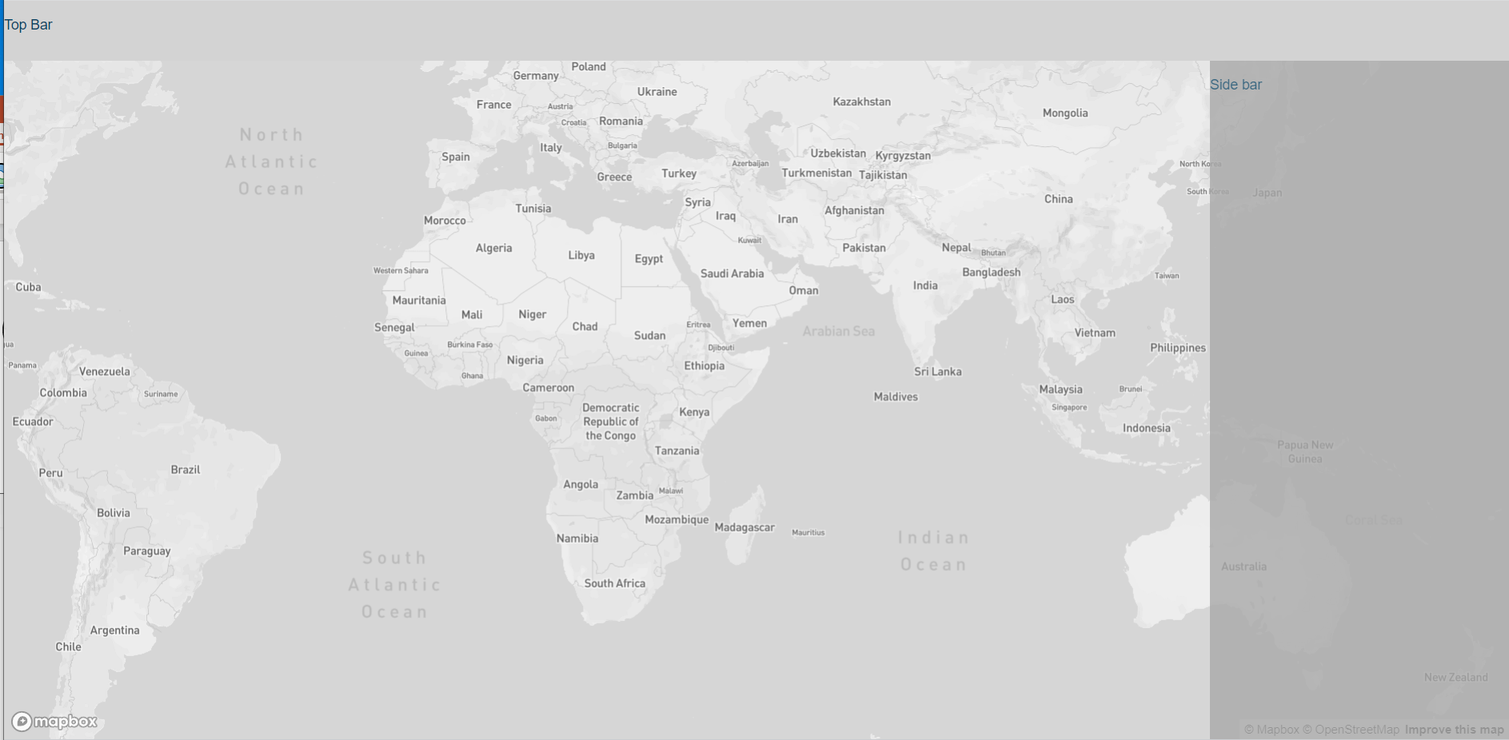
Adding the map
MapView component

Slide 14
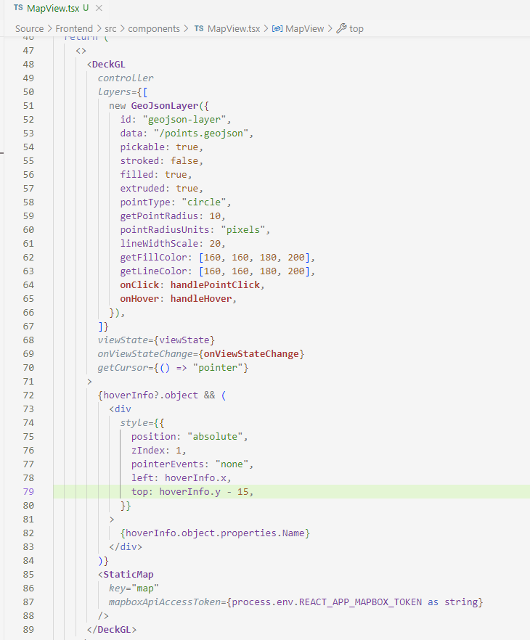
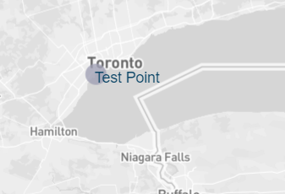
Adding a point layer

Slide 15
Showing a timeseries chart
MapView component

