Slide 1
Predicting pollution patterns in the sewer
Suzie Béasse, Christopher Gaszynski, Jaume Palmer
DHI ML Hackathon - April 2024

Slide 2
Can we forecast the concentration of C, N, P and suspended solids in a water stream for the next 6 hours?
Naïve approach (historic statistical analysis)
Linear model (Vector Auto-regressive)
XGBOOST
LTSM
Mechanistic model VS ML

Slide 3
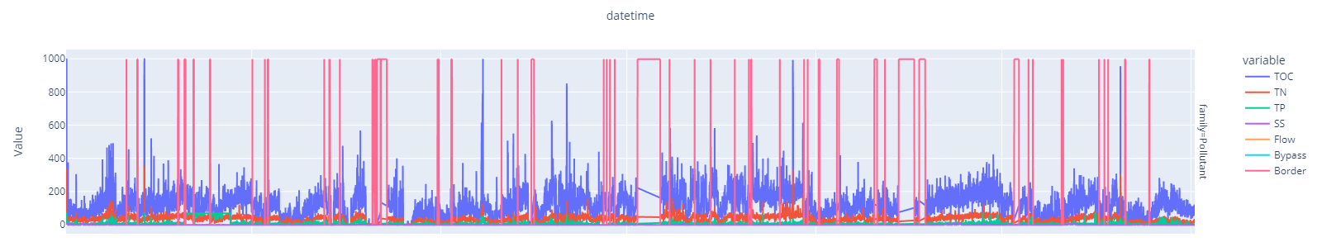
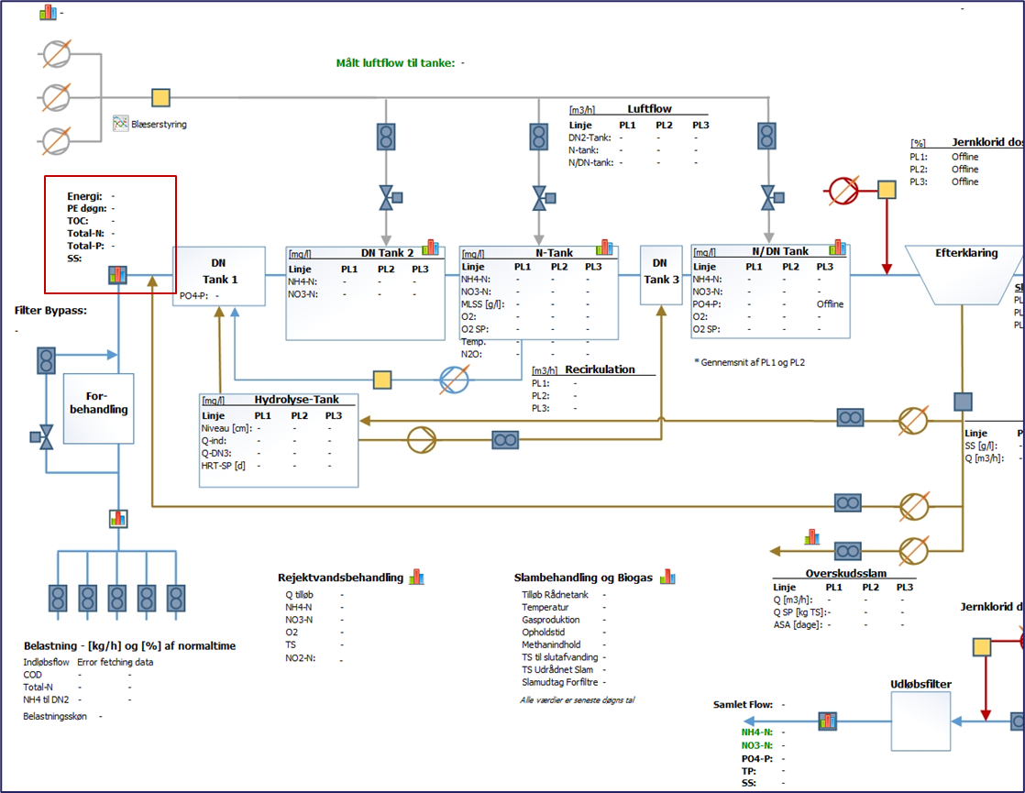
Data
3 years of data of
Pollutant concentrations [mg/l]
Carbon (TOC)
Nitrogen (TN)
Phosphorous (TP)
Suspended solids (SS)
Rain
Flow
1 min resolution resampled to 1 hour

Slide 4
Results
RMSE [mg/l] (With values 6 hours ahead)
 | TOC | TN | TP | SS
Naïve approach | 84.45 | 21.74 | 10.25 | 0.96
Linear model (VAR) | 65.74 | 15.31 | 7.03 | 0.33
XGBOOST | 37.98 | 8.26 | 6.56 | 0.48
LSTM | 45.36 | 11.94 | 6.52 | 0.98
Mean value of the pollutant concentration over the whole measurement period | 116.78 | 32.69 | 8.22 | 0.53

Slide 5

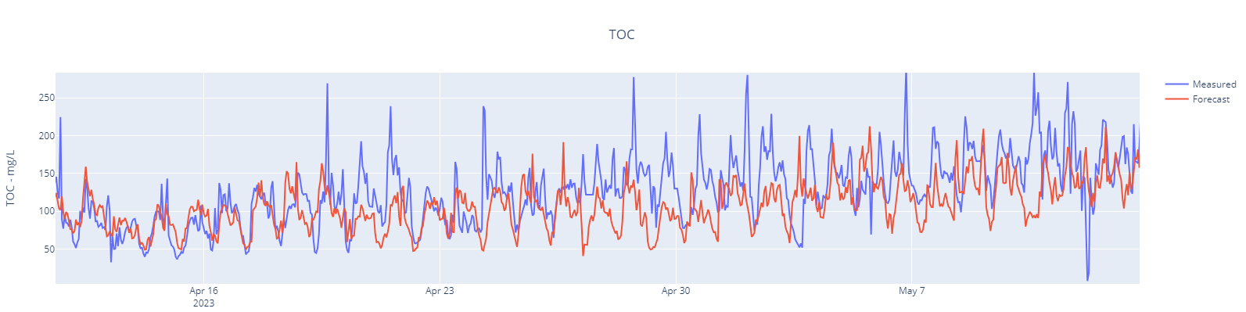
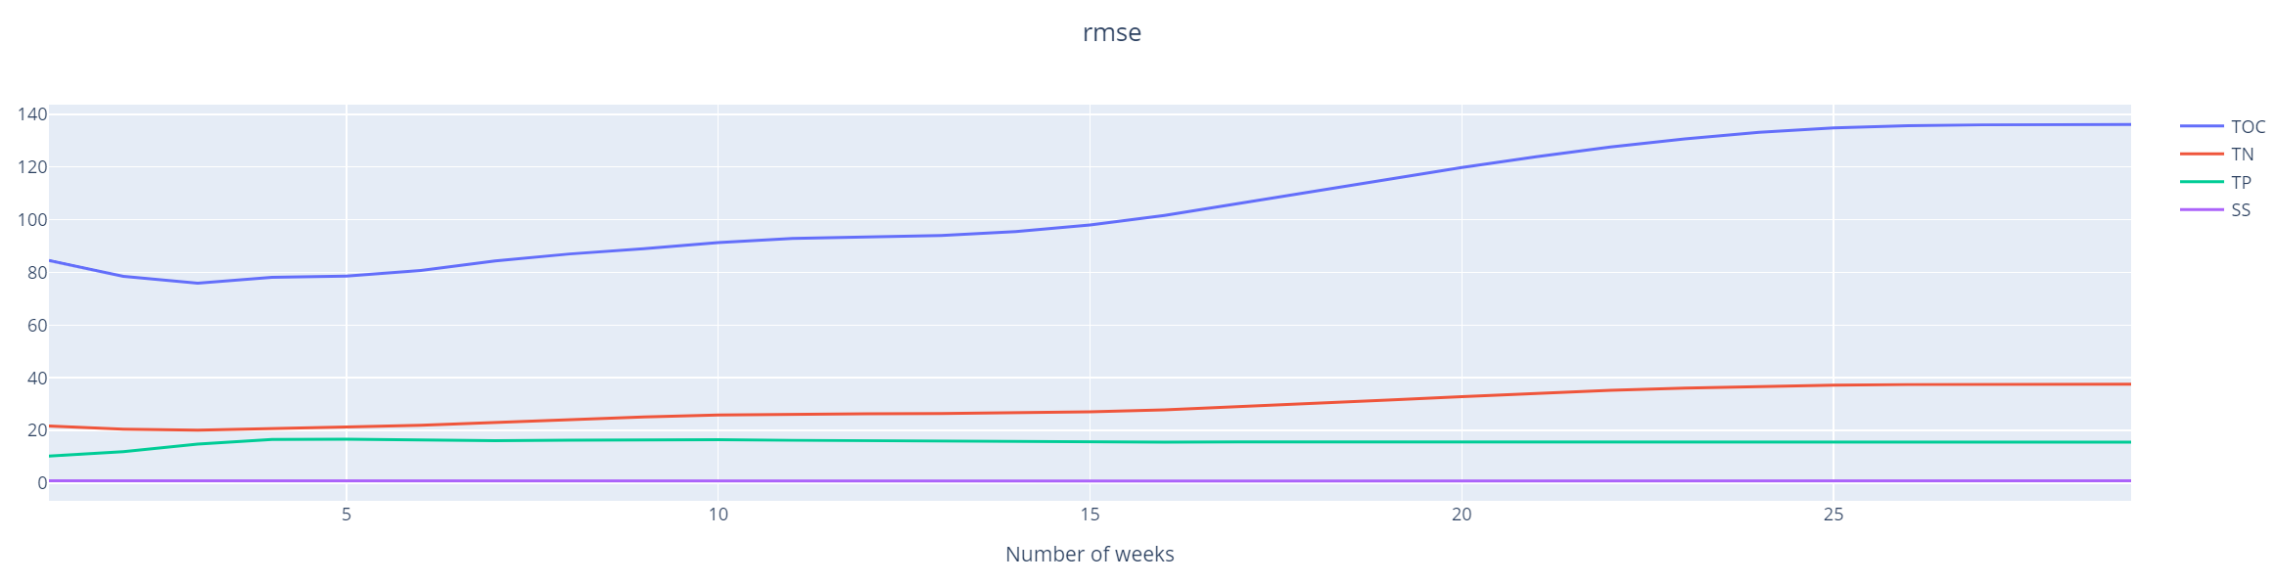
Results from the historical statistics
Periodicity of the wastewater load
Day of the week
Hour of the day
Dilution factor due to rain
→ Look at the average of the concentration over a given number of weeks, but only for that day of the week, at that time of the day
Best results obtained when taking the value from same day and same time up to four weeks before

Slide 6
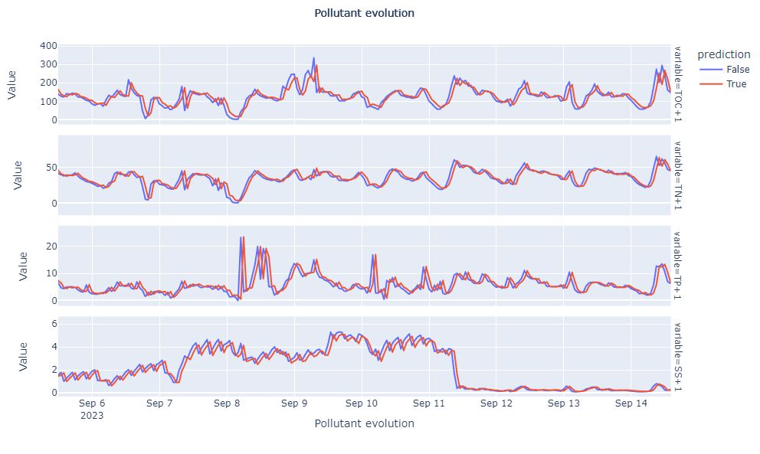
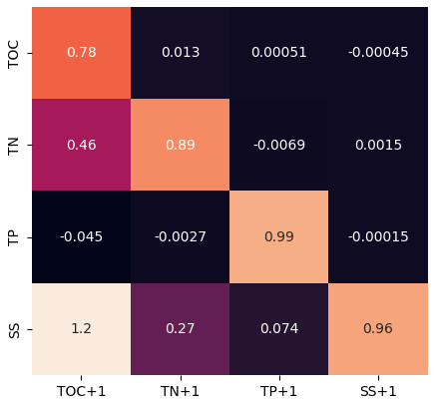

Results from the linear model
Estimated parameters
$$X_{t+1}=AX_{t}+Σ_{t}$$

Slide 7
Conclusions and next steps
VAR was too simplistic and over-prioritized the previous values. Would need more work dedicated to feature engineering (e.g. normalizing data or extracting seasonality)
XGBOOST shows good balance between performance and ease of application
LSTM requires more in-depth knowledge to set up and tune
The results of the best performing models will be compared against the mechanistic model

Slide 8
Thank you

