Slide 1
MIKE+Py: A Python Interface for MIKE+
Ryan Murray
2024-12-12

Slide 2
Overview
Motivation for MIKE+Py
Overview of capabilities
Quick demo
Questions / discussion

Slide 3
Motivation for MIKE+Py

Slide 4

Motivation for MIKE+Py (1)
Imagine you’re making a MIKE+ model.
Your client asks you to analyze 50 different scenarios.
How do you accomplish this?
Manually create 50 different scenarios?
What about pre and post processing?
How do you avoid doing similar things 50 times?
Motivation #1: automation of well-defined, repetitive workflows.

Slide 5

Motivation for MIKE+Py (2)
Your client was so satisfied that they want 50 more scenarios.
How do you accomplish this?
How do you ensure consistency with the original scenarios?
Assign the same modeler?
Carefully follow the same workflow?
How do you leverage previous work to go faster?
Motivation #2: reproduceable workflows

Slide 6

Motivation for MIKE+Py (3)
Browsing Viva Engage, you notice a coworker has a similar need.
How do you share your knowledge?
Explain over a meeting?
Send model and report examples?
Offer to assist on the project?
How could we more efficiently share workflows?
Motivation #3: shareable workflows

Slide 7

Motivation for MIKE+Py (4)
You realize MIKE+ is missing a feature you think is generally useful.
Your client has an immediate need for that feature.
How do you handle this?
Submit a feature request and wait?
Develop a workaround?
Motivation #3: enable user-driven feature prototyping

Slide 8
Framing MIKE+ and MIKE+Py
MIKE+
MIKE+ and
MIKE+Py
MIKE+ FEATURE MATURITY
MIKE+Py
(prototyping)
MIKE+Py
(one-off solutions)
PROJECT SPECIFICITY

Slide 9
Example use cases
Automating repetitive, tedious edits to a model.
Build model quality control logic into a reuseable script.
Automatic pipe sizing according to client-specific criteria.
Model calibration (iteratively running/editing model).
Customize plots and calibrations statistics.
Integrate alongside other python pipelines.

Slide 10
Overview of MIKE+Py

Slide 11
General info
Started development late 2023
Hosted on GitHub at https://github.com/DHI/mikepluspy
Available on PyPI via ‘pip install mikeplus’
Requires a valid MIKE+ license.
Requires MIKE+ 2024 or greater.

Slide 12
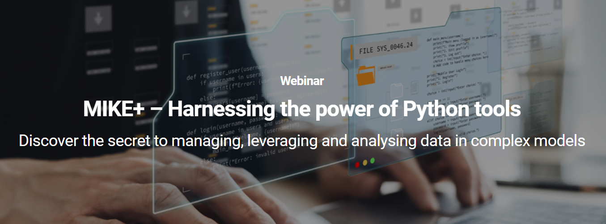
Past webinar (March 2024)
https://wod.theacademybydhi.com/mikeplus-harnessing-the-power-of-python-tools/
https://github.com/DHI/webinars

Slide 13
MIKE+Py design
MIKE+Py
Database
Tools
Engines
Thin Python layer
For modelers
MIKE+
MIKE+ code
For developers
Contains most of the real logic

Slide 14
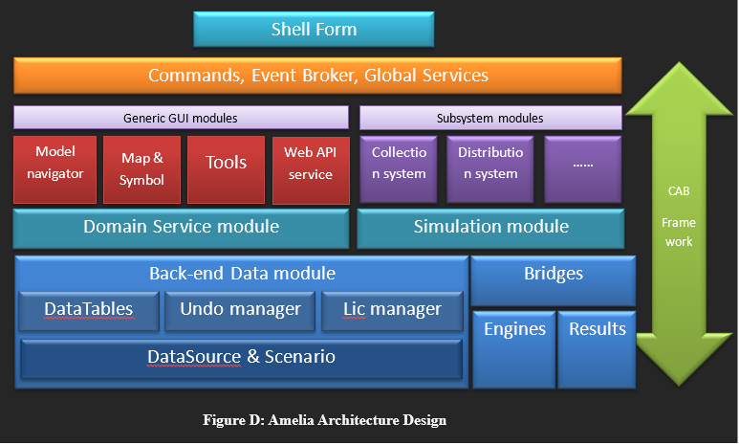
Why use MIKE+Py over libraries like sqlite3?
Leverage existing tools.
Same database propagations as if using MIKE+
Run engines conveniently

Slide 15
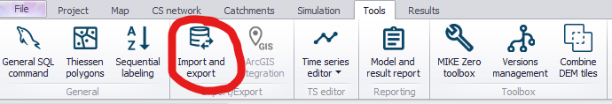
Currently available tools
Catchment slope and length processing tool
Catchment connection tool
Topology repair tool
Interpolation and assignment tool
Import and export tool

Slide 16
What to focus on next?
Better documentation?
More notebook examples?
More features?
Simpler syntax?
Self paced course?
Other suggestions?
It’s open source, so feel free to let us know what’s important to you ☺ https://github.com/DHI/mikepluspy

Slide 17
Quick demo

