Slide 1
rasterio
Raster data and GeoTIFF files

Slide 2
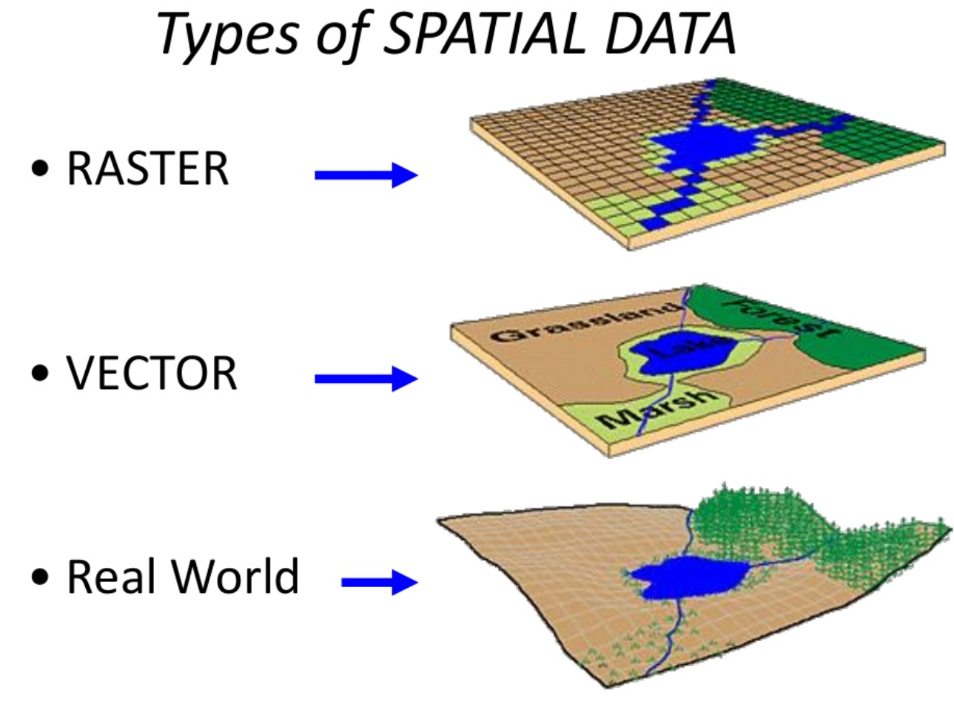
Types of spatial data
Data formats
Raster: geoTIFF, …
Vector: shape files, geoJSON
Python packages
CRS: pyproj, GDAL
Raster: rasterio
Vector: geopandas, shapely
Analysis: PySAL
Plotting: cartopy

Slide 3
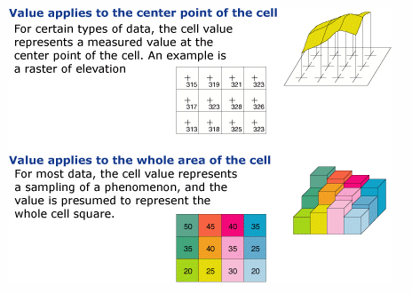
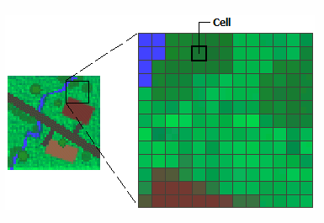
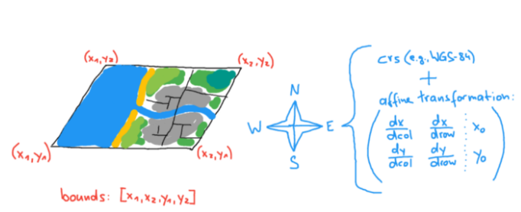
What is raster data?
CRS, affine transformation, bounds
Every pixel is mapped to a geospatial location based on an affine transformation and the underlying crs
Bands (e.g. RGB)
What is raster data?—Help | ArcGIS for Desktop
Dealing with Geospatial Raster Data in Python with Rasterio | by Michael Mommert | Medium

Slide 4
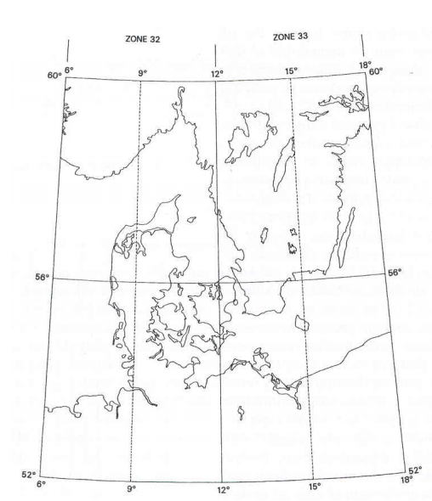
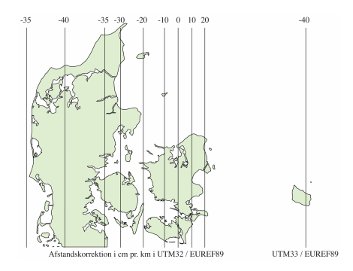
CRS – coordinate reference system
EPSG
EPSG:4326 = WGS84 (=LONG/LAT in MIKE lingo) – used by GPS
EPSG:3857 = web Mercator projection (e.g. google maps)
WKT = well known text representation of CRS
UTM = universal transverse Mercator (e.g. UTM-32)

Slide 5
Rasterio
read/write geoTIFF
meta data
Plot
CLI
> rio bounds myfile.tif
Masks
Coordinate transformations, reprojection
Resampling
Reading from wms
Rasterio: access to geospatial raster data — rasterio documentation

