Slide 1
checkpoint
Gomycode
Git & GitHub Project
Dhia Bouzaiene

Slide 2
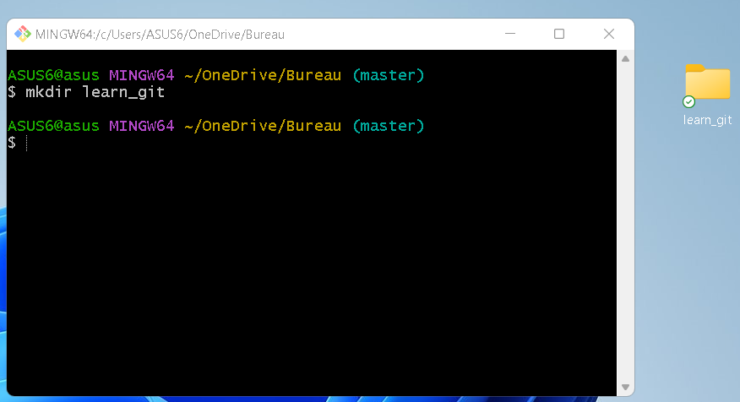
1-Create a folder called learn_git.

Slide 3
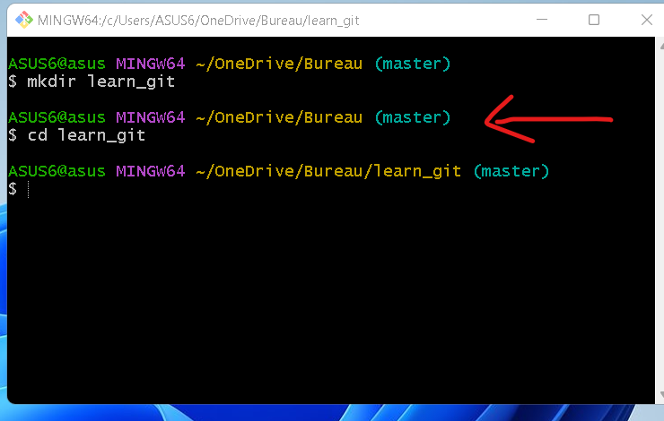
2-Cd (change directory) into the learn_git folder.

Slide 4
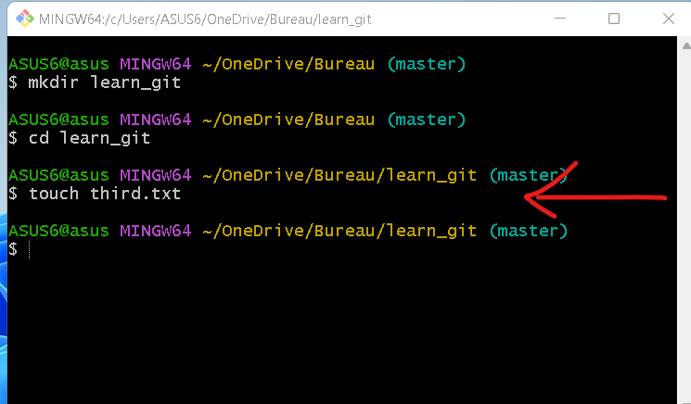
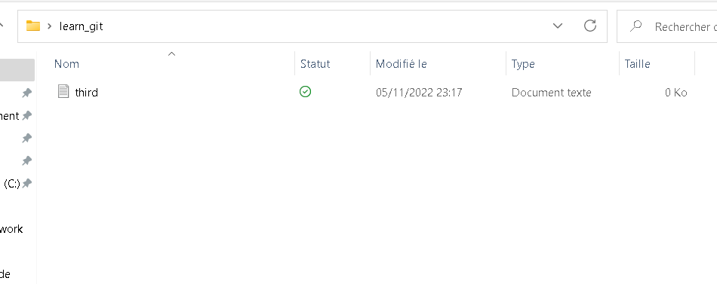
3-Create a file called third.txt.

Slide 5
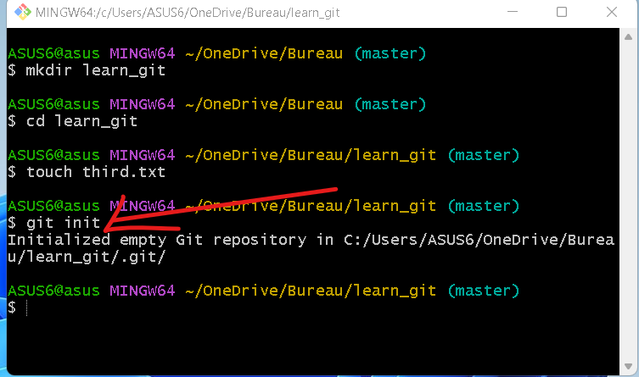
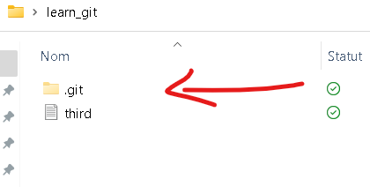
4-Initialize an empty git repository.

Slide 6
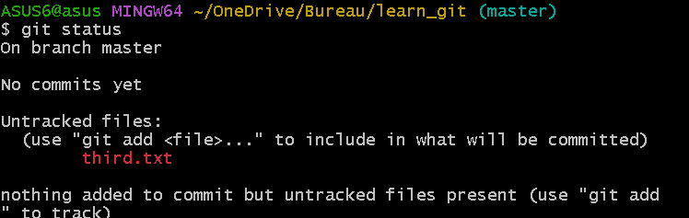
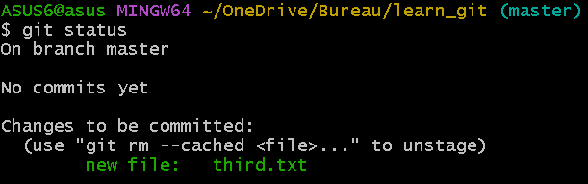
5-Add third.txt to the staging area.
before
after

Slide 7
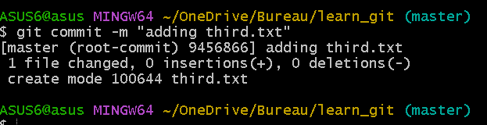
6-Commit with the message "adding third.txt".

Slide 8
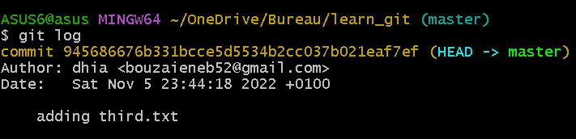
7-Check out your commit with git log

Slide 9

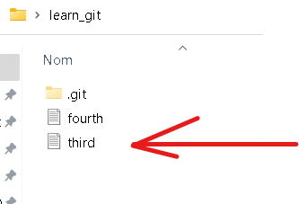
8-Create another file called fourth.txt.

Slide 10

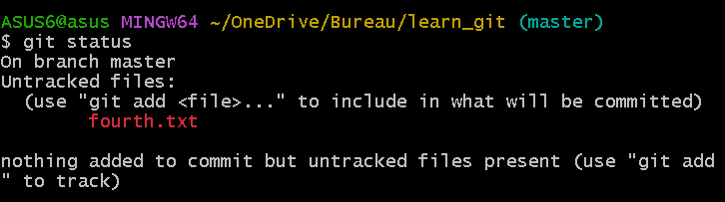
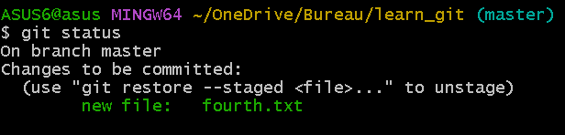
9-Add fourth.txt to the staging area.
before
after

Slide 11
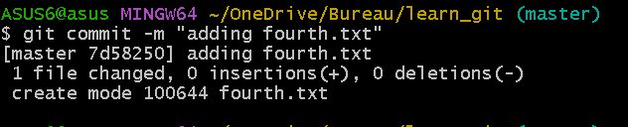
10-Commit with the message "adding fourth.txt"

Slide 12

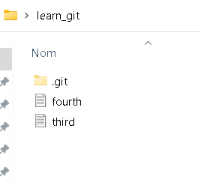
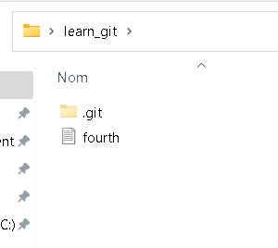
11-Remove the third.txt file.

Slide 13
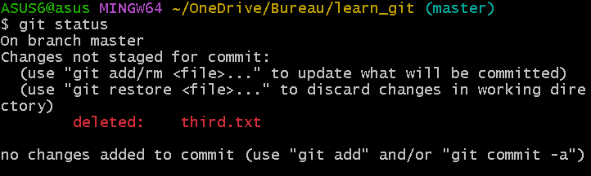
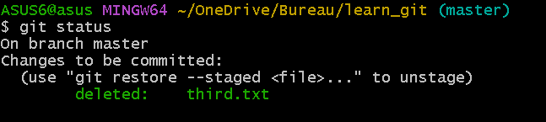
12-Add this change to the staging area. (Using the command "git add . "
before
after

Slide 14
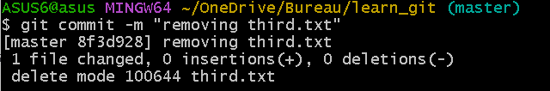
13-Commit with the message "removing third.txt".

Slide 15
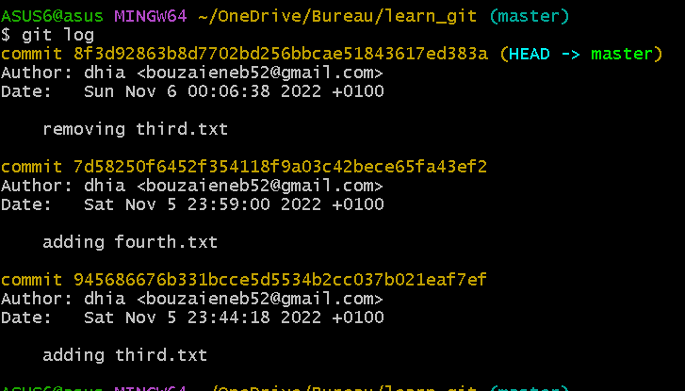
14-Check out your commits using git log.

Slide 16
15-Change your global settings to core.pager=cat - you can read more about that here.

Slide 17

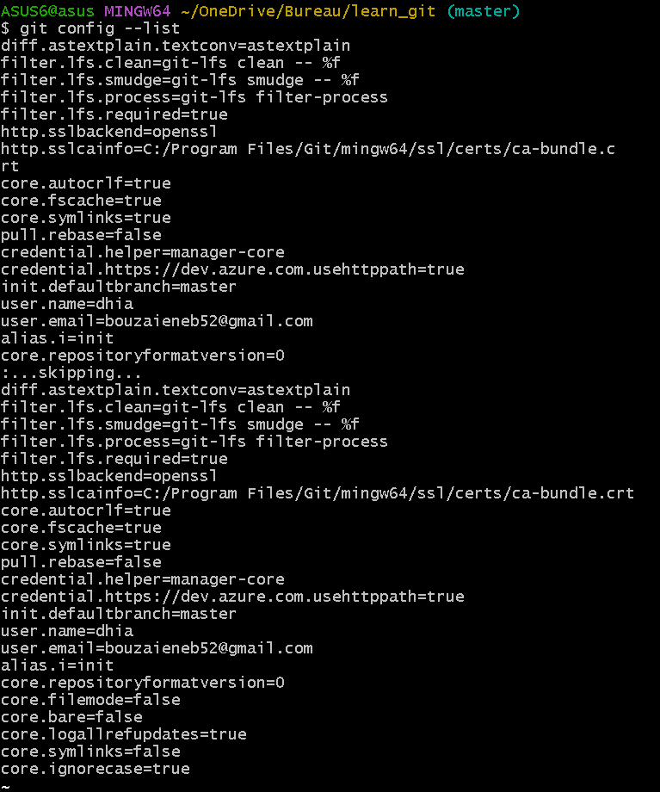

16-Write the appropriate command to list all the global configurations for git on your machine.

Slide 18
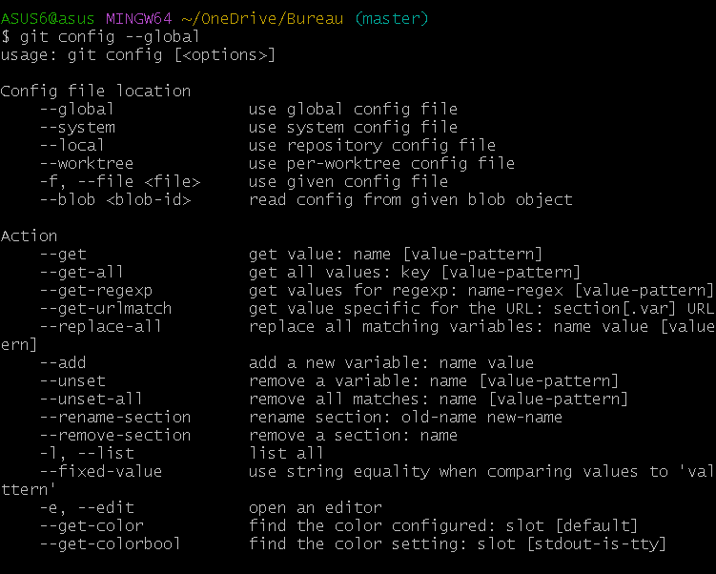
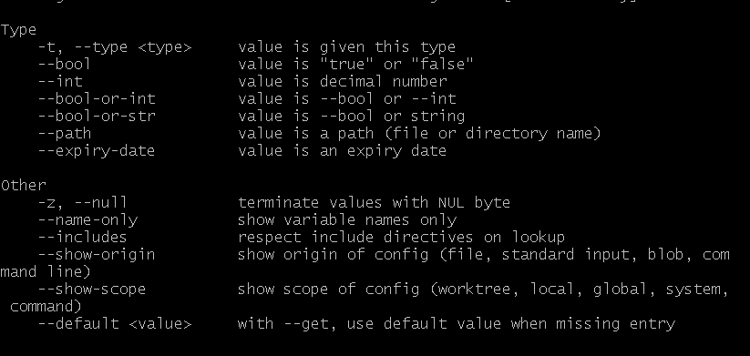
17-You can type git config --global to find out how to do this.

