Slide 1



Fastest way to create applications

Slide 2
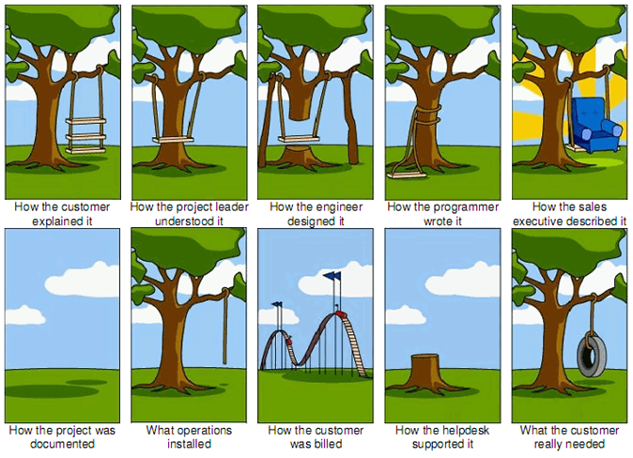
The Typical Software Project?

Slide 3




Bridges Teams
Customers
Analysts
Technical
Developers /Operations

Slide 4
Iteration Process
DEVELOP
PROTOTYPE
XPAPER NAPKIN
WORKING CODE
AGIILE PROJECT

Slide 5
Demo

Slide 6
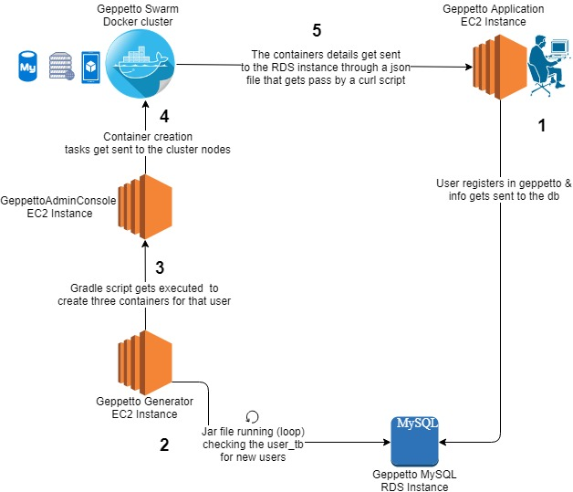
Geppetto Tech Flow

Slide 7
Geppetto Generated Code Features
Geppetto Development tools and techniques
Rapid prototyping using code generation
NodeJS/Express, AngularJS, Cordova, Ionic
Cloud or On-Prem deployments using Docker
Micro Services, Angular 4x/5.x, Ionic 2.0/Ionic 3.0
Lotus Notes Modernization/Migrations
Geppetto allows increase collaboration with off shore teams
Reduction in project start up due to project templating
AKA “opinionate software”

