Slide 1

YOGAM ORGANIC FARMS
A Direct-to-Consumer Sustainable E-Commerce Platform for Organic Produce using Next.js
Submitted By:
Your Name
Your Register Number
Under the Guidance of:
Guide Name
Guide Designation

Slide 2
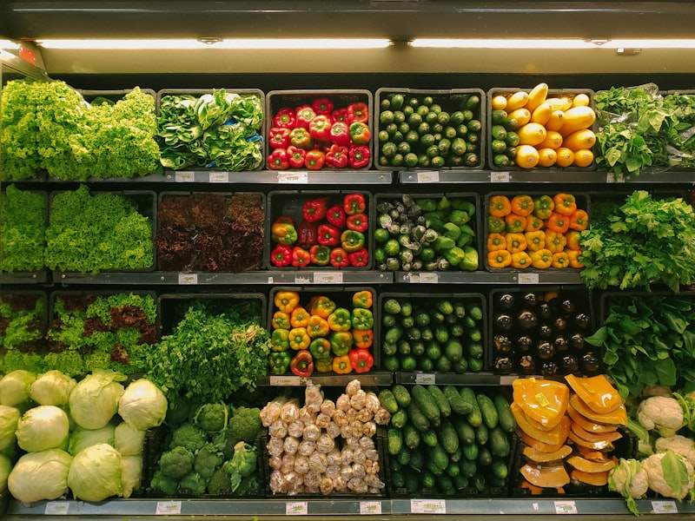
Abstract
• Built on Next.js, this platform resolves the disconnect between organic growers and sustainably-minded consumers. • Empowers farmers with a Direct-to-Consumer (D2C) pipeline, maximizing profits and cutting out wholesale intermediaries. • Features Server-Side Rendering (SSR) for blazing performance, full cart/checkout functionality, and Prisma-backed PostgreSQL storage. • Integrates modern UI libraries (Tailwind CSS, Framer Motion) for an enterprise-level shopping experience.

Slide 3
Scope of the Project
• Develop a scalable, React-based marketplace specifically for verified organic farm produce. • Provide an authenticated Admin Dashboard to track inventory, revenue analytics, and order fulfillment states dynamically. • Implement highly responsive front-end layouts adapting perfectly to mobile, tablet, and desktop environments. • Secure user data, local address formatting, and checkout sessions utilizing NextAuth.js and JWT. • Integrate a secure third-party Payment Gateway (e.g., Stripe/Razorpay) to process online transactions securely.

Slide 4
Systems Comparison
Existing Methods (Drawbacks)
Proposed System (Advantages)
• Over-reliance on wholesale brokers draining farmers' margins. • Slow, manual inventory tracking practices leading to food spoilage. • Inflated pricing for the end-consumer due to supply chain bloat. • Zero transparency regarding organic produce origin.
• Re-routing consumer purchases directly into farmers' revenue. • Real-time, Next.js API-driven automated stock management. • Integrated Payment Gateway for secure, instantaneous checkout. • Clear farm-to-table UI trust markers and product categories.

Slide 5
System Architecture
Client UI (React)
- Tailwind CSS
- Framer Motion
Next.js Server API
- Edge Runtime
- Server Actions
Data Layer
- PostgreSQL
- Prisma ORM
NextAuth.js
JWT Security
Payment Gateway
API (Stripe/Razor)

Slide 6
Core Application Modules
Module | Description
User Authentication | Secure Sign-up, Sign-in, and full session management using JSON Web Tokens (JWT) encrypted with Bcrypt.
Admin IT Dashboard | Central React-based interface to manage live products, analyze sales, and dynamically update order statuses.
Direct Produce Catalog | Filtering and search-enabled grid showcasing available organic stocks, fetching real-time JSON responses.
Modern Cart & Payment | React Context-powered cart holding state, integrating local address persistence and a secure Payment Gateway processor.
Order Tracking | Profile dashboard for end-users to oversee past purchases, verify tracking statuses, and maintain addresses.

Slide 7
UML Use Case Diagram
Next.js E-Commerce System
Auth / Login
Browse Produce
Cart / Checkout
Customer
Process Payment
Admin
Manage Inventory
Update Order Status

Slide 8
Database Schema (ER Diagram)
users
orders (FK: userId)
order_items (FKs: orderId, prodId)
PK: id
-----
name (VARCHAR)
email (VARCHAR)
role (ENUM)
PK: id
-----
totalAmount
paymentId
status
createdAt
PK: id
-----
quantity (INT)
price (DECIMAL)
addresses (FK: userId)
products (FK: categoryId)
PK: id
-----
street, city, zip
categories
PK: id
-----
name
price
stock
PK: id
-----
name
slug

Slide 9
Process Flow: Order to Delivery
Admin Update:
PROCESSING
START:
Add Products
Validate Cart
& DB Stock
Process Payment
(Gateway)
API POST:
Order PENDING
END:
Order DELIVERED
Admin Update:
SHIPPED

Slide 10
AI Integration: Market Basket Analysis
The Apriori Algorithm
• Purpose: Implemented an associative Data Mining algorithm to dynamically power the 'Frequently Bought Together' recommendations. • How it Works: - Analyzes historical PostgreSQL order data. - Calculates the 'Support' (how often items appear) and 'Confidence' (probability of buying Item B if Item A is purchased). - Returns real-time recommendations natively without relying on heavy external deep learning models. • Business Value: Increases Average Order Value (AOV) by intelligently up-selling correlated organic products during browsing.
User Views:
Organic Tomatoes
System Recommends:
Organic Onions
(Confidence: 85%)

Slide 11
IEEE Base Paper Reference
Paper Title:
Enhancing E-Commerce Sales through Market Basket Analysis using the Apriori Algorithm
Domain Area: Data Mining & Knowledge Discovery in Databases (KDD). Why This Paper Was Chosen: • The Apriori algorithm bridges the gap between Relational Database Management (PostgreSQL/Prisma) and Machine Learning. • It provides a scalable, pure-code solution to solve the 'cold-start' recommendation problem often faced by new organic markets. • Directly aligns with the project’s goal of optimizing digital D2C (Direct-to-Consumer) supply chains.

