Slide 1
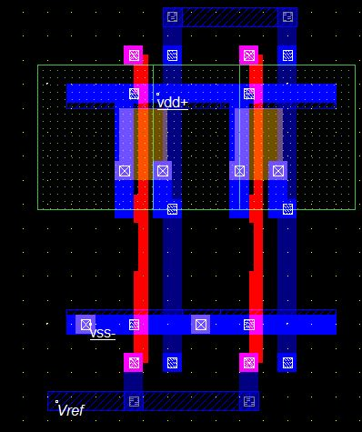
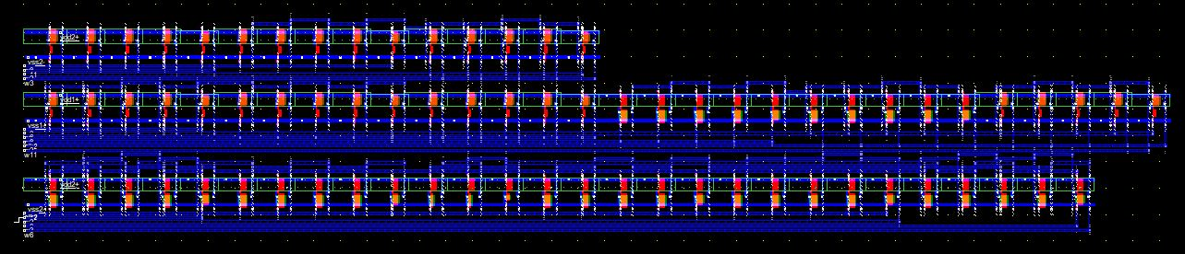
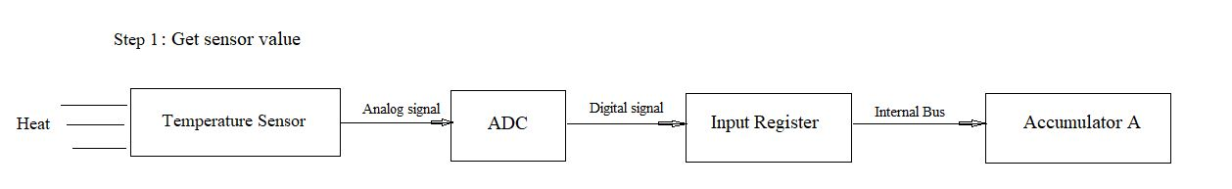
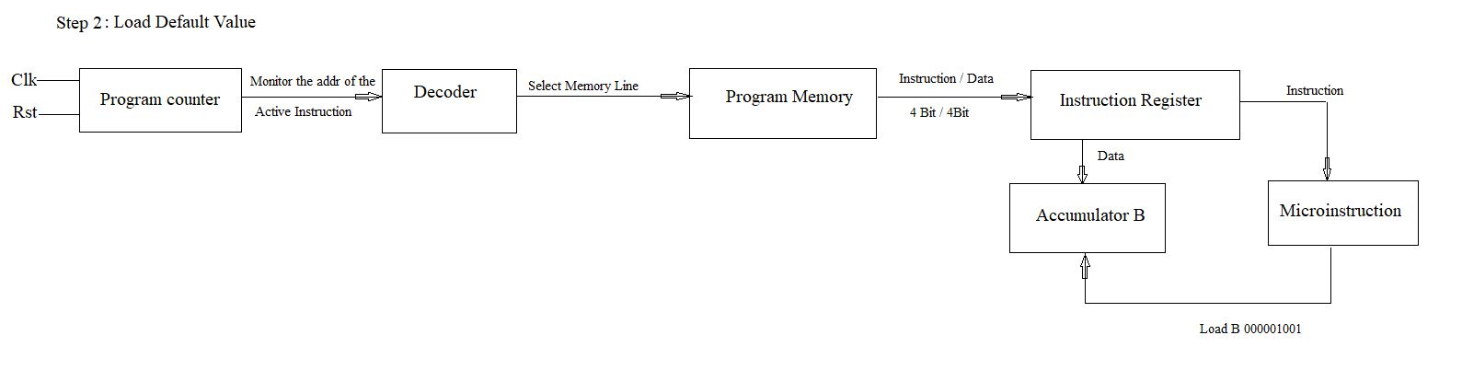
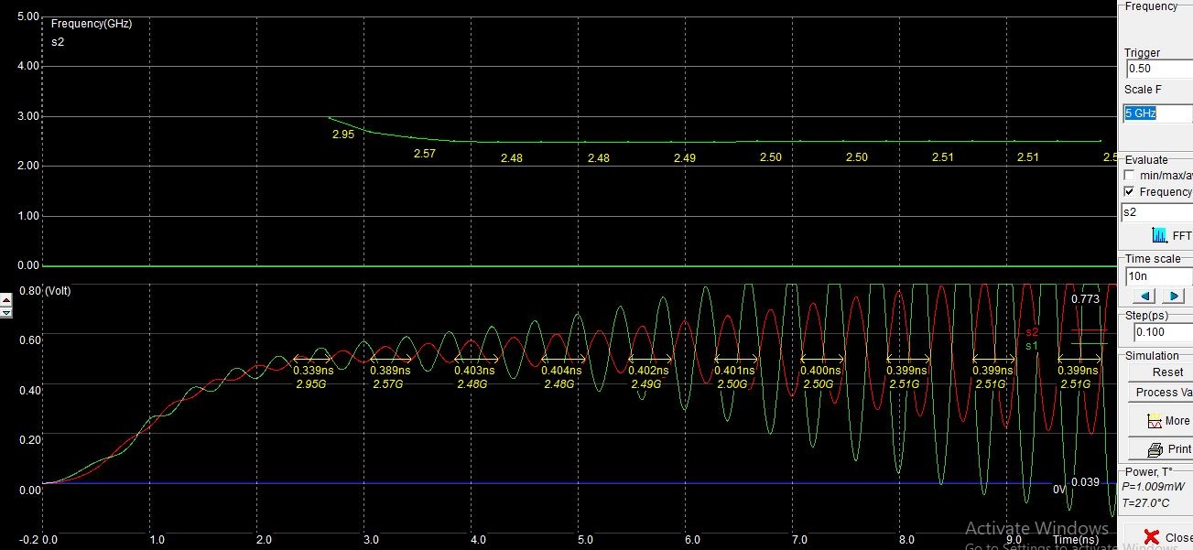
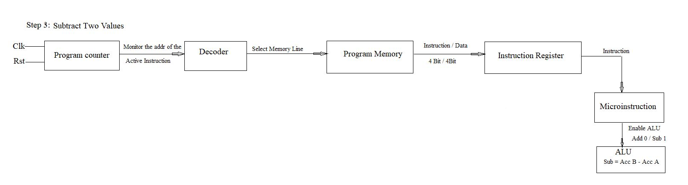
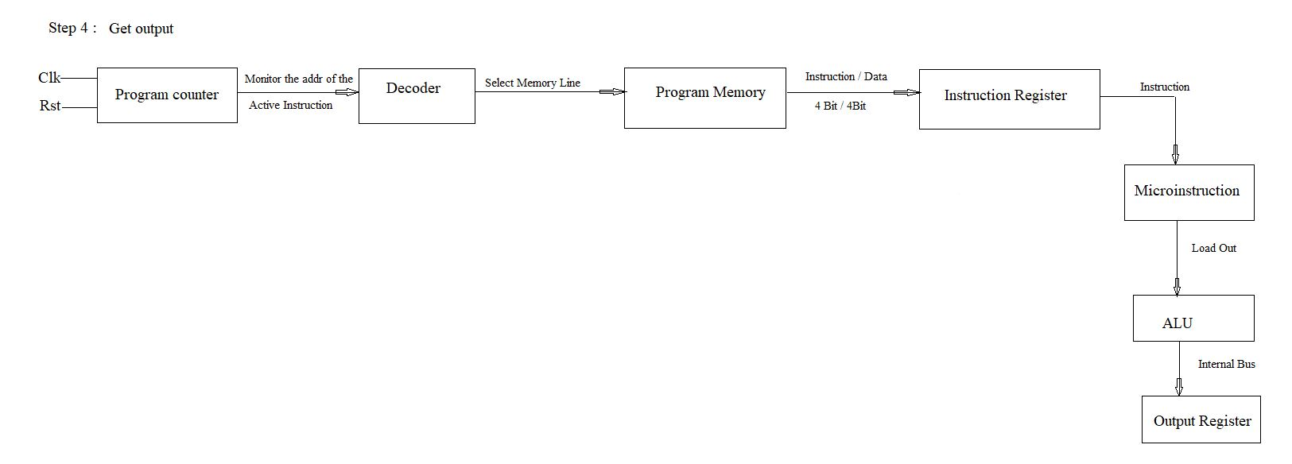
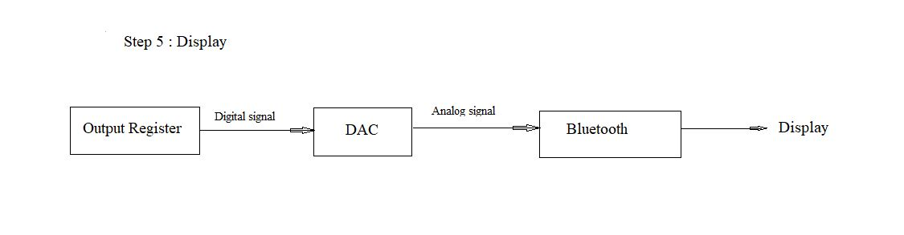
Implementation of Micro-Chip for IoT Applications
Add Author Names and Information
Institut supérieur d'électronique de Paris
Introduction
Temperature Sensor
Implement and simulate a SoC using a BT connection integrated for a wireless communication with a terminal and CMOS based sensors to interact with its environment.
This SoC will implemented using the platform MicroWind for a CMOS technology of 130nm.
Scale Down Benefits
120 nm Technology scale down
Gate dielectric – SiO2
Kgates – 240 mm2
Effective gate length – 70nm
Smaller
Faster
Less Power Consumption
Cheaper (If fabricates million)
Microwind Software
Bluetooth
User-friendly design tool
Simulate and design an integrated circuit at physical description level.
Innovative CMOS design tool for educational market.
It works in Lambda units (λ).
DRC Checks.
500 design rules for 130nm
Architecture
Results
Acknowledgements
The processor has numerus number of blocks based on the requirement but in all the blocks the main part is the clock. Based on the clock pulse the entire processor acts. In our project clock plays a vital role as we edge sensitive D-register in most of the blocks. ADC and DAC are used to make the transition easy from getting Analog data from temperature sensor and also to transmit the data by Bluetooth.

