Slide 1
Agile vs Waterfall SDLC
A Leadership Briefing on Software Development Methodologies, Core Framework Roles, and Strategic Implementation

Slide 2
Executive Briefing Overview
Evaluating modern software delivery frameworks to optimize product velocity, mitigate architectural risks, and drive continuous value alignment.

Slide 3
Core Scrum-Agile Team Role
Product Owner (value maximization), Scrum Master (process facilitation), and Developers (execution). These roles are defined by clear accountabilities to ensure transparency and inspection (Schwaber & Sutherland, 2020).
Product Owner
Owns the product vision, maintains and prioritizes the backlog, represents business stakeholders, and guarantees maximum value delivery.
Scrum Master
Facilitates team ceremonies, eliminates operational blockers, enforces Agile principles, and coaches cross-functional team execution.
Development Team
Self-organizing, cross-functional engineering team responsible for delivering fully tested, high-quality working increments each sprint.

Slide 4
Agile SDLC Sprint Lifecycle
Backlog & Planning
Select priority user stories, establish acceptance criteria, and commit to sprint goals.
Testing & Review
Continuous QA followed by live stakeholder demonstration for real-time validation.
Sprint Execution
Iterative design
and coding backed by daily standups for active progress synchronization
Retrospective & Release
Evaluate team performance, adjust workflow processes, and deploy working software.
Agile shifts focus toward iterative design, continuous QA, and rapid release loops over comprehensive documentation, with 71% of organizations actively integrating Agile into their SDLC (Digital.ai, 2024; Schwaber & Sutherland, 2020).

Slide 5
Development Paradigm Contrast
Linear vs. Iterative Philosophy
Waterfall: Follows a sequential flow (Requirements → Design → Code → Test → Deploy). Scope is frozen early, making downstream changes costly.
Agile: Operates in short, iterative loops (1-4 week sprints). Rapid releases allow continuous scope refinement based on real market usage.

Slide 6
Resolving Blockers: Waterfall vs Agile
Waterfall Blocker Response
Rigid Escalation: Unforeseen technical defects during late-stage testing require formal Change Control Board approval, causing milestone delays and major budget re-estimations.
Agile Blocker Response
Adaptive Resolution: Daily Standups surface blockers immediately. The Scrum Master assists in resolution while the Product Owner reprioritizes the backlog dynamically.
Traditional Waterfall relies on a sequential, phase-gated flow where scope is frozen early; empirical studies show plan-driven models suffer higher failure rates in dynamic environments compared to flexible Agile frameworks (Tetteh, 2024; Zare & Far, 2024).

Slide 7
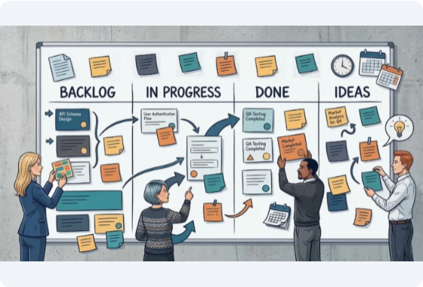
Decision Factors for Leadership
Scope Stability: Fixed regulatory mandates favor Waterfall; evolving product capabilities favor Agile.
Stakeholder Engagement: Agile requires continuous client feedback; Waterfall relies on upfront signoffs
Risk Tolerance: Agile reduces risk via frequent releases; Waterfall defers integration risk to late phases.
Time-to-Market: Agile delivers functional value early; Waterfall delivers at project completion.
Industry metrics indicate that adopting Agile practices accelerates time-to-market (52%), improves team alignment (57%), and significantly lowers project delivery risk (Digital.ai, 2022, 2024; Standish Group, 2020).

Slide 8
Methodology Comparative Matrix
Dimension Waterfall Model Scrum-Agile Model
Delivery Model Single major release at project conclusion Continuous working increments every 2-4 weeks
Requirement Flexibility Inflexible once phase baseline is set High; backlog refined iteratively
Customer Involvement Upfront planning & final user acceptance Continuous participation in reviews & demos
Project Risk Profile High risk during late-stage integration Low risk due to continuous validation

Slide 9
Questions & Strategic Alignment
Thank you for your time. Let's discuss adapting our SDLC framework for strategic success.

Slide 10
Sources
Digital.ai. (2024). 17th annual State of Agile report. https://stateofagile.com/
Schwaber, K., & Sutherland, J. (2020). The Scrum guide: The definitive guide to Scrum: The rules of the game. Scrum.org. https://scrumguides.org/scrum-guide.html
Standish Group. (2020). CHAOS 2020: Beyond infinity. The Standish Group International, Inc. https://www.standishgroup.com/sample_research_files/CHAOSReport2020.pdf
Tetteh, E. (2024). Empirical study of Agile software development methodologies: A comparative analysis. Asian Journal of Research in Computer Science, 17(5), 30–42. https://doi.org/10.9734/ajrcos/2024/v17i5385
https://www.kanbanchi.com/wp-content/uploads/2020/10/project-boards-illustration-board-and-team-700x391.png
Source: www.kanbanchi.com

