Slide 1
우리조발표

Slide 2
AI copywriter
Notes:
우리가 브레인스토밍을 할 때 서로가 낸 아이디어를 가지고 조합해보기도 하고, 뺄건 빼고, 확장시켜나가면서 하나의 아이디어가 완성되는 과정을 거칩니다. 이 과정에서 가장 어려운 것은 회의장에 참여하기 전, 회의장에서 뱉어낼 아이디어를 얻기 위한 과정이라 생각합니다. 우리가 유튜브 콘텐츠를 기획하는 1인 크리에이터라고 봅시다. 영상은 잘 뽑았지만 그 전에 사람들이 관심을 가질만한 제목으로 조회수를 끌어보려합니다. 이를 위해서 관련 주제를 다룬 사람들은 어떤 제목을 붙였고 최근 유행하는, 사람들 사이에서 많이 화자되는 재밌는 주제는 무엇인지 공부하고 이를 토대로 영상 제목에 적용할 것입니다. 생각만해도 굉장히 피로한 작업이 필요한데요. 어려운 과정을 생략해드리기 위해 만드려고 하는 것이 바로 이 AI 카피라이터입니다.

Slide 3
AI copywriter
새로운 영화의 태그라인을 추천해주는 모델
5 ~ 10
Notes:
저희는 다양한 분야 중 영화 포스터 태그라인에 집중했습니다. 정확한 태그라인을 추천해주기보다는 아이디어 확장을 도와줄 문구를 추천해주는 것을 목적으로 하고 있습니다.

Slide 4
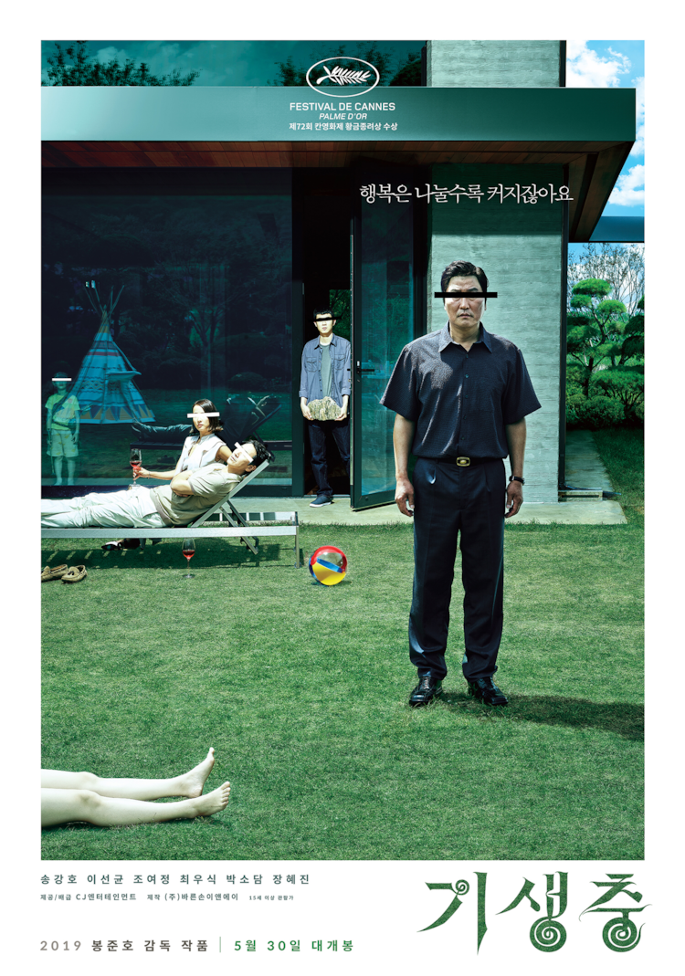

tagline: 행복은 나눌수록 커지잖아요
tagline: PUT ON A HAPPY FACE
Notes:
기생충과 조커같이 영화 전체를 관통하는 한 문장을 태그라인으로 작성합니다.

Slide 5
목차
진행절차
모델 + 결과
앞으로 계획

Slide 6
진행절차
name
genre
tagline
summary
synopsis
크롤링
AI copywriter
모델
gpt-2
seq2seq
genre + summary + synopsis = tagline
결과
new_tagline

Slide 7
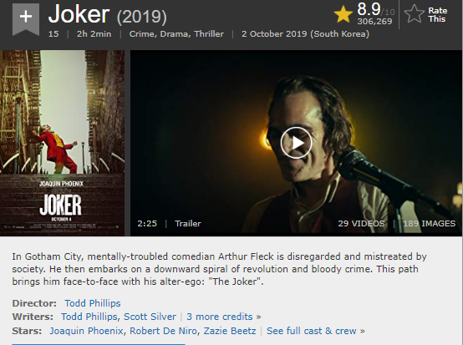
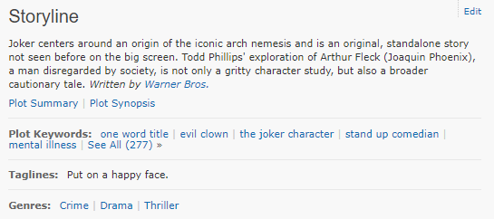
진행절차
Movie_name
Movie_summary
&
Movie_synopsis
Movie_tagline
Movie_genre

Slide 8
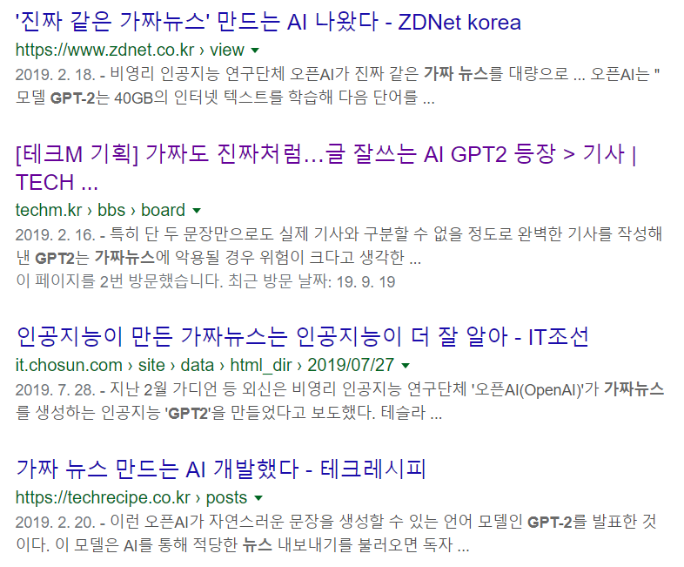
모델
- gpt-2
- Seq2seq
Notes:
Gpt-2 fakenews 모델로 유명

Slide 9
결과
- gpt-2
- Seq2seq
cious "biker-biker", "Gravity" and "The Lost Planet" stars as a retired Navy diver, whose mission is to recover, investigate and destroy the missing satellite.<|endoftext|>by Michael Moore. In June of 2005, Mikey, the best man in the world, decided to stop driving. He decided to find the best way to keep going at all cost. Mikey went to California to make his fortune with the money he saved going to his friends. His friends were a couple who helped him with his business problems, but he couldn't bring himself to follow them. It was going too far, because of some unfortunate incidents. He had to make a run at an abandoned school. He went in for his friend Dave of the New Yorker, so the poor man could do some good. That may have been the worst thing that could happen to Mikey, but since he hasn't been able to keep up with his friends, he can't be around to do it. This led to two things: (1) Mikey had a bad attitude from the beginning and (2) his friends are not taking him seriously. He was too busy working on the project to get up early because of a bad attitude. At some point, Mikey, who had already been through six jobs and several previous ones he hasn't worked for a week (which he hasn't done at all), decided to quit driving. He didn't realize that Mikey had just got $1,000 in his pocket. But he was wrong, as he discovered that the money had never been a problem before. For a while, he thought he was going to spend some of that money on a new car. But when he saw that Mikey had already paid for the current vehicle with no problems, it was enough to end his plans. He thought he could not do anything about the car now. So he had to pay Mikey. But when Mikey asked the good guys "Don't You Want to Fly" for a car and he was told that if he tried to take this money, he would get killed. Mikey did get some money, but he only made $4,000. So when he asked for more money, Mikey got a good deal. Mikey had been in the process of getting his life back in order when he stopped driving and he was not able to do it. He decided to take a break and go out to California and take his money. But with Mikey in the car just as he wanted it, Mikey got killed. But Mikey, who had started the car like a crazy car, still paid Mikey to drive the car and he was not able to use the money in any of the tasks which Mikey had asked him to do. The bad guys in the car also not like Mikey. And then Mikey came up with a strange idea which Mikey had never done and it is when he started thinking that Mikey wanted to stop driving because he needed to take the money. Mikey had to take Mikey to California where he lost in San Jose and got killed in the car, Mikey's friend Domenico, took it to California where he got killed and Mikey's friends found Mikey's place where Mikey went missing and he was not able to get him back. That Mikey decided to take his money, he did not have an answer to Mikey, Mikey and that Mikey did not like him and he would not do anything for his money. So he decided to take money from his friend Domenico and took Mikey to California where Mikey went missing and got killed. Because Mikey didn't like Mikey, his friends wanted Mikey to do it too. So Mikey went to California and lost in San Jose and Mikey's friends found Mikey's place where Mikey went missing and Mikey's friend Domenico took it. In that crash Mikey crashed in an abandoned house that Mikey didn't know about. Mikey lost all his friends when Mikey lost Mikey. So Mikey decided to go to California to do something with his money that happened to him. Mikey has to take Mikey to California where Mikey went missing and Mikey lost Mikey's place where Mikey went missing. So Mikey lost Mikey's friends. Mikey's friend Domenico, had Mikey's friend Domenico in the car that was Mikey's friend and got Mikey killed and Mikey's friends found Mikey's place where Mikey went missing and Mikey was not able to get Mikey back again. Domenico was a friend too and Mikey took Mikey there. That Mikey's friends would also not like Mikey either… So Mikey decided to take Mikey to California where Mikey's friends found Mikey's place where he went missing and Mikey's friends found Mikey's place where Mikey died. So that Mikey's friends could find Mikey and Mike
Notes:
번역 전 원문 번역 후 원문
Context vector 문맥 정보를 담고 있는 하나의 셀이 형성. 이것이 입력되었을 때 encoder, 출력은 decoder
Encoder와 decoder를 학습시킴.
Gpt2도 단어 예측
카피해서 정호에게 보내주기

Slide 10
결과
- gpt-2
- Seq2seq
cious "biker-biker", "Gravity" and "The Lost Planet" stars as a retired Navy diver, whose mission is to recover, investigate and destroy the missing satellite.<|endoftext|>by Michael Moore. In June of 2005, Mikey, the best man in the world, decided to stop driving. He decided to find the best way to keep going at all cost. Mikey went to California to make his fortune with the money he saved going to his friends. His friends were a couple who helped him with his business problems, but he couldn't bring himself to follow them. It was going too far, because of some unfortunate incidents. He had to make a run at an abandoned school. He went in for his friend Dave of the New Yorker, so the poor man could do some good. That may have been the worst thing that could happen to Mikey, but since he hasn't been able to keep up with his friends, he can't be around to do it. This led to two things: (1) Mikey had a bad attitude from the beginning and (2) his friends are not taking him seriously. He was too busy working on the project to get up early because of a bad attitude. At some point, Mikey, who had already been through six jobs and several previous ones he hasn't worked for a week (which he hasn't done at all), decided to quit driving. He didn't realize that Mikey had just got $1,000 in his pocket. But he was wrong, as he discovered that the money had never been a problem before. For a while, he thought he was going to spend some of that money on a new car. But when he saw that Mikey had already paid for the current vehicle with no problems, it was enough to end his plans. He thought he could not do anything about the car now. So he had to pay Mikey. But when Mikey asked the good guys "Don't You Want to Fly" for a car and he was told that if he tried to take this money, he would get killed. Mikey did get some money, but he only made $4,000. So when he asked for more money, Mikey got a good deal. Mikey had been in the process of getting his life back in order when he stopped driving and he was not able to do it. He decided to take a break and go out to California and take his money. But with Mikey in the car just as he wanted it, Mikey got killed. But Mikey, who had started the car like a crazy car, still paid Mikey to drive the car and he was not able to use the money in any of the tasks which Mikey had asked him to do. The bad guys in the car also not like Mikey. And then Mikey came up with a strange idea which Mikey had never done and it is when he started thinking that Mikey wanted to stop driving because he needed to take the money. Mikey had to take Mikey to California where he lost in San Jose and got killed in the car, Mikey's friend Domenico, took it to California where he got killed and Mikey's friends found Mikey's place where Mikey went missing and he was not able to get him back. That Mikey decided to take his money, he did not have an answer to Mikey, Mikey and that Mikey did not like him and he would not do anything for his money. So he decided to take money from his friend Domenico and took Mikey to California where Mikey went missing and got killed. Because Mikey didn't like Mikey, his friends wanted Mikey to do it too. So Mikey went to California and lost in San Jose and Mikey's friends found Mikey's place where Mikey went missing and Mikey's friend Domenico took it. In that crash Mikey crashed in an abandoned house that Mikey didn't know about. Mikey lost all his friends when Mikey lost Mikey. So Mikey decided to go to California to do something with his money that happened to him. Mikey has to take Mikey to California where Mikey went missing and Mikey lost Mikey's place where Mikey went missing. So Mikey lost Mikey's friends. Mikey's friend Domenico, had Mikey's friend Domenico in the car that was Mikey's friend and got Mikey killed and Mikey's friends found Mikey's place where Mikey went missing and Mikey was not able to get Mikey back again. Domenico was a friend too and Mikey took Mikey there. That Mikey's friends would also not like Mikey either… So Mikey decided to take Mikey to California where Mikey's friends found Mikey's place where he went missing and Mikey's friends found Mikey's place where Mikey died. So that Mikey's friends could find Mikey and Mike
Notes:
번역 전 원문 번역 후 원문
Context vector 문맥 정보를 담고 있는 하나의 셀이 형성. 이것이 입력되었을 때 encoder, 출력은 decoder
Encoder와 decoder를 학습시킴.
Gpt2도 단어 예측
카피해서 정호에게 보내주기

Slide 11
모델
나는
배가
고프다
<eos>
gpt-2
- Seq2seq
- Seq2seq 는 RNN의 가장 발전된 형태
- encoder 와 decoder
- 간단한 예제: 기계번역
- 인코더에는 번역 전 문장, 디코더는 번역 후 문장
- 인코더는 번역 전 문장의 정보를 압축, 디코더에서 압축된 정보를 토대로 아웃풋 출력
I
feel
hungry
<bos>
나는
배가
고프다
Notes:
그리고 RNN에서 발전된 seq2seq를 사용하고있습니다.

Slide 12
모델
나는
배가
고프다
<eos>
gpt-2
- Seq2seq
encoder
decoder
- Seq2seq 는 RNN의 가장 발전된 형태
- encoder 와 decoder
- 간단한 예제: 기계번역
- 인코더에는 번역 전 문장, 디코더는 번역 후 문장
- 인코더는 번역 전 문장의 정보를 압축, 디코더에서 압축된 정보를 토대로 아웃풋 출력
I
feel
hungry
<bos>
나는
배가
고프다
Notes:
위 그림을 이해를 돕기 위해 단어별로 셀을 만들어 보인 것이고 Seq2seq는 2개의 RNN 셀로 구성됩니다. 인코더와 디코더.
번역을 예로 들어 설명하겠습니다. 인코더에는 버역 전 문장, 디코너는 번역 후 문장을 넣고 번역 후 문장이 나오도록 학습을 합니다.
하나씩 보면

Slide 13
모델
나는
배가
고프다
<eos>
gpt-2
- Seq2seq
- Seq2seq 는 RNN의 가장 발전된 형태
- encoder 와 decoder
- 간단한 예제: 기계번역
- 인코더에는 번역 전 문장, 디코더는 번역 후 문장
- 인코더는 번역 전 문장의 정보를 압축, 디코더에서 압축된 정보를 토대로 아웃풋 출력
I
feel
hungry
<bos>
나는
배가
고프다
Notes:
I feel hungry가 인풋으로 들어가면 이를 단어별로 쪼개어 각각의 셀에 벡터값을 부여합니다. I에 해당하는 context vector 값이 나오고 이는 계속해서 다음 셀로 이동해가며 값에 영향을 줍니다.
이렇게 훈련된 모델은 I feel hungry가 차례대로 입력되고 디코더에 <bos>를 입력하여 시작을 알리며 결과값을 내뱉습니다.

Slide 14
모델
tagline a
tagline b
tagline c
tagline d
eos
gpt-2
- Seq2seq
genre
summary
synopsis
bos
tagline a
tagline b
tagline c
tagline d
Notes:
저희의 목적은 장르, 서머리, 시놉시스를 태그라인과 학습을 시켜 새로운 영화 정보가 들어갔을 때 최적의 태그라인과 그 외 태그라인들을 출력하는 모델을 만드는 것입니다. 그러나 현재 summary 데이터를 가지고 진행 중인데 가장 최선의 태그라인을 뽑아내는 건 가능하지만 태그라인 여러 개를 출력하는 데 어려움을 겪고 있습니다. 그래서 이 부분에 대한 결과값은 지금은 보여드리지 못하는 점 양해 바랍니다.

Slide 15
앞으로 계획
n개의 결과값을 내도록 알고리즘 수정
Summary 뿐 아니라 genre, synopsis도 추가하여 모델 학습
3. 추후 Flask와 미리 학습된 모델을 이용하여 REST API 서버를 구축하고 이것을 이용하여
Input에 따라 JSON형식으로 출력해주는 WEB, APP등으로 서비스 구현 테스트

Slide 16
Thank You

Slide 17
최종발표용

Slide 18

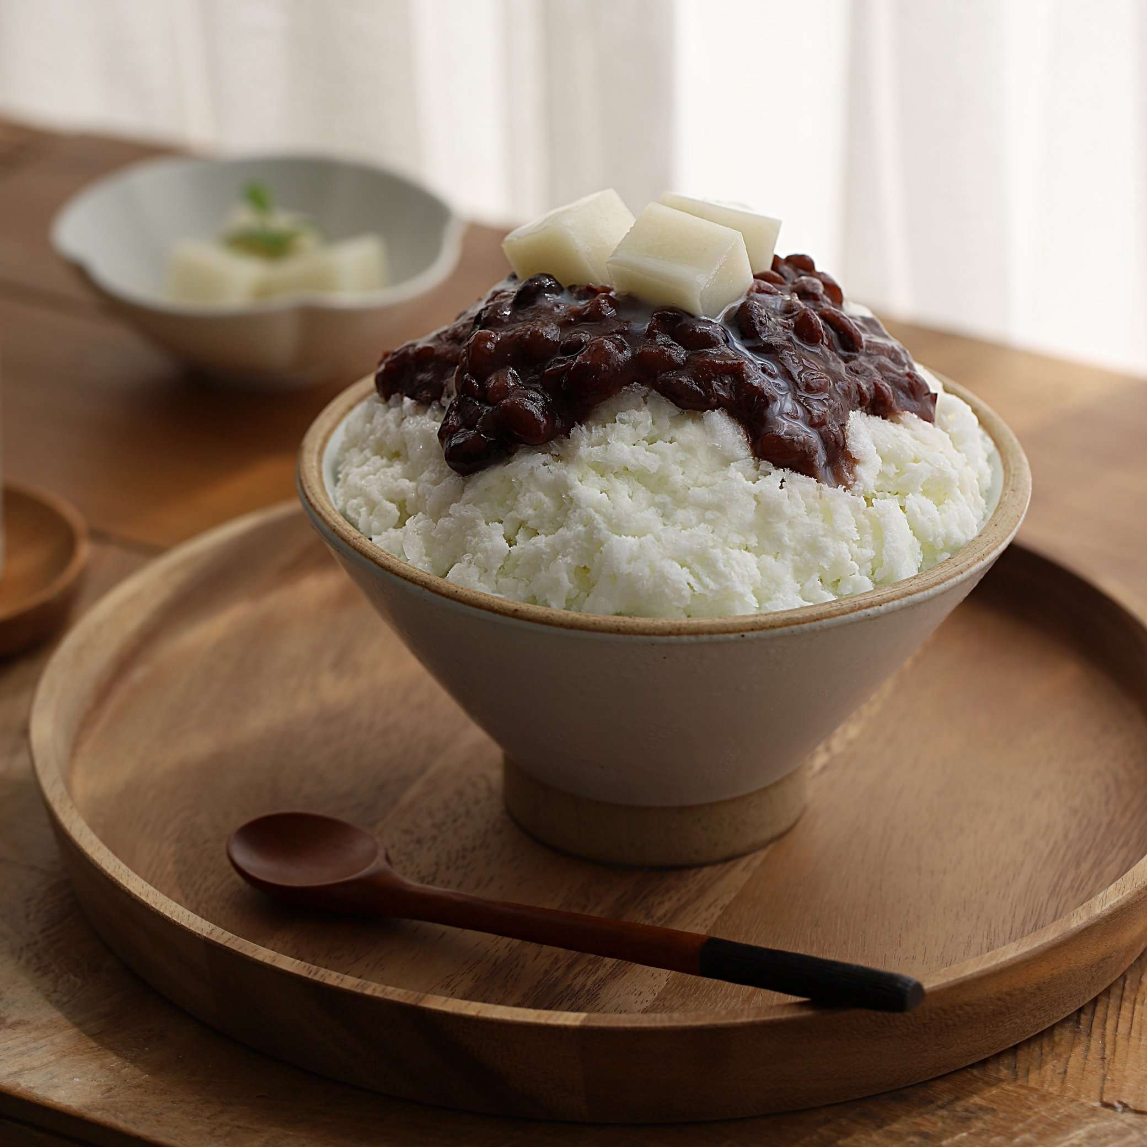
AI copywriter
버거킹
배달의 민족
Notes:
왼쪽은 버거킹에서 가격이 싼 신 제품, 오른쪽은 배달의 민족에서 배달이 가능해진 새로운 제품을 소개한다고 봅시다.
만약에 여러분들이 이 제품 또는 서비스를 광고해야한다면 어떤 문구로 사람들의 이목을 끌고 구매까지 끌고 가시겠습니까?
위 그림만 보고 뭘 써야 할까 바로 떠오르시나요? 아마 간단한 문구만 떠오르실 겁니다. 직관적인 가장 싼 햄버거! 그리고 팥빙수도 배달합니다~ 와 같은 문구가 될 수 있겠습니다.
그럼 해당 브랜드들의 마케터들이 어떻게 홍보했는지 살펴보겠습니다.

Slide 19

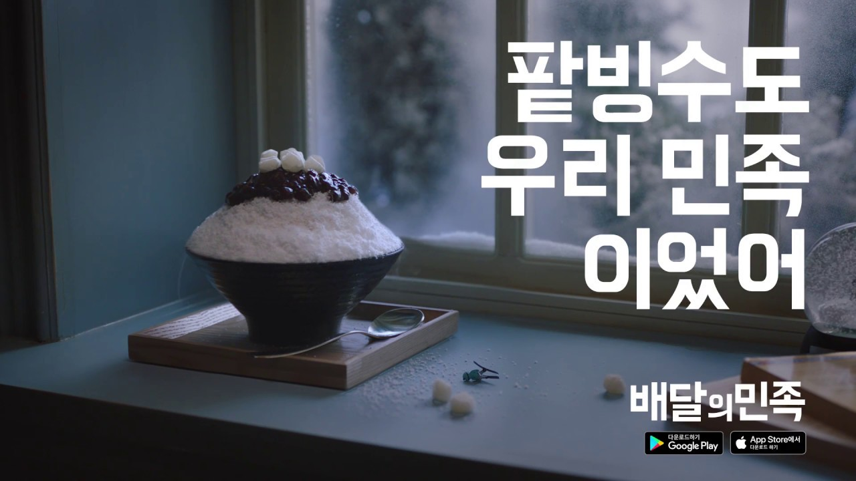
AI copywriter
Notes:
김두한의 4딸라 협상 전략이 인터넷 곳곳에서 튀어 오르던 때에 버거킹이 이를 이용해서 제품 광고에 사용했었죠. 저렴한 가격의 버거를 표현하기에 이보다 짧고 굵게 표현할 수는 없을 겁니다.
배달의민족의 ~도 우리 민족 이었어 시리즈는 설마 하던 것도 배달을 해주는 배민의 서비스를 브랜드 이름을 적절히 재사용해 우리의 이목을 끌었죠.
제품을 맛깔나게 설명해서 소비자들에게 정보만 줄 뿐 아니라 구매까지 이어지도록 하는 것이 바로 이 ‘카피라이터‘의 역할입니다.
우리 눈에 획기적으로 보이는 이 문구들은 실은 마케팅 전문가들이 오랜 기간 공들여서 꺼내놓은 카피라는 결과물입니다. 굉장히 다양한 아이디어들이 오고 갔겠죠?

Slide 20
AI copywriter
가격이 싸다
맛있다
버거King
햄버거세트
등등
햄버거 세트 = 4000원
요즘 사람들 사이에서 유행하는게 뭐지? = 김두한 협상
달러로 바꿔볼까? 4달러
김두한 협상 keypoint
= 사딸라

