Slide 1

https://github.com/DHLSan/ModArithAccel
MODARITHACCEL
İsmail Alperen AYTEKİN (i.alp.ayt@hotmail.com)
İbrahim TOPALOGLU (ibrahimttopaloglu@gmail.com)
SUPERVISOR
Assist. Prof. Dr. Ismail San (isan@eskisehir.edu.tr)
PLATFORMS
Vivado Design Suite 2017.4
Xilinx Zynq-7000 SoC architecture zedboard development kit

Slide 2
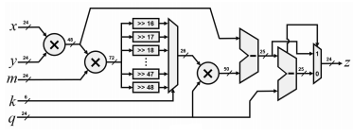
Barrett Reductiton
(pseudo-configurable modulus for Barrett reduction)

Slide 3

Reduction for a Fixed Prime

Slide 4
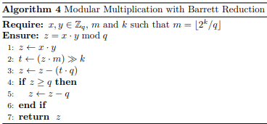
Barrett Reduction
Pseudo-code of algorithm

Slide 5
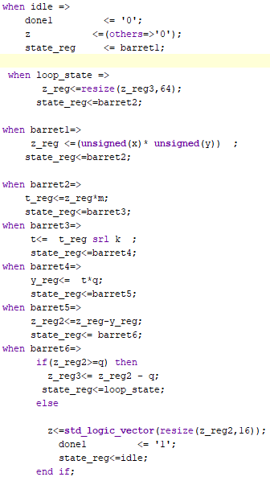
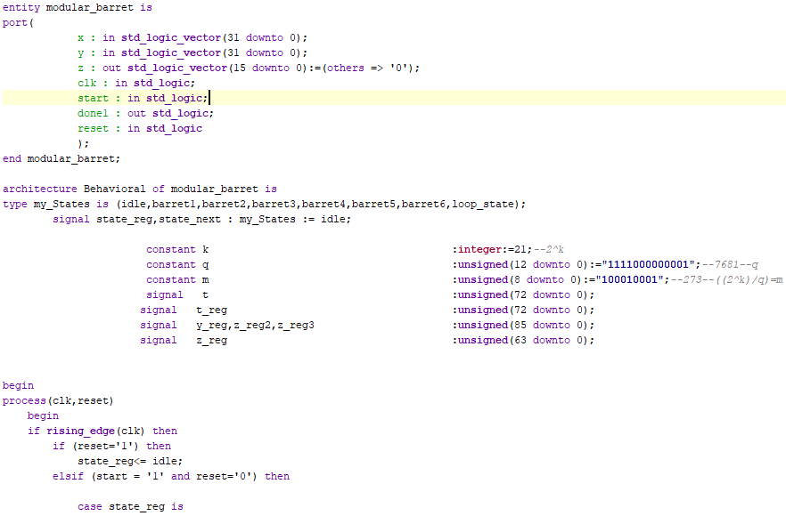
Converted to VHDL

Slide 6
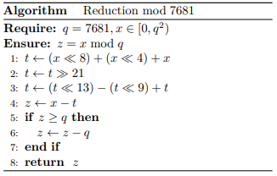
Reduction for a Fixed Prime
Pseudo-code of algorithm

Slide 7
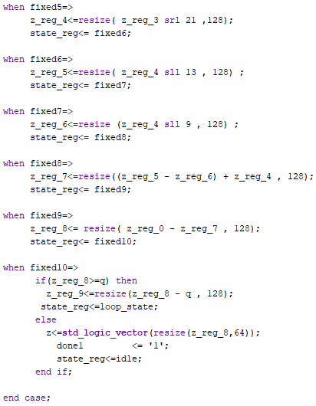
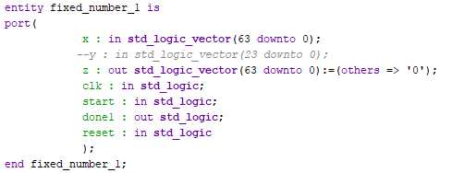
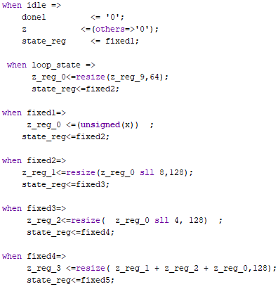
Converted to VHDL

Slide 8
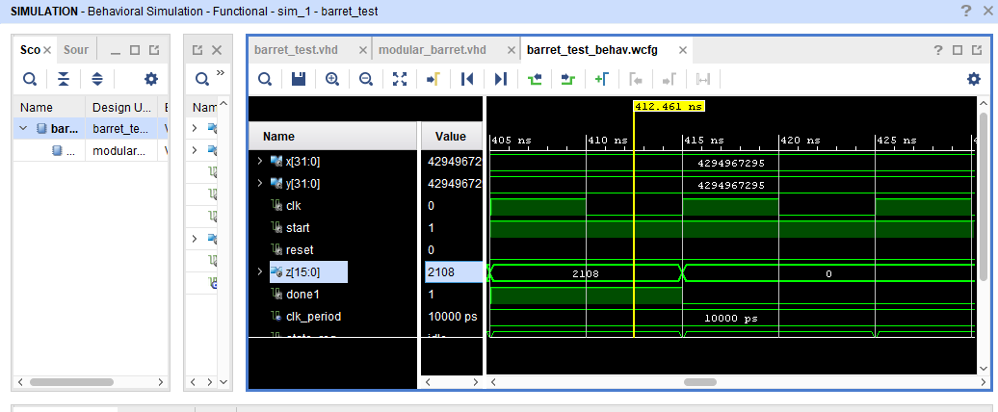
Empirical Setup (Barret Reduction)

Slide 9
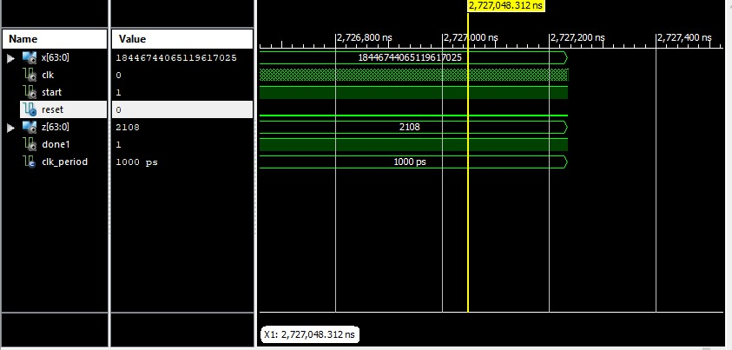
Empirical Setup (Reduction for a Fixed Prime)

Slide 10
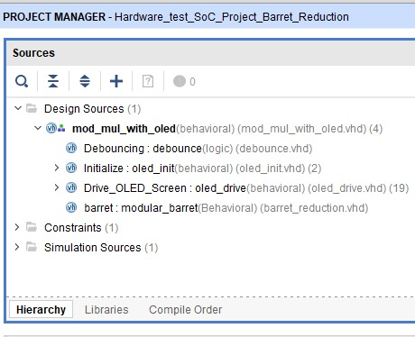
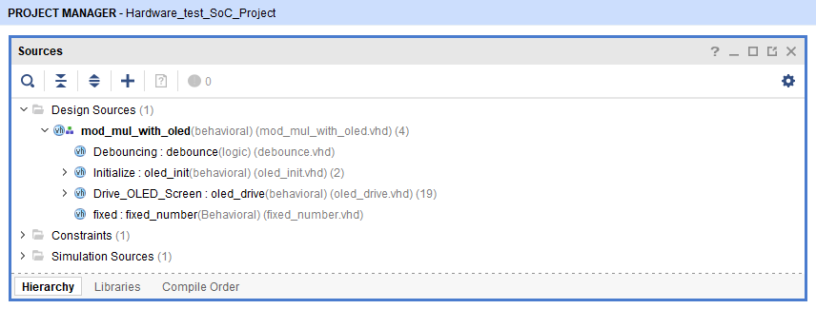
Emprical Setup

Slide 11
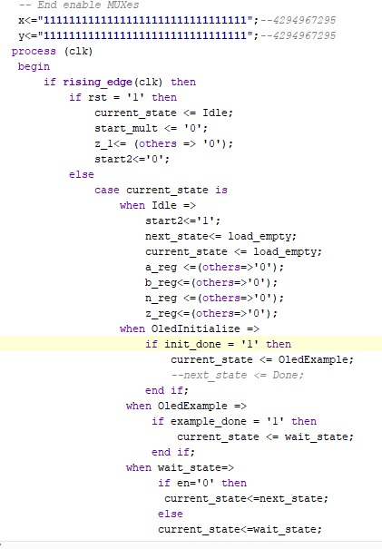
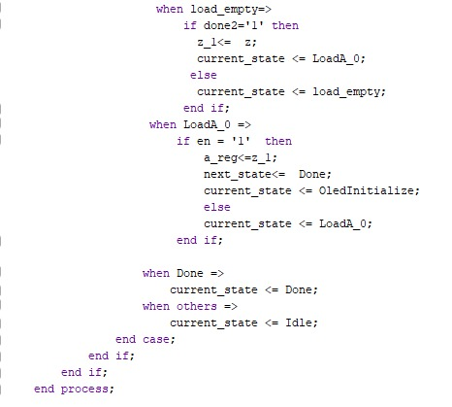
Emprical Setup

Slide 12
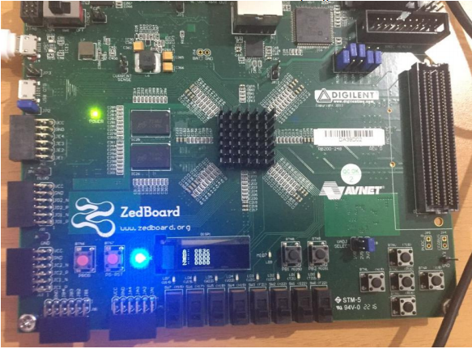
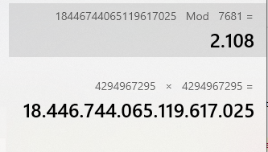


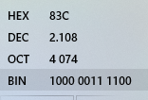
Emprical Results
083C
=>
2108

Slide 13
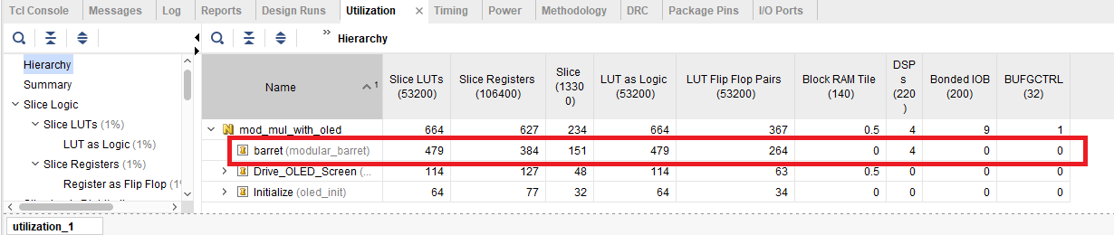
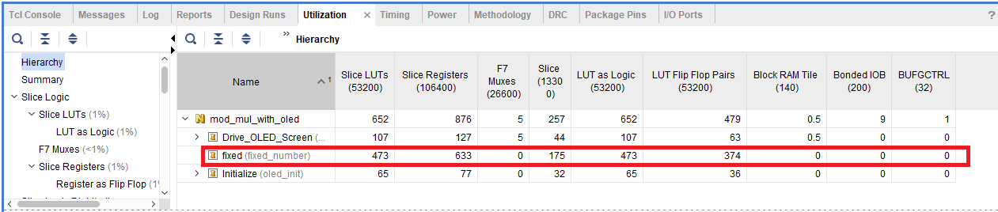
Emprical Results of Utilization

Slide 14
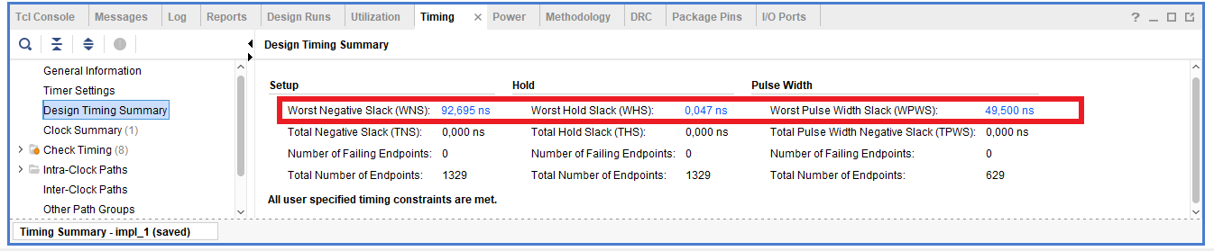
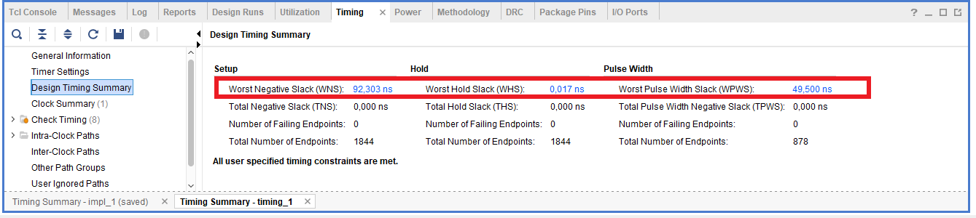
Emprical Results For Design Timing Summary
Barret Reduction
Fixed Prime Number(7681)

Slide 15
Thanks for listening..
İsmail Alperen AYTEKİN
İbraim TOPALOĞLU

Slide 16


QUESTİONS?

