Slide 1
emr R package
2019/08/22

Slide 2
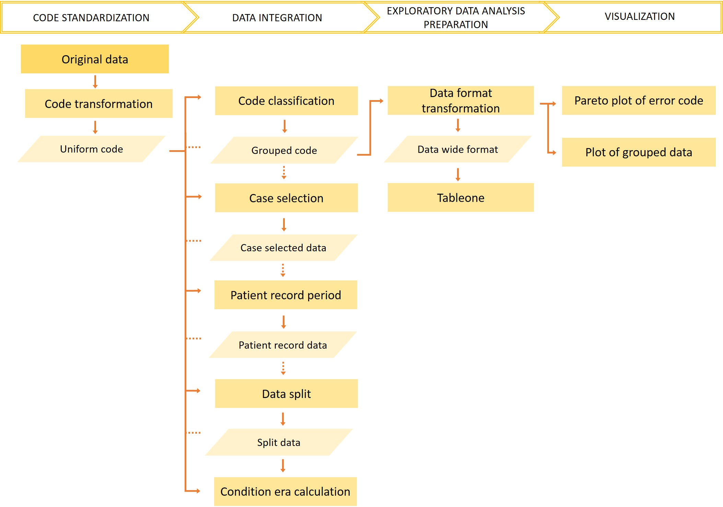
Fig 1. overview of emr package

Slide 3
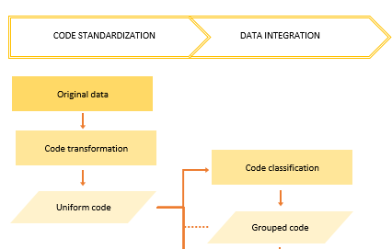
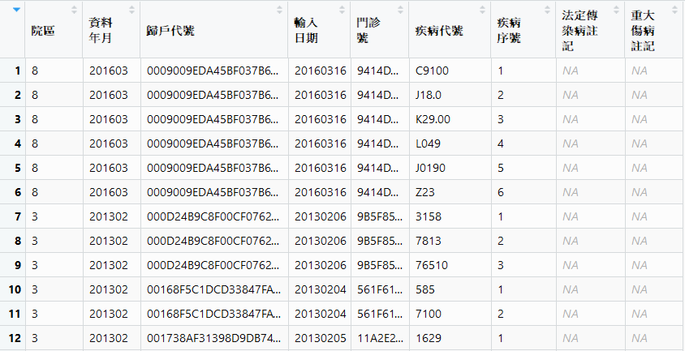


2016/01/01: icd10

Slide 4

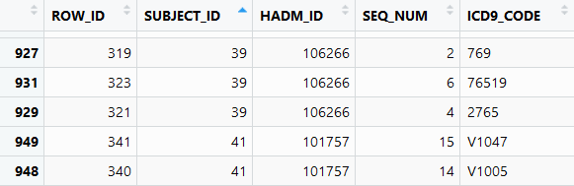
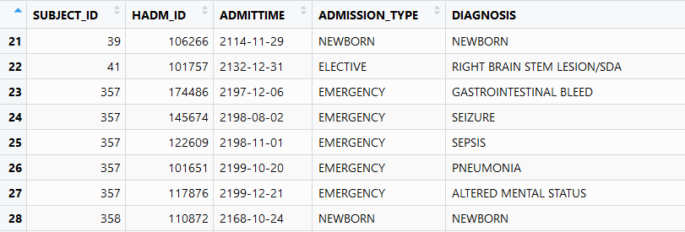
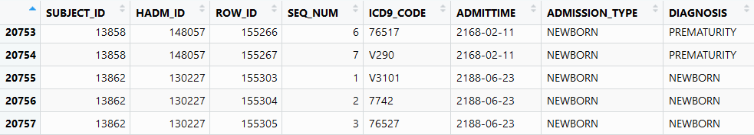
MATERIAL (MIMIC)

Slide 5
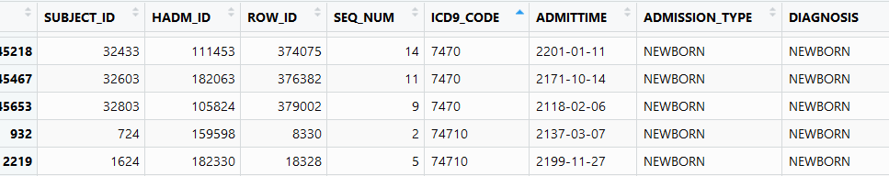
MATERIAL (MIMIC)
Population: 7833 patients with 45674 admissions
Case (PDA): 381
Control (non-PDA): 7452

Slide 6
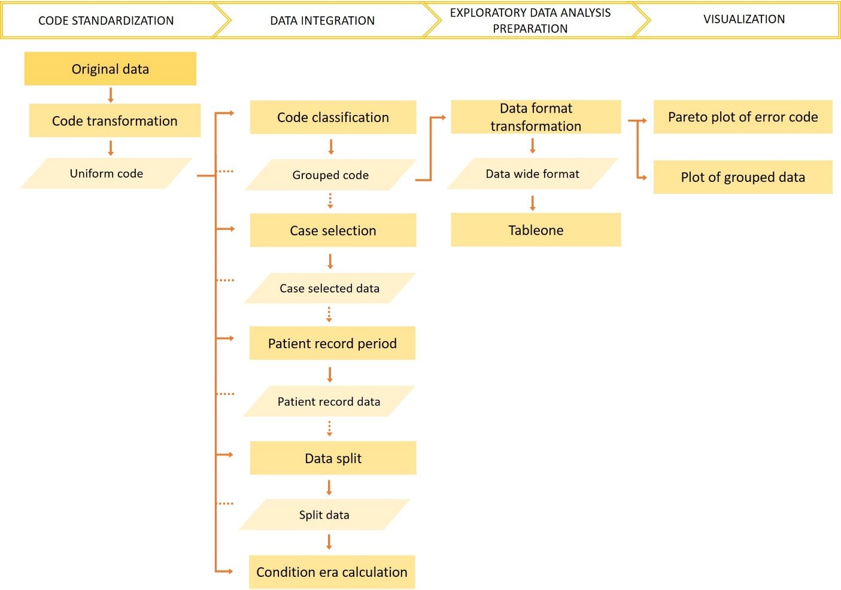
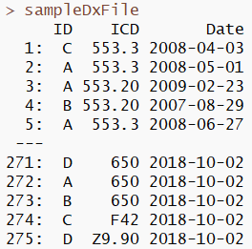
METHOD
Code transformation
Data integration
Exploratory data analysis (EDA) preparation
Visualization

Slide 7
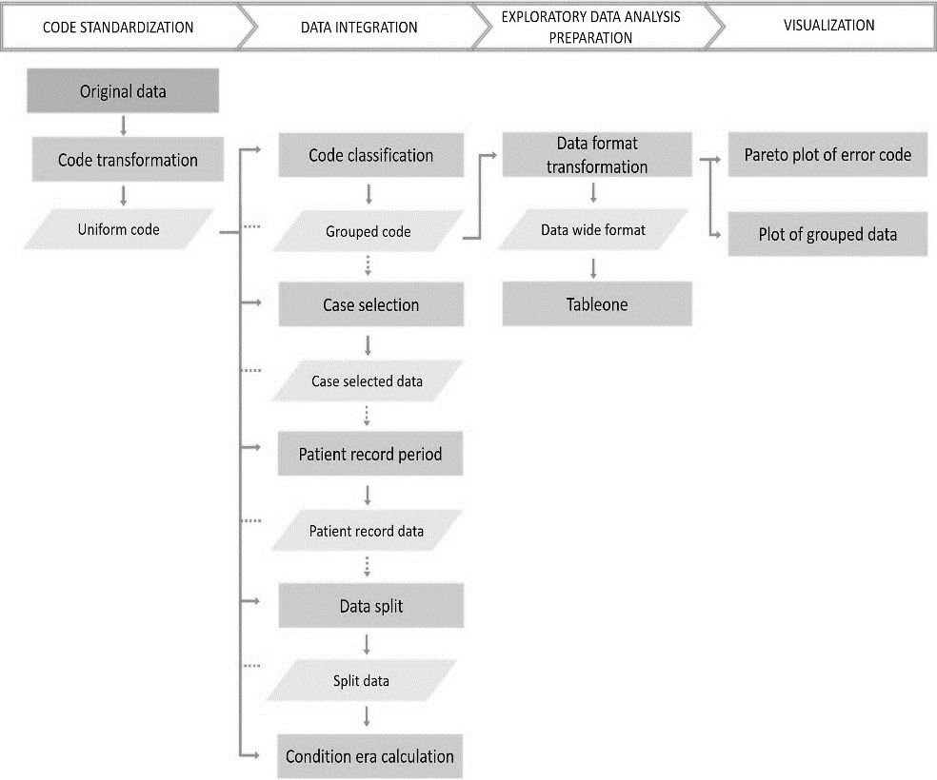

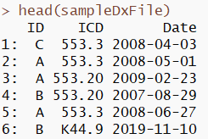
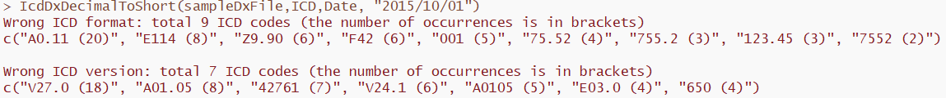
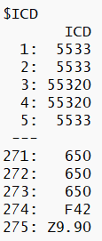
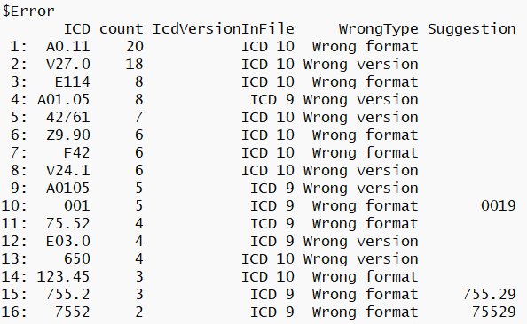
Code transformation

Slide 8
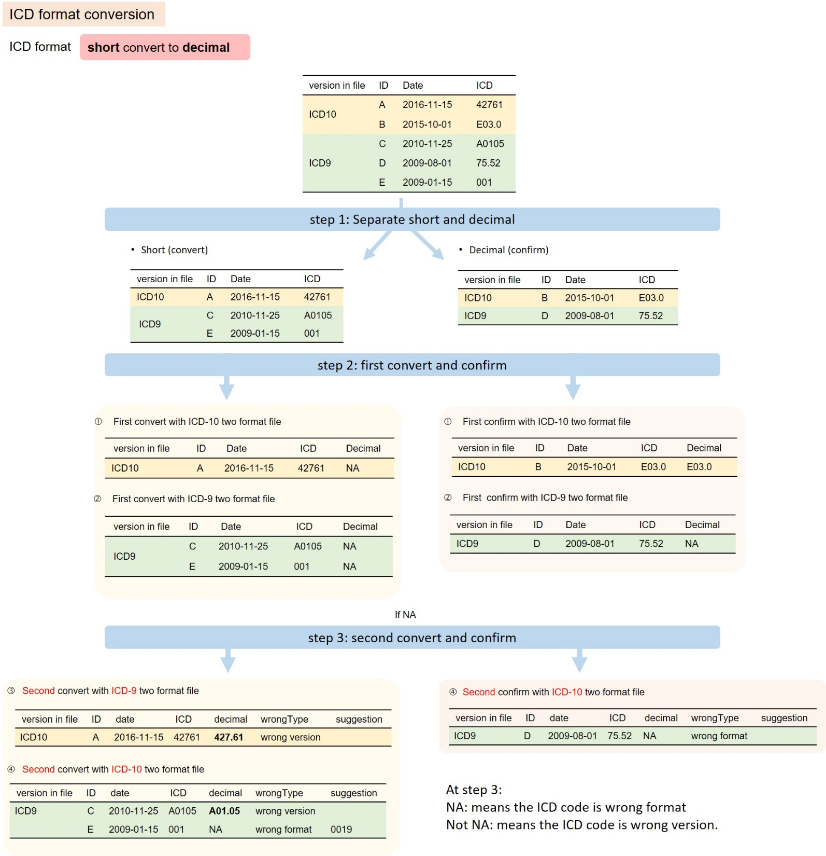
At step 3:
NA: wrong format
nonNA: wrong version
Figure 2: overview warning message of code transformation

Slide 9
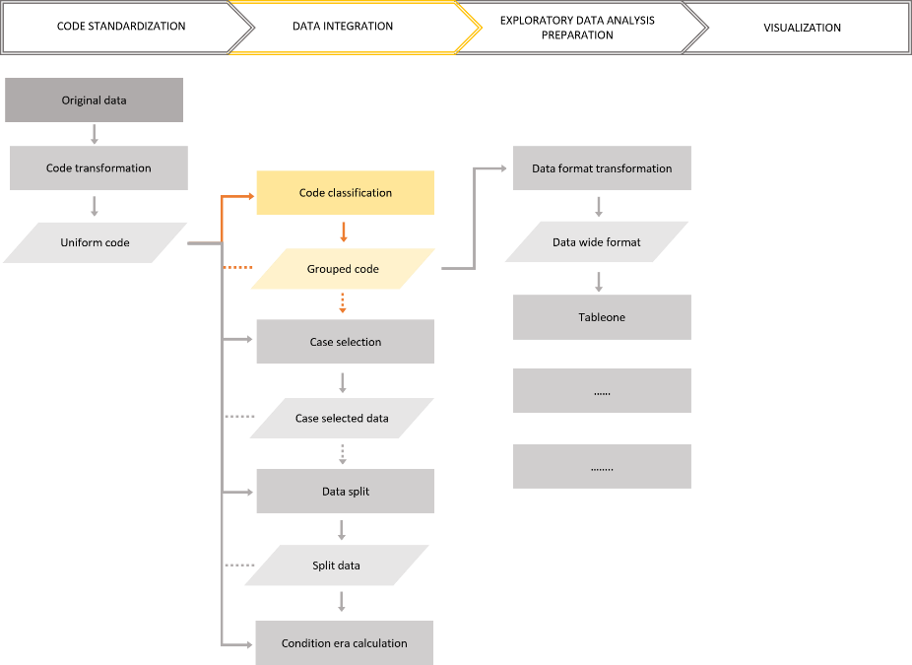
Data integration
code classification
Clinical Classifications Software (CCS, CCSLVL)
pheWAS
comorbidity (Elixhauser, Charlson, and AHRQ)
customized defined grouping methods

Slide 10
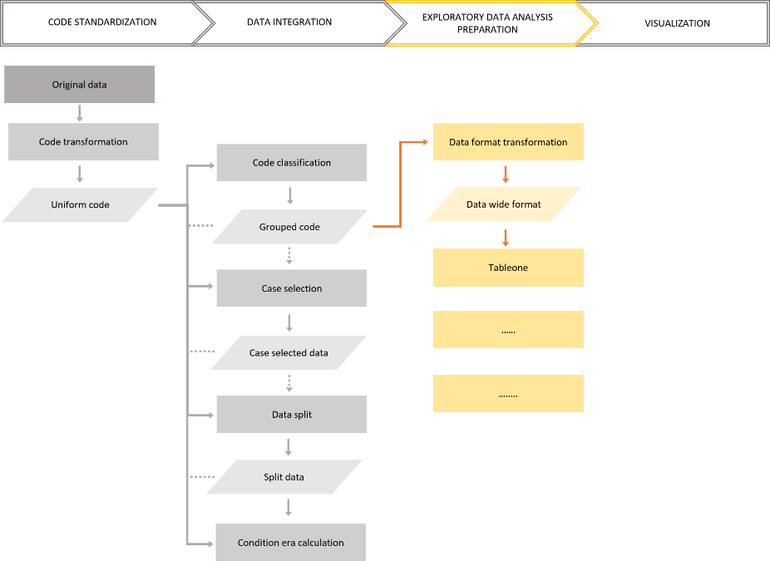
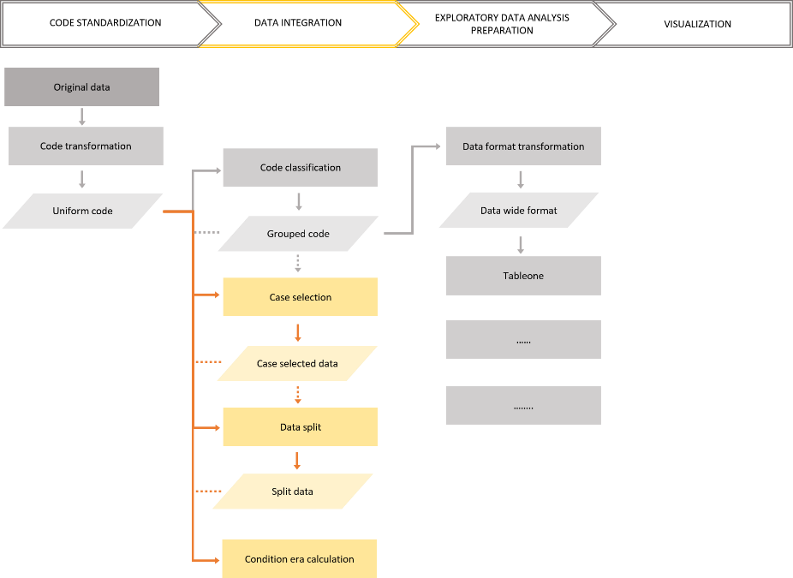
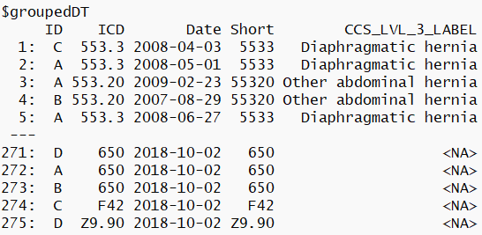
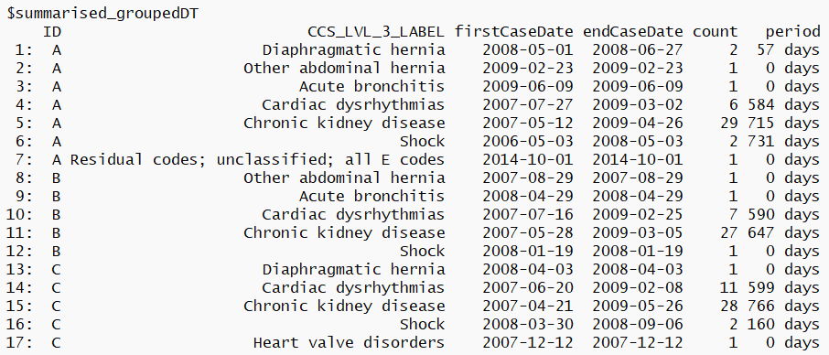
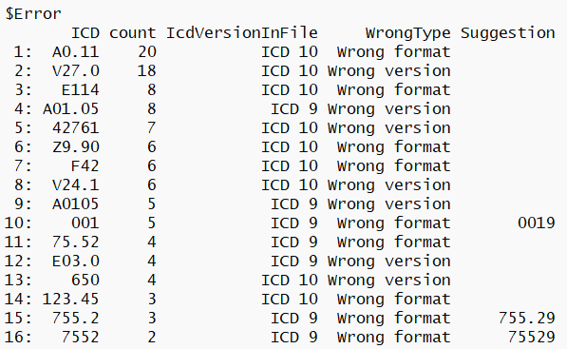
groupingFunction()$_____
Data integration
Exploratory data analysis (EDA) preparation

Slide 11
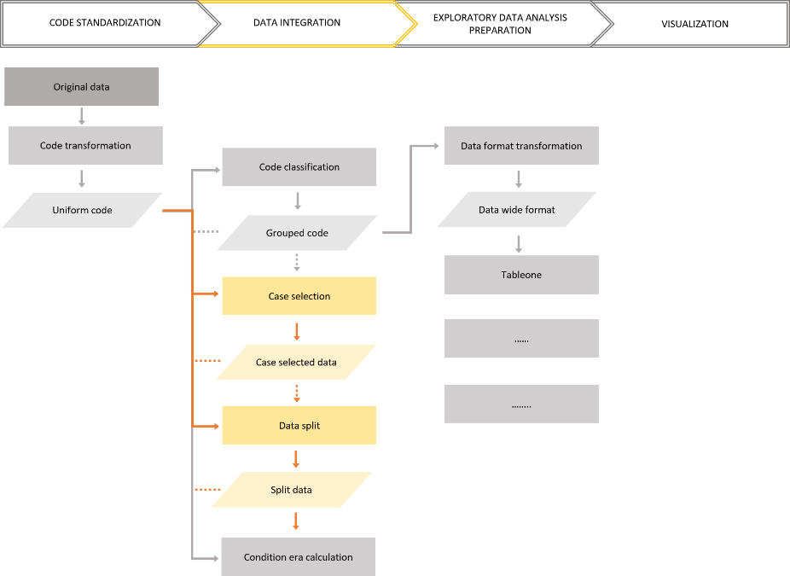

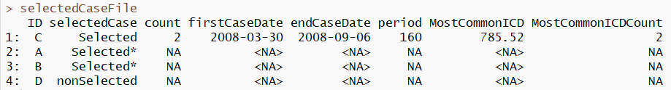
Data integration
Data selection
Case selection
Condition: Shock (CCSLVL3)
ICD number: 2
Range of days: 30~365 days

Slide 12
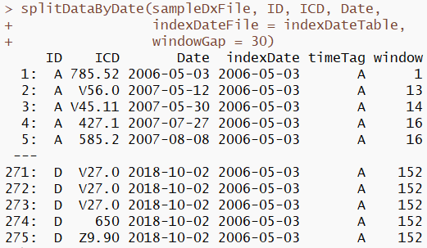
Data integration
Data selection
Data split
Gap
2007/11/01
2007/12/01
2008/02/01
2008/03/01
Index date

Slide 13
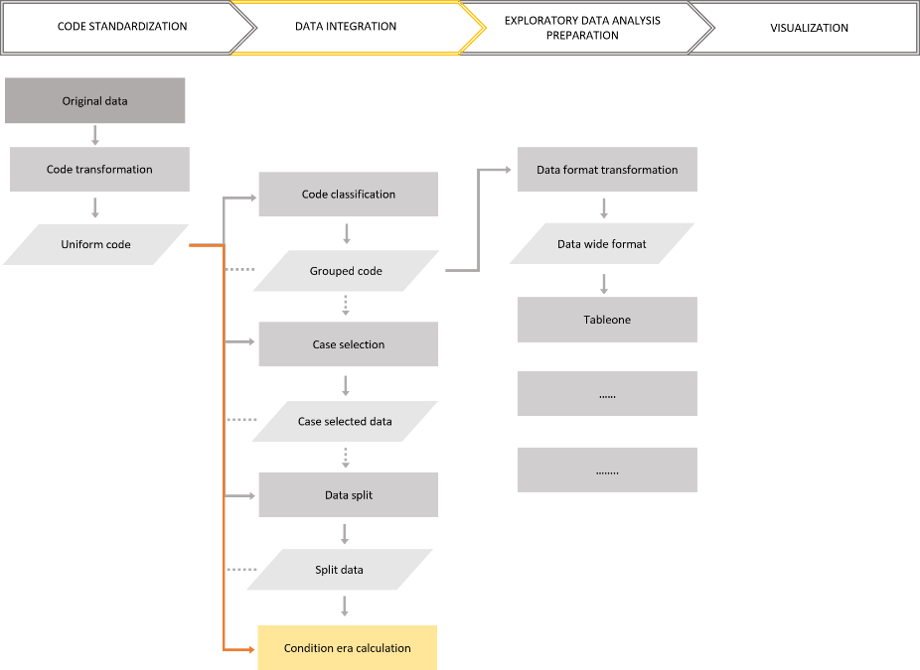
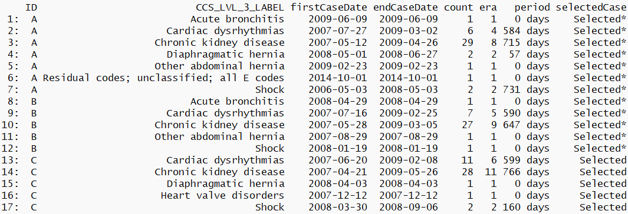
Data integration
Condition era calculation

Slide 14
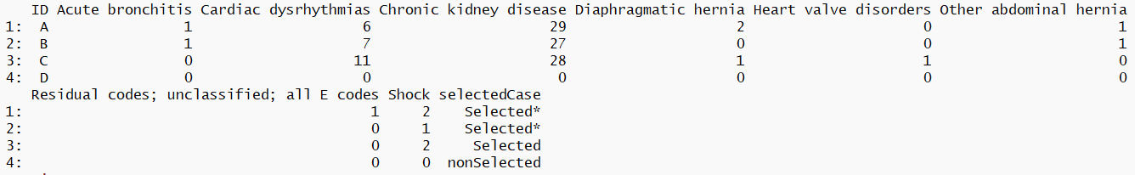
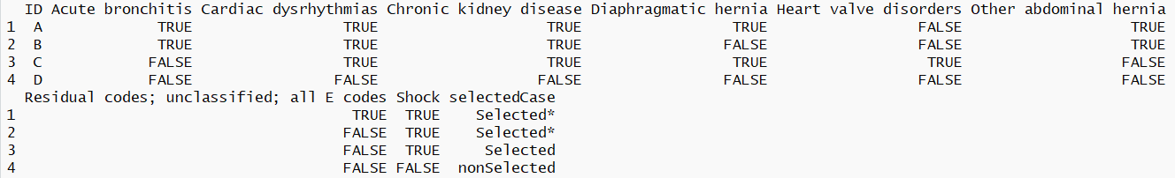
EDA preparation
Data format transformation
Notes:
在文章中提及, T or F 使用者可以自己設定門檻
並提供sample code

Slide 15
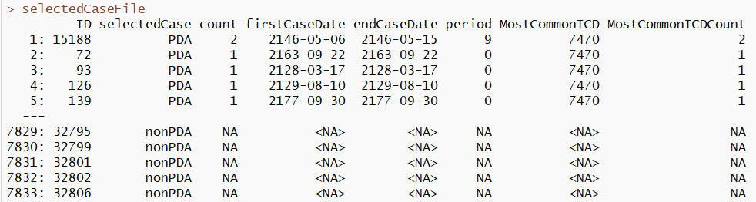
RESULT
Population: 7833 patients with 45674 admissions
Case (PDA): 381
Control (non-PDA): 7452
Condition: 7470 (ICD)
ICD number: 1

Slide 16
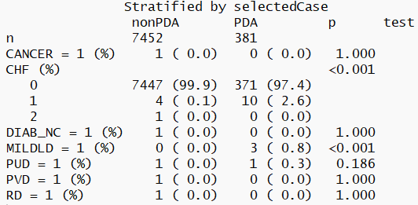
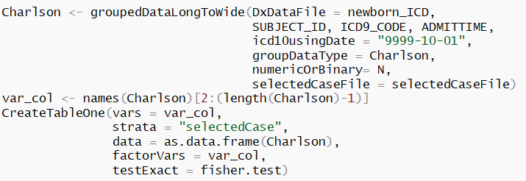
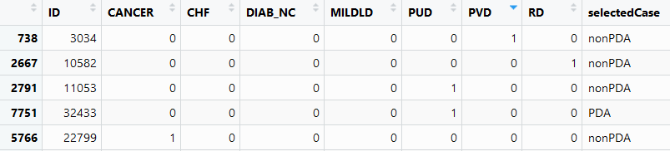
Charlson

Slide 17
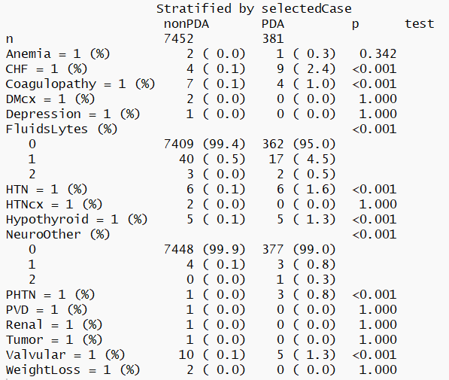
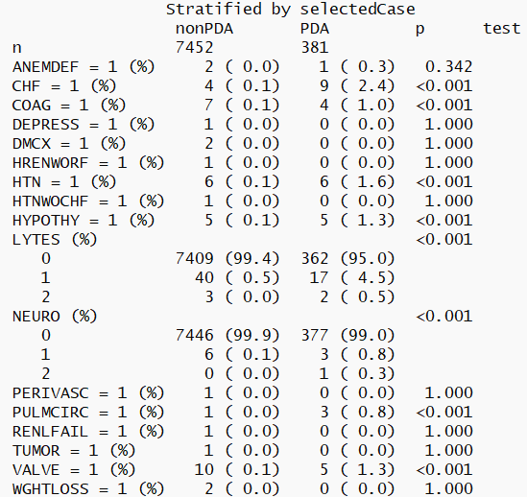
AHRQ
Elix

