Slide 1
Employee Attrition & Income Prediction
Understanding Key Factors and Predictive Modeling
David Laurel
April 9, 2023

Slide 2

Introduction
Understanding Attrition
Investigation Details:
Dealing with Noisy Data
Top 5 Factors to Predict Attrition
Comparison of Models
KNN
Naïve-Bayes
Predicting Monthly Income
Linear Regression

Slide 3
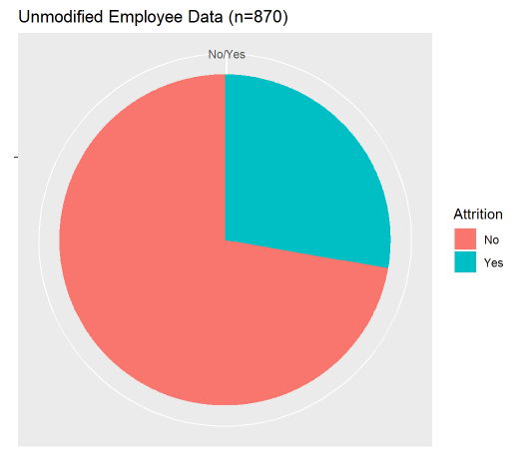
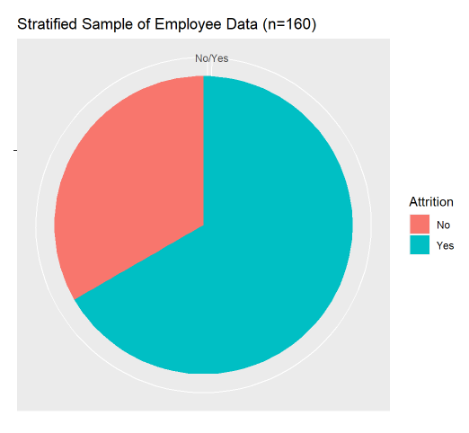
Stratified Sampling
Not enough Attrition!
Effect to Prediction Models
Stratified approach
Closer to even
Random sample

Slide 4

Top Five Predictive Factors
Mutual Information
Difference between Joint Distributions and Marginal Distributions
Raw Factors
Monthly Rate
Monthly Income
Daily Rate
Hourly Rate
Age
Total Working years
Overtime
Top 3 Factors by Model Accuracy
Monthly Income
Pay Rate
Age

Slide 5
Attrition Predictive Models
Some Predictive factors worsened model performance
Model | K-Nearest Neighbors | Naïve-Bayes
Accuracy | 64.25% | 62.76%
Sensitivity | 64.52% | 60.14%
Specificity | 62.86% | 76.43%

Slide 6

Predicting Monthly Income
Linear Regression
Top 3 Factors:
Age
Years At Company
Daily Rate
$$MonthlyIncome$$
$$=−3.16e3+\left(1.998e2\right)Age+\left(6.93e−2\right)DailyRate+\left(3.08e2\right)YearsAtCompany$$
RMSE: $3,911

Slide 7
External Resources
RShiny App
Video Presentation

