Slide 1
Results
Answers to our questions
How often does each word occur per year?
  Data is available, but not yet visualized
Which author used most Shakespeare words? In which book are most Shakespeare words?
  Not yet analyzed
Rank which Shakespeare words occurred most per year
Can we observe the words spread?
  See following graph

Slide 2
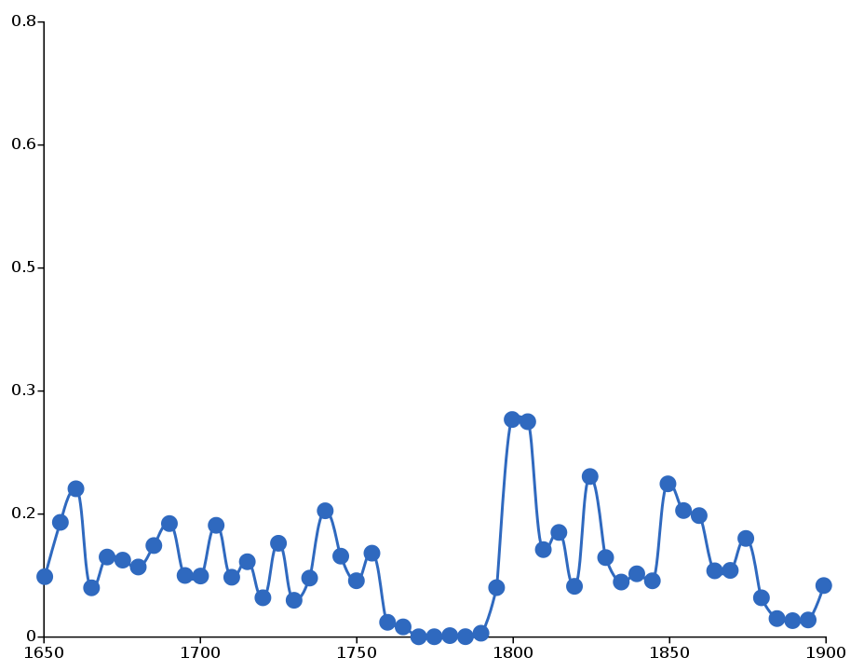
Results
Shakespeare words

Slide 3
Results
What does that mean?
  Graph isn't good
  We need a lot more Texts for a better analysis
  If we have enough texts, we can focus on further analysis
  We may need a slightly different calculation model

Slide 4
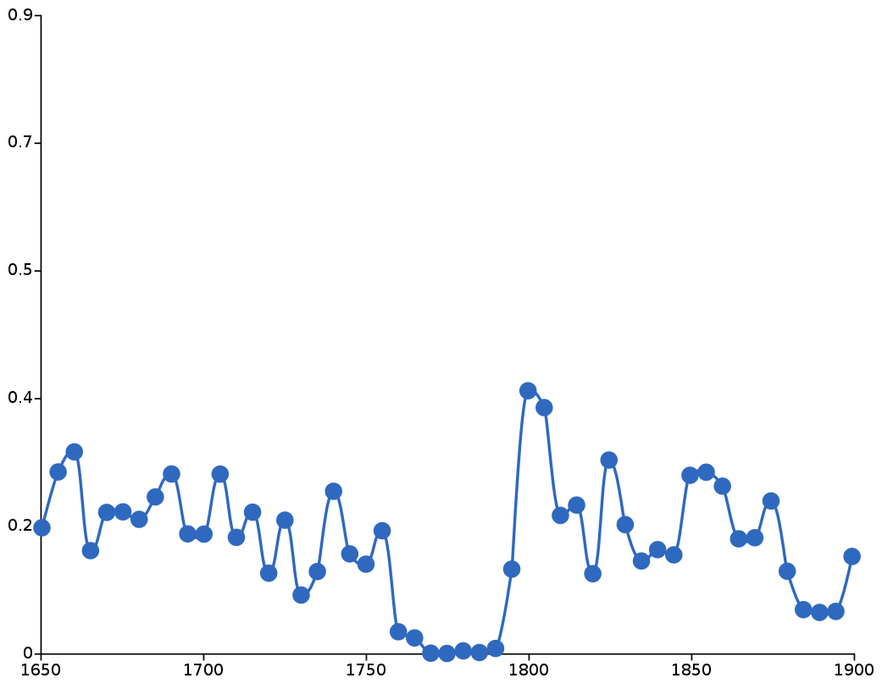
Results
a, the

Slide 5
Results
But there is a big plus:
Our software can be used to analyze any kind of text, not only shakespeare
Online service
Corpora and target words can be uploaded
Different calculations will be possible

Slide 6
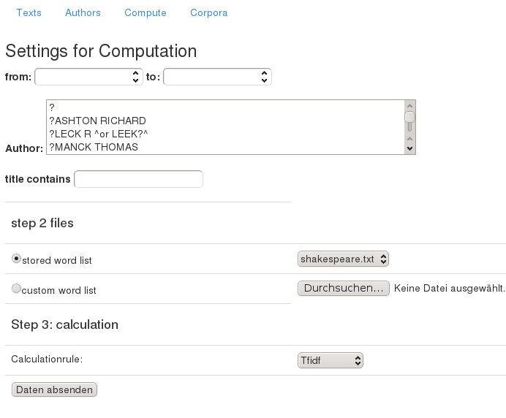
Results
Live preview (if we have enough time)

