Slide 1

Shakespeare Project
Robert Terbach, Simon Vetter,
Lukas Fischer, Thomas Döring,
Lukas Kairies
Current Topics in Digital Philology
Notes:
<Nummer>

Slide 2
Corpora
Shakespeare's words
from Oxford English Dictionary
(http://www.oed.com/)
Texts therefore unnecessary

Slide 3
Corpora
Project Gutenberg
Originally we wanted Project Gutenberg
Varying headers and footers → need to fix manually
Alternatives
Found other corpora with different kinds of text, not only books
Two sources: KU Leuven, University of Oxford Text Archive

Slide 4
Corpora
A Corpus of English Dialogues
(http://www.ota.ahds.ac.uk/desc/2507)
Text types: dialogues, constructed and authentic
Years: 1560-1760
Texts: 177
Words: 1,200,000
License: restricted, free for non-commercial, but needs permission

Slide 5
Corpora
The Lampeter Corpus of Early Modern English Tracts
(http://www.ota.ahds.ac.uk/desc/3193)
Text types: tracts (e.g. political)
Years: 1641-1739
Texts: 120
Words: > 1,000,000
License: CC-BY-SA 3.0 (credits, free, but result must also be CC-BY-SA 3.0)

Slide 6
Corpora
Corpus of English Novels
(https://perswww.kuleuven.be/~u0044428/cen.htm)
Text types: novels, british & north american
Years: 1881-1922
Texts: 290
Words: > 26,000,000
License: unknown, request free userid/password

Slide 7
Corpora
The Corpus of Late Modern English Texts (CLMET)
(https://perswww.kuleuven.be/~u0044428/clmet.htm)
Text types: various (e.g. letters, novels, drama, journals)
Years: 1710-1920
Texts: 333
Words: > 34,300,000
License: unknown, request free userid/password

Slide 8
Corpora
Overall
1560-1920
>900 Texts by 413 Authors
>62,000,00 Words (360,058 distinct)

Slide 9
Corpora
Questions to the Corpus
How often does each word occur per year
Which author used most Shakespeare words?
In which book are most Shakespeare words?
Rank which Shakespeare words occurred most per year
Can we observe the words spread?

Slide 10
Corpora
Why?
Shakespeare is one of the most influential writers
Has coined english language and more than 1500 words
Allows analysis of other Authors
Tracing how language evolves
Play around with the data (maybe find interesting relationships)

Slide 11
Our Methods
Preprocessing:
  Problem: many different corpora with different text layouts
  Solution → Parse corpora and use a similar xml format for all
  Iterating over all texts costs time and resources
  Solution → Use a database with some meta information to get a good selection
  No Semantic analysis or part of speech
    → Our questions don't need it

Slide 12
XML Format
<xml>
<author> ... </author>
<title> ... </title>
<year> … </year>
<text>
# Text comes here
</text>
</xml>

Slide 13
Scheme of the database
Text = (id,corpus,year,author,title,text)
Author = (id,name,places,birthyear,deathyear)
Corpus = (name)
Word = (word,stemmed,in_text_count)
WordInTextCount=(word, text, in_text_count)
Users can select pretty fast their wanted corpora or textes
Easy to expand
DB Engine: SQLite3

Slide 14
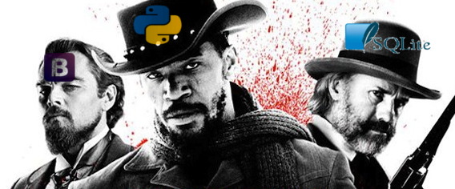
Our Interface
We use Django as webframework with bootstrap and SQLite3

Slide 15
Features
Upload new Corpora through webinterface
List of all uploaded textes
  Metadata: Author, Year
  Text
  Wordlists, stemmed and the wordcount
List of all authors with their texts
Different computations with an HTML Form for an easy filter
Graphical output of the results

Slide 16
How are we analyzing our texts?
Features
  words
Metrics
  TF-IDF (Term frequency - inverse document frequency)
    TF-IDF shows how relevant Shakespeare words are in texts
  Word counts
    Word Count shows how often Shakespeare words are used in other texts

Slide 17
How are we analyzing our texts?
Algorithm
  Filter corpus by user defined criteria
  Split corpus into chunks of five years (based on publication date of texts)
  Calculate relevance of Shakespeare words for every chunk
    Using word counts
    Using TF-IDF
  Calculate the mean over all Shakespeare words and all texts
  Plot one data point per chunk

Slide 18
Results
Answers to our questions
How often does each word occur per year?
  Data is available, but not yet visualized
Which author used most Shakespeare words? In which book are most Shakespeare words?
  Not yet analyzed
Rank which Shakespeare words occurred most per year
Can we observe the words spread?
  See following graph

Slide 19
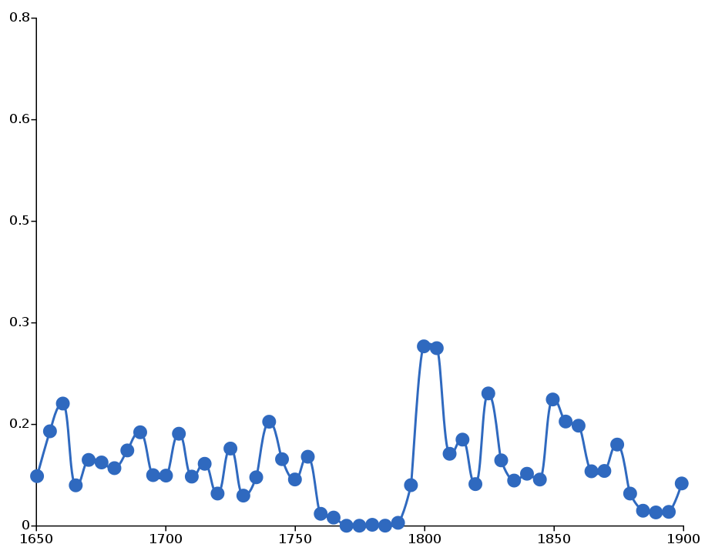
Results
Shakespeare words

Slide 20
Results
What does that mean?
  Graph isn't good
  We need a lot more Texts for a better analysis
  If we have enough texts, we can focus on further analysis
  We may need a slightly different calculation model

Slide 21
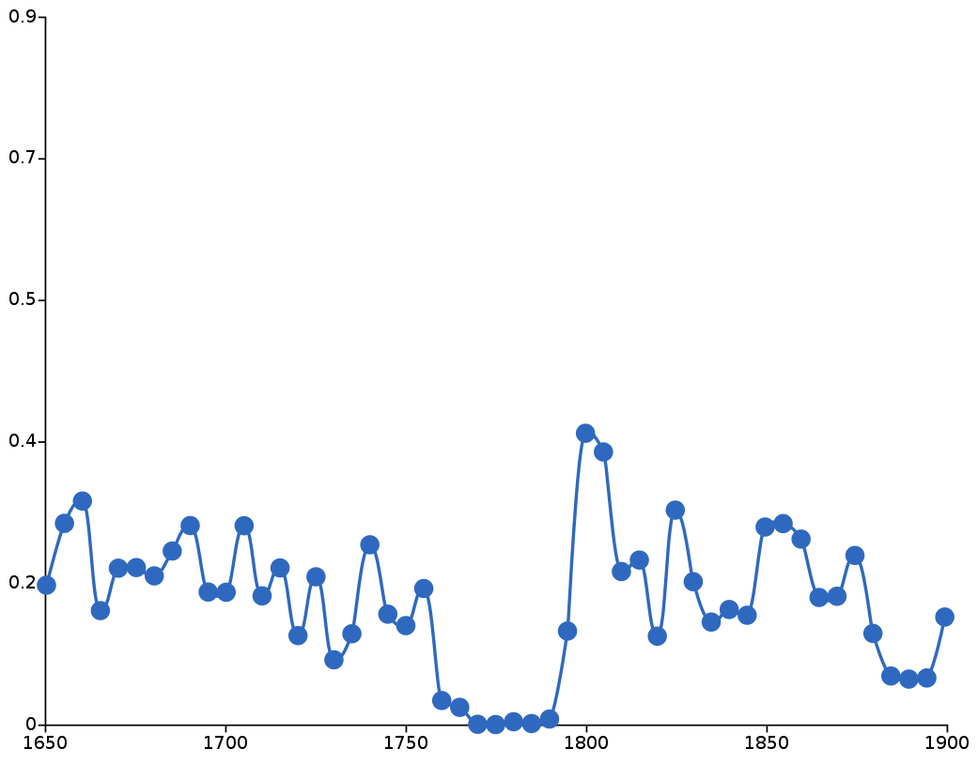
Results
a, the

Slide 22
Results
But there is a big plus:
Our software can be used to analyze any kind of text, not only shakespeare
Online service
Corpora and target words can be uploaded
Different calculations will be possible

Slide 23
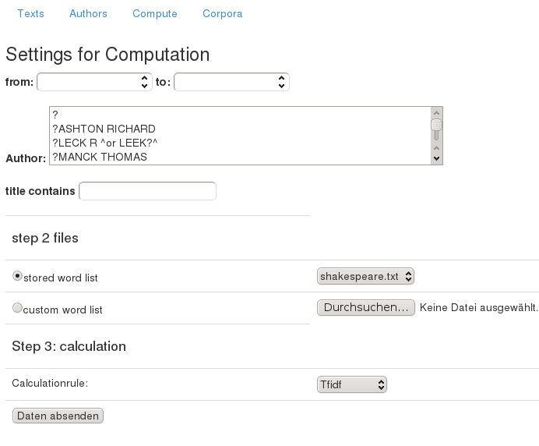
Results
Live preview (if we have enough time)

Slide 24
The Outlook
Next Tasks
  Add more calculation options
  More output formats (e.g. tables)
Expected state at the end of the Semester
  Visualization of geographical dissemination (Ausbreitung) of the words

Slide 25
Why you should fund our project?
methodological advances
  Open Source alternative to Google's Ngram Viewer
  flexible
    supports arbitrary corpora
  Expandable
    e.g. pairwise_distance, cooc, logL
  Possibility to use more information than occurrence per year
    More use cases

Slide 26
Why you should fund our project?
What does it tell us about human history etc.?
  how authors influence language in general
  how knowledge distributes regarding geographical information about authors and place of publishing
  Even more thinks depending on which information and corpora are included.

