Slide 1

Shakespeare Project
Names
University of Leipzig
Department of Computer Science
Chair
Augustusplatz 10, 04109 Leipzig
http://website/
Notes:
<Nummer>

Slide 2
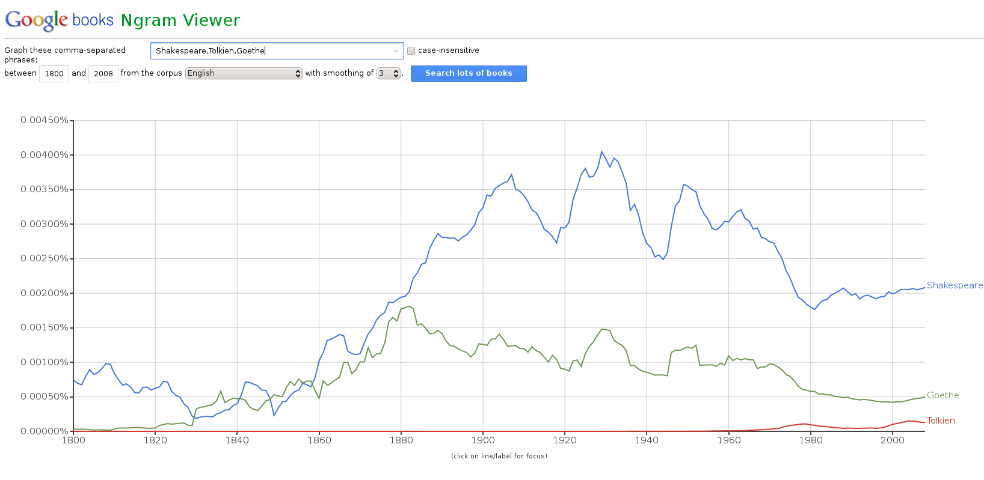
Our questions
How often does each word occur per year

Slide 3
Our questions
Which author used most shakespeare words?
In which book are most shakespeare words?
Rank which shakespeare words occurred most per year

Slide 4
Why are we asking this
Why are these questions interesting?
  Because there is literature about Shakespeare created without the use of the internet
  Get as much information as possible from the gathered data
  Can we find new interesting facts

Slide 5
Why are we asking this
Why should they be of interest to others?
  Shakespeare is an important writer of his time

