Slide 1


Presented by Damien Hajjar
Energy Market
Analysis and Forecasting
Romania and Hungary
23/05/2024

Slide 2



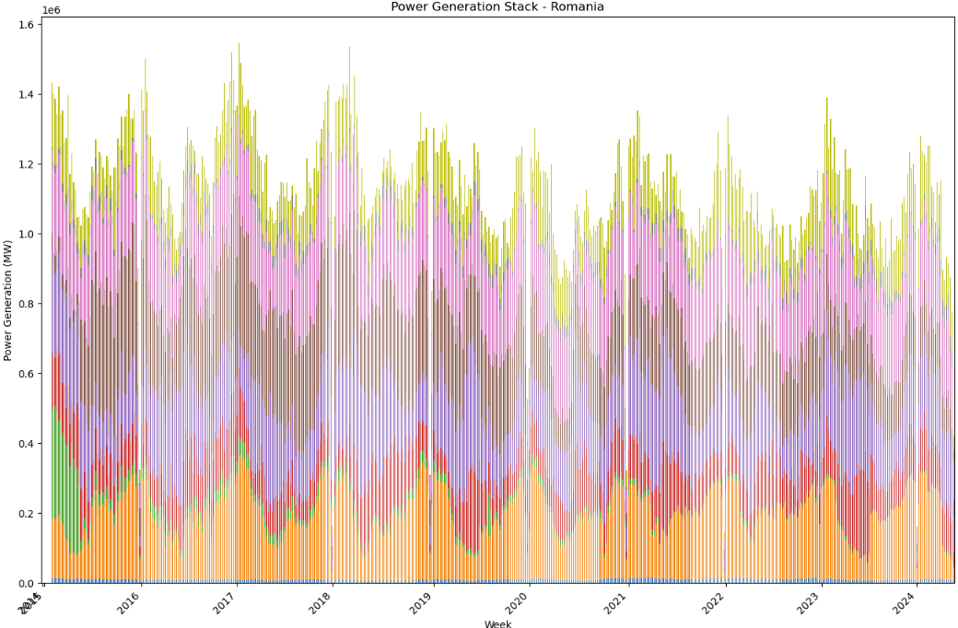
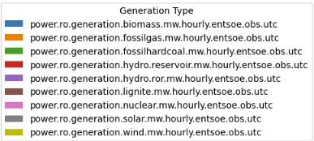
Power Generation Stack - Romania
Key observations
Seasonal variations :
Peaks in winter and dip in summer due to heating demand
Multiple sources of energy generation :
Hydro and Nuclear : significant and constant contributions
Fossils fuels : lignite and hard coal are tending to decline but fossilgas remains predominant
Renewable energy : wind depends on weather conditions and solar energy is still underdeveloped
Biomass : minor contribution
Global View :
The visualization highlights the complexity and dynamics of managing an energy grid with multiple sources, each with its own characteristics and variability.

Slide 3
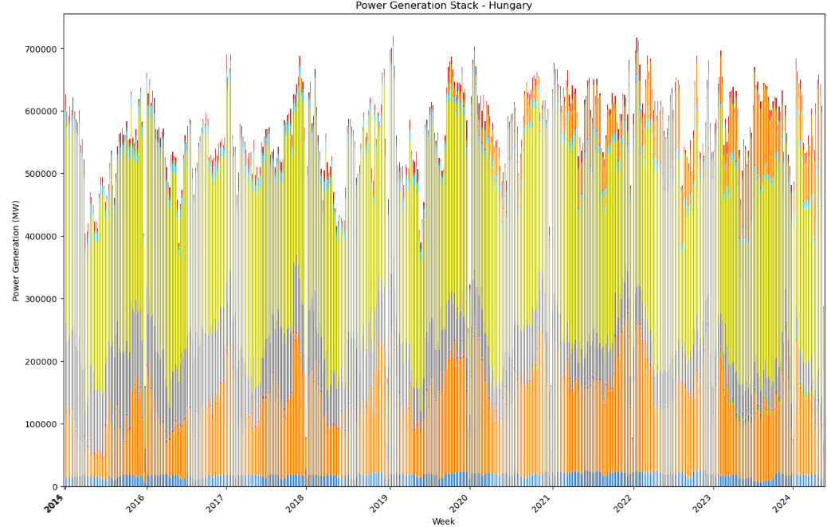
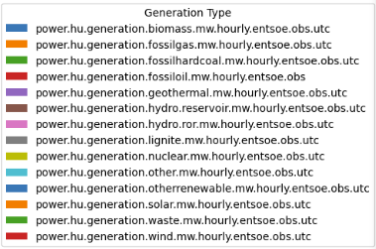
Power Generation Stack - Hungary
Key observations
Seasonal variations :
Peaks in winter and dip in summer due to heating demand
Dominant energy sources :
Nuclear : major and constant contribution
Lignite : significant but declining contribution
Fossil Gas : significant and constant contribution
Wind : visible but minor contribution
Solar : rapidly increasing since 2020
Biomass : steadily and small contribution
Global View :
Hungary relies primarily on nuclear power, lignite, and fossil gas, but is aiming to reduce its fossil fuel dependence by significantly developing solar energy production.

Slide 4

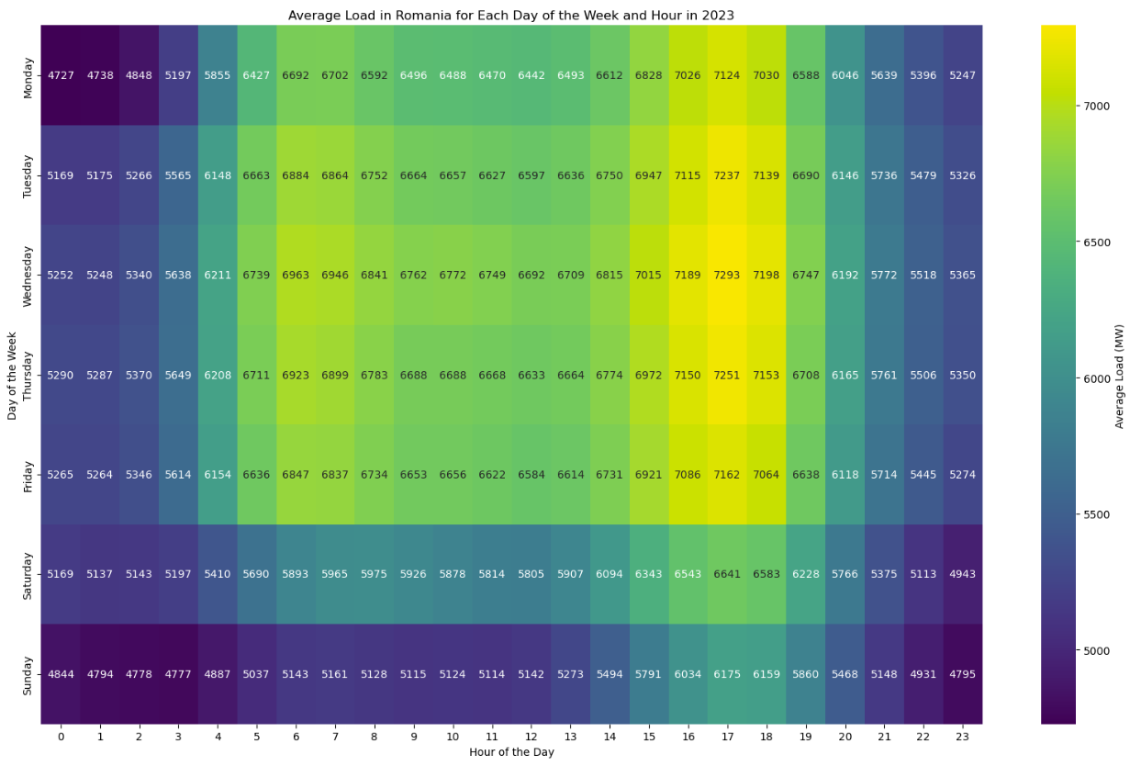
Average Load in Romania
Key Observations
Daily patterns :
Morning increase when people start their day
Afternoon peak when people returning home
Weekly patterns :
The load is generally higher on weekdays with a maximum on Wednesday
Saturday and Sunday have a lower load due to reduced commercial and industrial activity
General Trends :
Daily and weekly patterns reflects the regular routines of residential, comercial and industrial consumers.
Variation in demand indicates the need for flexible energy sources

Slide 5
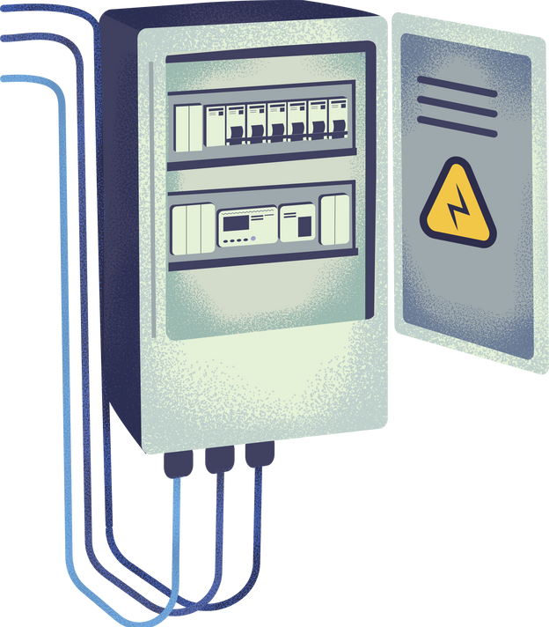
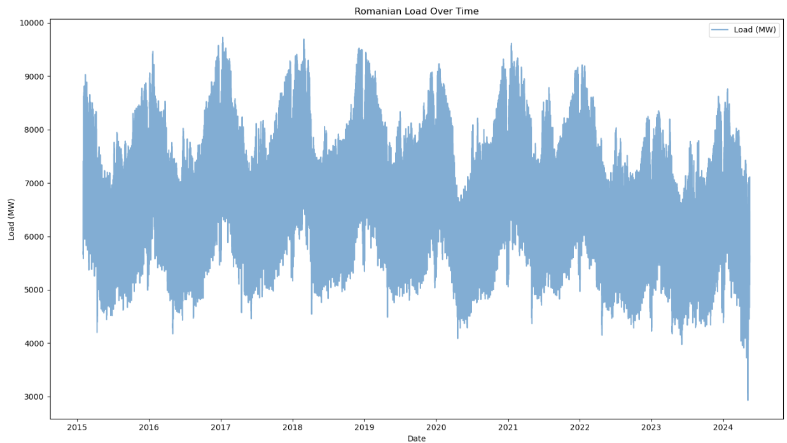
Romanian Load Forecast
Key observations
Seasonal variations
Yearly trends :
Recurrent pattern of rising and falling demand
Peak Load :
Highest load reach above 9000 MW
Notable secondary peaks during summer due to air conditioning
Lower loads drop to 3000 MW in 2024 which sounds like an outlier

Slide 6
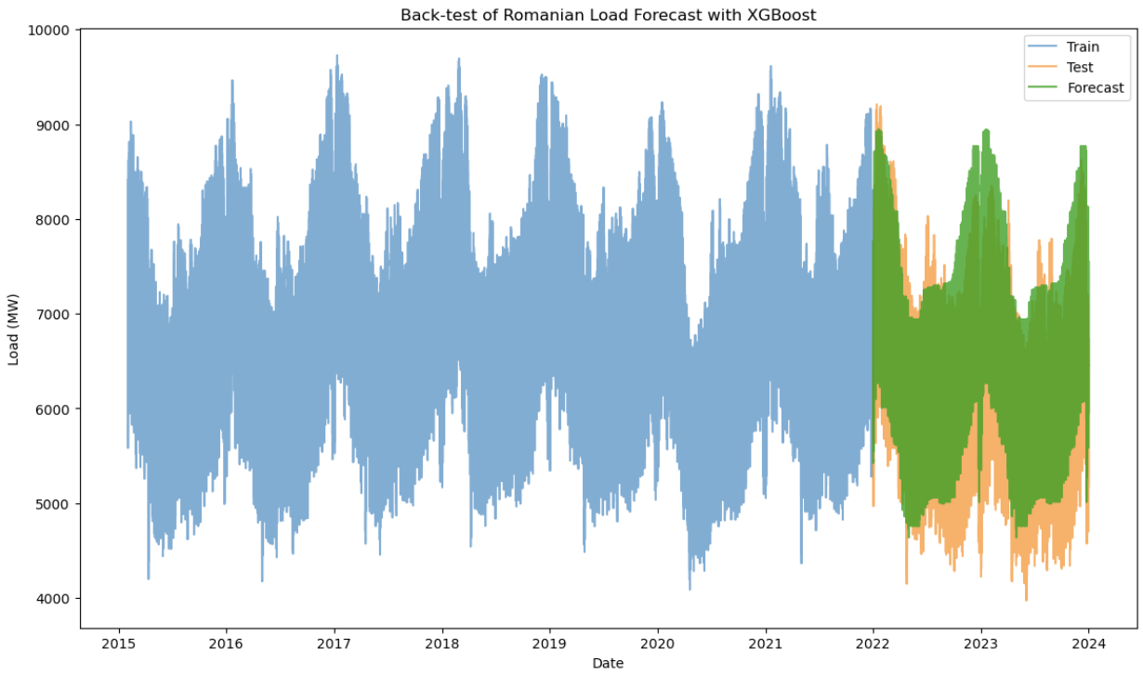
Romanian Load Forecast
XGBoost Model
Additional parameters and features
Weather data :
Temperature , Humidity
Precipitation ,Wind speed
Economic indicators :
GDP
Industrial Production Index
Unemployment Rate
Demographic data :
Population Growth
Urbanization Rate
Energy prices :
Electricity tariffs
Fuel Prices
Renewable Energy Integration
Features
Day of the week
Hour
Day of the year
Training data < 2022
Test data >= 2022
Mean Squared Error: 453,167
Root Mean Squared Error: 673
Mean Absolute Error: 558
Mean Absolute Percentage Error: 9.39%
Limitations
Data avaibility and quality
Model complexity
Uncertainty and variability

Slide 7
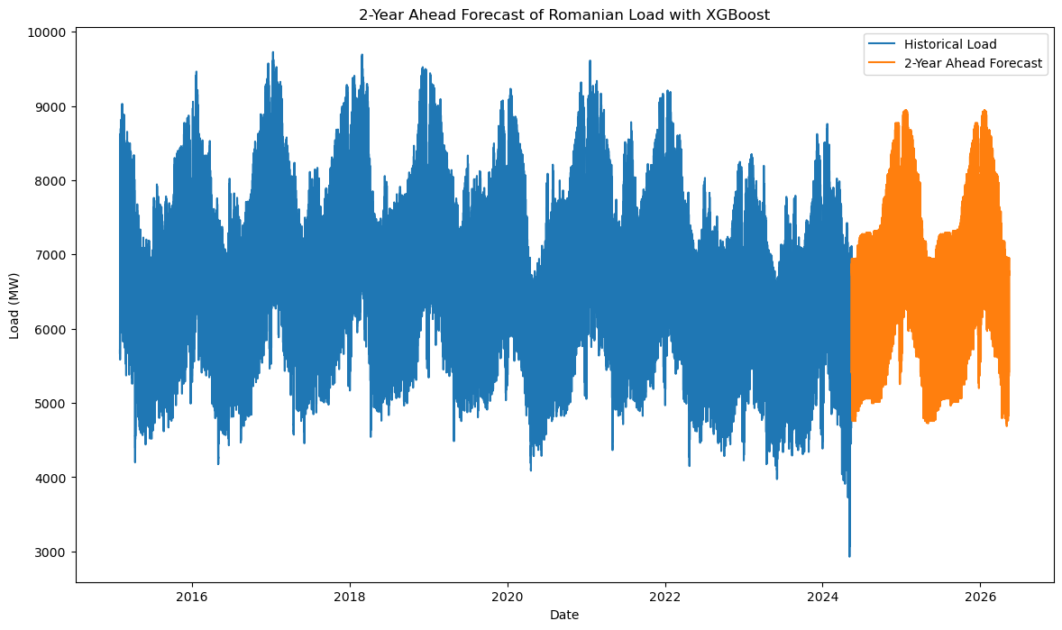
Romanian Load Forecast
XGBoost Model
Key observations
Seasonal trends :
The forecasted load maintains the seasonal patterns observed in the historical data
Load variation :
Range of load values similar to the historical data
Planning and Management :
Anticipate demand and ensure a reliable supply
Optimizing ressource allocation, managing energy reserves...

Slide 8

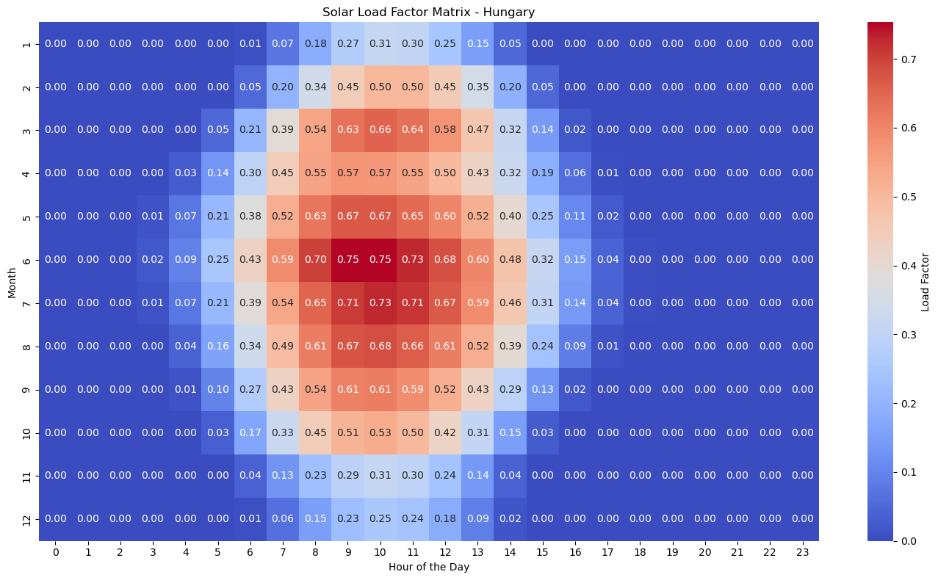
Hungarian Solar Generation Forecast
Solar Load Factor
The load factor is a measure of the efficiency of solar power generation relative to its installed capacity, with higher values indicating more efficient generation
Key Observations
Peak solar efficiency :
Midday hours : highest load factors
Summer months : June and July exhibit the highest load factor
Seasonal Variations
Spring and Fall : moderate load factors
Winter Months : lower load factors
Consistent patterns :
Predictable solar generation behavior based on the time of the day and the season

Slide 9
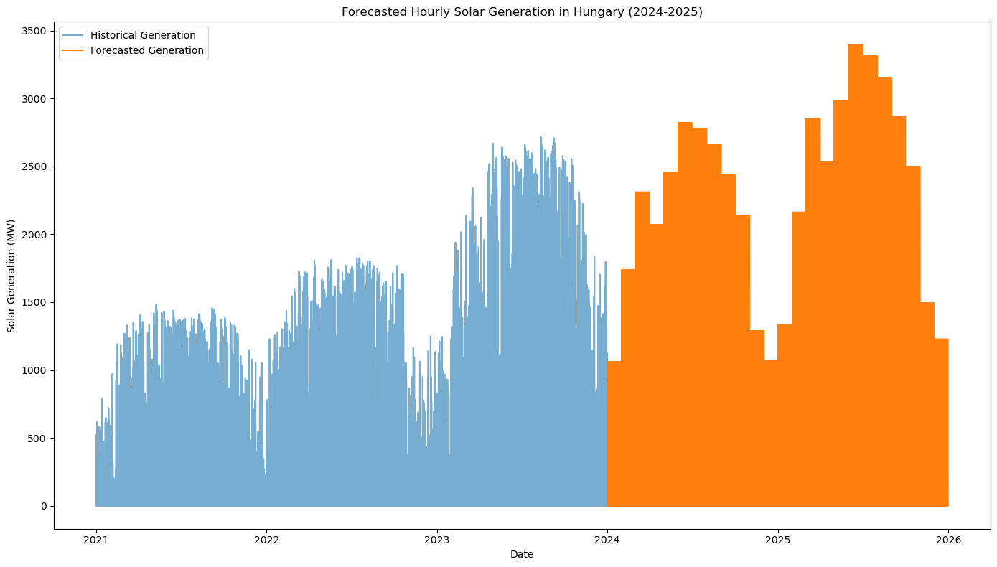
Hungarian Solar Generation Forecast
Hourly Solar Generation Forecast with Load Factor Matrix and installed capacity projection
Key Observations
Seasonal patterns
Installed capacity impact :
Reach up to almost 3500 MW indicating a growth in installed dcapacity
Insights and implication :
Grid stability and flexibility : accomodate the variable nature of solar power.
Environmental impact

Slide 10

Presented by Damien Hajjar
Thank you very much!
23/05/2024

