Slide 1

NHAI FACE AUTH
Offline-first biometric authentication & attendance for highway worksites
99.28% LFW
1.15 MB MODEL
63 ms / FACE
100% OFFLINE
NHAI HACKATHON 7.0 · DATALAKE 3.0 READY

Slide 2
THE PROBLEM
Attendance breaks down where the highway is built
NHAI manages 50,000+ construction workers across remote highway stretches with little or no connectivity.
Paper registers invite proxy punching. Online biometric devices fail in the field. There is no reliable way to prove who was actually on-site — or that they were safe to be there.
50,000+
workers across remote sites
0
bars of signal in the field
NIL
verifiable proof of presence
NHAI FACE AUTH
NHAI Hackathon 7.0
2

Slide 3

OUR SOLUTION
Authenticate any worker by face — fully offline
Custom face recognition
A MobileFaceNet model we trained ourselves — 99.28% LFW.
Liveness + anti-spoofing
Blink / smile / head-turn challenges defeat photo & video replay.
Privacy by design
BioHash cancellable templates — the raw face is never stored.
Safety + presence
GPS geofencing and PPE checks gate every check-in.
Syncs when online
Offline-first; pushes to NHAI Datalake 3.0 when a signal returns.
Command Center
NHAI FACE AUTH
NHAI Hackathon 7.0
3

Slide 4
THE AI WE BUILT
A custom model — trained from scratch, not an API
490,623
10,572
1.0 M
99.28%
training images
identities
parameters
128-D
1.15 MB
63 ms
LFW 10-fold
verification accuracy
embedding
INT8 model size
CPU latency / face
TRAINING PIPELINE
MobileFaceNet + ArcFace
CASIA-WebFace
MobileFaceNet
ArcFace s=64 m=0.5
SGD + cosine LR
PyTorch -> ONNX -> INT8
LFW / CFP-FP / AgeDB
ALL HACKATHON CONSTRAINTS PASS · < 20 MB · < 1 s/face · > 95% LFW · self-trained
NHAI FACE AUTH
NHAI Hackathon 7.0
4

Slide 5
HOW IT WORKS
From camera frame to verified identity
1
2
3
4
5
>
>
>
>
Capture
Detect
Embed
Protect
Match
VisionCamera v5
front / back
ML Kit face +
landmarks
128-D MobileFaceNet
vector
BioHash +
AES-256
Cosine vs adaptive
threshold
Resilience by design
The neural ONNX embedding runs with an eye-aligned geometric landmark fallback — translation-, scale- and rotation-invariant — so recognition works on every phone, even where the runtime lacks the quantized operator set. No device is left unsupported.
NHAI FACE AUTH
NHAI Hackathon 7.0
5

Slide 6
TRUST & SECURITY
Hard to fool. Safe with the data.
Active Liveness
Anti-Spoofing
Three randomized challenges — blink, smile, head-turn — with live progress. Defeats printed photos and video replay.
Laplacian-variance texture analysis flags screens and prints before a match is ever attempted.
BioHash Privacy
Encryption & Lockout
ISO/IEC 24745 cancellable templates. The raw 128-D face vector is never stored and can be revoked & re-issued.
AES-256-GCM at rest, 3-attempt lockout with cooldown, and GDPR-style retention with auto-purge.
NHAI FACE AUTH
NHAI Hackathon 7.0
6

Slide 7
BUILT FOR THE FIELD
More than attendance — a worksite safety checkpoint
GPS Geofencing
PPE Compliance
Aadhaar Linkage
Check-in / out validated against site boundaries.
Helmet & hi-vis vest detection gates site entry.
Optional capture with Verhoeff checksum + masking.
Offline-First Sync
Live Analytics
Hindi / English
Zero-signal operation; retries to Datalake 3.0.
Pass rate, confidence, spoof blocks, 7-day trends.
Voice prompts and high-contrast outdoor UI.
NHAI FACE AUTH
NHAI Hackathon 7.0
7

Slide 8

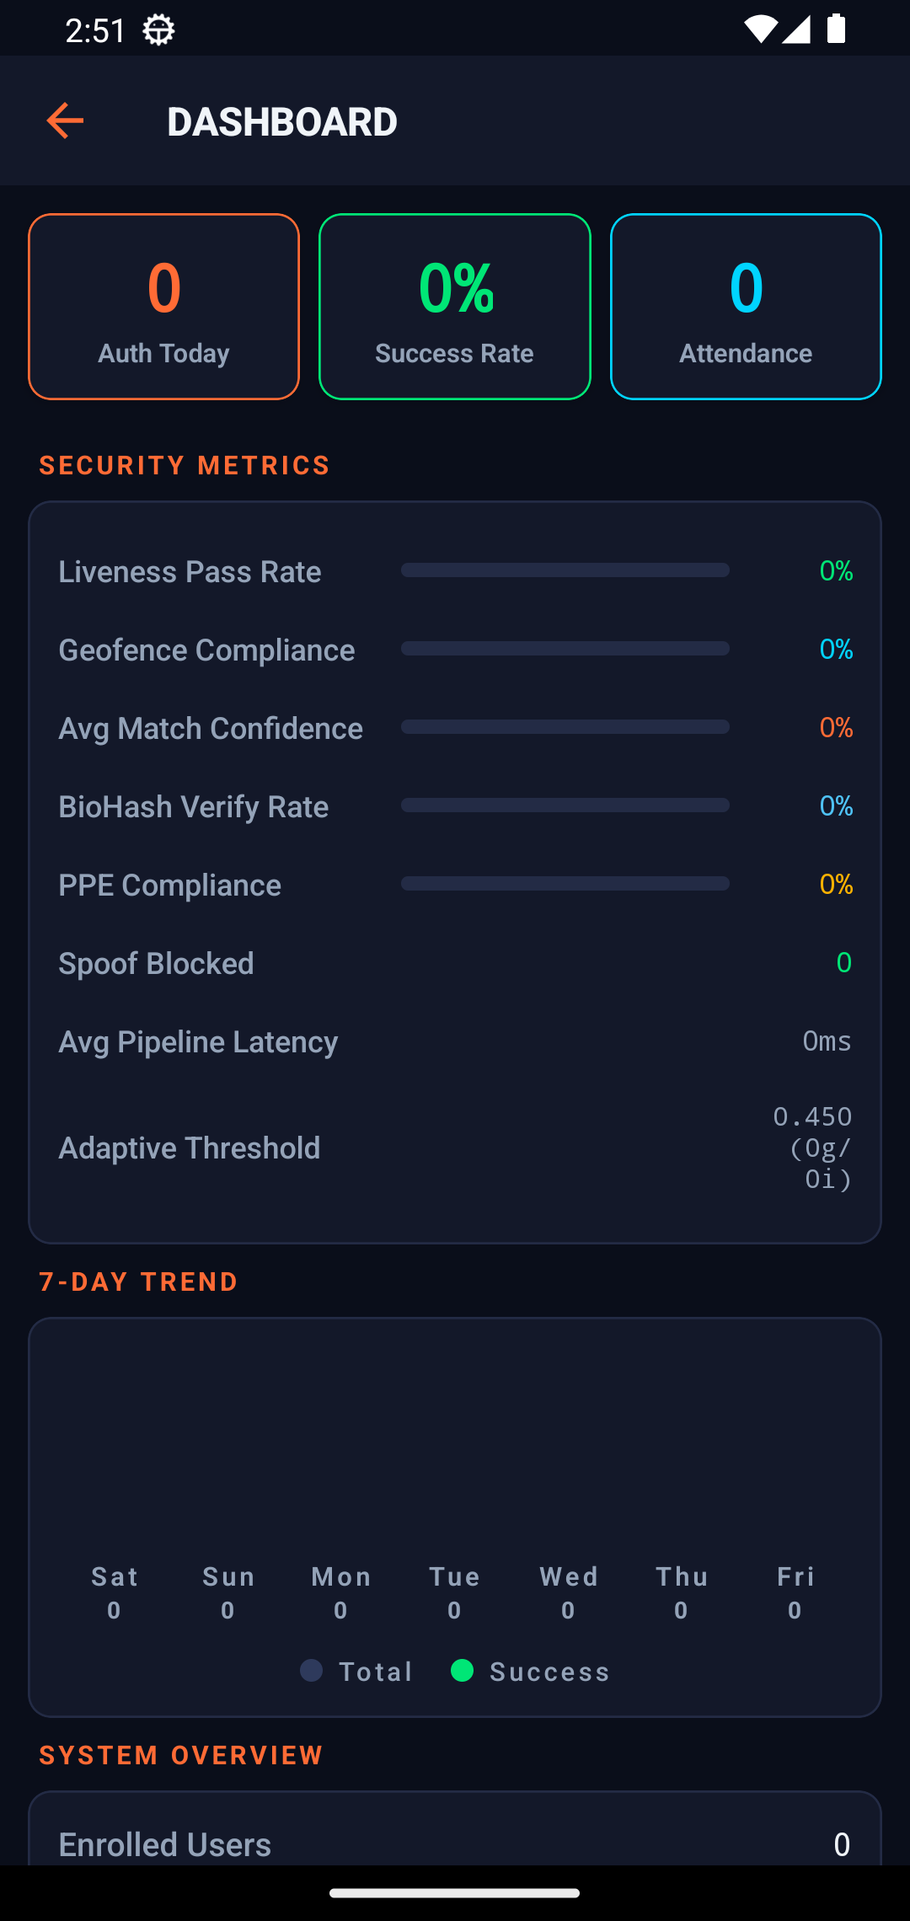
THE APP
A dark command center for site supervisors
Command Center
Face Enrolment
Security Analytics
NHAI FACE AUTH
NHAI Hackathon 7.0
8

Slide 9



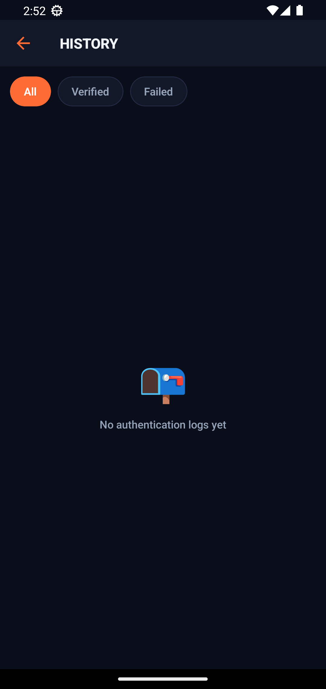
THE APP
Twelve screens, one coherent system
Attendance
Calendar
Worker Registry
Auth History
NHAI FACE AUTH
NHAI Hackathon 7.0
9

Slide 10
UNDER THE HOOD
Engineering that holds up in production
On-Device Pipeline
Security & Privacy
VisionCamera v5 capture
ML Kit detection + landmarks
MobileFaceNet 128-D (ONNX)
Eye-aligned geometric fallback
Cosine match · adaptive threshold
BioHash ISO/IEC 24745
AES-256-GCM at rest
Liveness + Laplacian anti-spoof
3-attempt lockout + cooldown
GDPR-style retention & purge
Platform
Field Features
React Native 0.85 · Hermes
Native Kotlin face-processor
Encrypted offline-first store
Background sync → Datalake 3.0
Standalone APK · no server
GPS geofencing
PPE helmet / vest gate
Aadhaar Verhoeff validation
Hindi / English voice
Live analytics & trends
NHAI FACE AUTH
NHAI Hackathon 7.0
10

Slide 11
WHY WE WIN
Built for the brief — and beyond it
Capability | NHAI Face Auth | Typical systems
Works fully offline | Yes — every feature on-device | Needs connectivity
Face model | Self-trained, 99.28% LFW, 1.15 MB | Cloud API or 10–50 MB
Template protection | BioHash (raw face never stored) | Raw embedding stored
Liveness & anti-spoof | 3 challenges + texture analysis | Single-factor or none
Device coverage | Neural + geometric fallback | Fails on unsupported ops
Beyond attendance | Geofence + PPE safety gate | Attendance only
NHAI FACE AUTH
NHAI Hackathon 7.0
11

Slide 12
Ready for the field. Ready to win.
A custom-trained face model at 99.28% LFW, wrapped in an offline-first, privacy-first app that makes NHAI worksite attendance trustworthy — with or without a signal.
99.28% LFW
1.15 MB
63 ms/FACE
100% OFFLINE
NHAI FACE AUTH · NATIONAL HIGHWAYS AUTHORITY OF INDIA · HACKATHON 7.0

