Slide 1
Ethics for digital projects and research
Session leader and content created by: Kelsey Chatlosh @kchatlosh
Edited by: Patrick Sweeney @pswee and Patrick Smyth @psmyth01
dhinstitutes.org #DHRI
[See: README.MD]

Slide 2
institutional compliance
ethics beyond compliance
[See: README.MD]

Slide 3
What are ethics? What do we mean by digital projects and research?
[See: introduction.md]

Slide 4
“situated ethics”
[See: introduction.md]

Slide 5
for example: how were computers developed? By whom? Where? Why? (see Broussard 2018, chapter 6)
[See: introduction.md]

Slide 6
Ethics from the standpoint of the institution
[See: institutional.md]

Slide 7
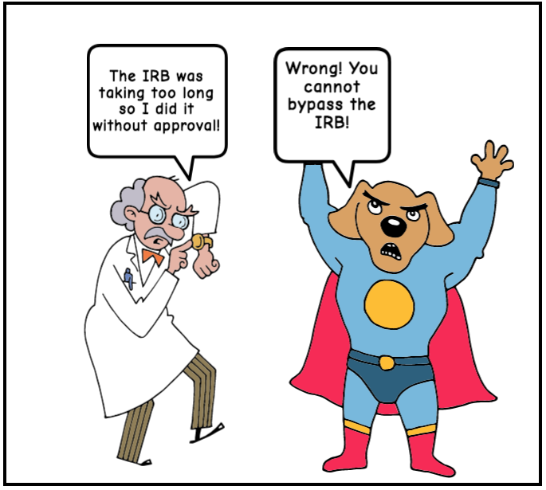
[Image source: Source: This comic was created for free at MakeBeliefsComix.com]
[See: institutional.md]

Slide 8
The Belmont Report
The National Commission for the Protection of Human Subjects of Biomedical and Behavioral Research, created as a result of the National Research Act of 1974, published the Belmont Report in 1979.
[See: belmont.md]

Slide 9
The Belmont Report
3 core principles
3 key concerns
Respect for persons
Beneficence
Justice
Informed consent
Assessment of risks and benefits
Selection of subjects
[See: belmont.md]

Slide 10
*See the Planned Parenthood Tumblr page [tinyurl.com/consentpp] for a great definition of consent
[See: belmont.md]

Slide 11
Every university or research institution must, legally, have its own or an affiliated Institutional Review Board (IRB).
[See: irb.md]

Slide 12
Usually, IRB review is required when ALL of the criteria below are met:
The investigator is conducting research or clinical investigation,
The proposed research or clinical investigation involves human subjects, and
Your university or research institution is engaged in the research or clinical investigation involving human subjects.
[See: irb.md]

Slide 13
Activity Think about a digital project or research you are or will be working on. Pair up with another person near you and discuss: >> In 1 minute each, what is the purpose of your project—what does it aim to do? >> In 1 minute each, what is the design of your project—how will you do this? >> In relation to each of your projects' purpose and design, what might be some ethical concerns that fall beyond questions of legality or the purview of the IRB? Share as a class.
[See: beyond.md]

Slide 14
Ethics beyond compliance
An “impact approach” (Markham 2016 [tinyurl.com/markhamethics])
[See: levelsimpact.md]

Slide 15
This session, drawing from Markham (2016), will focus on three levels of impact:
Direct impacts on people
Ramifications of (re)producing categories
Social, political and economic effects
[See: levelsimpact.md]

Slide 16
Additionally, this workshop will address the range of impact, or the range of accessibility to your work:
>> to people with disabilities,
>> to people in different countries or who speak different languages, and
>> in terms of cost and proprietary accessibility.
[See: levelsimpact.md]

Slide 17
Level of impact 1: “how our methods of data collection impact humans, directly” (Markham 2016)
[See: impact1.md]

Slide 18
What counts as "human"? What data should be off limits?
[See: impact1.md]

Slide 19
Commonly blurred definitions
>> “human subjects”
>> public vs. private
>> data(text) vs. persons
(Source: AoIR 2012 report)
[See: impact1.md]

Slide 20
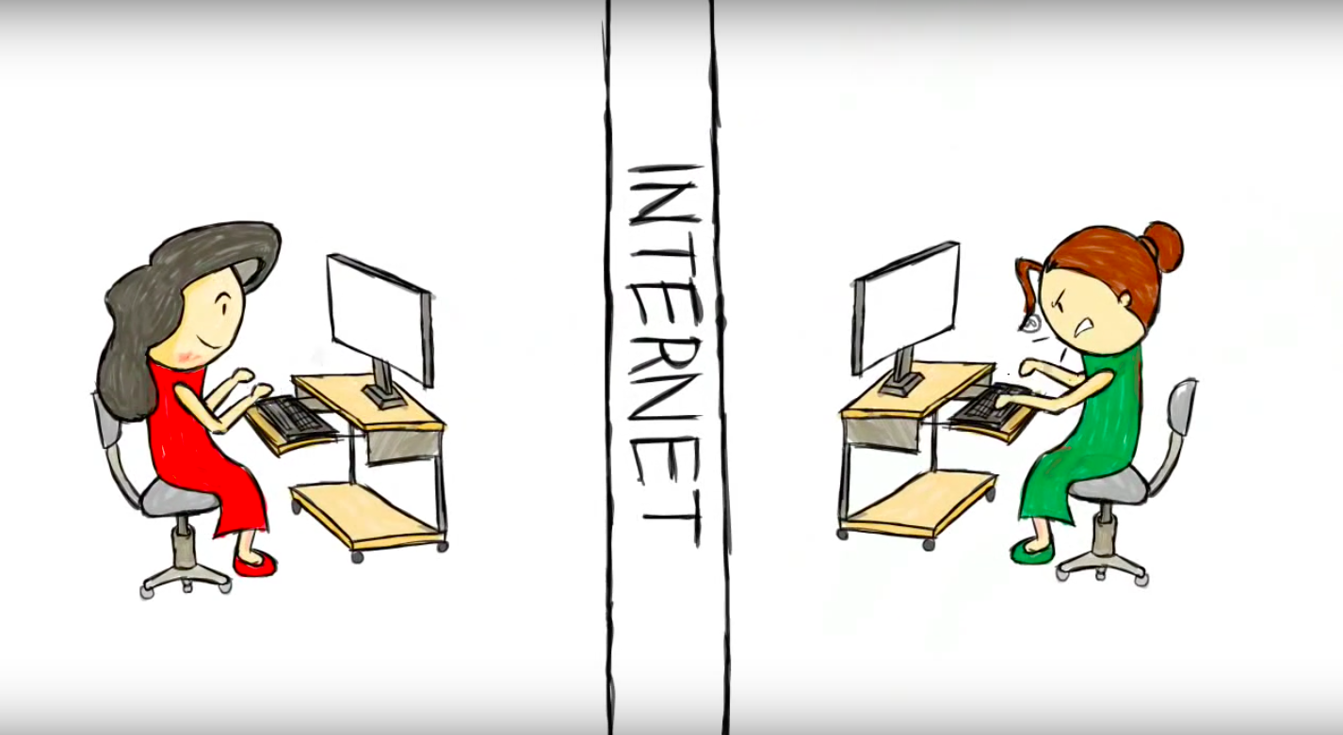
Human subjects & “the distance principle” (Markham 2016)
[Image source: A still image from "A real person, a lot like you" by Derek Sivers, shared with his permission]
[See: impact1.md]

Slide 21
“public data”
[See: impact1cont.md]

Slide 22
the question of personhood
[See: impact1cont.md]

Slide 23
Activity Let's analyze and discuss a case study. Review Joshua Tabak and Vivian Zayas's academic article [tinyurl.com/tabakzayas] and their summary of it for the New York Times [tinyurl.com/gaydarscience], and discuss: >> What kinds of “human subjects” are involved in this study? >> Is a social media photo of oneself an extension of the self? >> Does their methodology raise any ethical concerns? Discuss with your table, then share as a group. Further reading: Patrick Sweeney, "Images of Faces Gleaned from Social Media in Social Psychological Research on Sexual Orientation," 2017 [tinyurl.com/sweeneyimages]
[See: impact1cont.md]

Slide 24
Level of impact 2: the ramifications of (re)producing categories
[See: impact2.md]

Slide 25
“how our methods of organizing data, analytical interpretations, or findings as shared datasets are being used—or might be used—to build definitional categories or to profile particular groups” (Markham 2016)
[See: impact2.md]

Slide 26
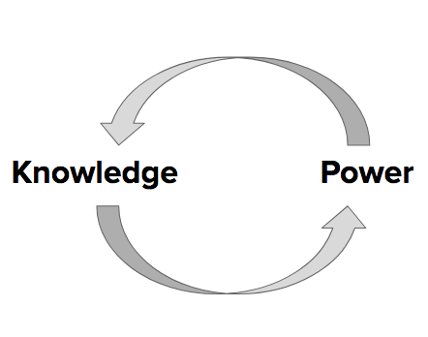
[See: impact2.md]

Slide 27
How do digital tools and projects categorize or rely on categorizations?
[See: impact2.md]

Slide 28
What are some ramifications of (re)producing categories?
[See: impact2cont.md]

Slide 29
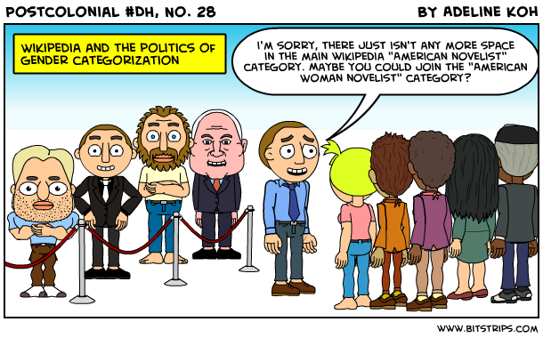
[Image source: A comic by Adeline Koh from #DHPoco: Postcolonial Digital Humanities, shared here with her permission.]
[See: impact2cont.md]

Slide 30
bias in
bias out
[See: impact2cont.md]

Slide 31
Can categorical hierarchies and existing bias be resisted through digital projects? If so, how?
[See: impact2cont.md]

Slide 32
Activity Let's analyze and discuss a case study. Check out the Interference Archive (IA) website [interferencearchive.org], read this brief article [tinyurl.com/joynerhidden] and discuss: >> What kinds of materials does IA host and do they have rights to it? >> In reference to the article, how does IA see itself as “resisting the hierarchy” (Joyner 2016)? >> What levels of impact does IA aim to take into account? Discuss with your table, then share as a group.
[See: impact2cont.md]

Slide 33
Level of impact 3: social, political, and economic impacts
[See: impact3.md]

Slide 34
Whose labor and what materials are used to make the digital tools we use? How should we attribute others' labor? How can we be held accountable?
[See: impact3.md]

Slide 35
How may digital projects or research be used to justify or facilitate potentially harmful control or surveillance?
[See: impact3.md]

Slide 36
How may digital projects or research influence social or political discourse? Modes of profit?
[See: impact3.md]

Slide 37

All projects and research have impacts.
[Image source: Image source: Sergiu Bacioiu from Romania, "Ripple effect on water," Wikimedia, Creative Commons Attribution 2.0 Generic license.]
[See: impact3.md]

Slide 38
Activity Think about a digital project or research you are or will be working on. Pair up with another person near you and discuss: >> Whose labor and what materials do you rely upon to do your work? >> Could your research or project be used to justify or facilitate potentially harmful control or surveillance—by e.g. the state, a vigilante group, an abusive partner? >> How could your work cause changes to or justify social, economic or political discourses? >> Will your work be used for profit, for who? Share as a class.
[See: impact3.md]

Slide 39
Range of impact: accessibility to your work
[See: range.md]

Slide 40
What is universal design? What is accessibility?
[See: range.md]

Slide 41
Accessibility to people with disabilities
[See: range.md]

Slide 42
International accessibility and language access
[See: range.md]

Slide 43
Openness and accessibility
[See: range.md]

Slide 44
*A note on "free software" and user control (Factor interview with Stallman, 2017)
[See: range.md]

Slide 45
Other kinds of accessibility?
[See: range.md]

Slide 46
When might researchers or makers not want to make their work or data fully open and accessible?
[See: range.md]

Slide 47
When might researchers or makers decide not to even record data or media, or to delete?
[See: range.md]

Slide 48
Activity Think about a digital project or research you are or will be working on. Pair up with another person near you and discuss: >> Who will be able to access your research or project? >> Where and through what media will it be accessible? >> Will it cost money to access? >> Will it be accessible in different languages? >> Will it be accessible to people with visual, hearing, mobility, or other physical, sensory, or cognitive disabilities? Share as a class.
[See: range.md]

Slide 49
See additional case examples, a glossary of key terms and concepts, and a resources page on the DHRI ethics curriculum on GitHub
[See: cases.md, glossary.md, and resources.md]

Slide 50
Workshop debrief By the end of this workshop, participants have: >> Reviewed ethical practices to satisfy institutional needs (IRB) when working with "human subjects.” >> Learned specific ethical questions and levels of impact to consider when doing various forms of digital research and using digital tools. >> Engaged with alternative approaches and case examples. >> Envisioned the ethics of their own projects and methodologies.
[See: review.md]

Slide 51
Next steps: >> Determine institutional requirements >> Explore ethics beyond compliance >> Reassess your research methodology
[See: review.md]

Slide 52
Ethics for digital projects and research
Session leader and content created by: Kelsey Chatlosh @kchatlosh
Edited by: Patrick Sweeney @pswee and Patrick Smyth @psmyth01
dhinstitutes.org #DHRI
[See: README.MD]

