Slide 1
BlockFund
Presentation team:shail
Notes:
1

Slide 2
Project analysis slide 2
Blockchain for shared economy
What is crowdfunding?
Crowdfunding is the use of small amounts of capital from a large number of individuals to finance a new business venture. Crowdfunding makes use of the easy accessibility of vast networks of people through social media and crowdfunding websites to bring investors and entrepreneurs together, and has the potential to increase entrepreneurship by expanding the pool of investors from whom funds can be raised beyond the traditional circle of owners, relatives and venture capitalists.
Notes:
2

Slide 3
Project analysis slide 2
Blockchain for shared economy
Current problems in crowdfunding
Trust: When you are a brand with no prior record, you have to consider how you can generate enough brand credibility with investors. Without trust you might not generate enough interest in your campaign and fail to meet your targets.
Accounting, recordkeeping and managing compliance: There is a huge amount of uncertainly when it comes to the accounting rules for funds raised through crowdfunding.Should they be declared as an income or as capital? The answer will tend to be different depending on which expert you ask. For e.g. Also, states in the US will have their own rules on how this money should be taxed.
Security gaps in present payment infrastructure: Some inherent payment bottleneck with present payment platforms like wePay, amazonPay, PayPal have caused the investors wary of investing in through crowdfunding platforms.
Notes:
2

Slide 4
Project analysis slide 2
Blockchain for shared economy
How do we aim to solve these problem
1. Blockchain technology provides the underpinnings of popular cryptocurrencies like Bitcoin and Ether (the currency on the Ethereum network). The blockchain also provides a robust, decentralized way for information to be stored in immutable blocks — great for crowdfunding.
2. The ledger in a blockchain system would allow for accurate record keeping of all campaign activity: before the campaign starts, during the donation period, and after the campaign is funded. This level of visibility into a project helps all parties involved, including the creators, backers, and platform administrators. By having an immutable receipt, you can have proof of your contribution and the reward that is due to you. This is something that cannot be guaranteed by the current system.
Notes:
2

Slide 5
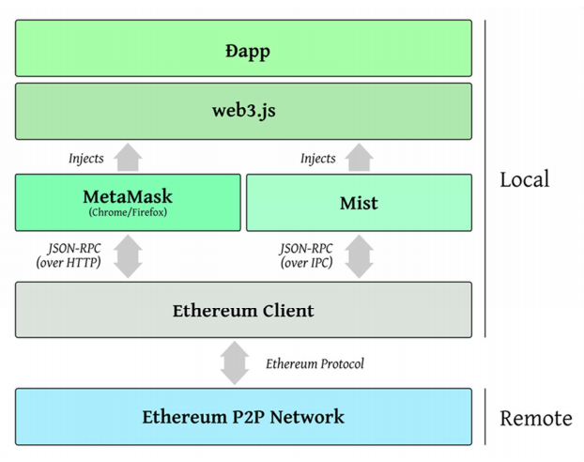
Project analysis slide 2
Blockchain for shared economy
Architecture
Notes:
2

Slide 6
Thank You
Notes:
10

