Slide 1
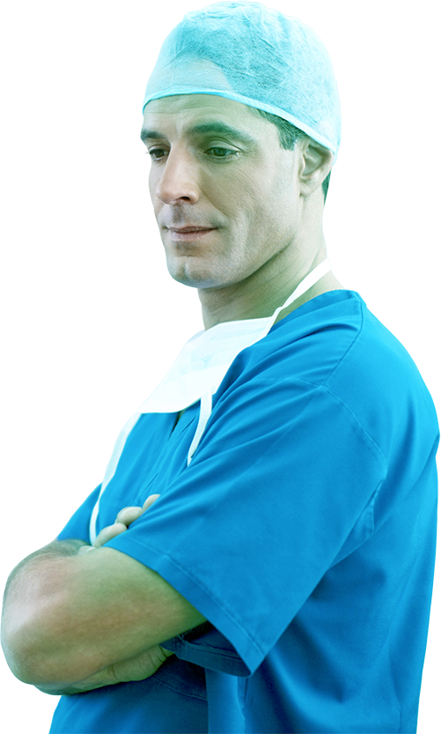










hack_x
SKIN-SENSE
Diagnosis of skin lesions through images

Slide 2
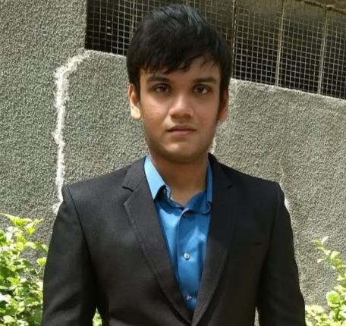
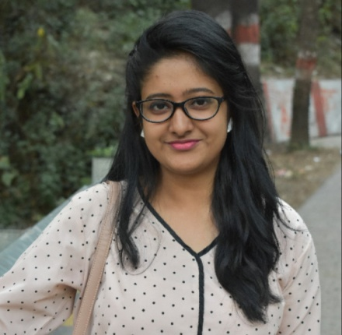
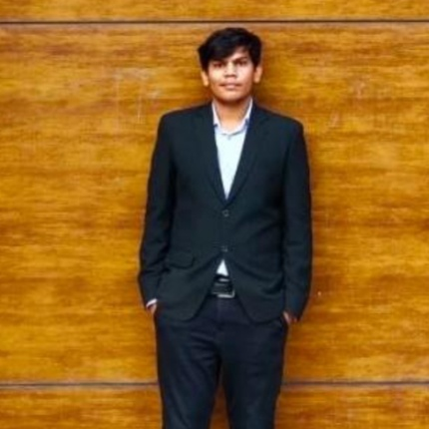
TEAM PROFILE
DHRUV PATEL
PRATIKSHYA MISHRA
YOGISHANKAR
TEAM LEADER
EMAIL: dhruvgcet29@gmail.com
TEAM MEMBER
EMAIL:
pratikshya.mishra72@gmail.com
TEAM MEMBER
.

Slide 3
contents
INTRODUCTION
Problem statement
Proposed Solution
Challenges faced
SYSTEM DIAGRAMS:
Architecture diagram
Use case diagram
FRAMEWORS/TOOLS USED
Programming languages
Tools/Software etc
SOLUTION/SYSTEM DESCRIPTION
Detailed description of the application
IMAGES/SCREENSHOTS
Screenshots of android/web-app
CONCLUSION AND FUTURE WORK

Slide 4

INTRODUCTION

Slide 5
PROBLEM STATEMENT :- We rely on your expertise to help doctors and surgeons to identify the associated allergies from capture images of skin, predict the probability of skin cancer, and suggest remedies to prevent further damage. Enabling smart features like connecting with forums offering discussions around the problem or prescribing a skin specialist based on a geographic location will give extra advantages to your solutions!

Slide 6
PROPOSED SOLUTION :- The recent emergence of machine learning and deep learning methods for medical image analysis has enabled the development of intelligent medical imaging-based diagnosis systems that can assist physicians in making better decisions about a patient’s health. In particular, skin imaging is a field where these new methods can be applied with a high rate of success.
Our solution aims to classify 7 common types of skin infections namely
ACTINIC KERATOSES
BASAL CELL CARCINOMA
BENINGN KERATOSES
DERMATOFIBROMA
MELANOCYTIC NEVI
MELANOMA
VASCULAR LESIONS

Slide 7
Out of the above 7 categories (MELANOMA) is considered to be cancerous other categories of infections can be classifies as non-cancerous.
Our solution will classify all the 7 classes with high precision and accuracy.
Our solution can be used my medical professional to identify the skin disease it helps automate the identification process.
Our solution can also be used by common people to detect which type of skin infection they have.
Our solution aims to detect Melanoma which is predominant skin cancer in early stages so lives of the patients can be saved.

Slide 8
We also provide a functionality which will enable users to find a dermatologist closest to their current location
We have a embedded discussion forum that allows users to connect with people having similar issues, discuss around the problem , give recommendations to people etc.

Slide 9
CHALLENGES FACED :- Following are some challenges we came across.
Finding the dataset was a tough task due to its scarcity and even tough dataset were there they were highly imbalanced.
Choosing the model to train images on , as our solution is mobile based we had to choose a model that was small in size and efficient on mobile as a result there is trade-off between accuracy and efficiency.

Slide 10
SYSTEM DIAGRAMS

Slide 11
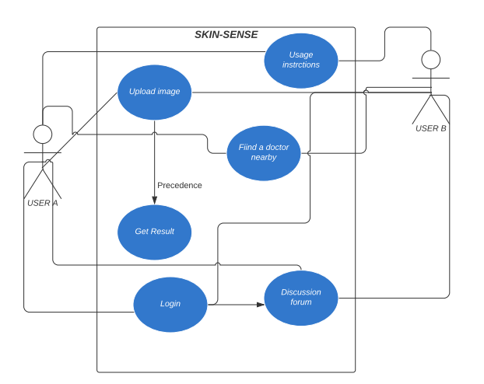
USE CASE DIAGRAM :-

Slide 12
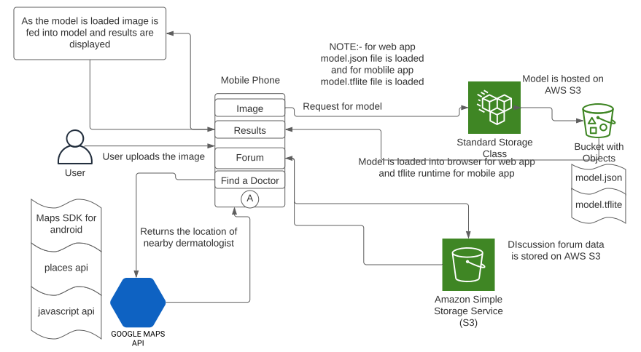
SYSTEM ARCHITECTURE :-

Slide 13
FRAMEWORKS/TOOLS

Slide 14
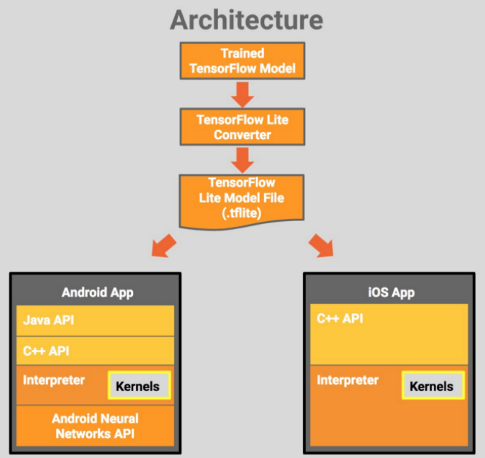
PROGRAMMING LANGUAGES USED :- As we have developed a web application , an Android application , an IOS application so different languages for used.
Web application:- (HTML , CSS , JAVASCRIPT) were used for frontend design , Tensorflow.js is a library for machine learning in java script which enables deep learning models to directly run in Web browser.
Android:- Native android libraries are used to develop the application (java for android) below is the figure.

Slide 15
TOOLS/LIBRARIES USED FOR DEEP LEARNING MODEL :- Native Keras libraries are used to develop deep learning model.
Mobile-Net is used as a model which is used to classify skin lesion images into 7 listed categories.(Further detail about model is given in next section)
Native Keras model is then converted to tensorflow.js(model.json) model using tensorflow_converter api to be used for web app.
Native keras model is also converted to tensorflow-lite(model.tflite) model which is used to develop mobile app.
Conversion is done in order to make the model compatible to be able to run directly into web-browser.

Slide 16
SYSTEM DESCRIPTION

Slide 17
SYSTEM DESCRIPTION :- The whole solution has been composed of three features namely
Identification of skin lesions form images.
Finding a Doctor near ones current location.
Discussion Forum for people to connect with each other.
We will describe the functioning of each of the components in detail

Slide 18
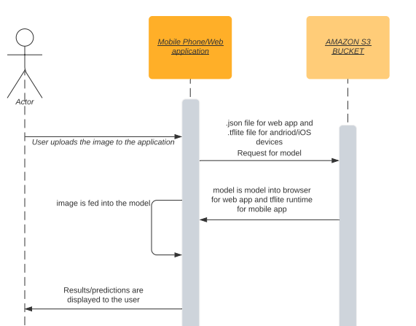
IDENTIFICATION OF SKIN DESEASE FROM IMAGE :- This is the core functionality of our solution , here users will require to upload the image of a skin lesion either by clicking a picture form phone camera (for android and iOS) devices or by uploading a already stored images(for web app and mobile device).

Slide 19
BRIEF ABOUT THE MOBILE-NET MODEL :- We shall be using Mobilenet as it is lightweight in its architecture. It uses depth wise separable convolutions which basically means it performs a single convolution on each colour channel rather than combining all three and flattening it. This has the effect of filtering the input channels. Or as the authors of the paper explain clearly: “ For MobileNets the depth wise convolution applies a single filter to each input channel. The point wise convolution then applies a 1×1 convolution to combine the outputs the depth wise convolution. A standard convolution both filters and combines inputs into a new set of outputs in one step. The depth wise separable convolution splits this into two layers, a separate layer for filtering and a separate layer for combining. This factorization has the effect of drastically reducing computation and model size. ”

Slide 20
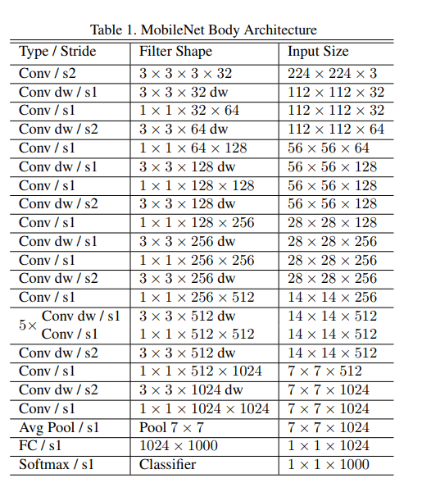
MobileNET Architecture

Slide 21
FINDING NEARBY LOCATION :- This feature uses users current location to fetch nearby dermatologist and point their location on the map.
It also displays the website of the clinic (if it has one) along with mobile number so they can book their appointments.
It uses Google maps Api to achieve the functionality.

Slide 22
DISCUSSION FORUM :- The discussion forum is a place where people can connect with each other and share information , discuss around the issues , suggest or recommend doctors to people suffering from skin ailments.
It is developed on a platform called muut.com and is embedded into the application.
Users would require to sign-in in order to post comments/images on the forum.
Note:- As this is prototype sign by (Google , facebook , twitter) has not been enabled because they are paid services and this forum uses free-trail version users will have to sign in via traditional method.

Slide 23
SCREENSHOTS/IMAGES

Slide 24
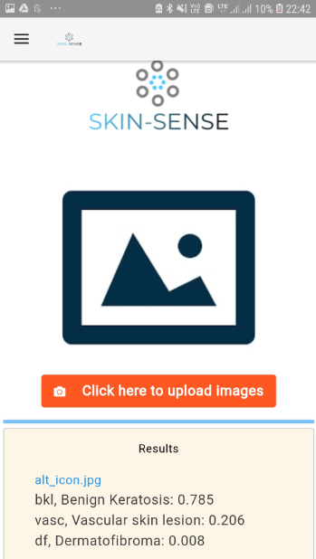
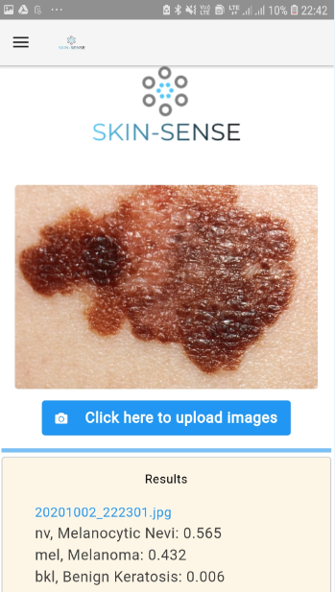
HOME PAGE :- In the main page results displayed are dummy for user understanding
USER UPLOADS THE IMAGE :- Predicted class (top 3) are displayed along with their probability.

Slide 25
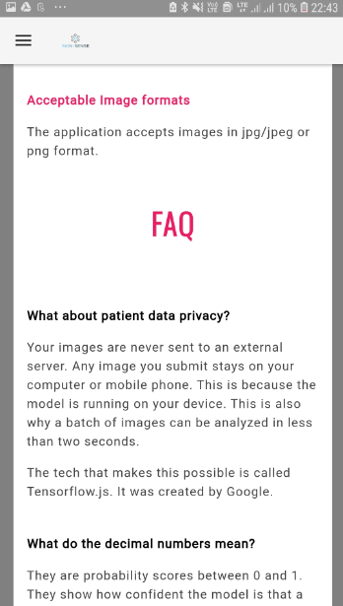
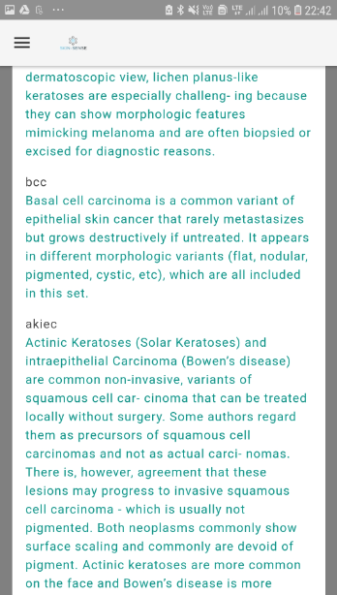
HOW TO USE (INSTRUCTIONS PAGE)

Slide 26
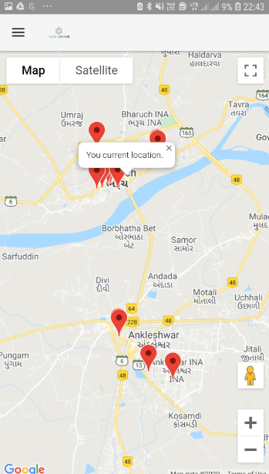
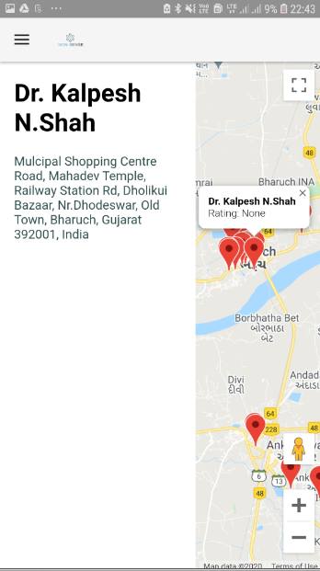
FIND a DOCTOR:- Users can find a dermatologist near his/her location.
DETAILS OF THE CLINIC :- Details(address , website, ratings) are displayed in the side panel.

Slide 27
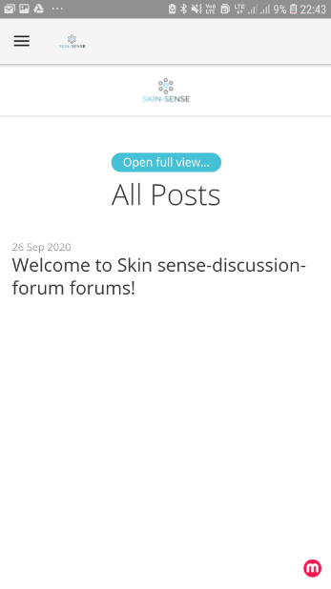
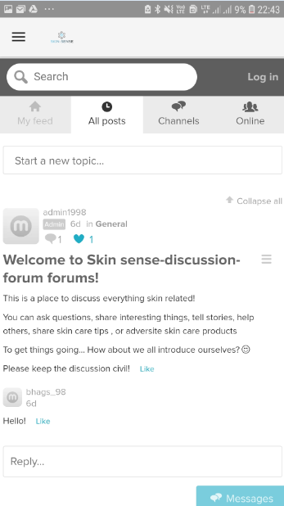
DISCUSSION FORUM:-This page displays all the active channels.
SKIN-SENSE CHANNEL:- Below is one of the channel initiated by admin.

Slide 28
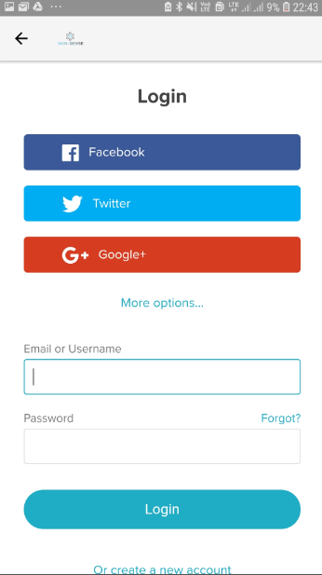
LOGIN PAGE:- Users need to login before accessing the forum.

Slide 29
FUTURE WORK/CONCLUSION

Slide 30
SUMMARY :- Below is the summary of the accuracy of this application in predicting the correct label of the skin lesion.
As one can see we have displayed the top 3 predicted classes because due to imbalance in dataset and bottleneck in the model the categorical accuracy i.e.(accuracy with which the correct class is predicted) is 0.8081023454157783 (80 %).
Whereas the application is significantly better in predicting top_2 or top 3_accuracy.
It has achieved top_2 accuracy of 0.9125799573560768 (91 %) and top_3 accuracy of 0.9626865671641791 (96 %).
Note: Above mentioned accuracy is calculated on the validation dataset

Slide 31
FUTURE SCOPE:- After the contest is over we plan to build further on this prototype in the following manner.
Try out more neural-net architecture to improve on categorical accuracy.
Providing batch prediction functionality so users can submit bunch of images and get the results in parallel.
Integrating an interactive Chabot which can recommend medicines based on symptoms and book doctors appointment for the user.
As of now we have developed web application and android application we will also develop the ios app for iPhone users.

Slide 32










Thank You
Prepared by :- Team hack_x

