Slide 1
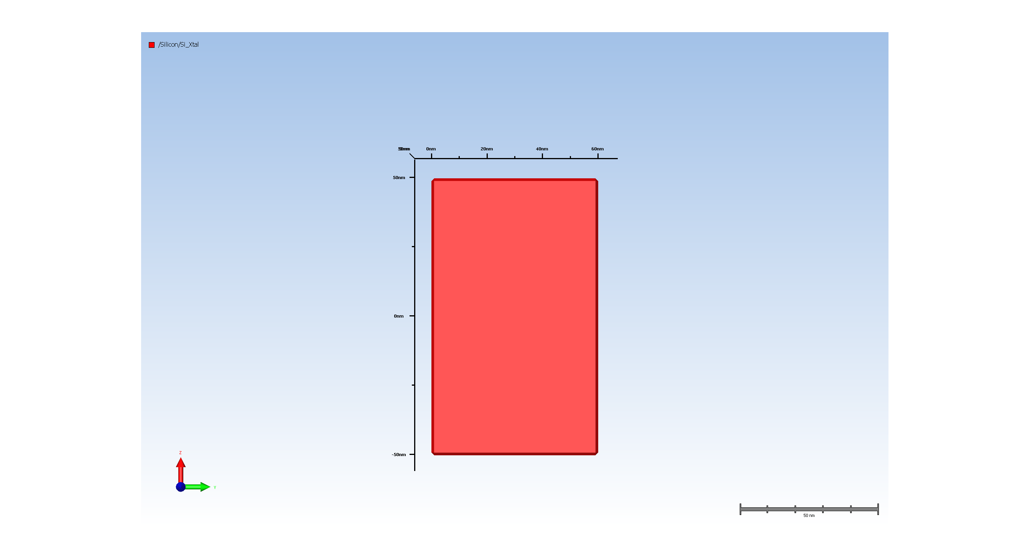
1. Wafer Setup

Slide 2

2. Fin formation

Slide 3
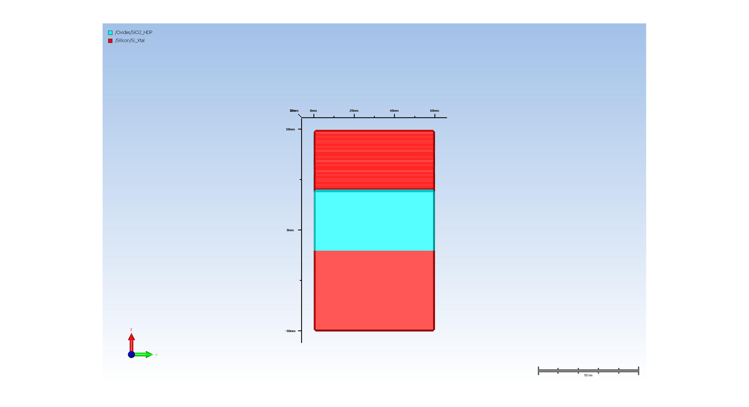
3. STI

Slide 4
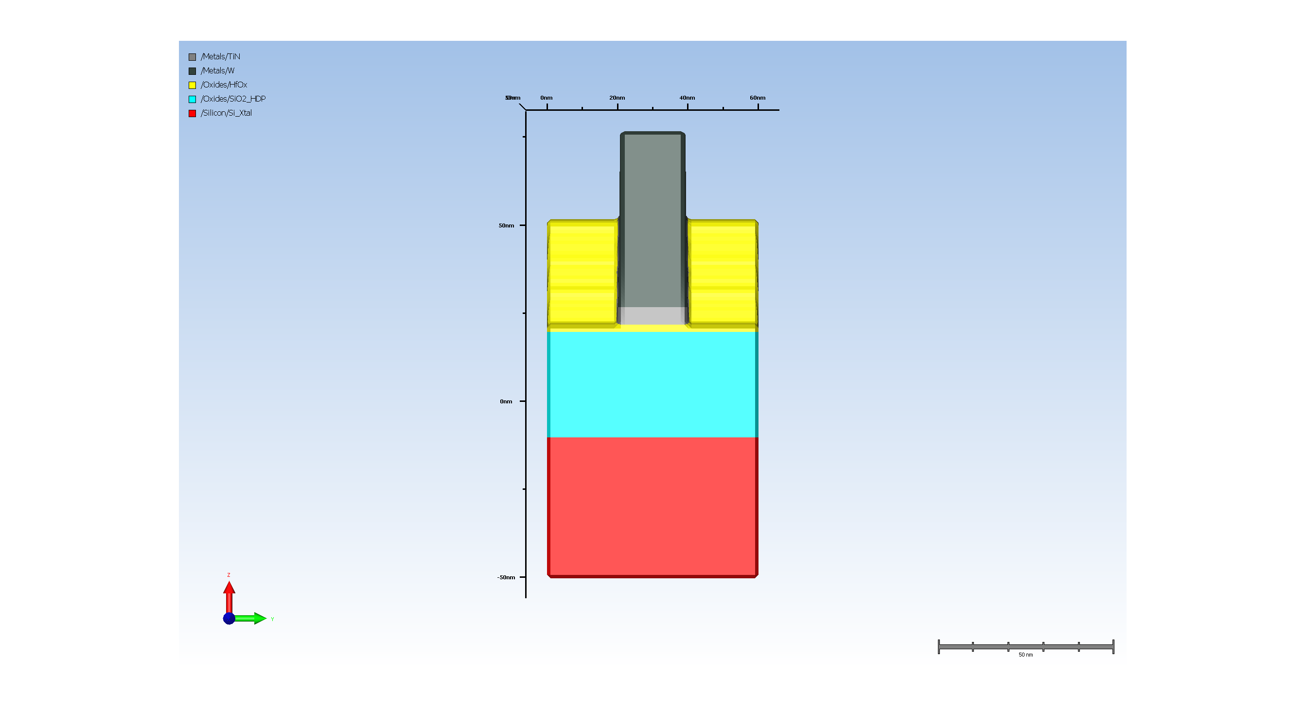
4. Gate metal pattern

Slide 5
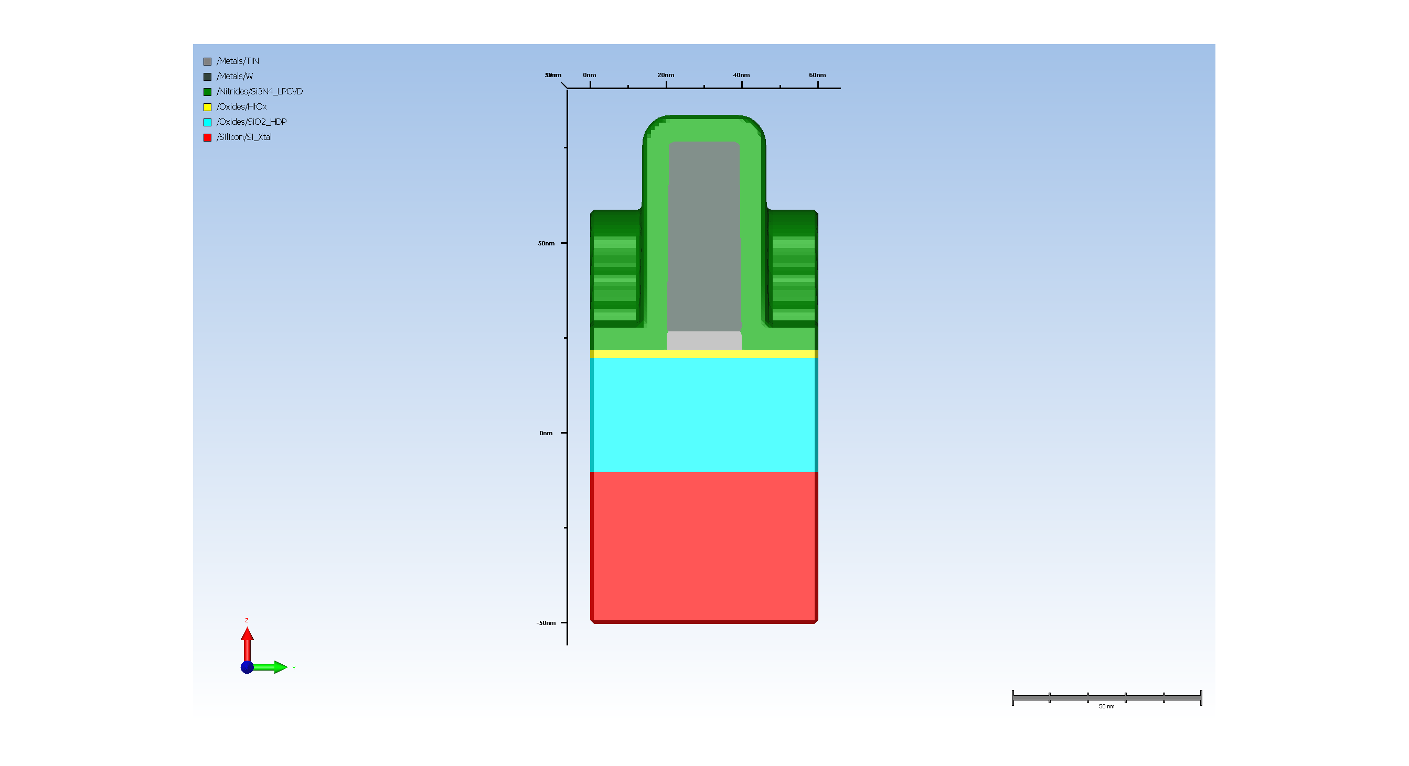
5.1. Spacer deposition

Slide 6
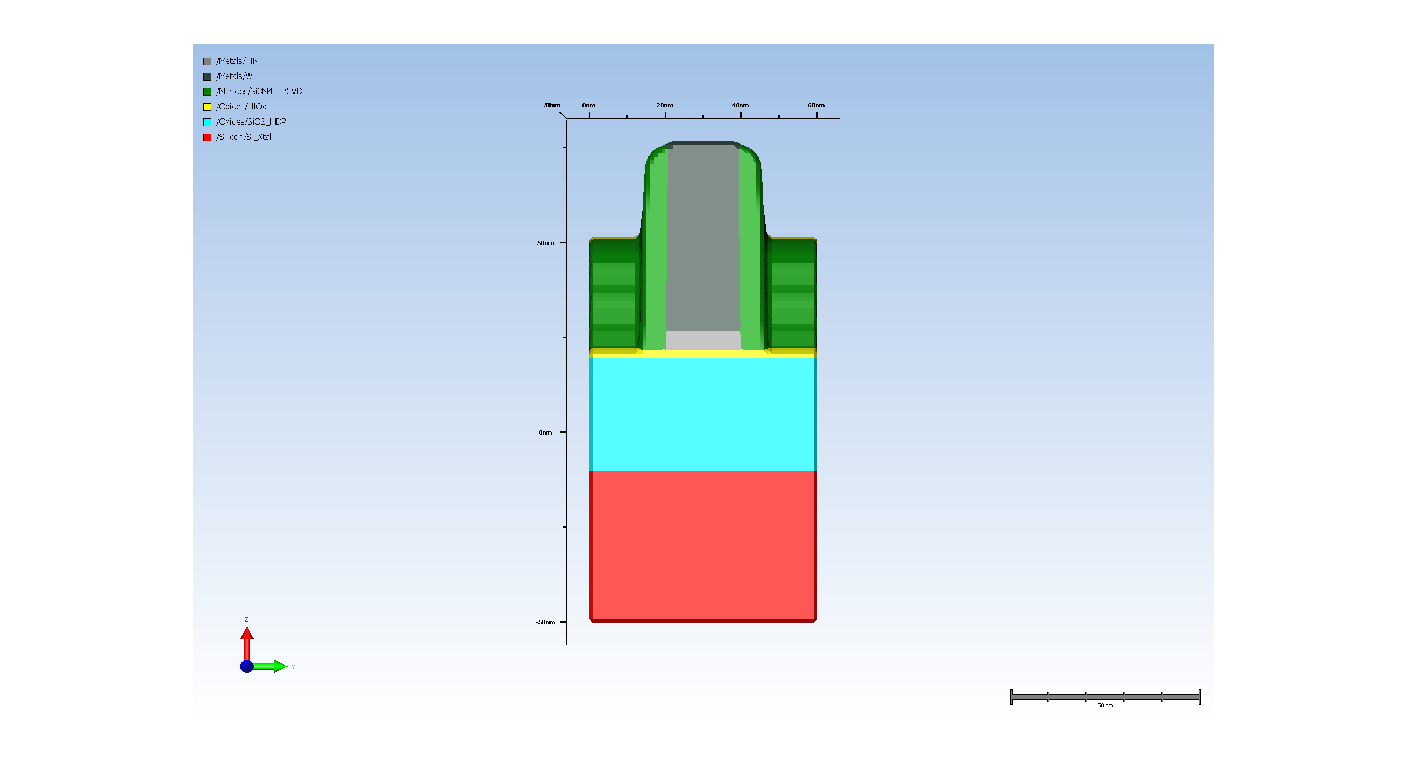
5.2. spacer Etch

Slide 7
A-1. Cal_width_spacer
Metrology results:
CD measurement at (54.999999999999986, 0.0, 54.999999999999986, 37.99999999999999):
cd_width = 7.011719

Slide 8
A-2. Cal_inflection_spacer
Metrology results:
CD measurement at (54.999999999999986, 0.0, 54.999999999999986, 37.99999999999999):
cd_inflection_5 = 6.972015

Slide 9
A-3. Cal_inflection_spacer
Metrology results:
CD measurement at (54.999999999999986, 0.0, 54.999999999999986, 37.99999999999999):
cd_inflection_10 = 6.902577

Slide 10
A-4. Cal_inflection_spacer
Metrology results:
CD measurement at (54.999999999999986, 0.0, 54.999999999999986, 37.99999999999999):
cd_inflection_15 = 6.745773

Slide 11
A-5. Cal_inflection_spacer
Metrology results:
CD measurement at (54.999999999999986, 0.0, 54.999999999999986, 37.99999999999999):
cd_inflection_20 = 6.738281

Slide 12
A-6. Cal_inflection_spacer
Metrology results:
CD measurement at (54.999999999999986, 0.0, 54.999999999999986, 37.99999999999999):
cd_inflection_25 = 6.732538

Slide 13
A-7. Cal_inflection_spacer
Metrology results:
CD measurement at (54.999999999999986, 0.0, 54.999999999999986, 37.99999999999999):
cd_inflection_30 = 6.718109

Slide 14
A-8. Cal_inflection_spacer
Metrology results:
CD measurement at (54.999999999999986, 0.0, 54.999999999999986, 37.99999999999999):
cd_inflection_35 = 6.703679

Slide 15
A-9. Cal_inflection_spacer
Metrology results:
CD measurement at (54.999999999999986, 0.0, 54.999999999999986, 37.99999999999999):
cd_inflection_40 = 6.689249

Slide 16
A-10. Cal_inflection_spacer
Metrology results:
CD measurement at (54.999999999999986, 0.0, 54.999999999999986, 37.99999999999999):
cd_inflection_45 = 6.673857

Slide 17
A-11. Cal_inflection_spacer
Metrology results:
CD measurement at (54.999999999999986, 0.0, 54.999999999999986, 37.99999999999999):
cd_inflection_50 = 6.649137

Slide 18
A-12. Cal_inflection_spacer
Metrology results:
CD measurement at (54.999999999999986, 0.0, 54.999999999999986, 37.99999999999999):
cd_inflection_55 = 6.625379

Slide 19
A-13. Cal_inflection_spacer
Metrology results:
CD measurement at (54.999999999999986, 0.0, 54.999999999999986, 37.99999999999999):
cd_inflection_60 = 6.588619

Slide 20
A-14. Cal_inflection_spacer
Metrology results:
CD measurement at (54.999999999999986, 0.0, 54.999999999999986, 37.99999999999999):
cd_inflection_65 = 6.546088

Slide 21
A-15. Cal_inflection_spacer
Metrology results:
CD measurement at (54.999999999999986, 0.0, 54.999999999999986, 37.99999999999999):
cd_inflection_70 = 6.451959

Slide 22
A-16. Cal_inflection_spacer
Metrology results:
CD measurement at (54.999999999999986, 0.0, 54.999999999999986, 37.99999999999999):
cd_inflection_75 = 6.376195

Slide 23
A-17. Cal_inflection_spacer
Metrology results:
CD measurement at (54.999999999999986, 0.0, 54.999999999999986, 37.99999999999999):
cd_inflection_80 = 6.275944

Slide 24
A-18. Cal_inflection_spacer
Metrology results:
CD measurement at (54.999999999999986, 0.0, 54.999999999999986, 37.99999999999999):
cd_inflection_85 = 6.132113

Slide 25
A-19. Cal_inflection_spacer
Metrology results:
CD measurement at (54.999999999999986, 0.0, 54.999999999999986, 37.99999999999999):
cd_inflection_90 = 5.918727

Slide 26
A-20. Cal_inflection_spacer
Metrology results:
CD measurement at (54.999999999999986, 0.0, 54.999999999999986, 37.99999999999999):
cd_inflection_95 = 4.983500

Slide 27
A-21. Cal_thickness_spacer
Metrology results:
Film thickness measurement for ('/Nitrides/Si3N4_LPCVD',) at (55.000000,19.000000):
thickness_spacer = 53.834025

