Slide 1
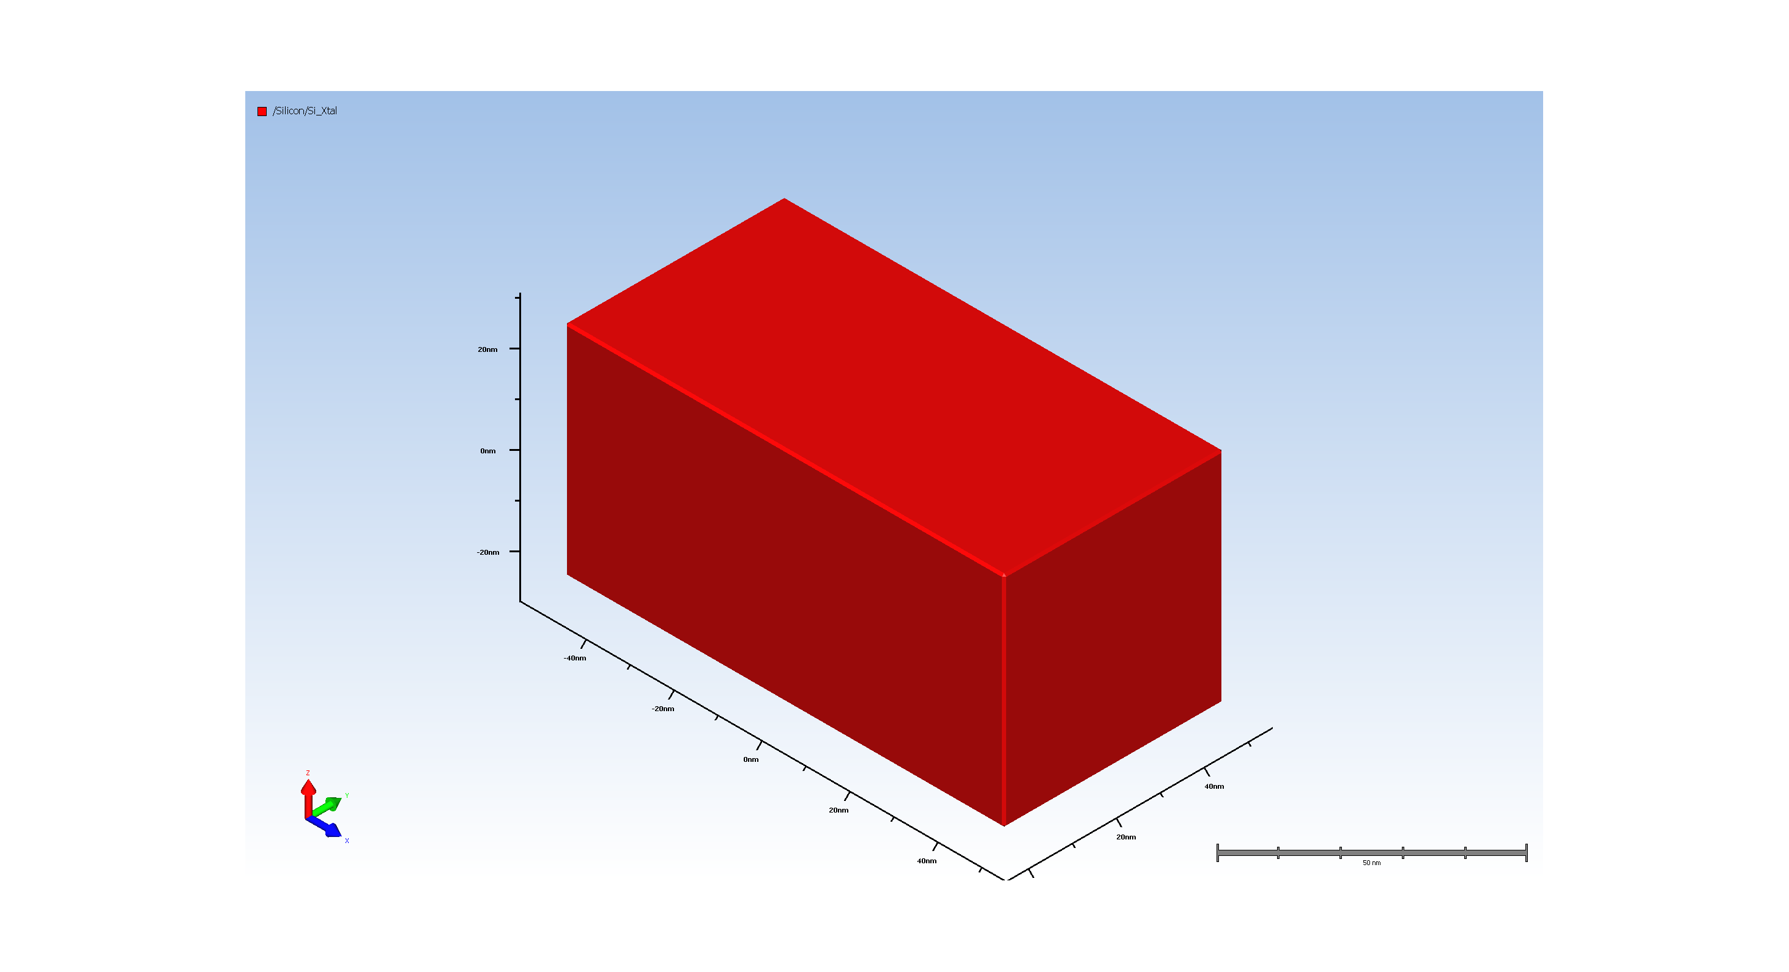
1. Wafer Setup

Slide 2
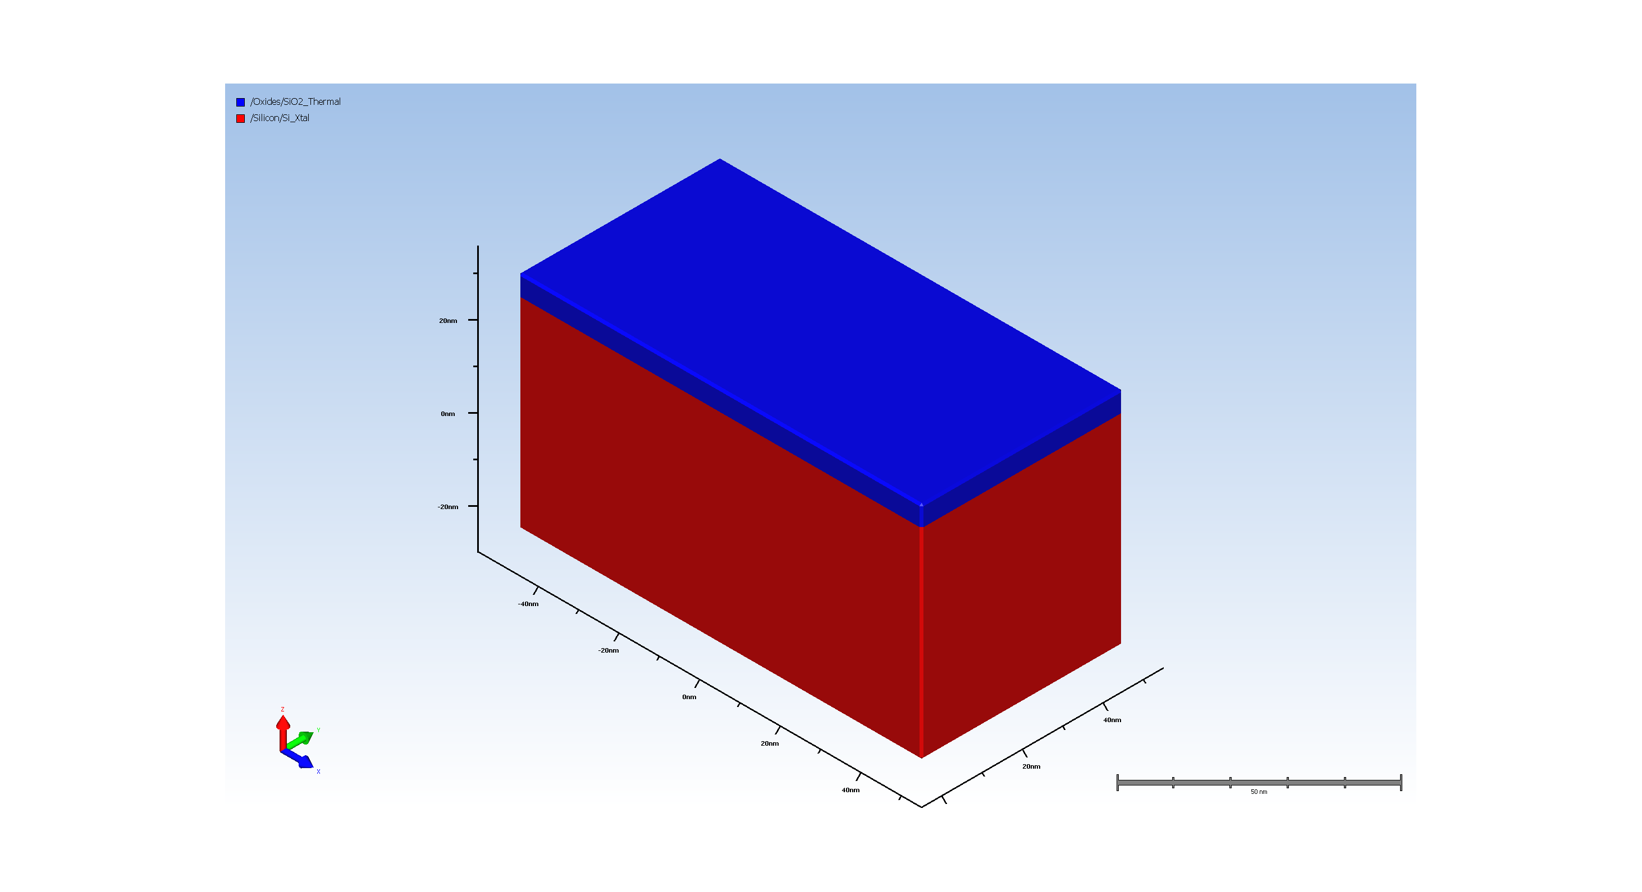
2. Pad Oxide Deposition

Slide 3
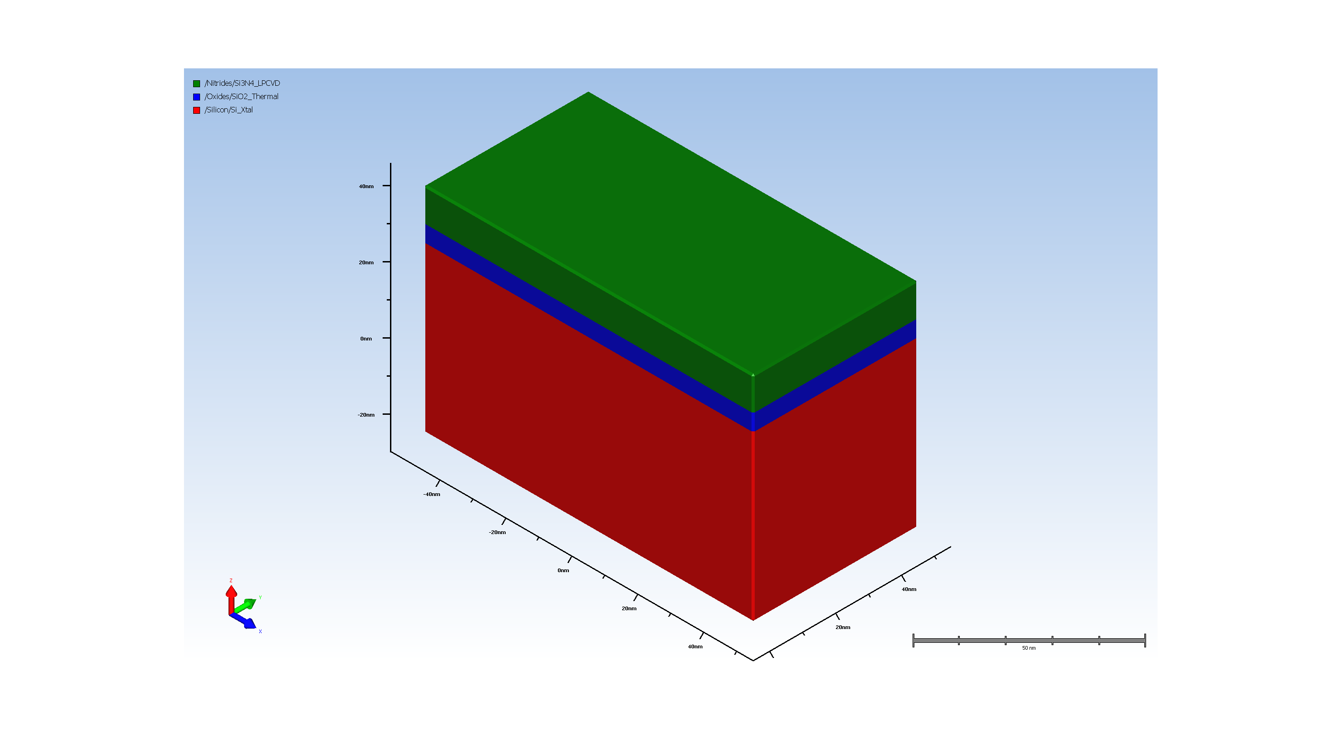
3. SiN hardmask

Slide 4
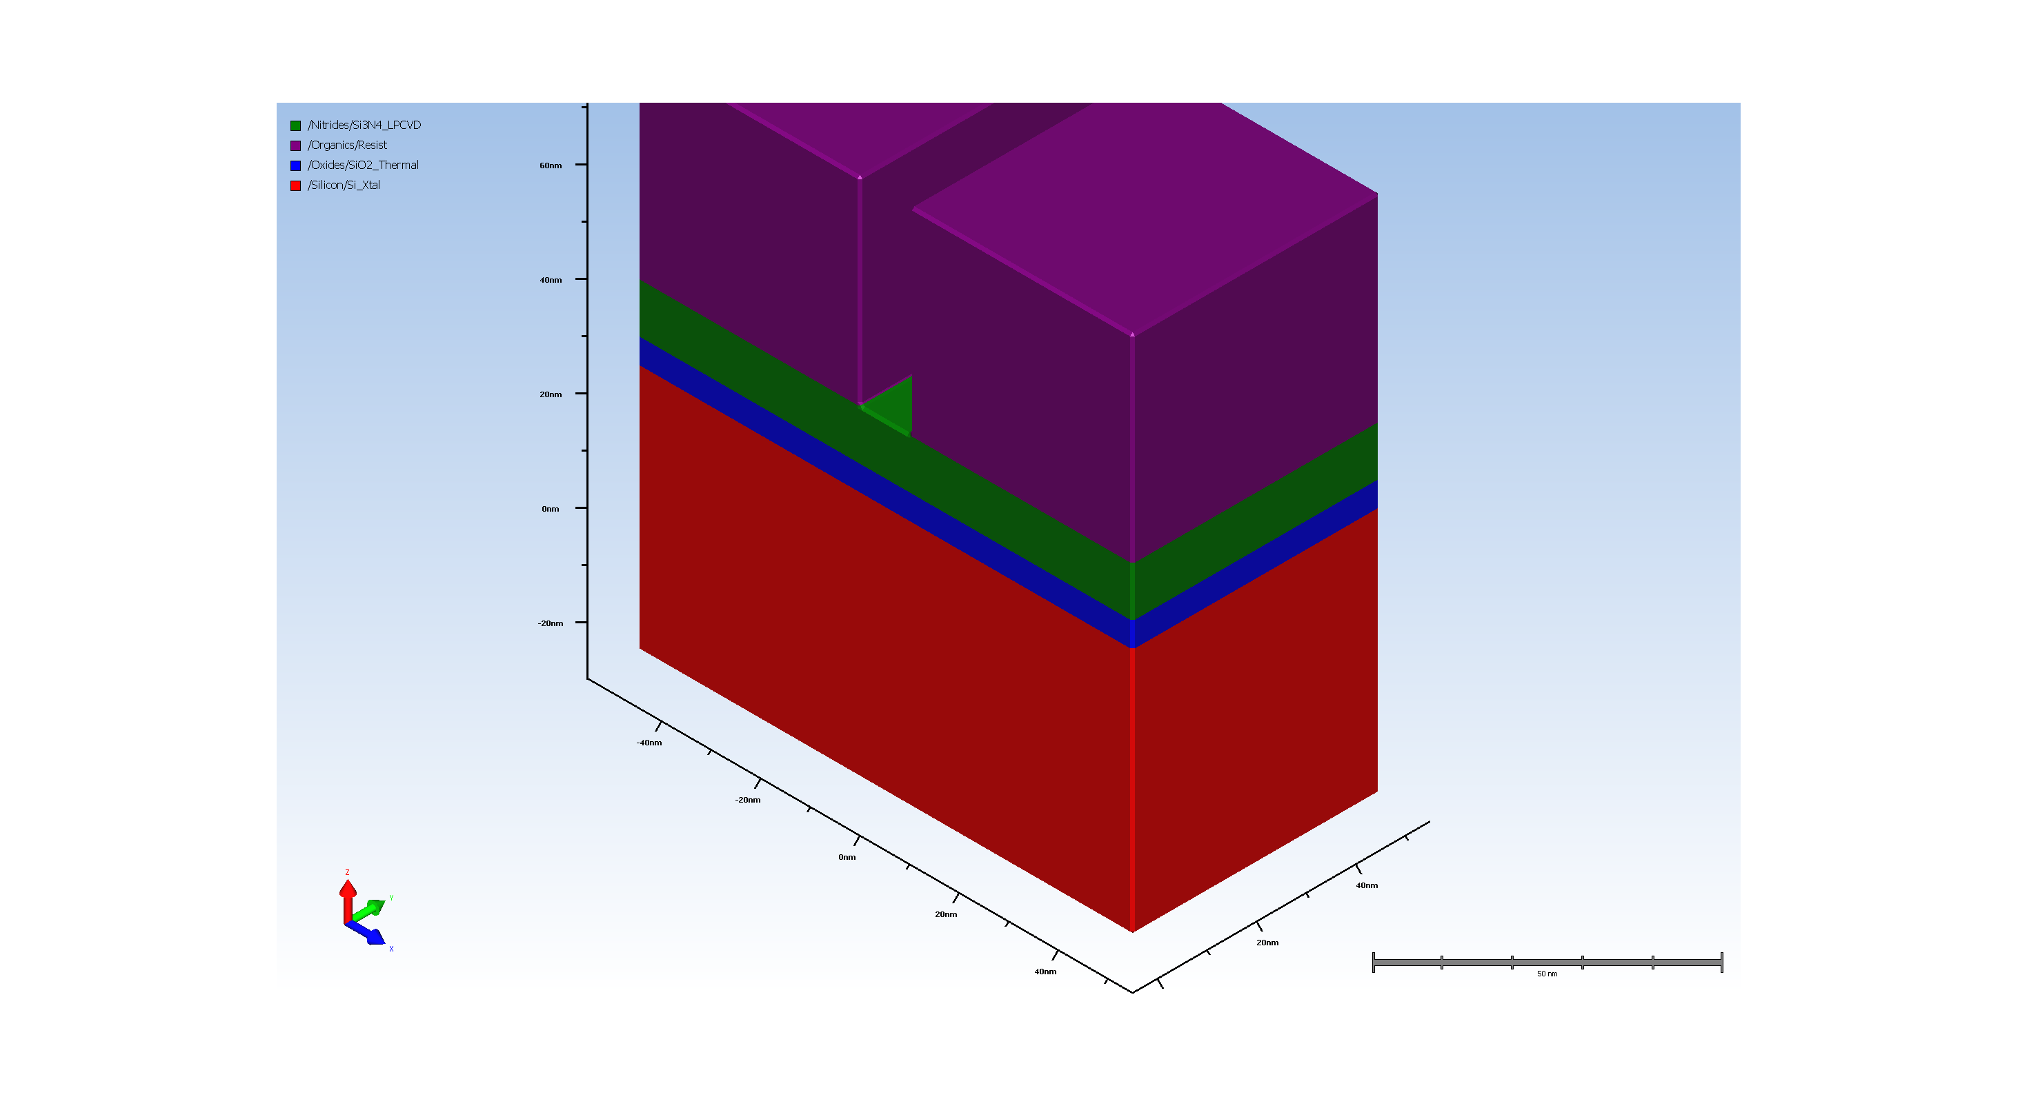
4. STI_Trench_Lithography

Slide 5
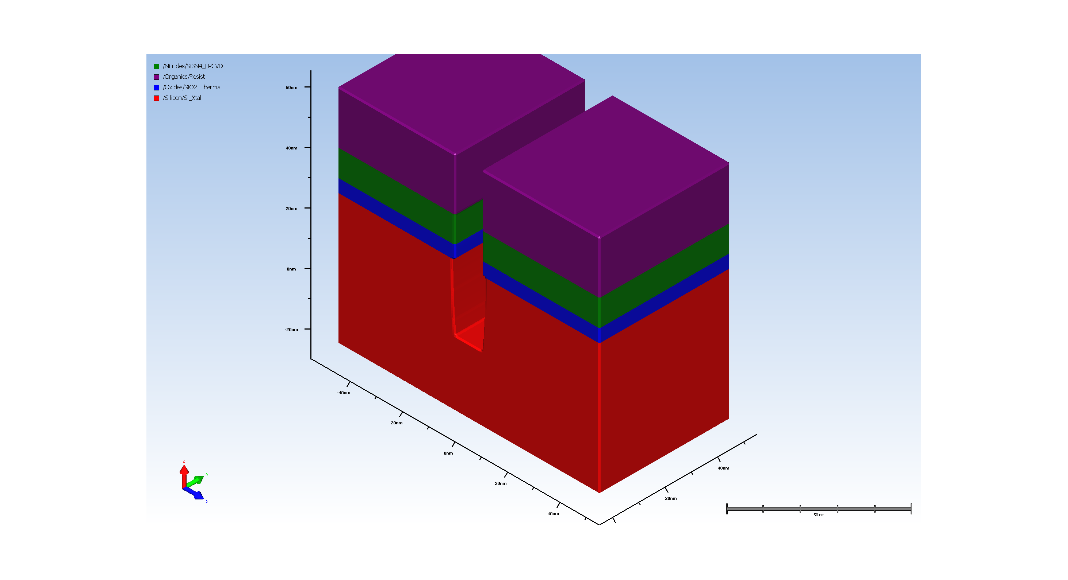
5. Etching trench

Slide 6

6. resist removal

Slide 7
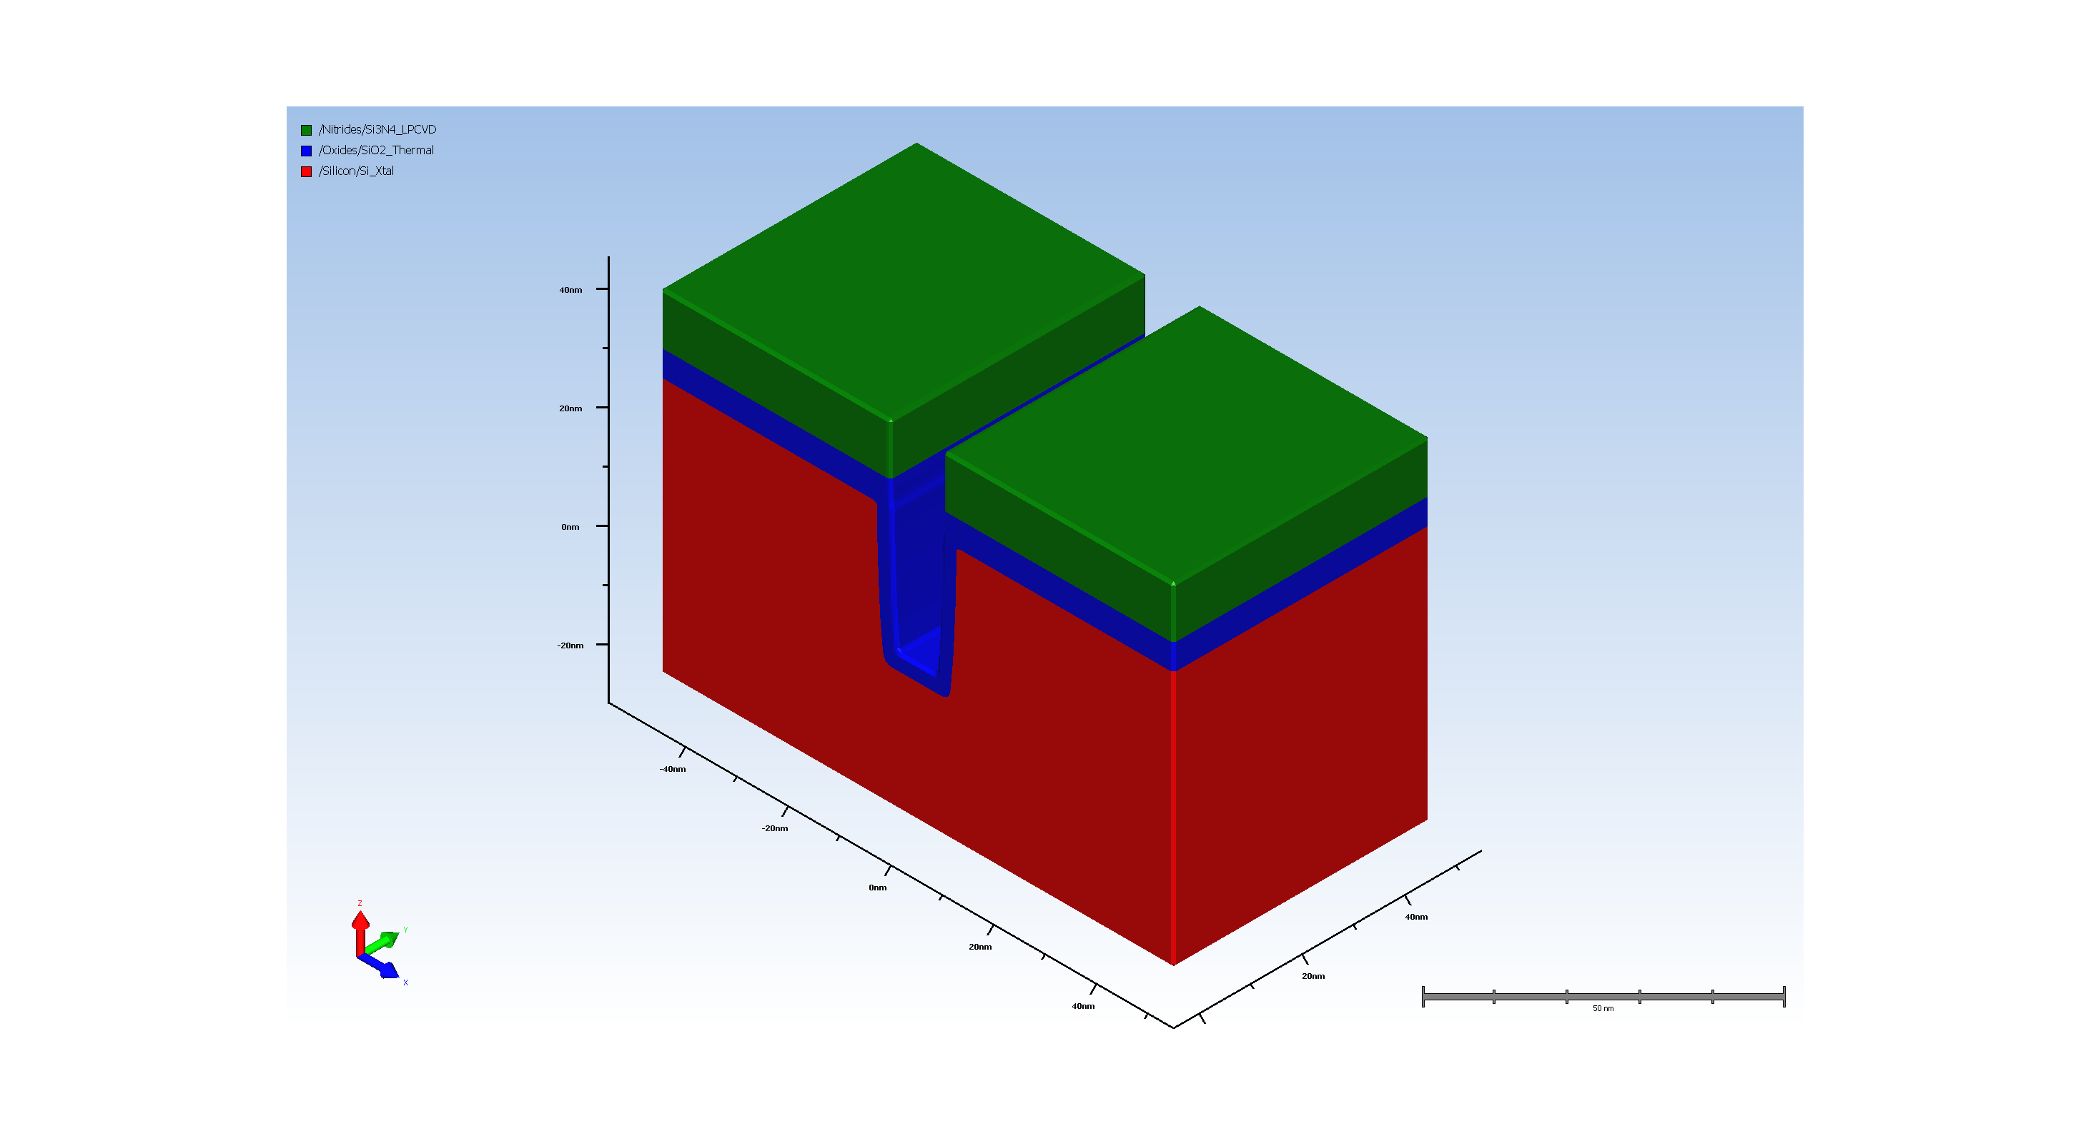
7. Thermal Oxidation of opened trench

Slide 8
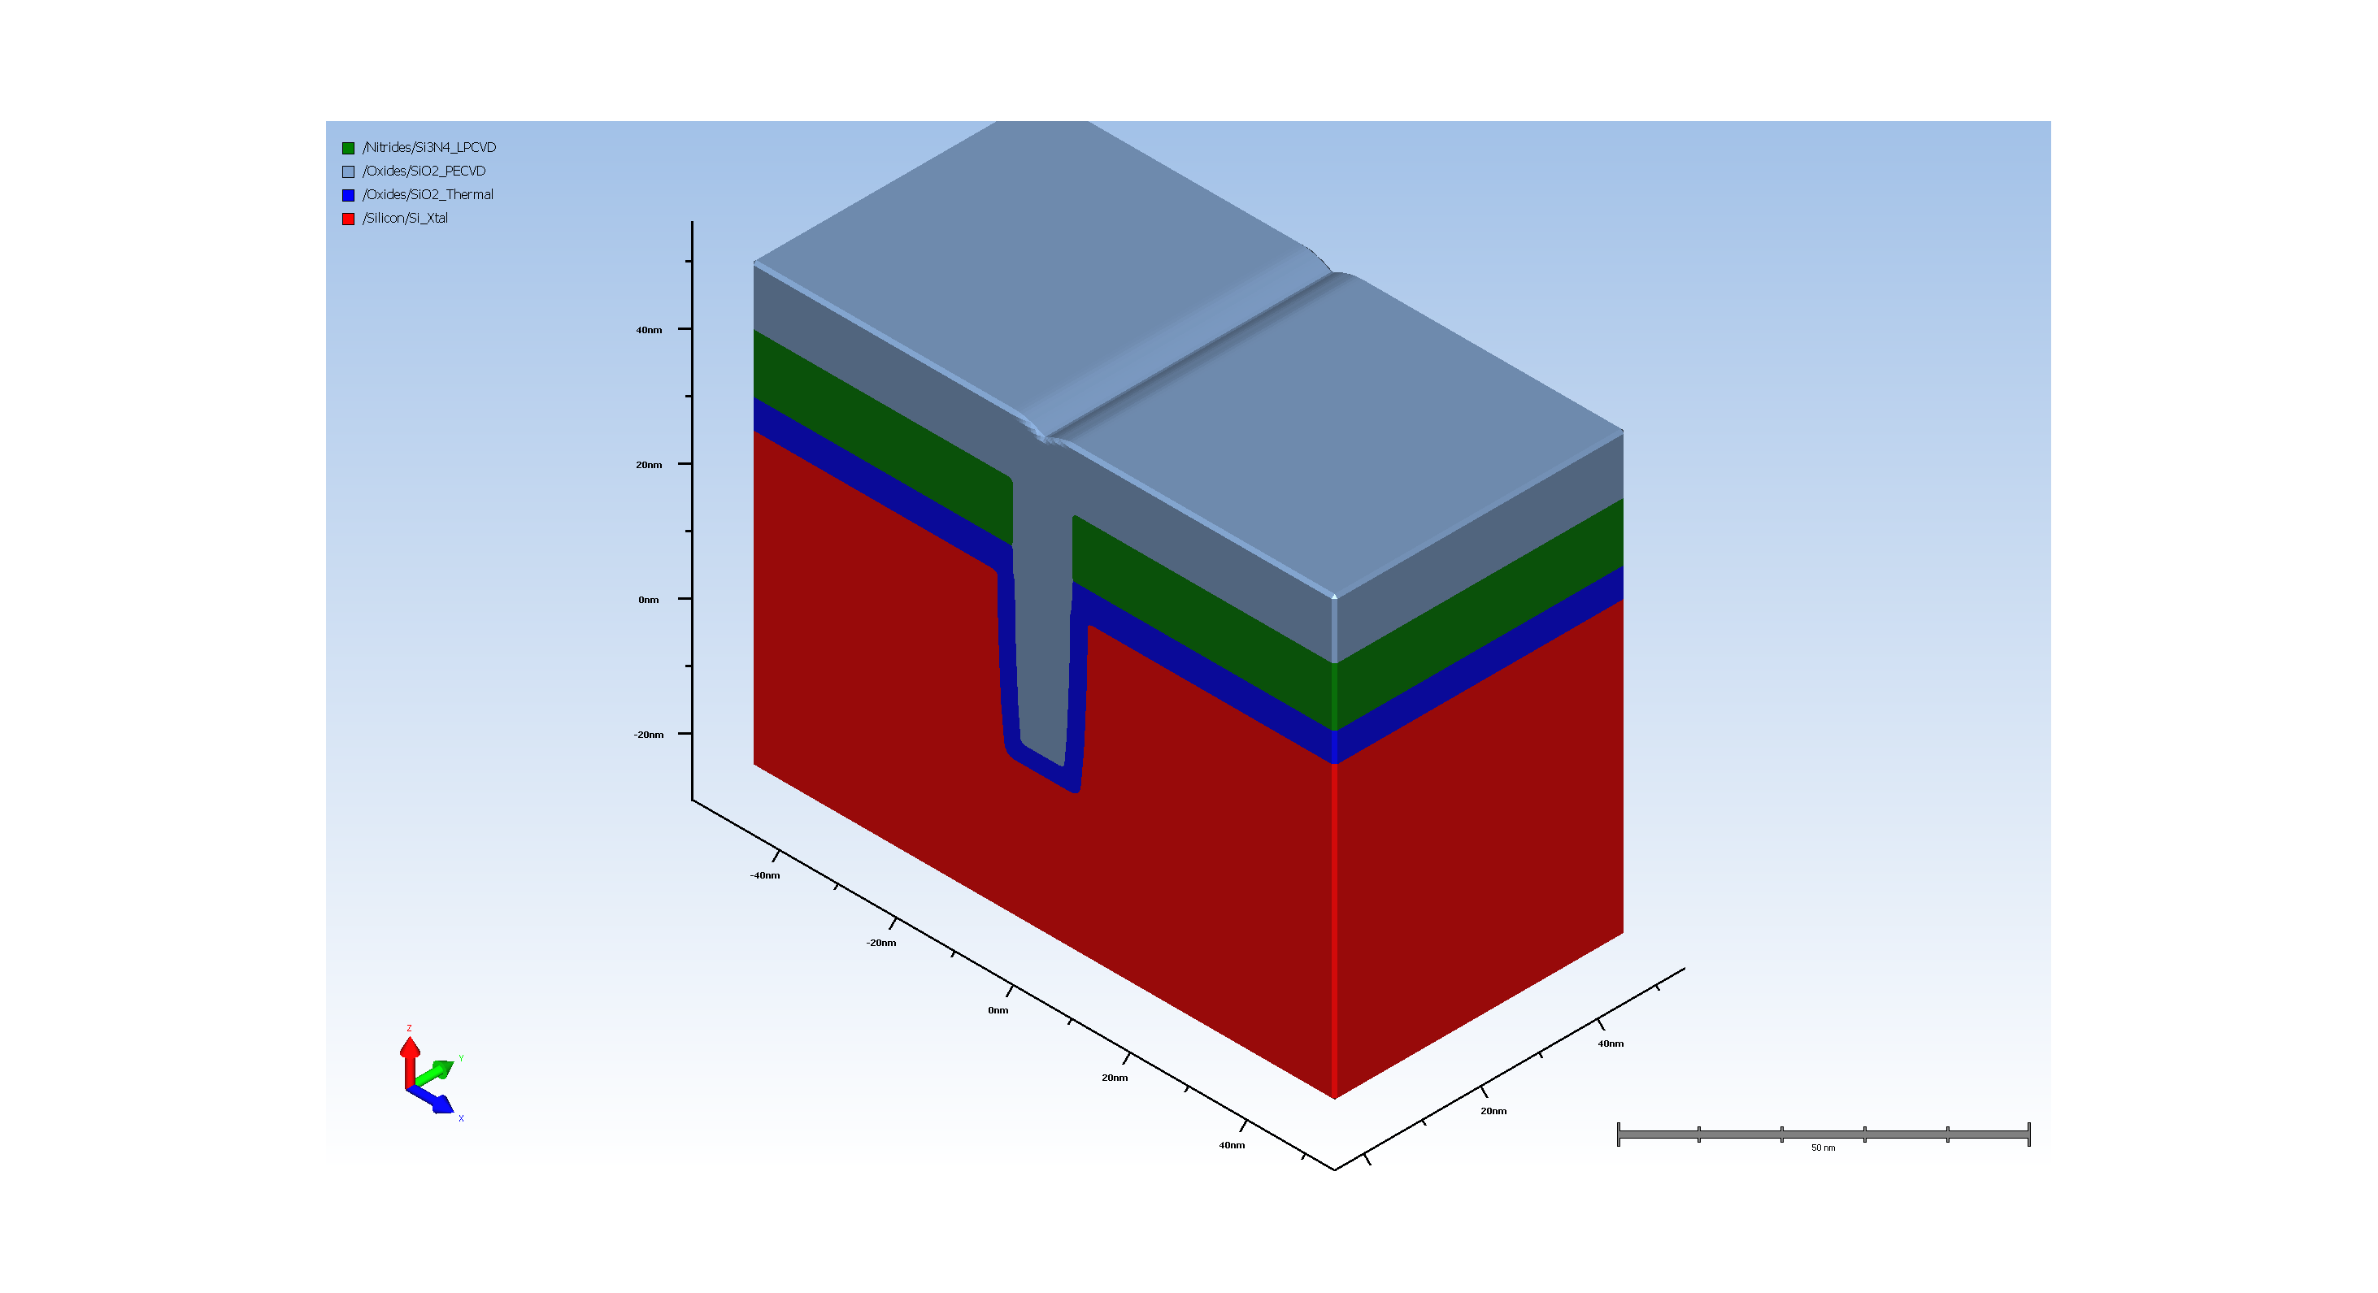
8. Filling trench with CVD oxide

Slide 9
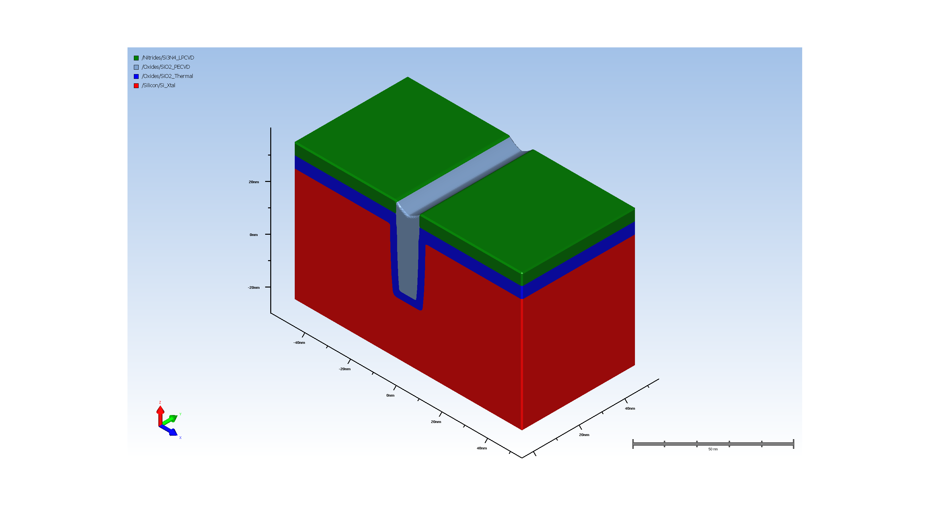
9. STI oxide CMP

Slide 10
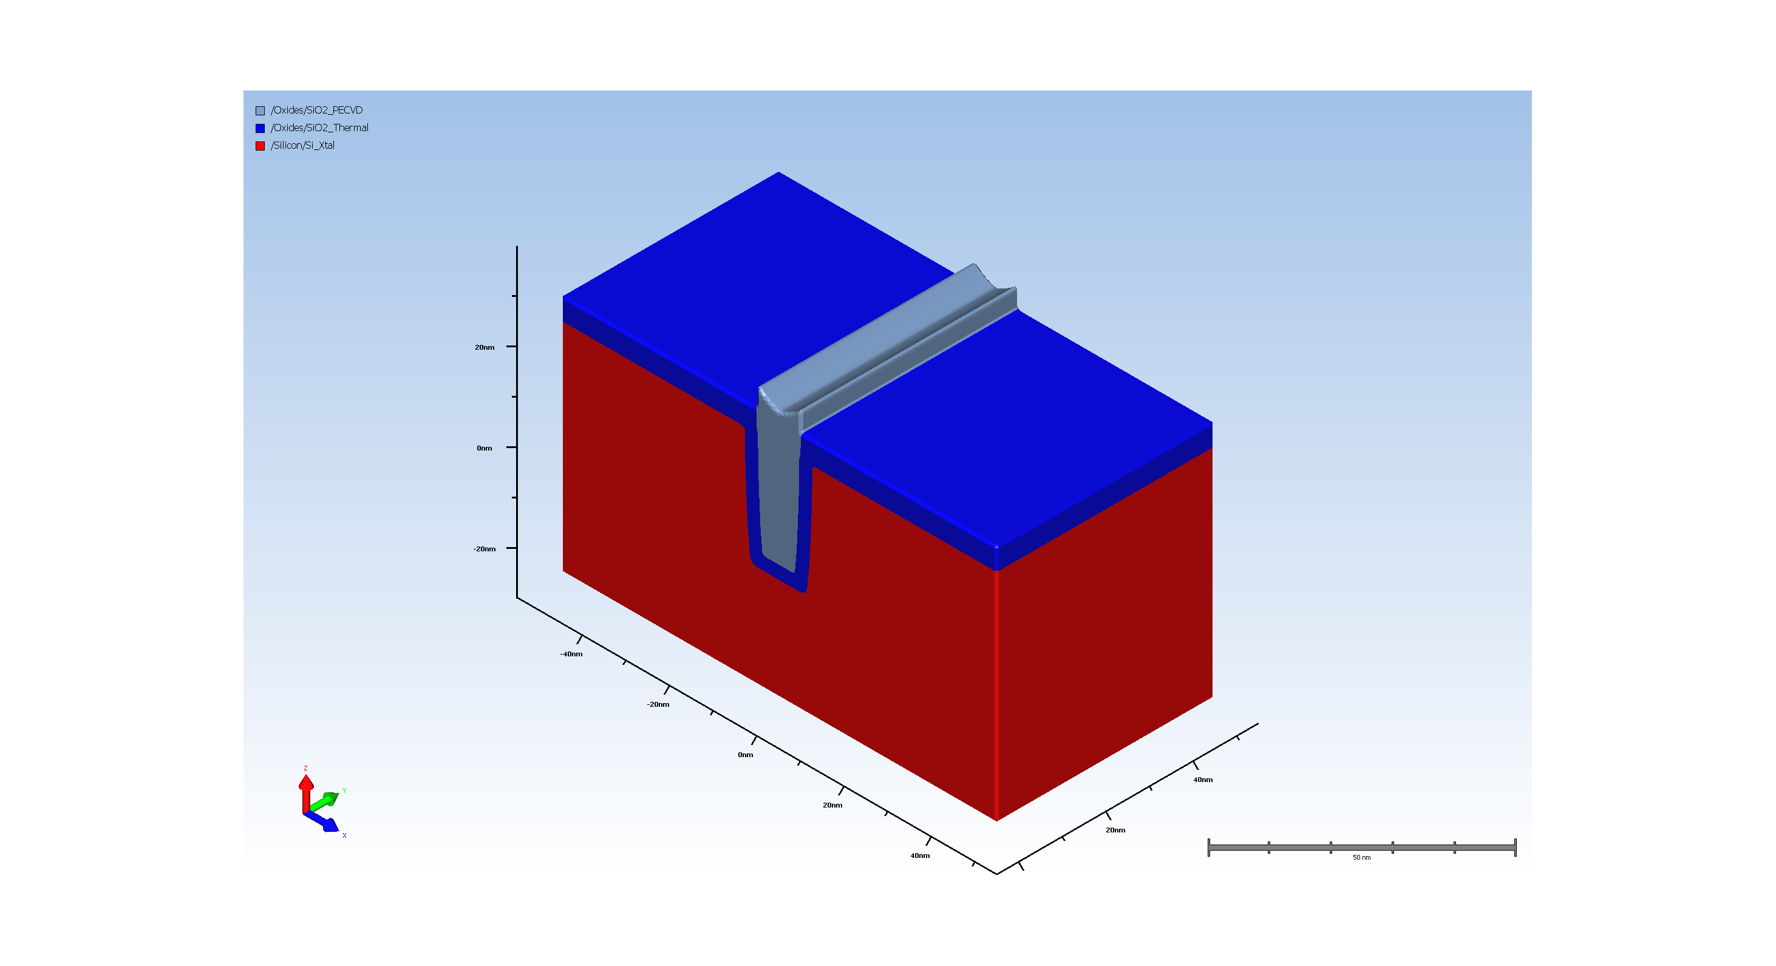
10. Removal of SiN hard mask

Slide 11
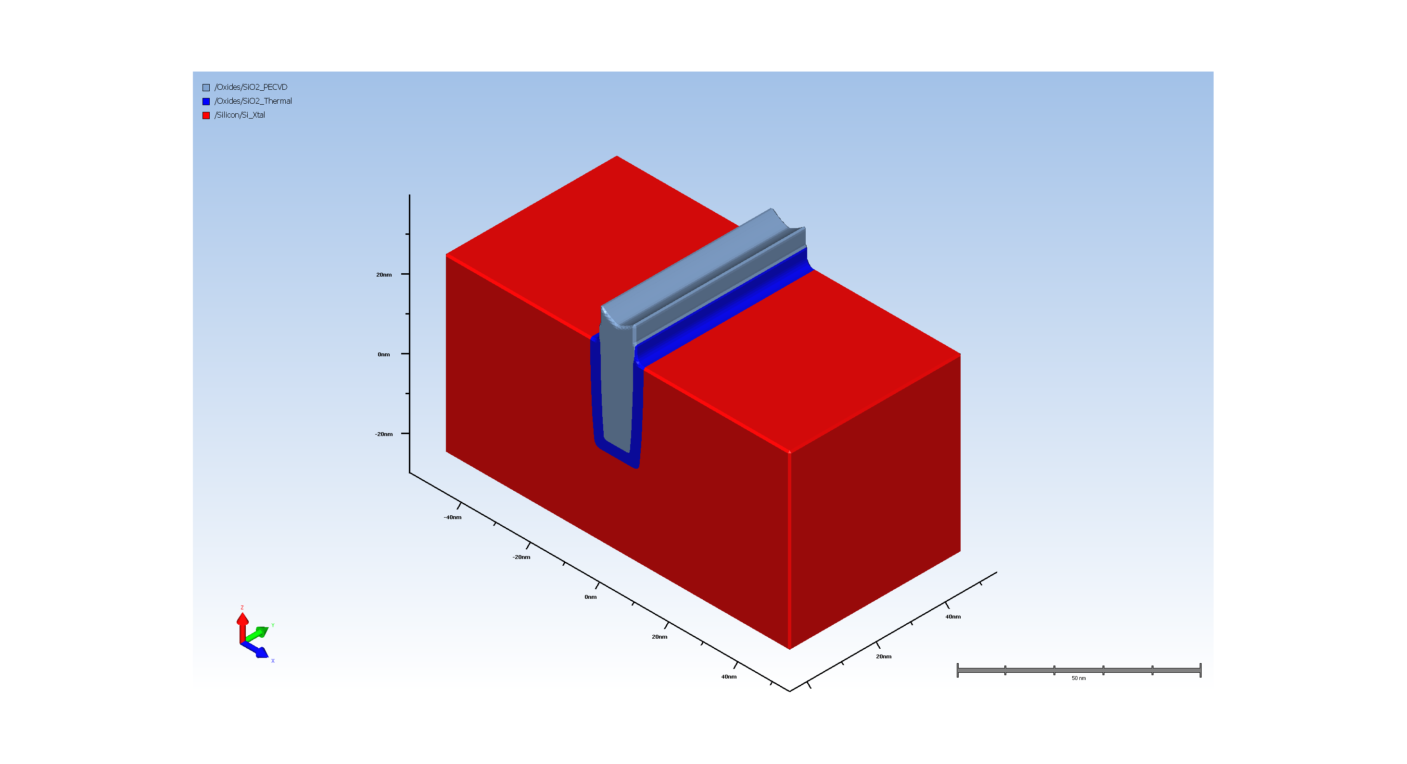
11. Pad_oxide ramoval
Unknown Step Properties:
name: hdm
Num. of attributes: 3
VersionNumber : 12.2.0.0
uiHidden : true
uiHideChildNodes : true
name: simultaneousDeposit
Num. of attributes: 1
isEnable : false
name: depositMaterial
Num. of attributes: 3
VersionNumber : 12.2.0.0
readonly : true
uiHideChildNodes : true
name: depositRatio
Num. of attributes: 5
___expression :
___lastKnownValue : nan.0
___unitConversionExpr :
___unitName : nounit
readonly : true
name: depositIsotropicRatio
Num. of attributes: 5
___expression : 0
___lastKnownValue : 0.0
___unitConversionExpr :
___unitName : nounit
readonly : true
name: depositLateralRatio
Num. of attributes: 5
___expression : 1
___lastKnownValue : 1.0
___unitConversionExpr :
___unitName : nounit
readonly : true
name: depositSourceSigma
Num. of attributes: 5
___expression : 100.0
___lastKnownValue : 100.0
___unitConversionExpr :
___unitName : nounit
readonly : true
name: depositTransport
Num. of attributes: 2
isEnable : false
readonly : true
name: conformality
Num. of attributes: 5
___expression : 0.1
___lastKnownValue : 0.1
___unitConversionExpr :
___unitName : nounit
readonly : true
name: depositTiltAndTwist
Num. of attributes: 2
___activeMember : sameAsEtch
readonly : true
name: sameAsEtch
Num. of attributes: 2
isEnable : true
readonly : true
name: fixed
Num. of attributes: 1
isEnable : true
name: tilt
Num. of attributes: 4
___expression : 0
___lastKnownValue : 0.0
___unitConversionExpr :
___unitName : nounit
name: twist
Num. of attributes: 4
___expression : 0
___lastKnownValue : 0.0
___unitConversionExpr :
___unitName : nounit
name: rotating
Num. of attributes: 1
isEnable : true
name: tilt
Num. of attributes: 4
___expression : 0
___lastKnownValue : 0.0
___unitConversionExpr :
___unitName : nounit
name: transport
Num. of attributes: 1
isEnable : false
name: conformality
Num. of attributes: 5
___expression : 0.1
___lastKnownValue : 0.1
___unitConversionExpr :
___unitName : nounit
readonly : true

Slide 12
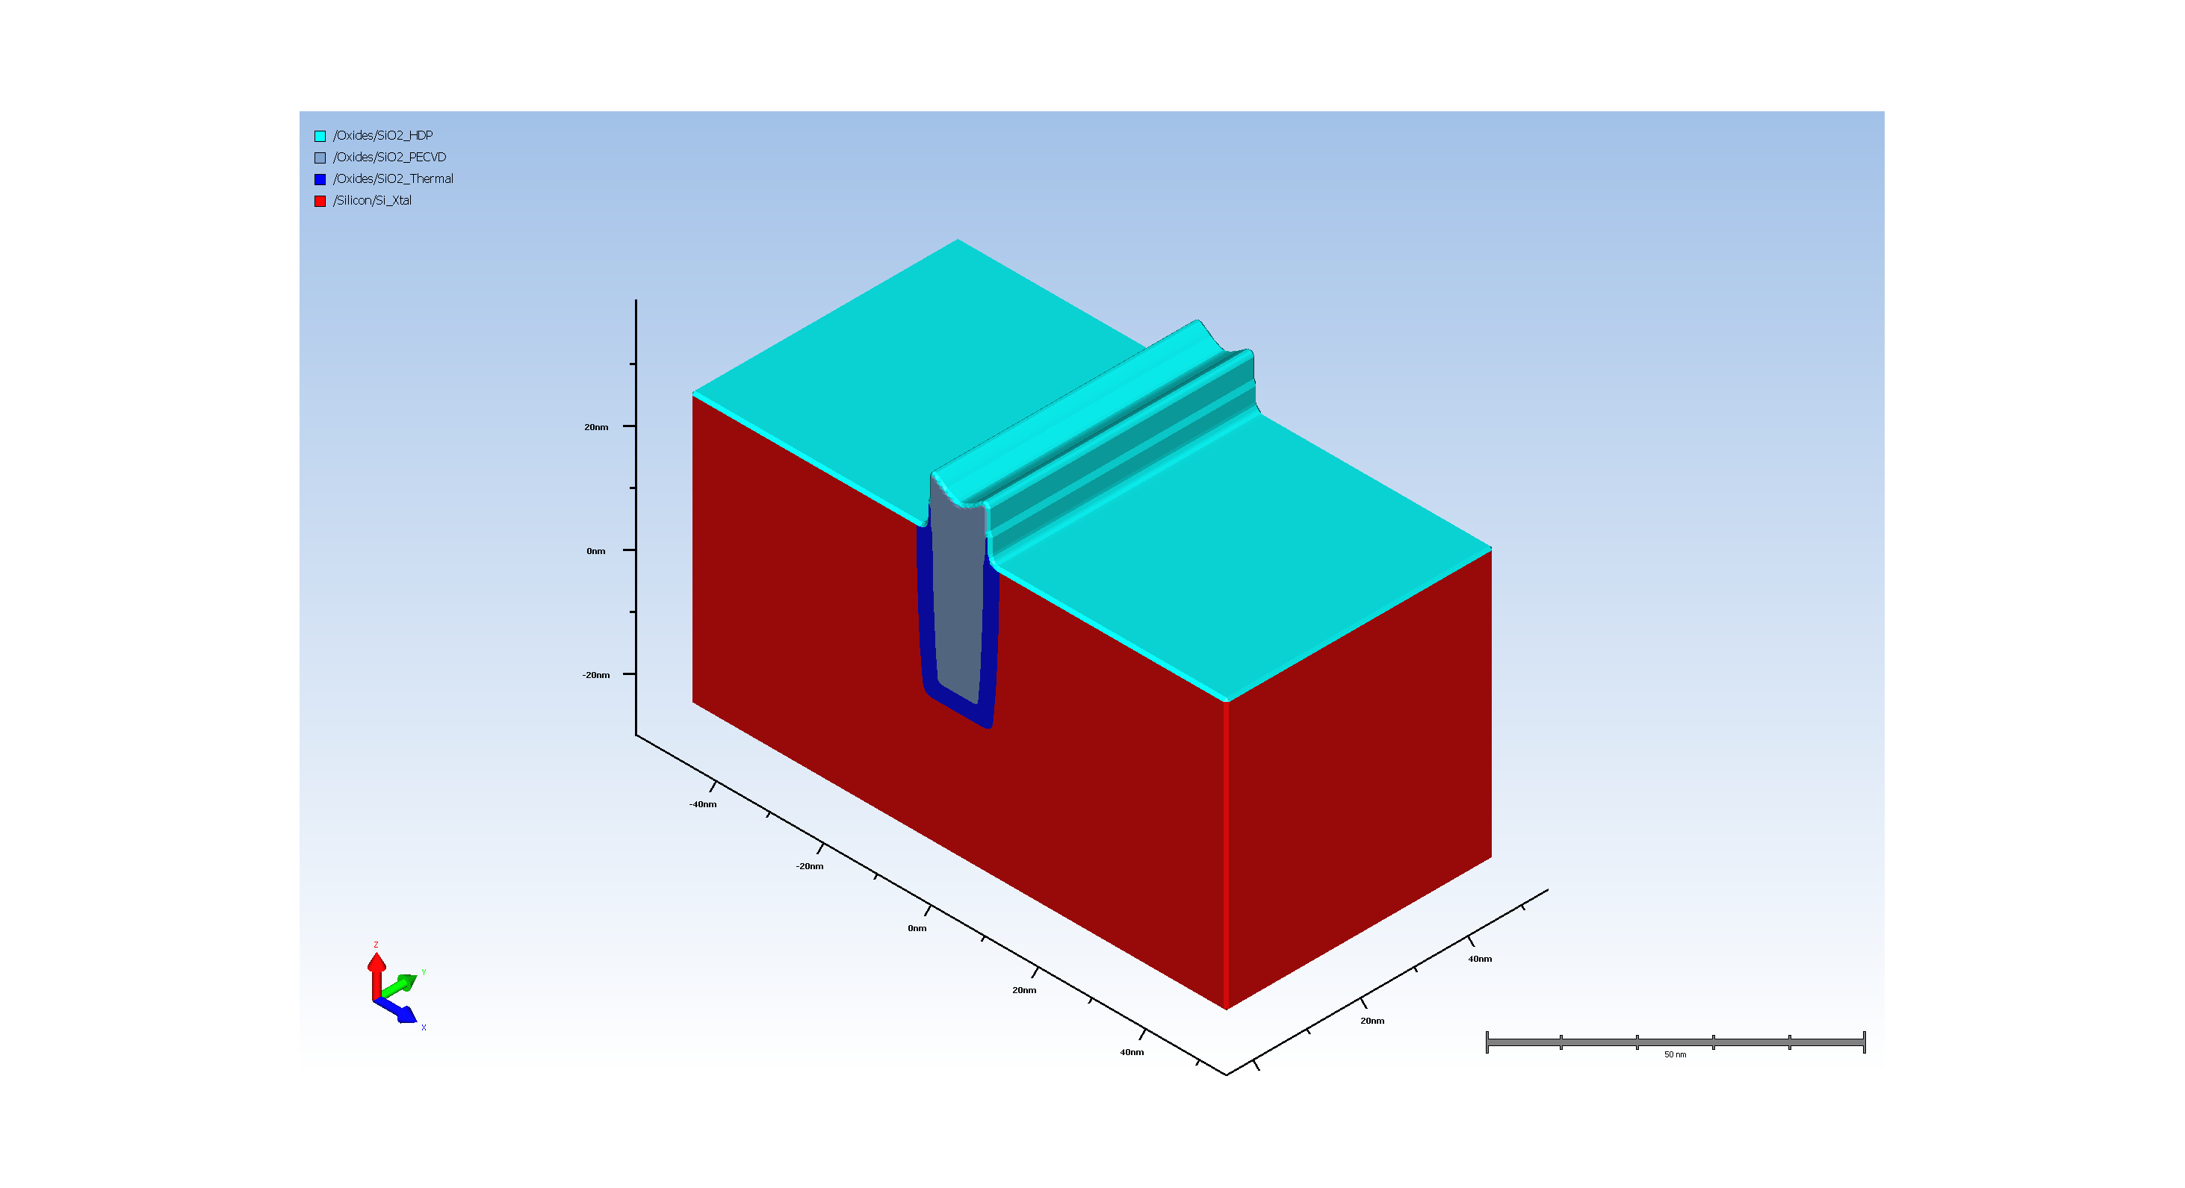
12. Gate oxide deposition

Slide 13
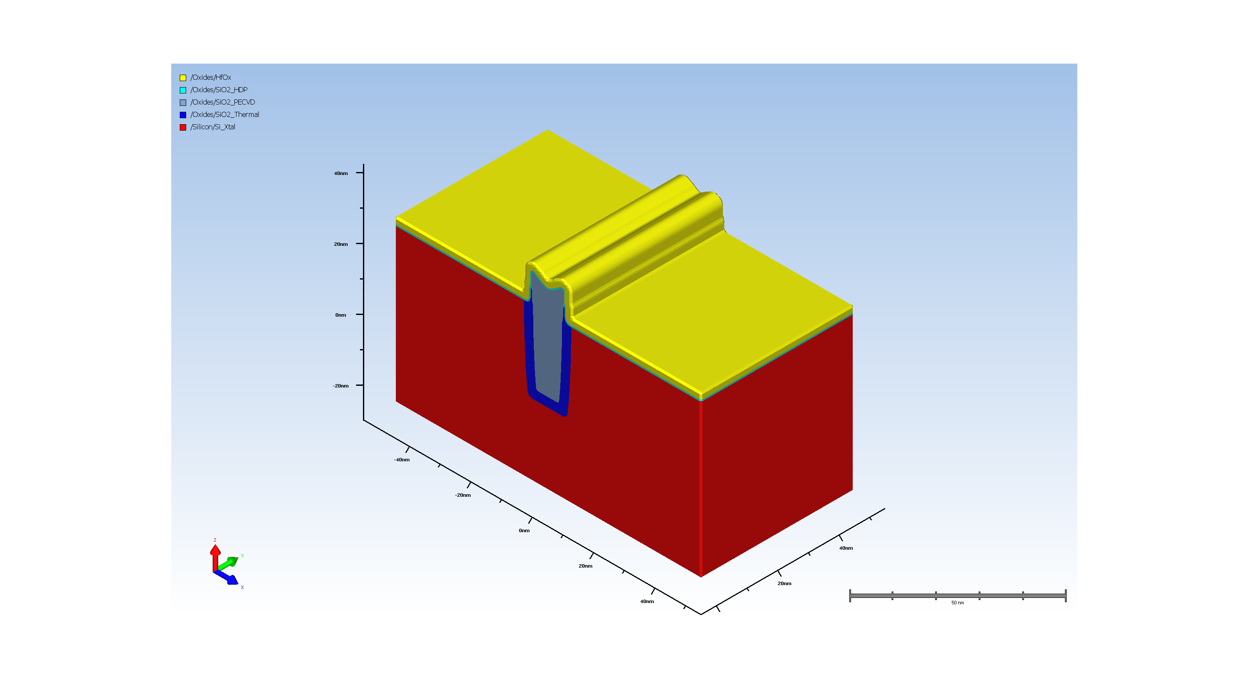
13. High k deposition for Gate

Slide 14
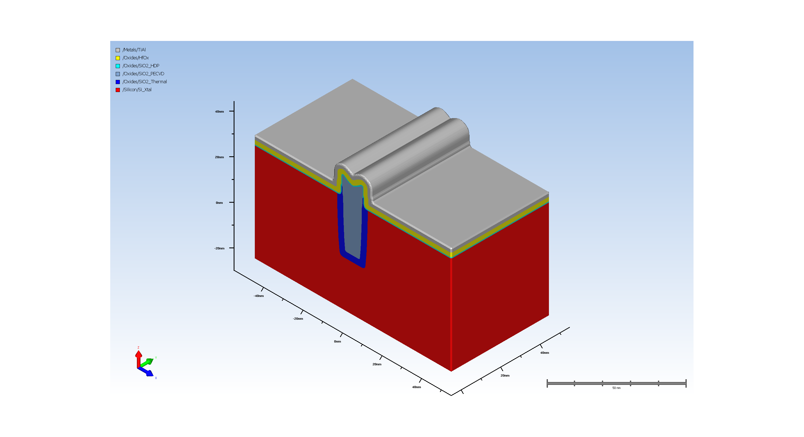
14. NMOS gate metal

Slide 15
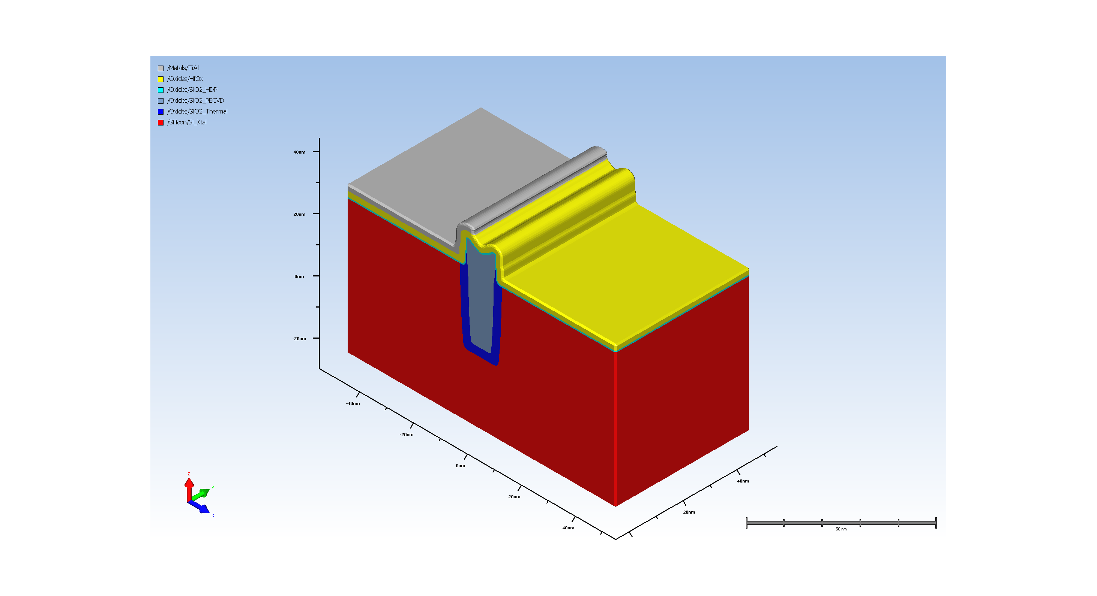
15. gate patterning

Slide 16
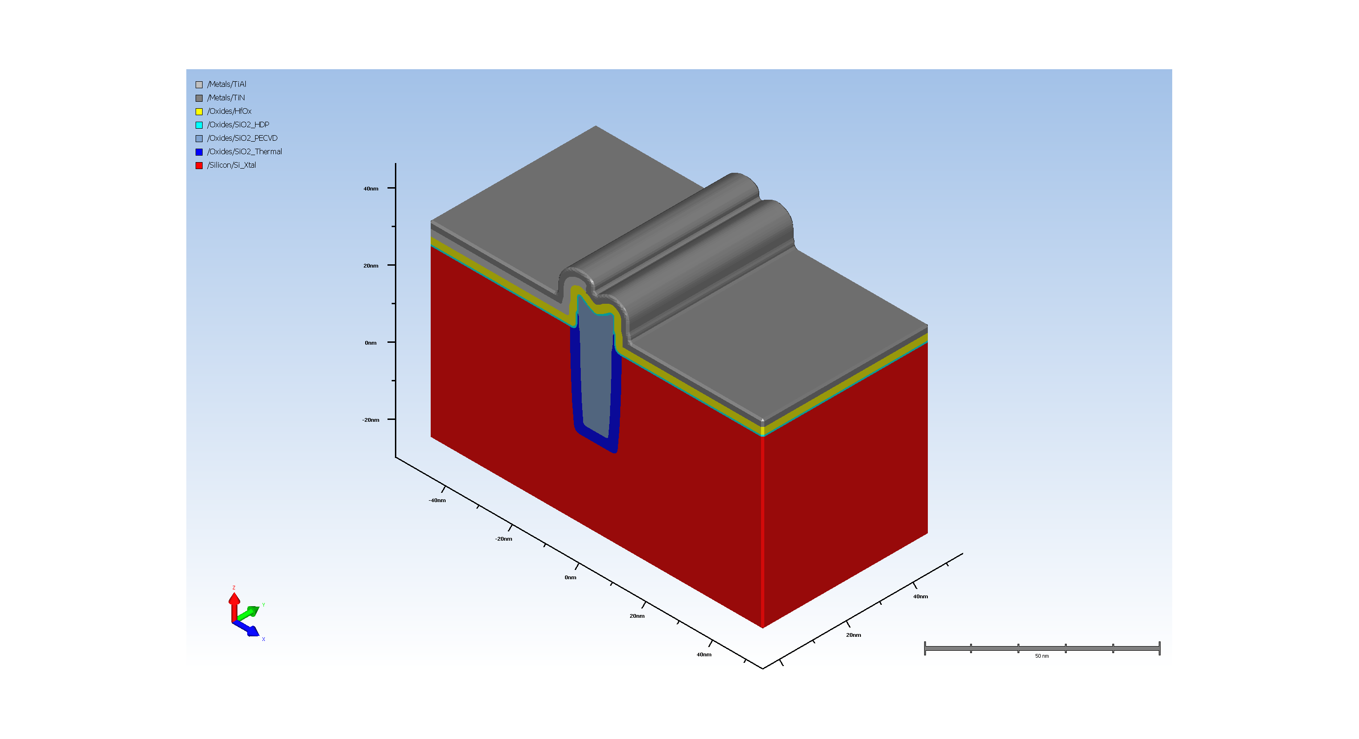
16. gate metal deposition

Slide 17
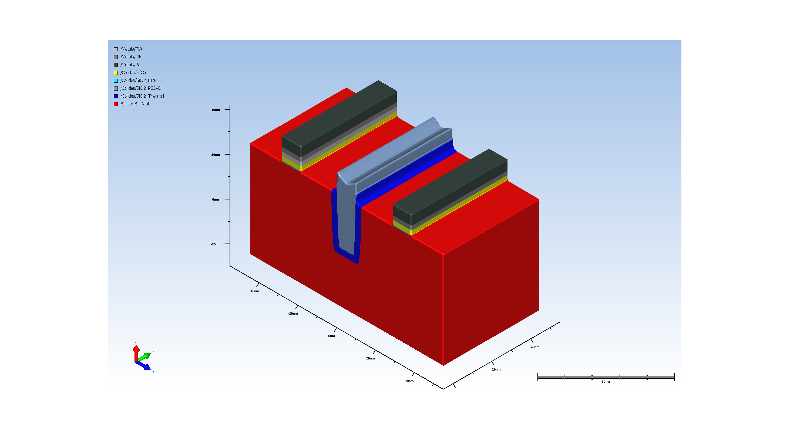
17. NMOS PMOS gates final pattern

Slide 18
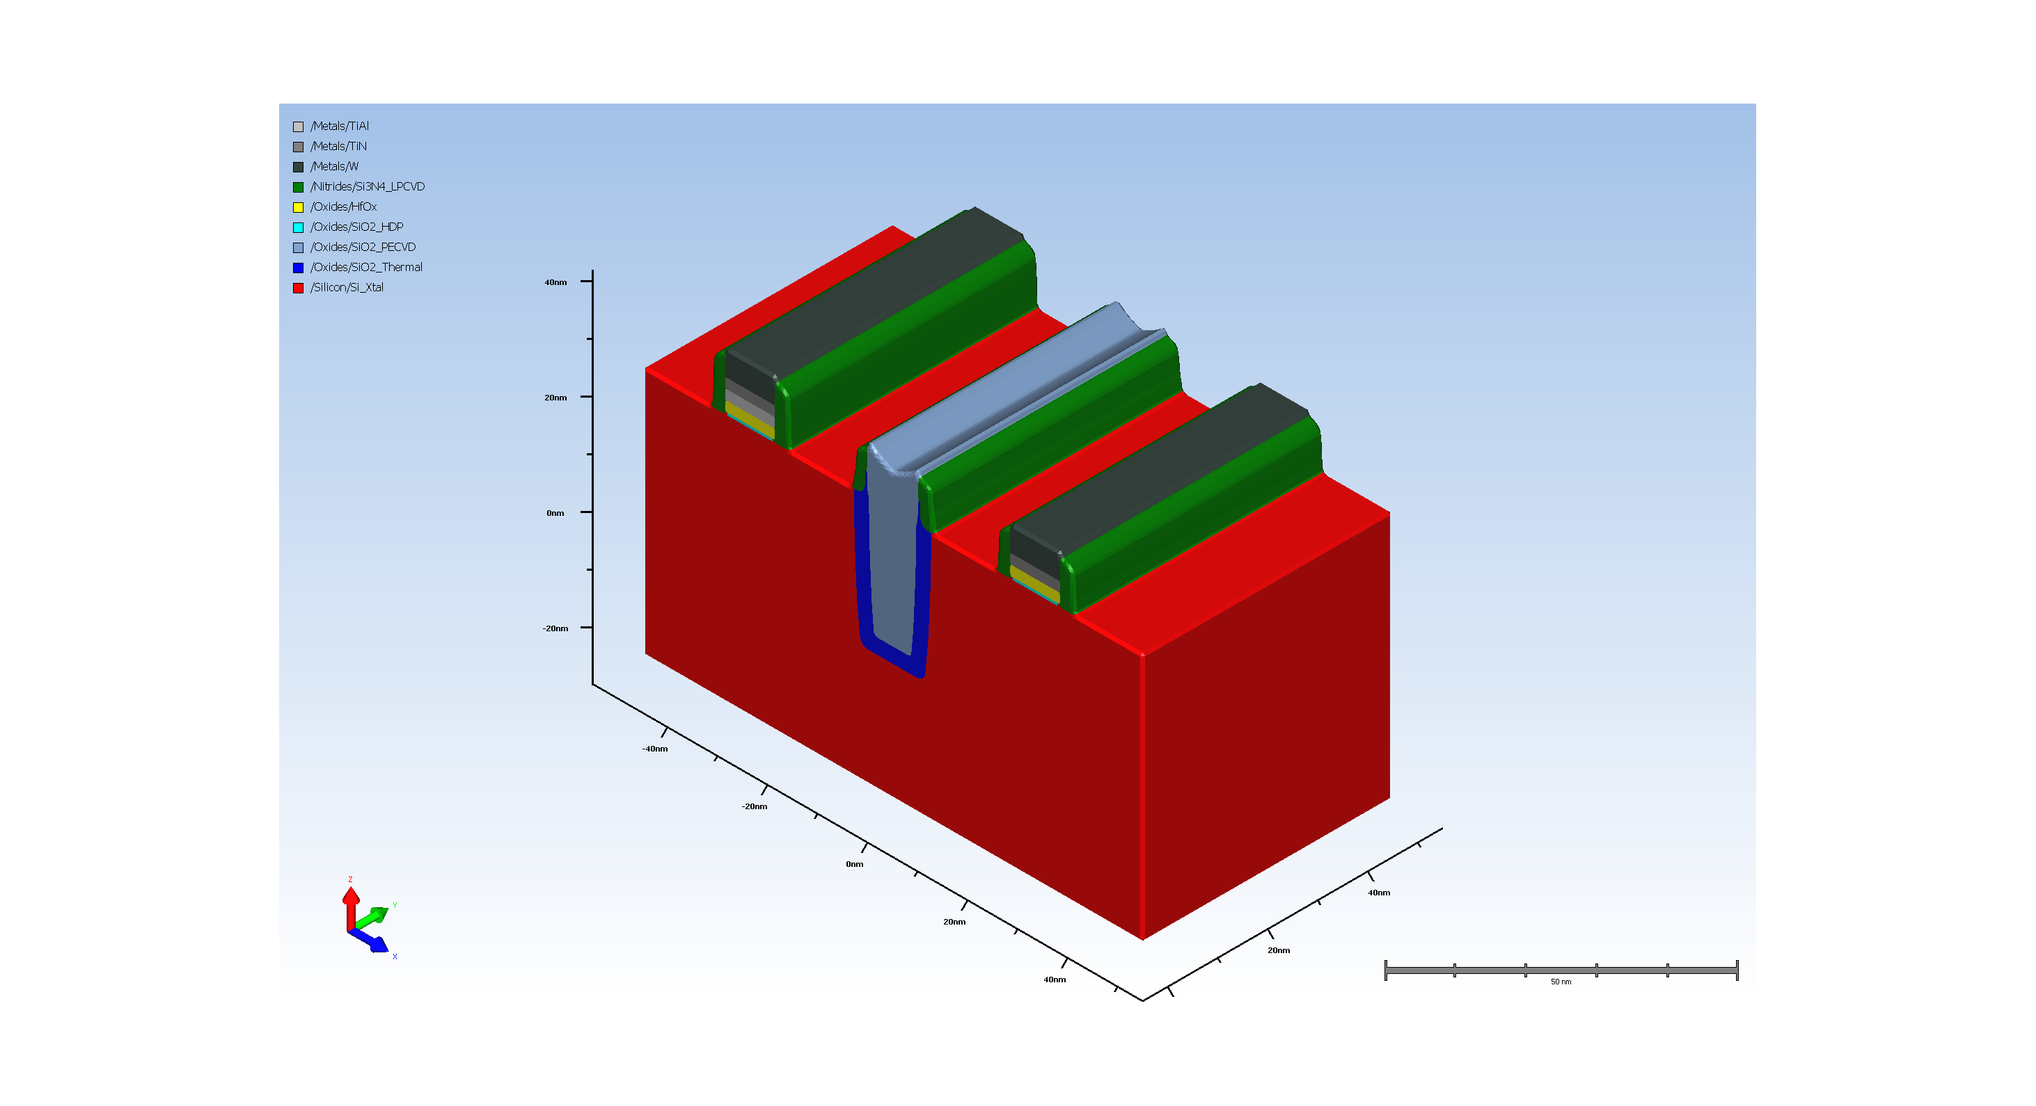
18. NMOS source and Drain

Slide 19

19. PMOS source and Drain

Slide 20
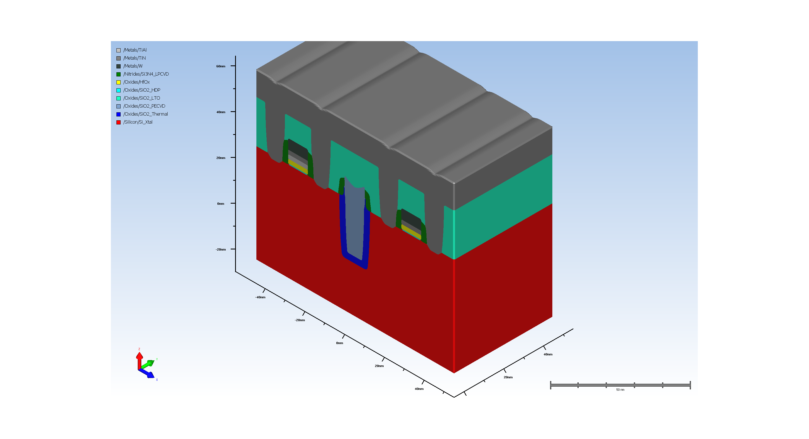
20. Source drain metal contacts

Slide 21
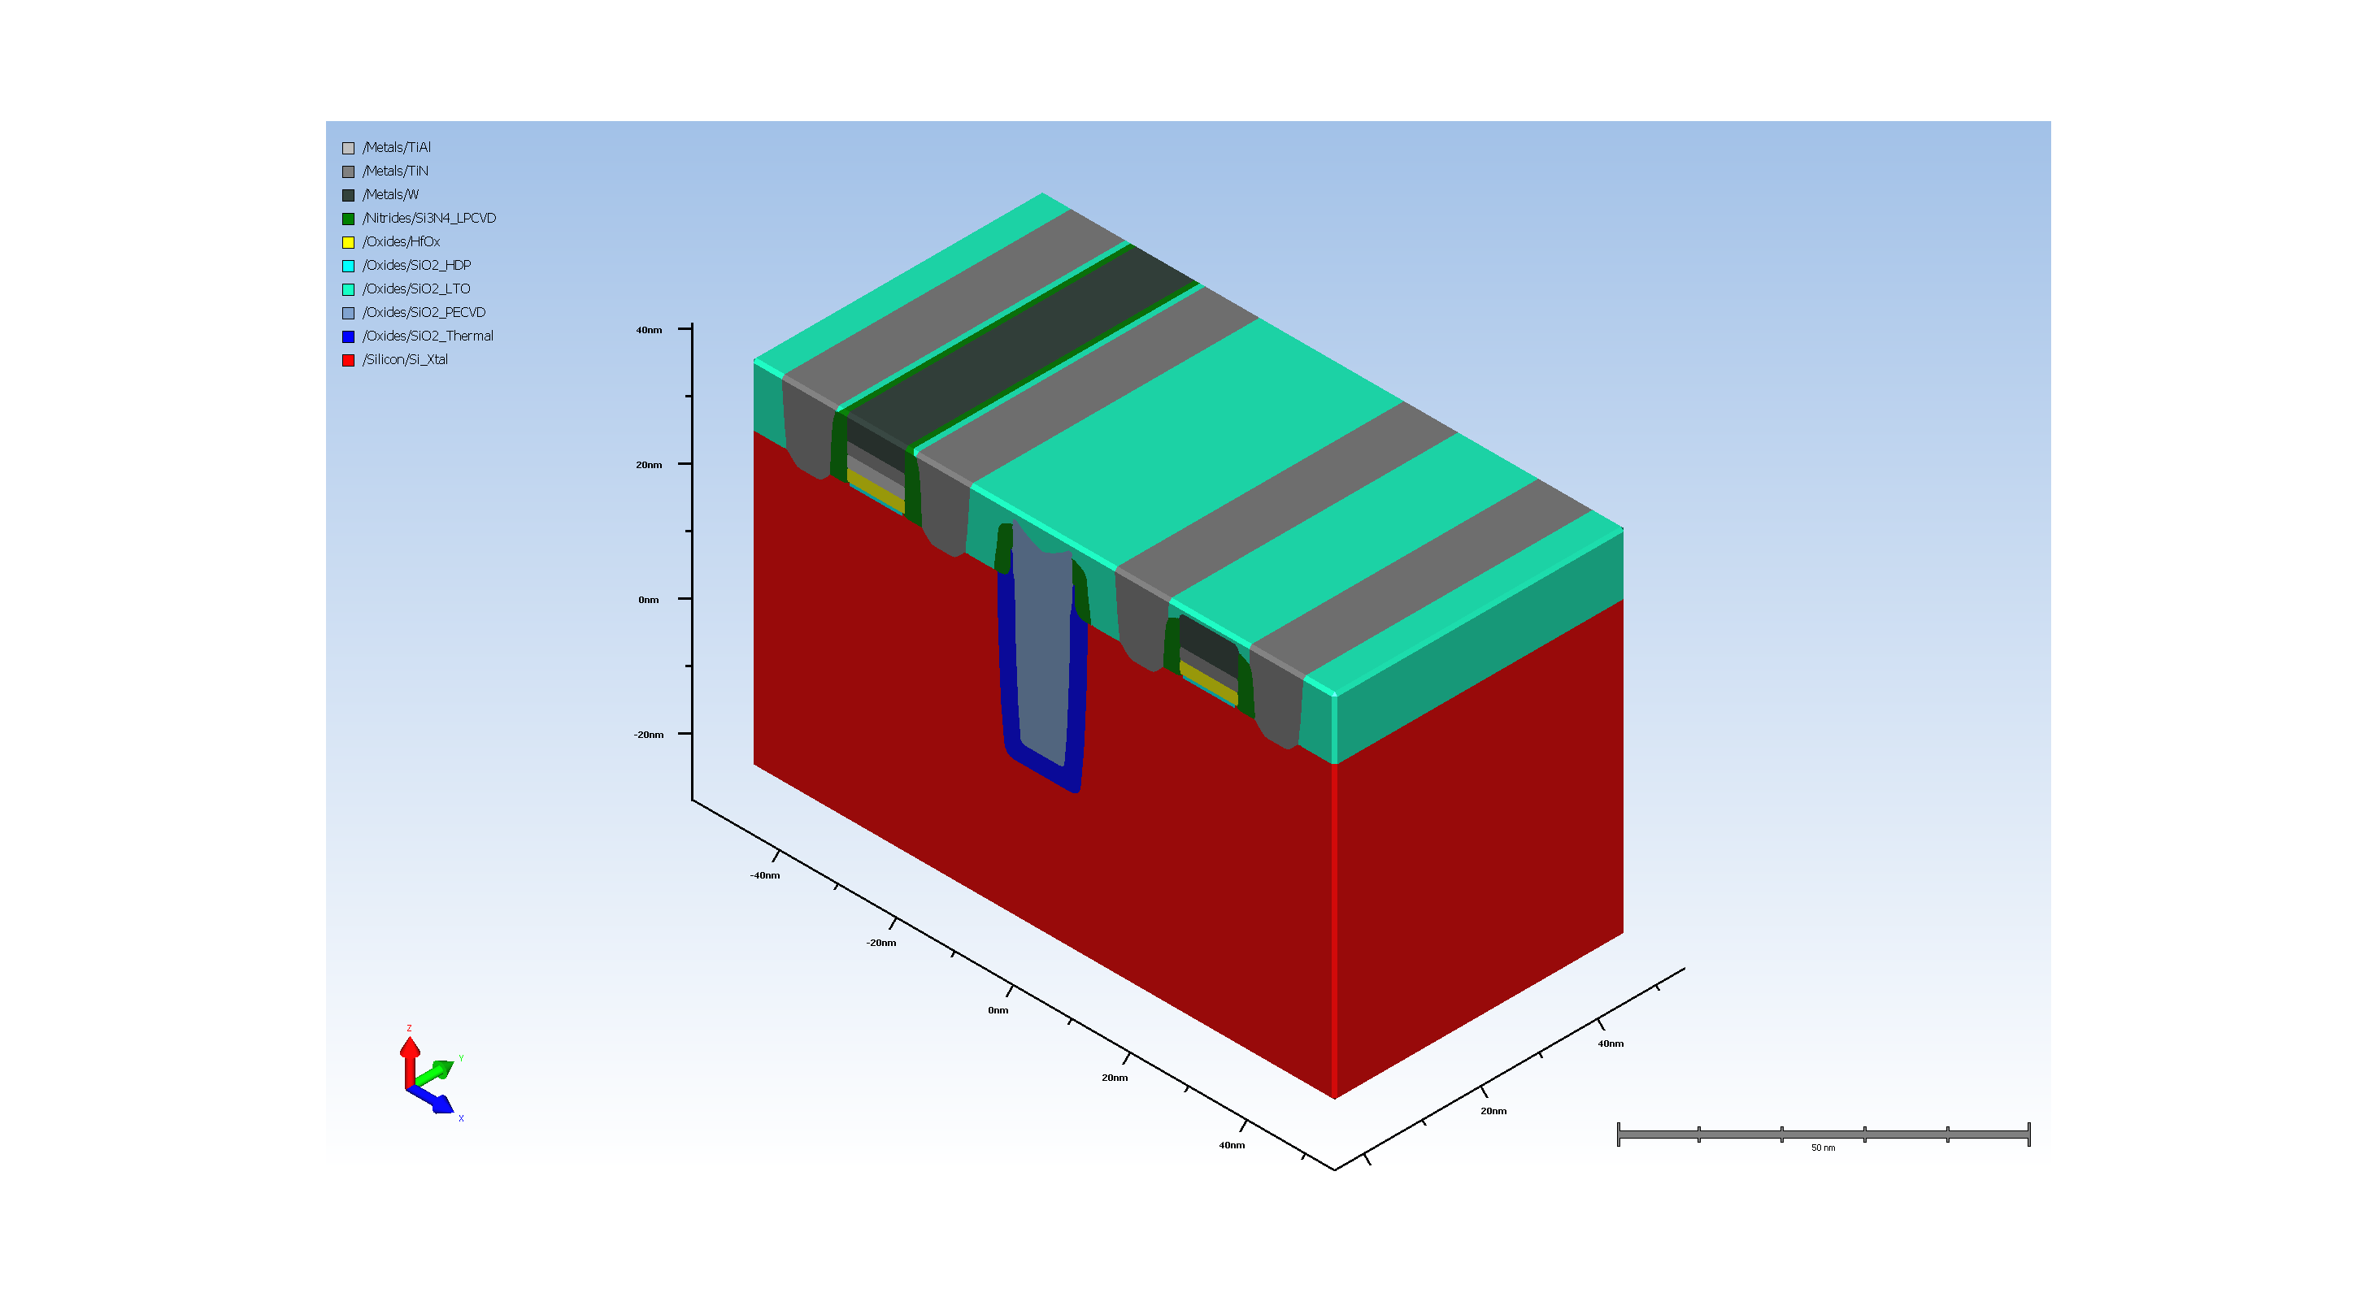
21. Final CMP of ILD

