Slide 1
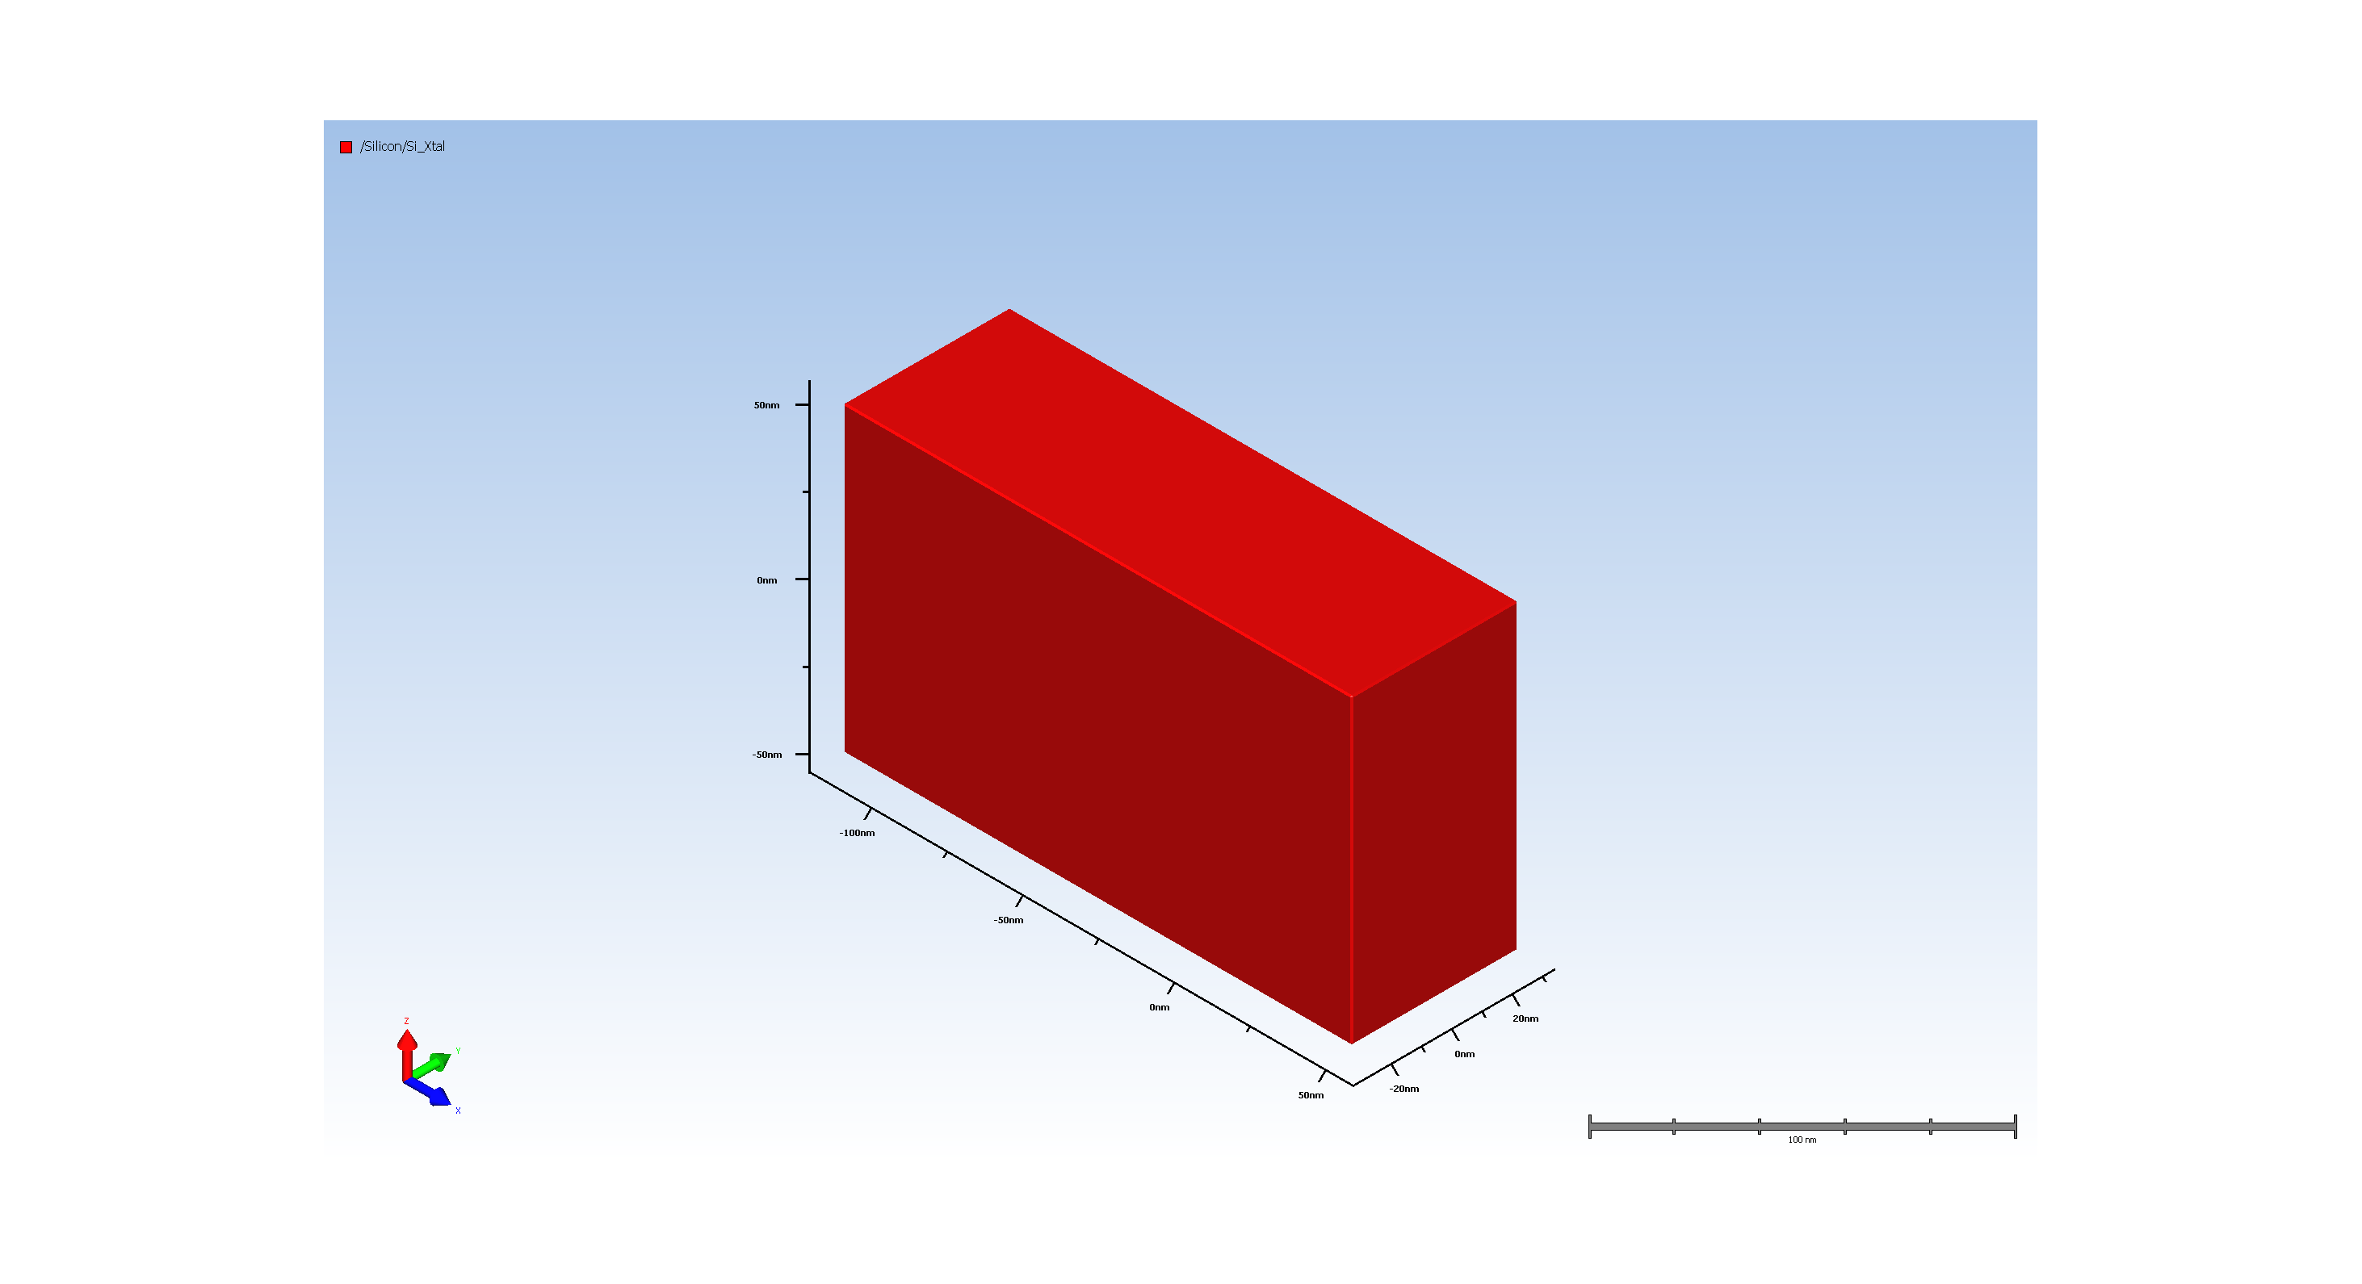
1. Wafer Setup

Slide 2
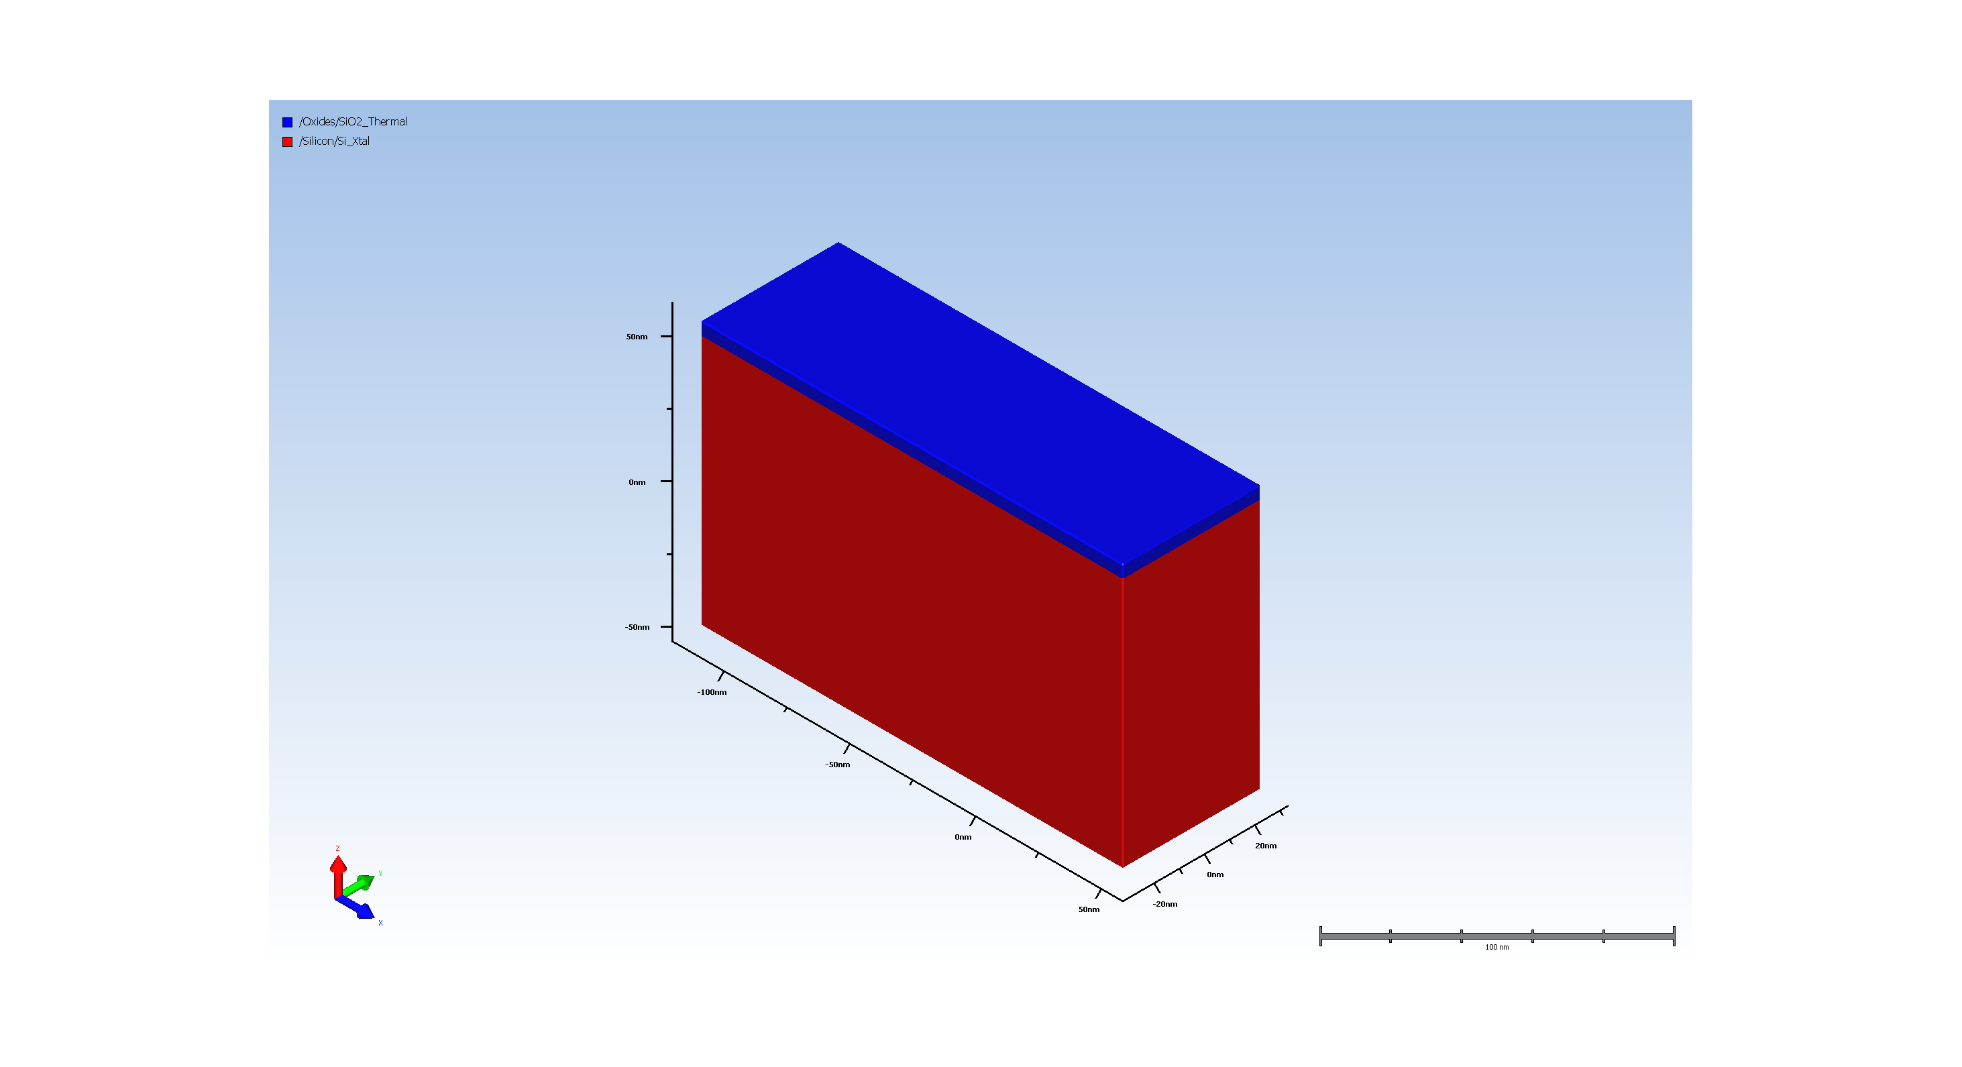
2. Pad Oxide Deposition

Slide 3
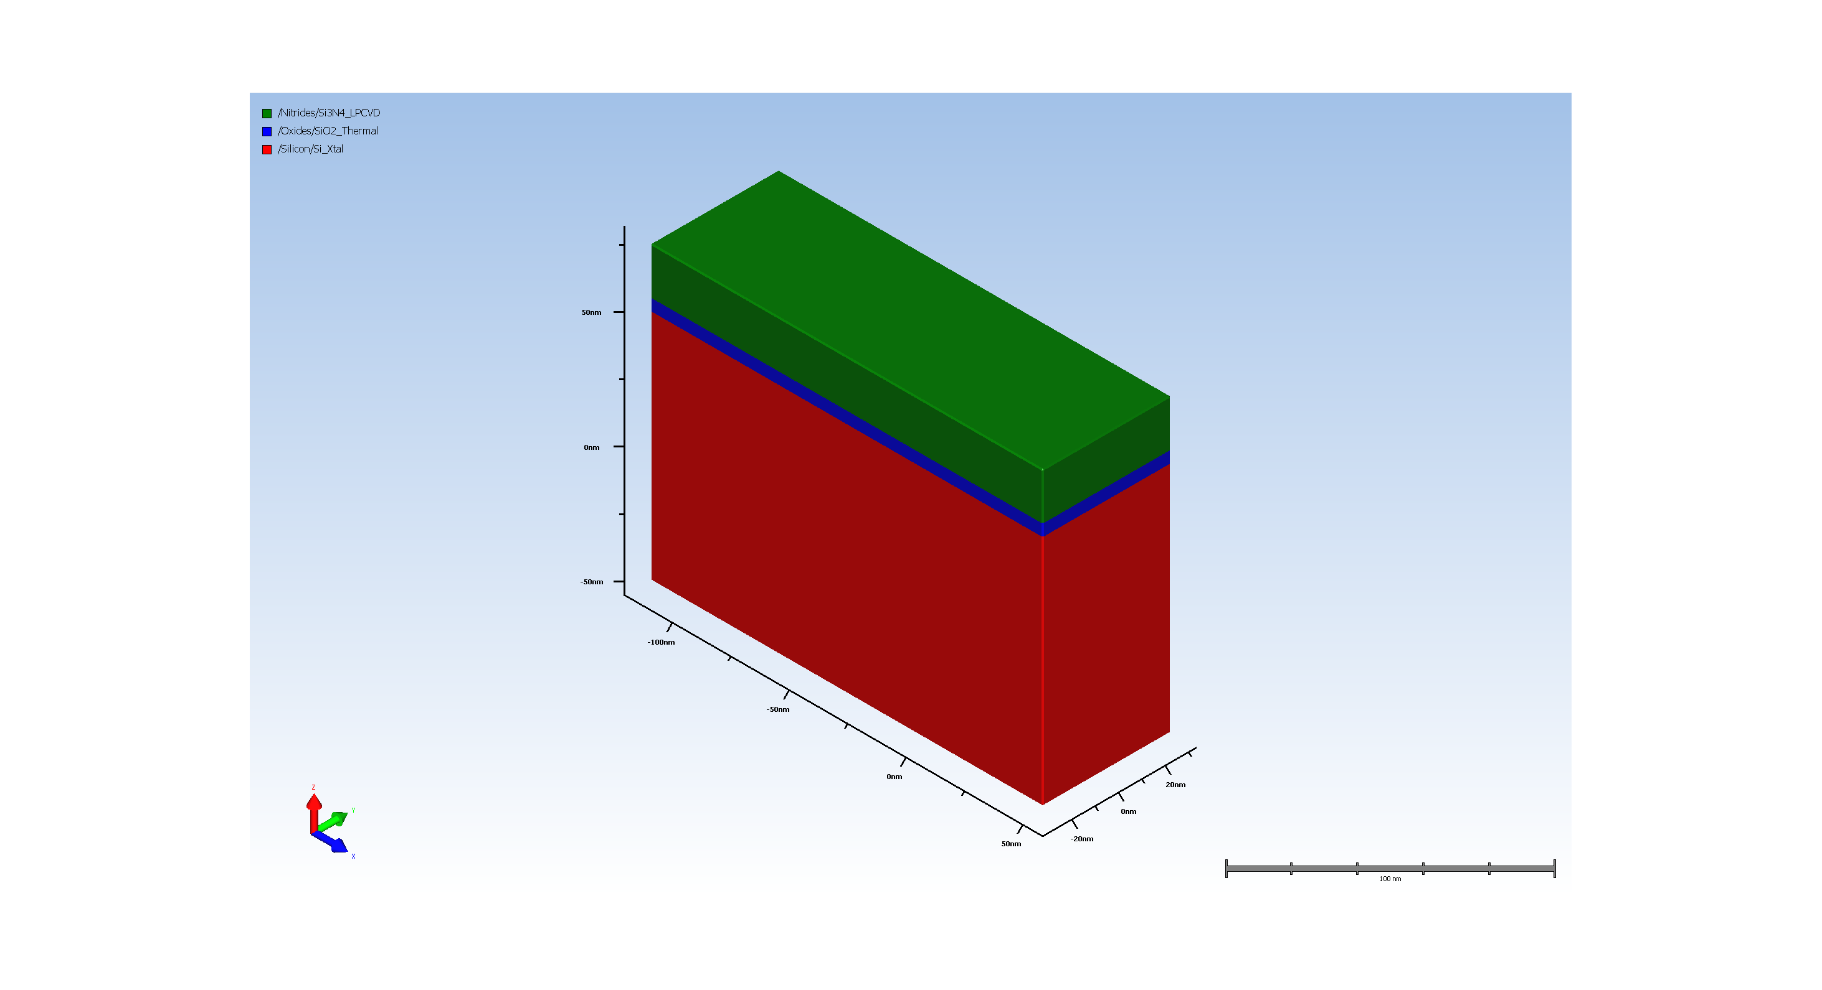
3. SiN hardmask

Slide 4
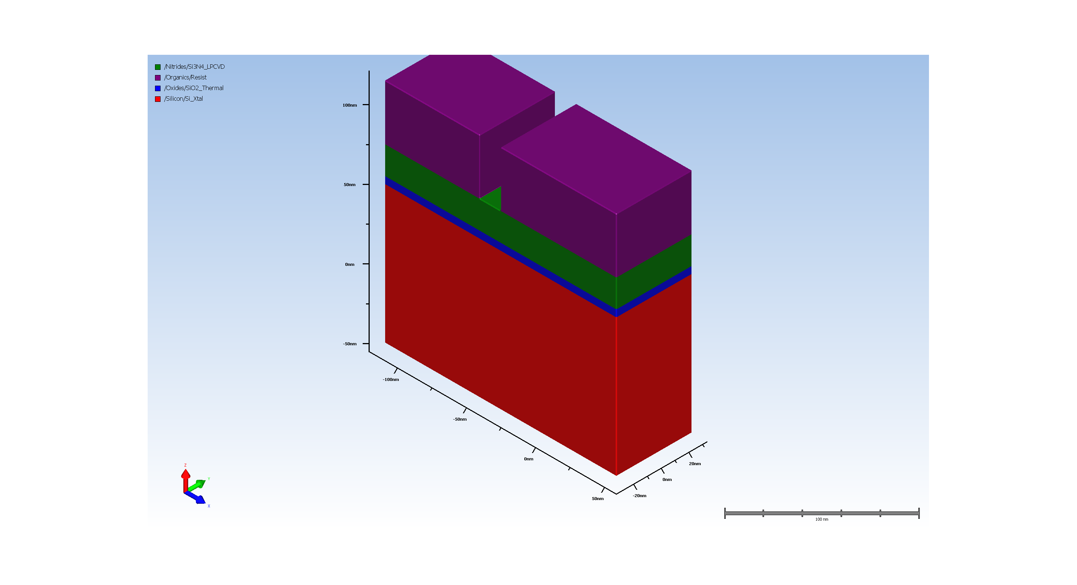
4. STI_Trench_Lithography

Slide 5
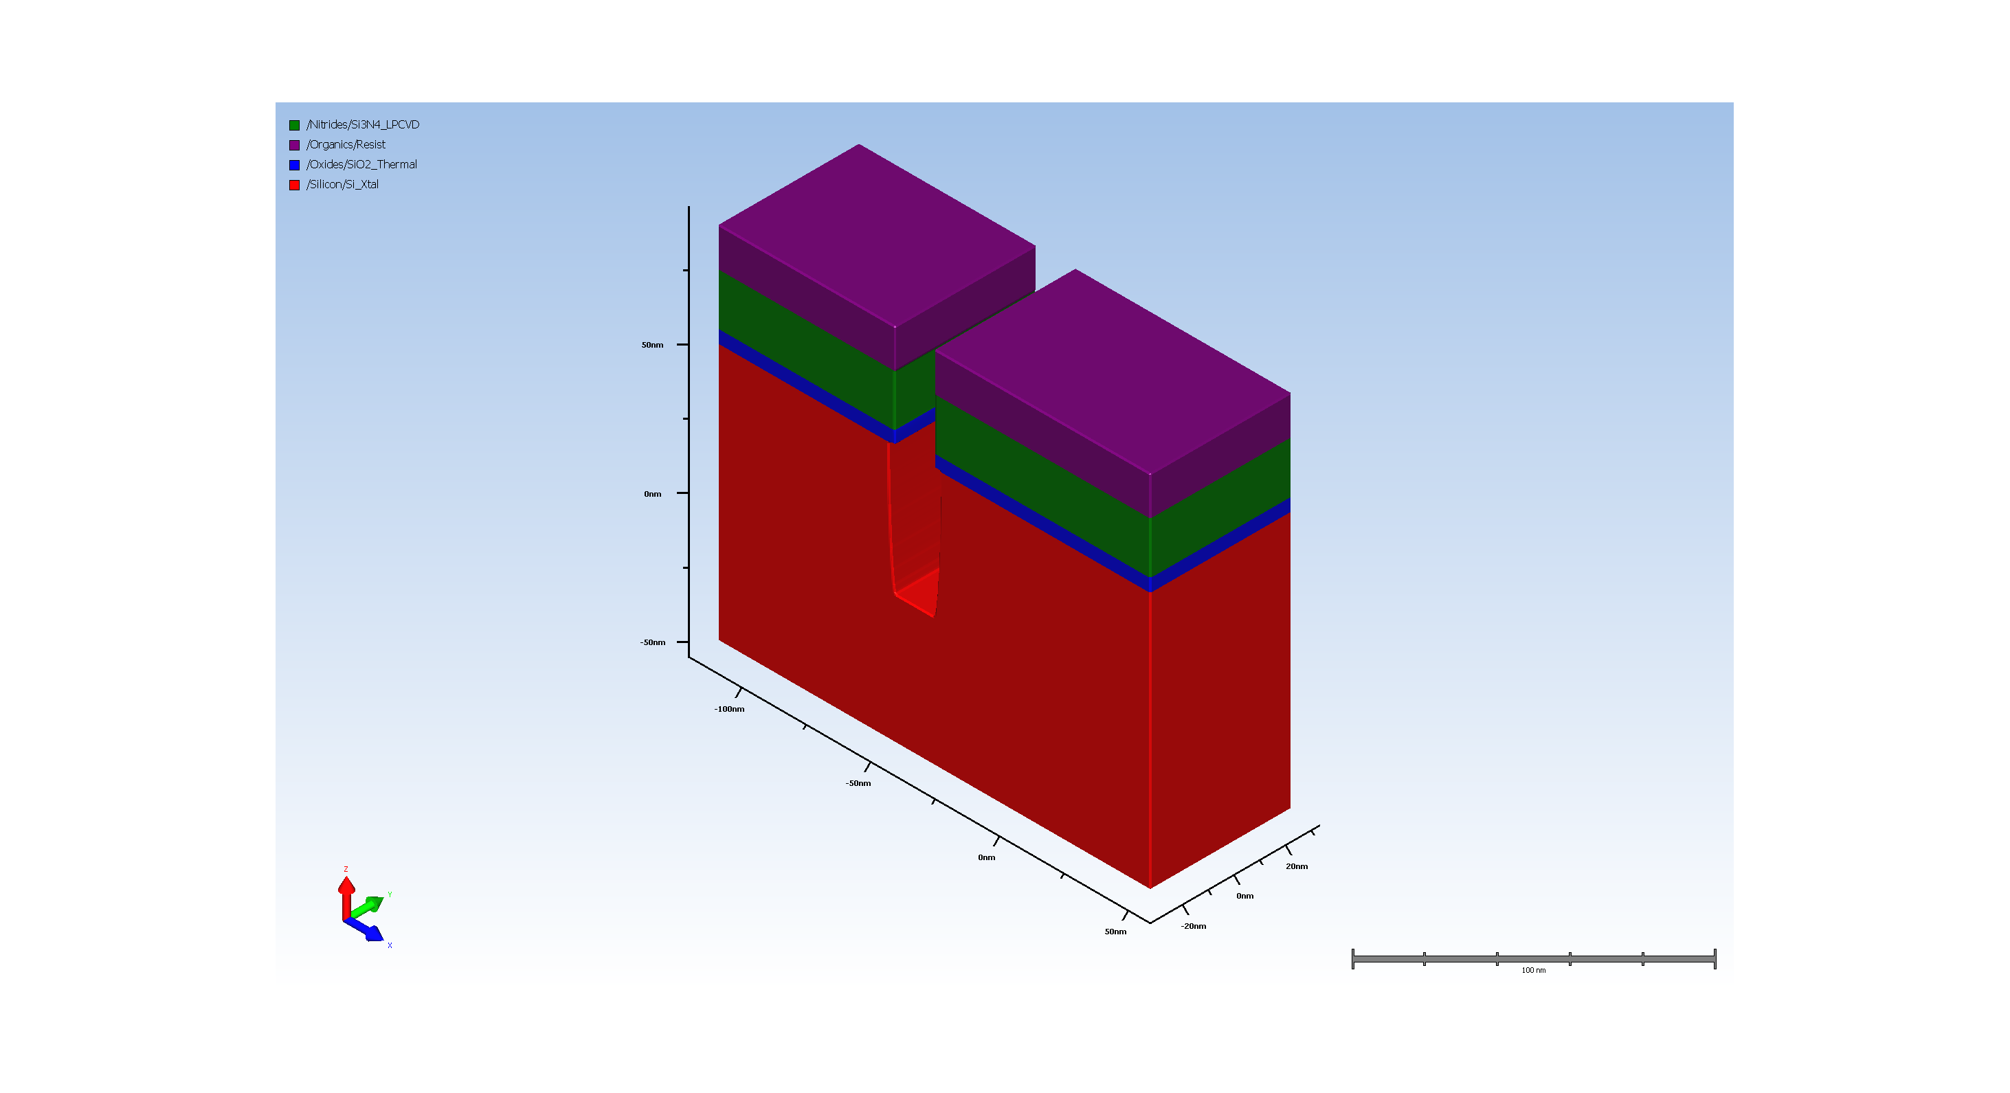
5. Etching trench

Slide 6

6. resist removal

Slide 7
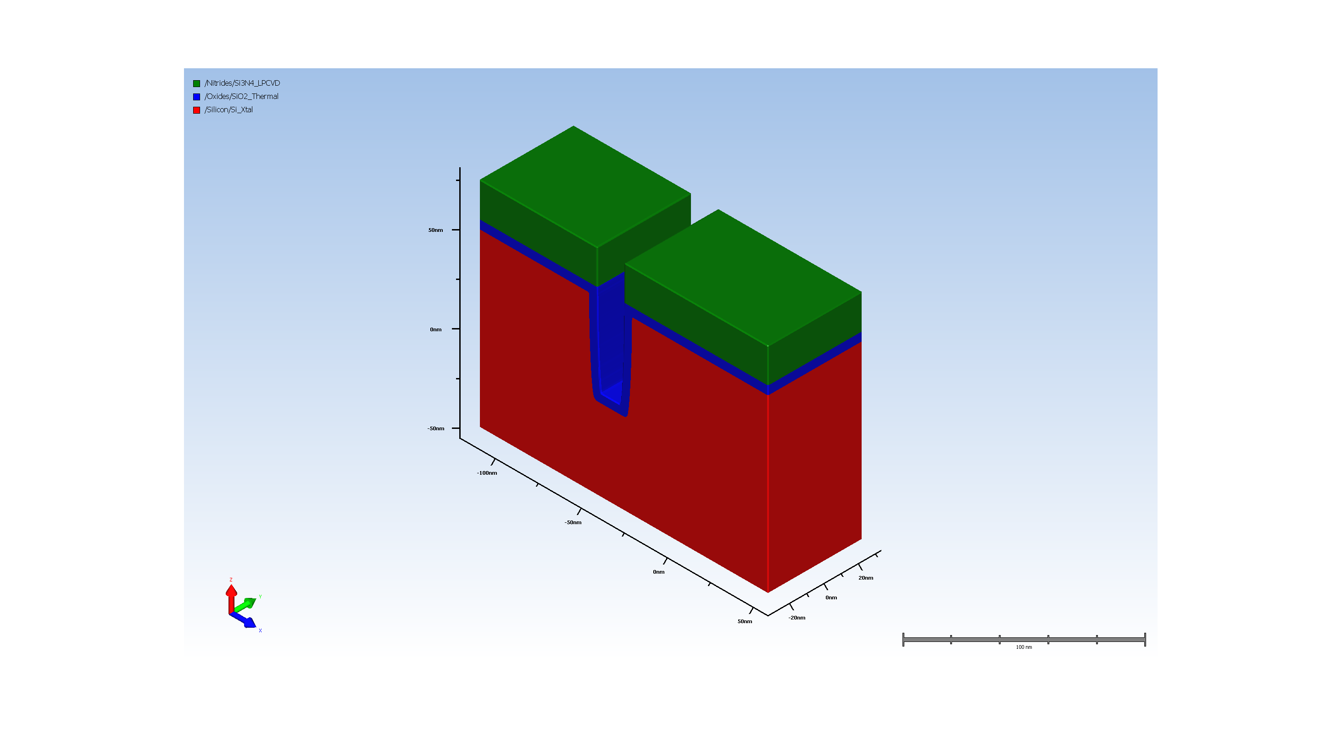
7. Thermal Oxidation of opened trench

Slide 8
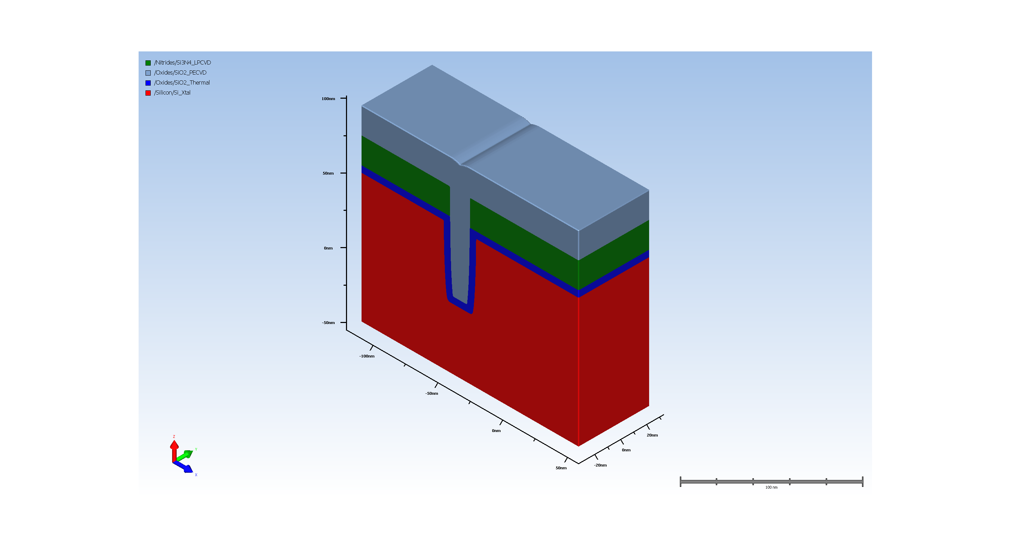
8. Filling trench with CVD oxide

Slide 9
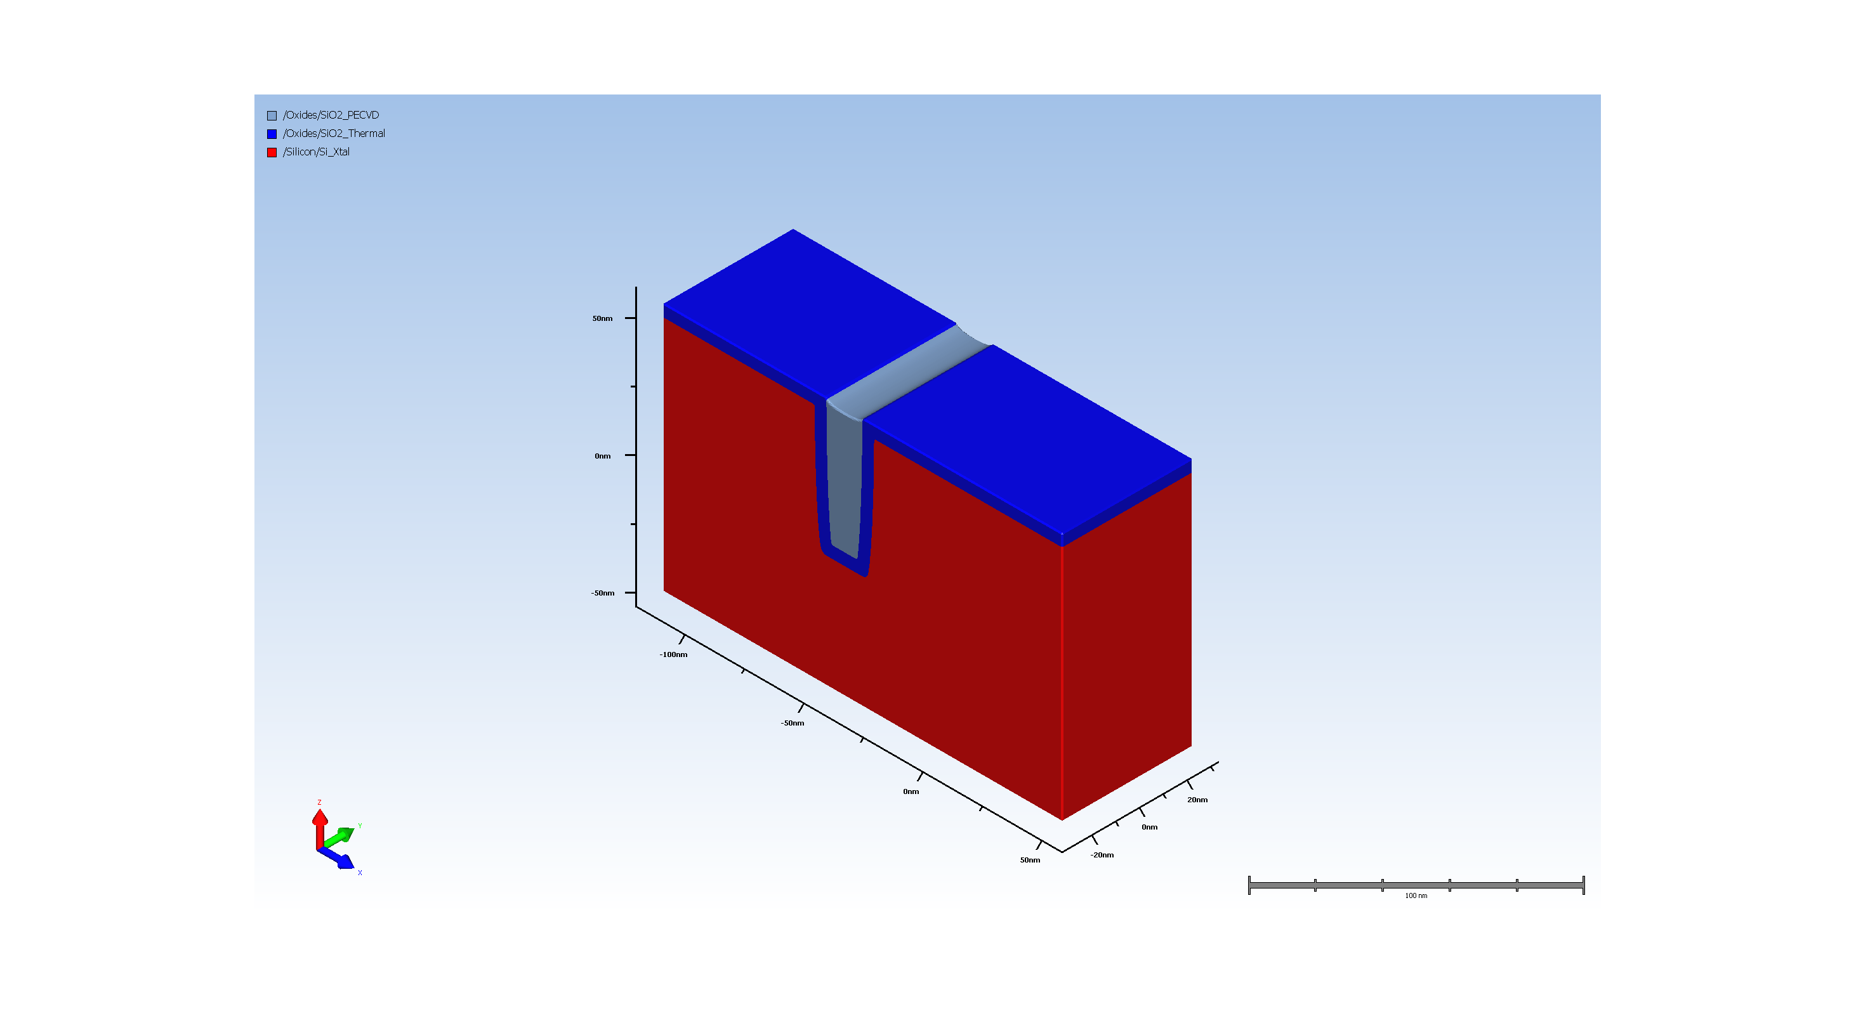
9. STI oxide CMP

Slide 10
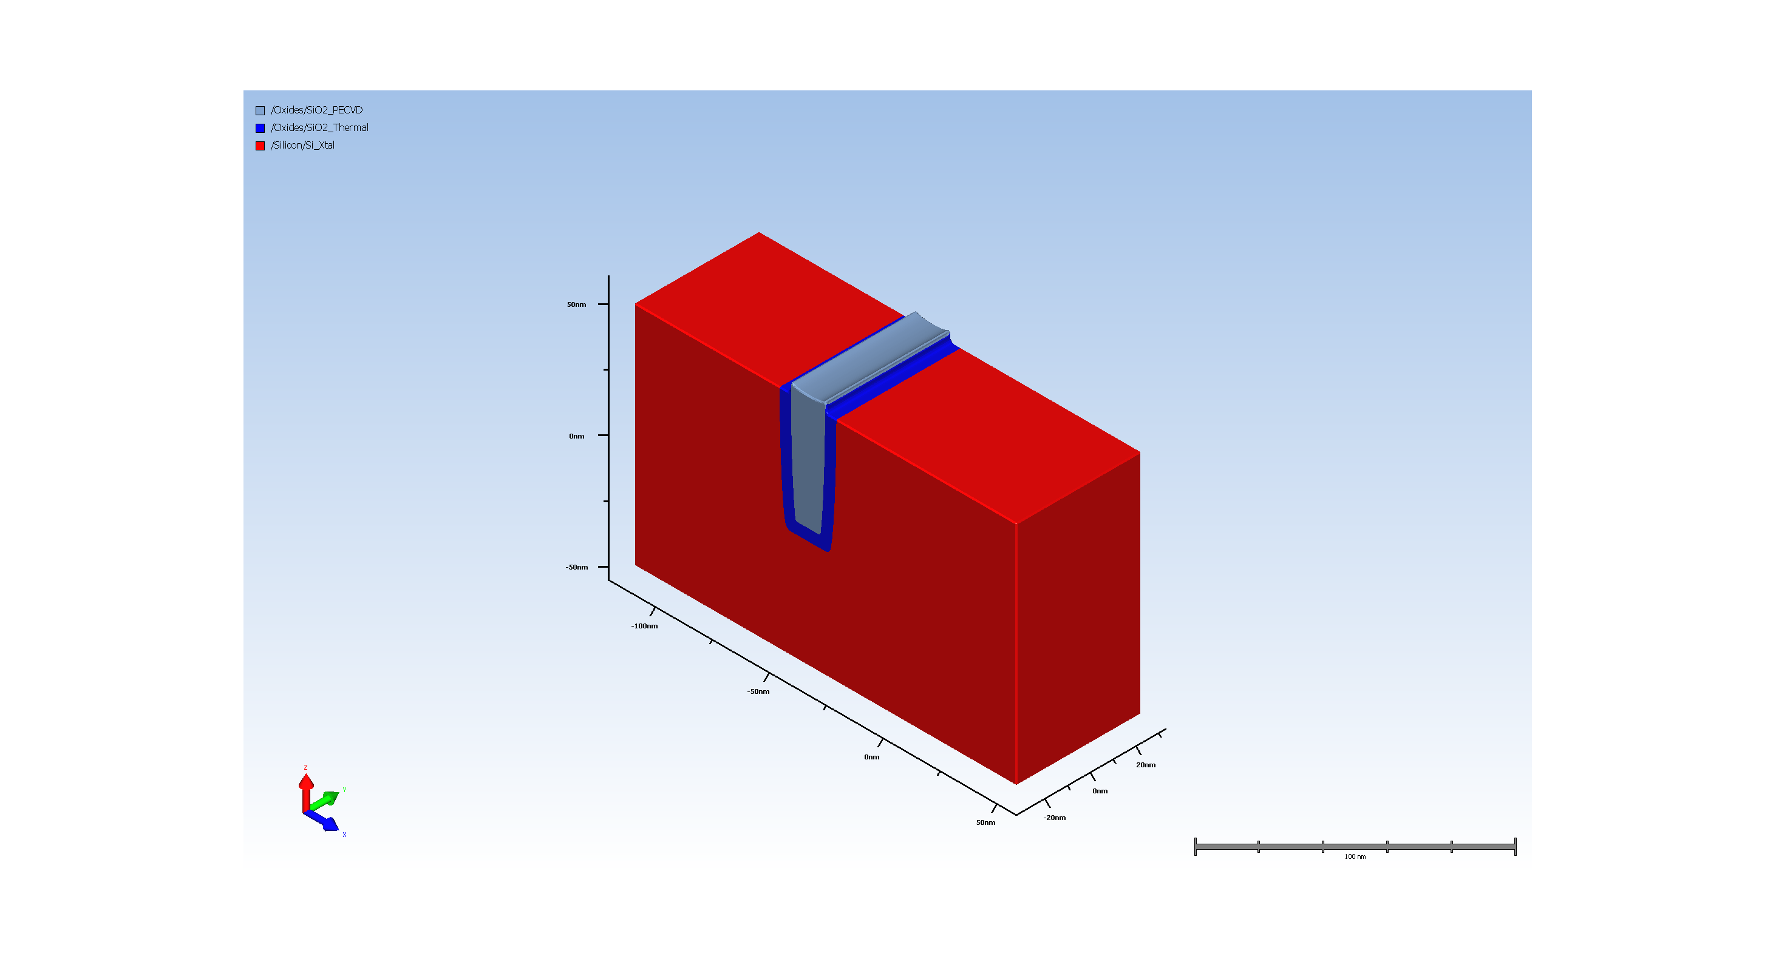
11. Pad_oxide ramoval
Unknown Step Properties:
name: hdm
Num. of attributes: 3
VersionNumber : 12.2.0.0
uiHidden : true
uiHideChildNodes : true
name: simultaneousDeposit
Num. of attributes: 1
isEnable : false
name: depositMaterial
Num. of attributes: 3
VersionNumber : 12.2.0.0
readonly : true
uiHideChildNodes : true
name: depositRatio
Num. of attributes: 5
___expression :
___lastKnownValue : nan.0
___unitConversionExpr :
___unitName : nounit
readonly : true
name: depositIsotropicRatio
Num. of attributes: 5
___expression : 0
___lastKnownValue : 0.0
___unitConversionExpr :
___unitName : nounit
readonly : true
name: depositLateralRatio
Num. of attributes: 5
___expression : 1
___lastKnownValue : 1.0
___unitConversionExpr :
___unitName : nounit
readonly : true
name: depositSourceSigma
Num. of attributes: 5
___expression : 100.0
___lastKnownValue : 100.0
___unitConversionExpr :
___unitName : nounit
readonly : true
name: depositTransport
Num. of attributes: 2
isEnable : false
readonly : true
name: conformality
Num. of attributes: 5
___expression : 0.1
___lastKnownValue : 0.1
___unitConversionExpr :
___unitName : nounit
readonly : true
name: depositTiltAndTwist
Num. of attributes: 2
___activeMember : sameAsEtch
readonly : true
name: sameAsEtch
Num. of attributes: 2
isEnable : true
readonly : true
name: fixed
Num. of attributes: 1
isEnable : true
name: tilt
Num. of attributes: 4
___expression : 0
___lastKnownValue : 0.0
___unitConversionExpr :
___unitName : nounit
name: twist
Num. of attributes: 4
___expression : 0
___lastKnownValue : 0.0
___unitConversionExpr :
___unitName : nounit
name: rotating
Num. of attributes: 1
isEnable : true
name: tilt
Num. of attributes: 4
___expression : 0
___lastKnownValue : 0.0
___unitConversionExpr :
___unitName : nounit
name: transport
Num. of attributes: 1
isEnable : false
name: conformality
Num. of attributes: 5
___expression : 0.1
___lastKnownValue : 0.1
___unitConversionExpr :
___unitName : nounit
readonly : true

Slide 11
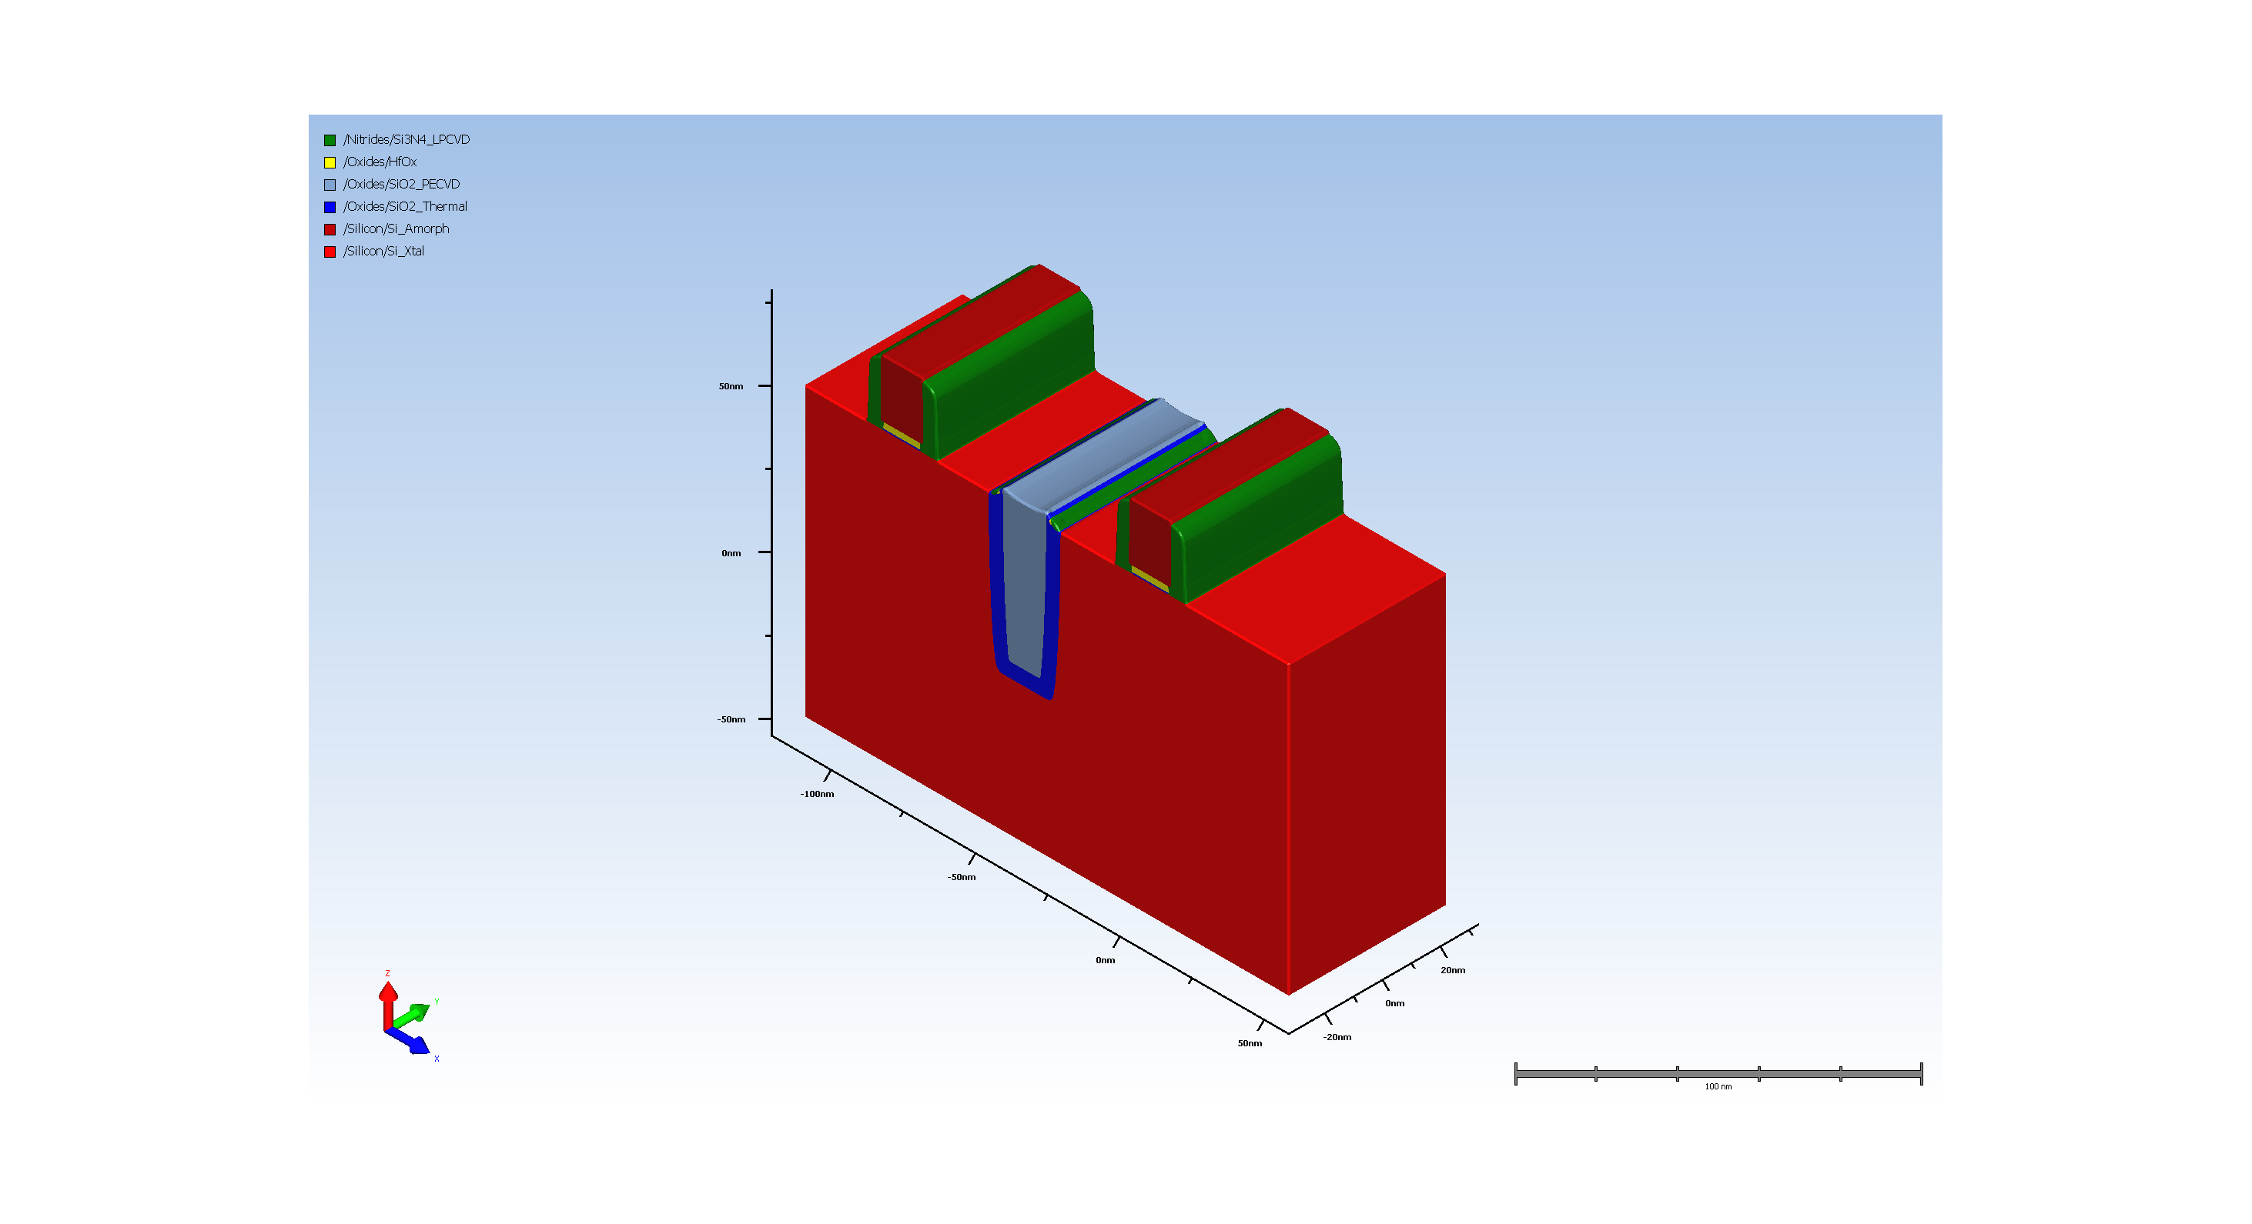
12. Deposition_and_Patterning_of_HighK_Dielectric_and_Polygate

Slide 12

13. Source_and_Drain_Formation

Slide 13
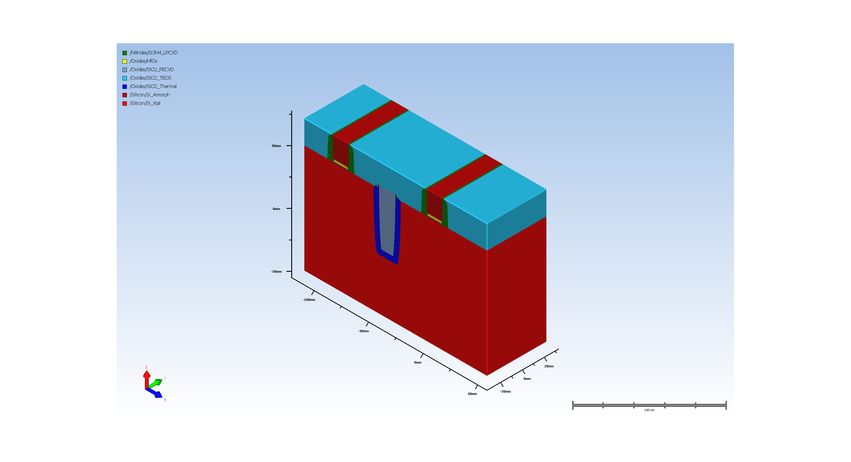
14. ILD_Deposition_and_Polish

Slide 14
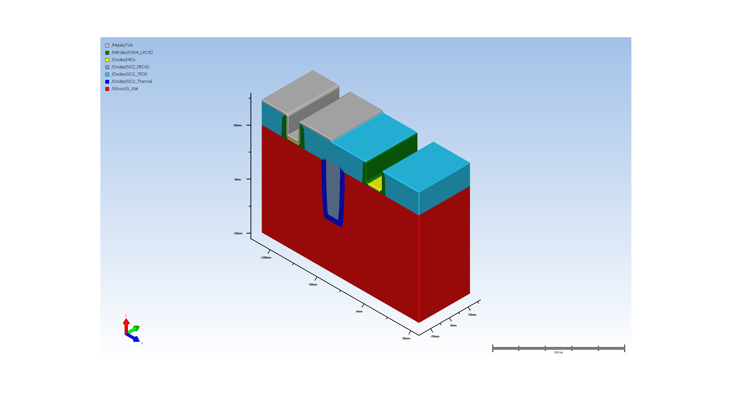
15. RMG_Pattern_Metal_1

Slide 15

16. RMG_Pattern_Metal_2

Slide 16

17. Diffusion (Requires Advanced Modeling)

