Slide 1
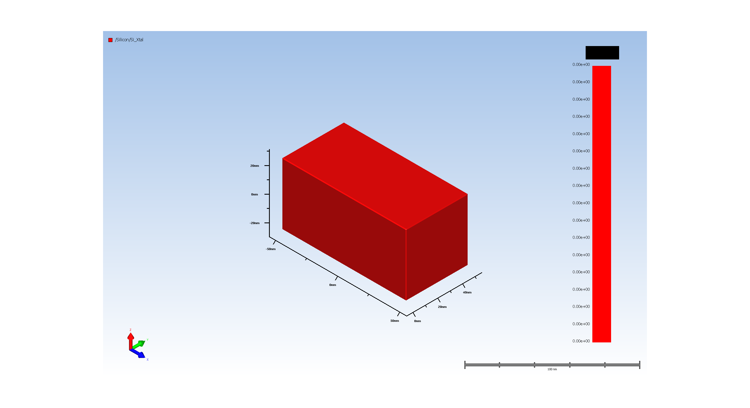
1. Wafer Setup

Slide 2
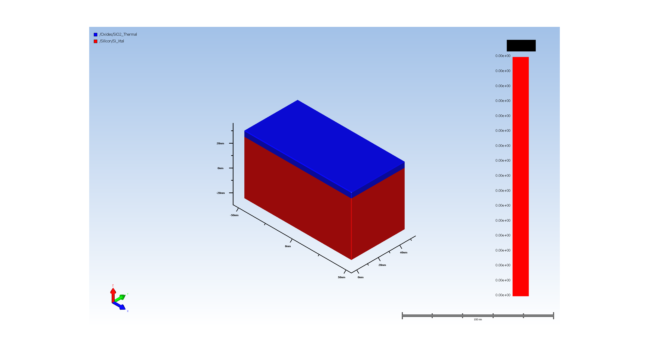
2. Pad Oxide Deposition

Slide 3
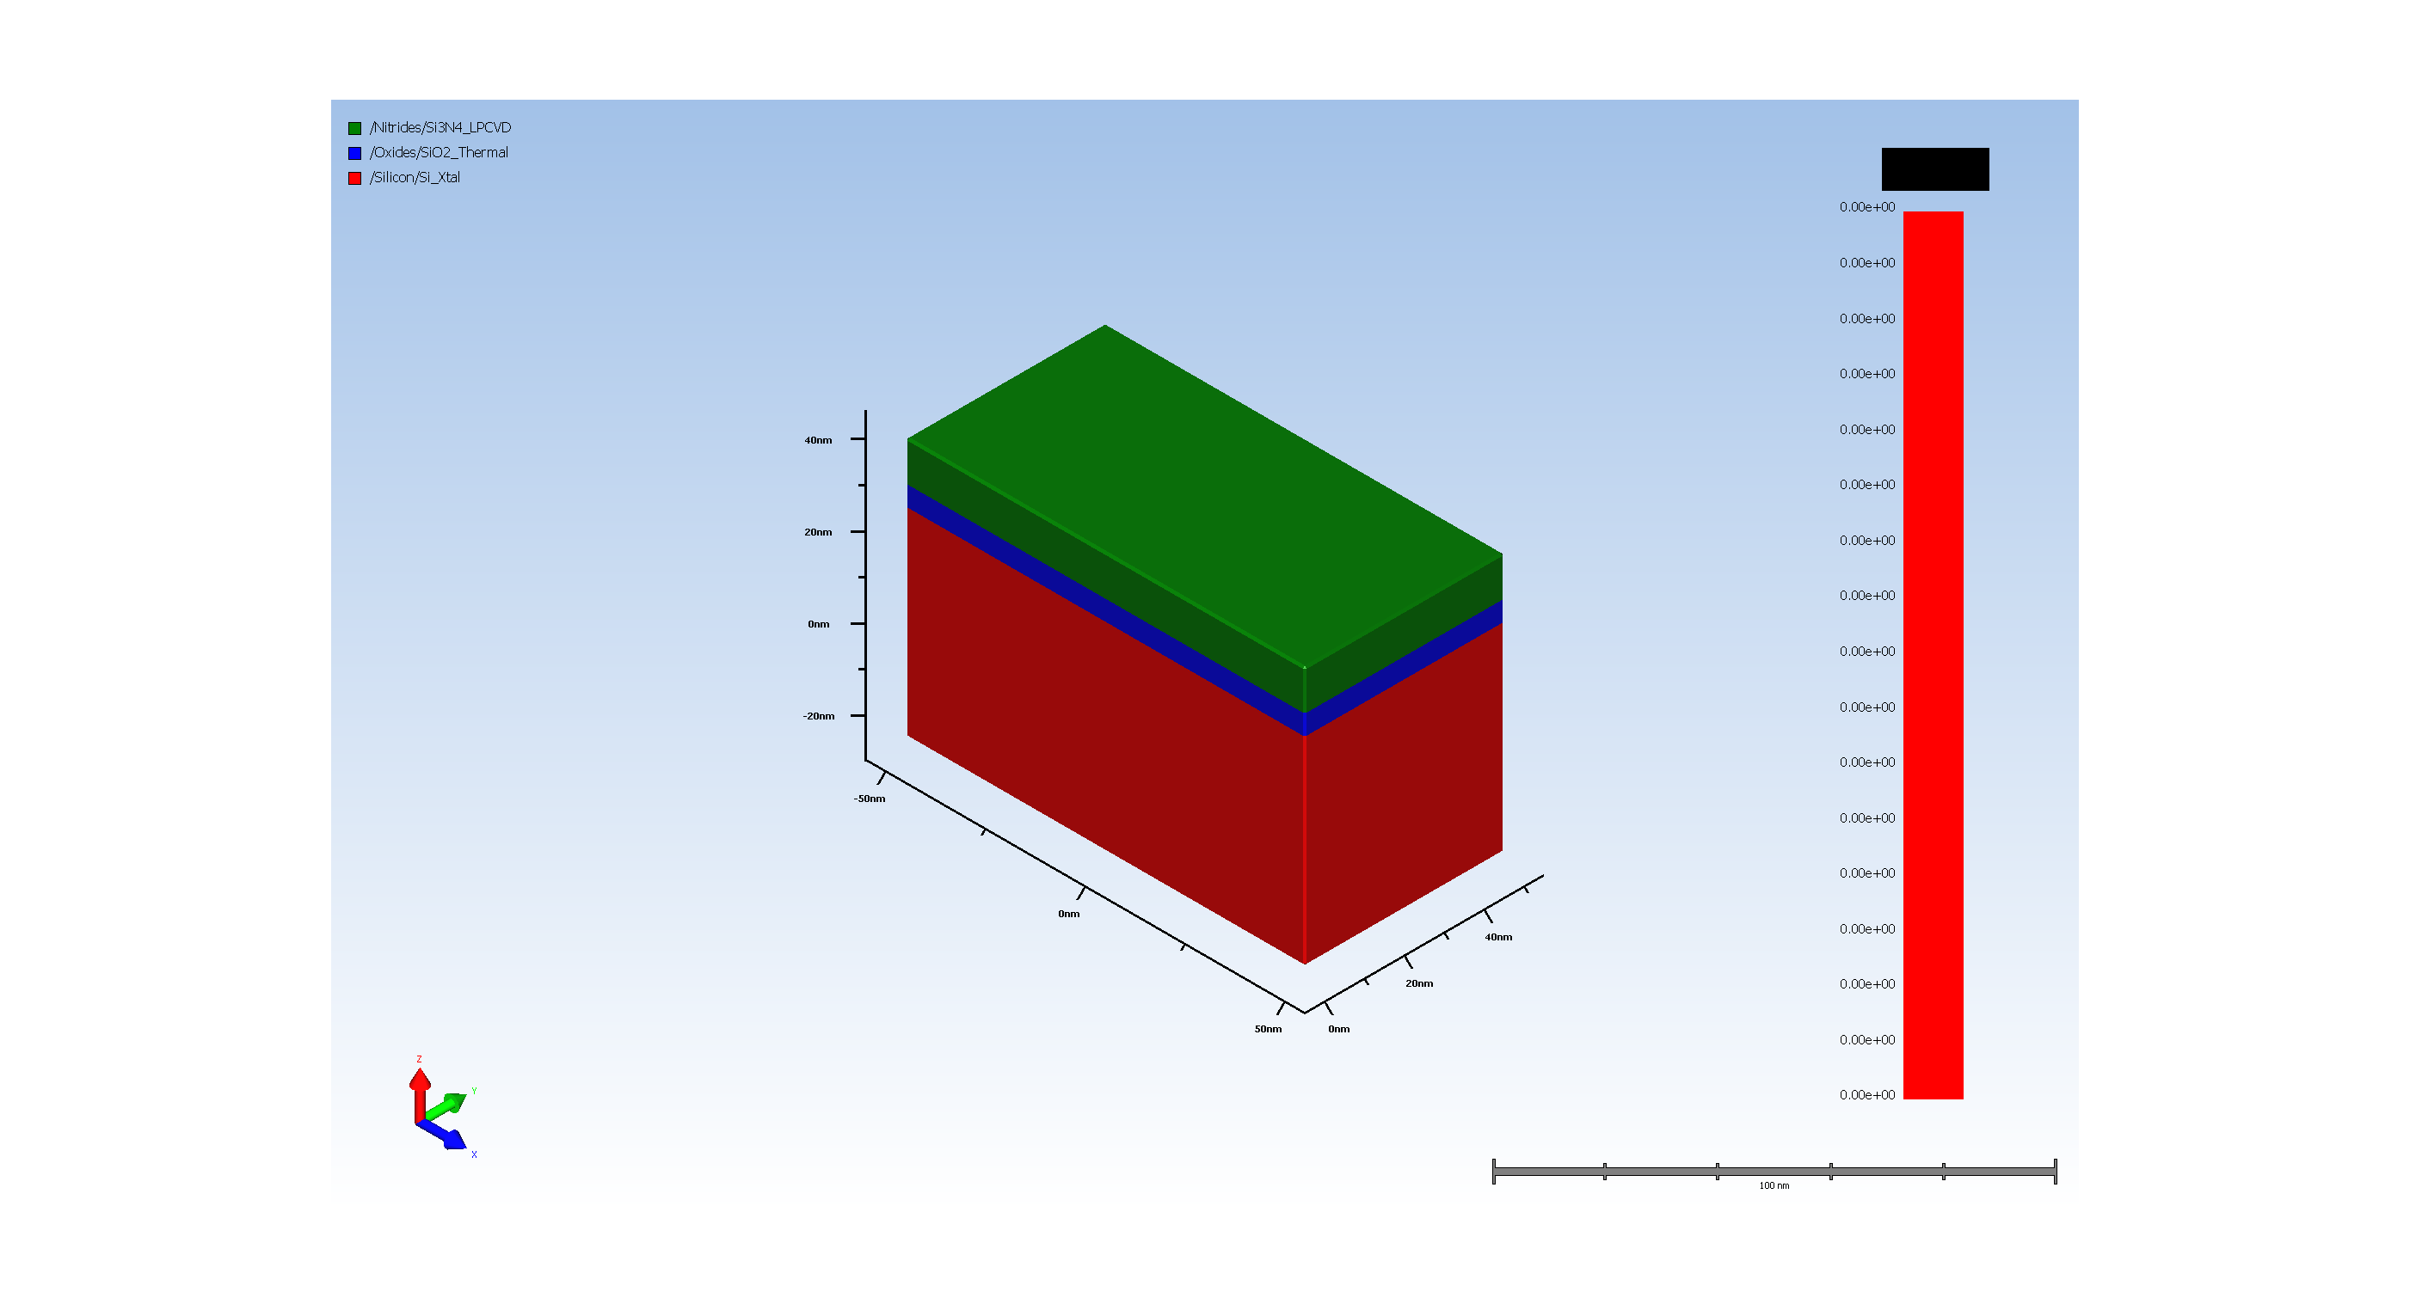
3. SiN hardmask

Slide 4
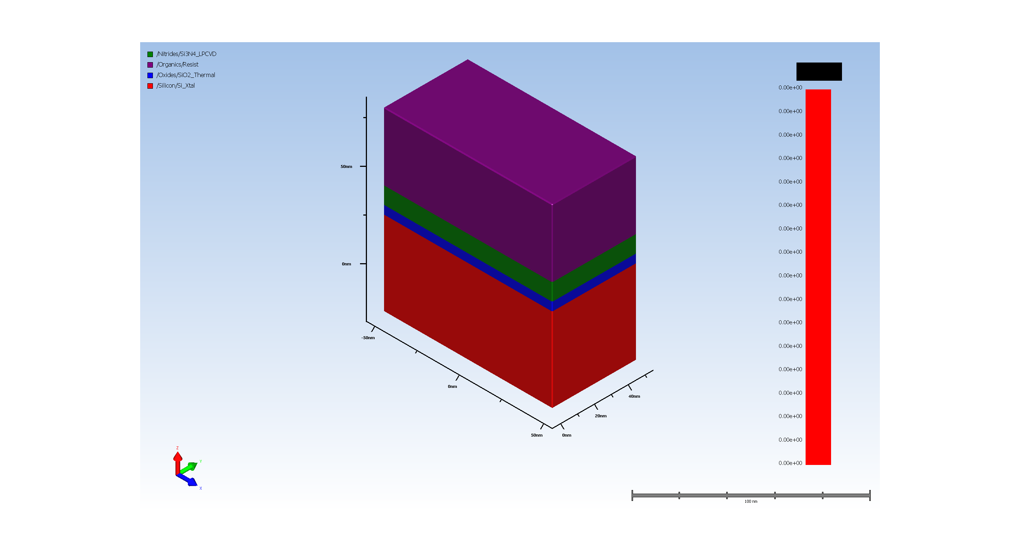
4.1. Photo Resist coating

Slide 5
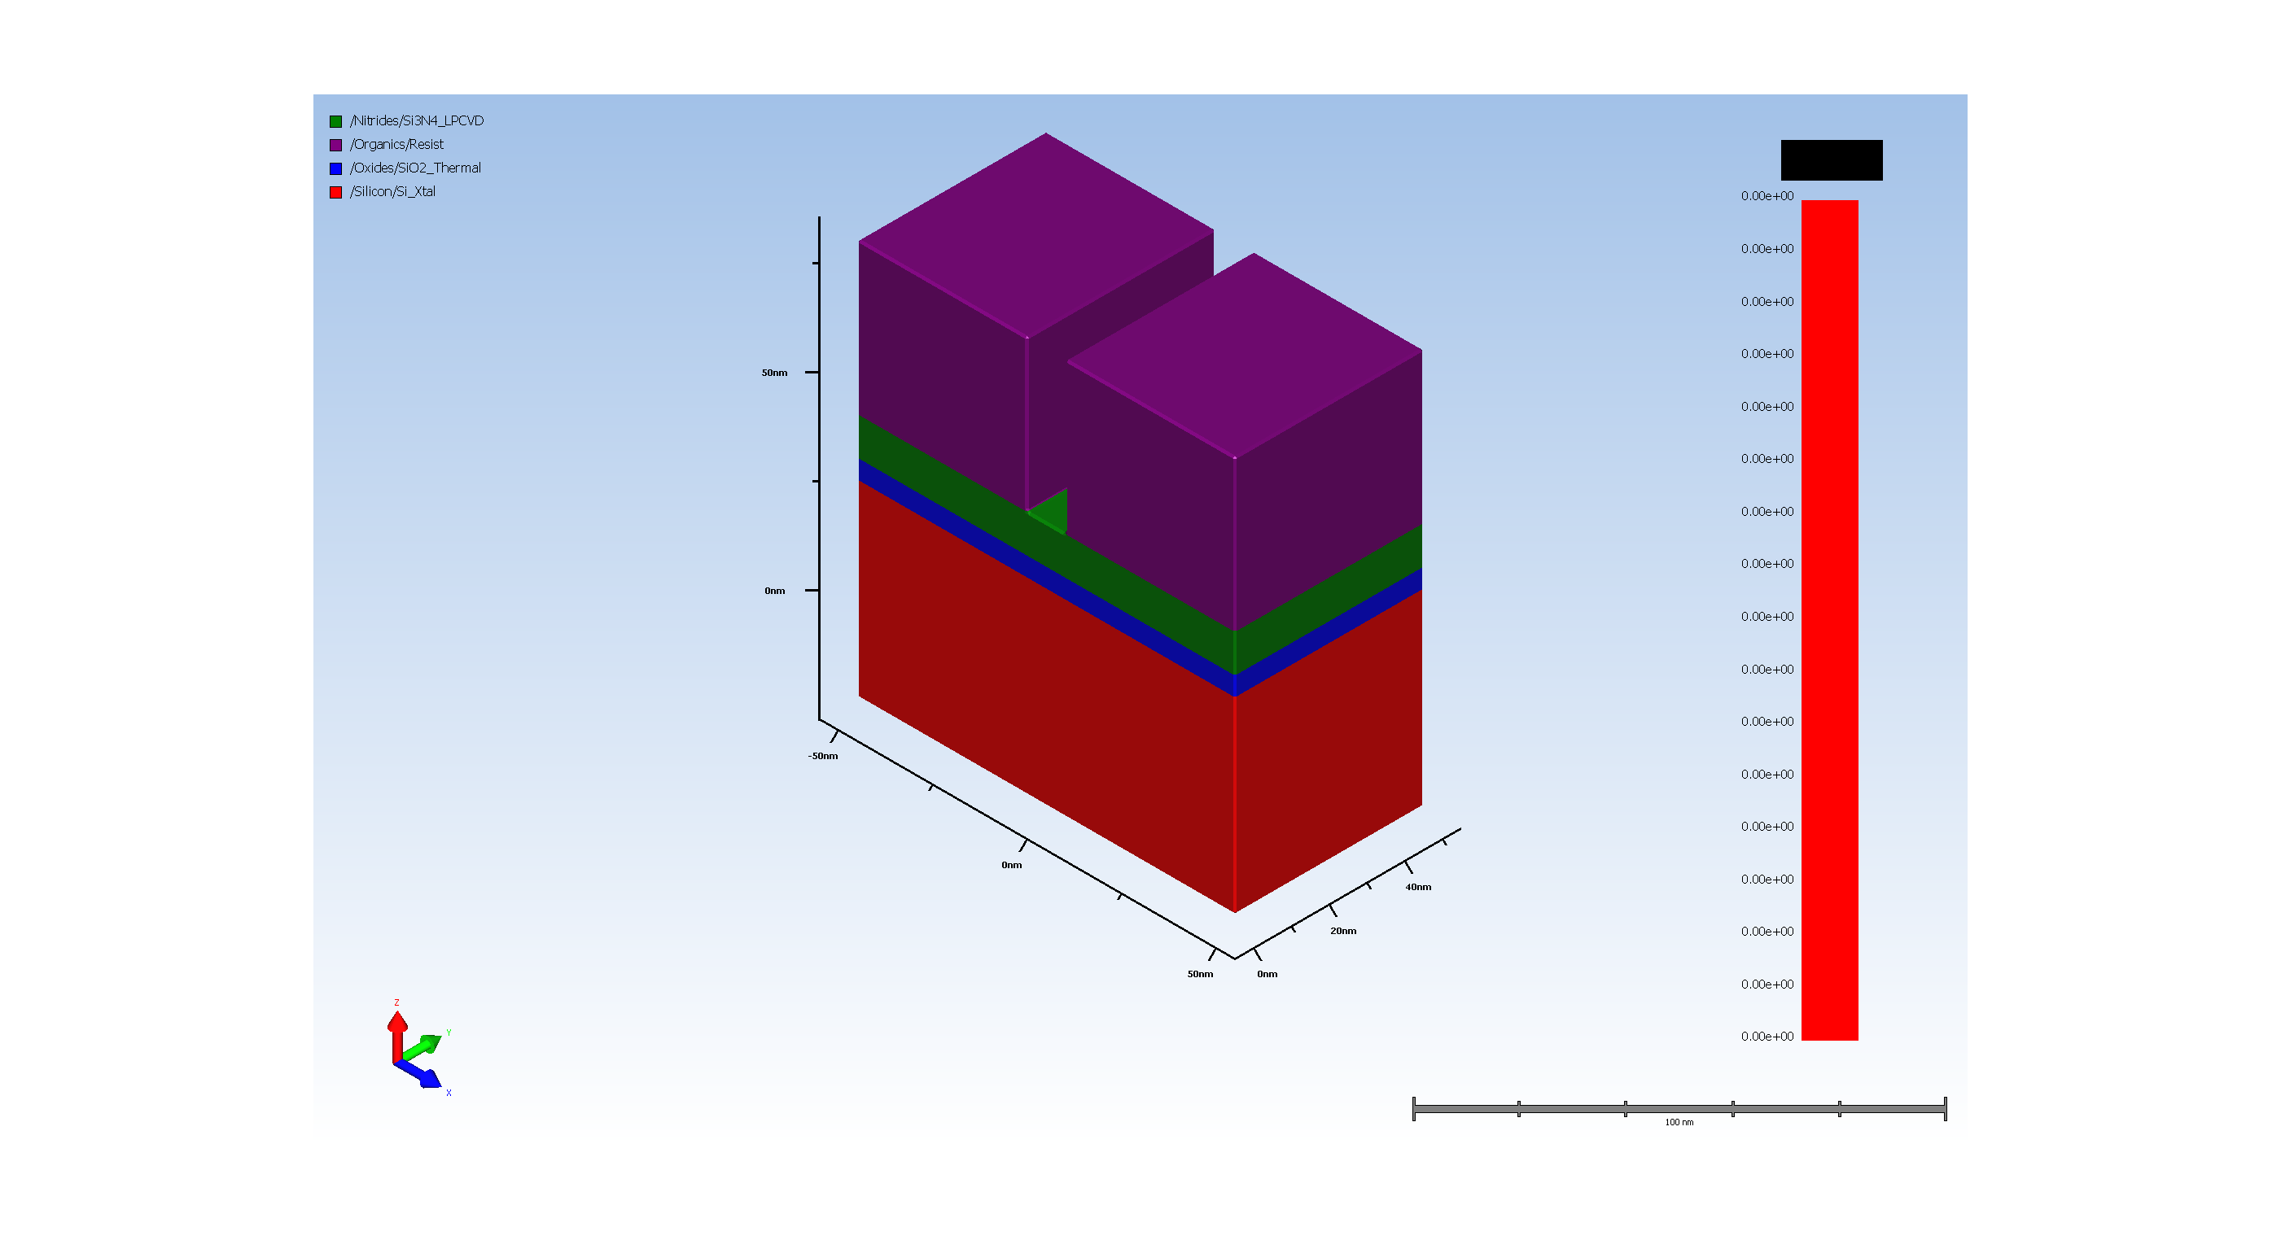
4.2. Expose STI_Trench

Slide 6
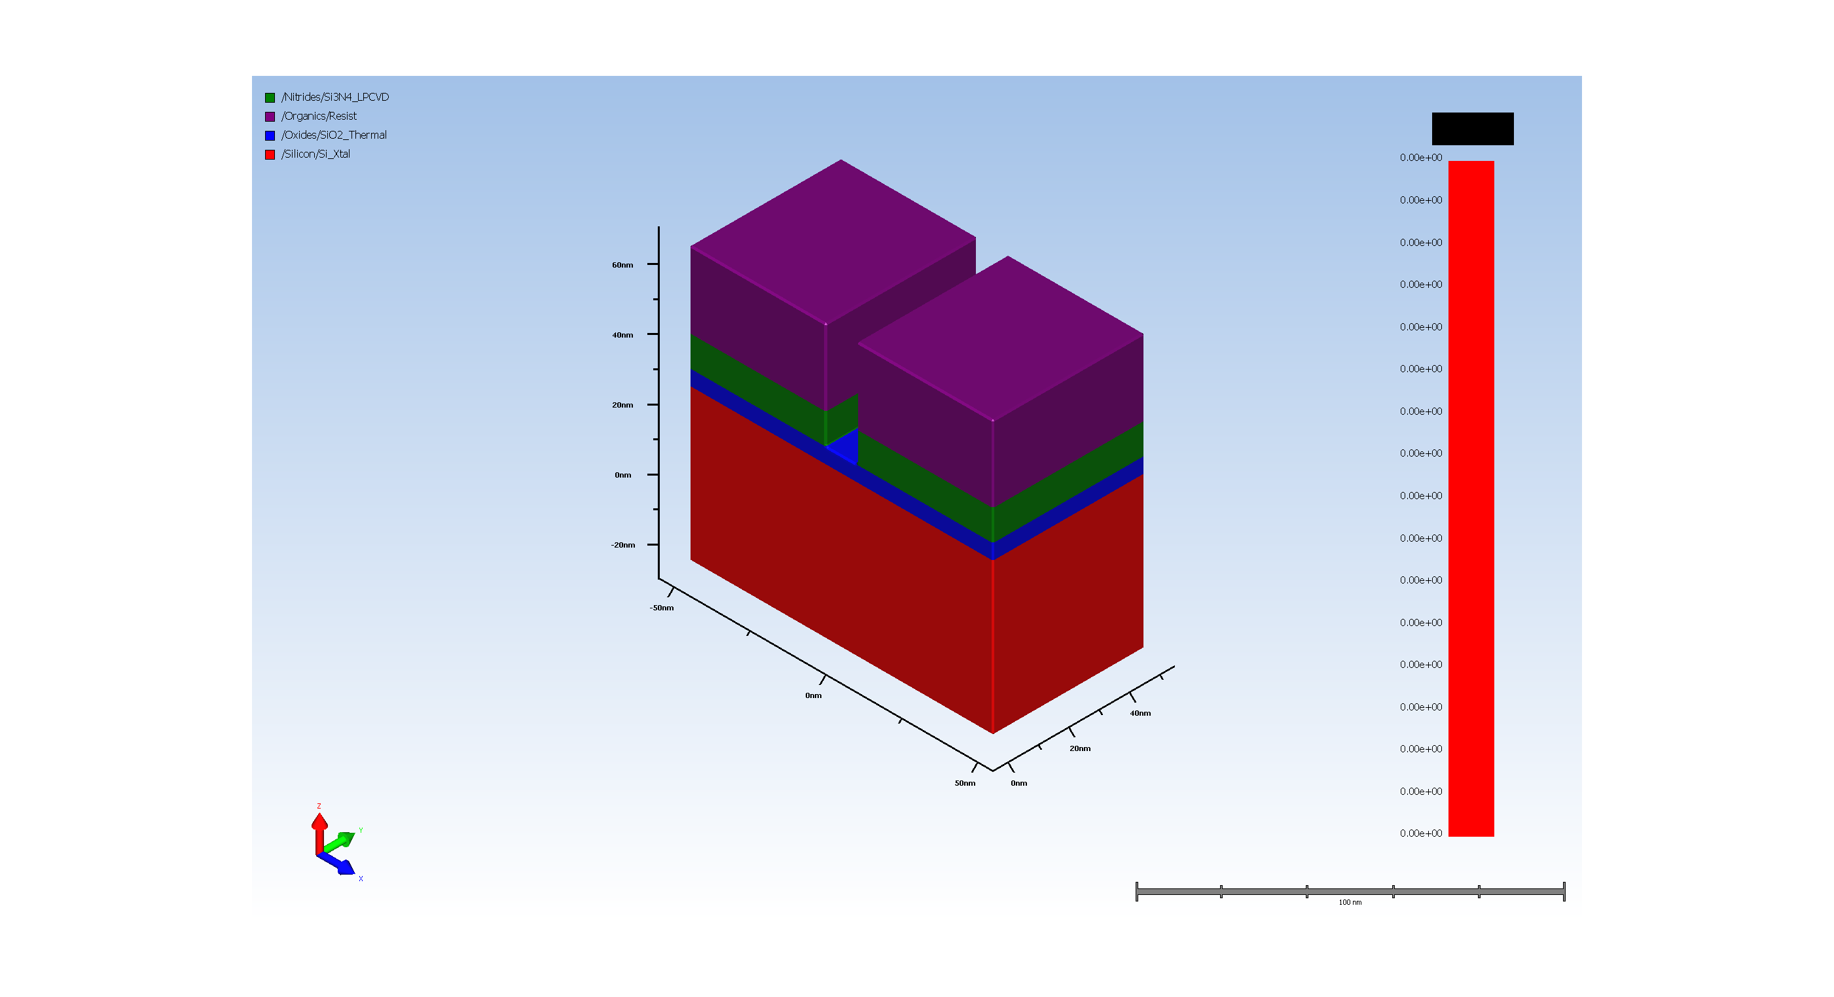
5.1. SiN hardmask etch

Slide 7
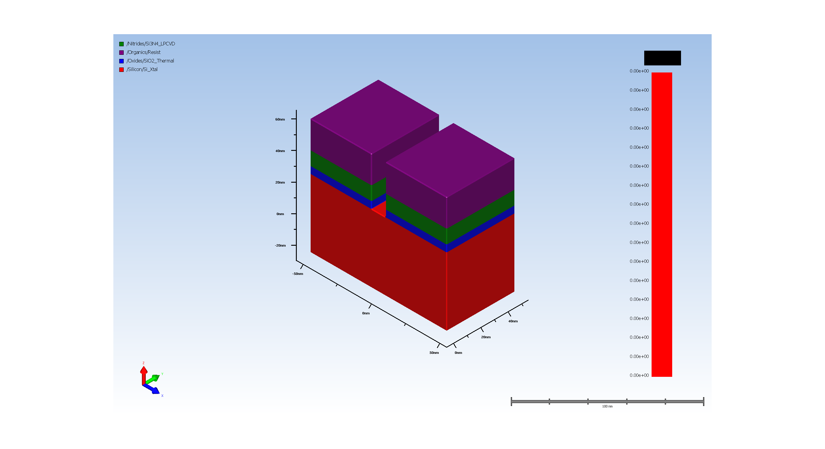
5.2. pad oxide Etch

Slide 8

5.3. substrate silicon Etch

Slide 9
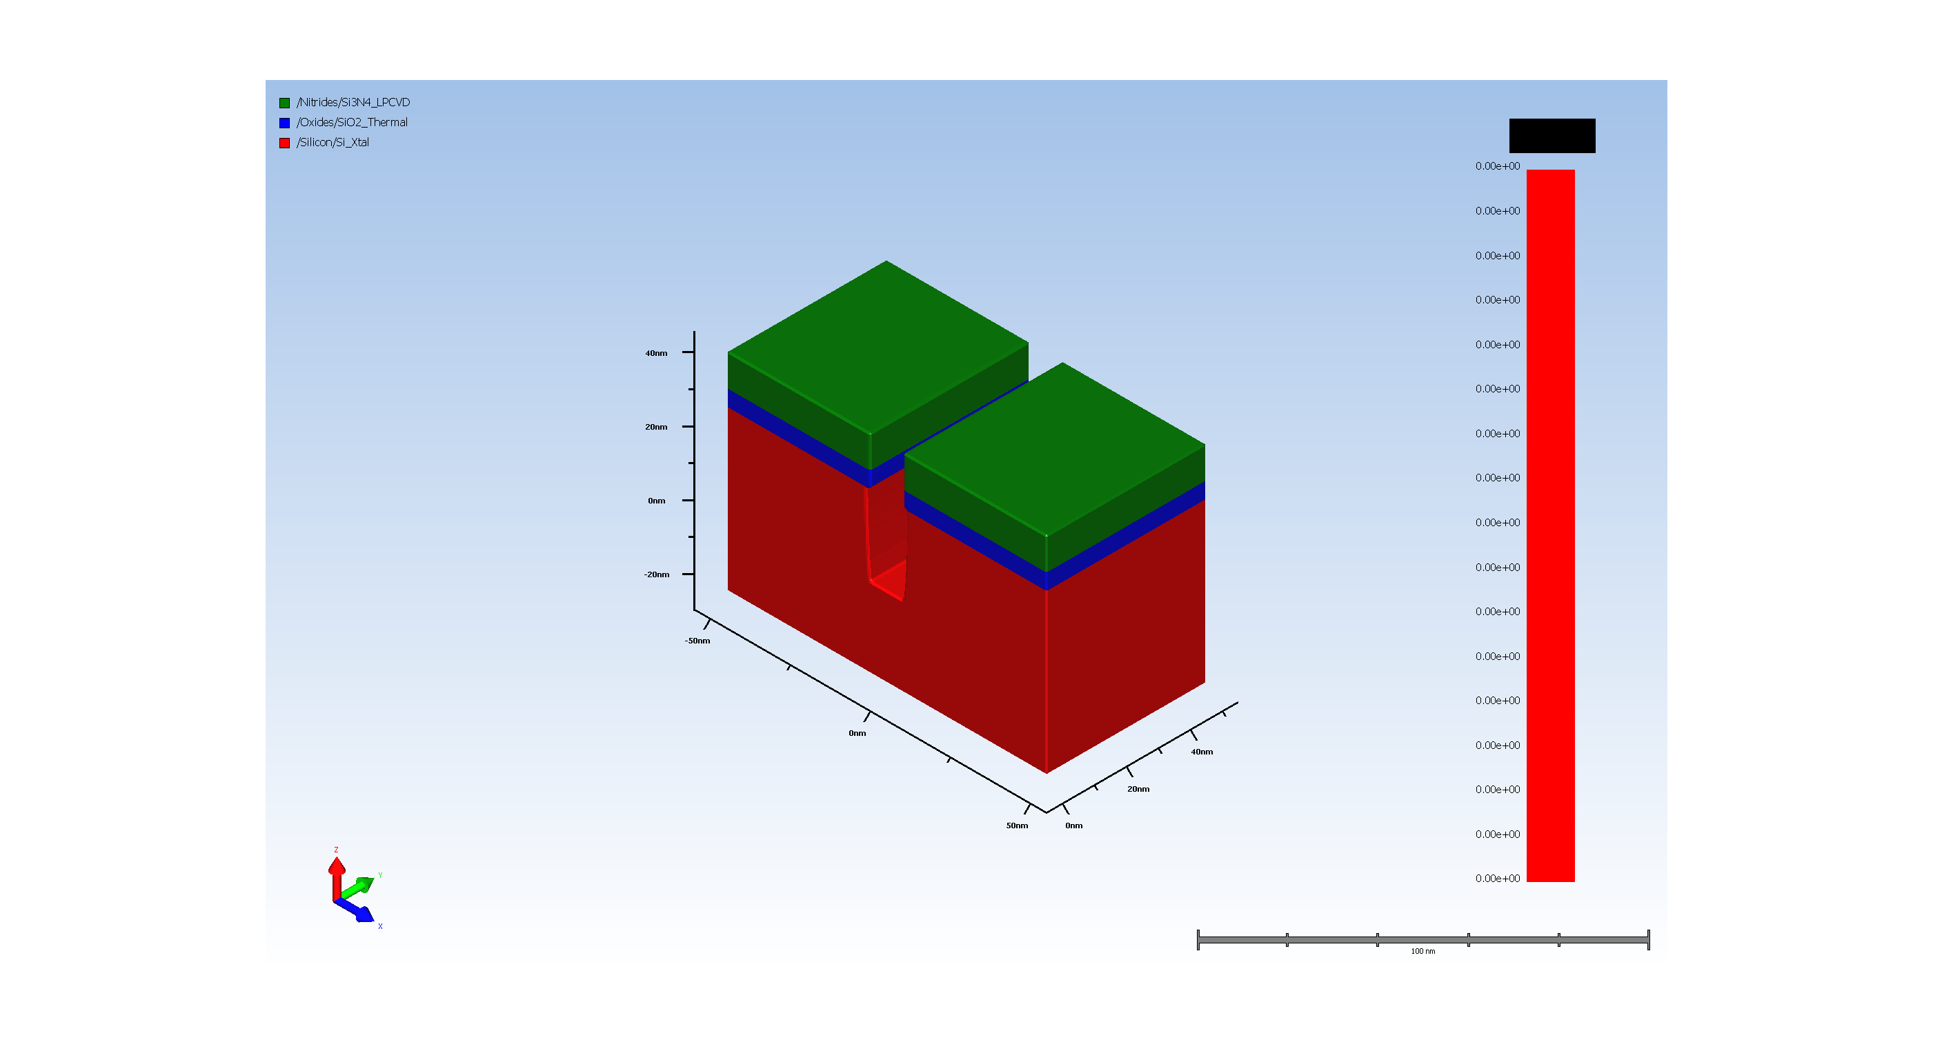
6. resist removal

Slide 10

7. Thermal Oxidation of opened trench

Slide 11
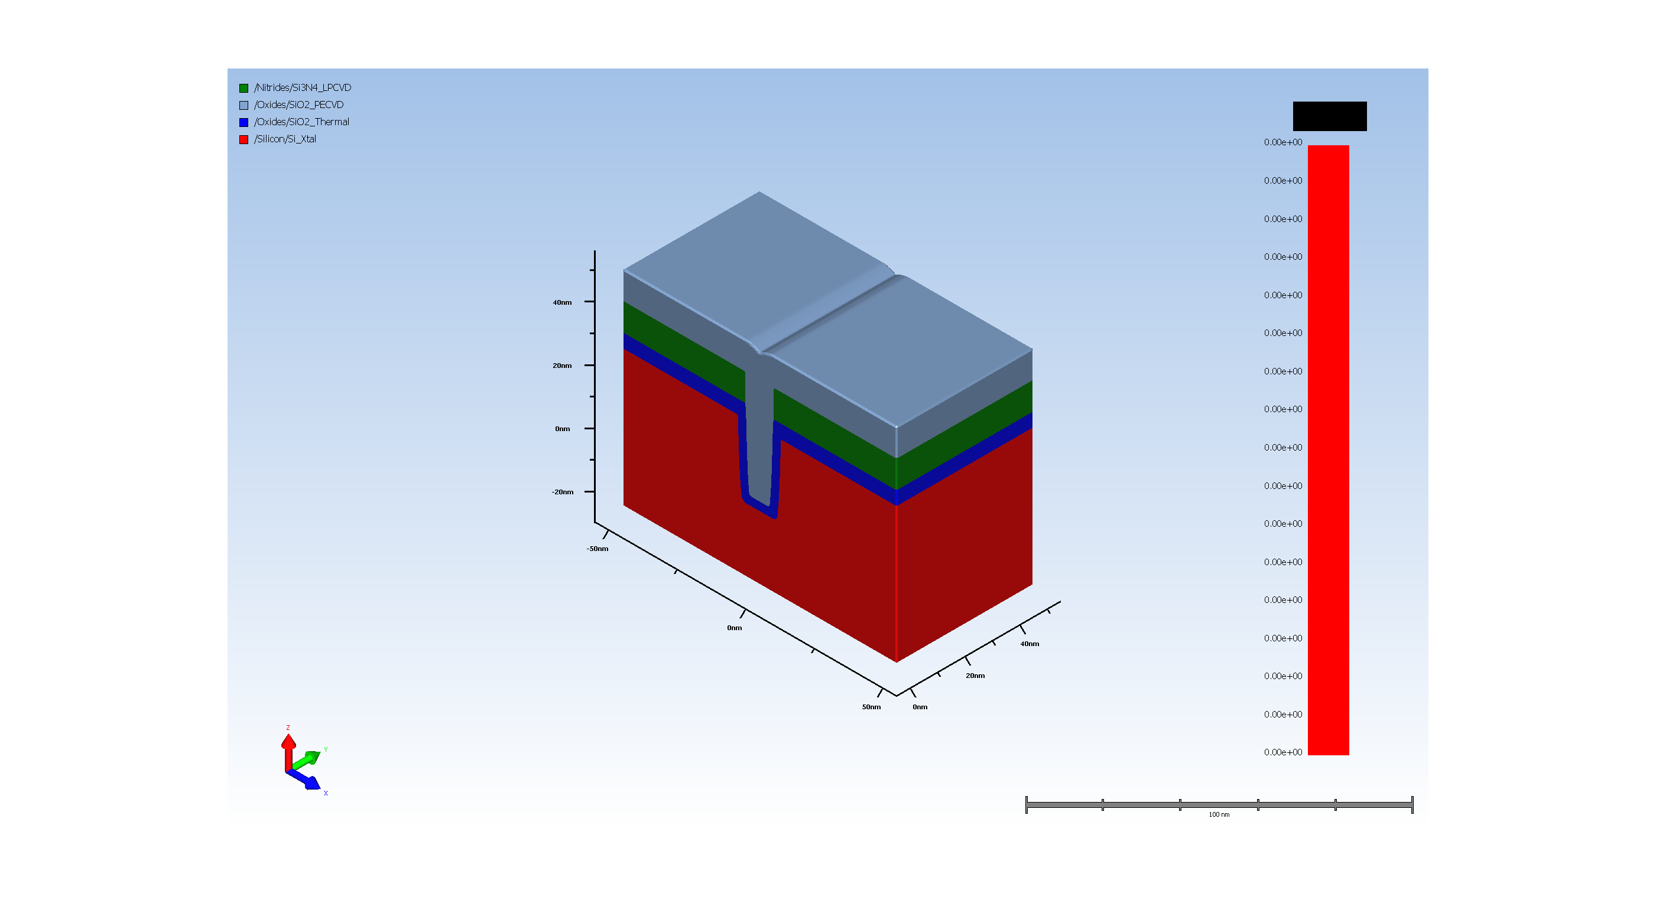
8. Filling trench with CVD oxide

Slide 12
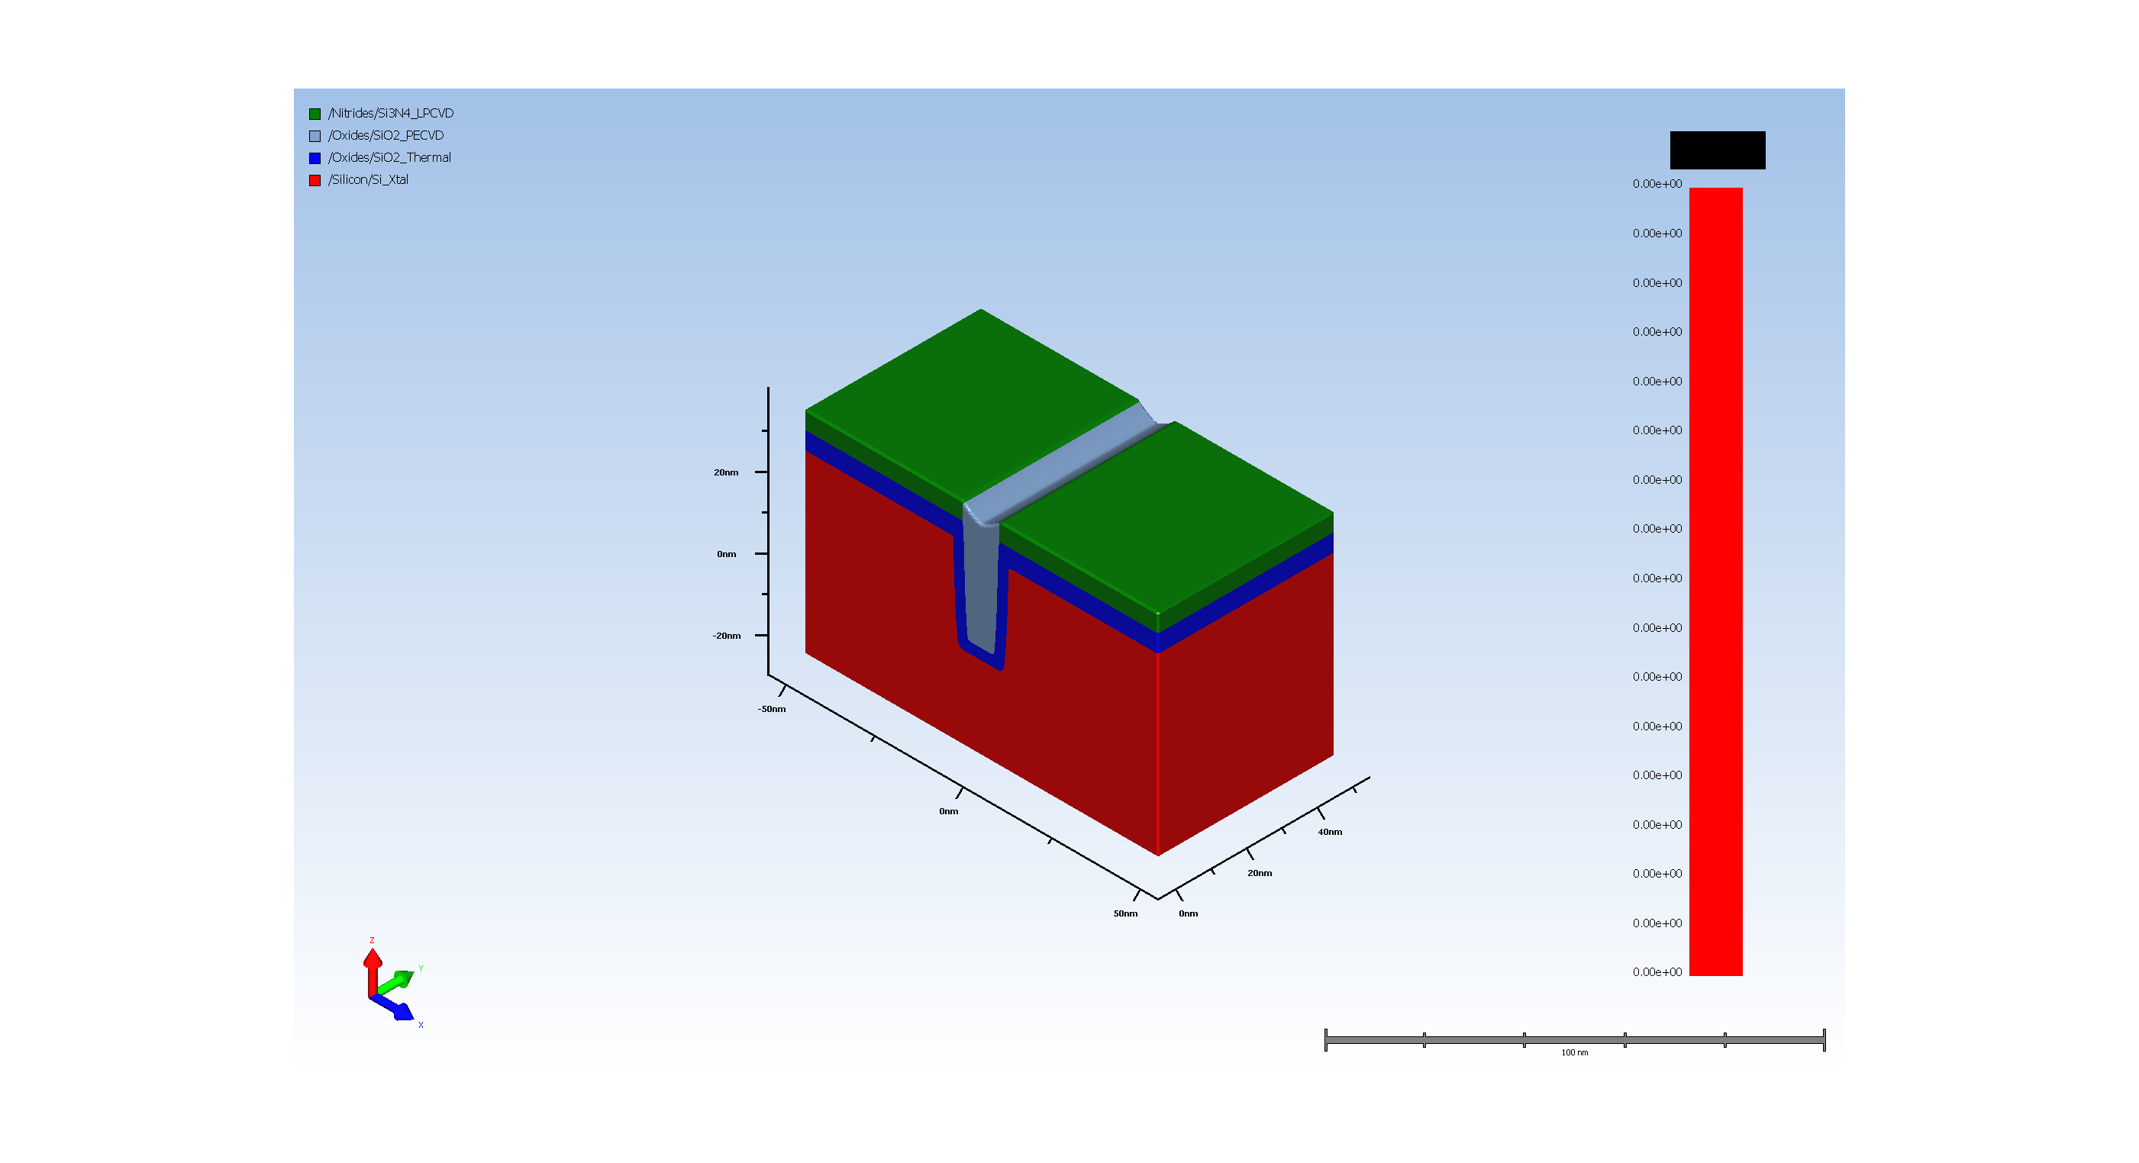
9. STI oxide CMP

Slide 13

10. Removal of SiN hard mask

Slide 14
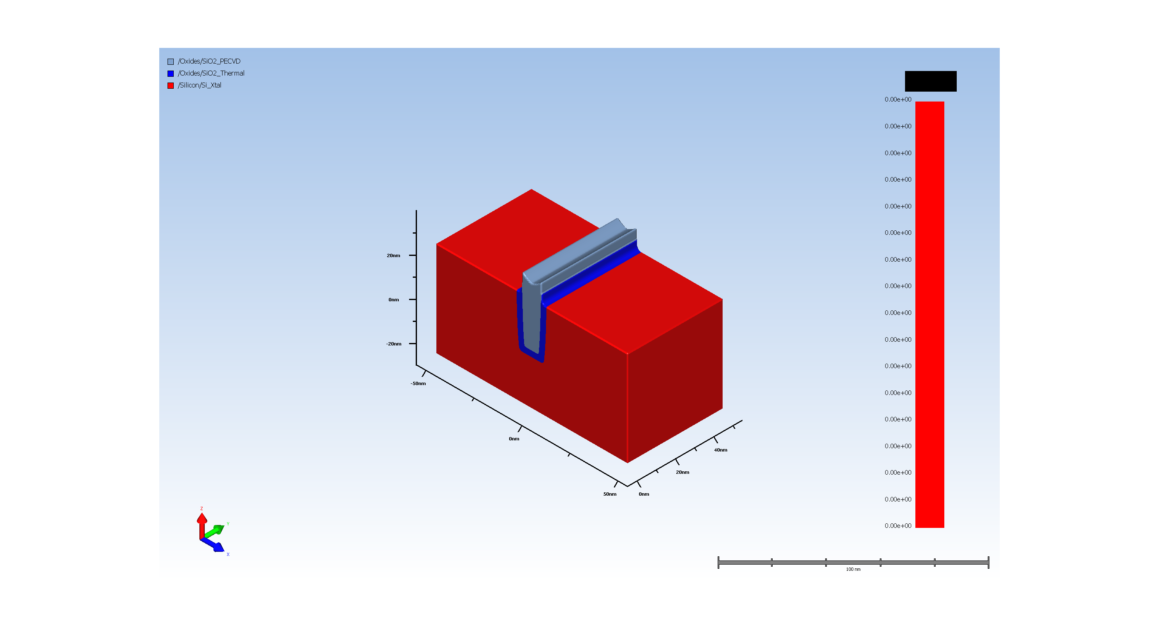
11. Pad_oxide ramoval

Slide 15
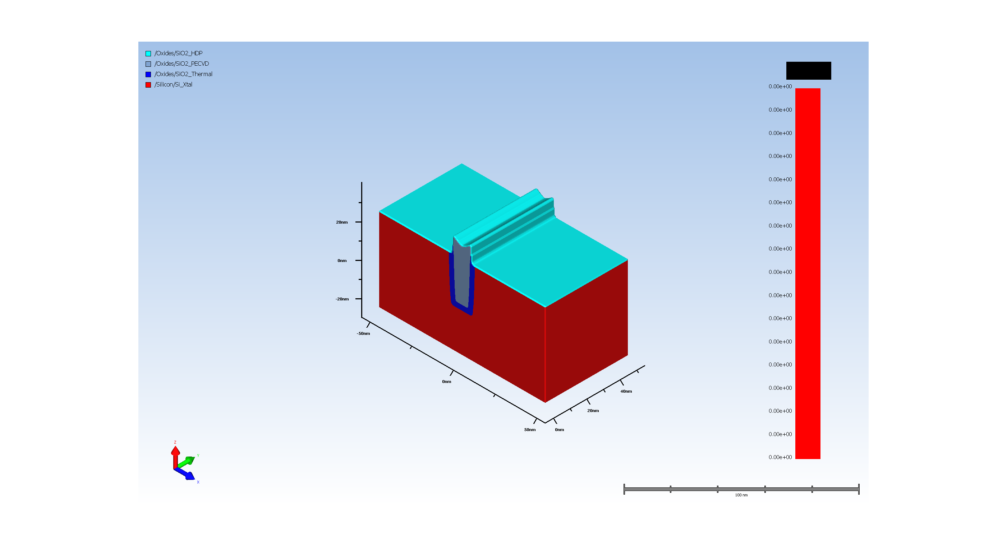
12. Gate oxide deposition

Slide 16
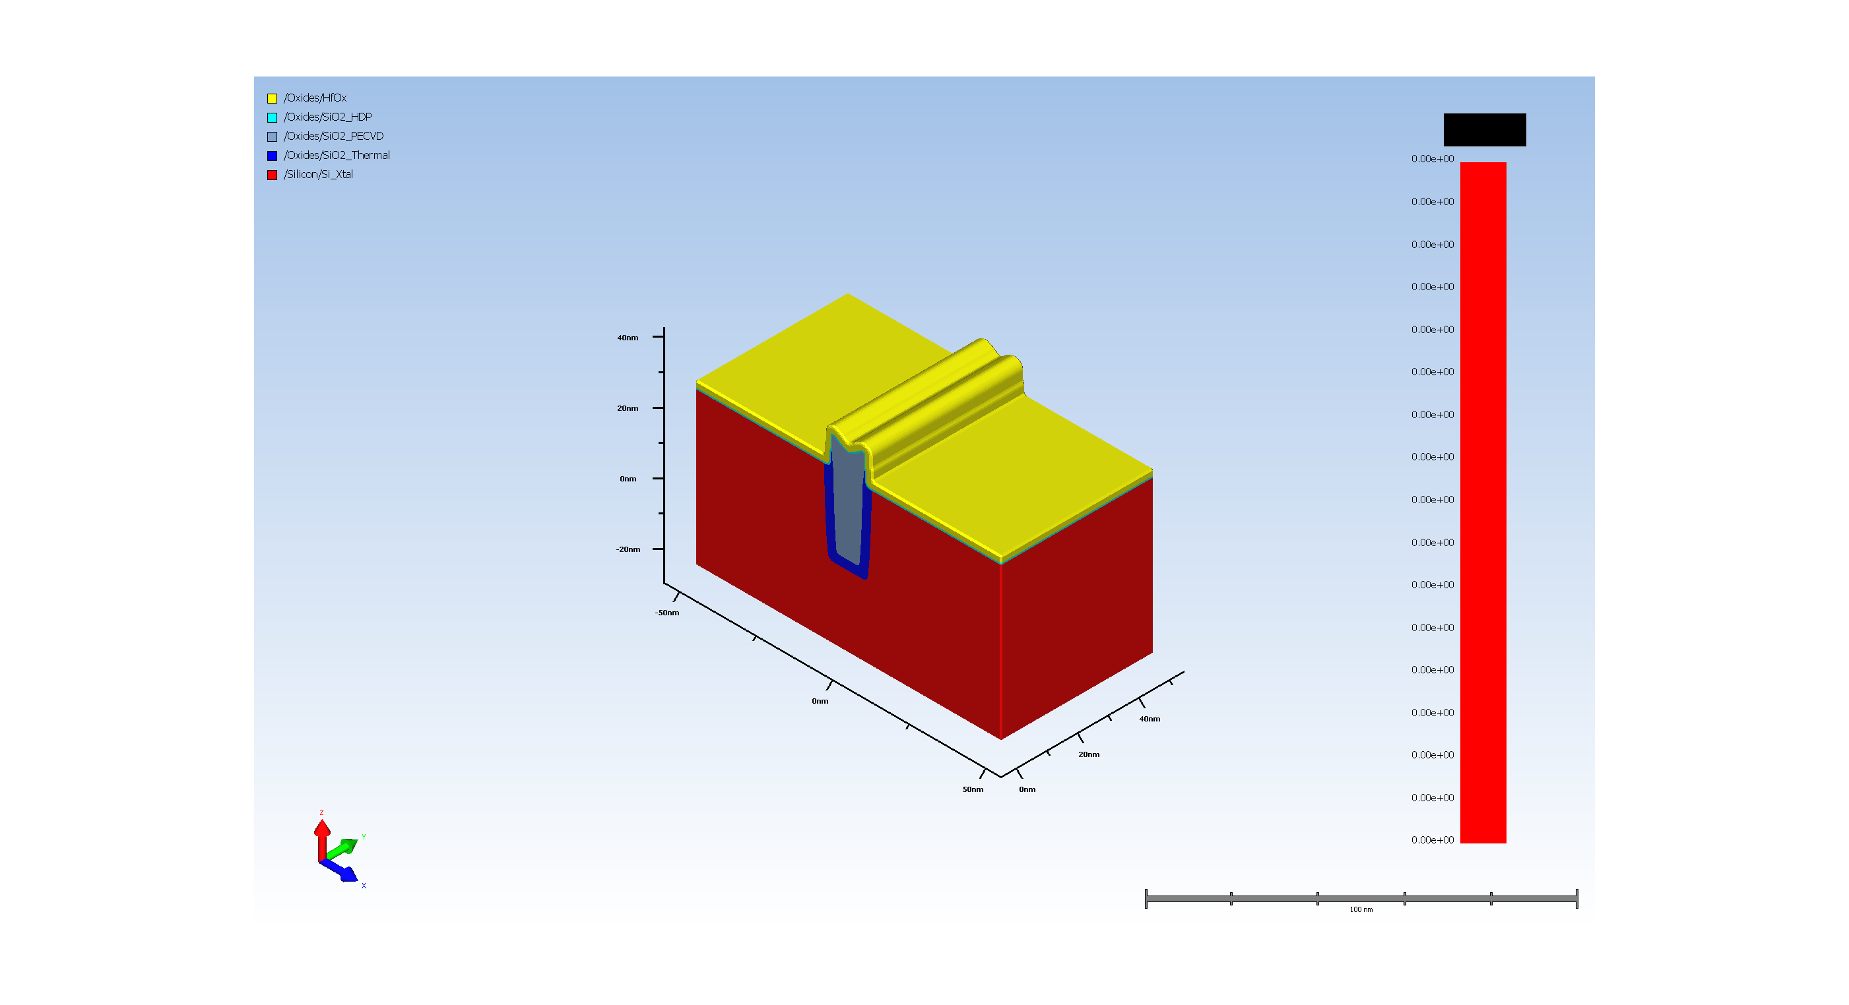
13. High k deposition for Gate

Slide 17
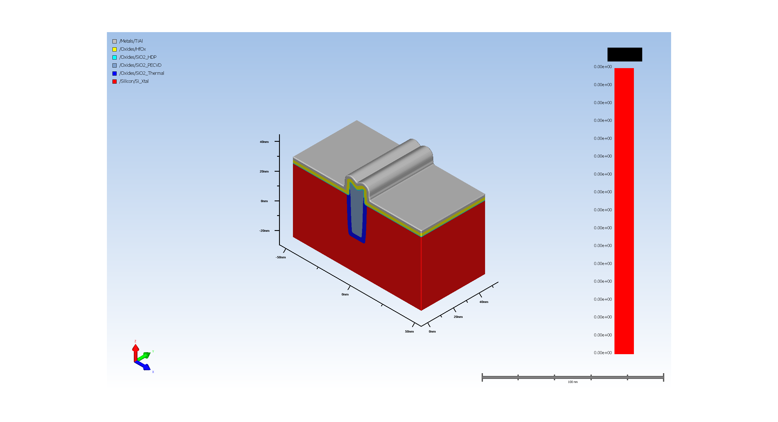
14. NMOS gate metal

Slide 18
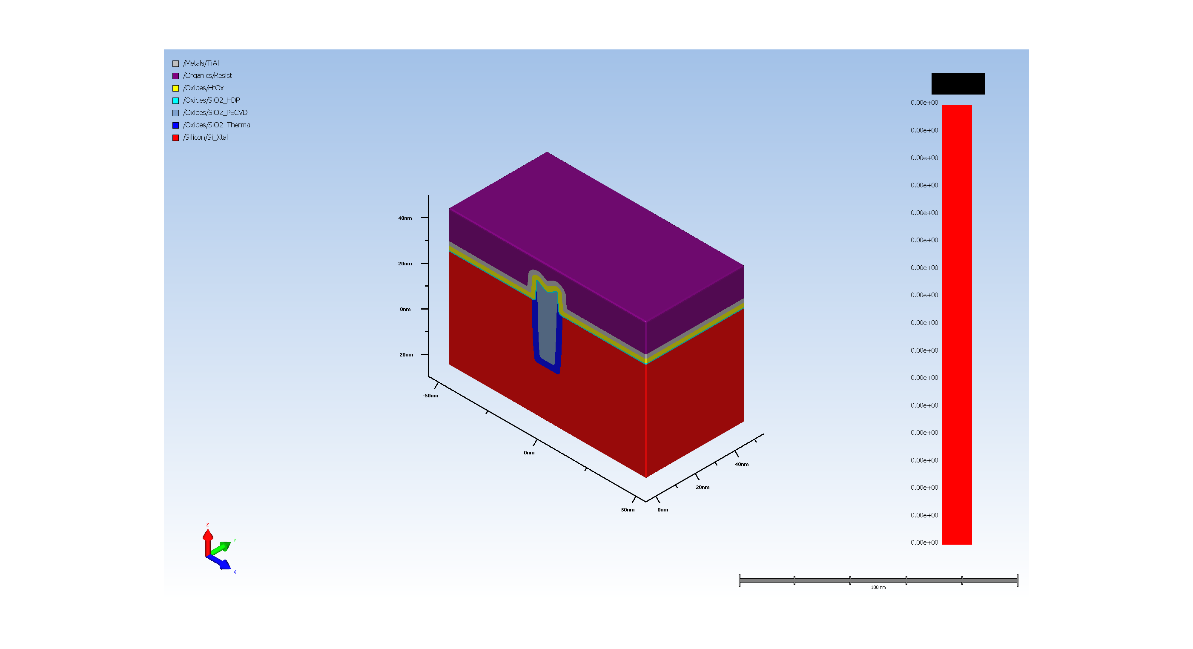
15.1.1. Photo Resist coating

Slide 19
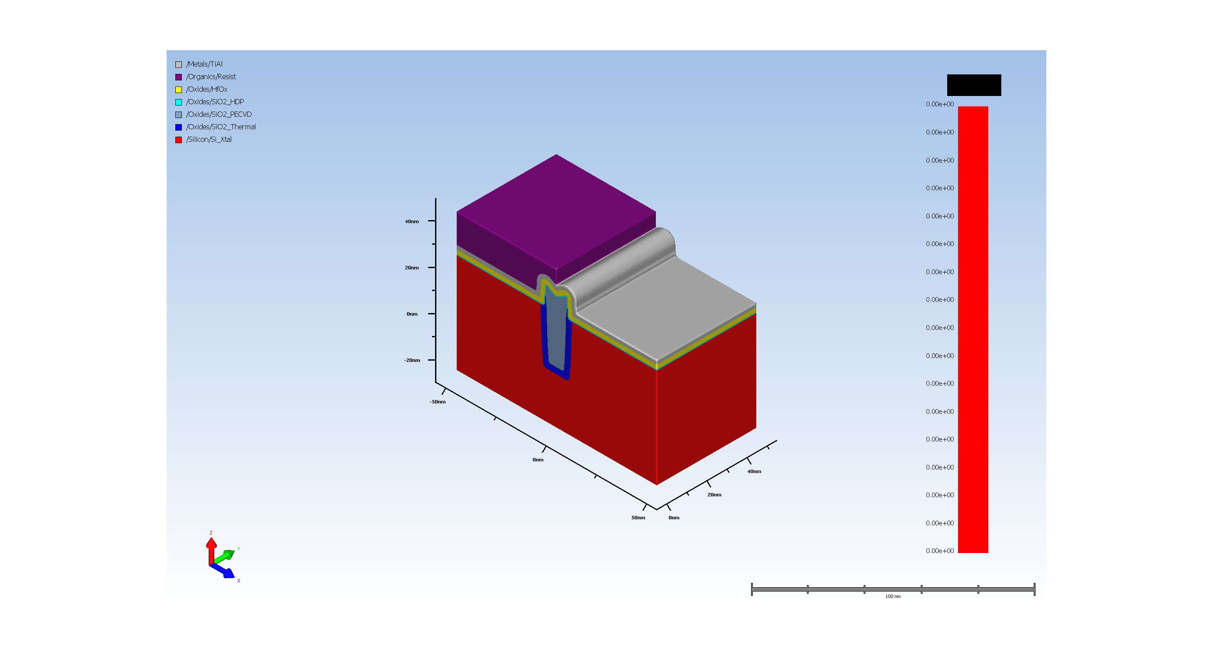
15.1.2. Expose for NMOS gate

Slide 20
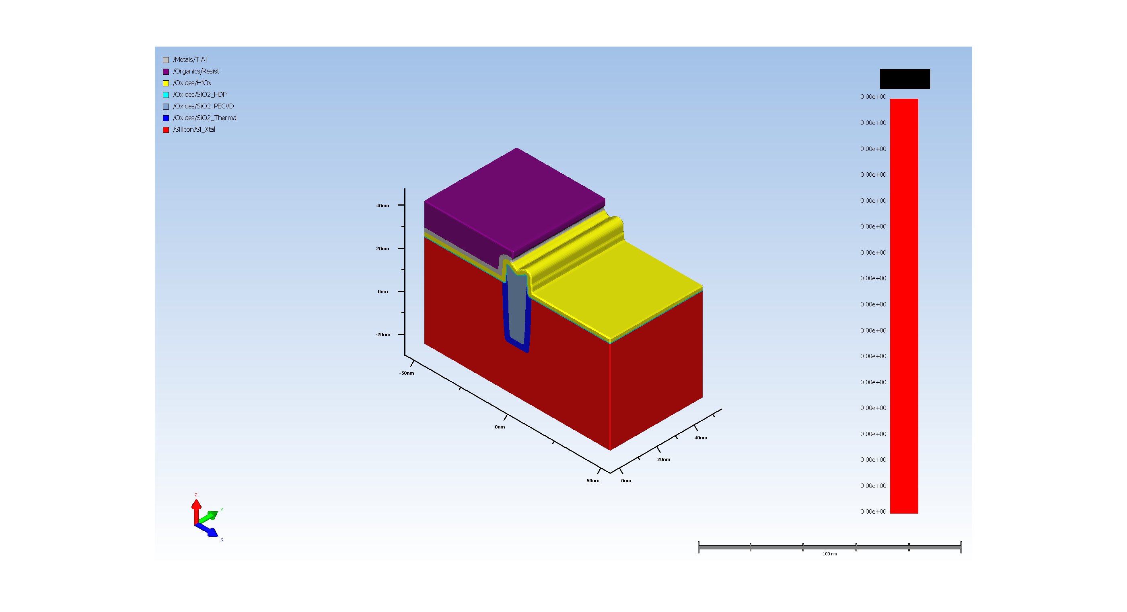
15.2. NMOS Metal Removal to pattern PMOS gate

Slide 21
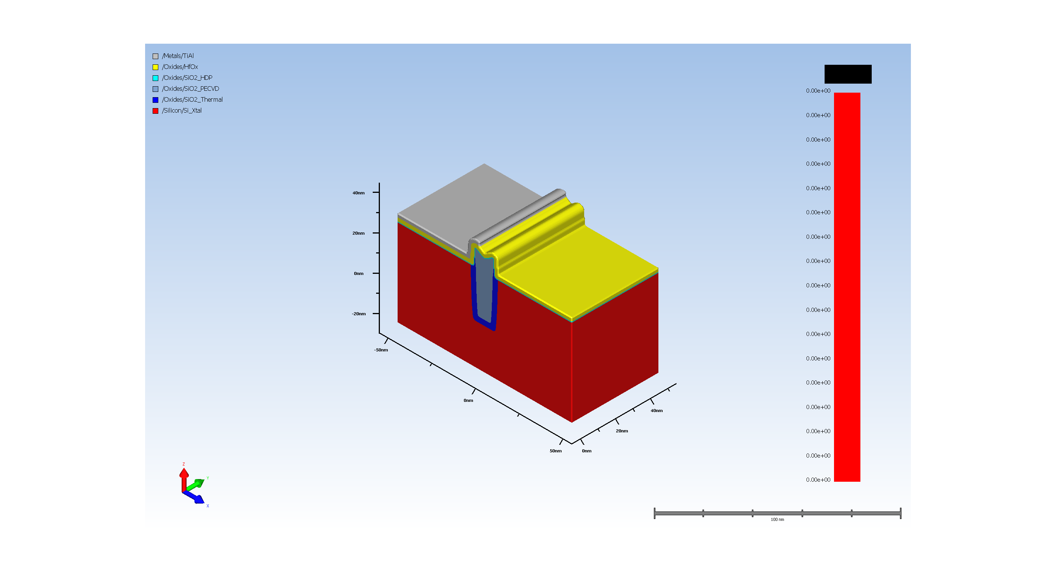
15.3. resist removal after NMOS gate pattern

Slide 22

16. gate metal deposition

Slide 23
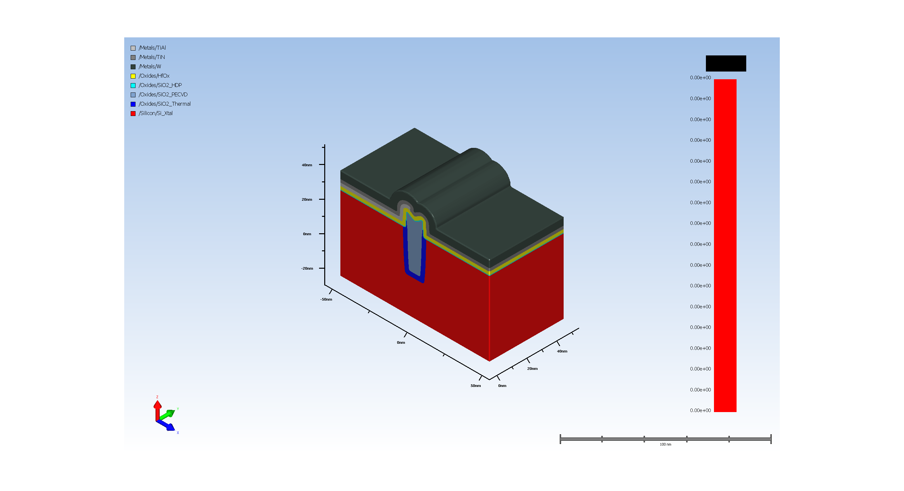
17.1. Final Gate metal deposition

Slide 24
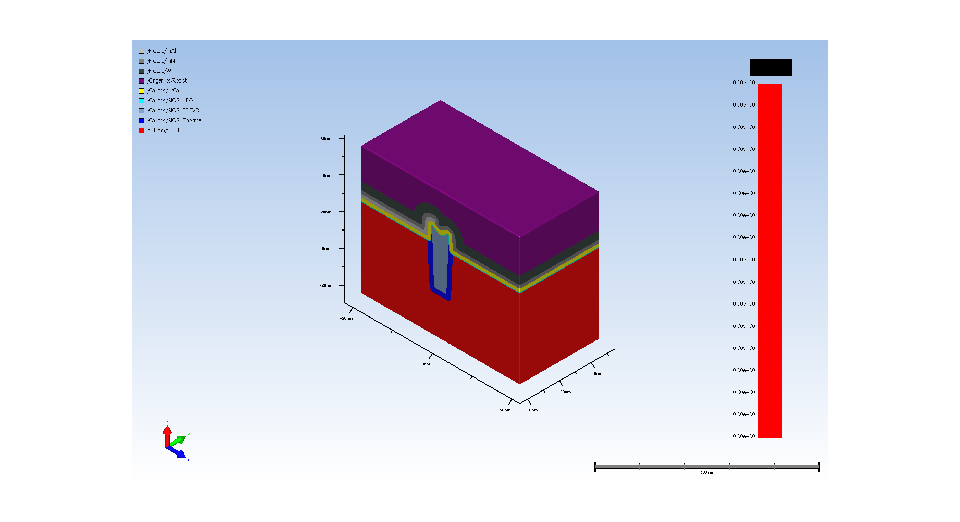
17.2. patterning NMOS AND PMOS gates

Slide 25
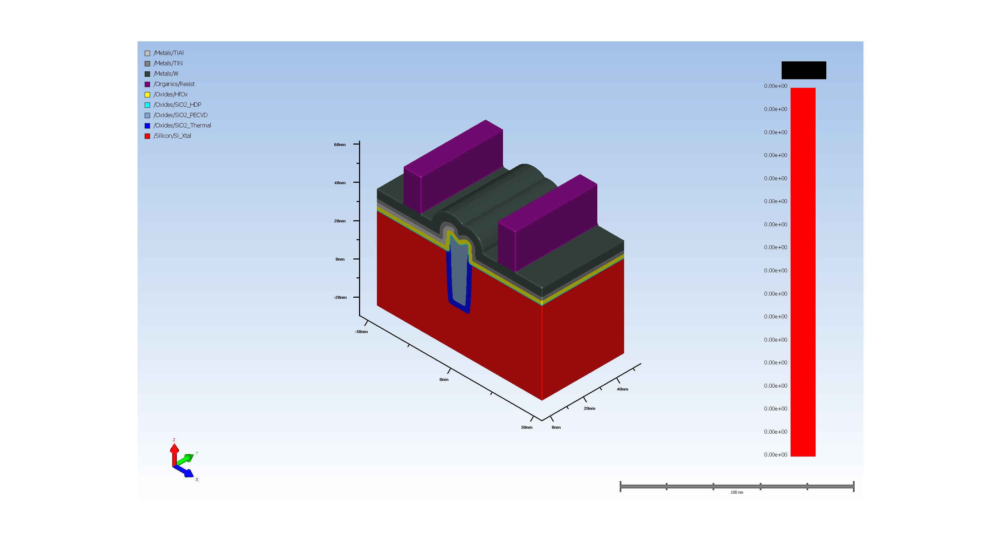
17.3. Expose for NMOS gate

Slide 26

17.4. W Etch

Slide 27
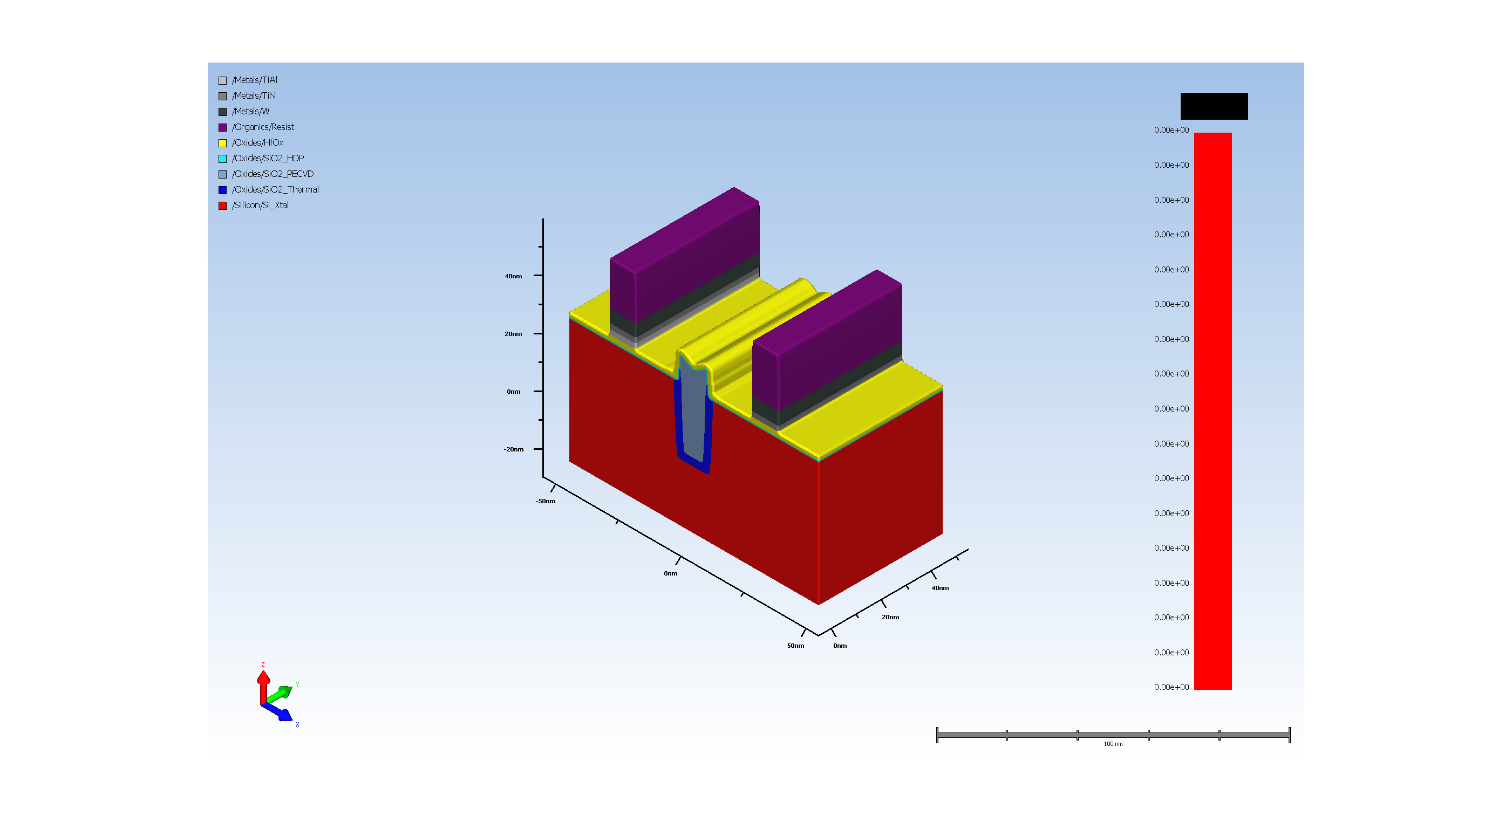
17.5. TiN/TiAl Etch

Slide 28
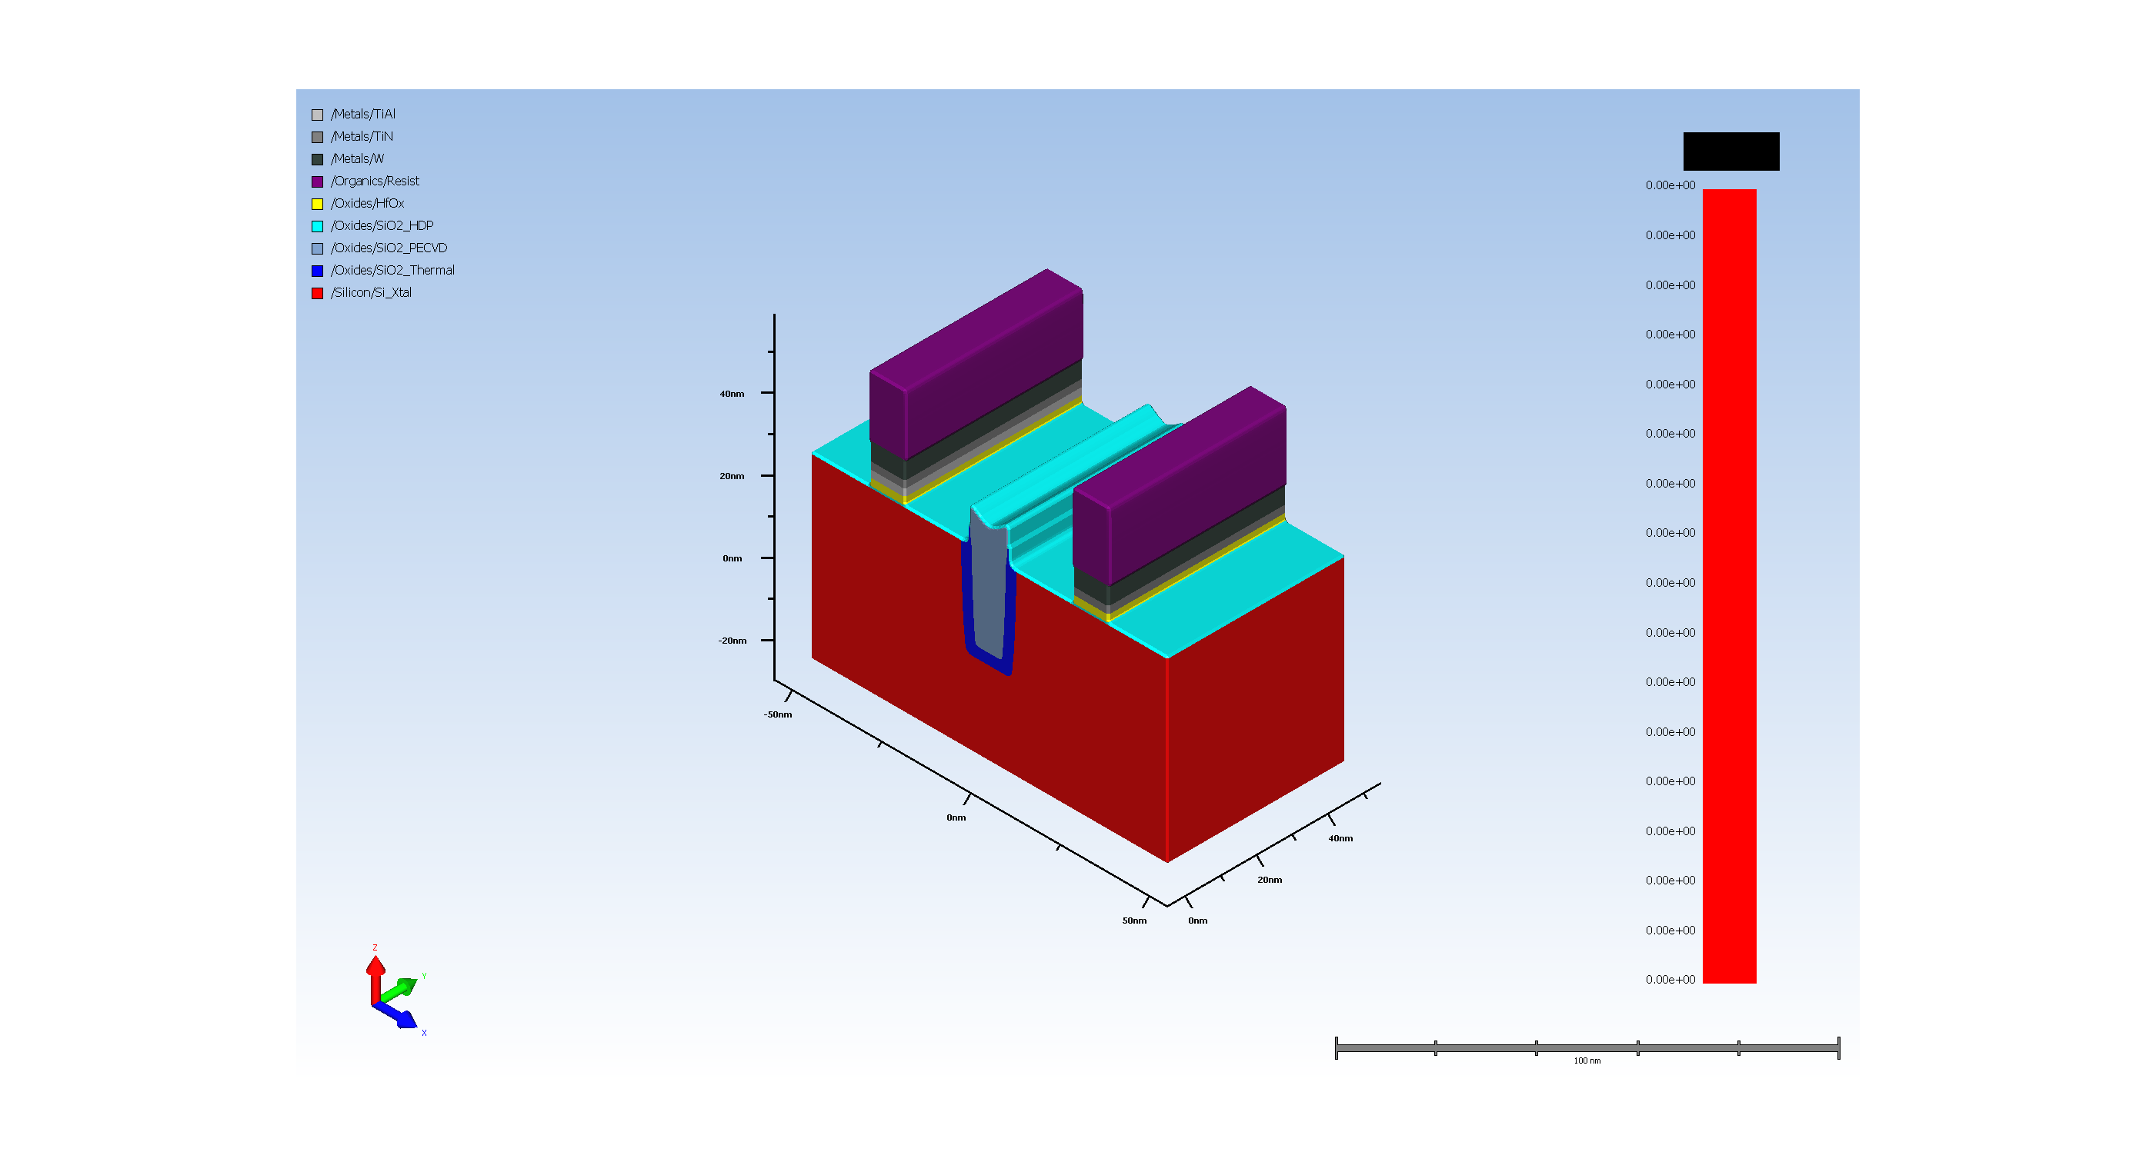
17.6. high k Etch

Slide 29
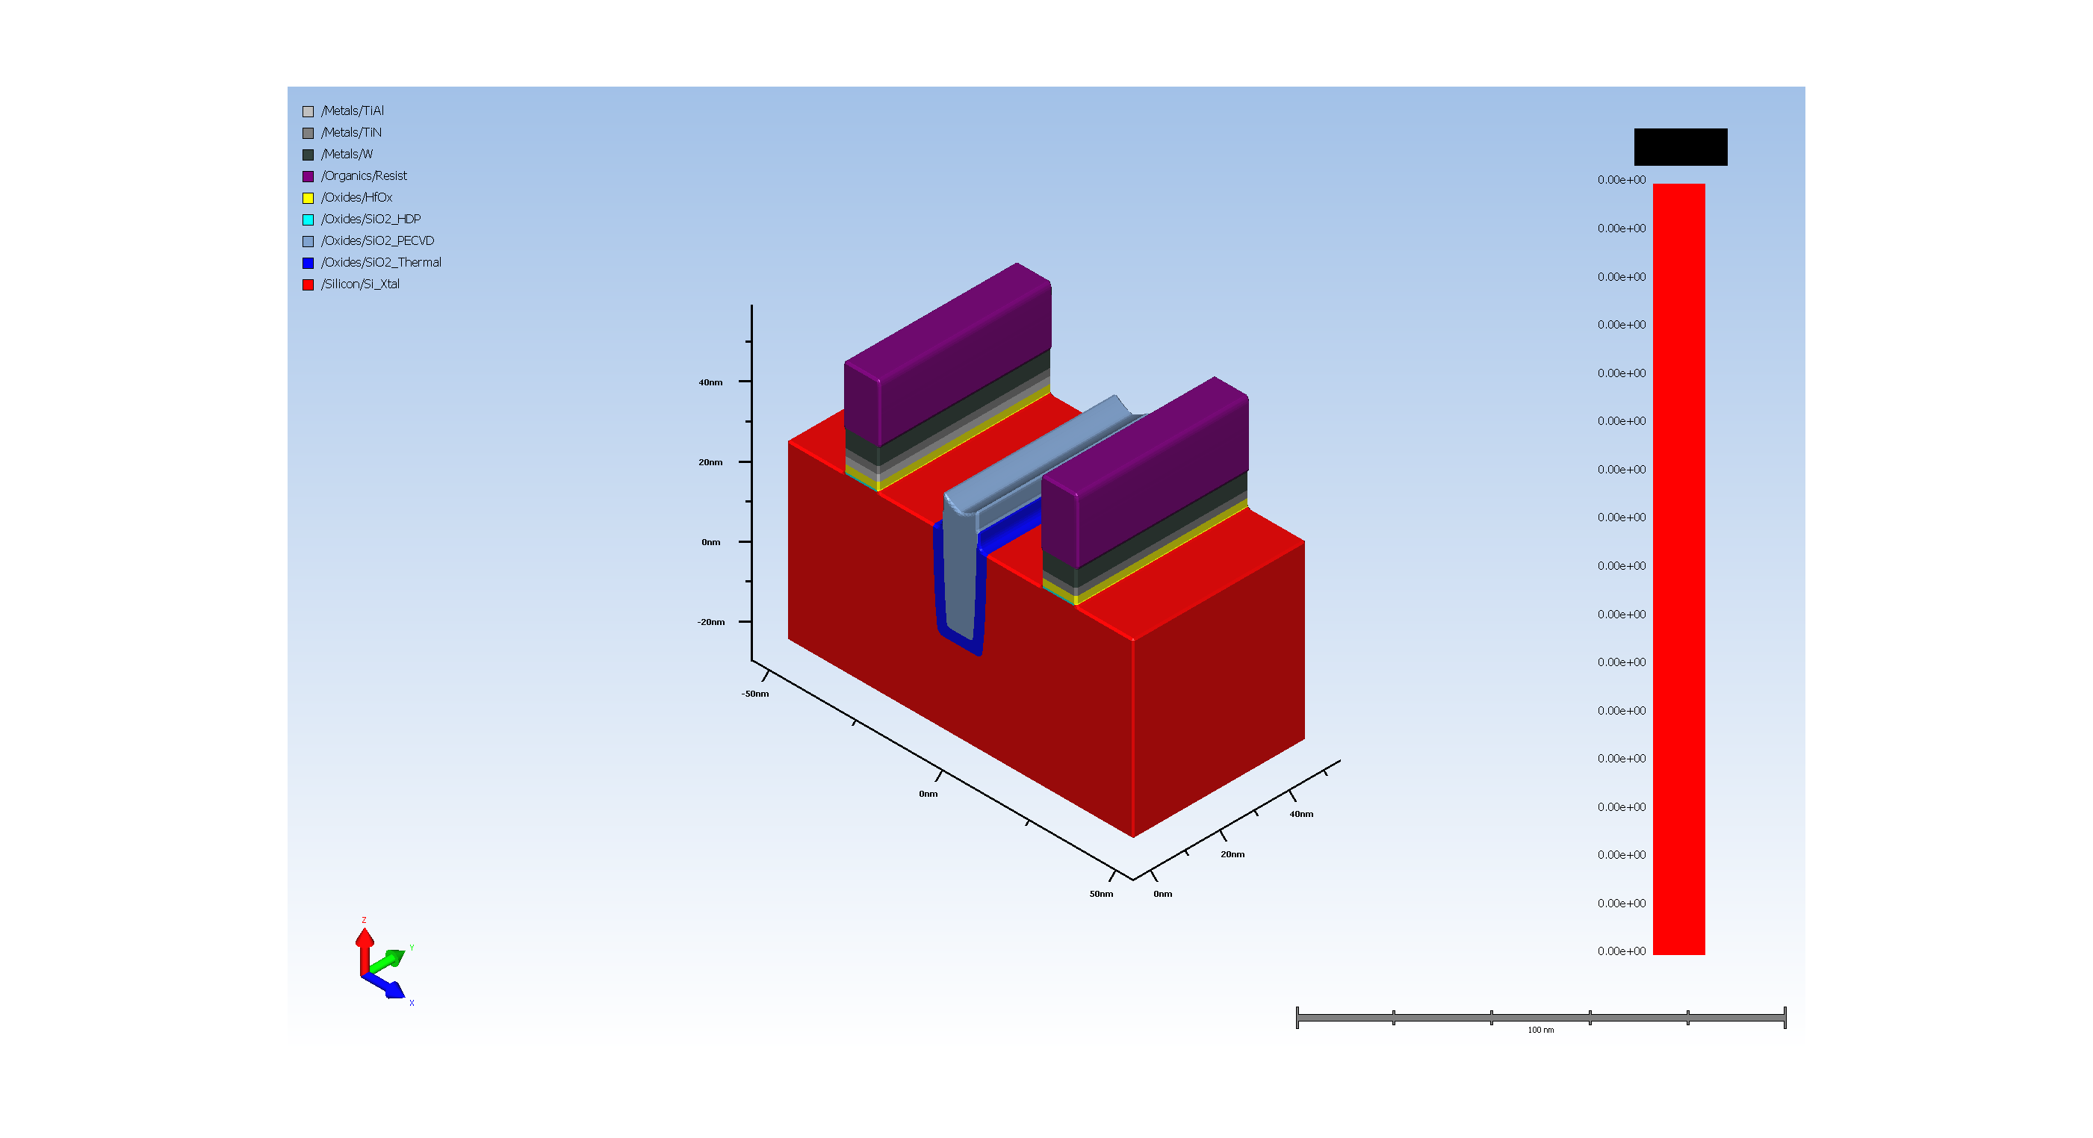
17.7. Gate oxide Etch

Slide 30
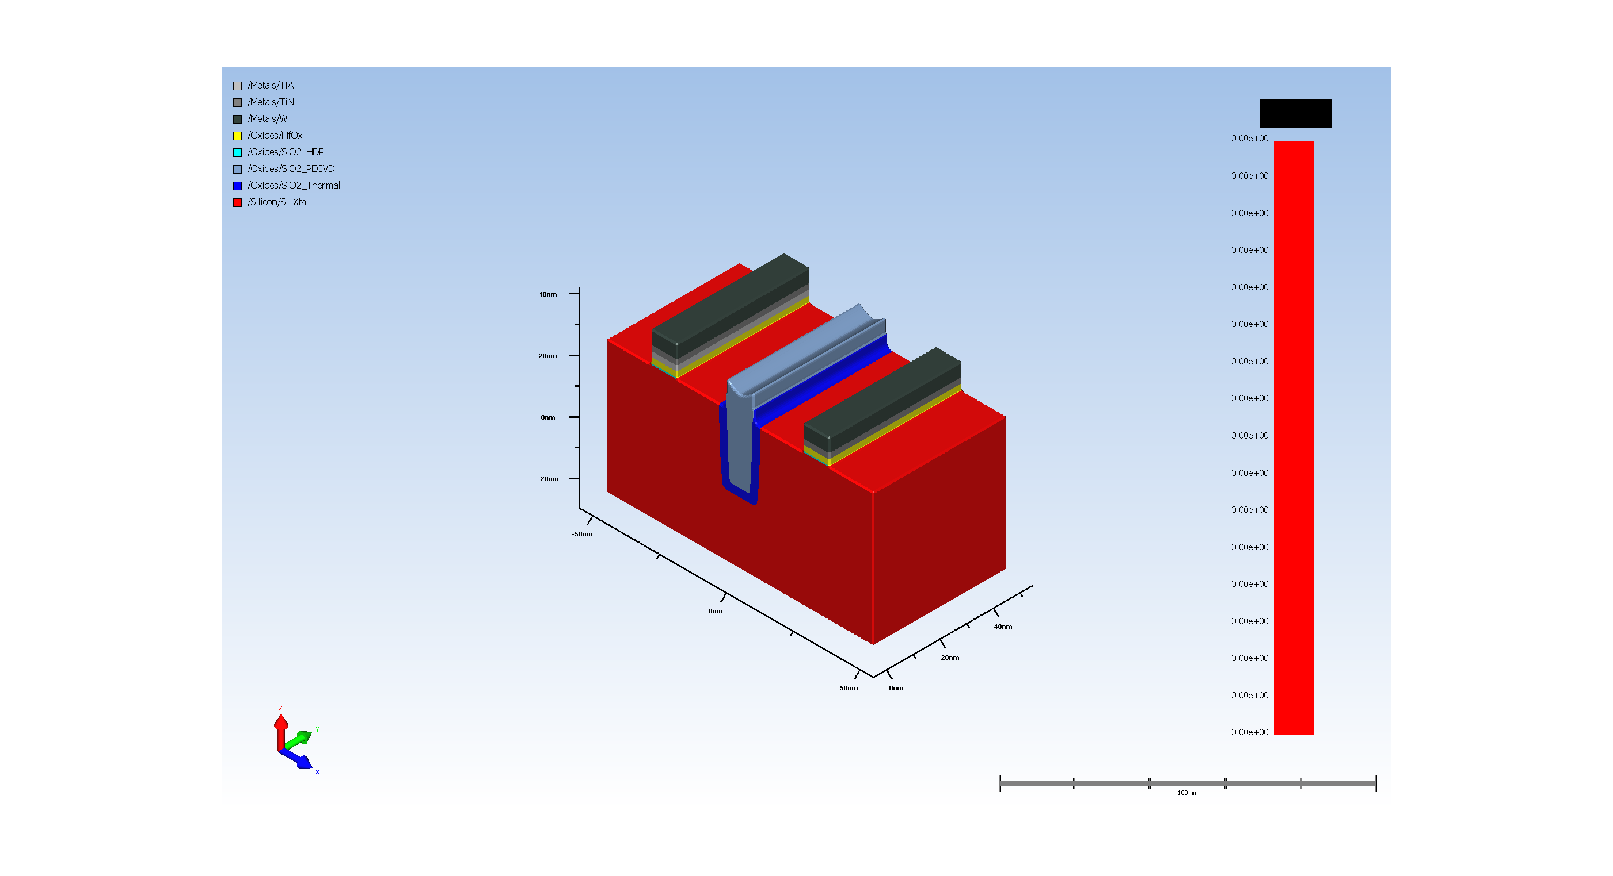
17.8. resist removal after gate pattern

Slide 31
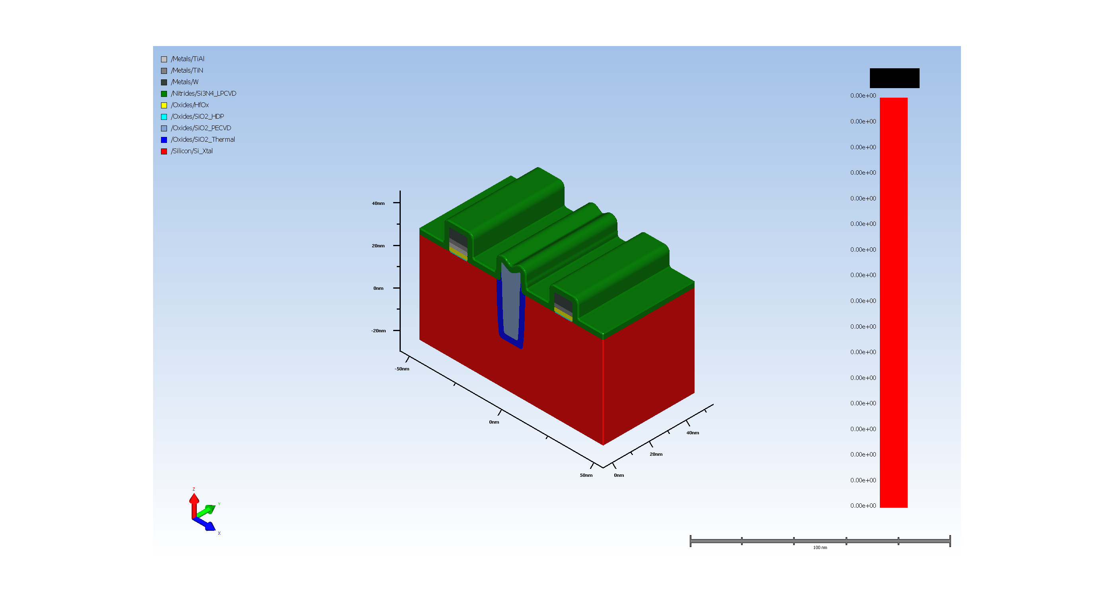
18.1. Conformal Deposit

Slide 32

18.2. Basic Etch

Slide 33
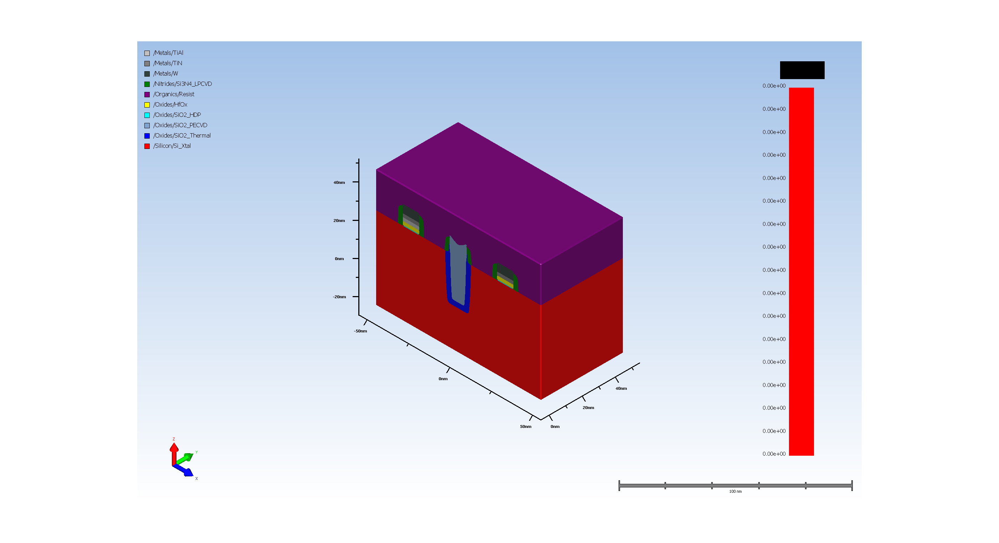
18.3. Resist pattern for Nmos source and Drain

Slide 34
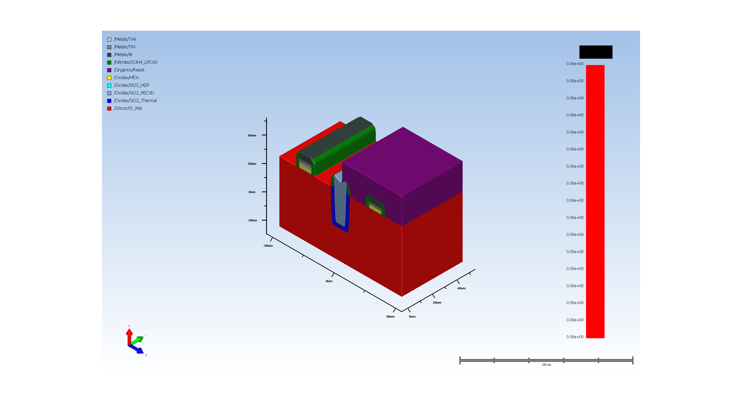
18.4. Expose resist for source and drain

Slide 35
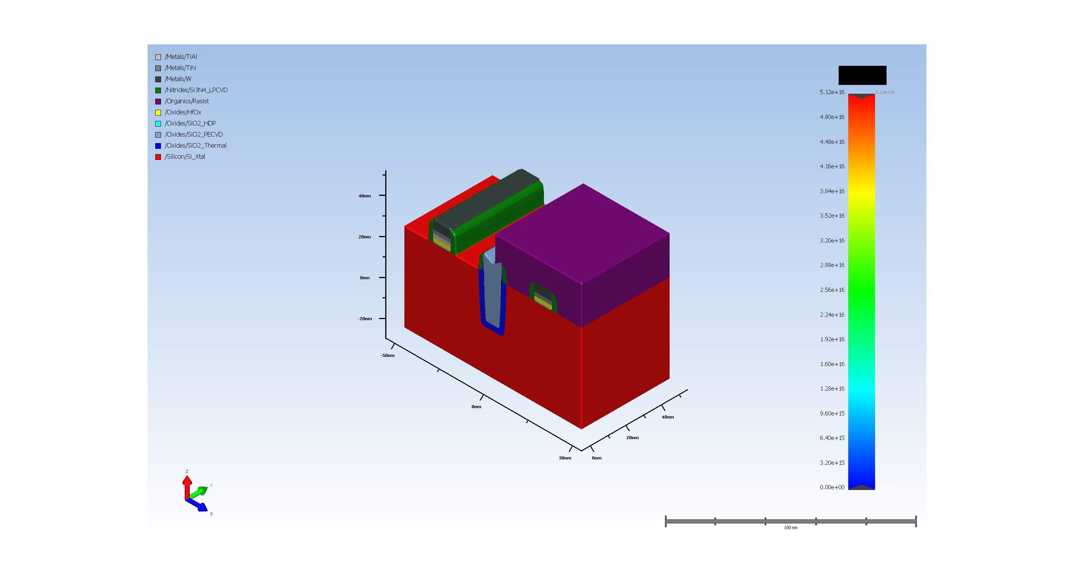
18.5. NMOS source and drain doping

Slide 36
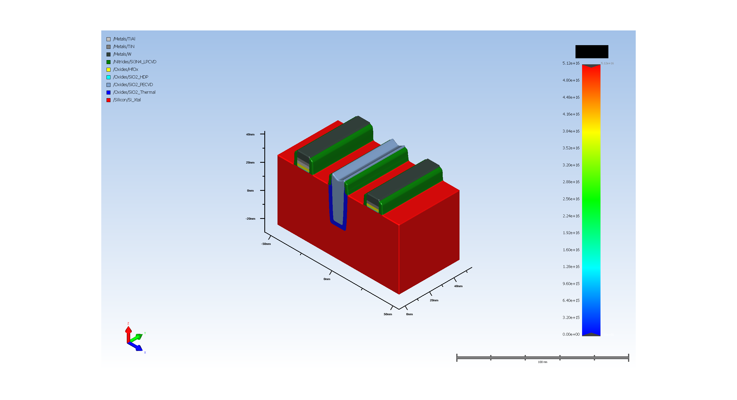
18.6. resist removal after PMOS gate pattern

Slide 37
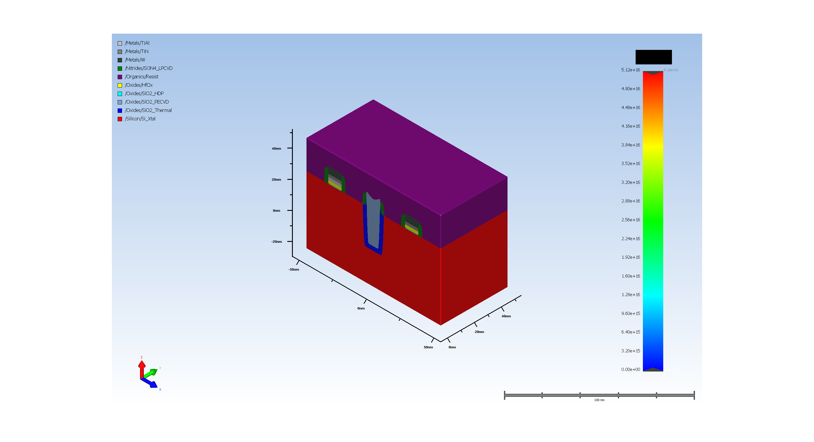
19.1. Resist pattern for Nmos source and Drain

Slide 38
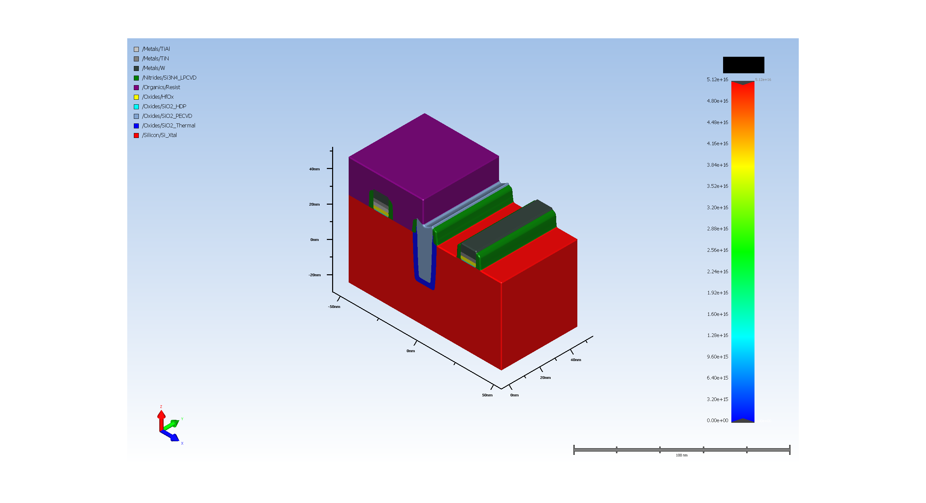
19.2. Expose resist for source and drain

Slide 39

19.3. PMOS source and drain doping

Slide 40
19.4. resist removal after PMOS gate pattern

Slide 41
19.5. Diffusion (Requires Advanced Modeling)

Slide 42
20.1. interlayer dielectric depsoition

Slide 43
20.2. ressit pattern for source and Drain metal contacts

Slide 44
20.3. Expose resist for source and drain metal contacts

Slide 45
20.4. source and drain metal cotanct Etch

Slide 46
20.5. resist removal after source drain metal contacts

Slide 47
20.6. TiN Deposit

Slide 48
21. Final CMP of ILD

Slide 49
A-1.1. Model for Dopant Profile

