Slide 1
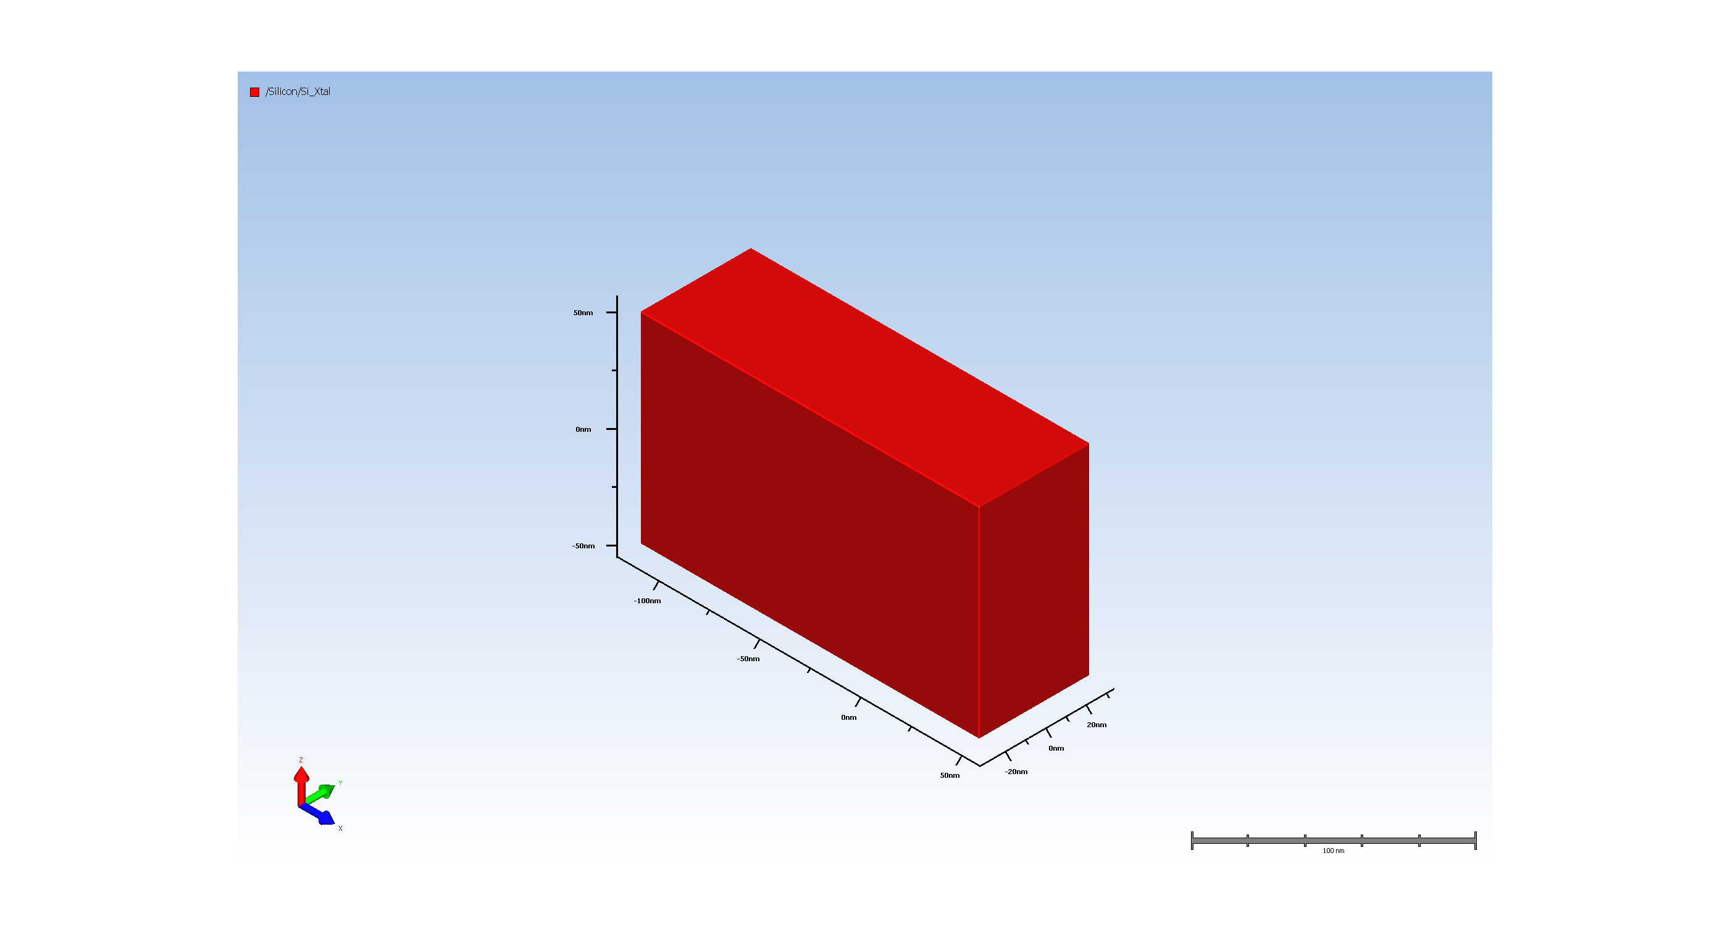
1. Wafer Setup

Slide 2
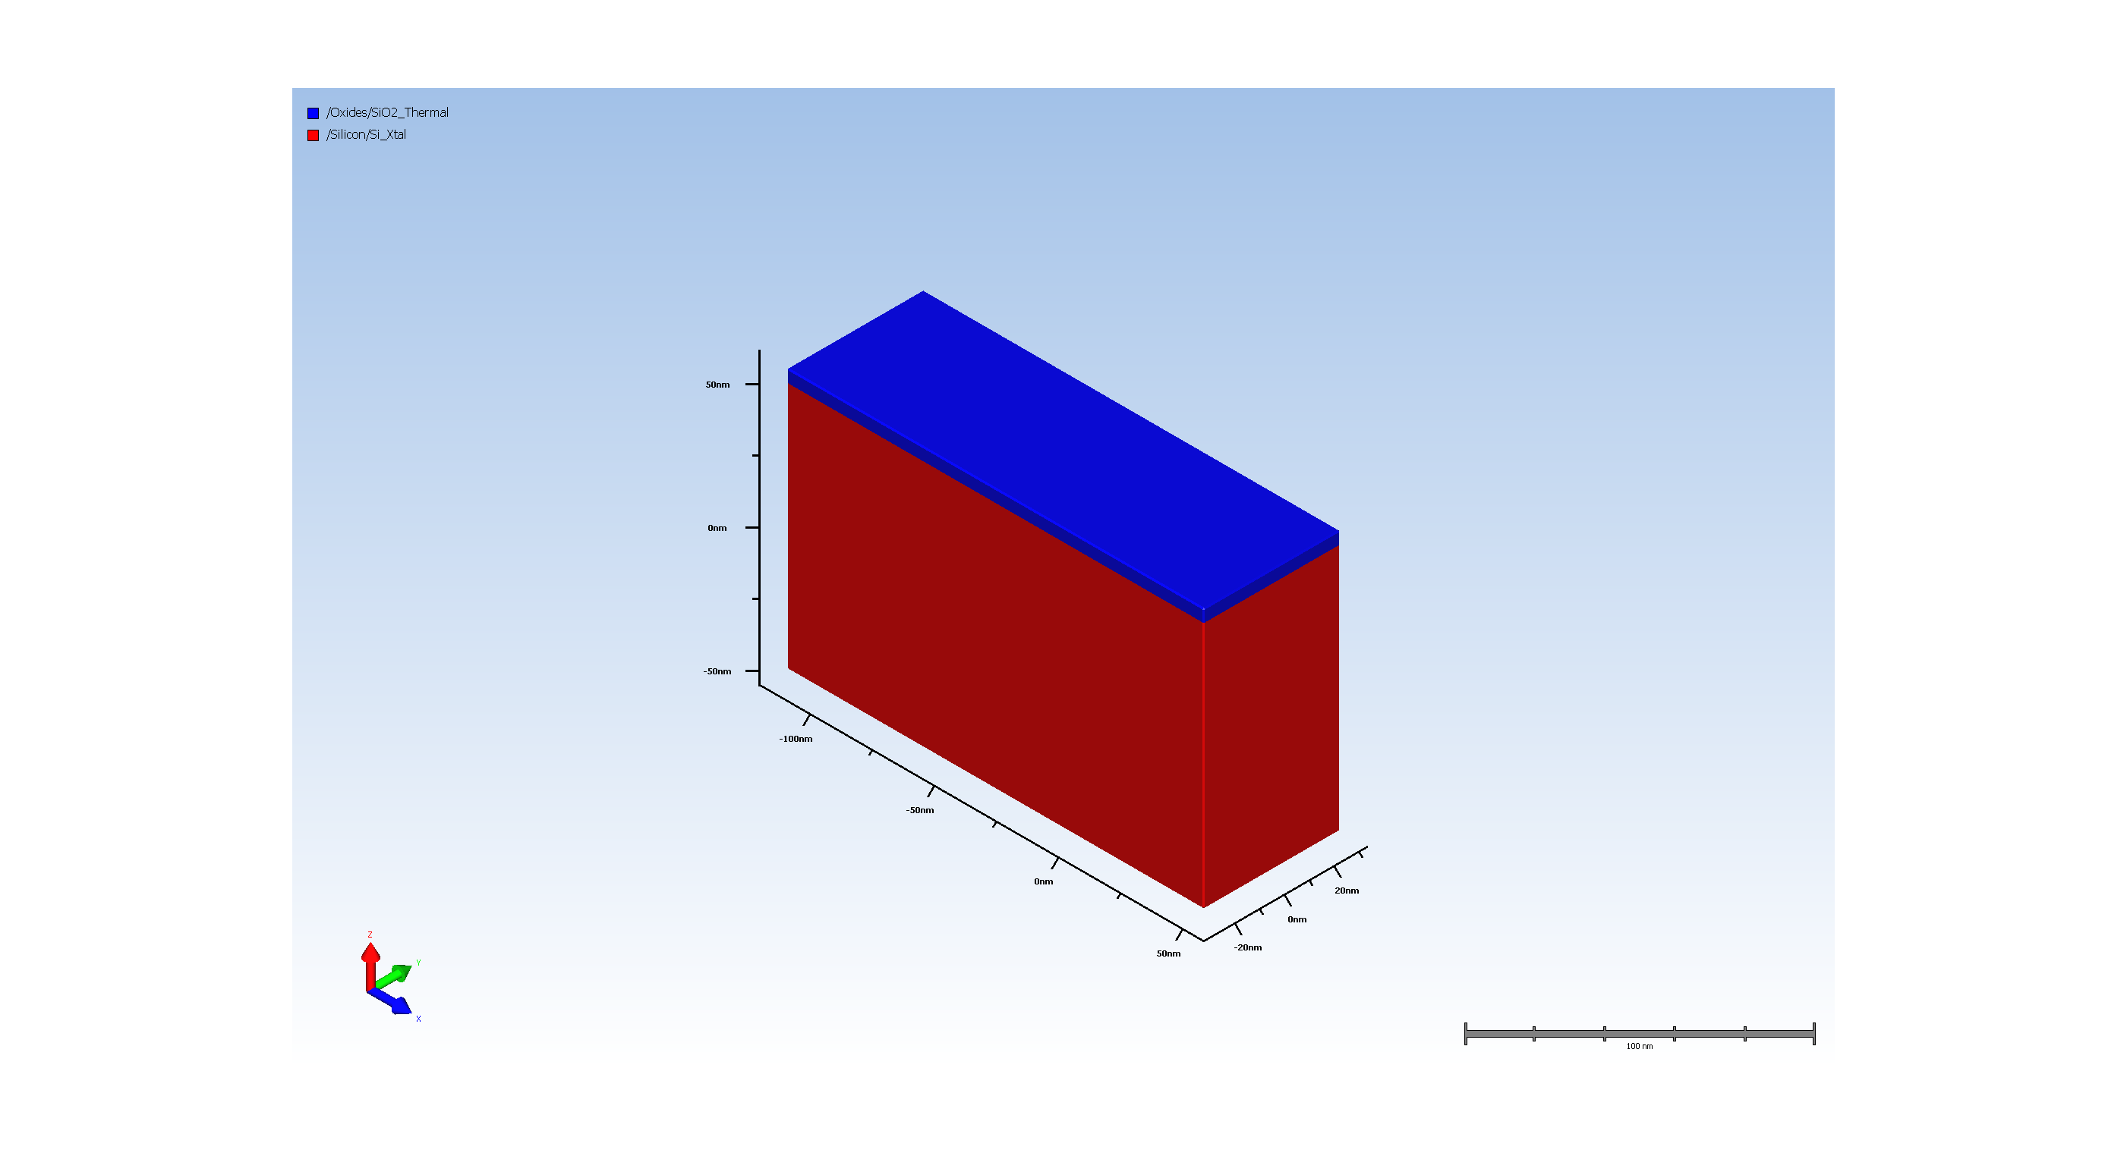
2. Pad Oxide Deposition

Slide 3
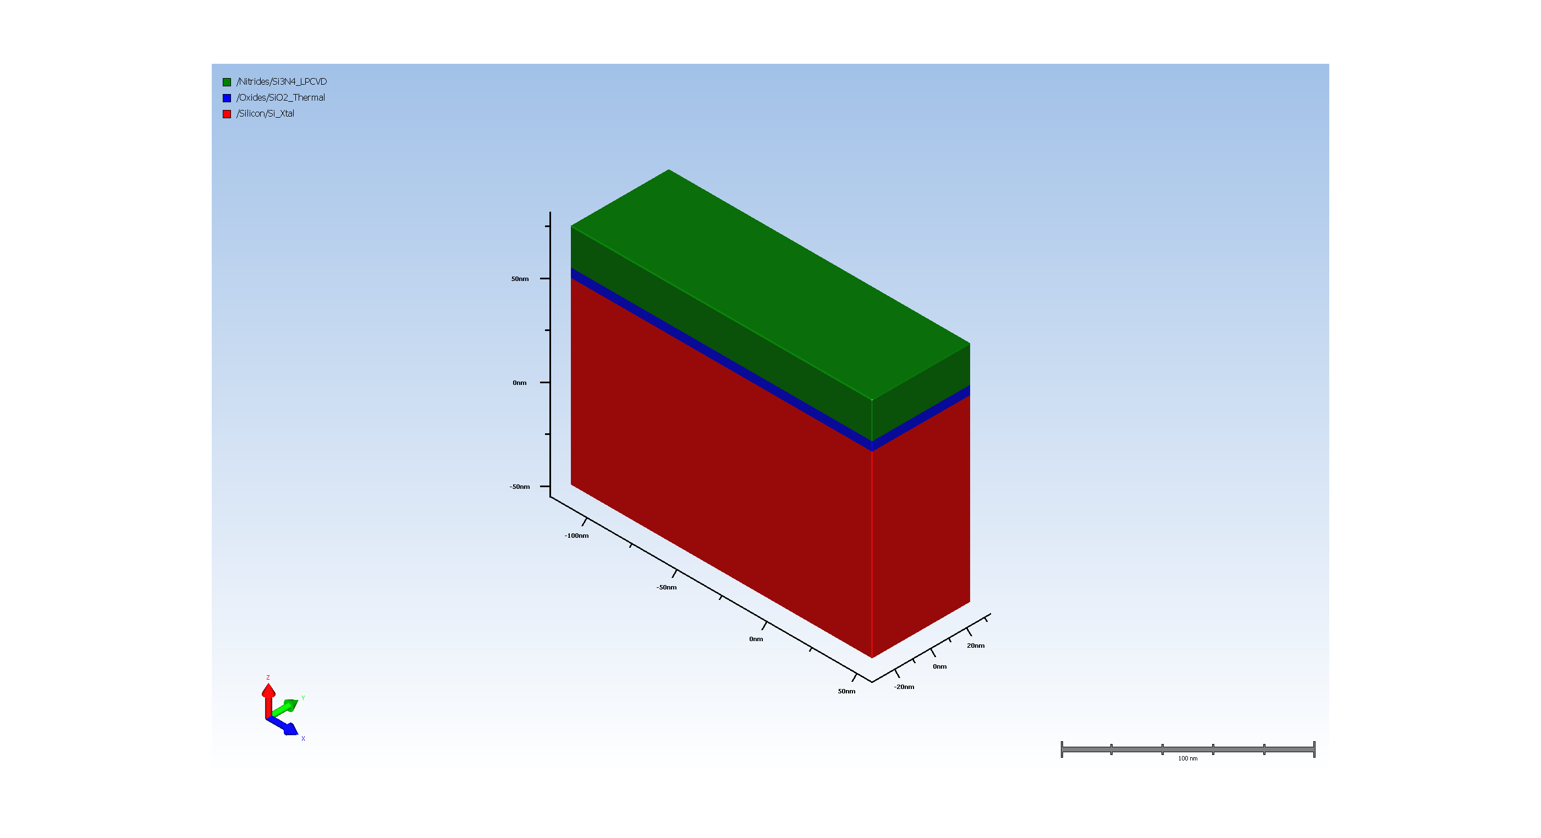
3. SiN hardmask

Slide 4
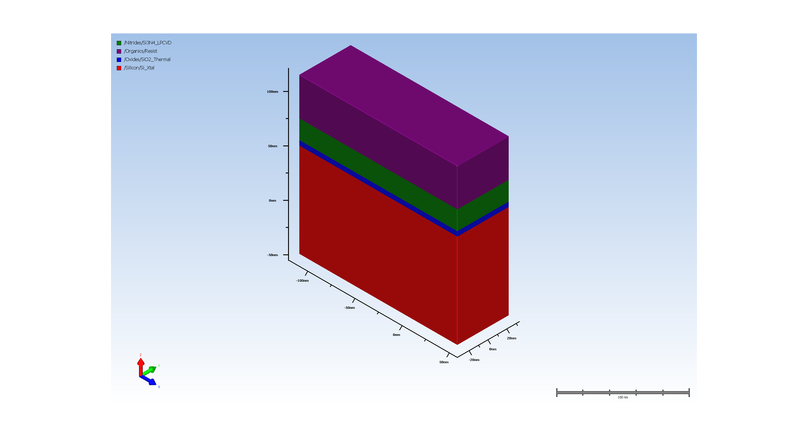
4.1. Photo Resist coating

Slide 5

4.2. Expose STI_Trench

Slide 6
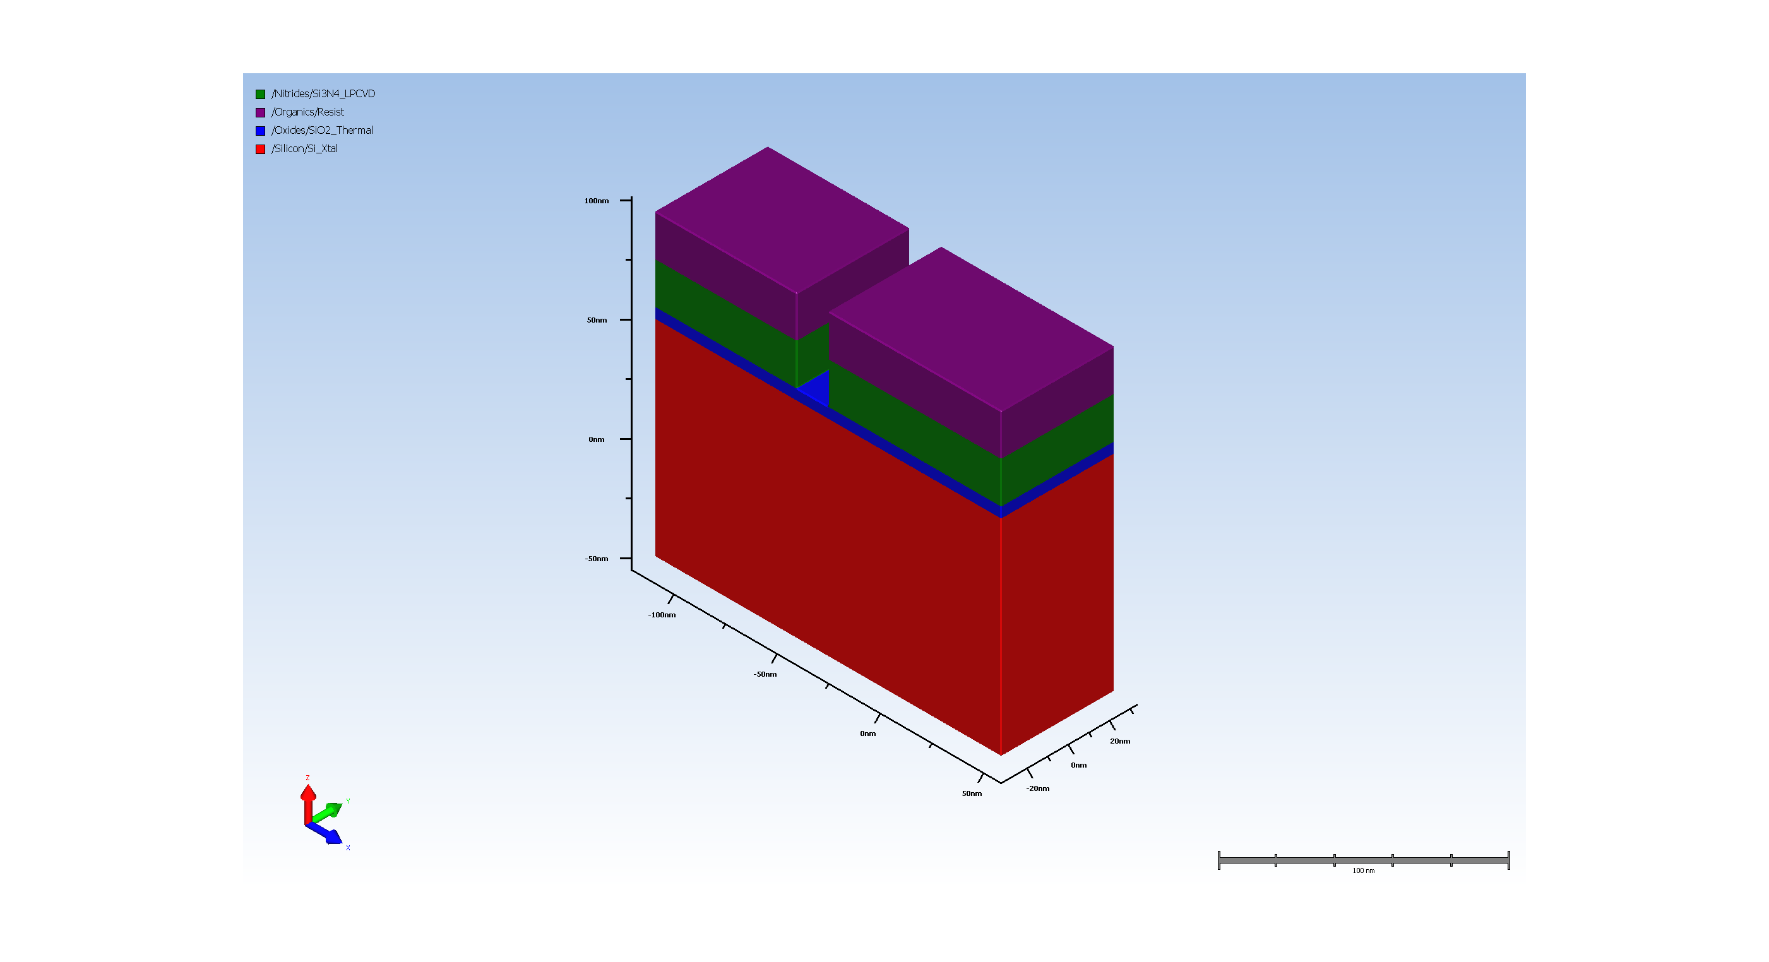
5.1. SiN hardmask etch

Slide 7
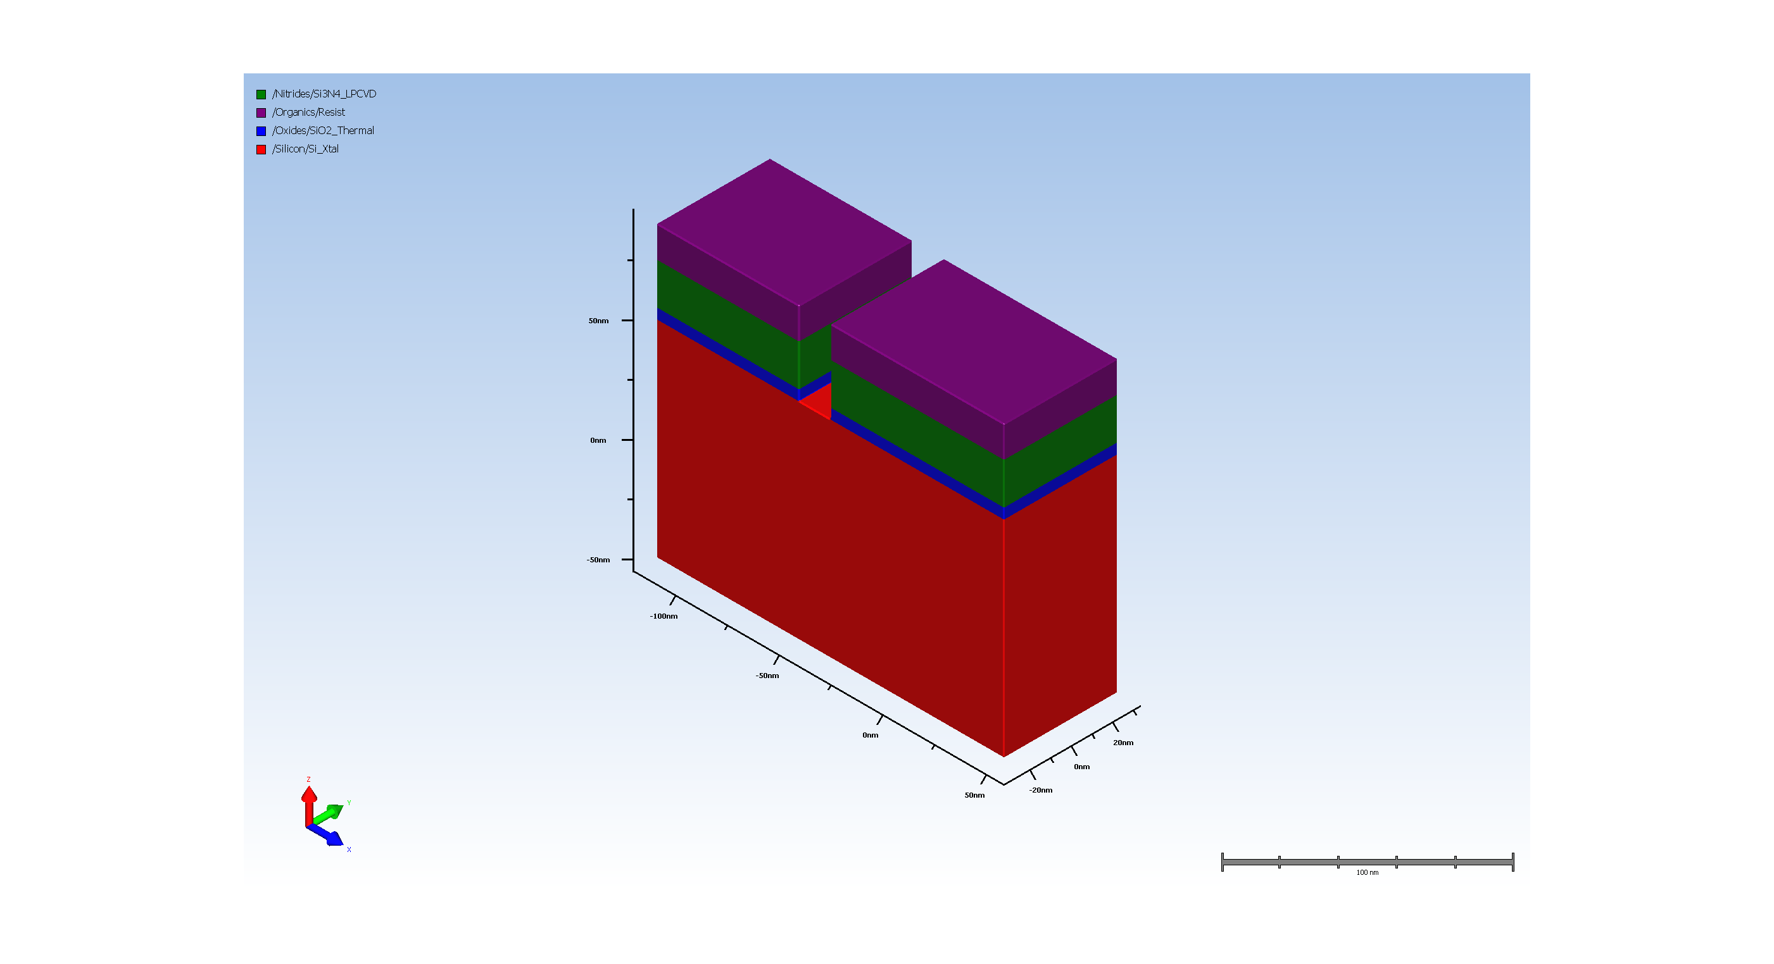
5.2. pad oxide Etch

Slide 8

5.3. substrate silicon Etch

Slide 9
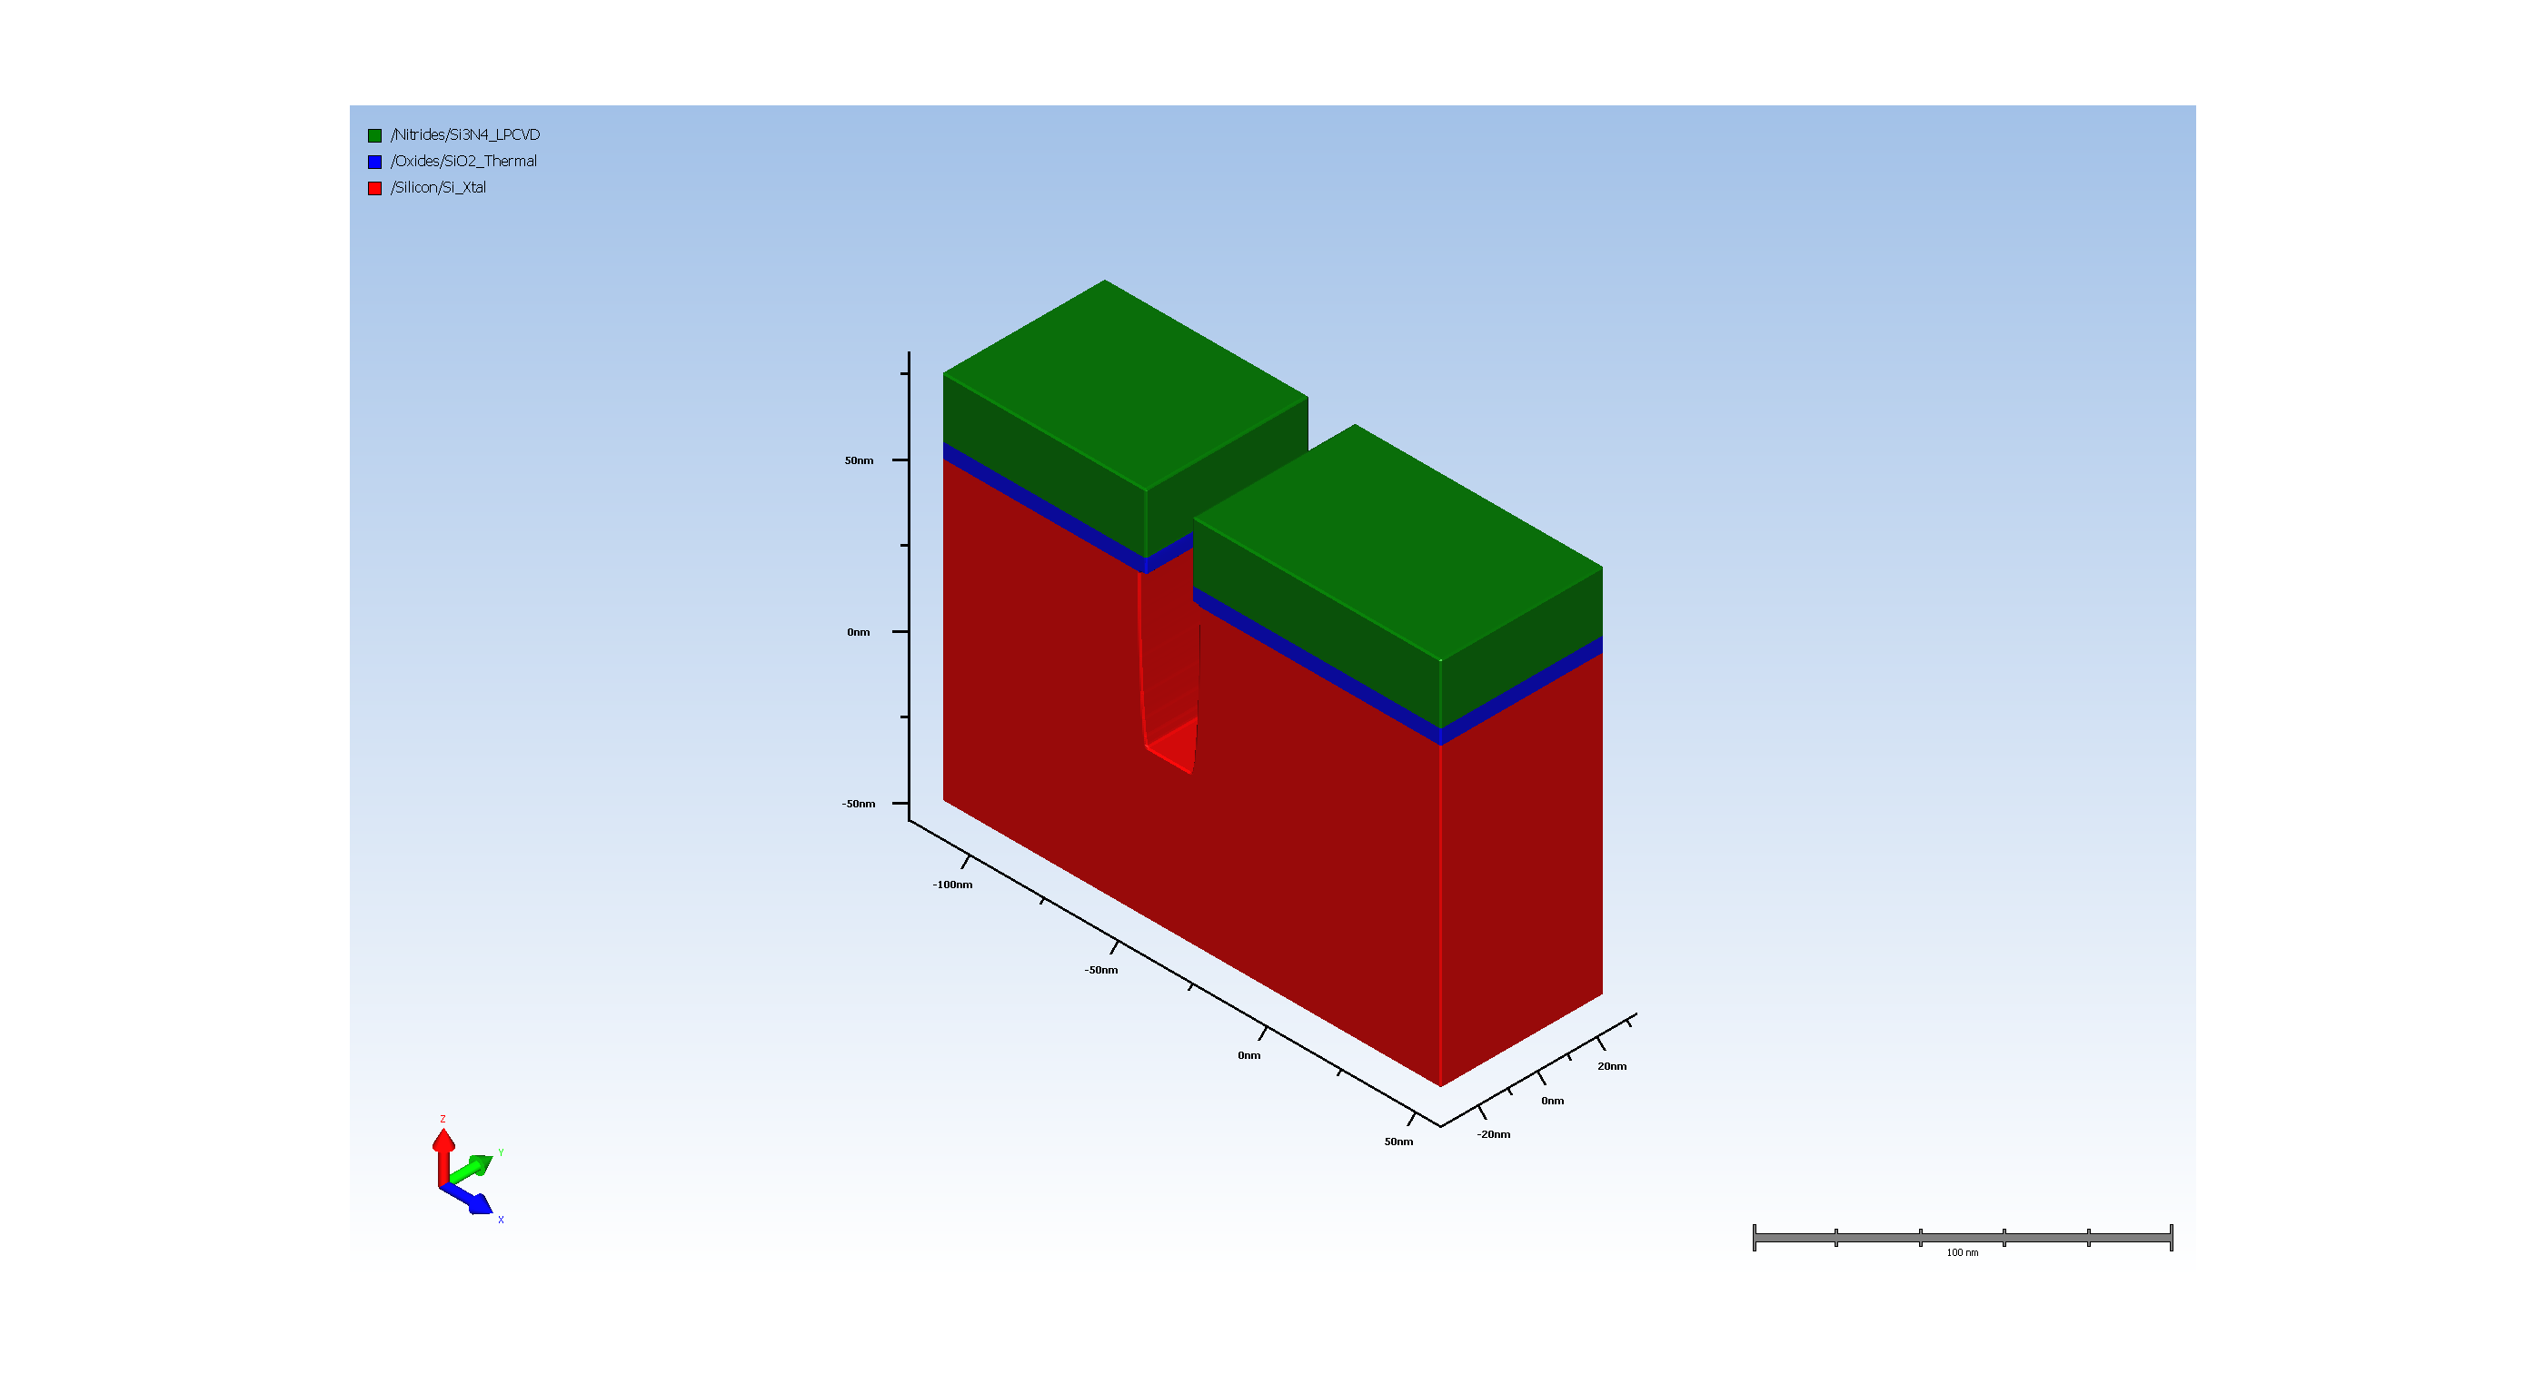
6. resist removal

Slide 10
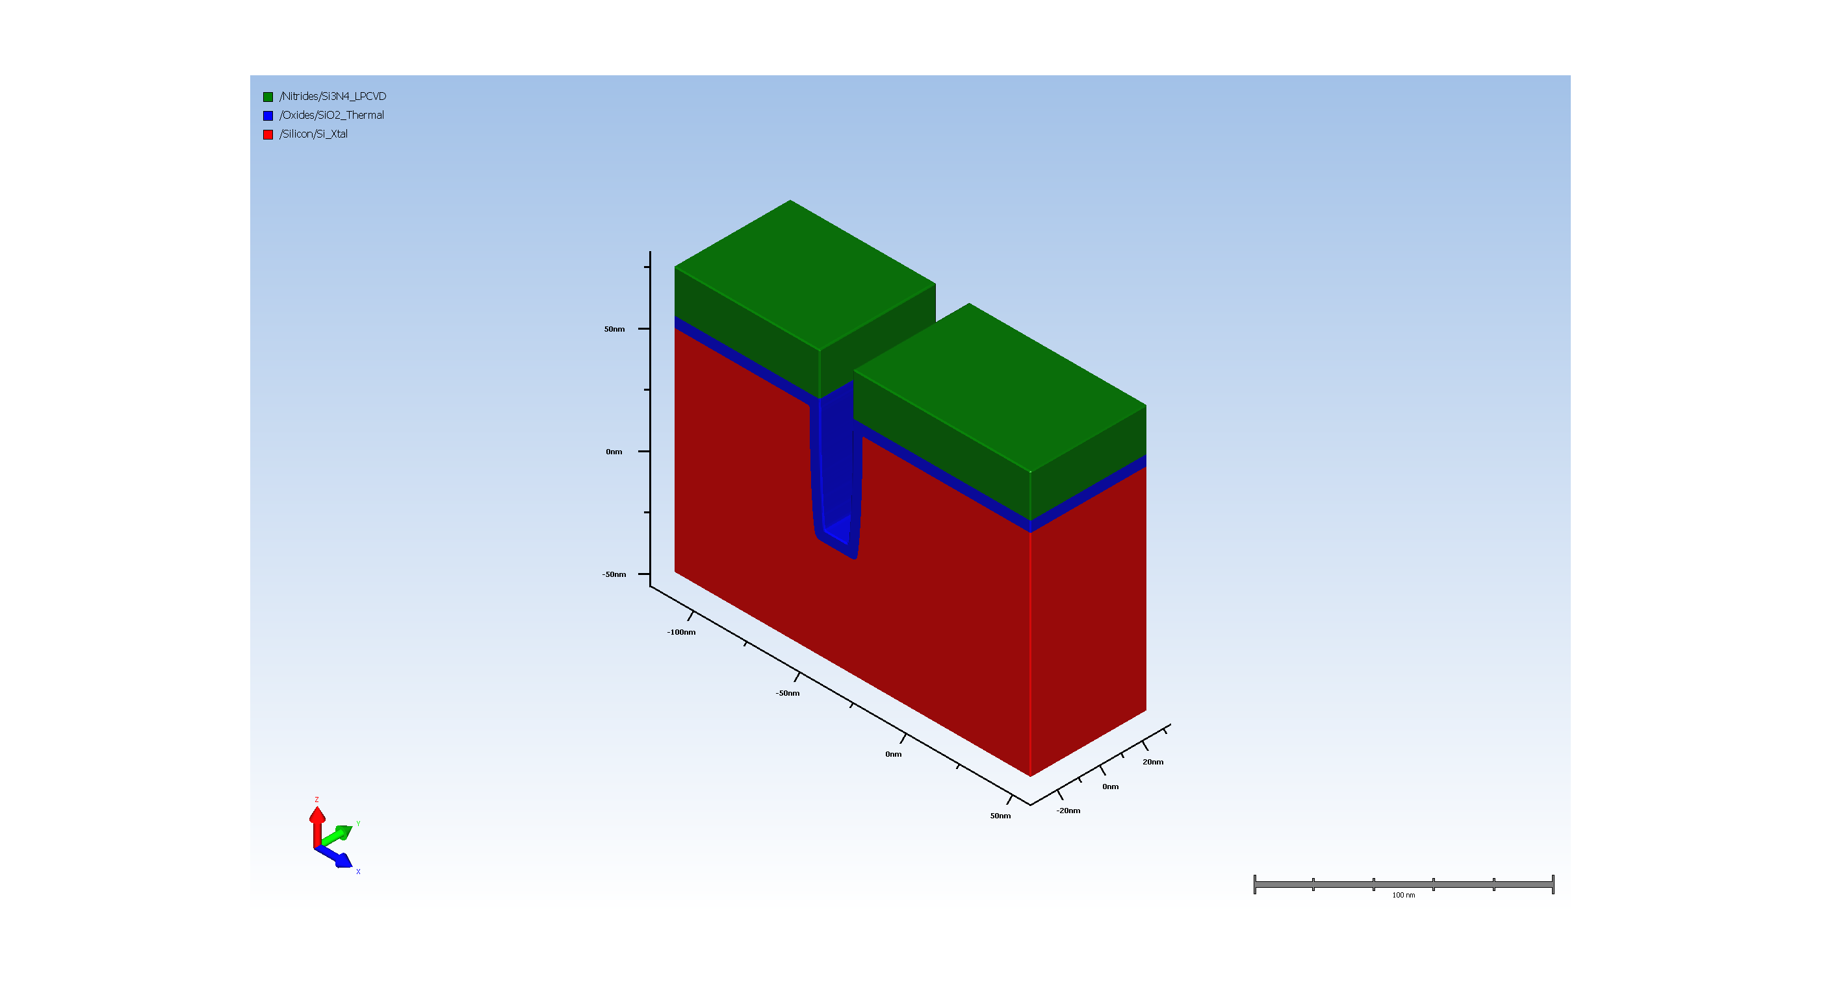
7. Thermal Oxidation of opened trench

Slide 11
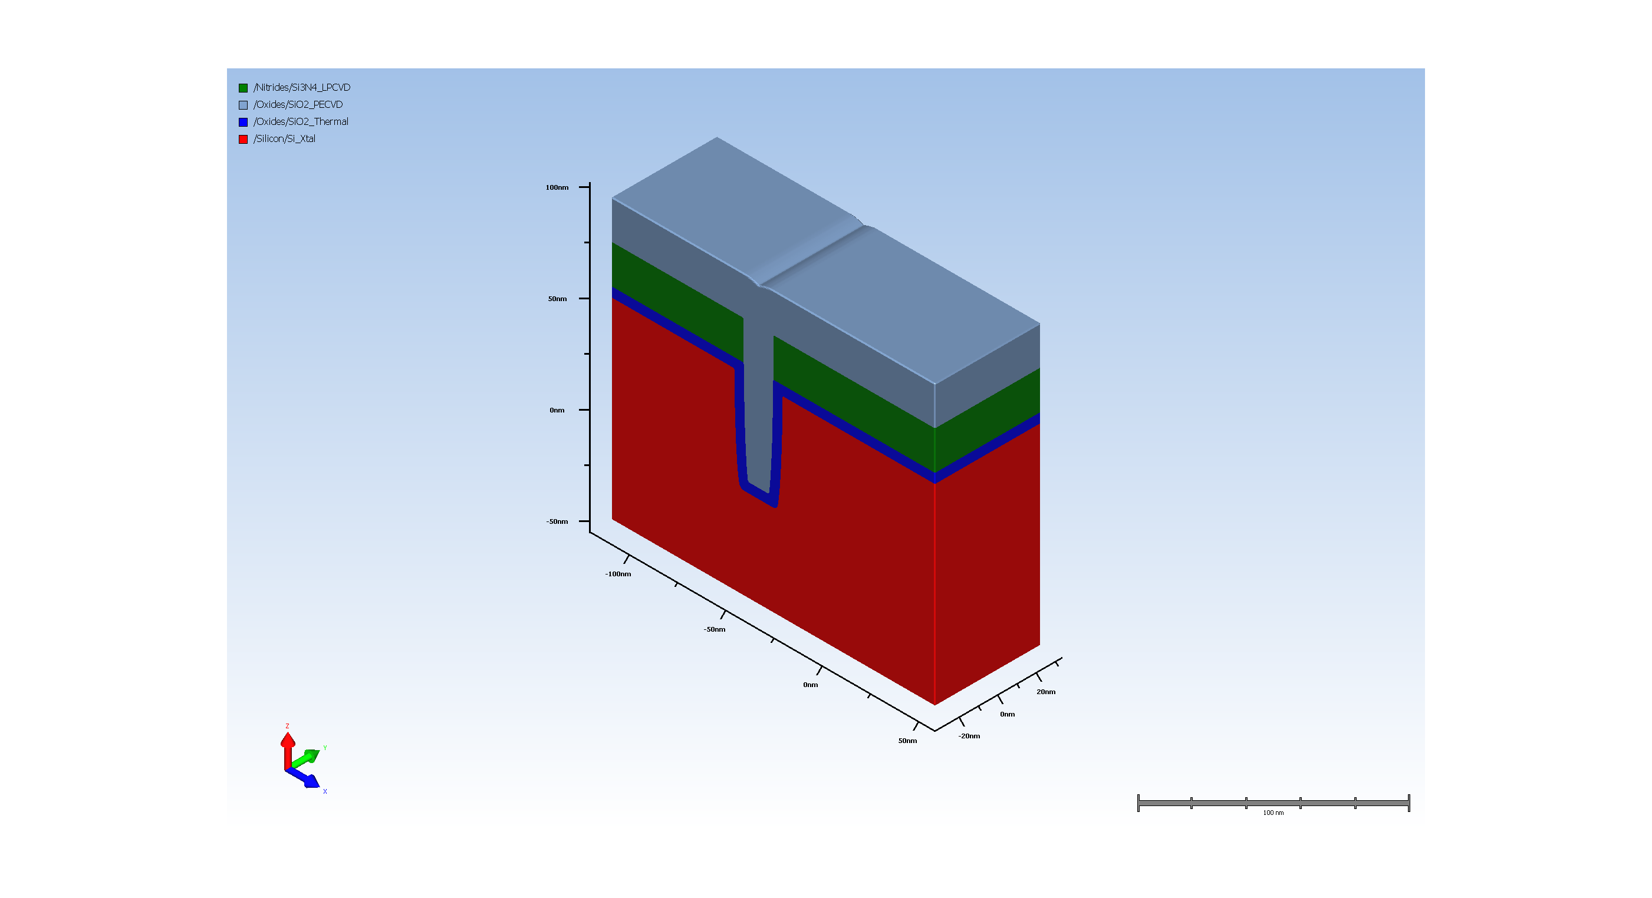
8. Filling trench with CVD oxide

Slide 12
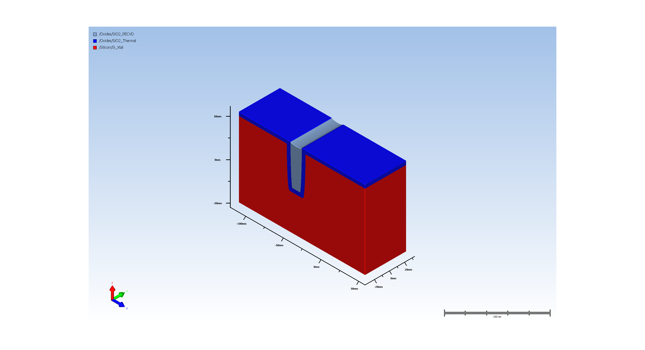
9. STI oxide CMP

Slide 13
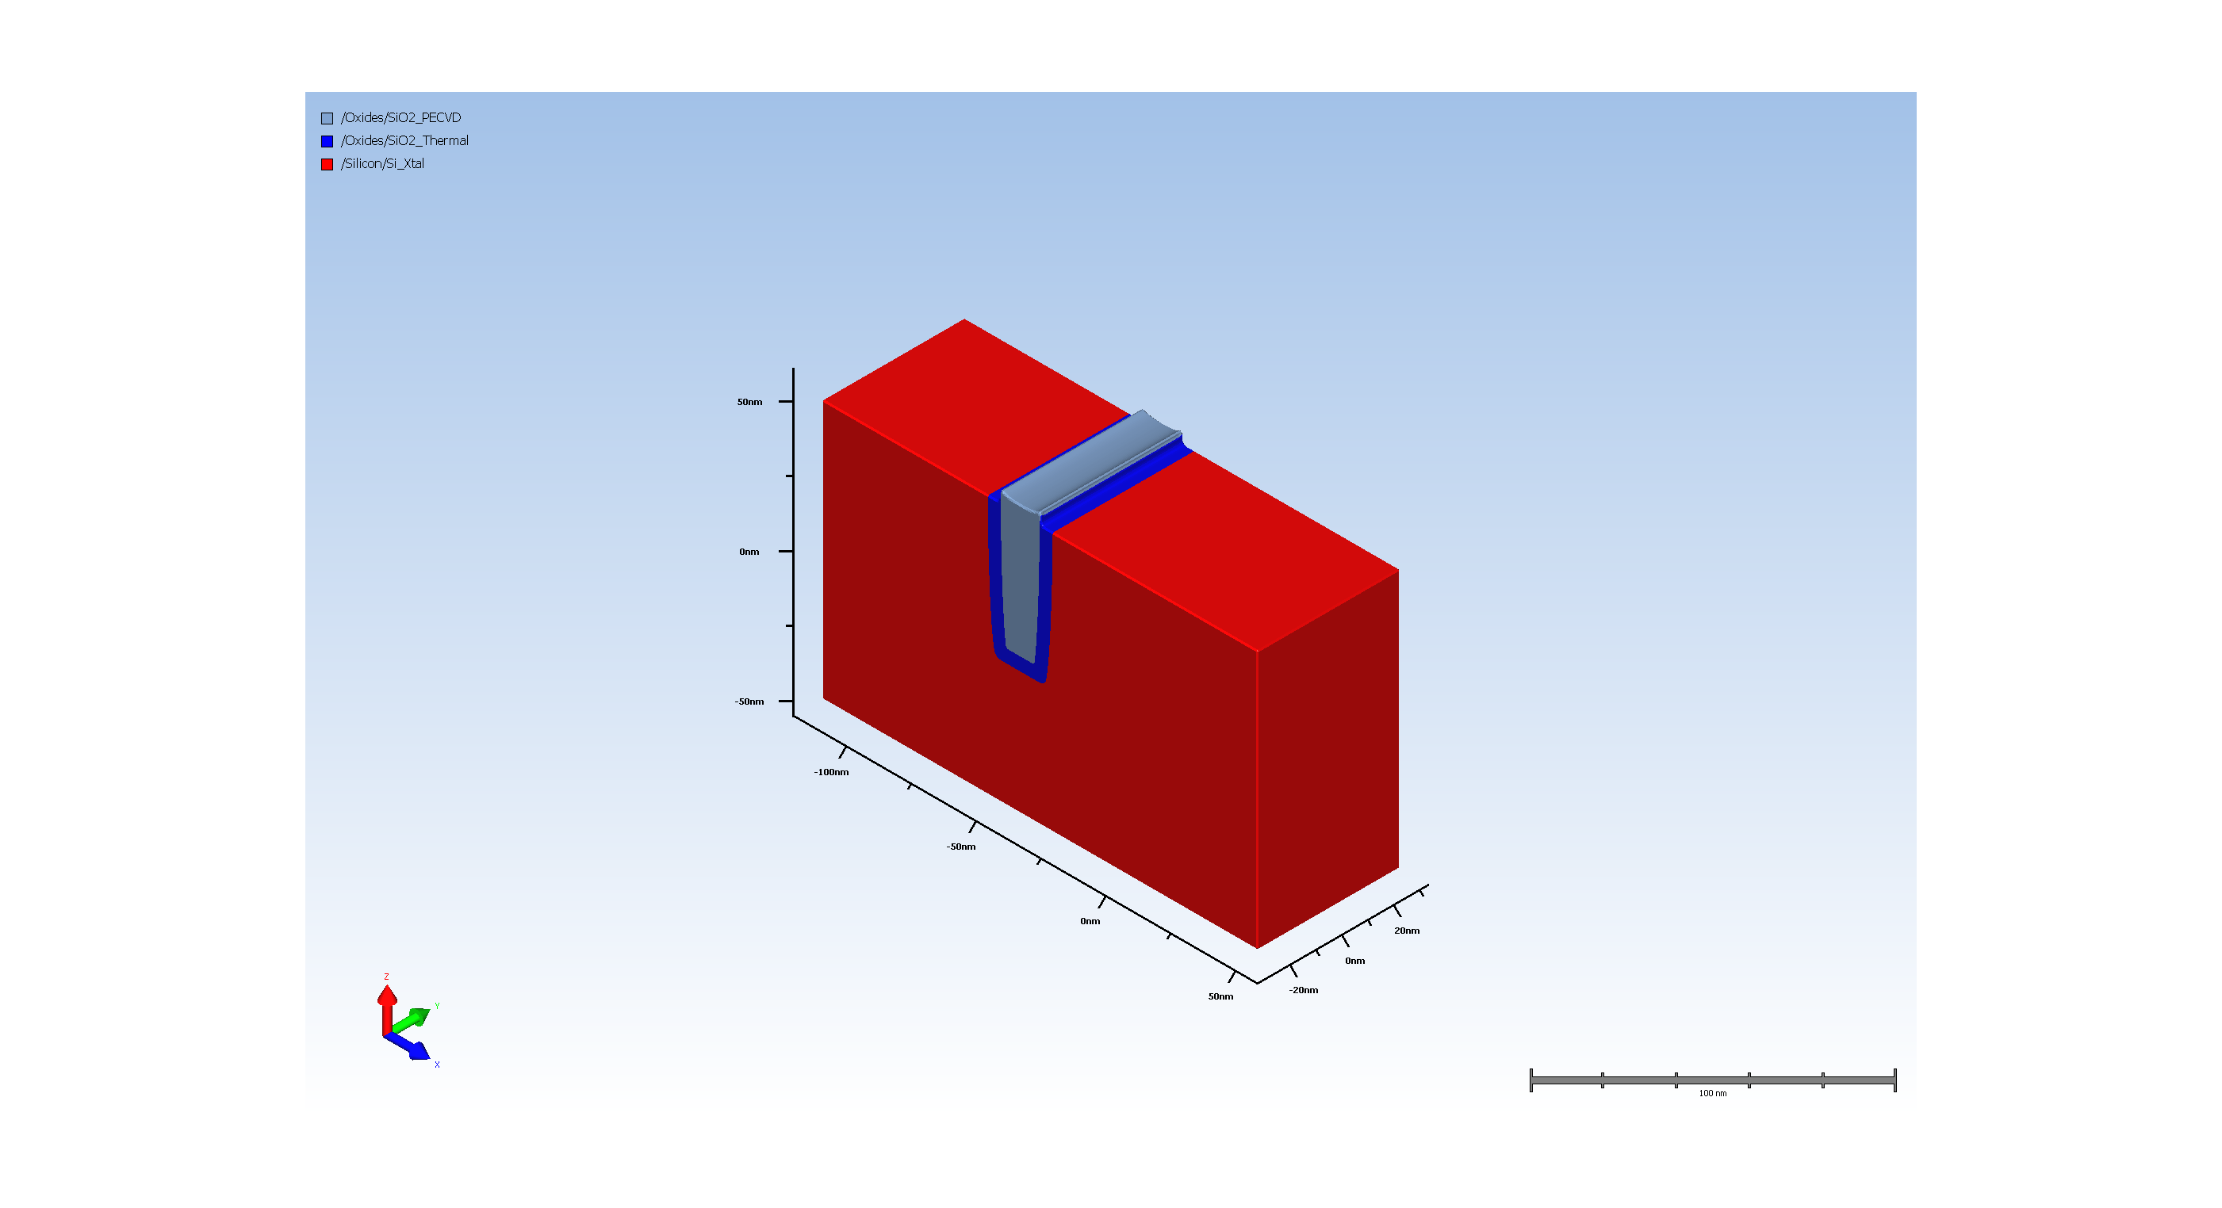
11. Pad_oxide ramoval
Unknown Step Properties:
name: hdm
Num. of attributes: 3
VersionNumber : 12.2.0.0
uiHidden : true
uiHideChildNodes : true
name: simultaneousDeposit
Num. of attributes: 1
isEnable : false
name: depositMaterial
Num. of attributes: 3
VersionNumber : 12.2.0.0
readonly : true
uiHideChildNodes : true
name: depositRatio
Num. of attributes: 5
___expression :
___lastKnownValue : nan.0
___unitConversionExpr :
___unitName : nounit
readonly : true
name: depositIsotropicRatio
Num. of attributes: 5
___expression : 0
___lastKnownValue : 0.0
___unitConversionExpr :
___unitName : nounit
readonly : true
name: depositLateralRatio
Num. of attributes: 5
___expression : 1
___lastKnownValue : 1.0
___unitConversionExpr :
___unitName : nounit
readonly : true
name: depositSourceSigma
Num. of attributes: 5
___expression : 100.0
___lastKnownValue : 100.0
___unitConversionExpr :
___unitName : nounit
readonly : true
name: depositTransport
Num. of attributes: 2
isEnable : false
readonly : true
name: conformality
Num. of attributes: 5
___expression : 0.1
___lastKnownValue : 0.1
___unitConversionExpr :
___unitName : nounit
readonly : true
name: depositTiltAndTwist
Num. of attributes: 2
___activeMember : sameAsEtch
readonly : true
name: sameAsEtch
Num. of attributes: 2
isEnable : true
readonly : true
name: fixed
Num. of attributes: 1
isEnable : true
name: tilt
Num. of attributes: 4
___expression : 0
___lastKnownValue : 0.0
___unitConversionExpr :
___unitName : nounit
name: twist
Num. of attributes: 4
___expression : 0
___lastKnownValue : 0.0
___unitConversionExpr :
___unitName : nounit
name: rotating
Num. of attributes: 1
isEnable : true
name: tilt
Num. of attributes: 4
___expression : 0
___lastKnownValue : 0.0
___unitConversionExpr :
___unitName : nounit
name: transport
Num. of attributes: 1
isEnable : false
name: conformality
Num. of attributes: 5
___expression : 0.1
___lastKnownValue : 0.1
___unitConversionExpr :
___unitName : nounit
readonly : true

Slide 14
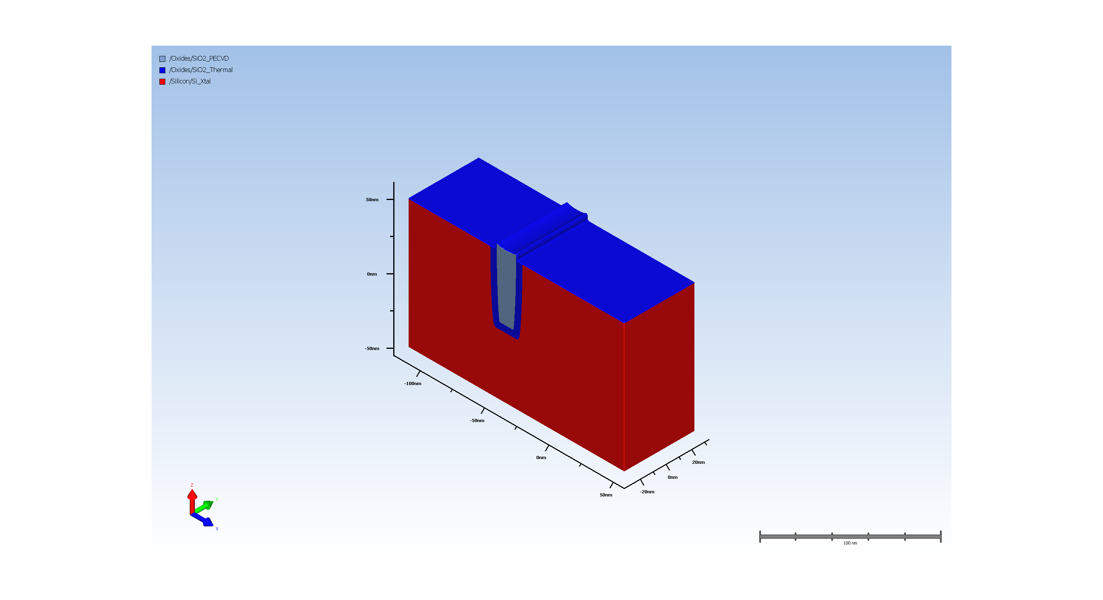
12.1. Thermal Oxide

Slide 15
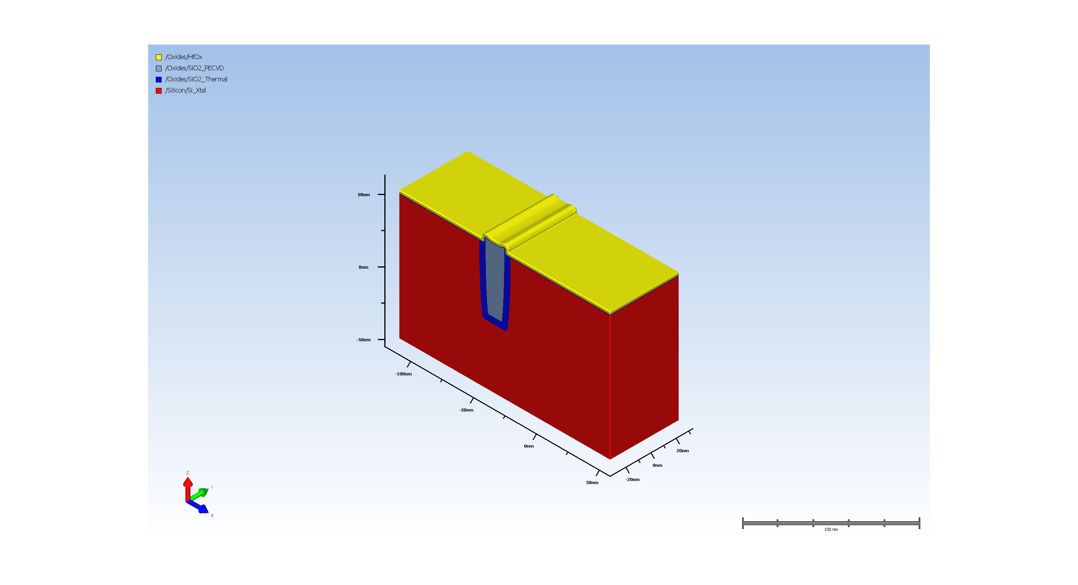
12.2. High-K_dielectric_deposition

Slide 16
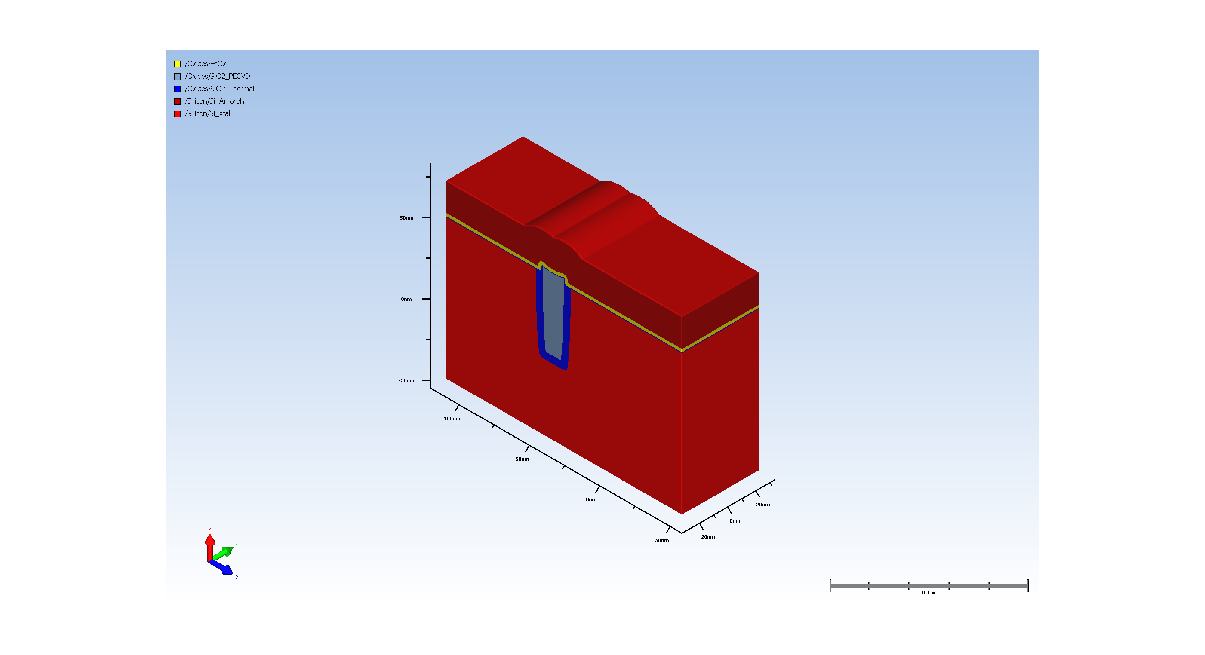
12.3. Gate_Poly_Silicon_Deposition

Slide 17
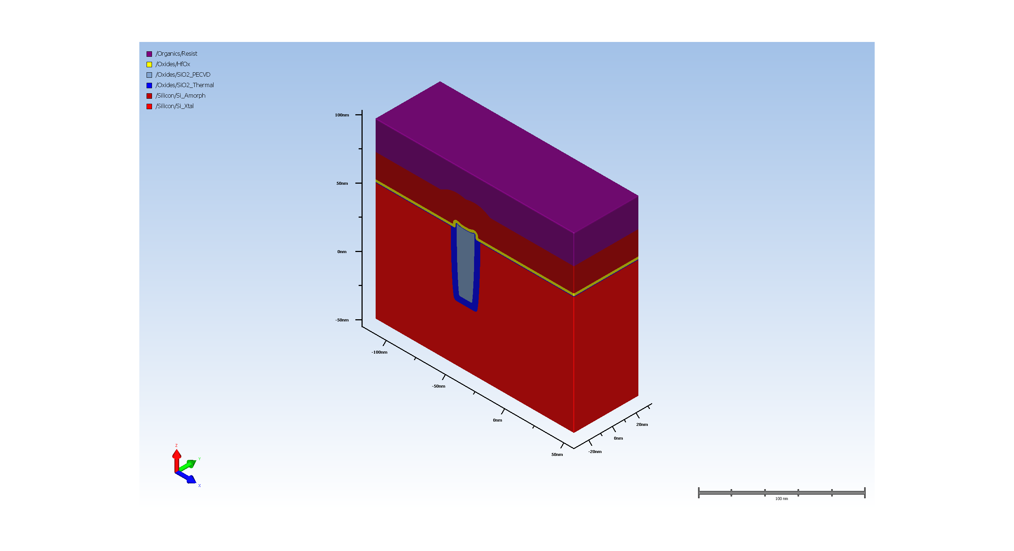
12.4. Planar Deposit

Slide 18
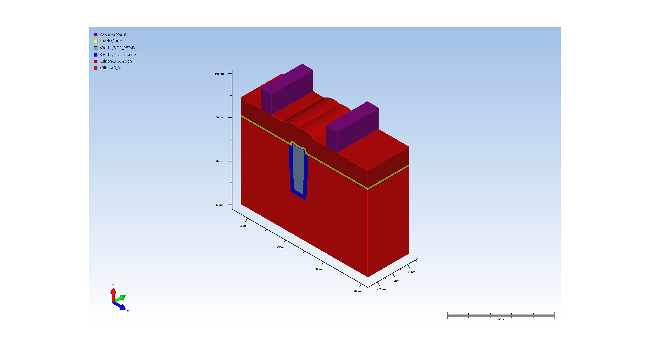
12.5. Expose Material

Slide 19
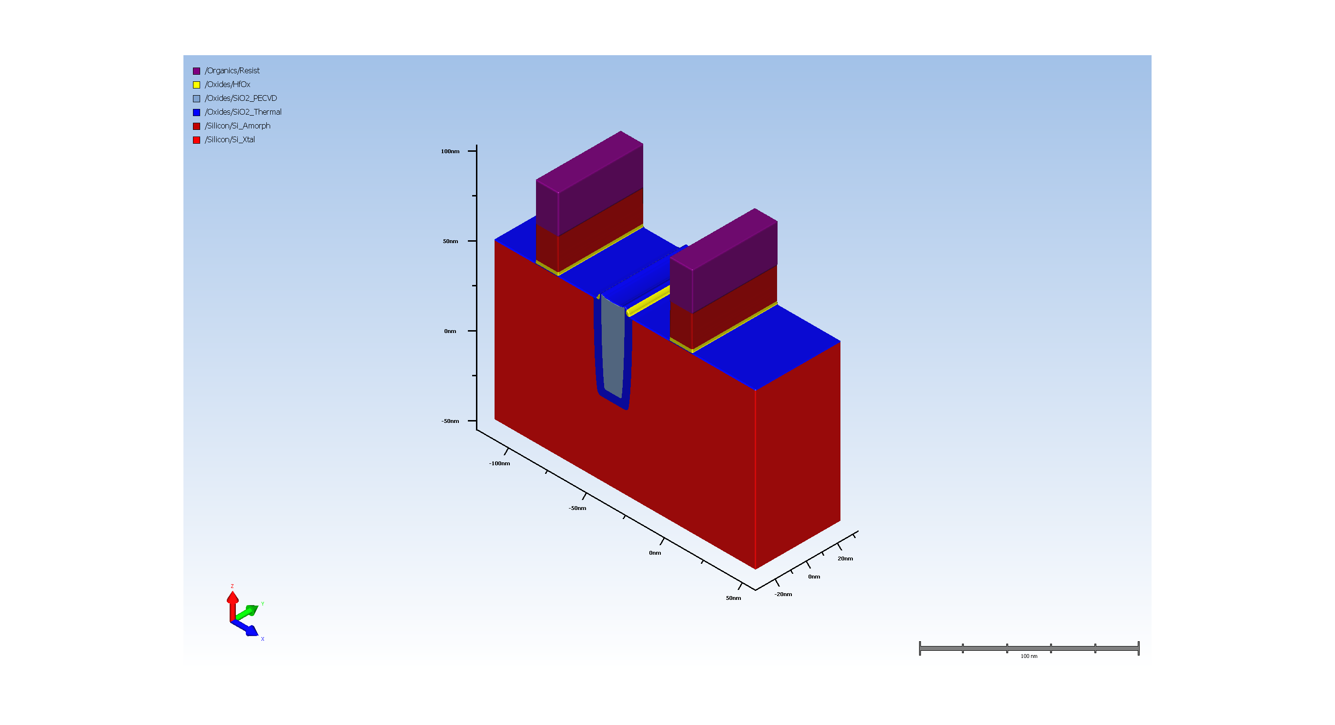
12.6. Basic Etch

Slide 20
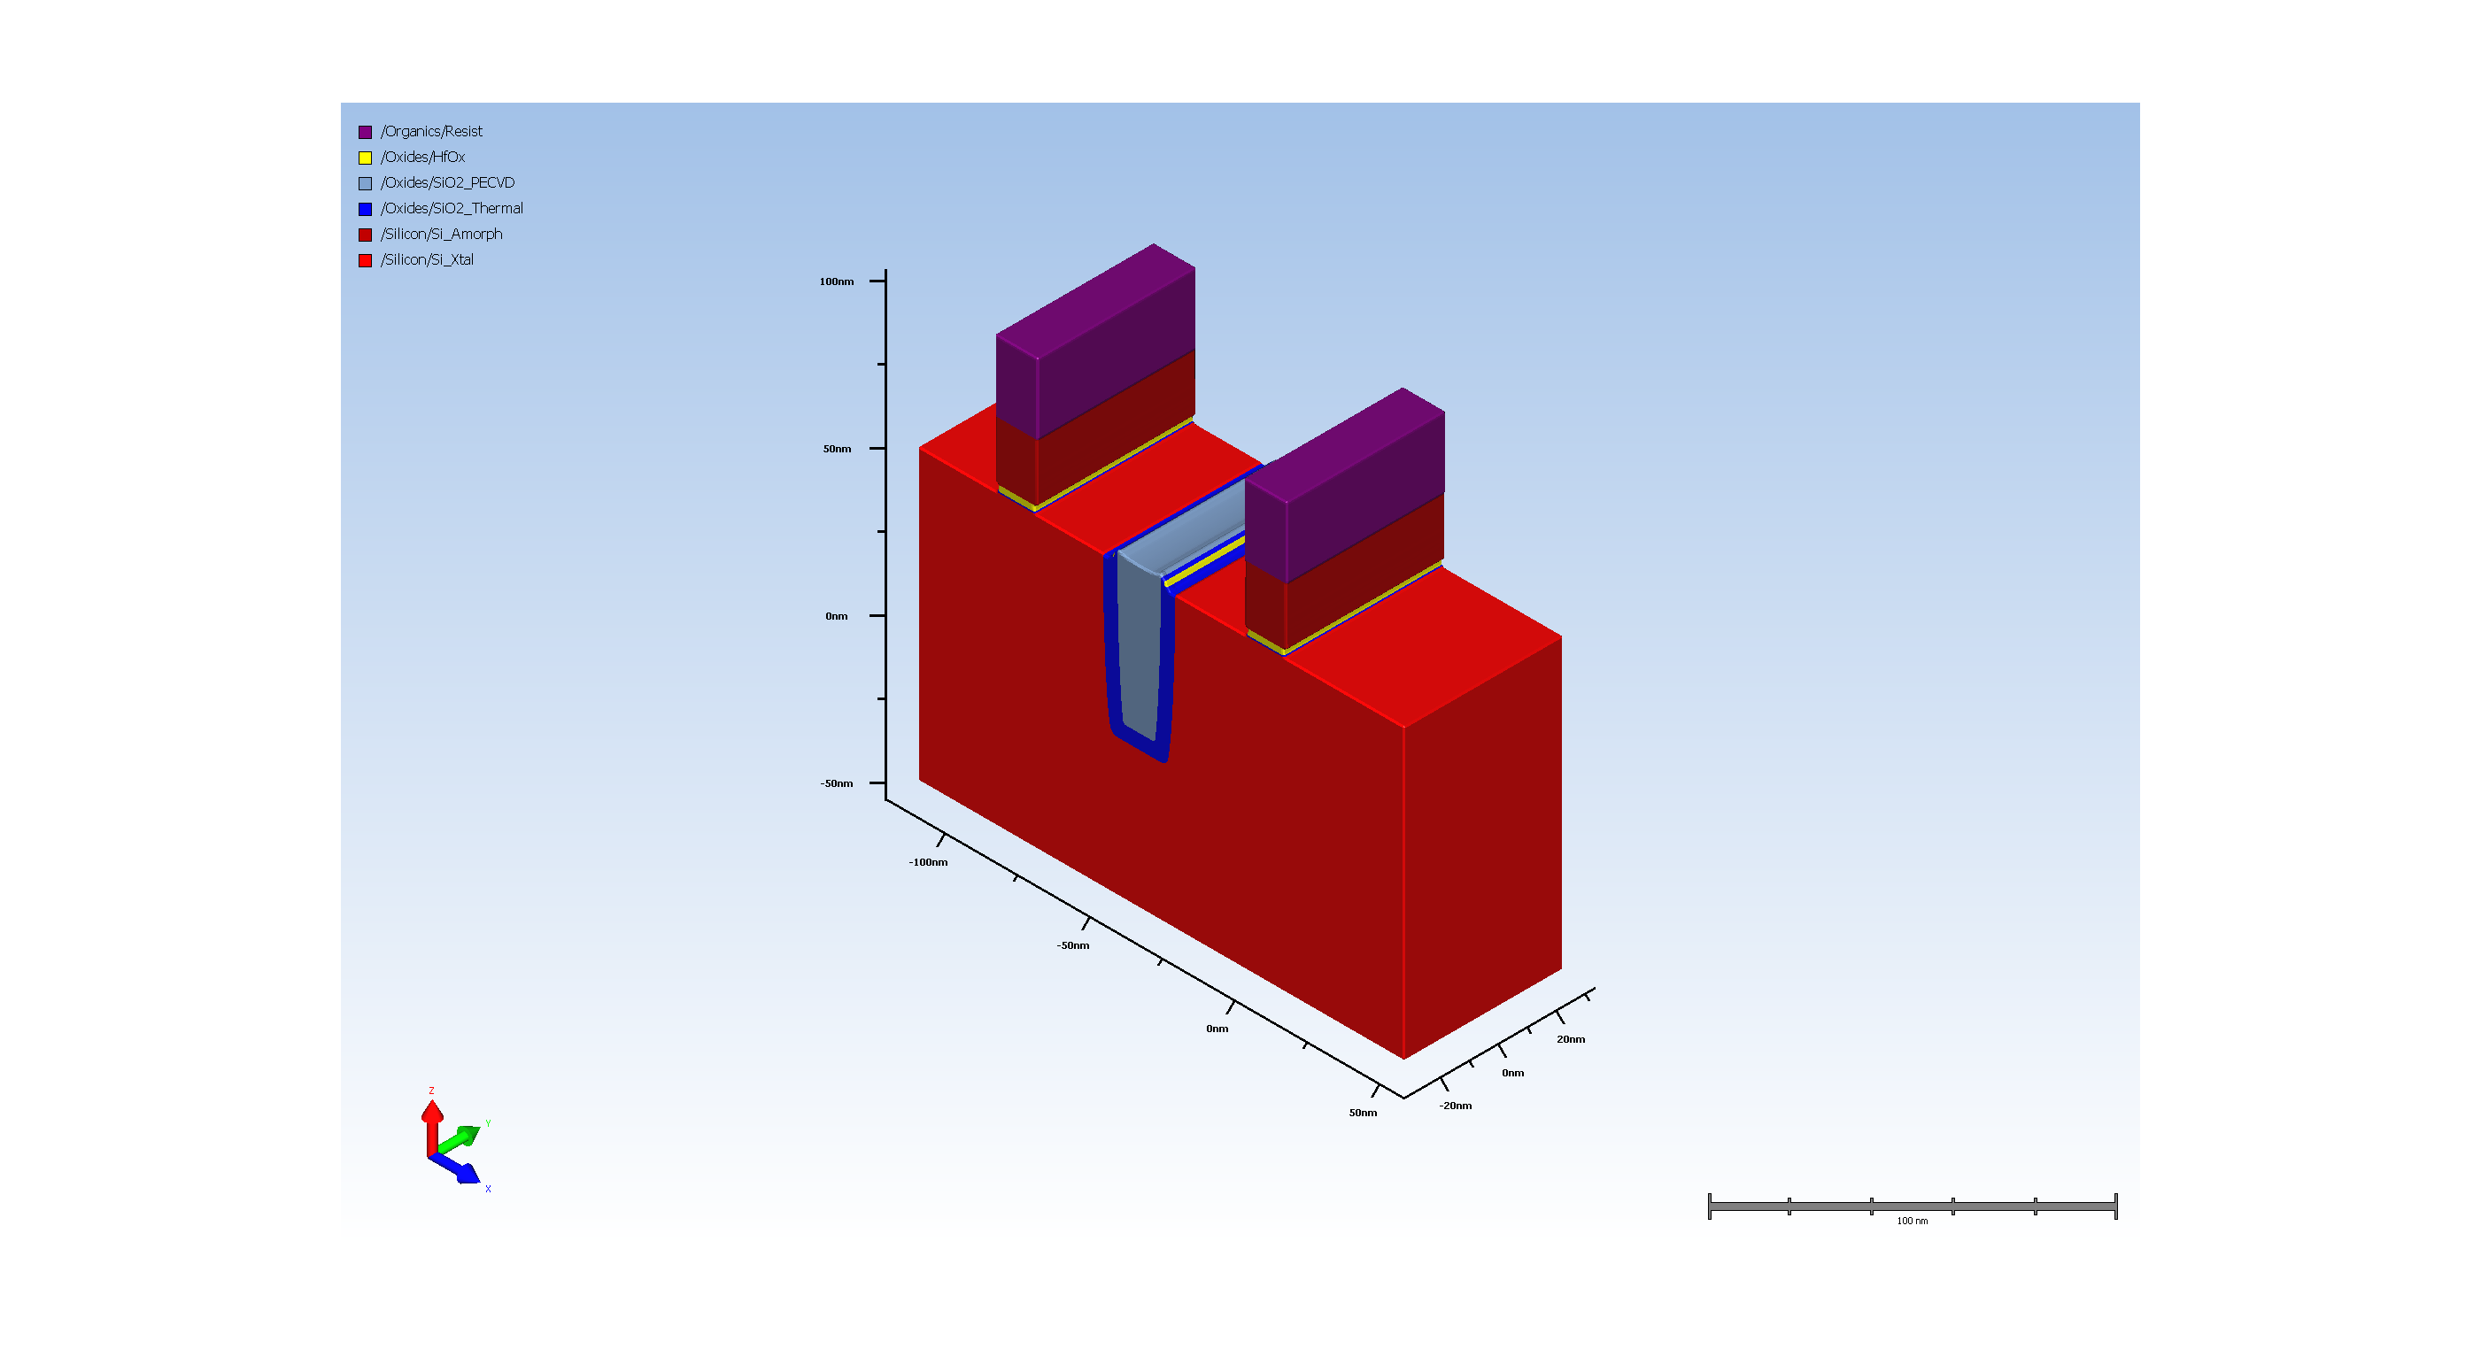
12.7. Basic Etch

Slide 21
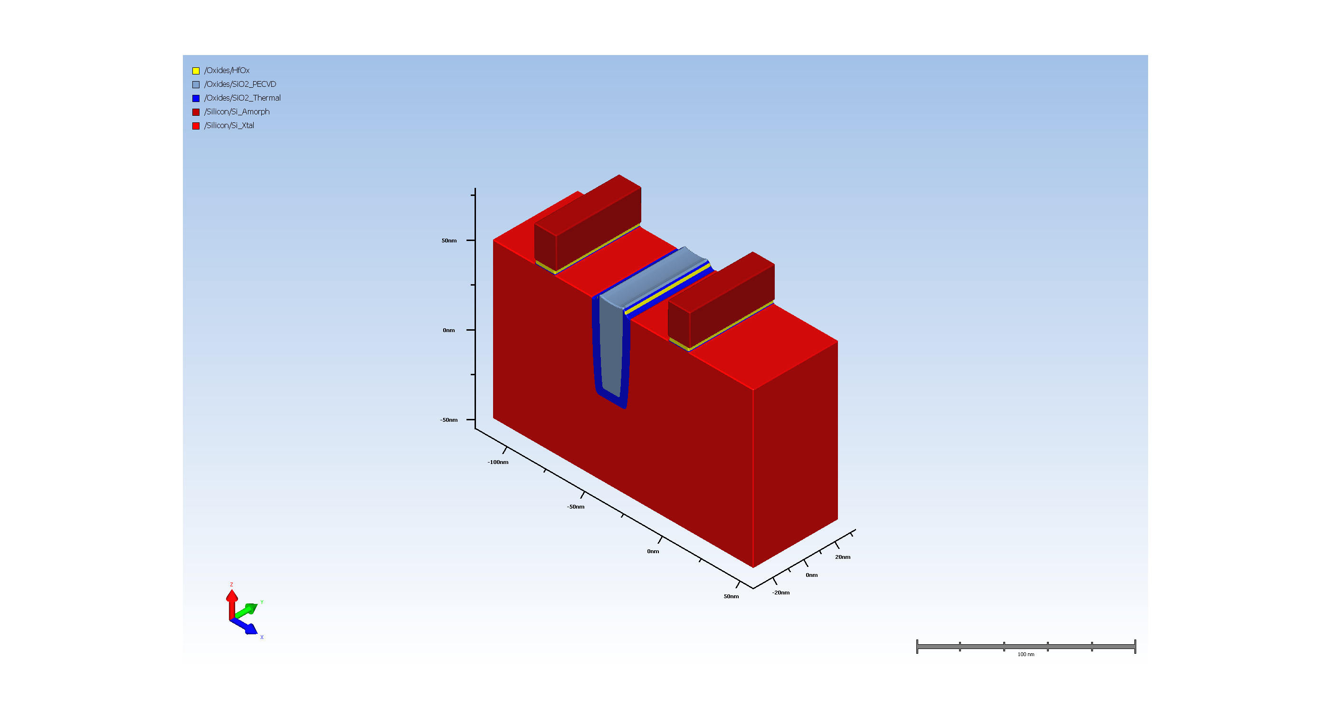
12.8. resist removal

Slide 22
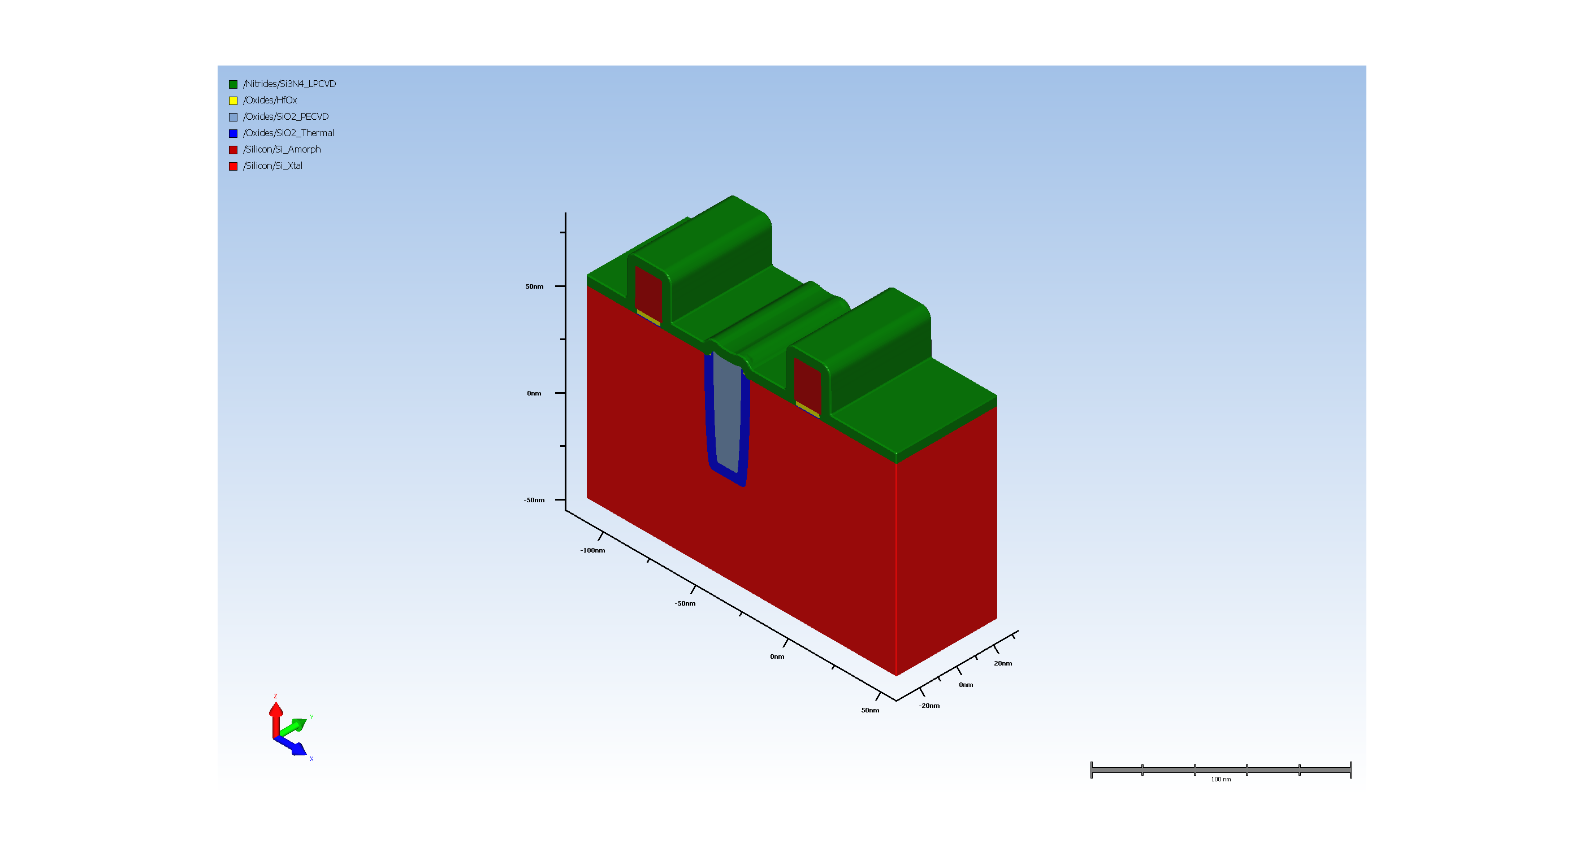
12.9. Conformal Deposit

Slide 23
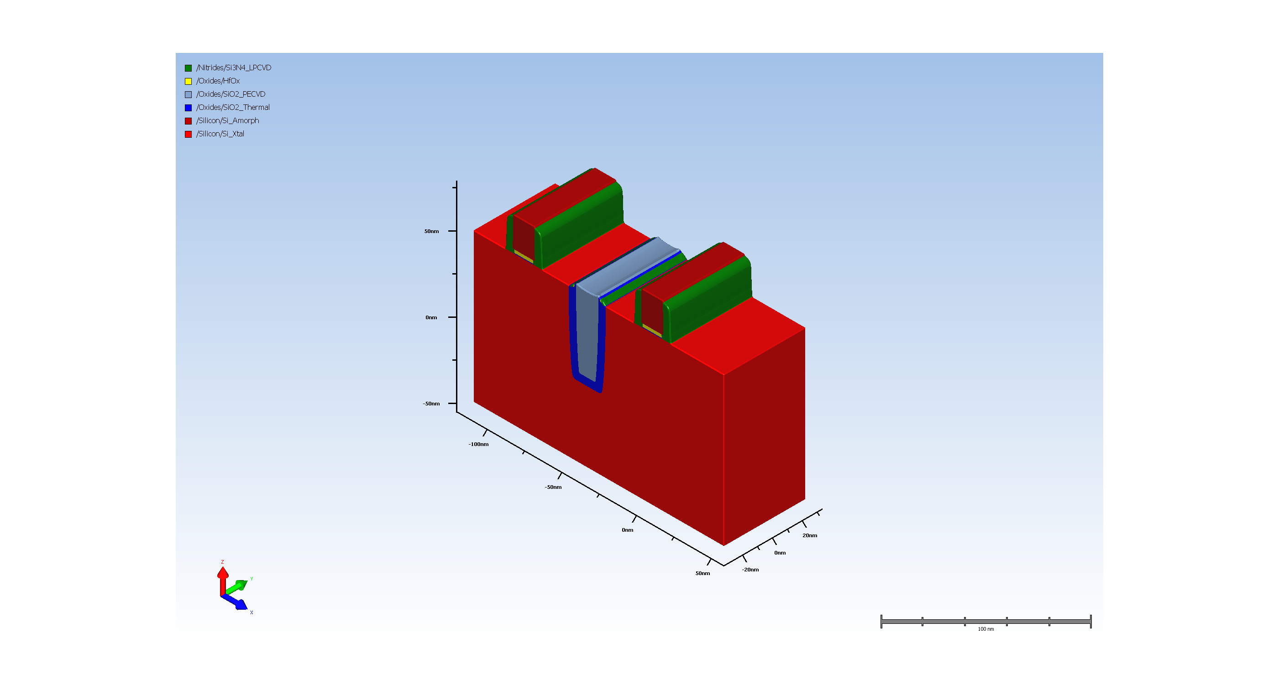
12.10. Basic Etch

Slide 24
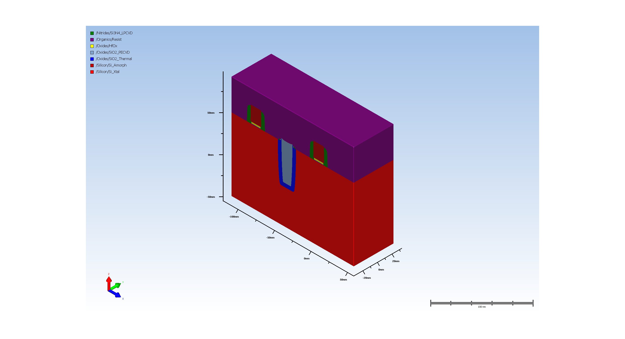
13.1. Planar Deposit

Slide 25
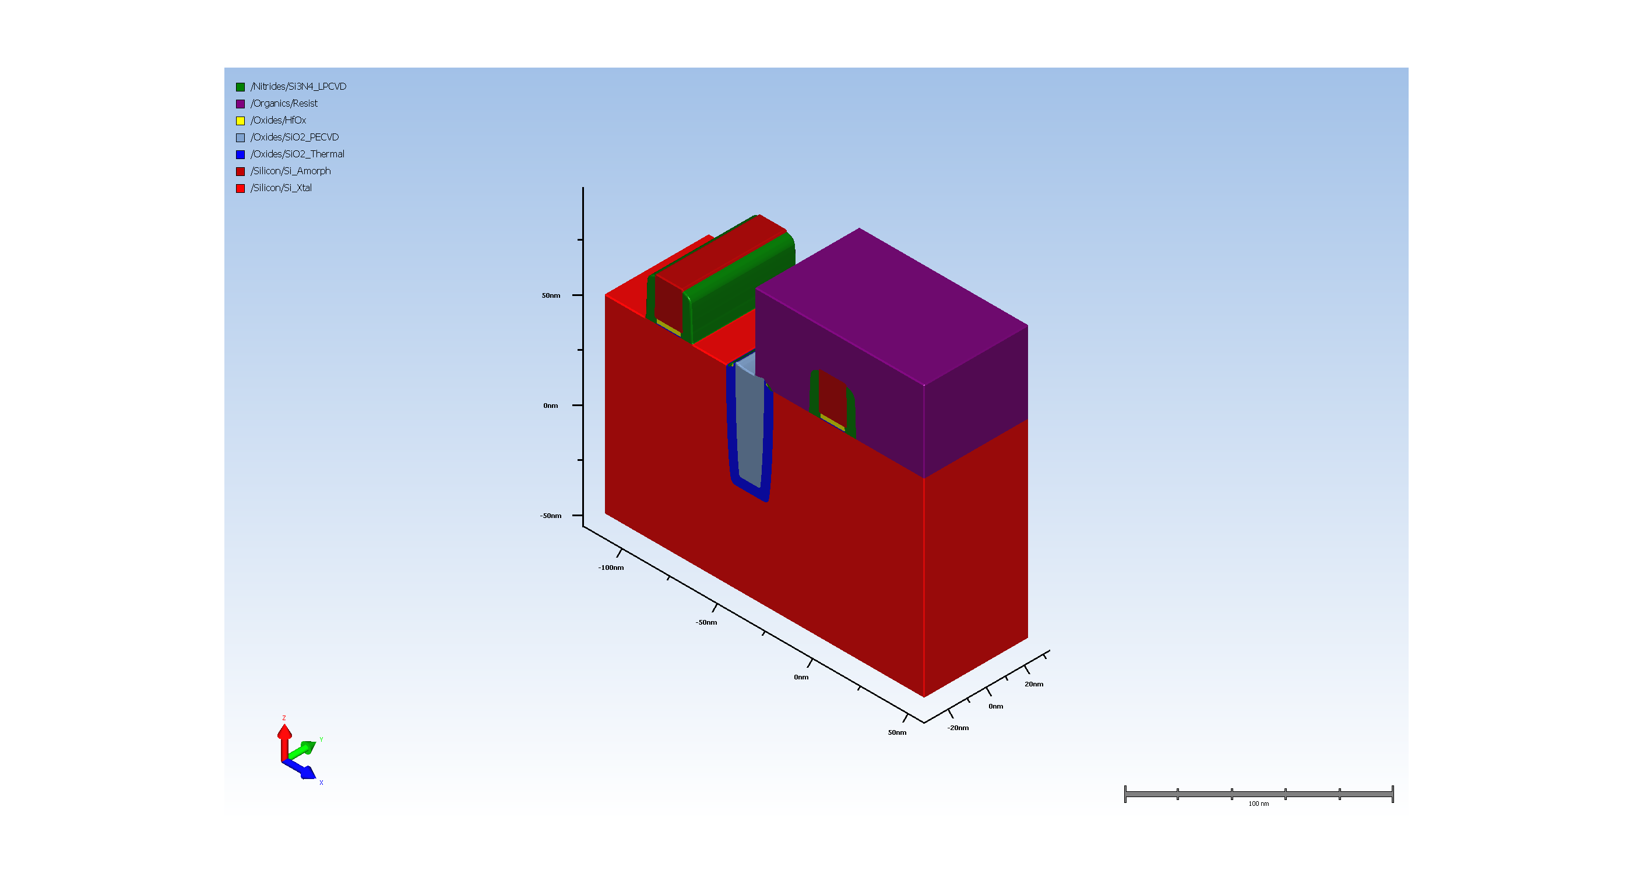
13.2. Expose Material

Slide 26
13.3. Implant (Requires Advanced Modeling)

Slide 27
13.4. resist removal

Slide 28
13.5. Planar Deposit

Slide 29
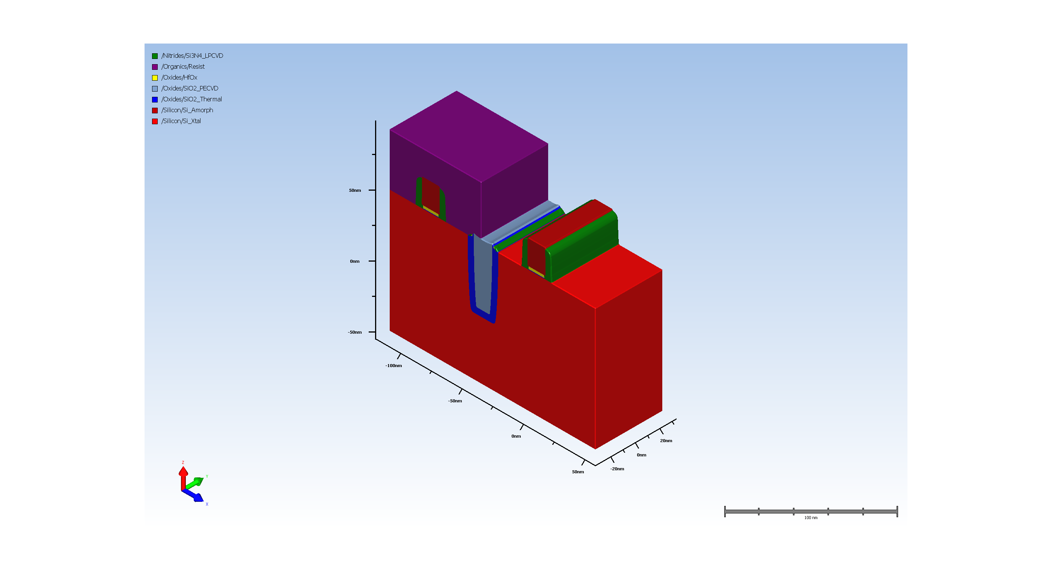
13.6. Expose Material

Slide 30
13.7. Implant (Requires Advanced Modeling)

Slide 31
13.8. resist removal

Slide 32

13.9. Diffusion (Requires Advanced Modeling)

Slide 33
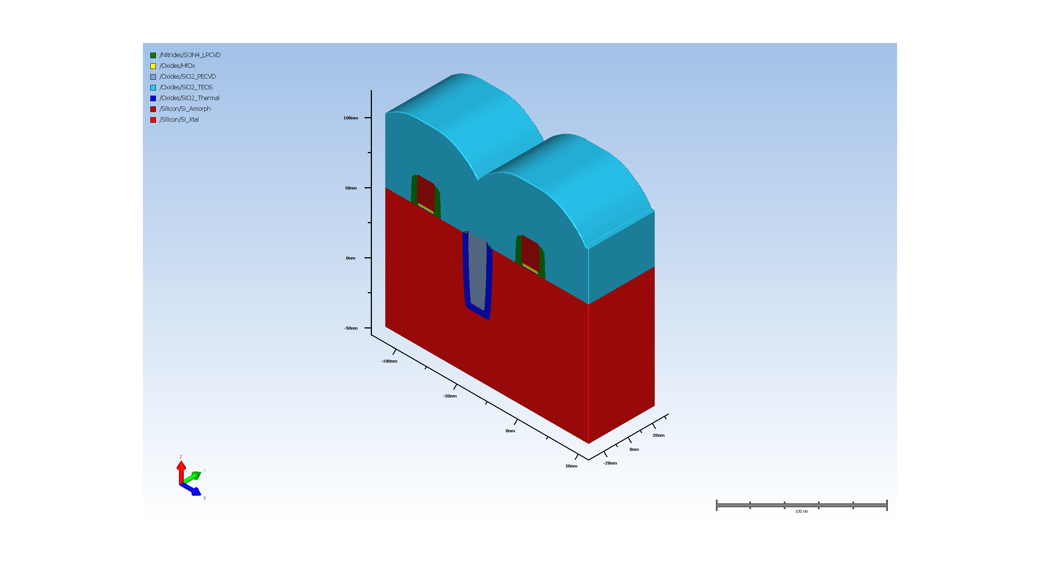
14.1. Conformal Deposit

Slide 34
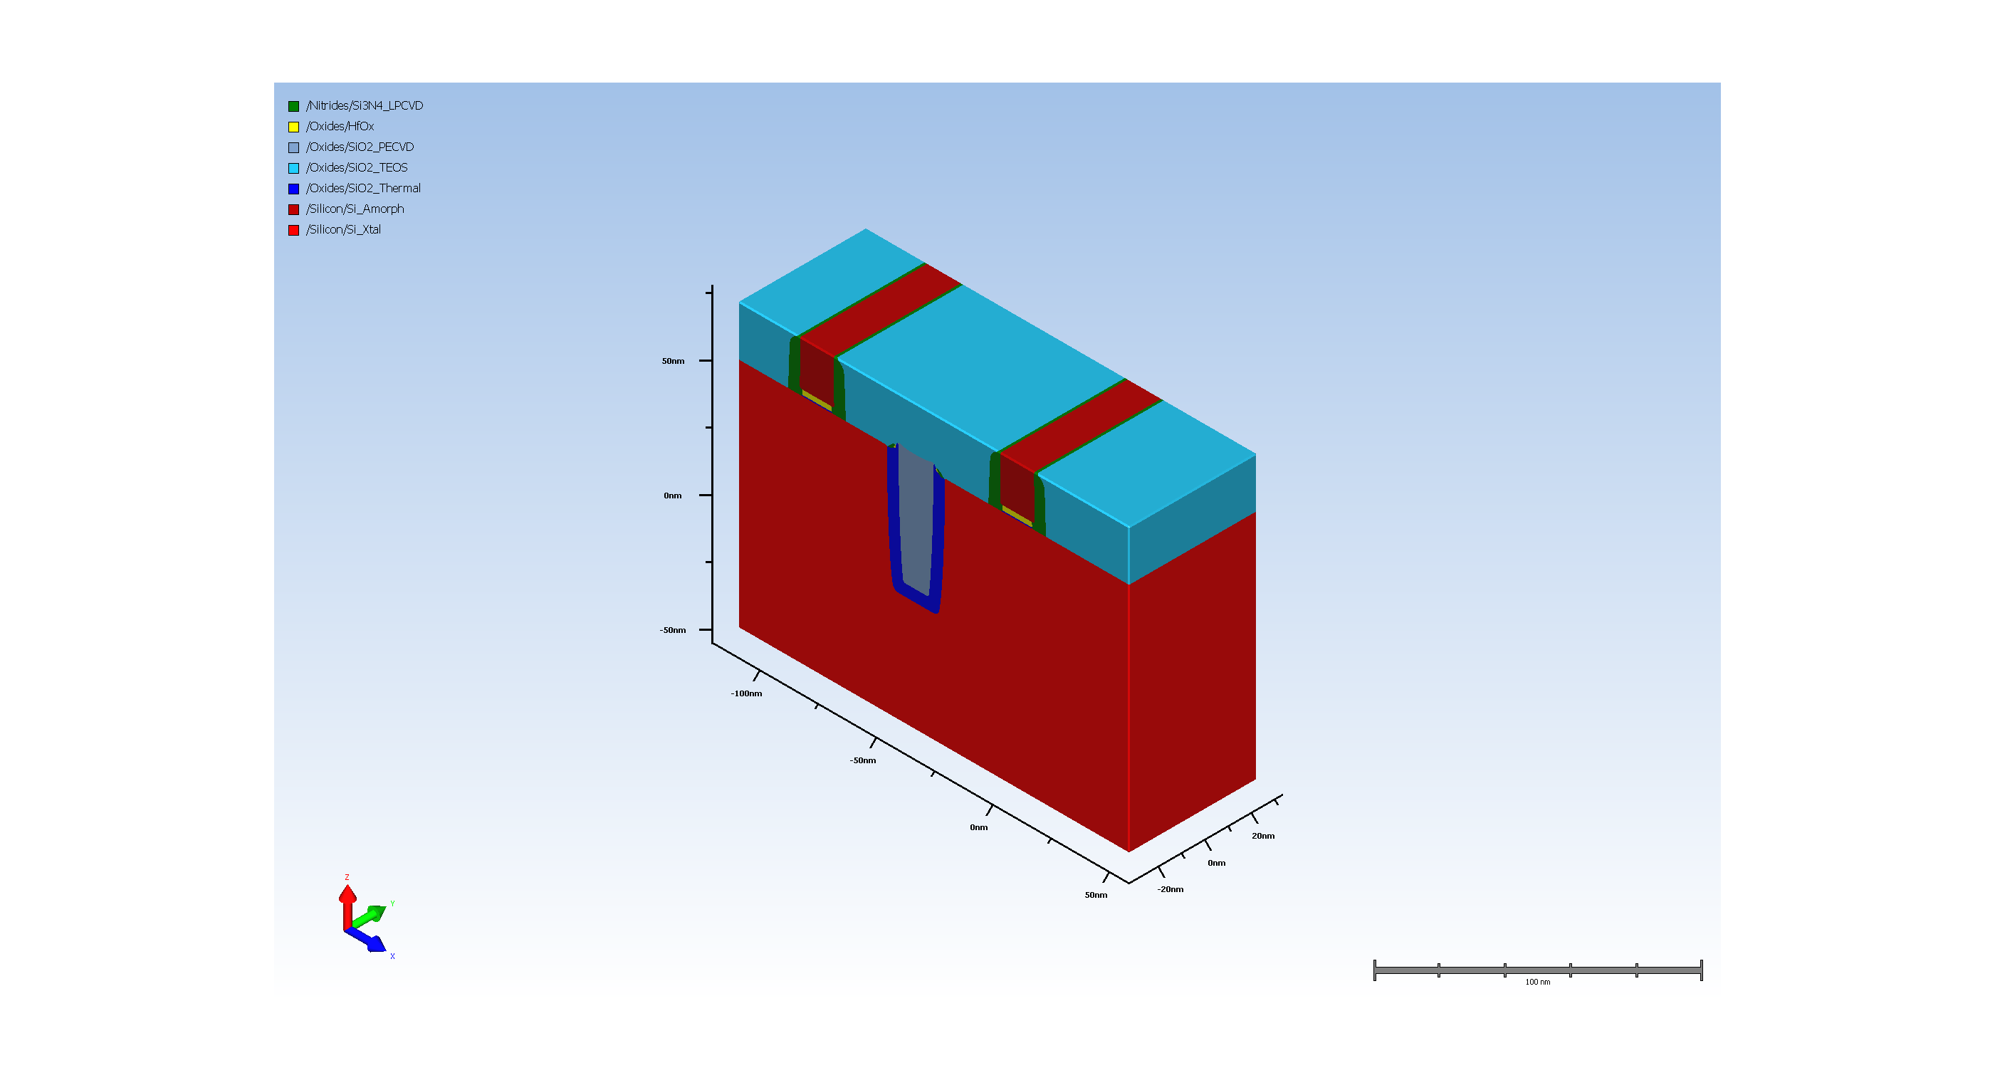
14.2. STI oxide CMP

Slide 35

15.3. Poly Pull Etch

Slide 36
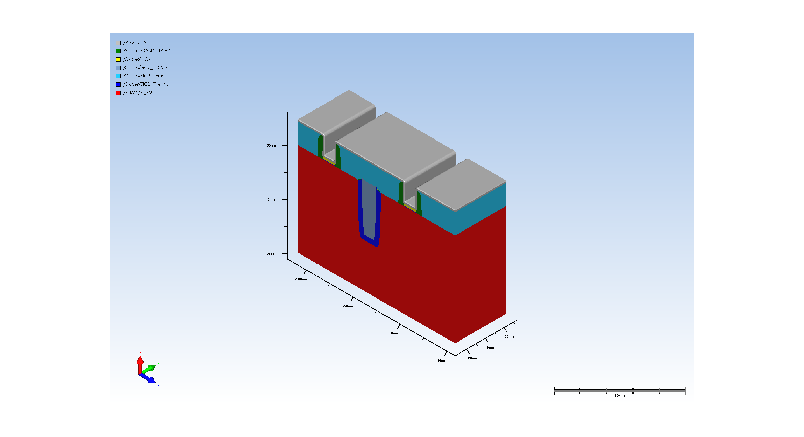
15.5. Conformal Deposit

Slide 37
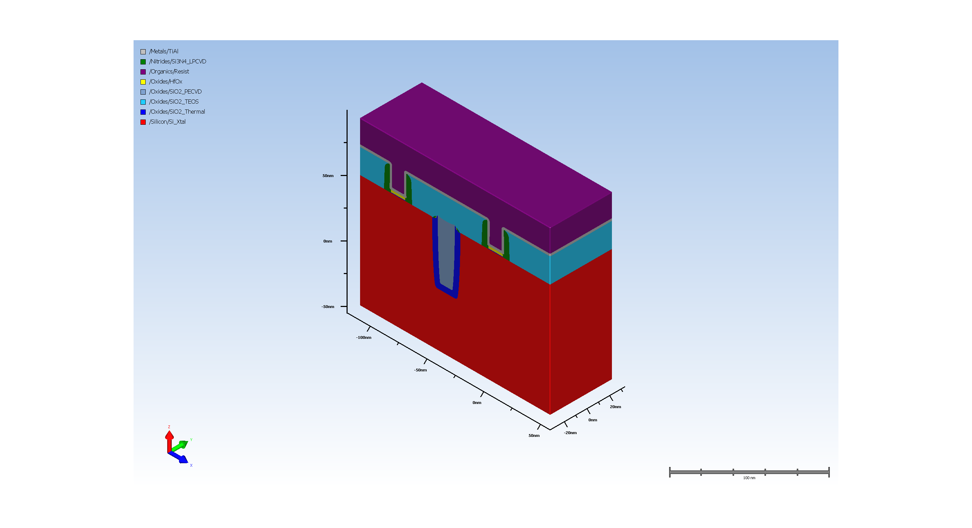
15.6. Planar Deposit

Slide 38
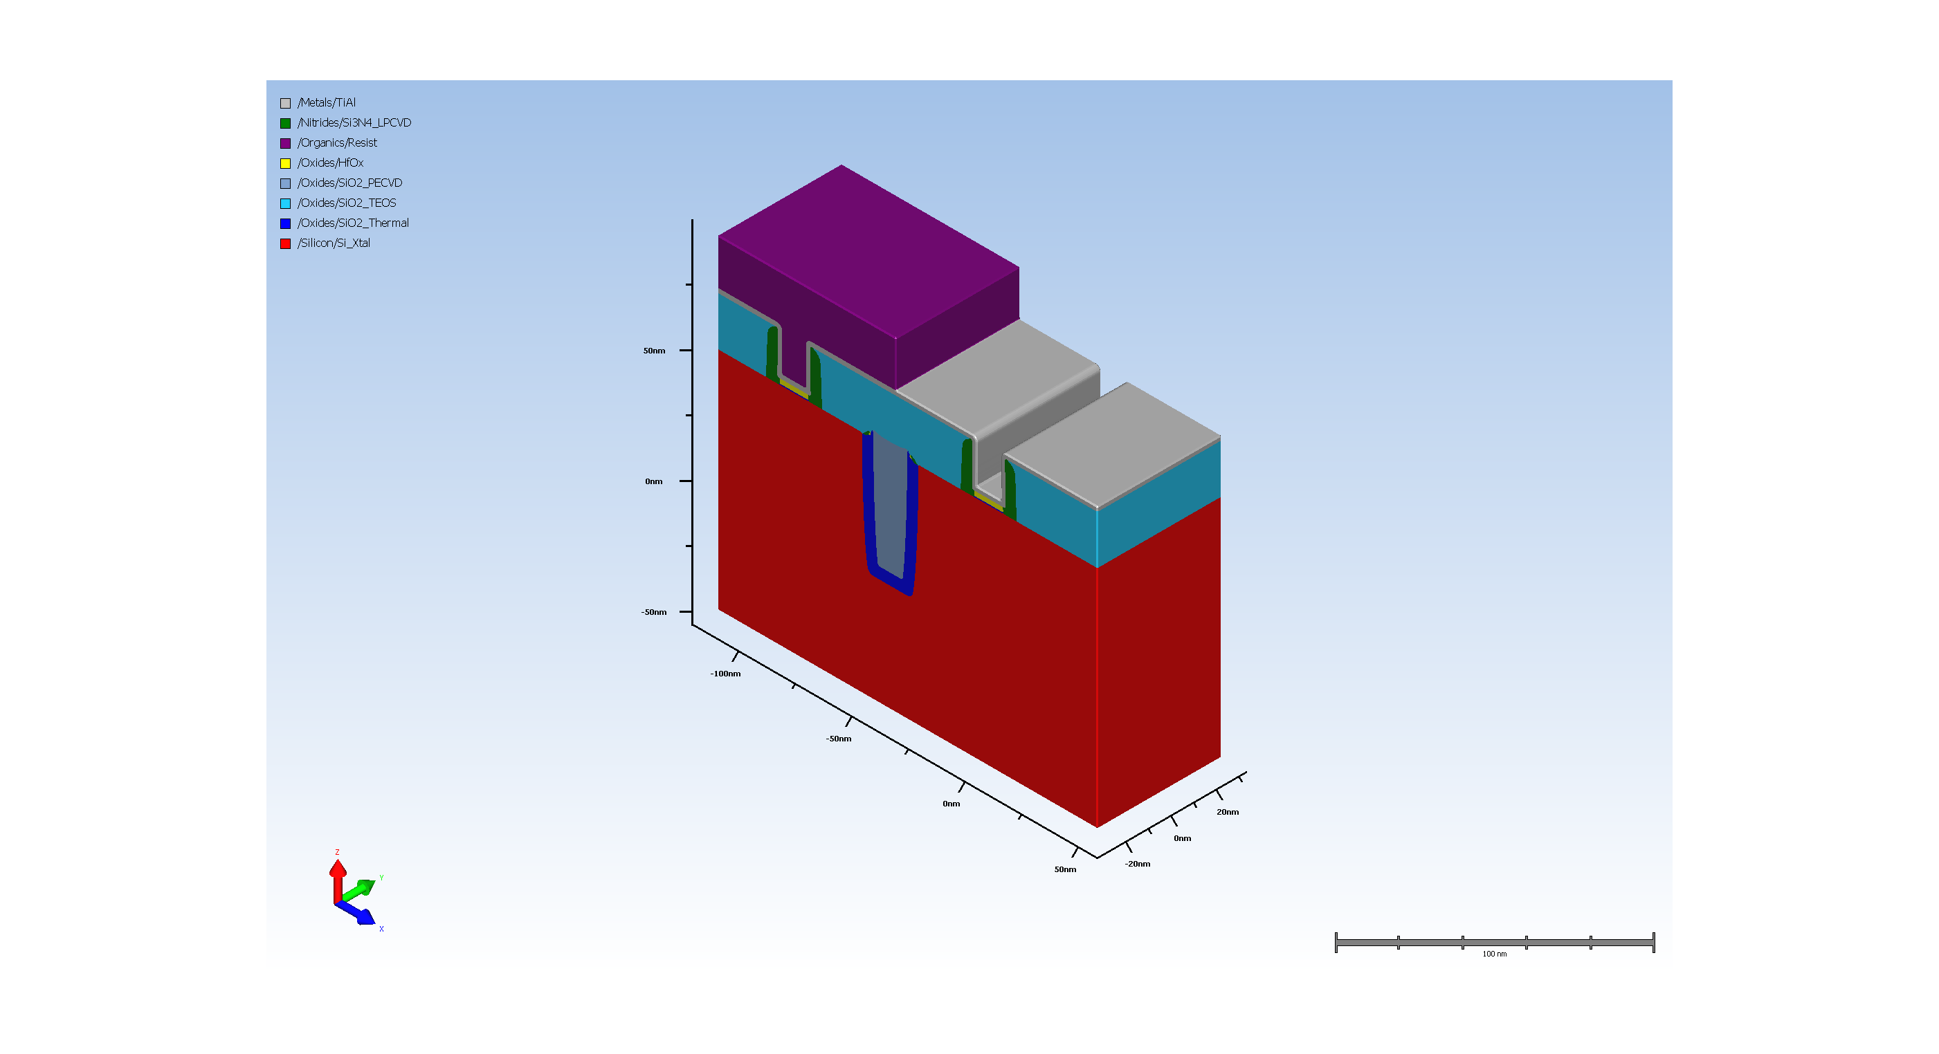
15.7. Expose Material

Slide 39
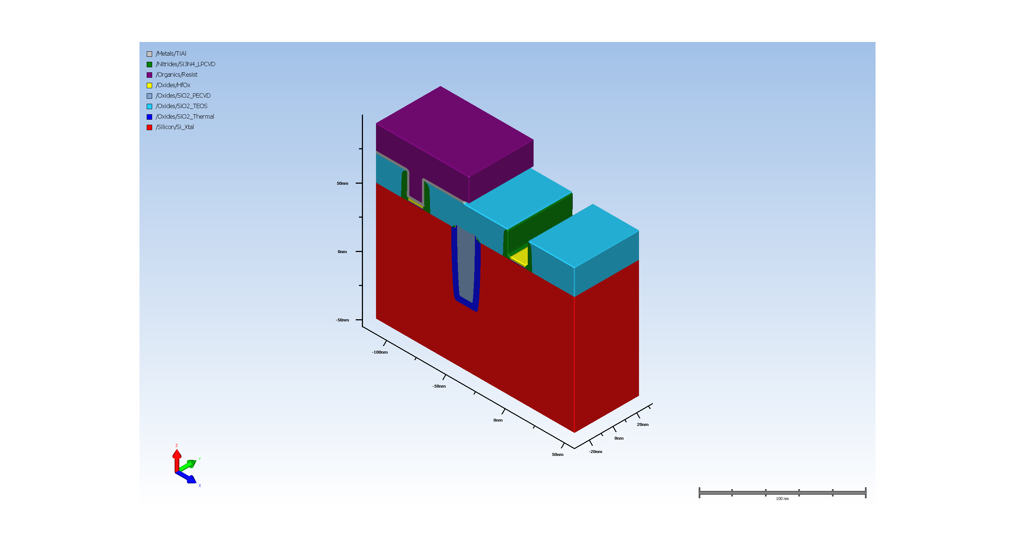
15.8. Basic Etch

Slide 40

15.9. resist removal

Slide 41
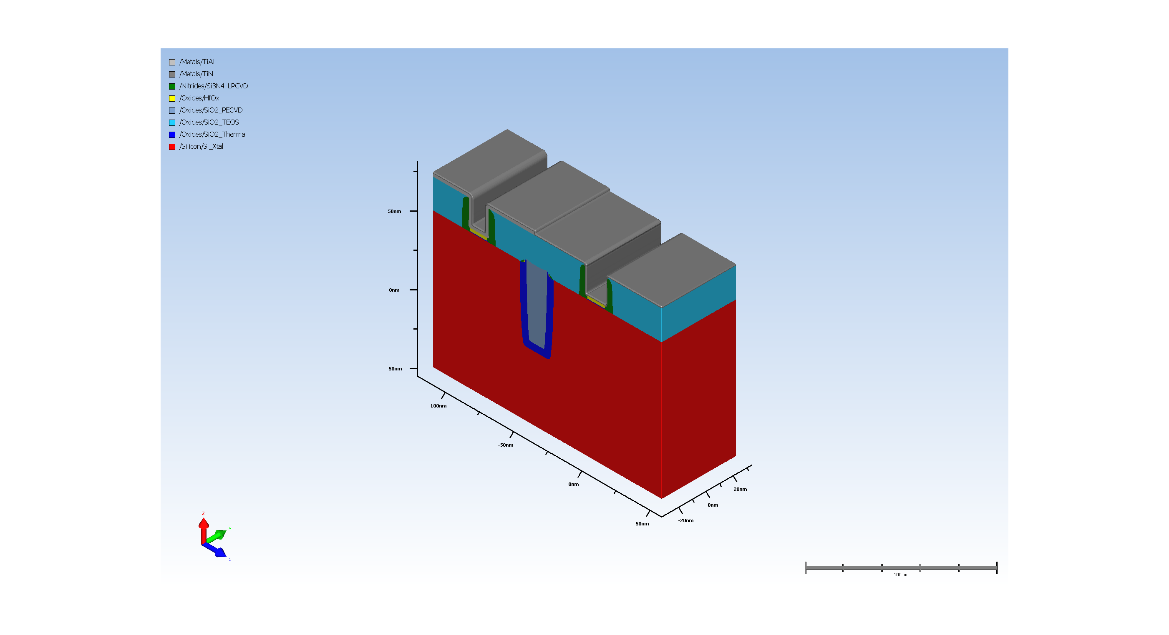
16.5. Conformal Deposit

Slide 42
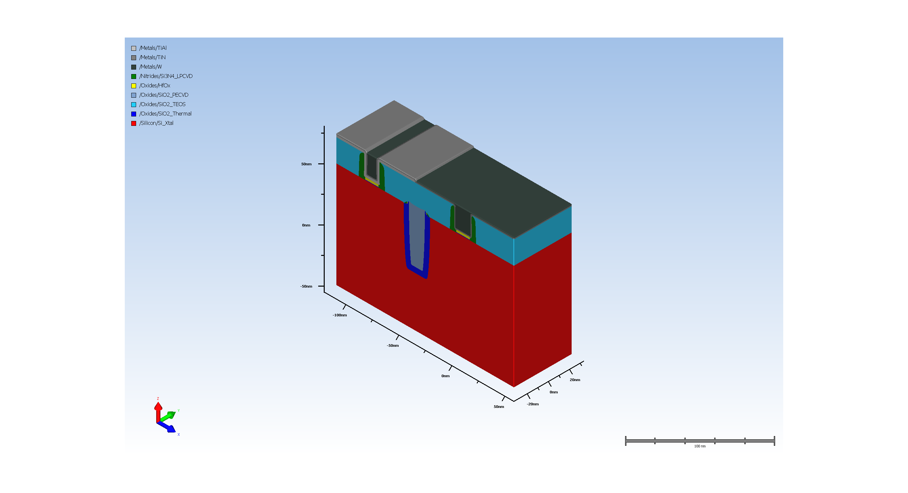
16.6. Planar Deposit

Slide 43

16.7. Stopping CMP

Slide 44

17. Diffusion (Requires Advanced Modeling)

