Slide 1
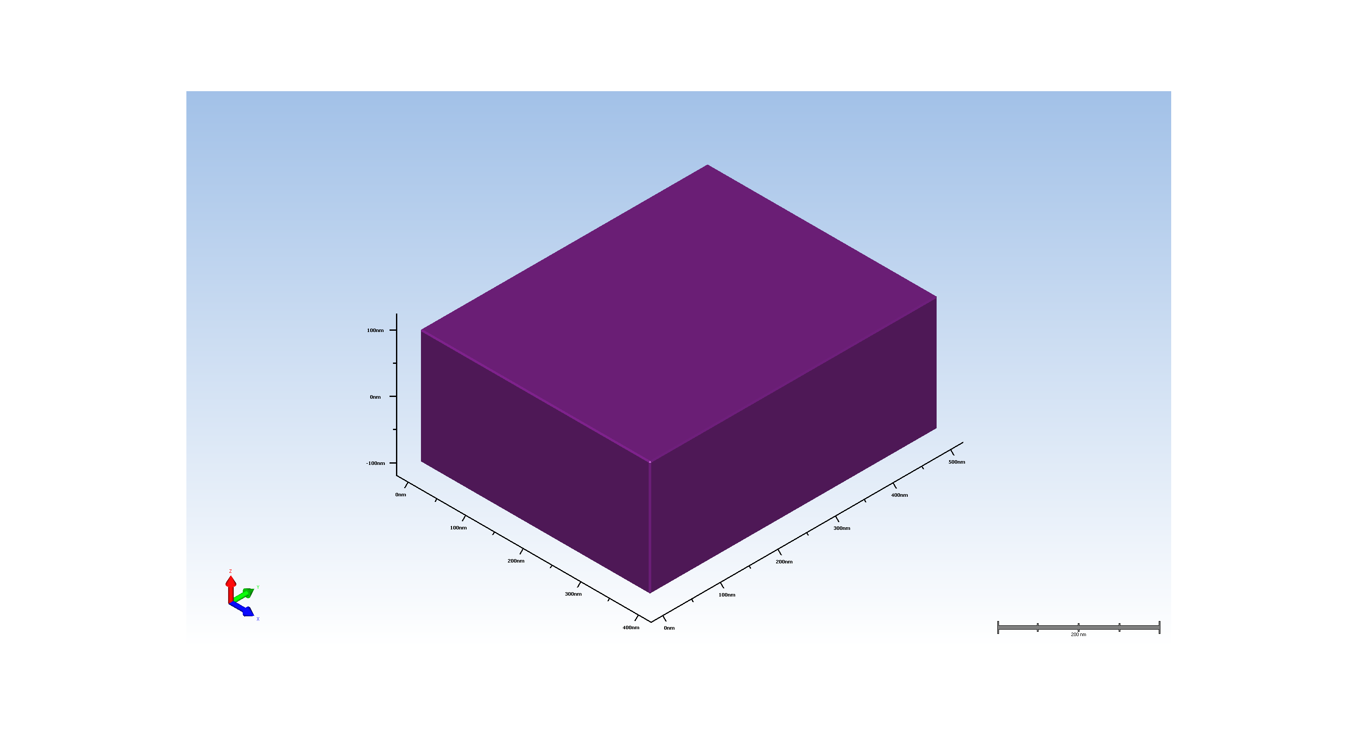
1. Wafer Setup

Slide 2
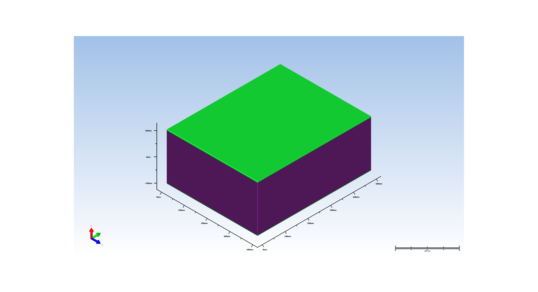
2. pad oxide deposition

Slide 3
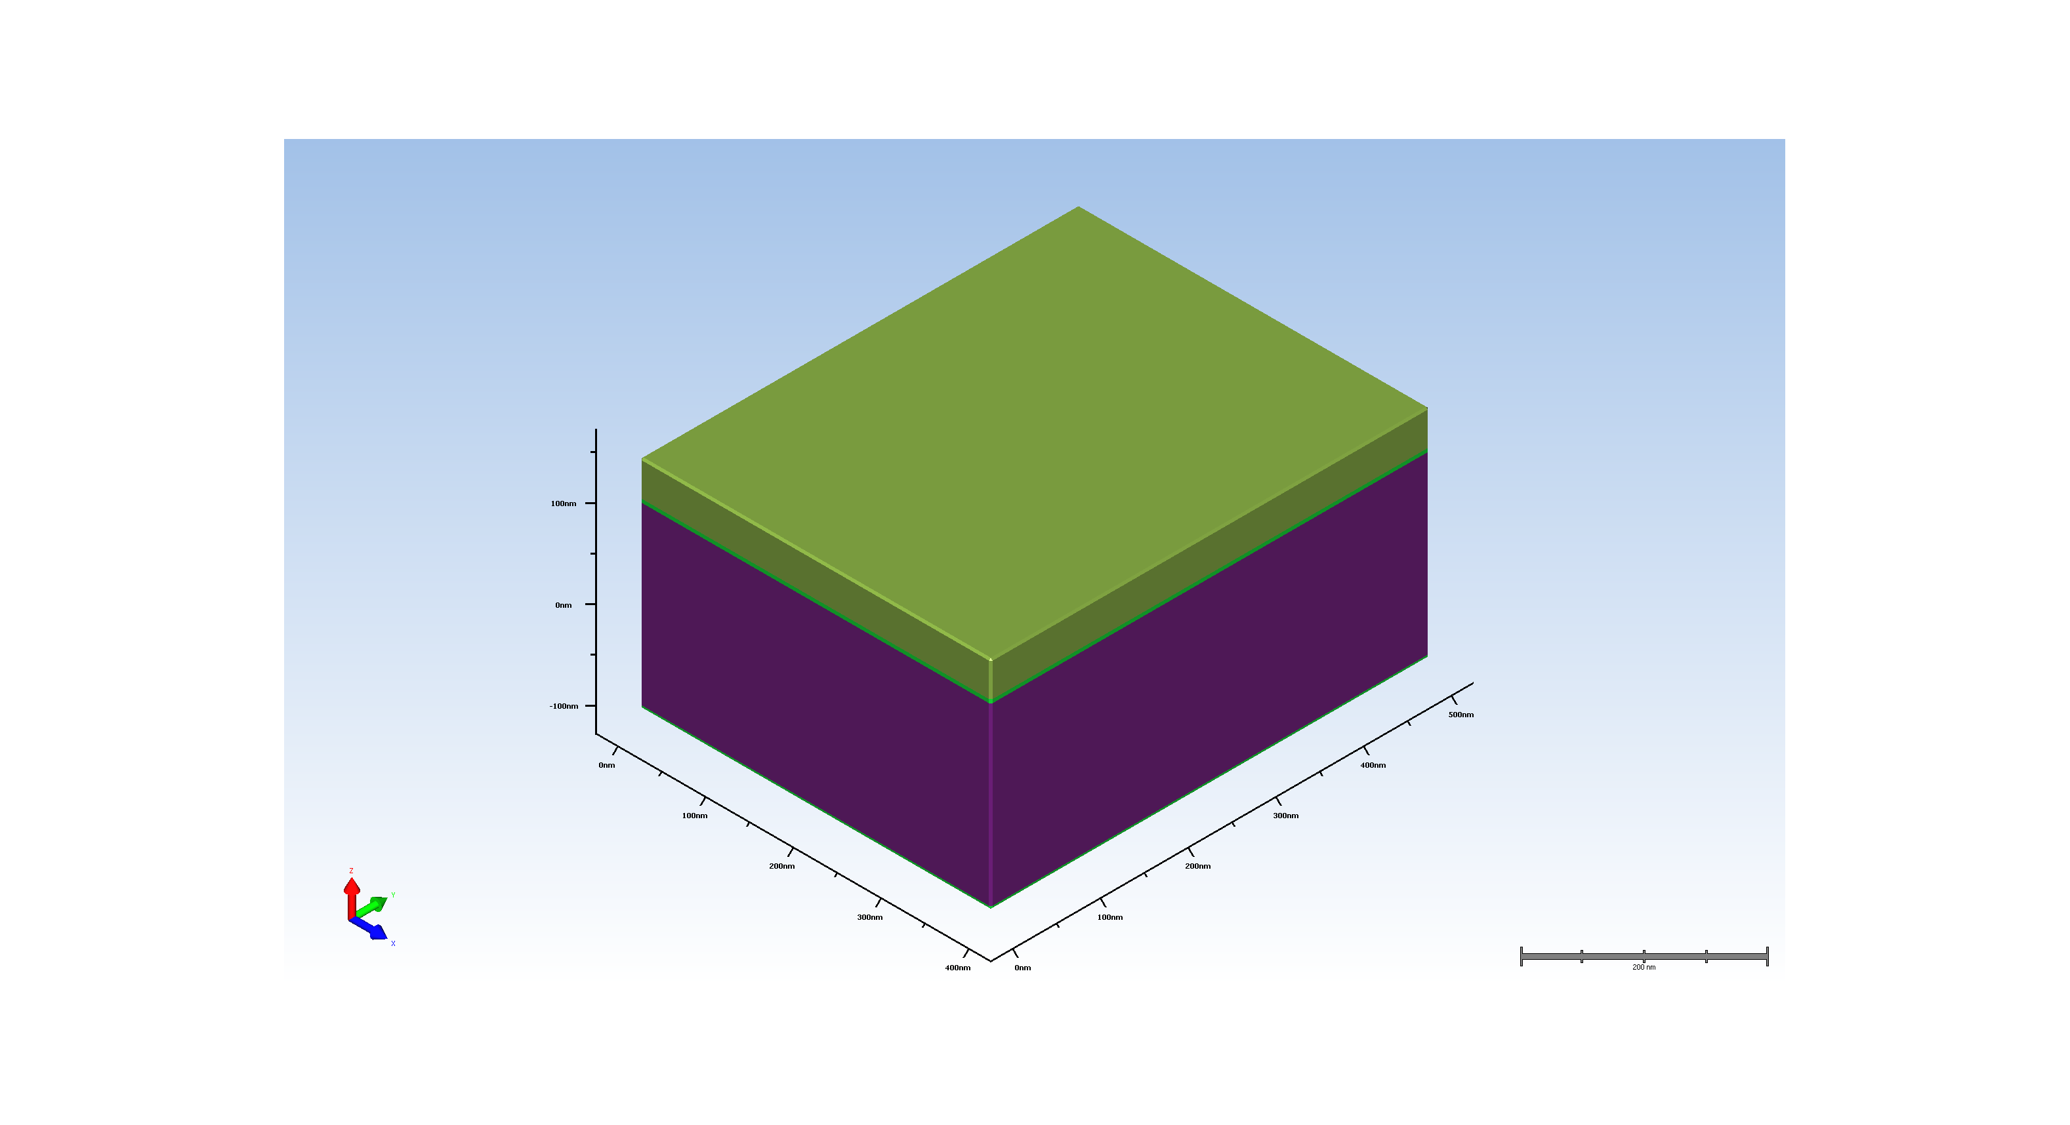
3. pad nitride

Slide 4
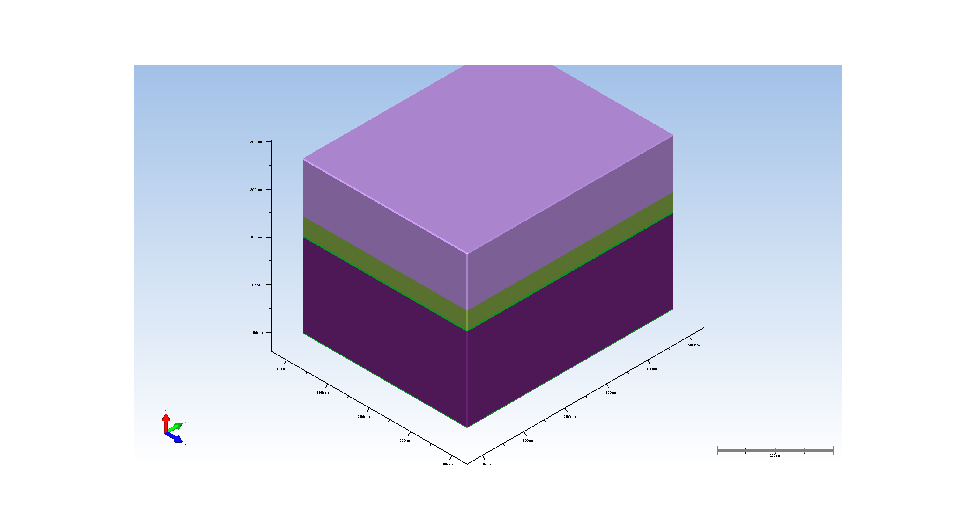
4.1. spin rx resist

Slide 5
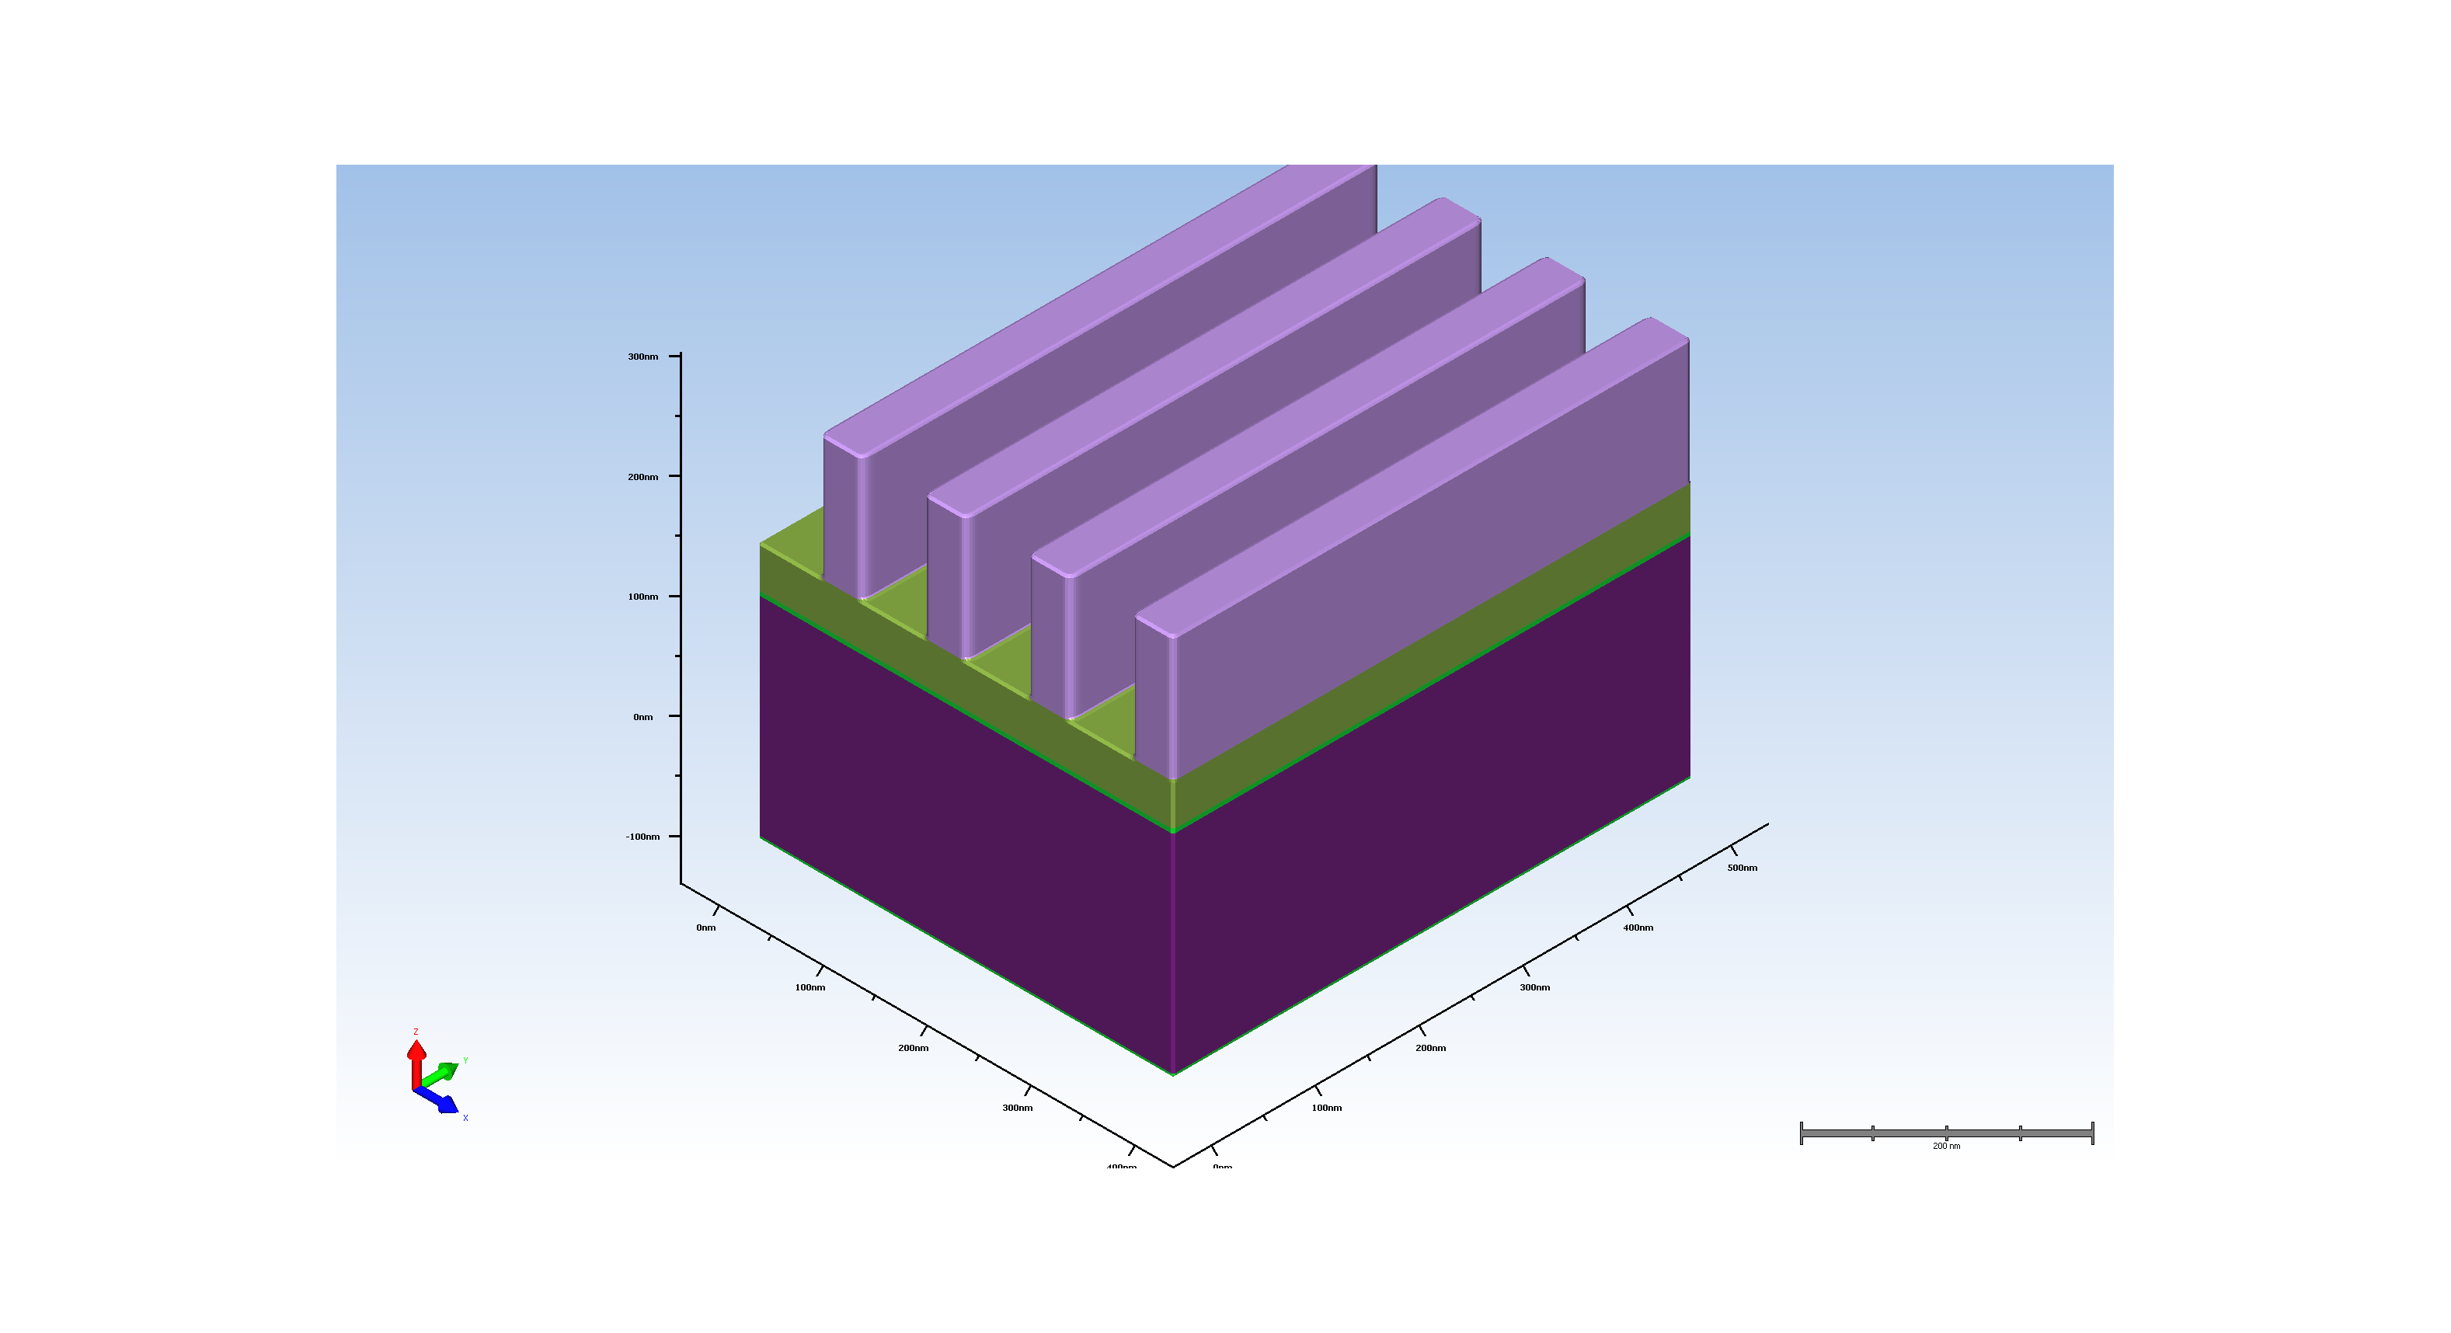
4.2. Expose rx

Slide 6
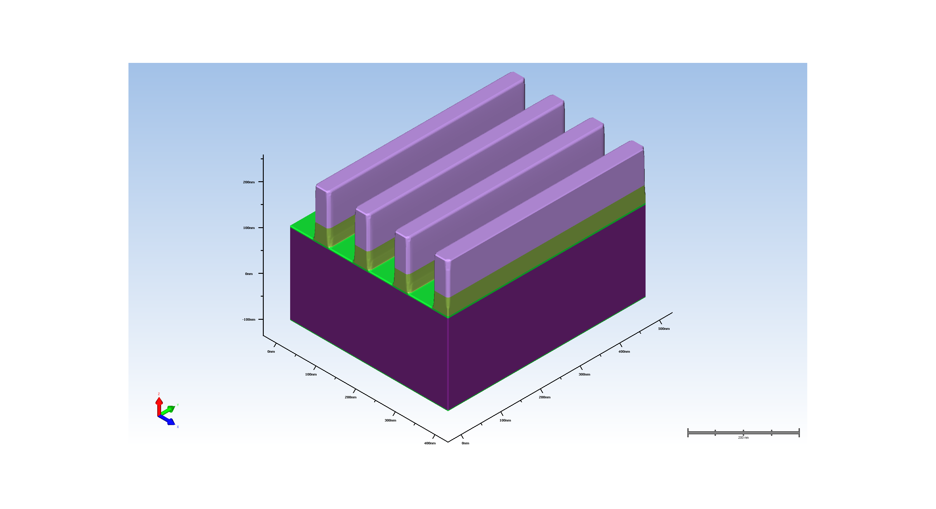
5.1. pad nitride etch

Slide 7
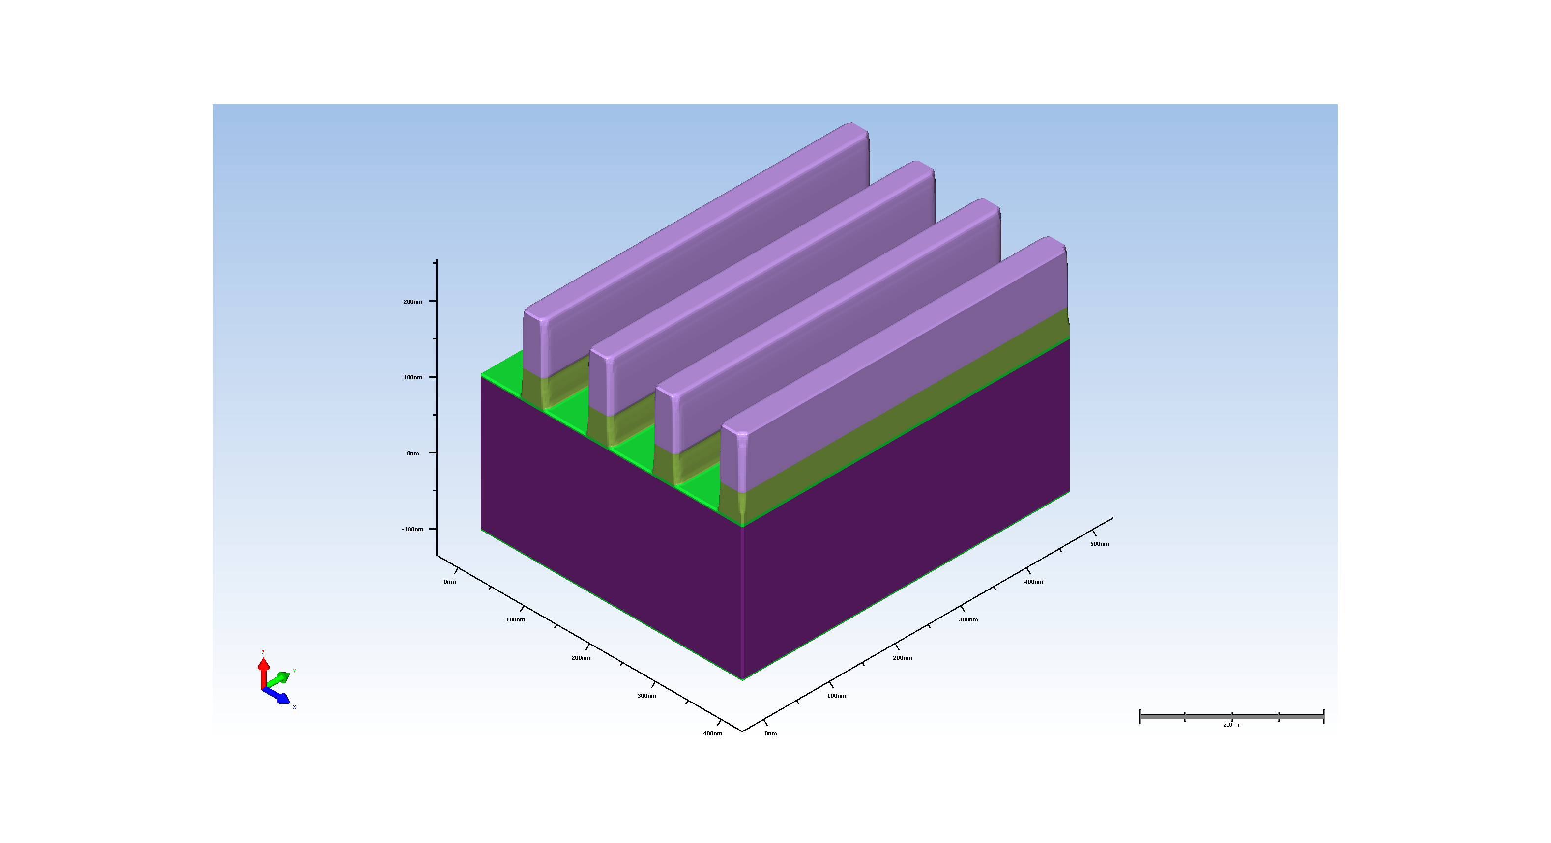
5.2. pad oxide etch

Slide 8
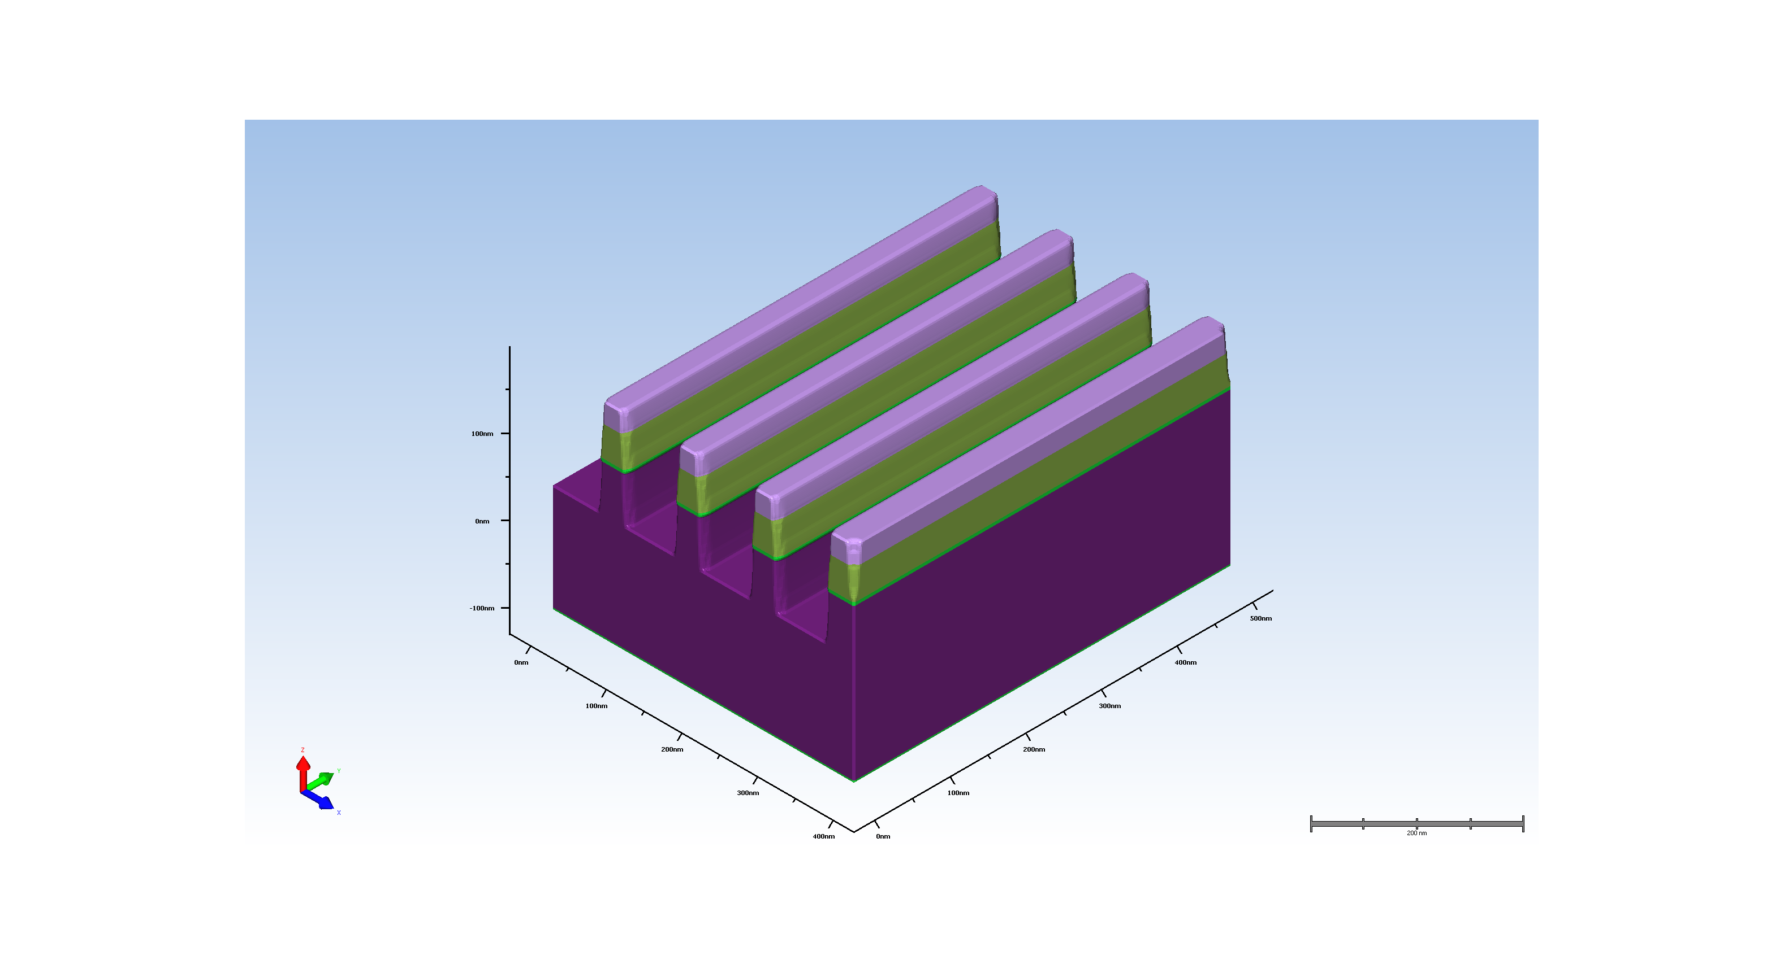
5.3. sillicon etch

Slide 9
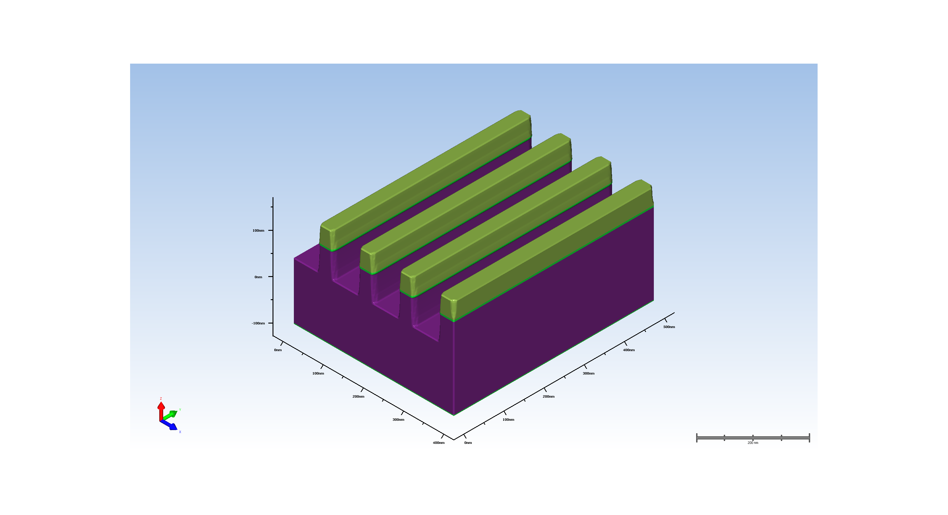
6. resiste strip

Slide 10
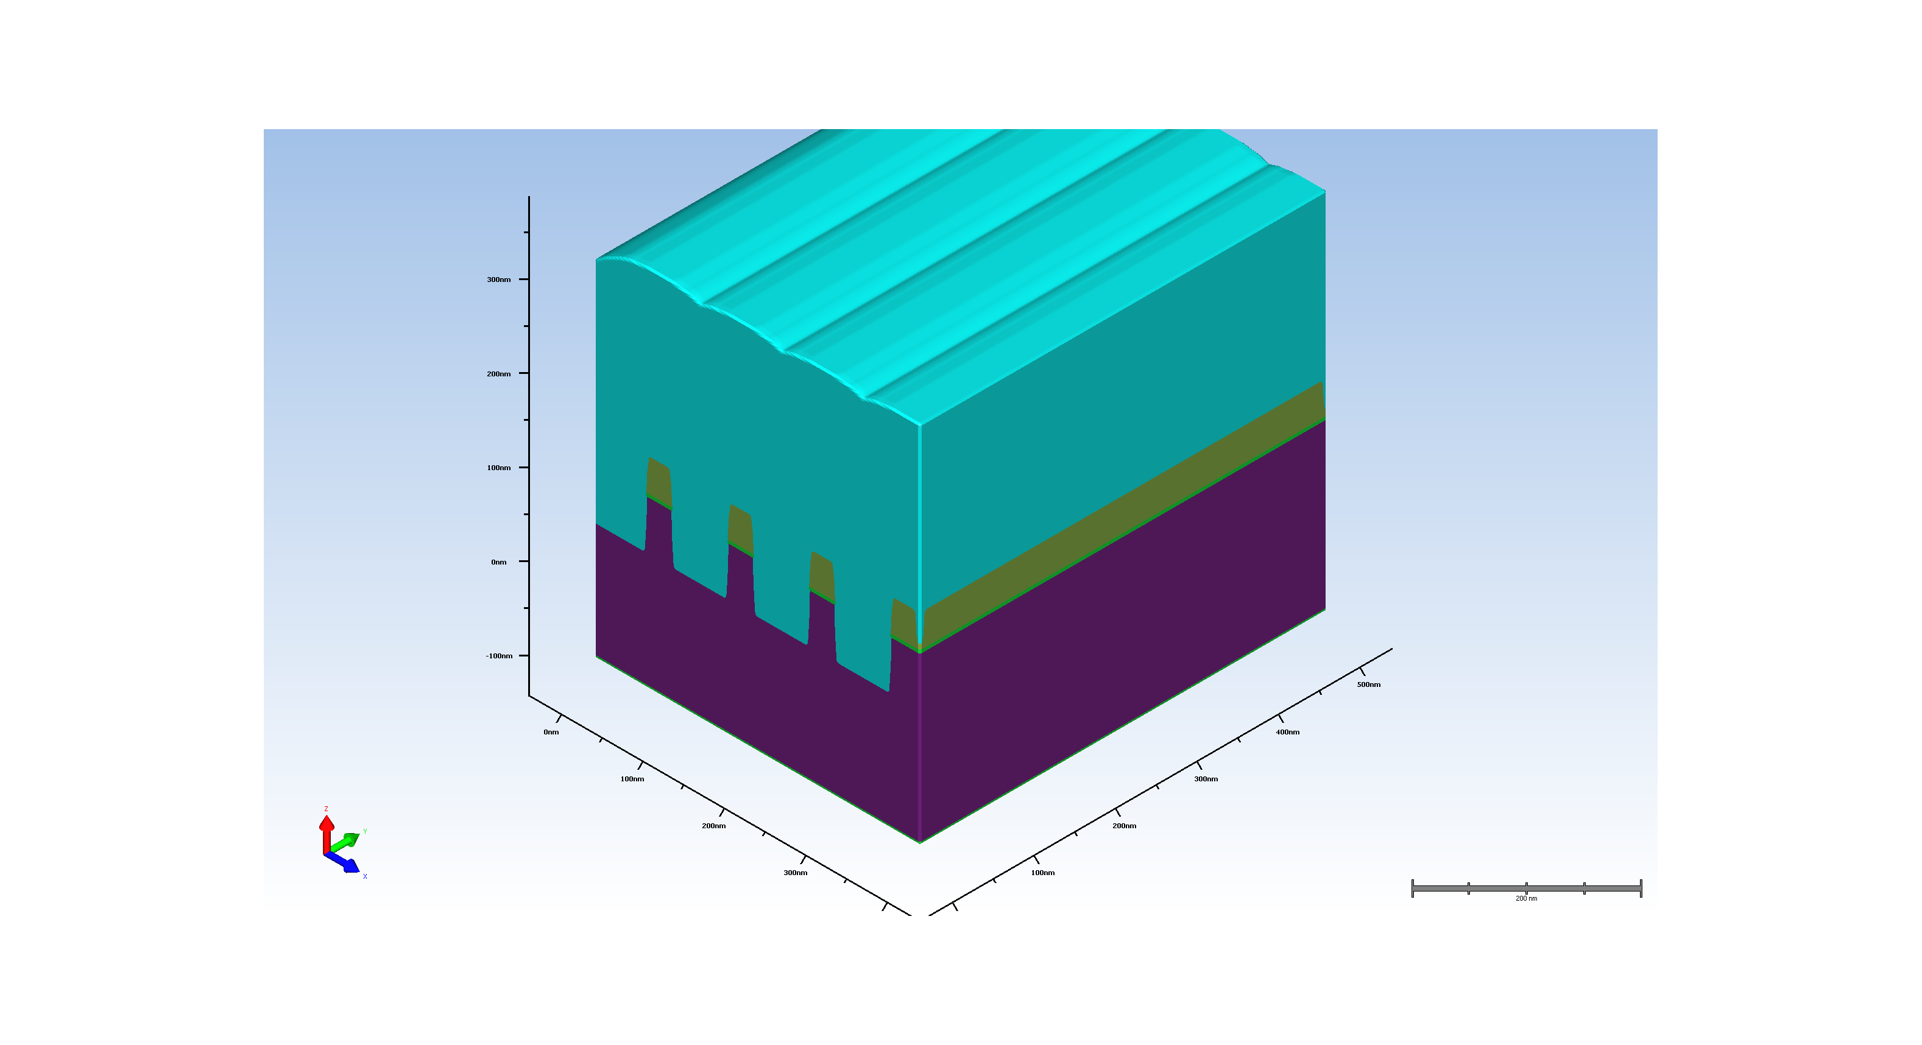
7. sti fill deposition

Slide 11
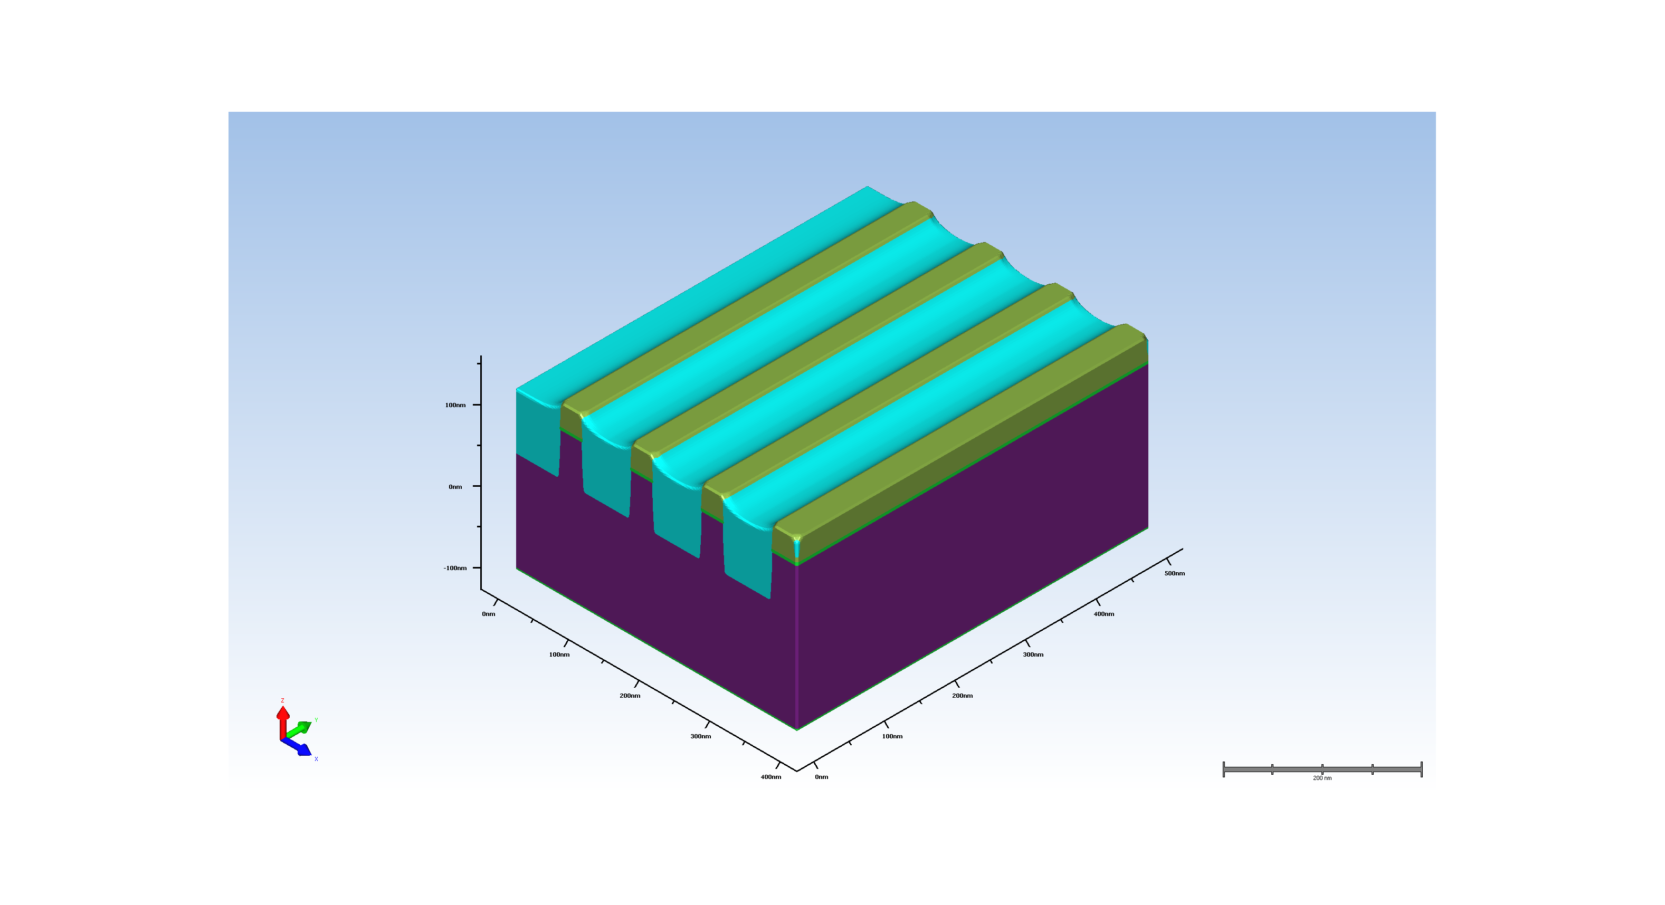
8. sti oxide cmp

