Slide 1
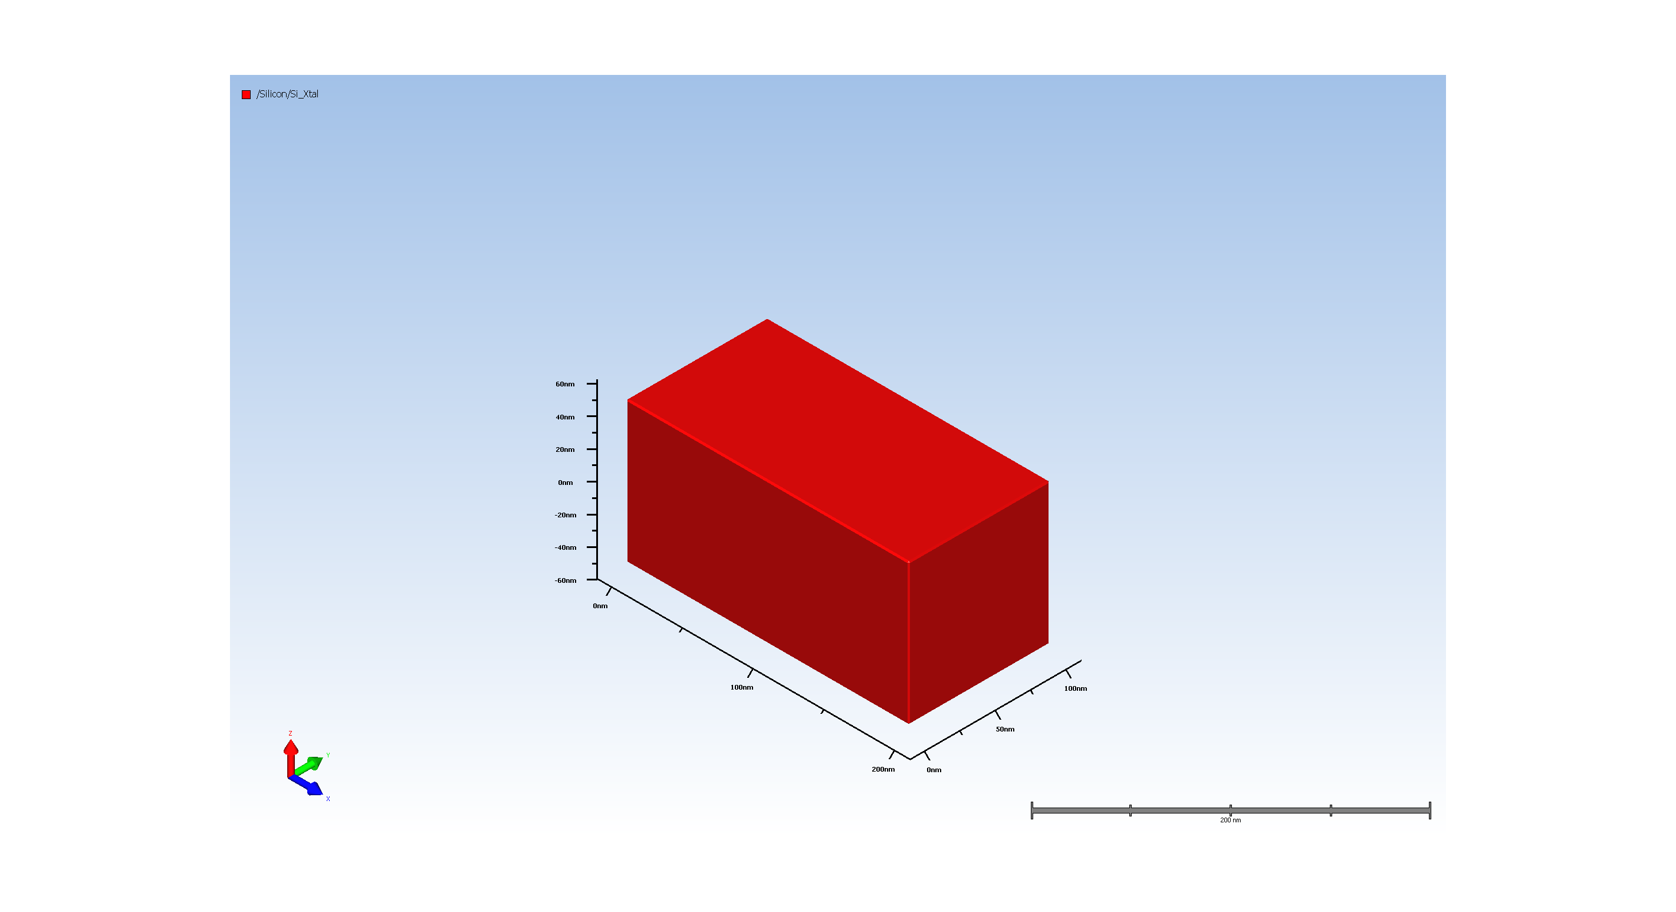
1. Wafer Setup

Slide 2

2. Enable Void Tracking

Slide 3
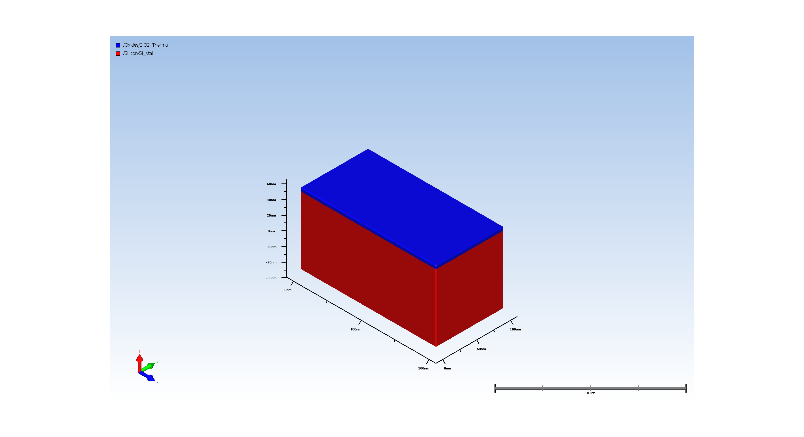
3.1. Gate oxide Deposit

Slide 4
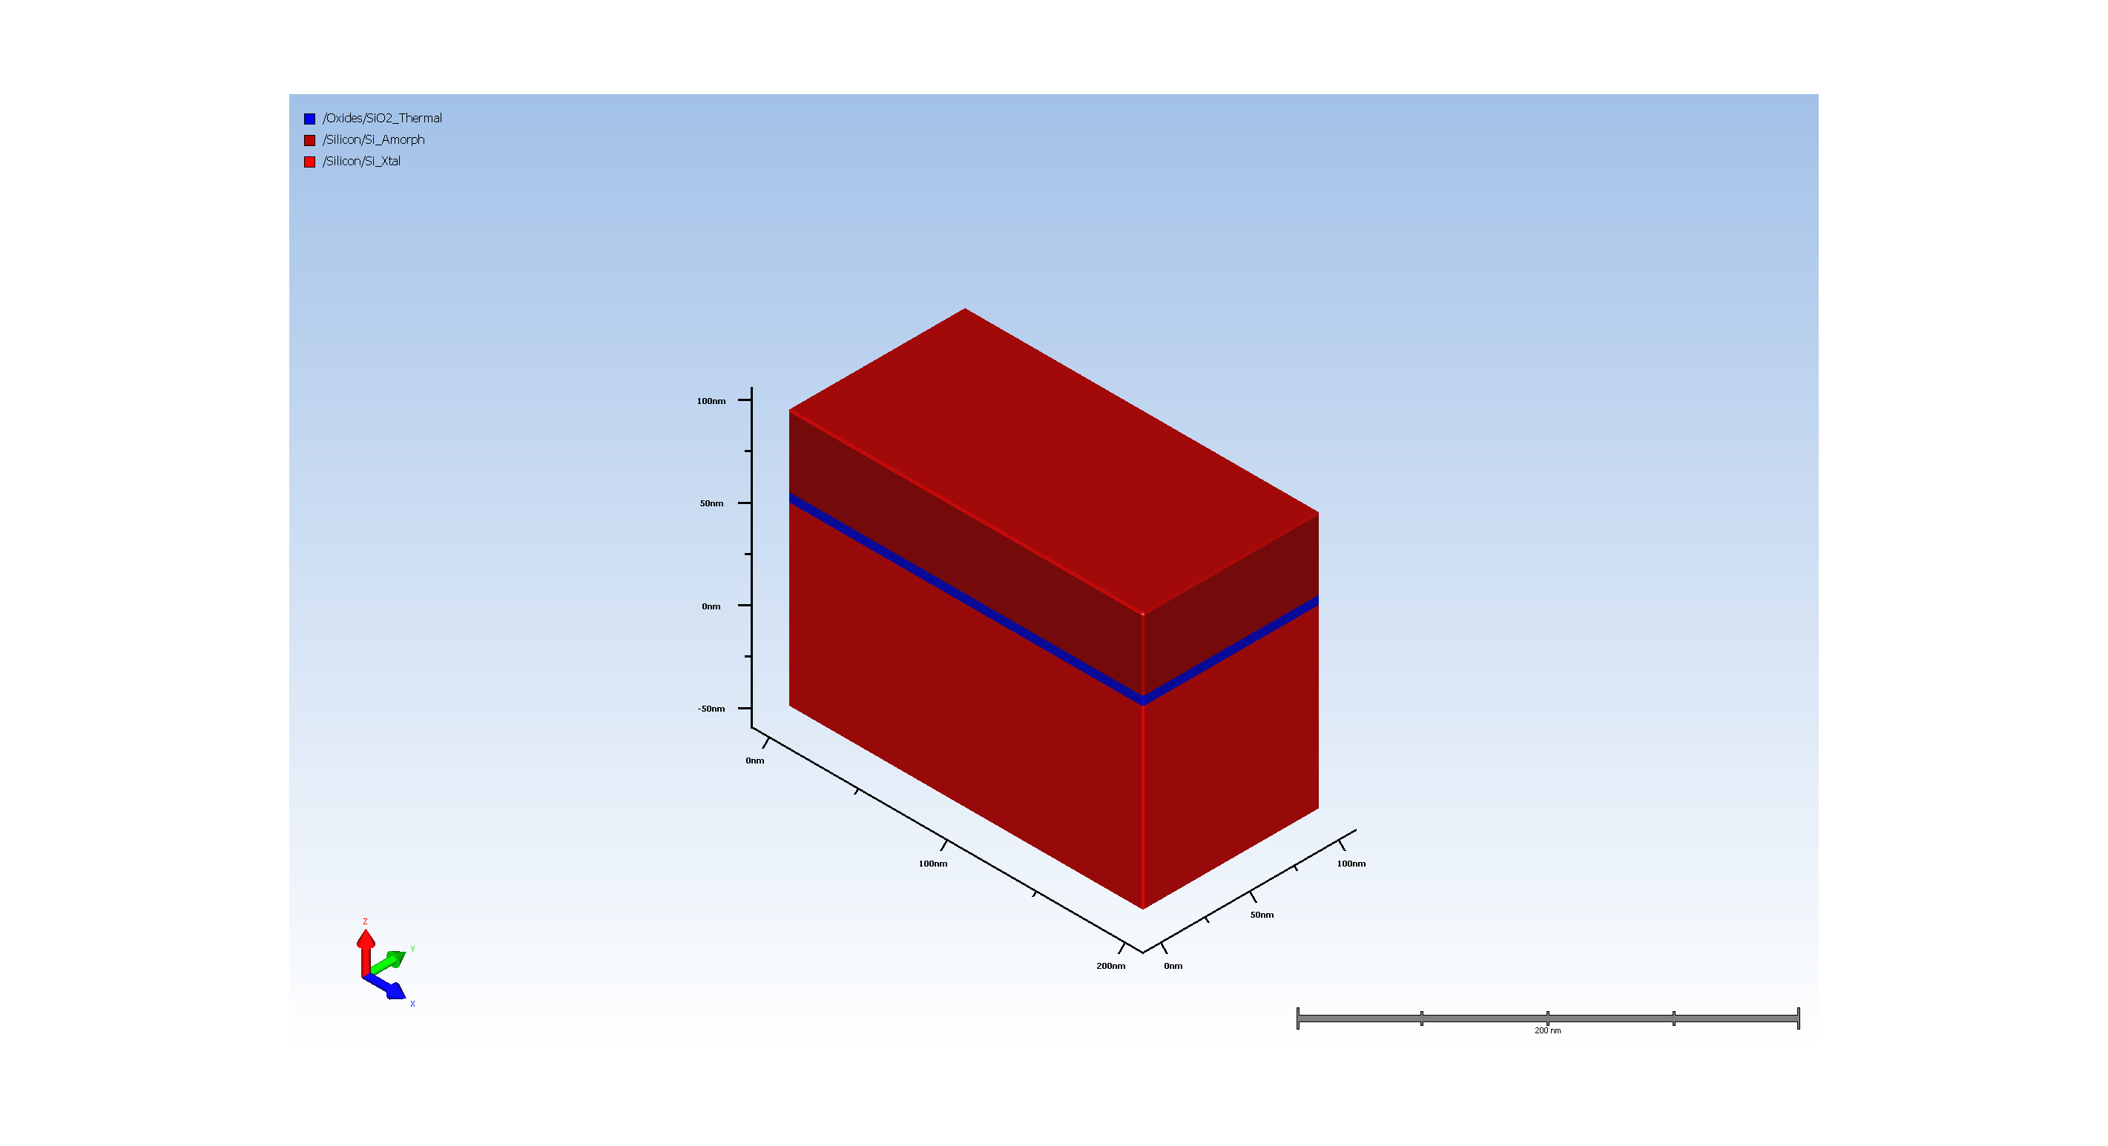
3.2. Gate polysilicon Deposit

Slide 5
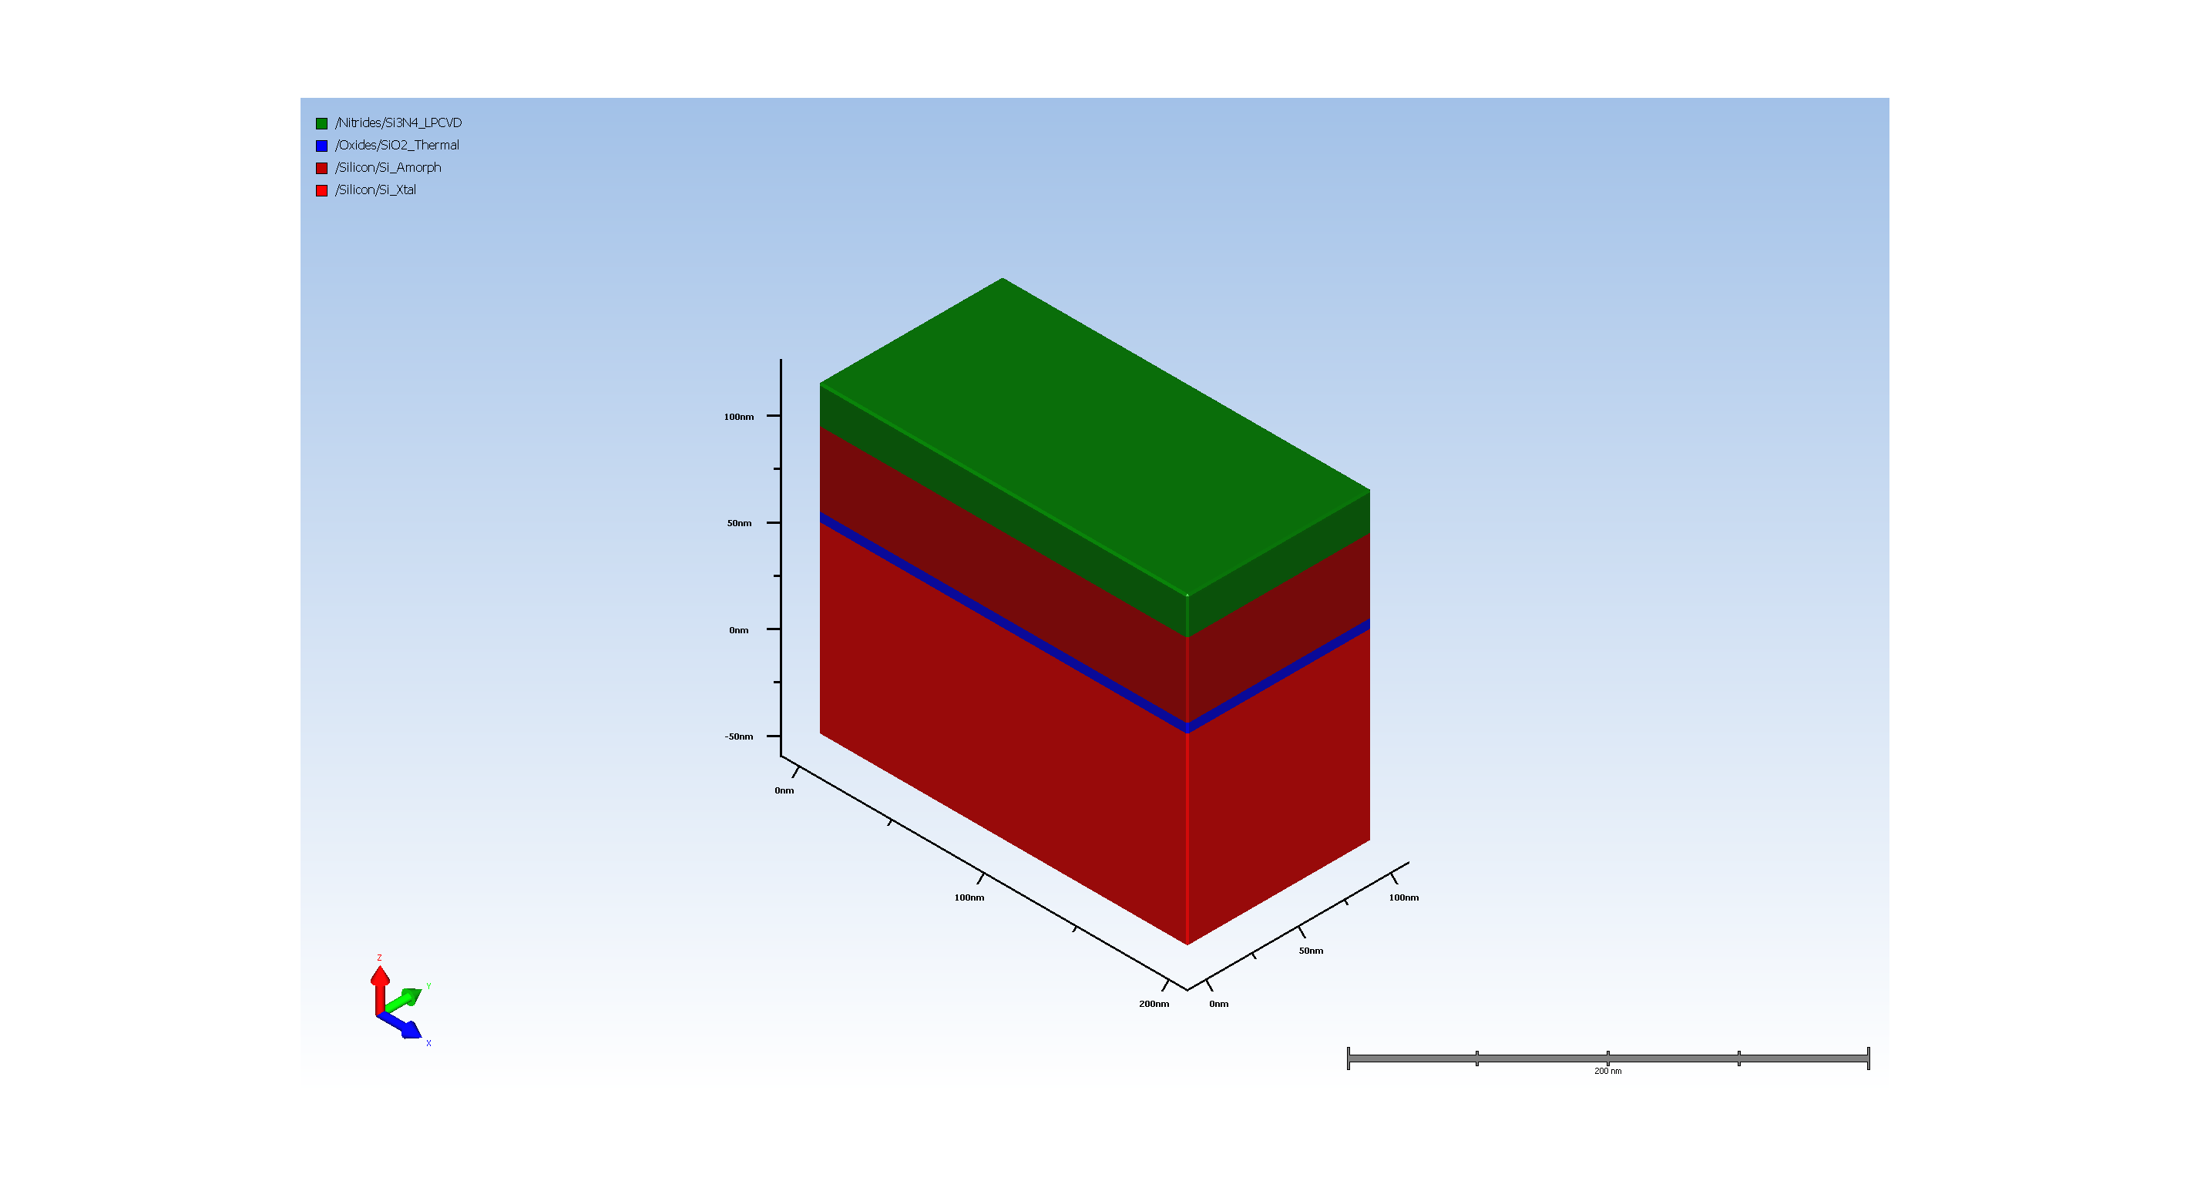
3.3. SiARC Deposition

Slide 6
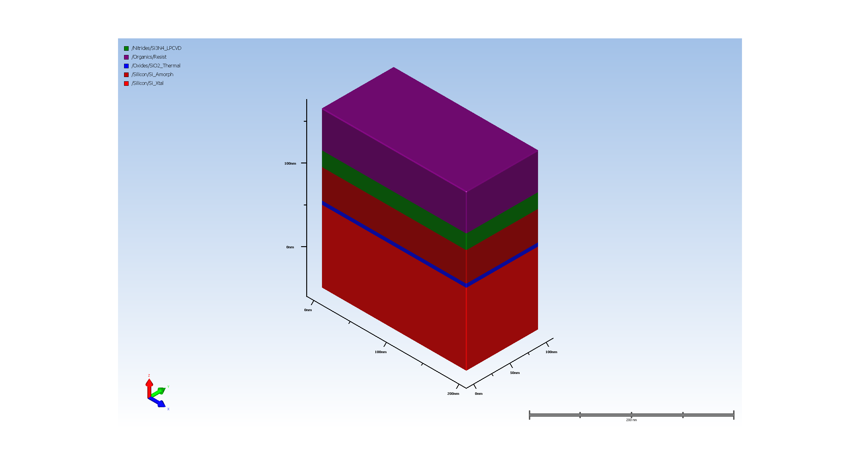
3.4. dummy gate resist pattern

Slide 7
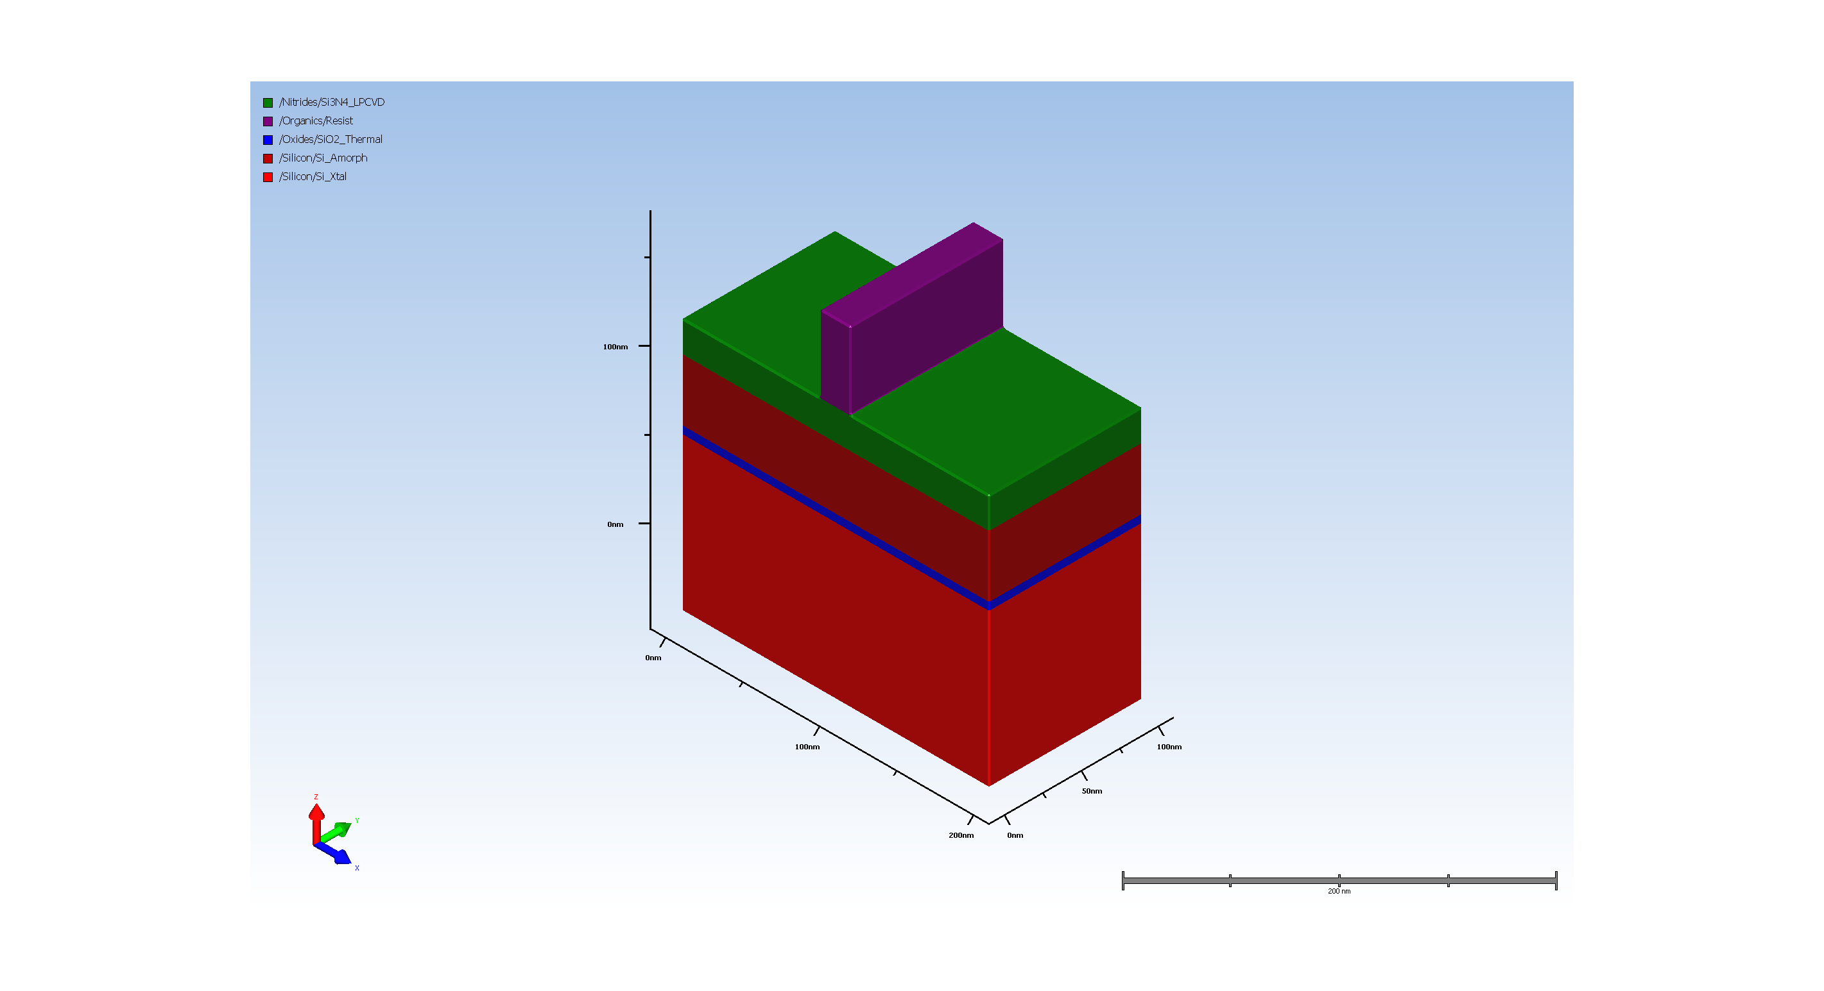
3.5. Expose resist for gate oxide etch

Slide 8
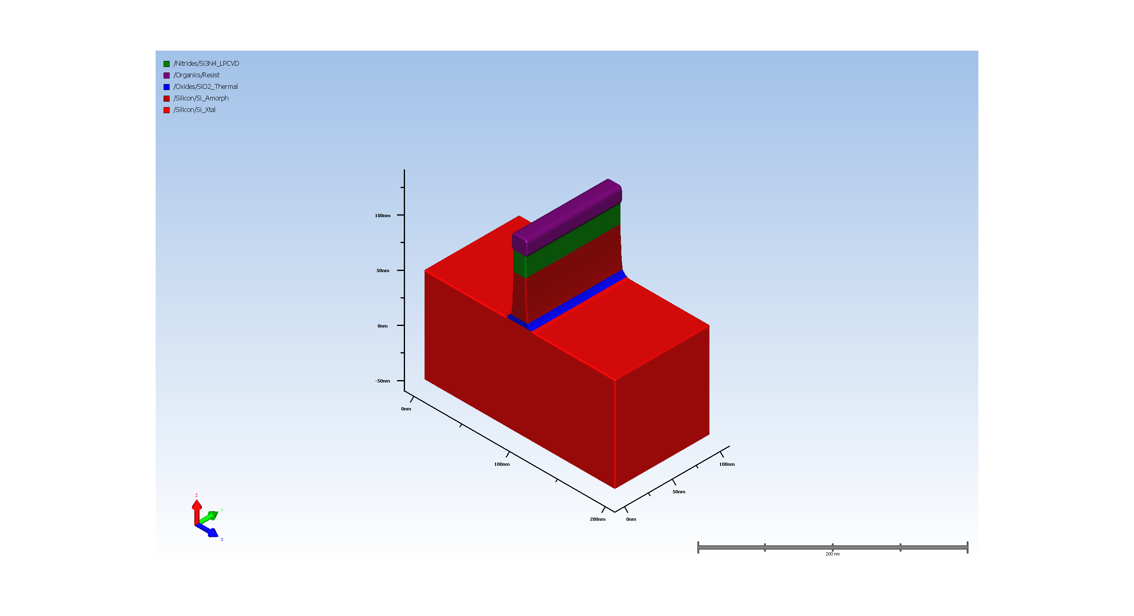
3.6. Multi Etch (Requires Advanced Modeling)
Unknown Step Properties:
name: hdm
Num. of attributes: 3
VersionNumber : 12.2.0.0
uiHidden : true
uiHideChildNodes : true
name: simultaneousDeposit
Num. of attributes: 1
isEnable : false
name: depositMaterial
Num. of attributes: 3
VersionNumber : 12.2.0.0
readonly : true
uiHideChildNodes : true
name: depositRatio
Num. of attributes: 5
___expression :
___lastKnownValue : nan.0
___unitConversionExpr :
___unitName : nounit
readonly : true
name: depositIsotropicRatio
Num. of attributes: 5
___expression : 0
___lastKnownValue : 0.0
___unitConversionExpr :
___unitName : nounit
readonly : true
name: depositLateralRatio
Num. of attributes: 5
___expression : 1
___lastKnownValue : 1.0
___unitConversionExpr :
___unitName : nounit
readonly : true
name: depositSourceSigma
Num. of attributes: 5
___expression : 100.0
___lastKnownValue : 100.0
___unitConversionExpr :
___unitName : nounit
readonly : true
name: depositTransport
Num. of attributes: 2
isEnable : false
readonly : true
name: conformality
Num. of attributes: 5
___expression : 0.1
___lastKnownValue : 0.1
___unitConversionExpr :
___unitName : nounit
readonly : true
name: depositTiltAndTwist
Num. of attributes: 2
___activeMember : sameAsEtch
readonly : true
name: sameAsEtch
Num. of attributes: 2
isEnable : true
readonly : true
name: fixed
Num. of attributes: 1
isEnable : true
name: tilt
Num. of attributes: 4
___expression : 0
___lastKnownValue : 0.0
___unitConversionExpr :
___unitName : nounit
name: twist
Num. of attributes: 4
___expression : 0
___lastKnownValue : 0.0
___unitConversionExpr :
___unitName : nounit
name: rotating
Num. of attributes: 1
isEnable : true
name: tilt
Num. of attributes: 4
___expression : 0
___lastKnownValue : 0.0
___unitConversionExpr :
___unitName : nounit
name: transport
Num. of attributes: 1
isEnable : false
name: conformality
Num. of attributes: 5
___expression : 0.1
___lastKnownValue : 0.1
___unitConversionExpr :
___unitName : nounit
readonly : true

Slide 9
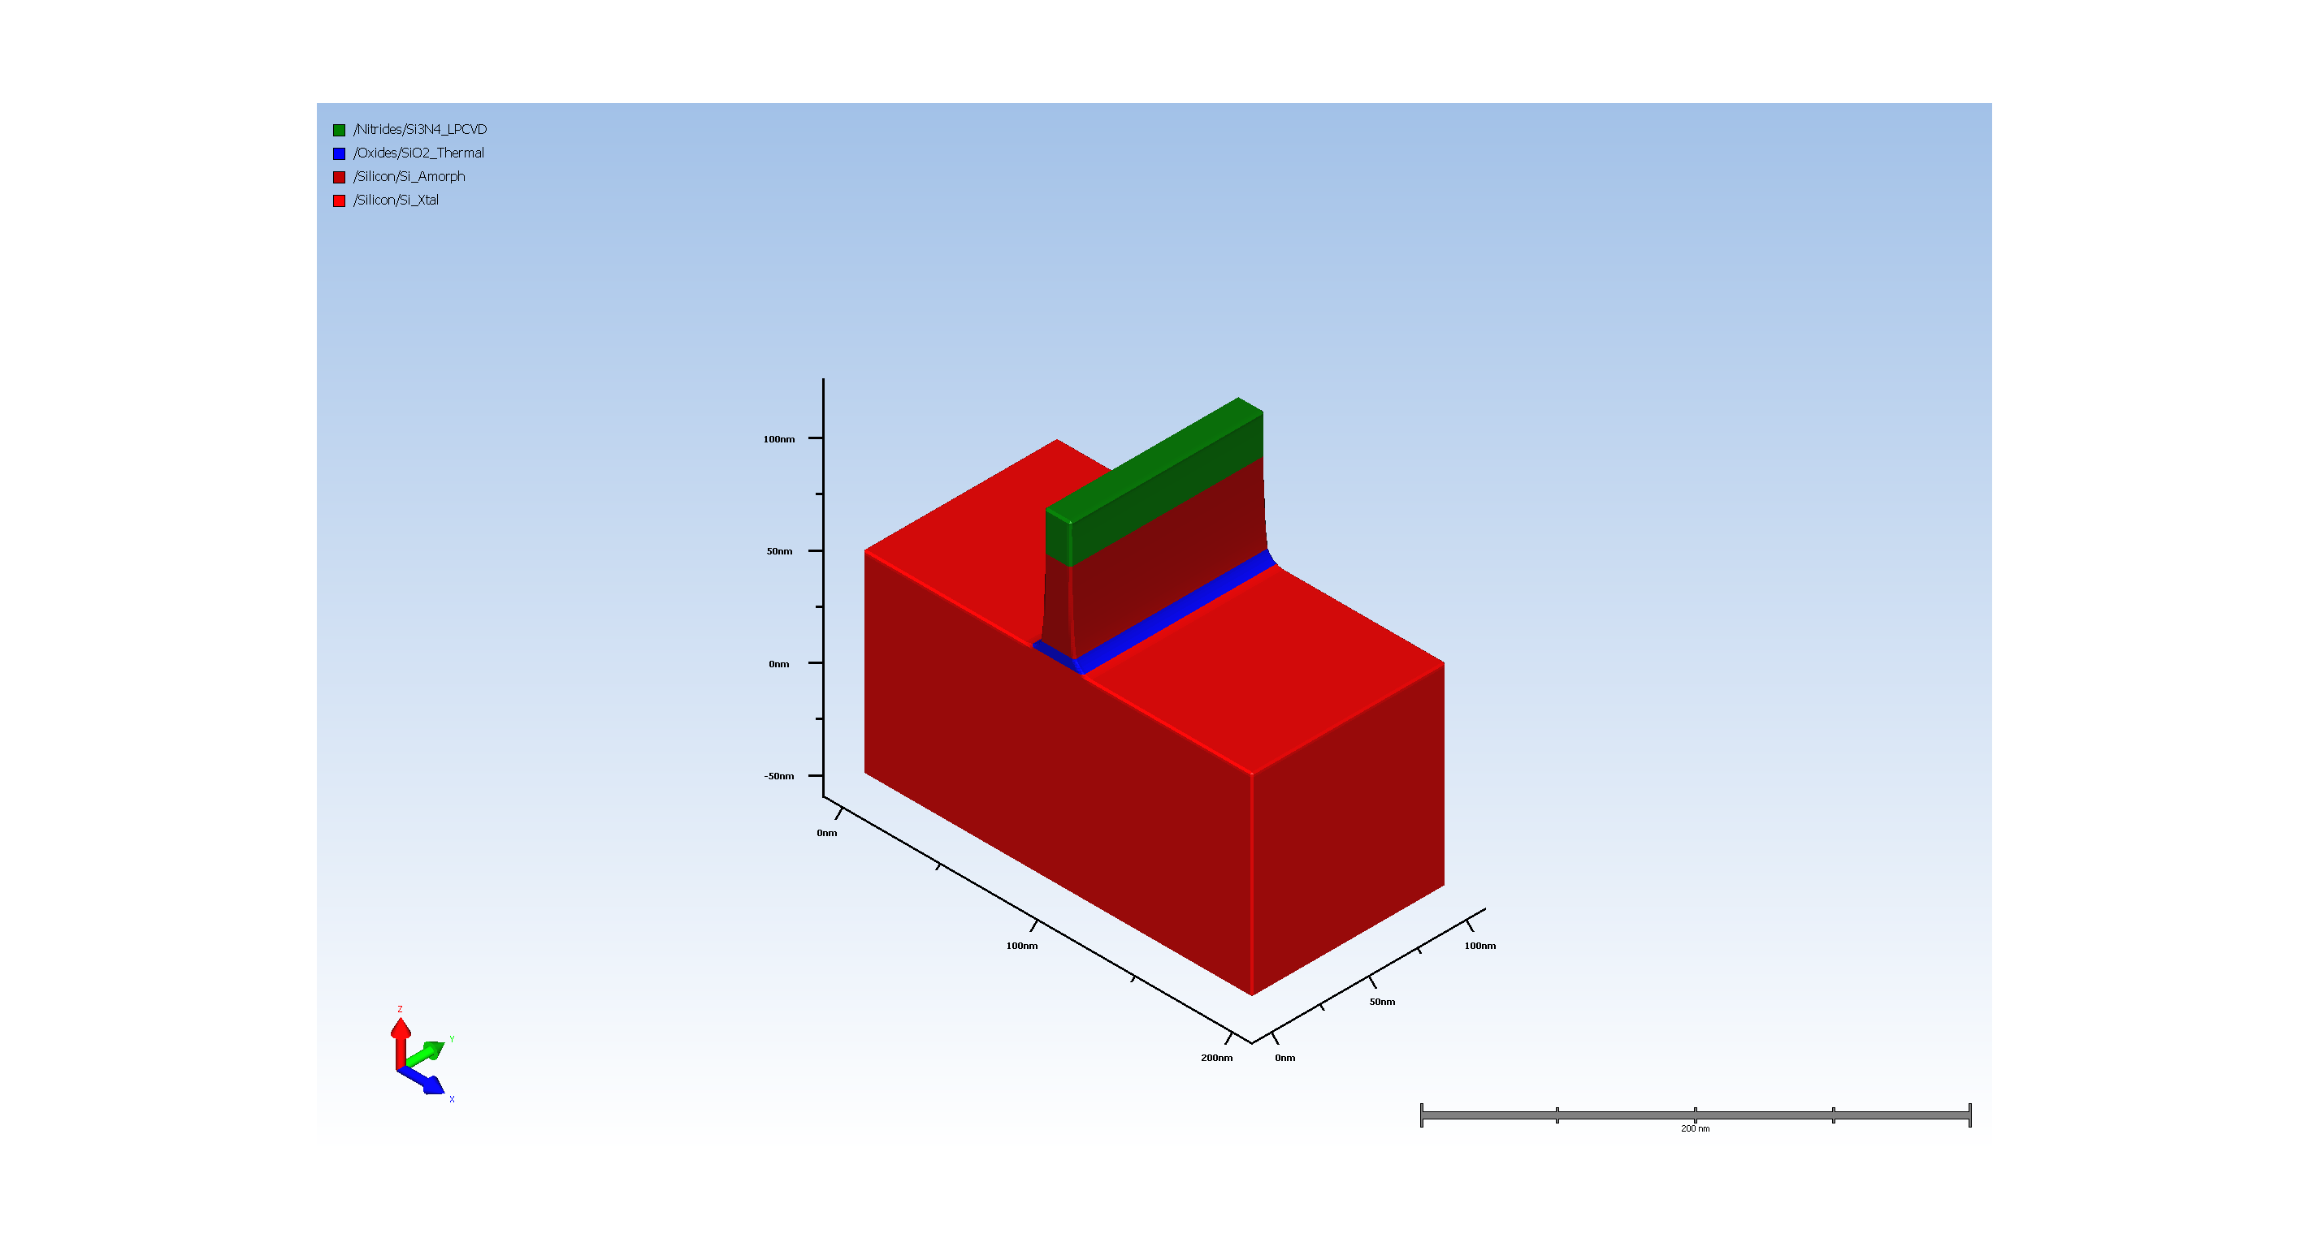
3.7. Remove organics

Slide 10
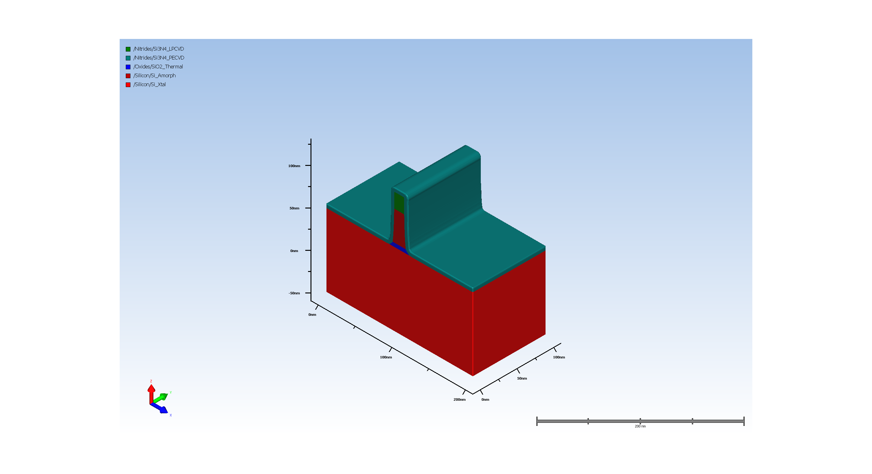
4.1. Conformal Deposit

Slide 11
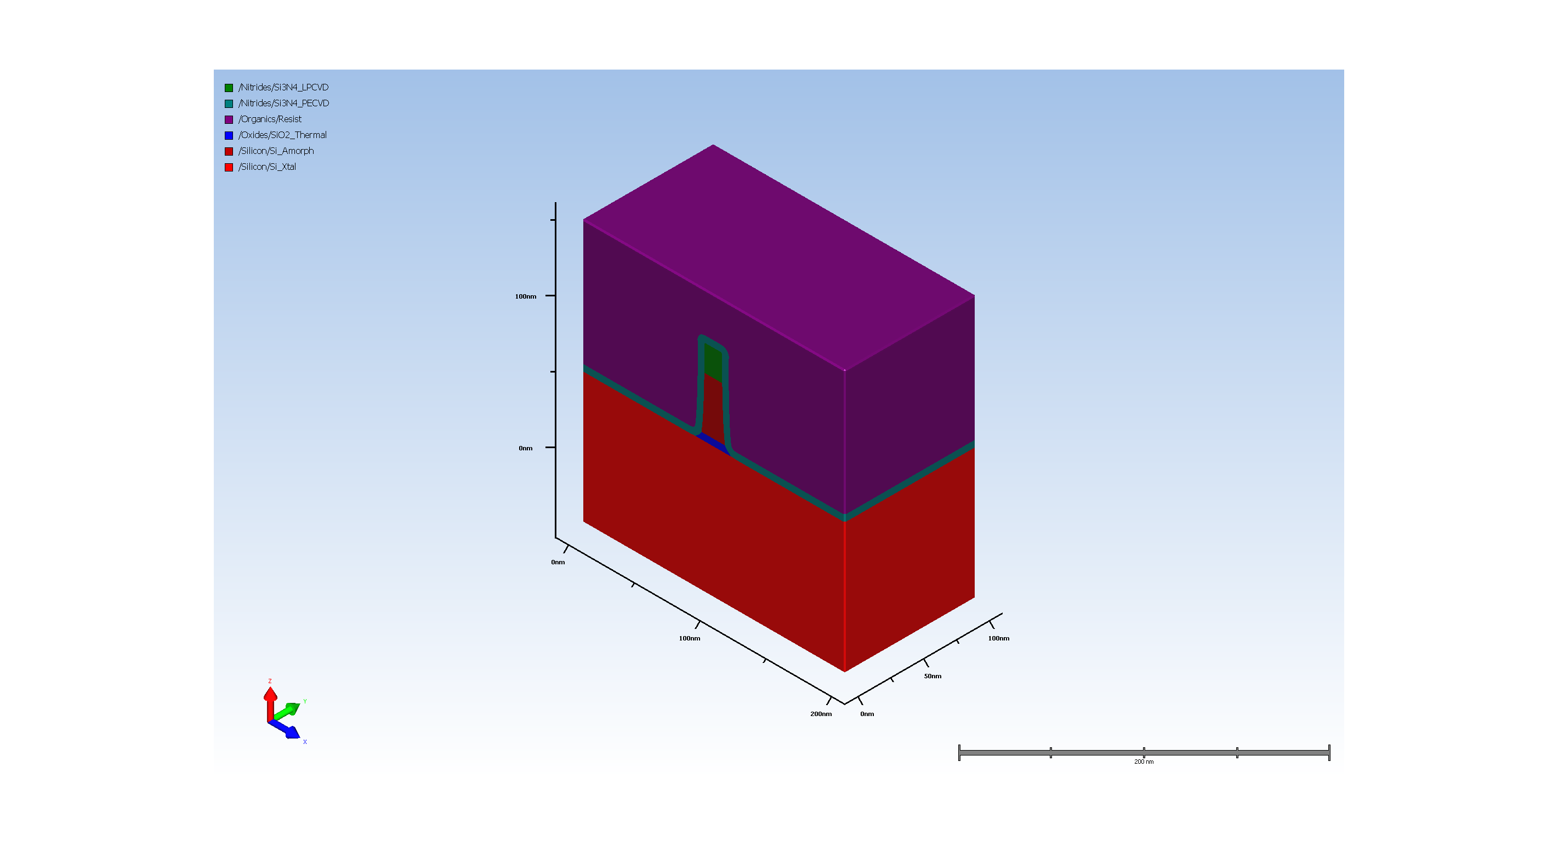
4.2. source drain pattern

Slide 12
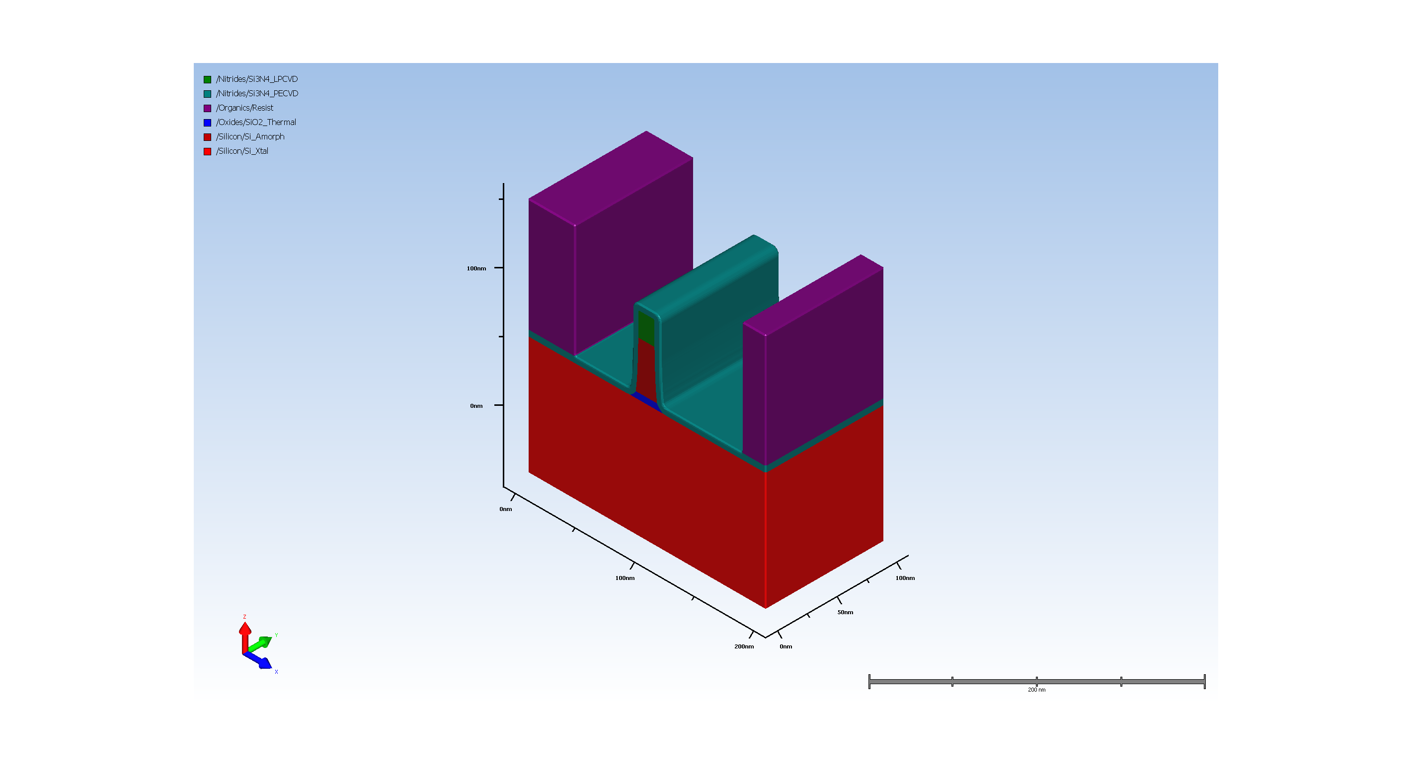
4.3. Expose resit for ILD etch

Slide 13
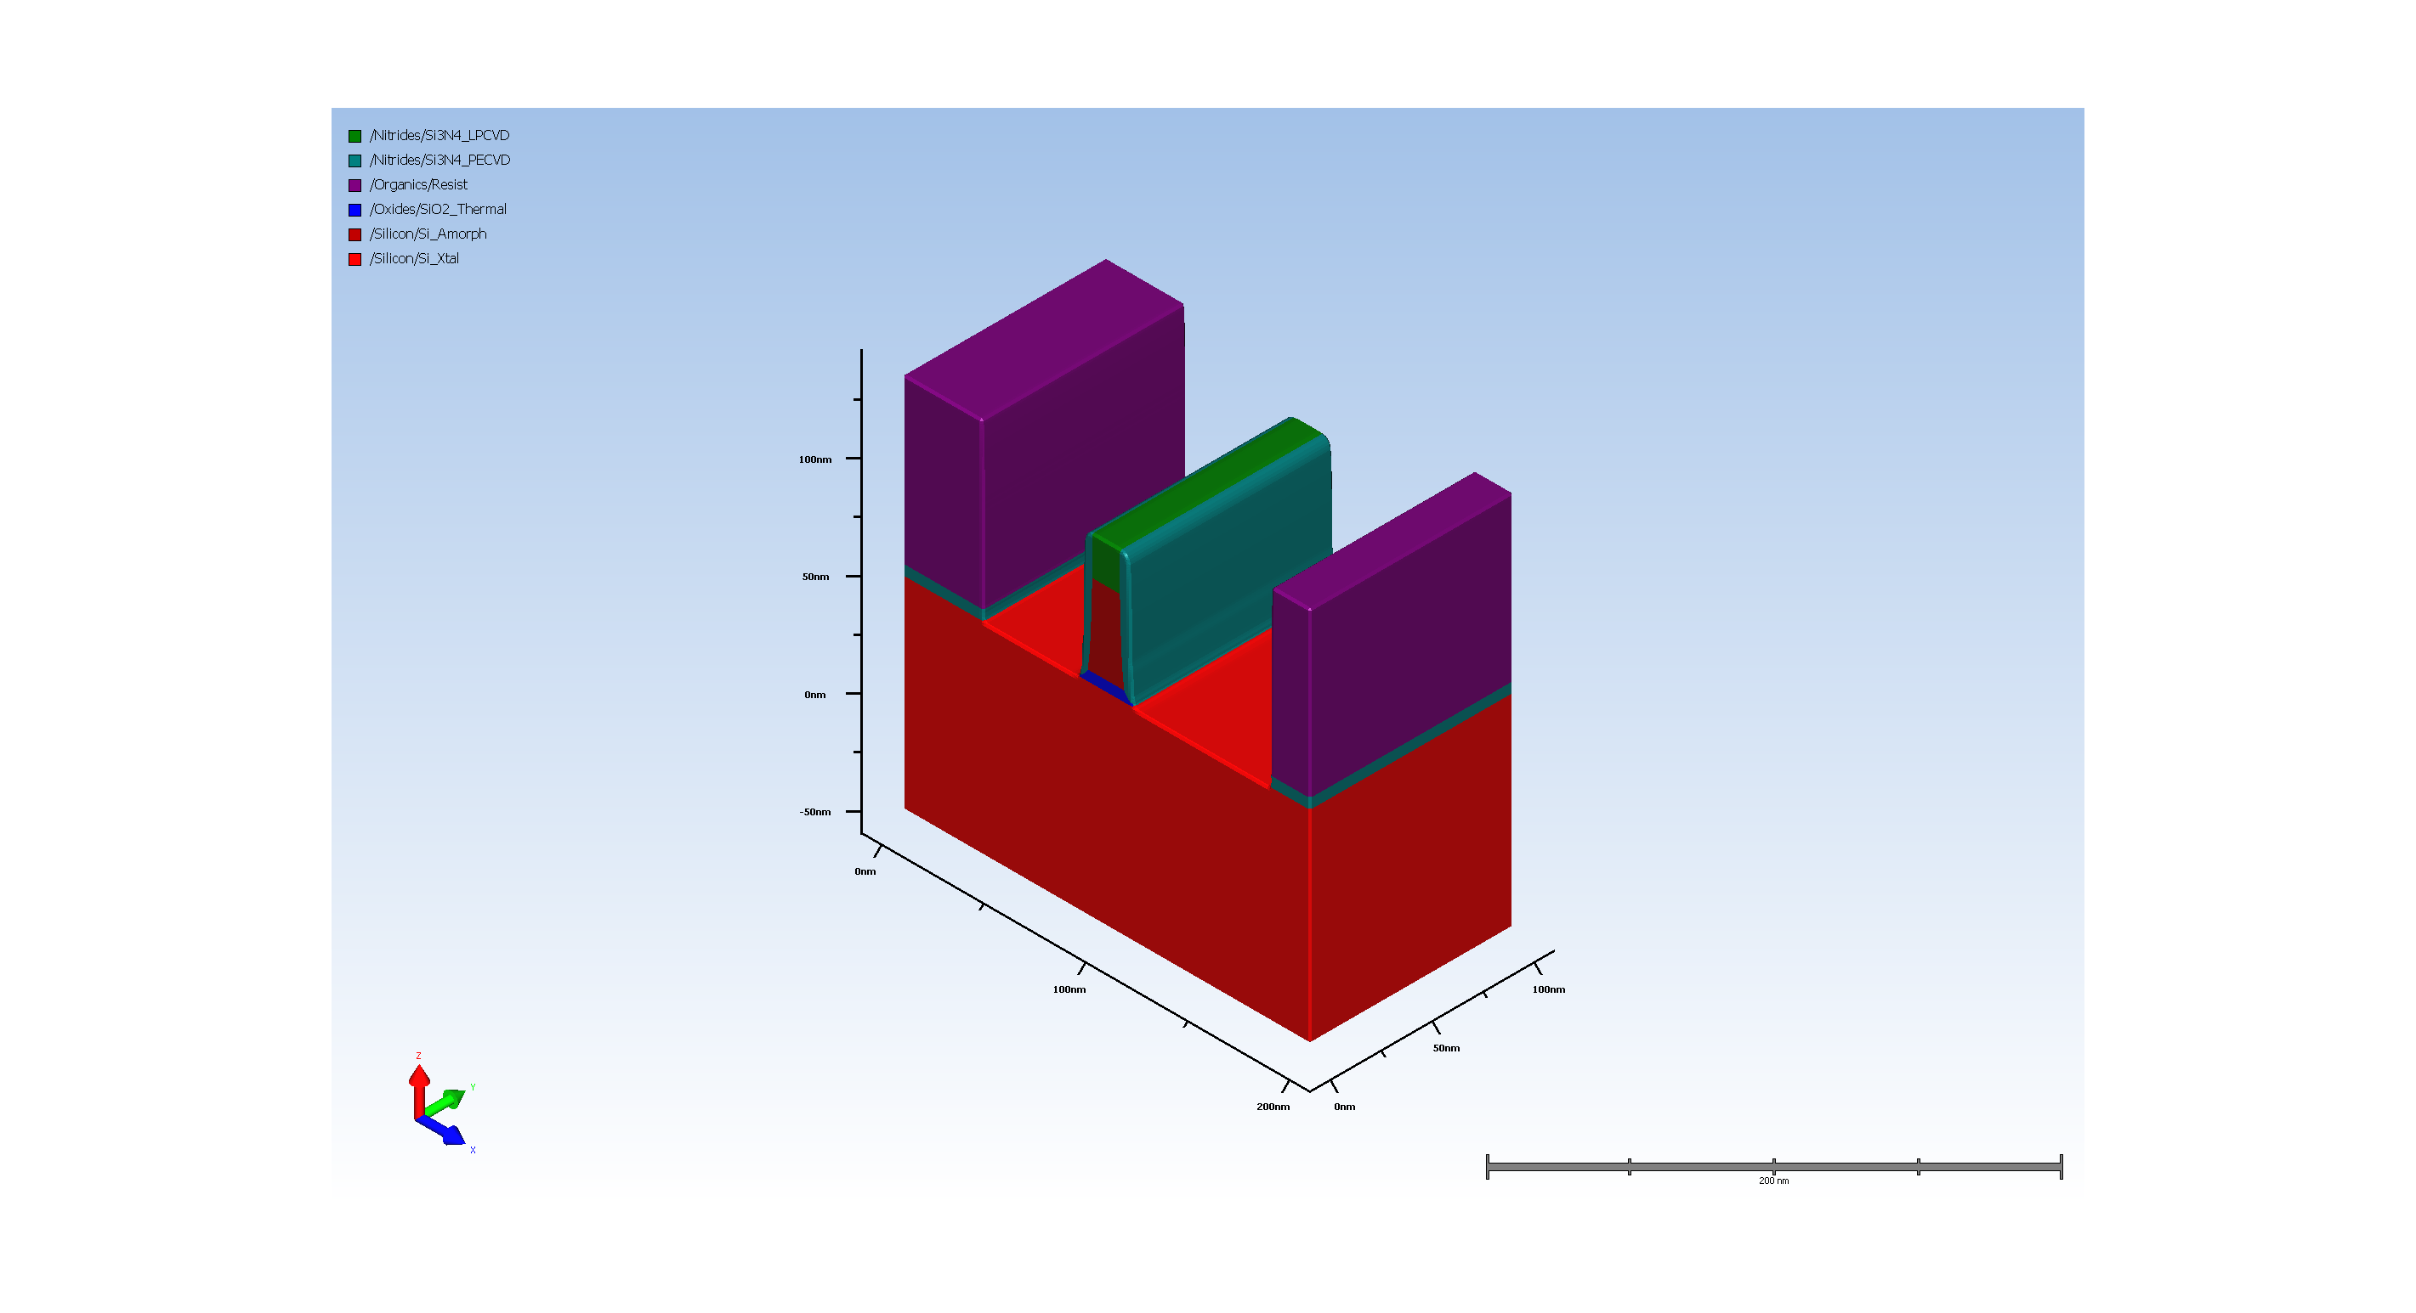
4.4. Basic Etch

Slide 14
4.5. Implant (Requires Advanced Modeling)

Slide 15
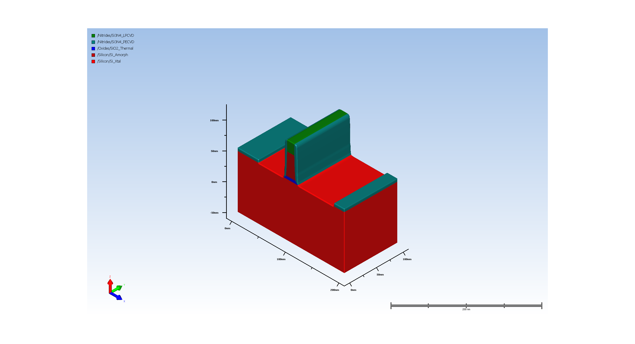
4.6. Remove resist

Slide 16
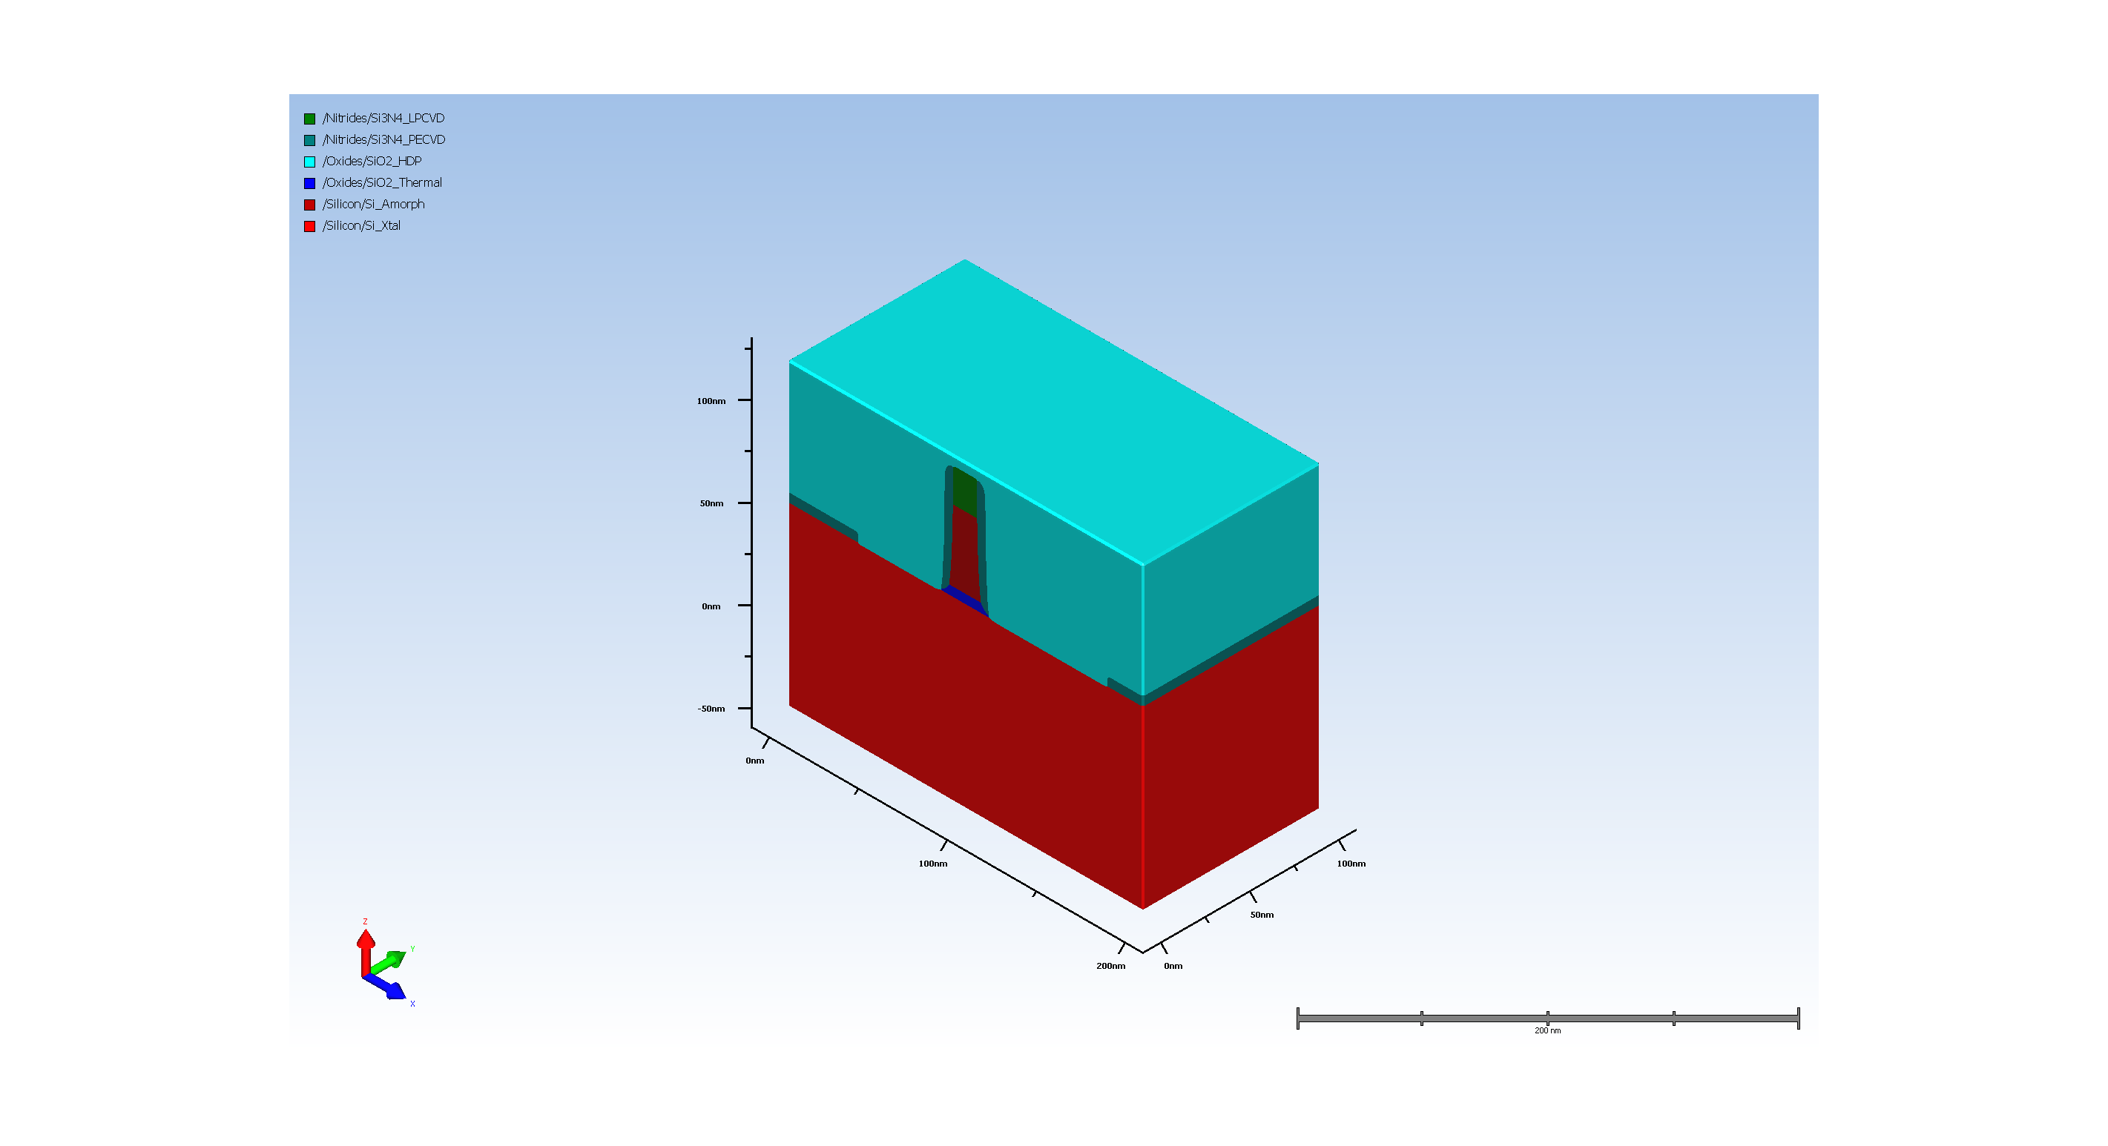
4.7. Conformal Deposit

Slide 17
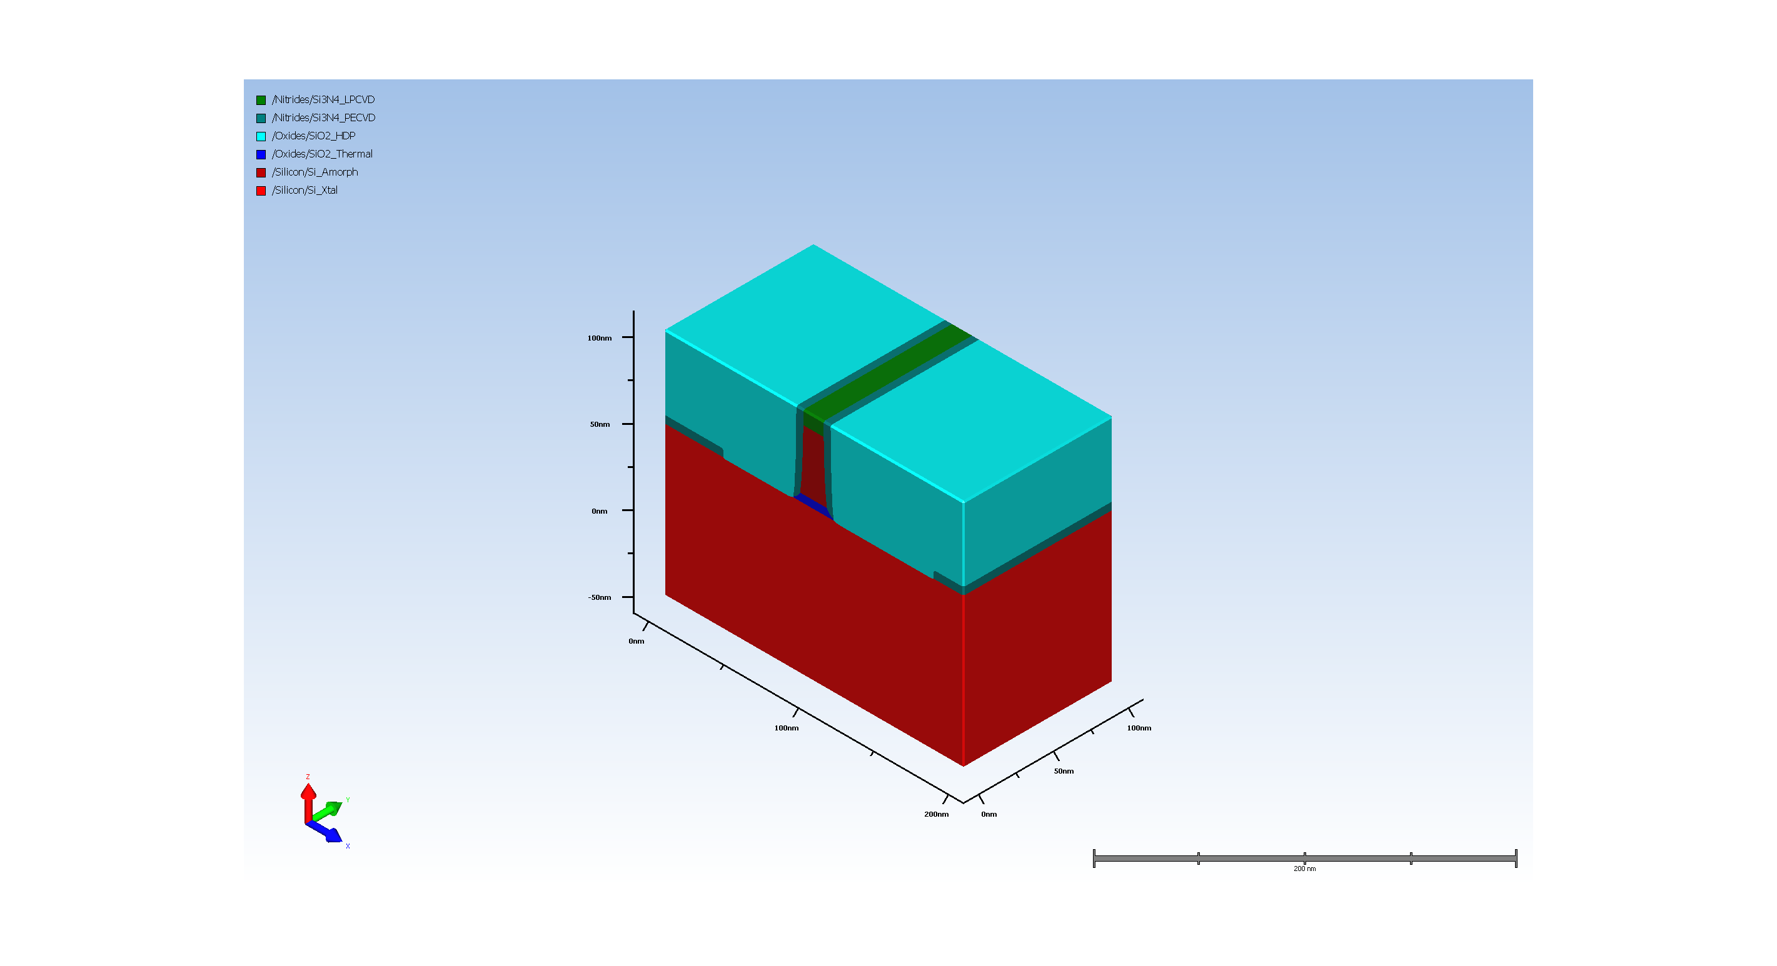
4.8. Stopping CMP

Slide 18

5. Dummy gate cap removal Etch

Slide 19

6. Dummy gate silicon removal Etch

Slide 20
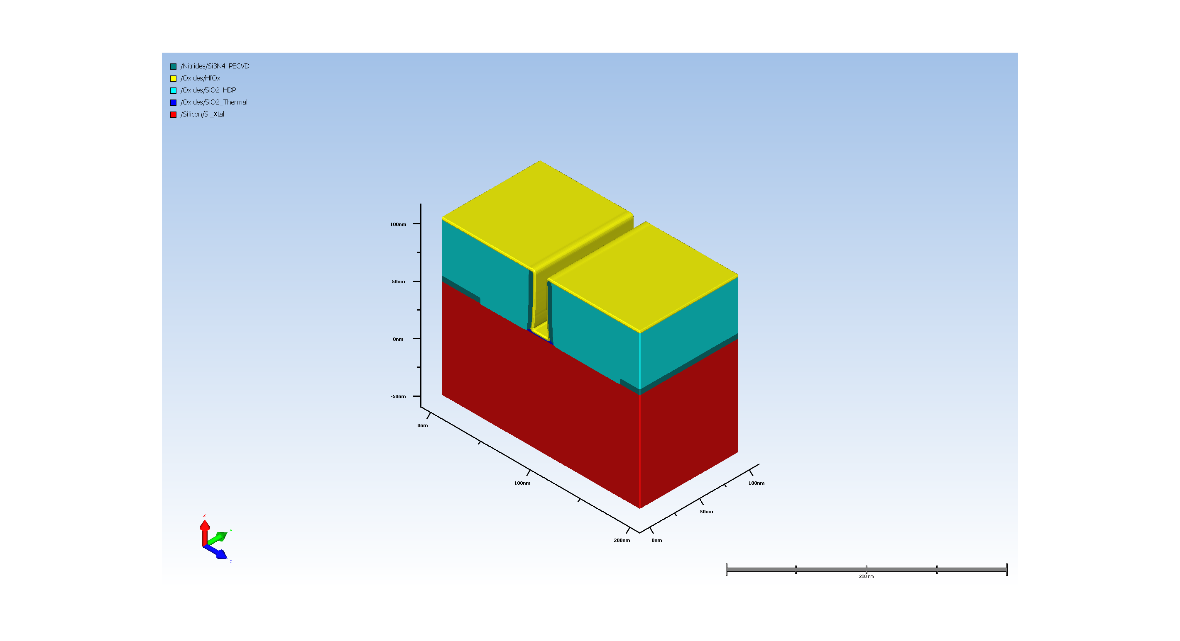
7. Gate high k Deposit

Slide 21
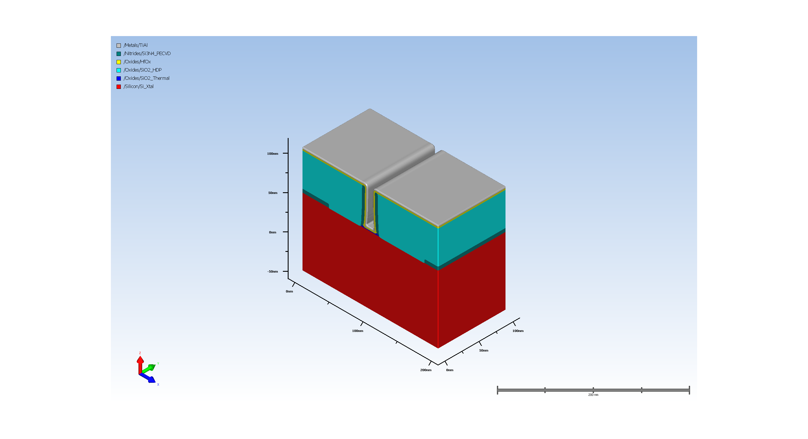
8. Visibility Deposit (Requires Advanced Modeling)

Slide 22
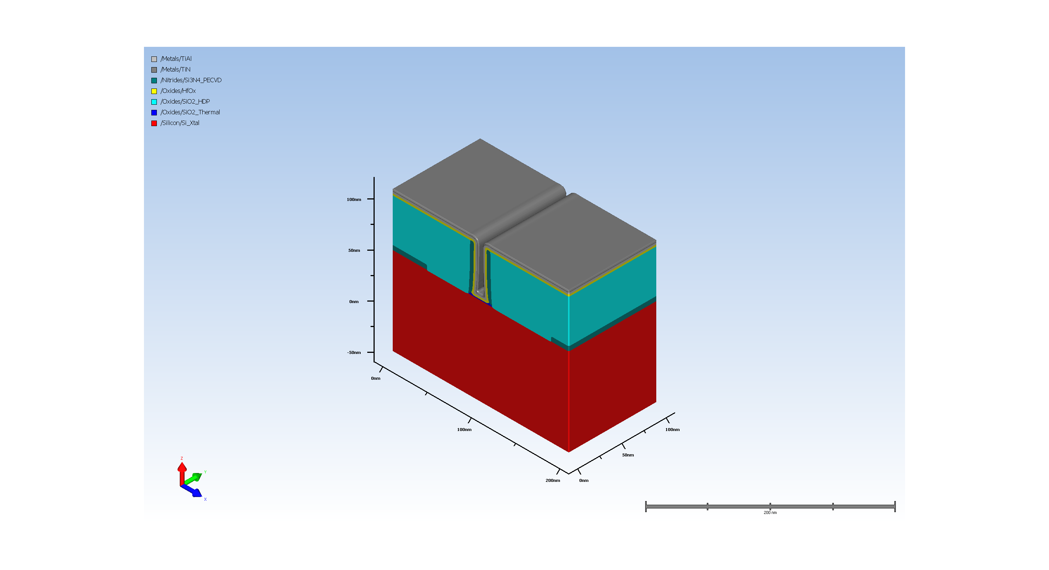
9. Visibility Deposit (Requires Advanced Modeling)

Slide 23
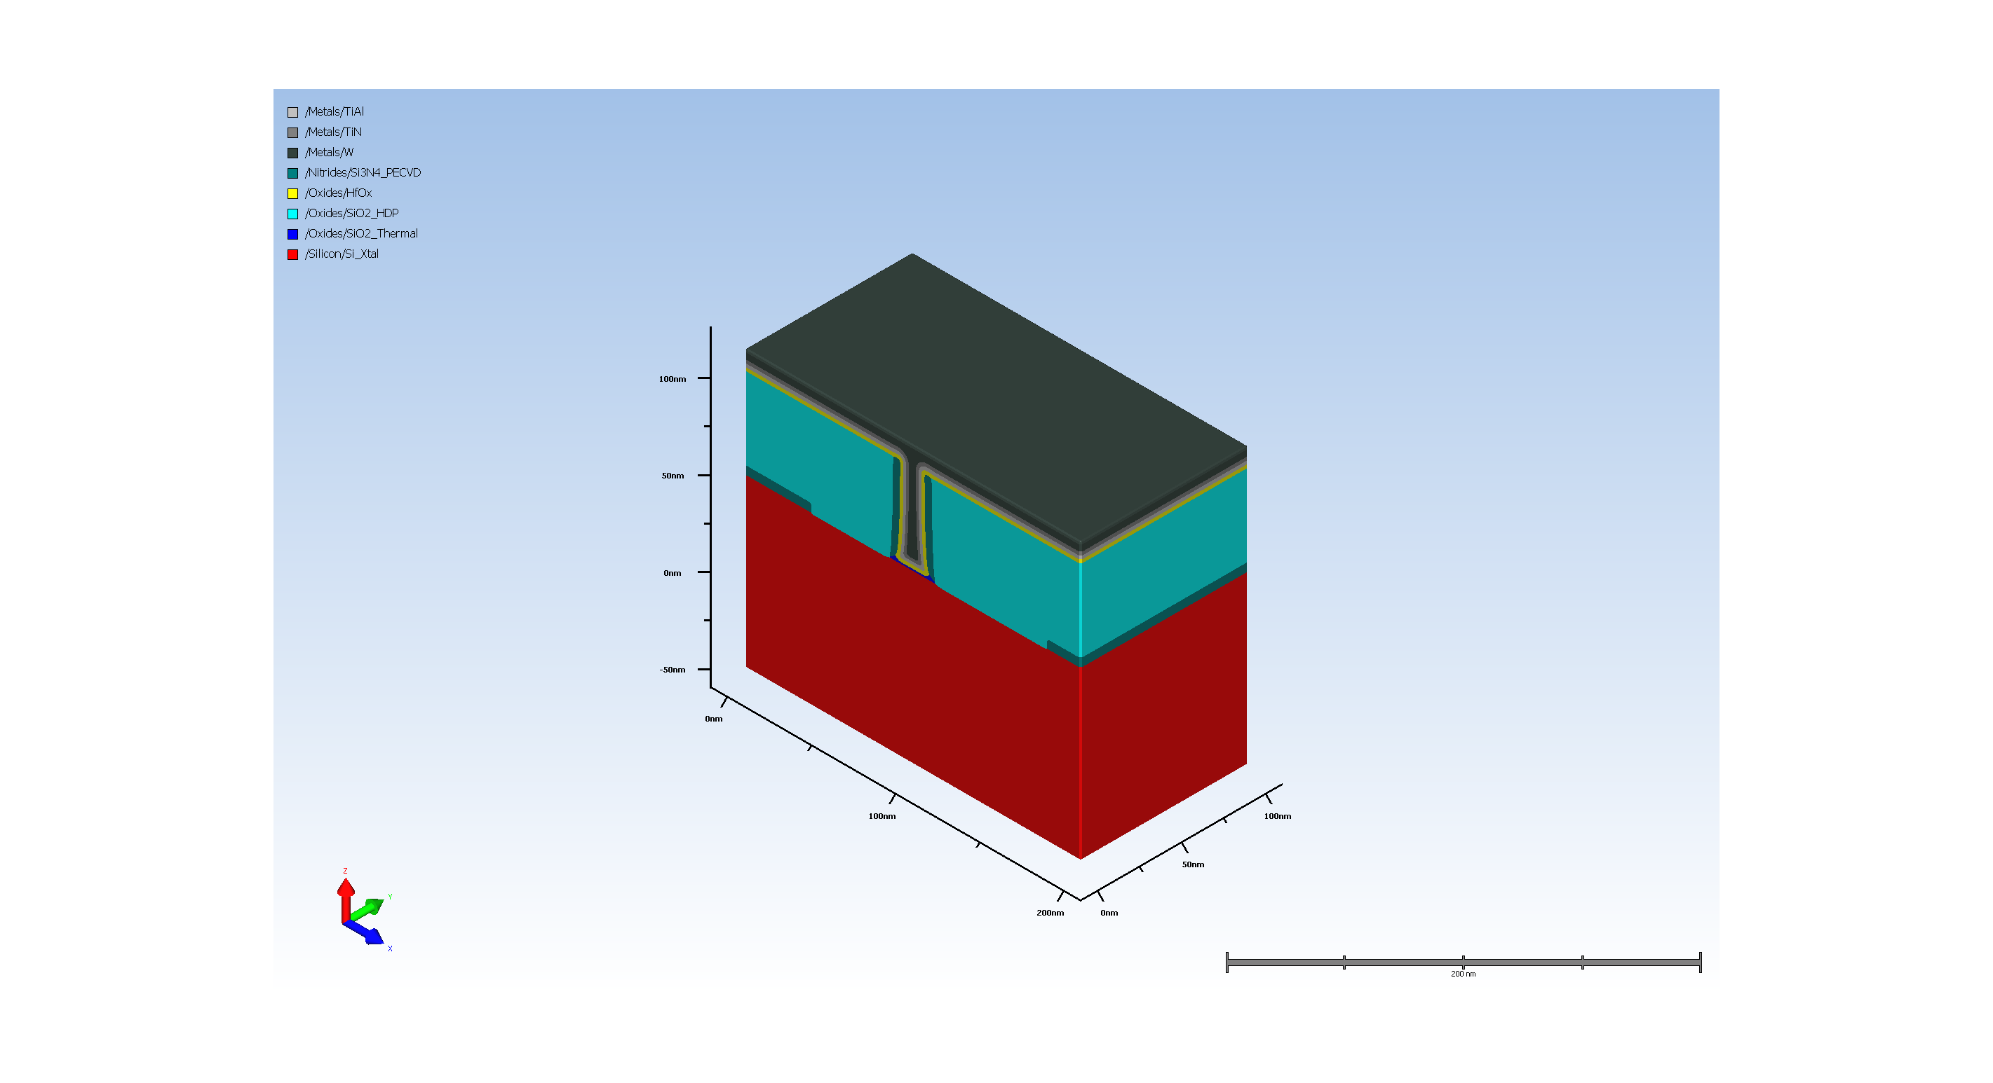
10. Filler gate metal Deposit

Slide 24

11. Stopping CMP

Slide 25
12. Dummy Anneal

Slide 26
A-1.1. Model for Dopant Profile

Slide 27
A-2.1. Model for Dopant Profile

Slide 28
A-3.2. Virtual Metrology (Requires Automation)
Metrology results:
CD measurement at (78.99999999999999, 57.499999999999986, 120.99999999999997, 57.499999999999986):
GateCD = 13.558716
GateCD_xStart = 93.22064208984375
GateCD_yStart = 57.499999999999986
GateCD_zStart = 57.3671875
GateCD_xEnd = 106.77935791015625
GateCD_yEnd = 57.499999999999986
GateCD_zEnd = 57.3671875

Slide 29
A-4.14. Void metrology
Metrology results:
void_measure_n_voids = 0
void_measure_void-1_max_cd = 0
void_measure_void-1_top_depth = 0
void_measure_void-1_bottom_depth = 0
void_measure_void-1_centroid_depth = 0
void_measure_void-1_length = 0
void_measure_void-1_area = 0
void_measure_void-1_top_x = 0
void_measure_void-1_top_y = 0
void_measure_void-1_top_z = 0
void_measure_void-1_bottom_x = 0
void_measure_void-1_bottom_y = 0
void_measure_void-1_bottom_z = 0

