Slide 1
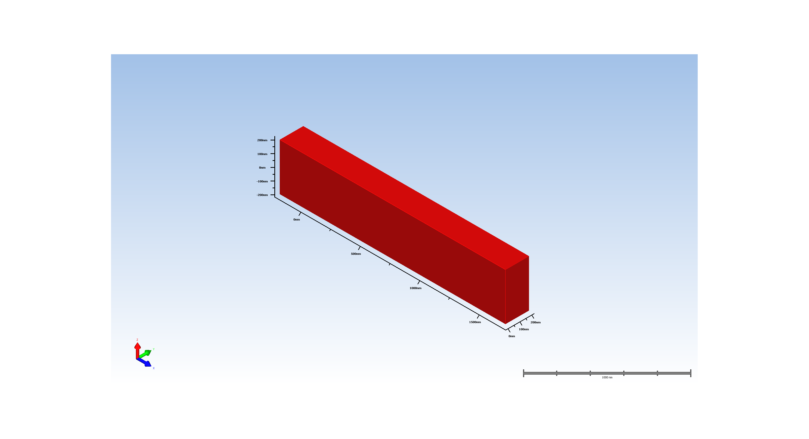
1. Wafer Setup

Slide 2
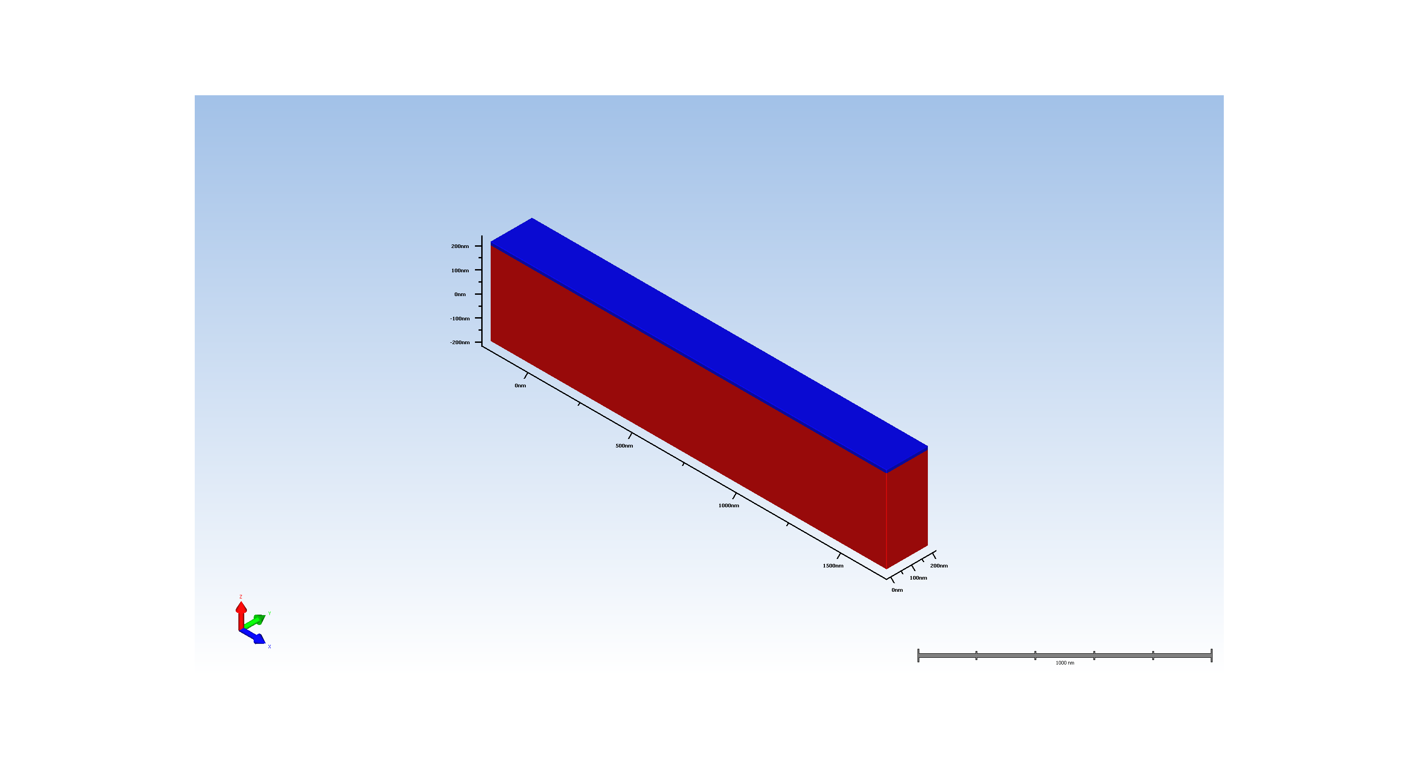
2. pad oxide deposition

Slide 3
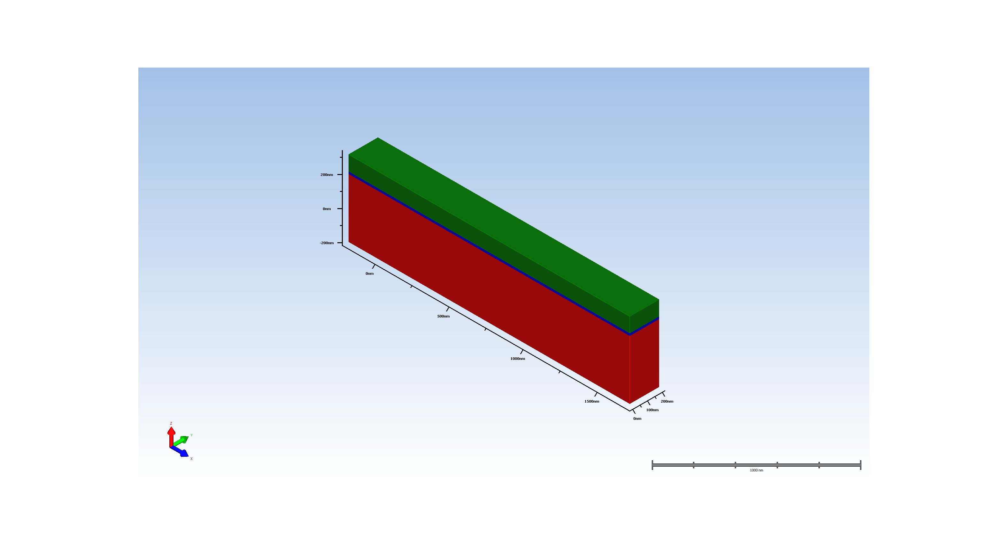
3. sin hard mask deposition

Slide 4
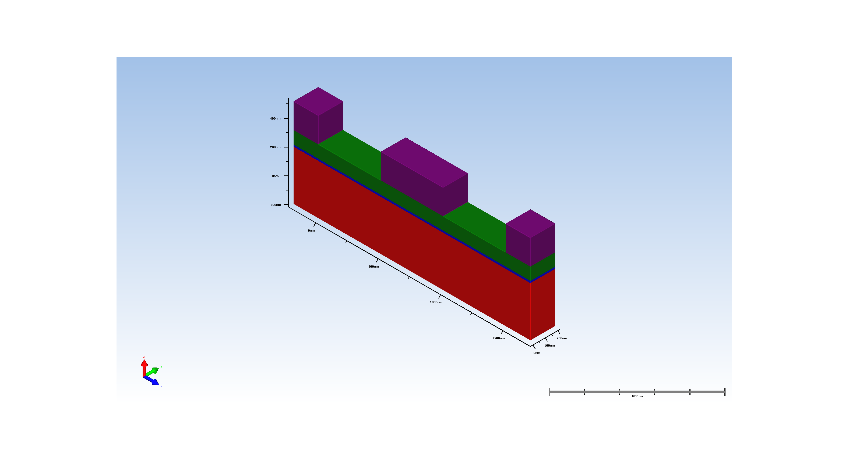
4. lithography

Slide 5
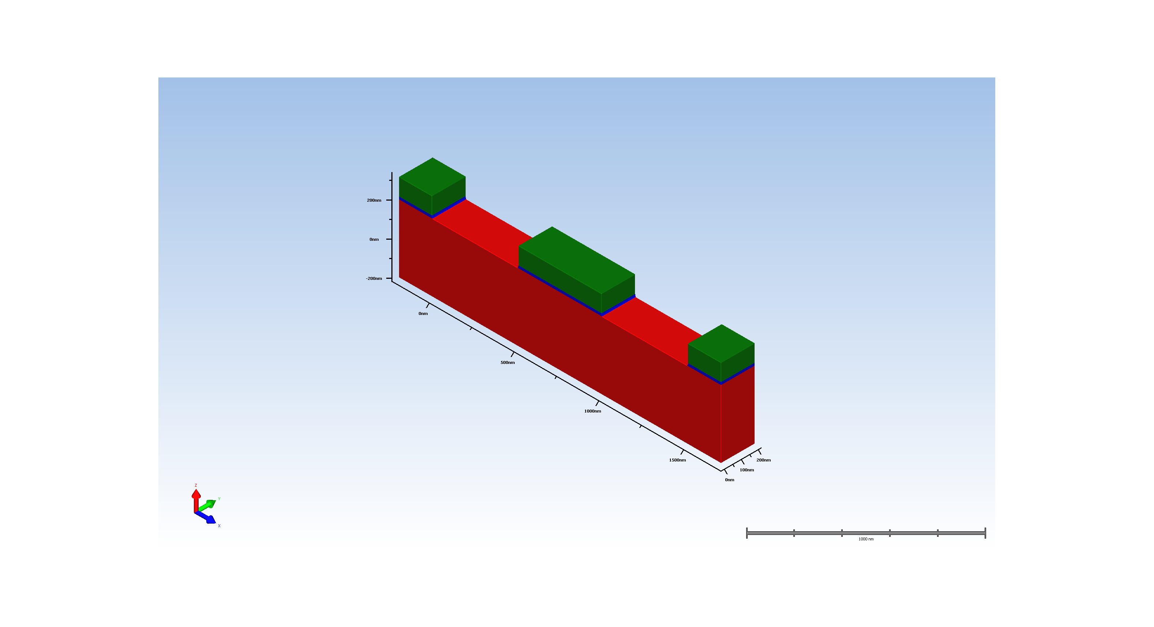
5. etch

Slide 6
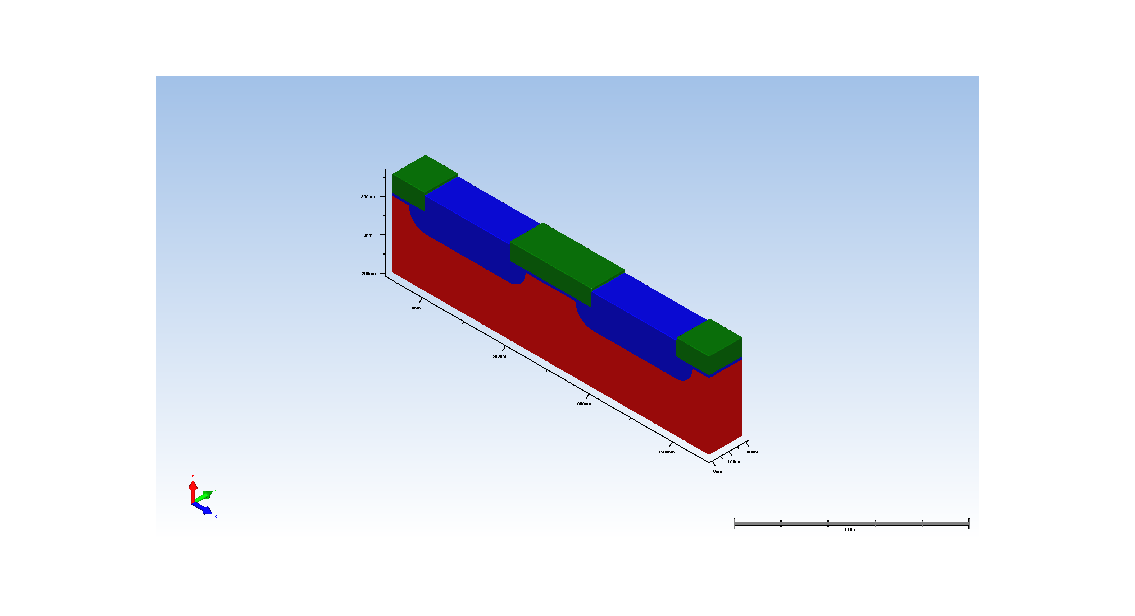
6. thermal oxidation

Slide 7
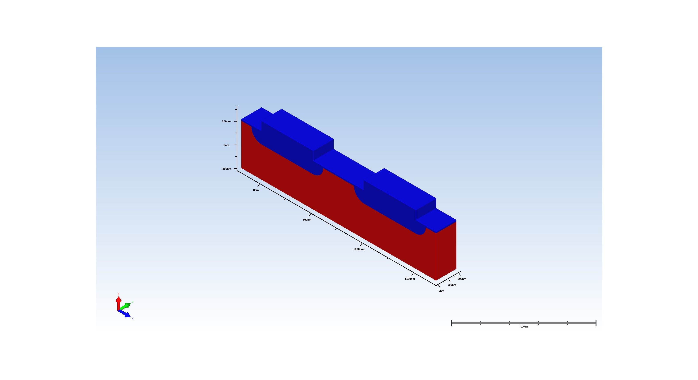
7. sin hardmask strip

Slide 8

8. Multi Etch

