Slide 1
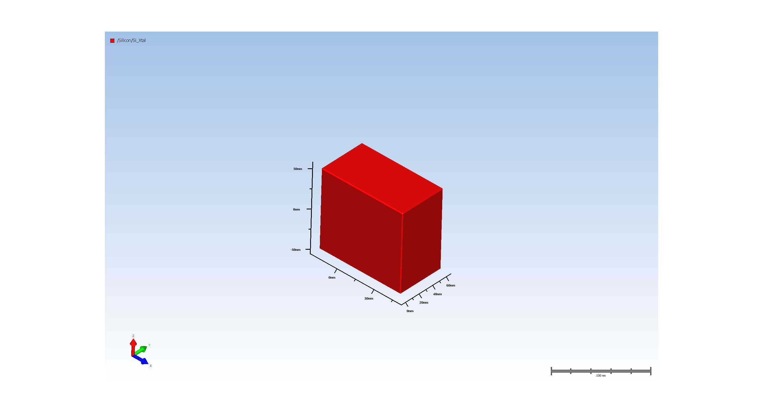
1. Wafer Setup

Slide 2
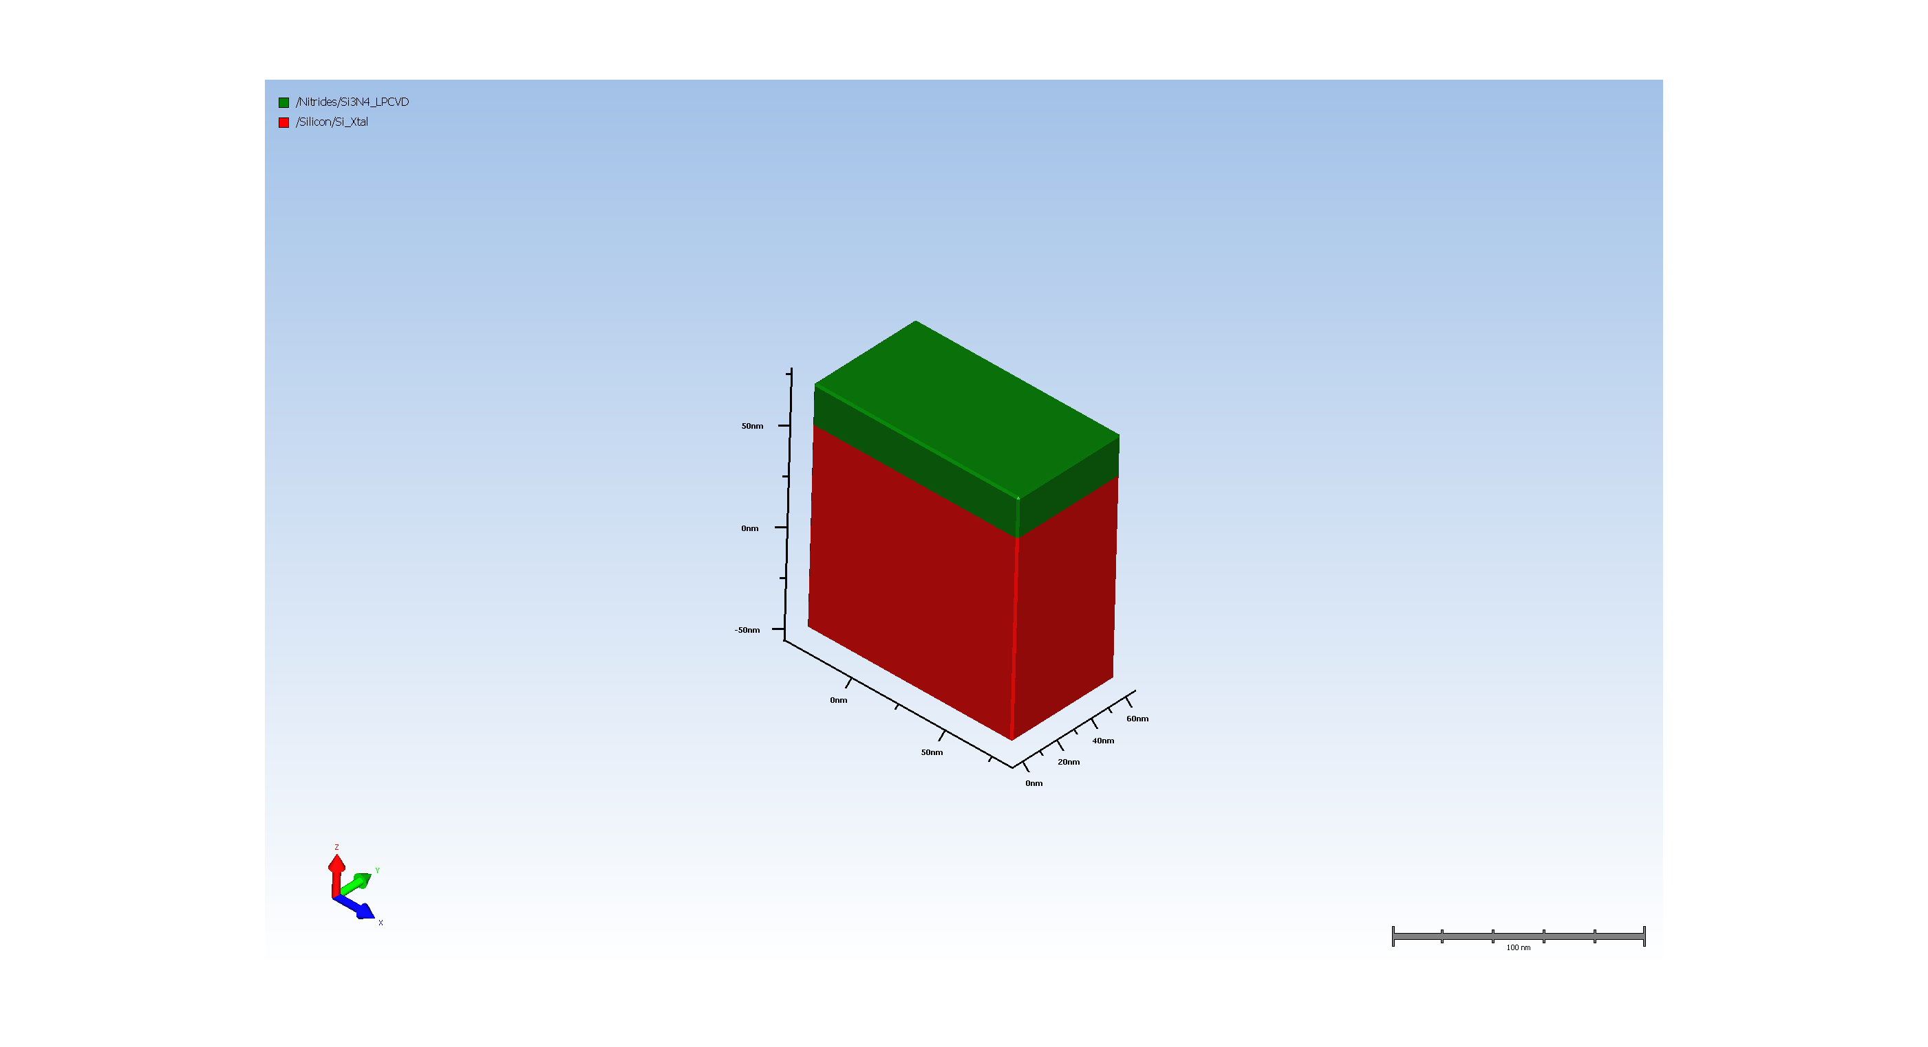
2.1. Silicon Nitride hard mask for Fin etch

Slide 3
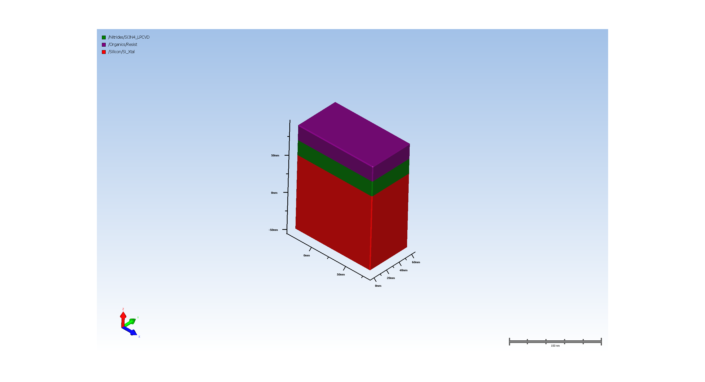
2.2. resist for SiN hard mask pattern

Slide 4
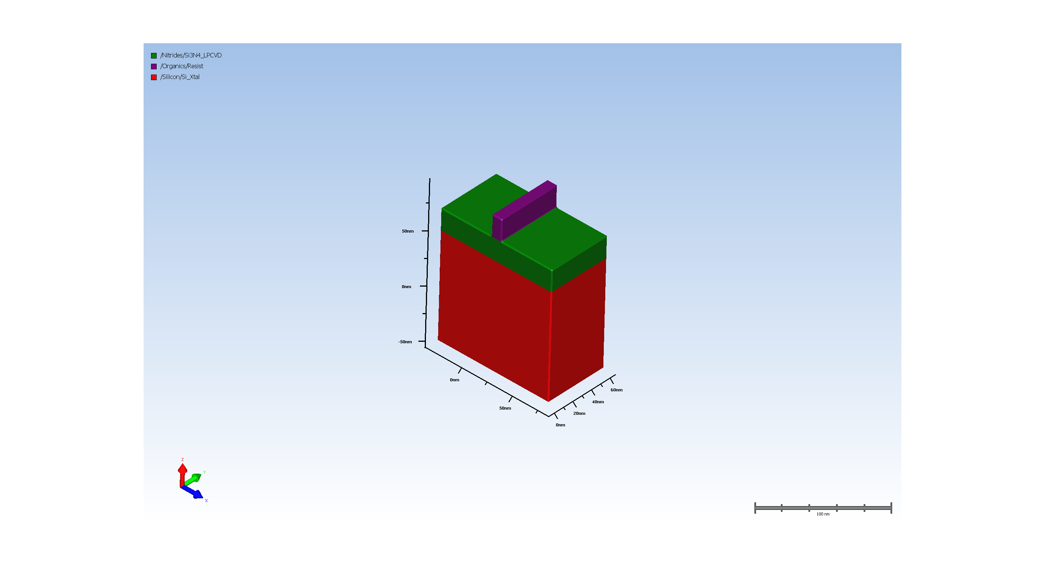
2.3. Expose resist

Slide 5

2.4. SiN hard mask etch

Slide 6

2.5. Remove resist

Slide 7
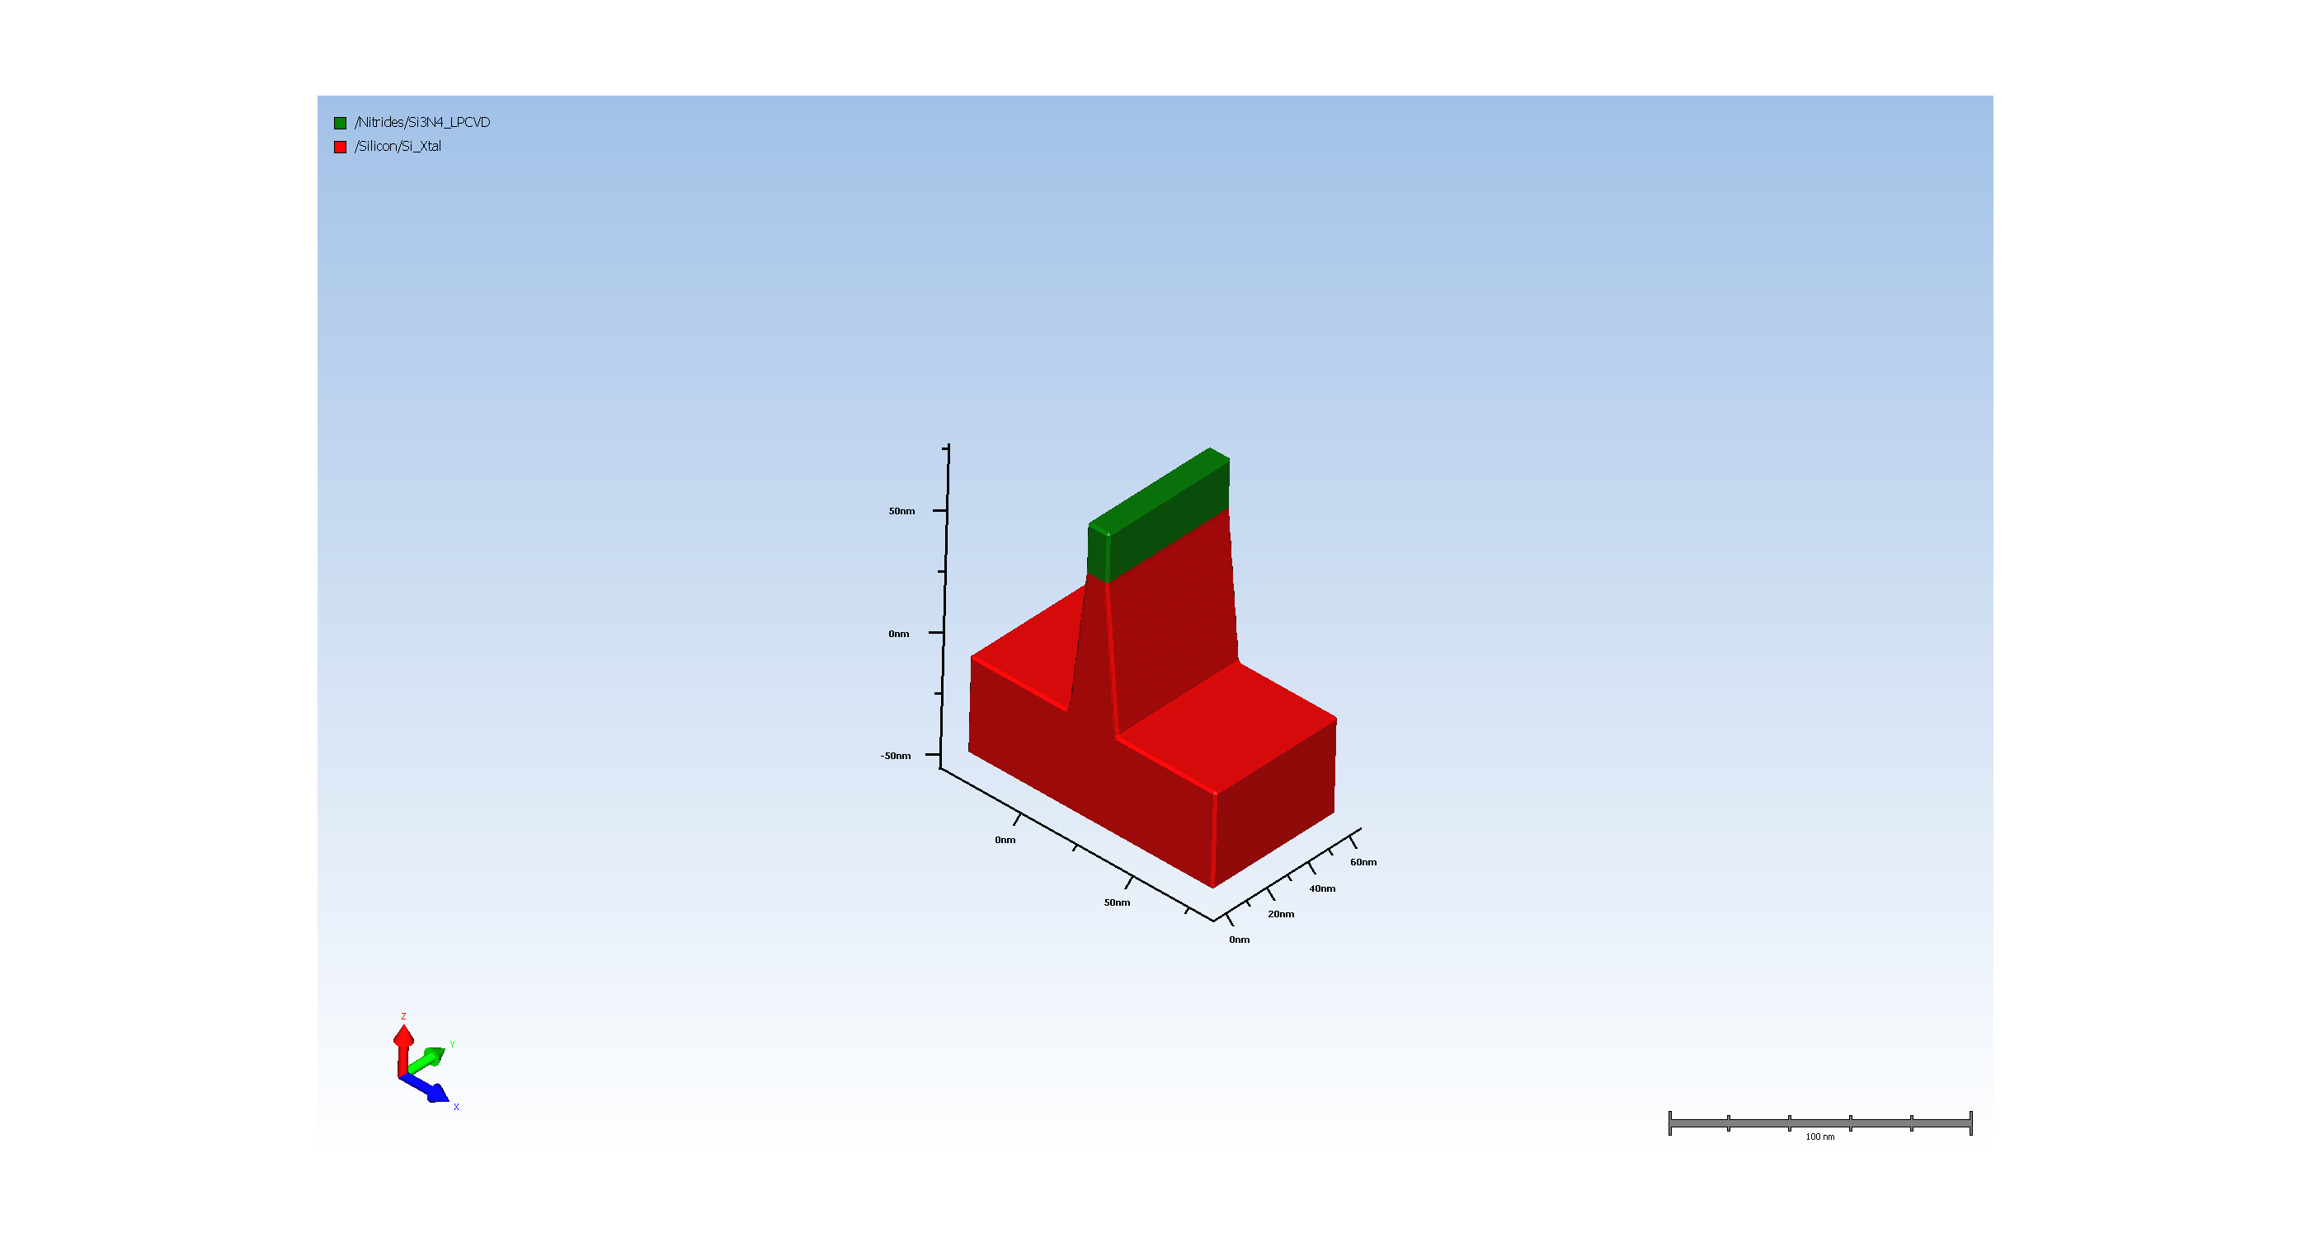
2.6. Etch for Fin formation

Slide 8
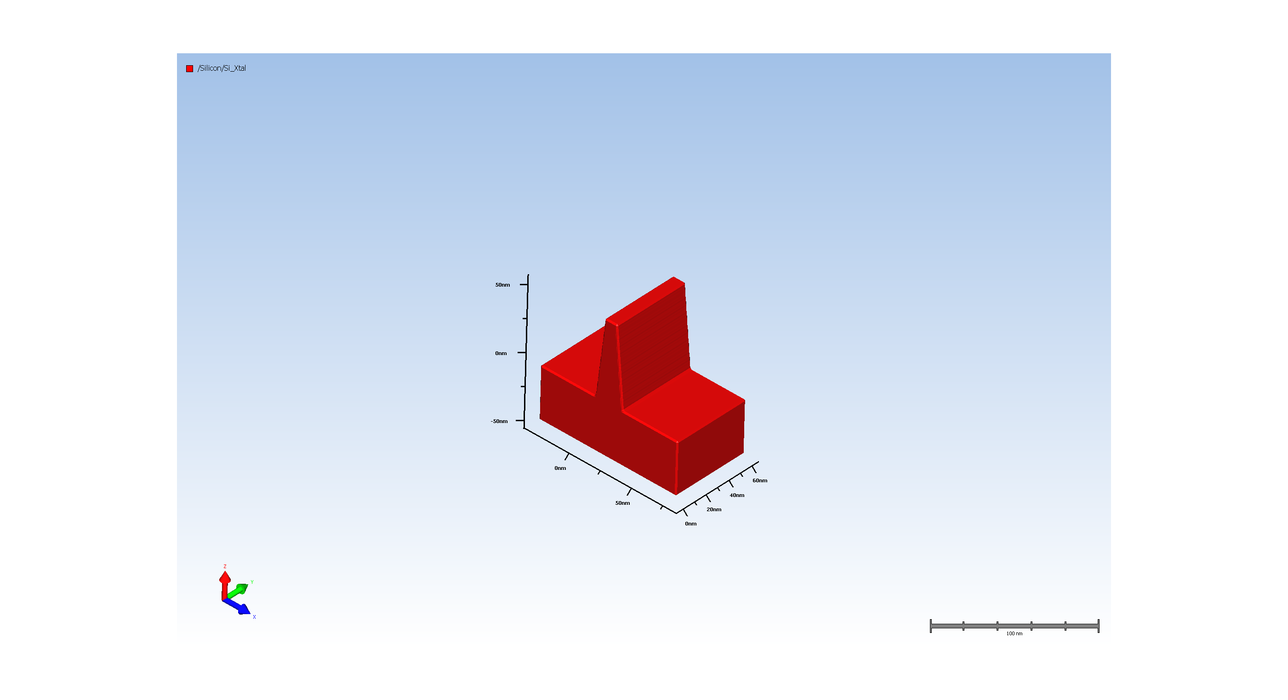
2.7. Remove SiN hard mask

Slide 9
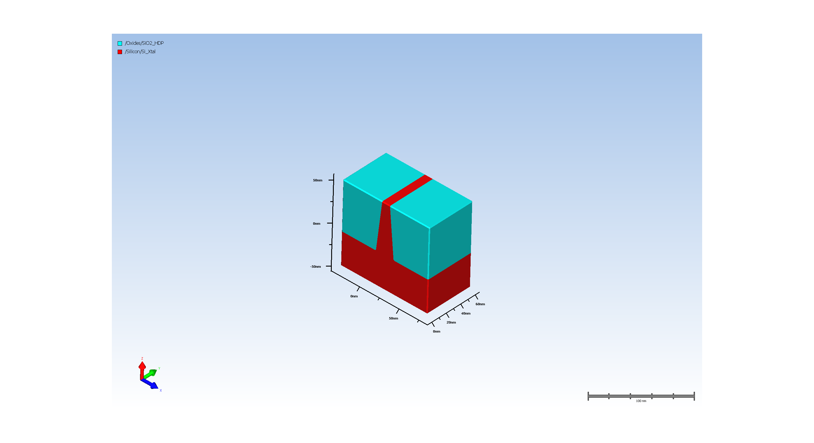
3.1. Planar Deposit

Slide 10
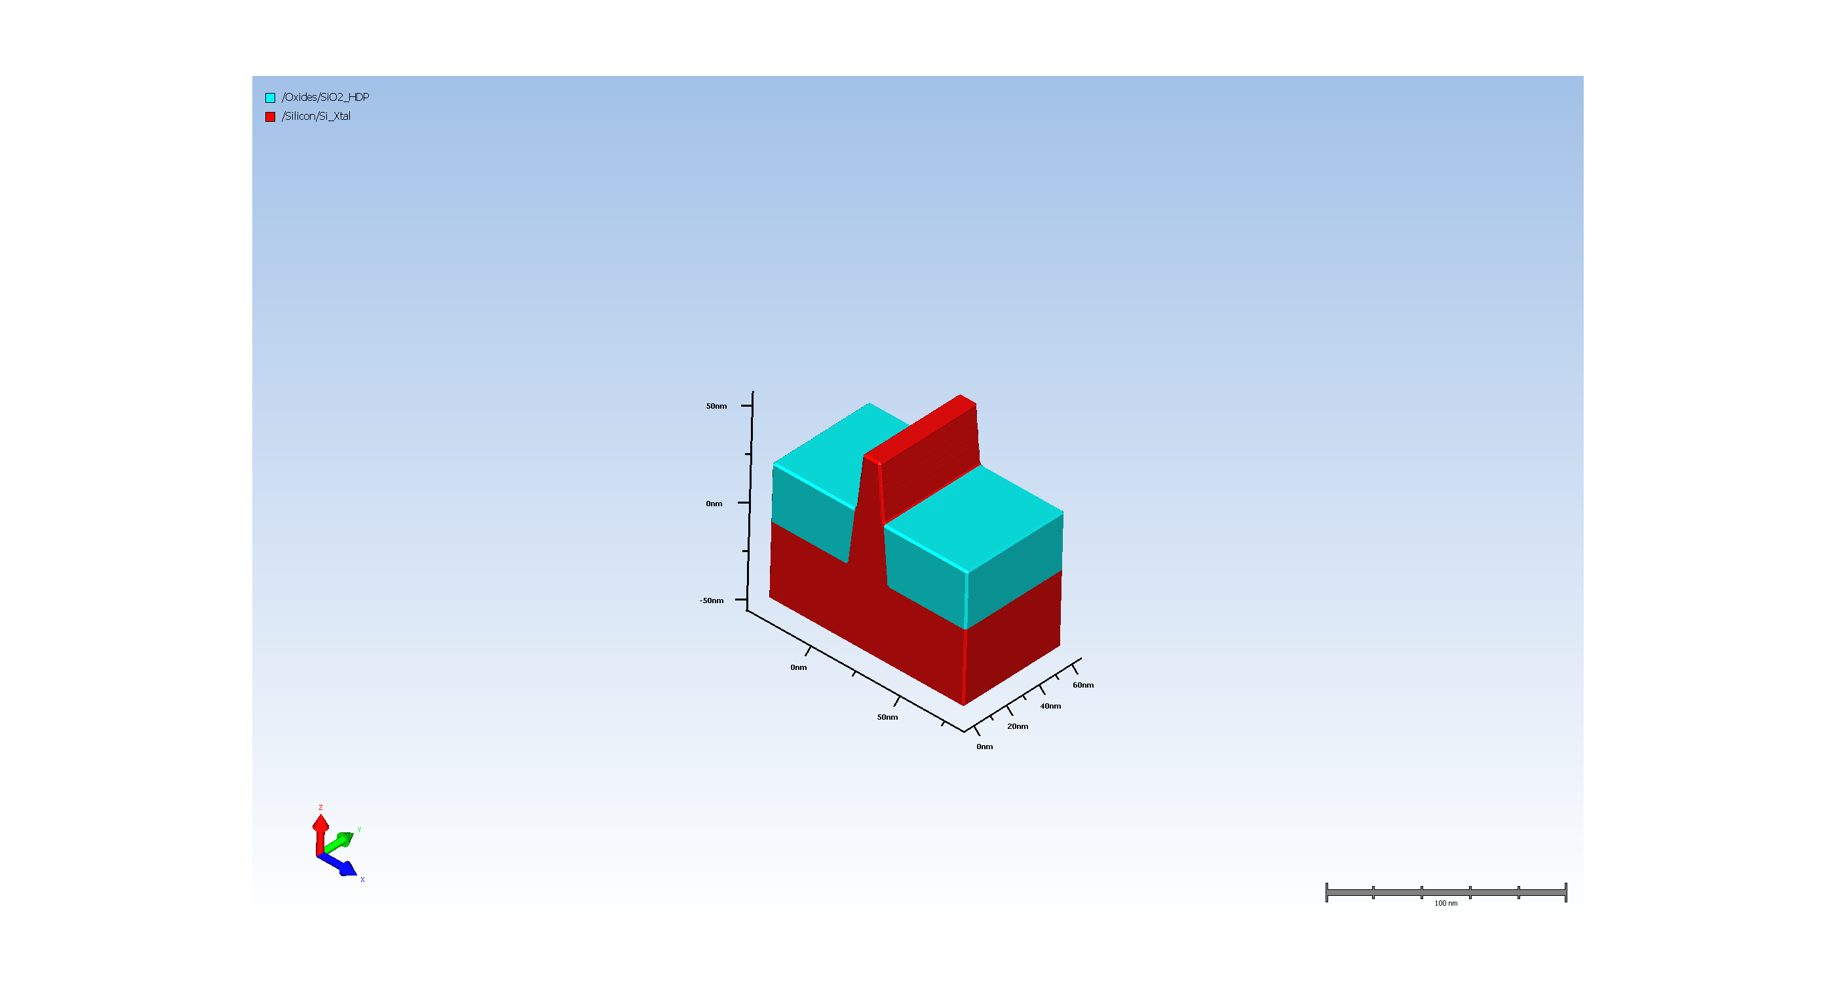
3.2. Basic Etch

Slide 11
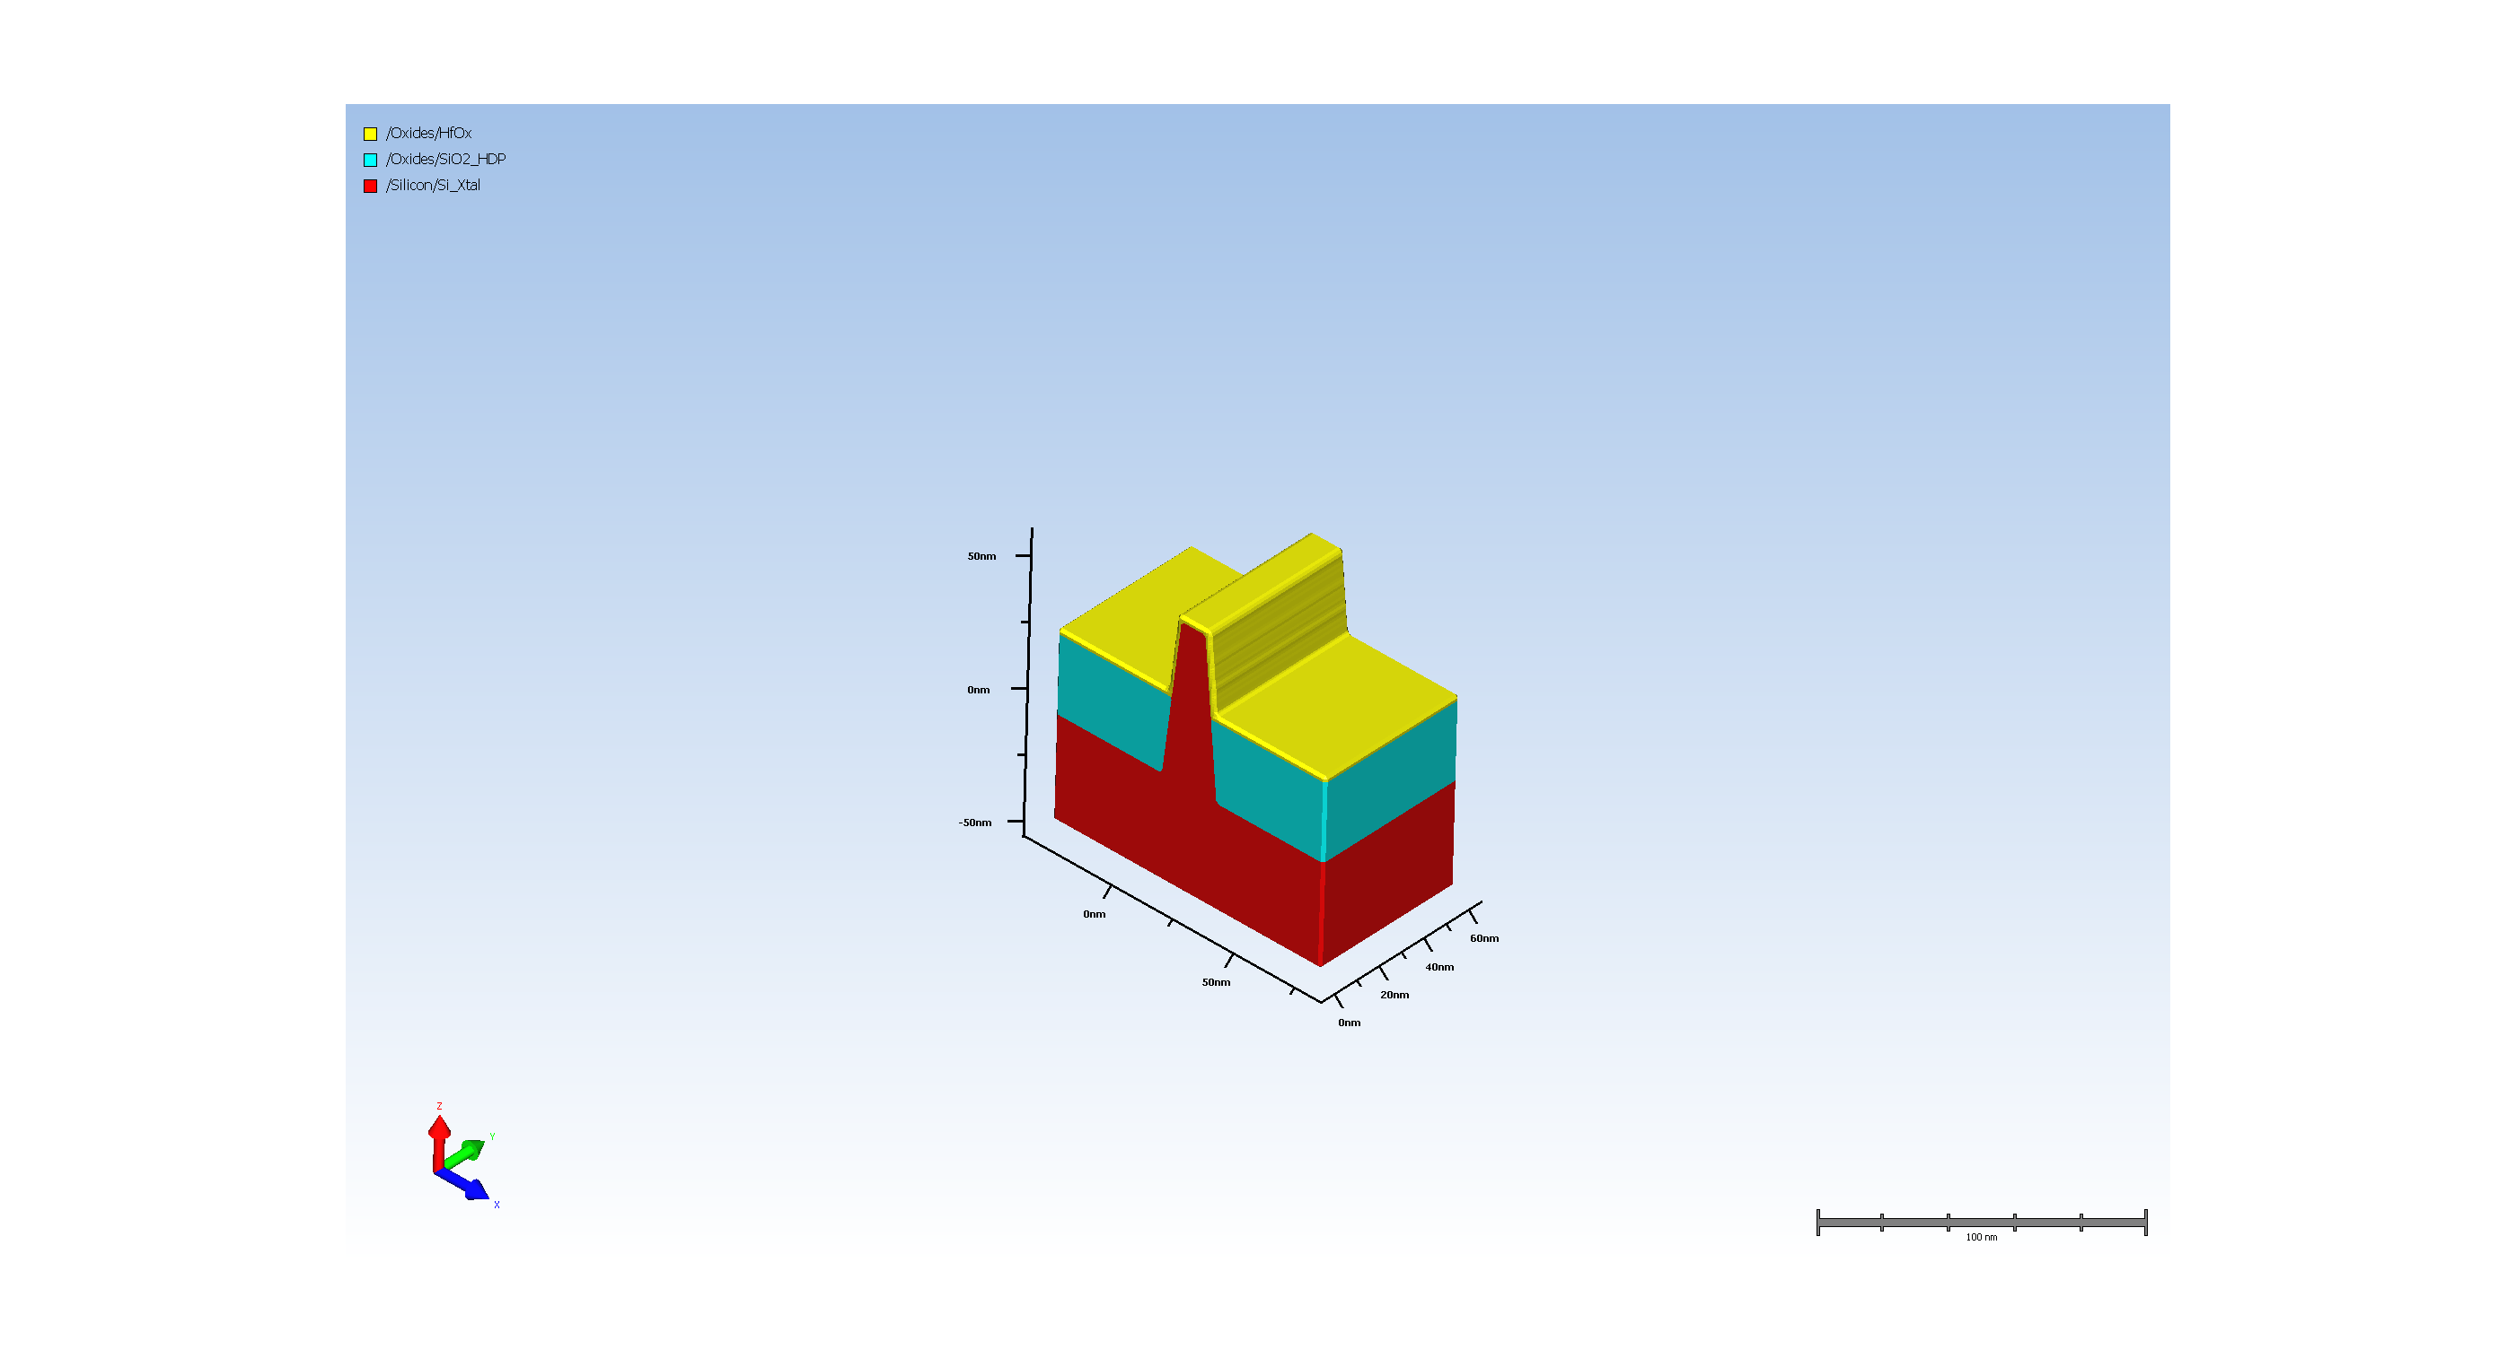
4.1. Gate high K

Slide 12
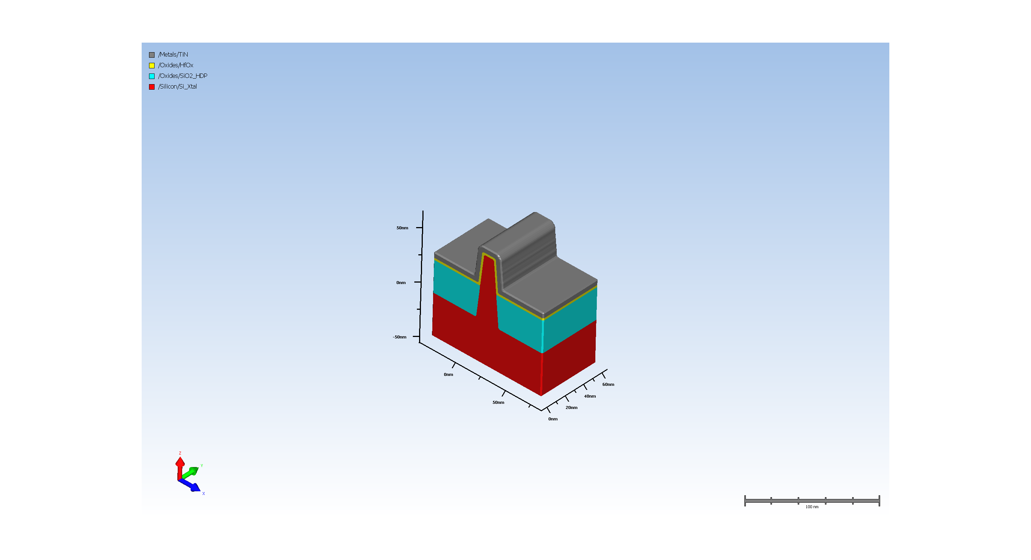
4.2. Gate metal deposition

Slide 13
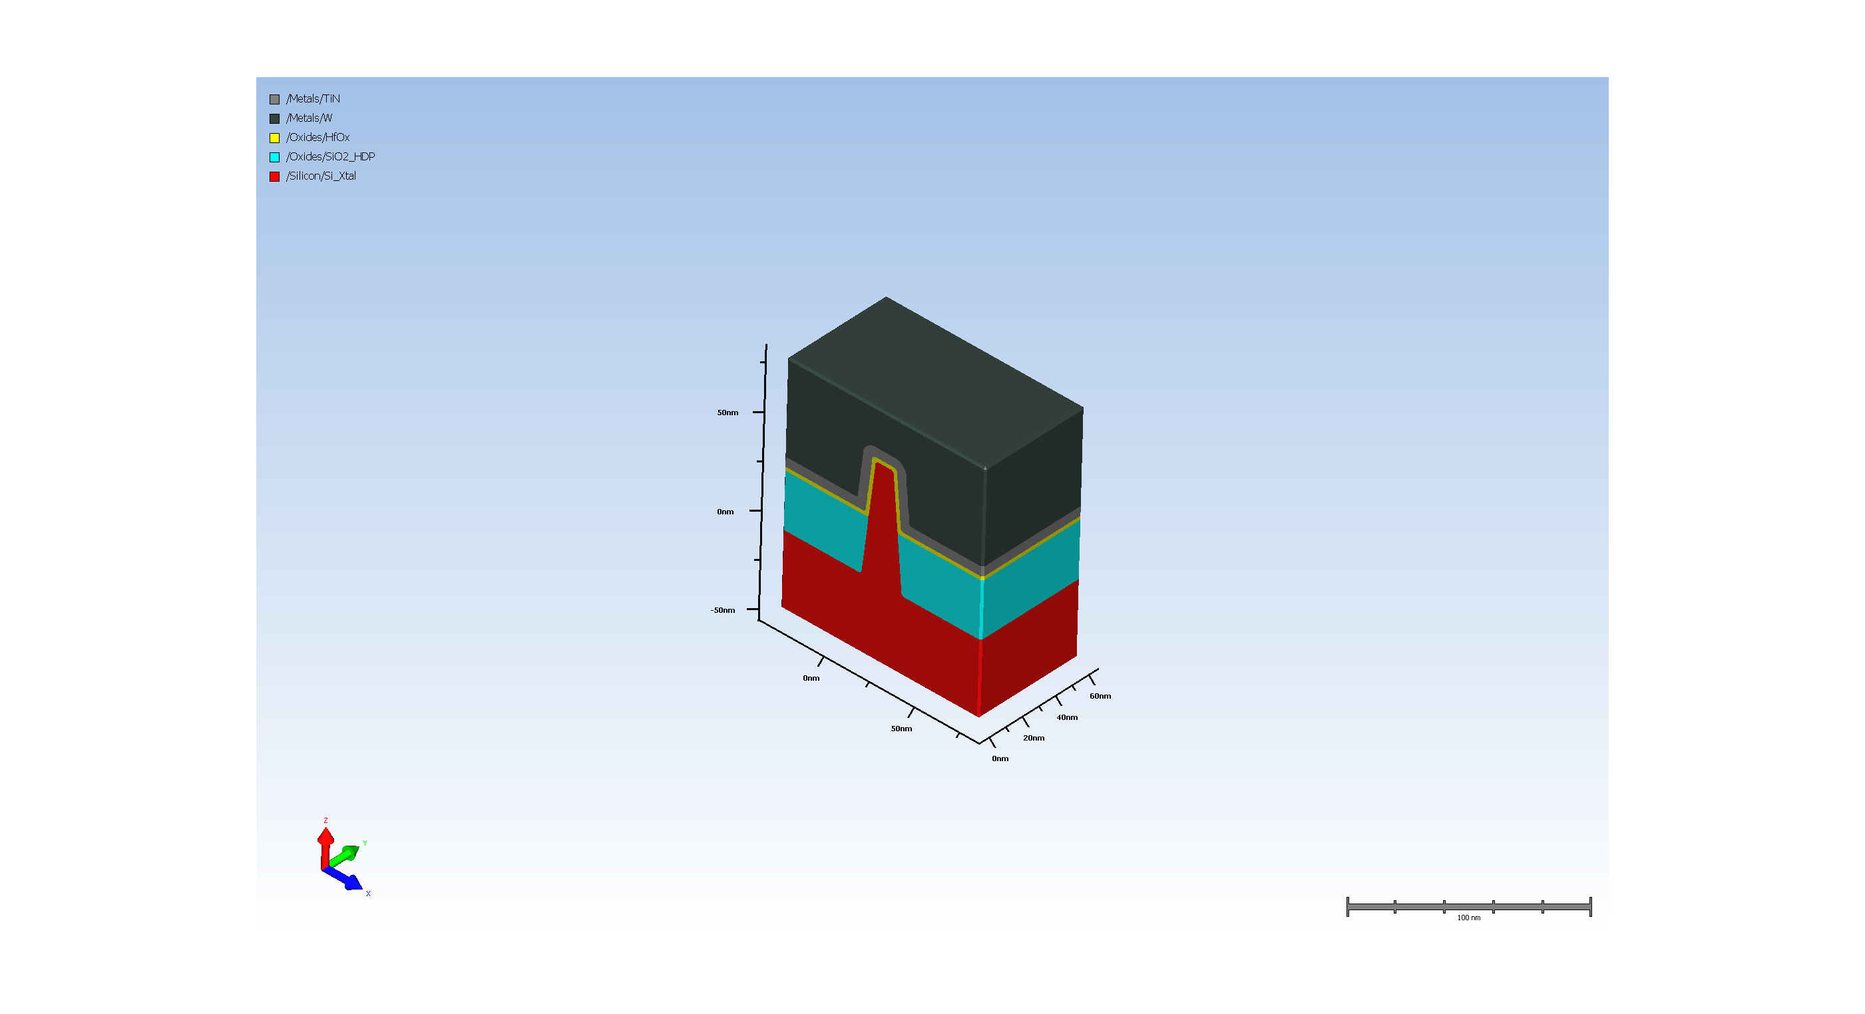
4.3. Gate metal deposition

Slide 14
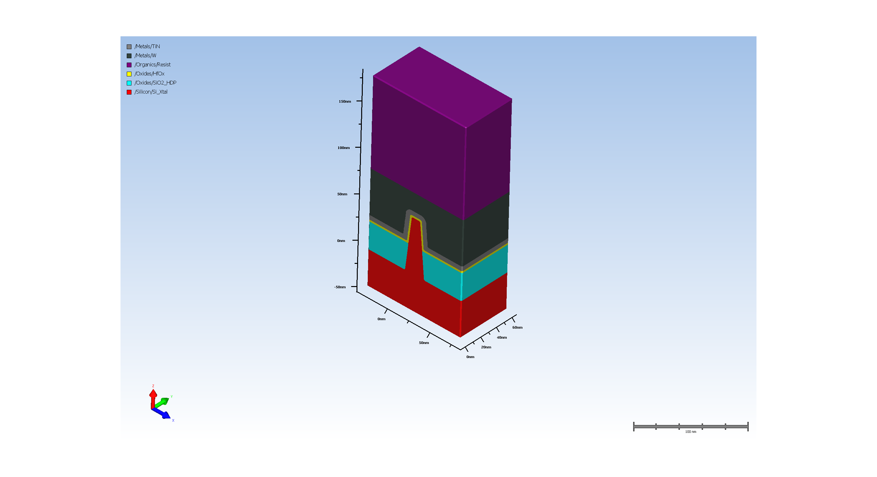
4.4. resist for gate metal pattern

Slide 15
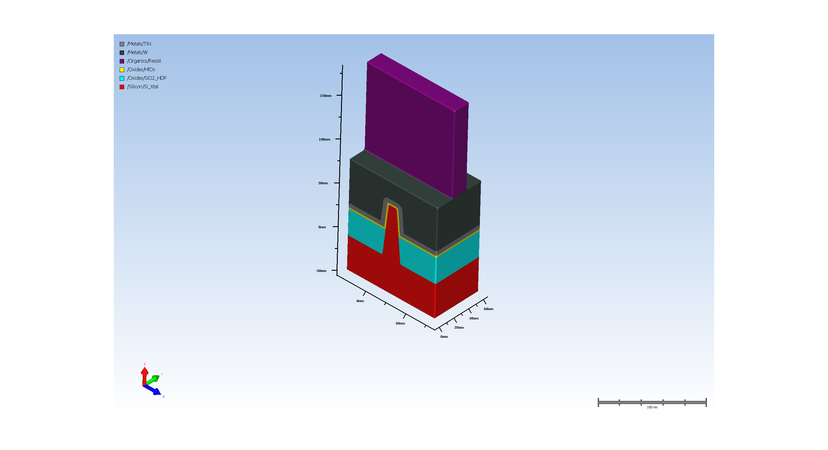
4.5. Expose resist

Slide 16
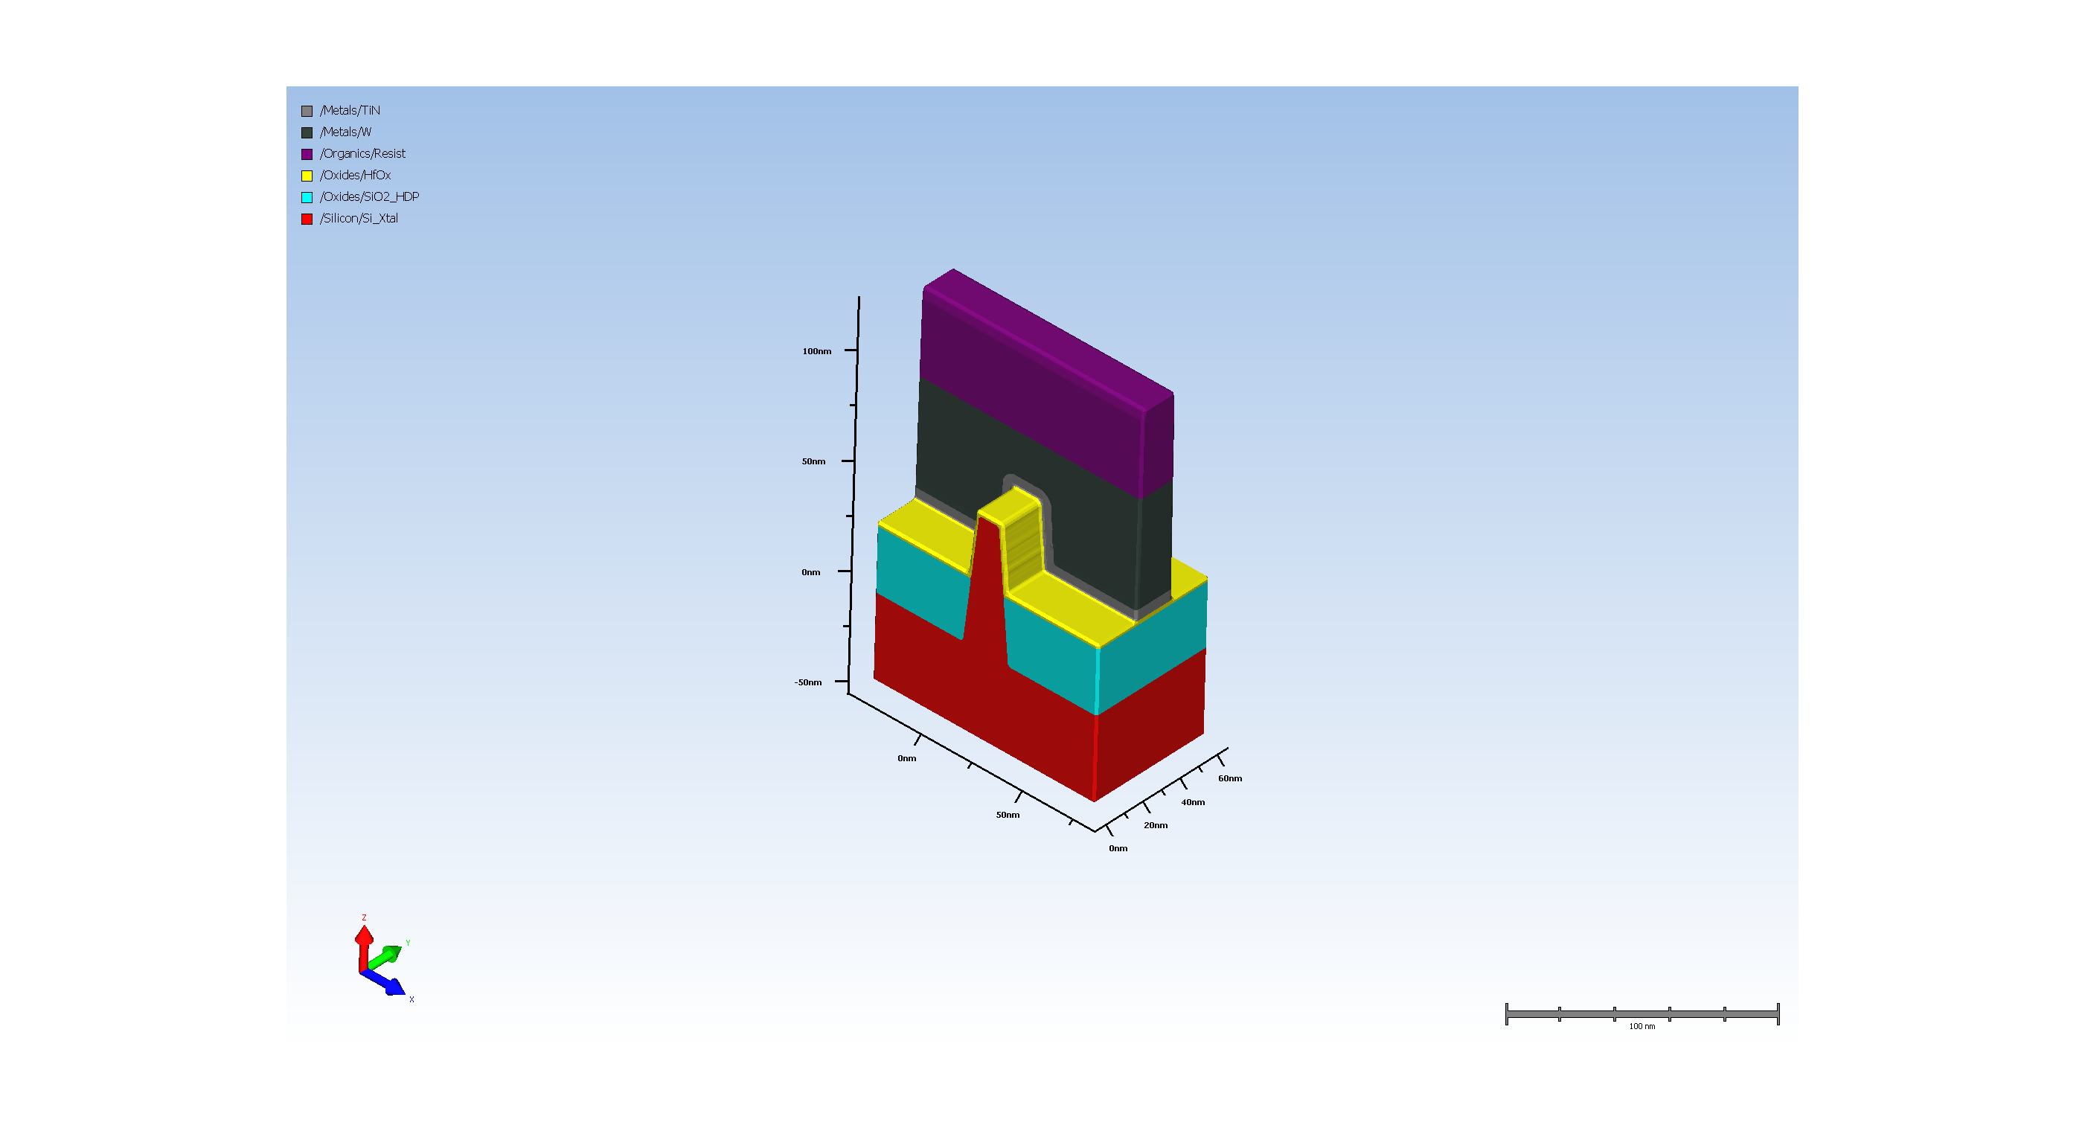
4.6. metal Etch

Slide 17
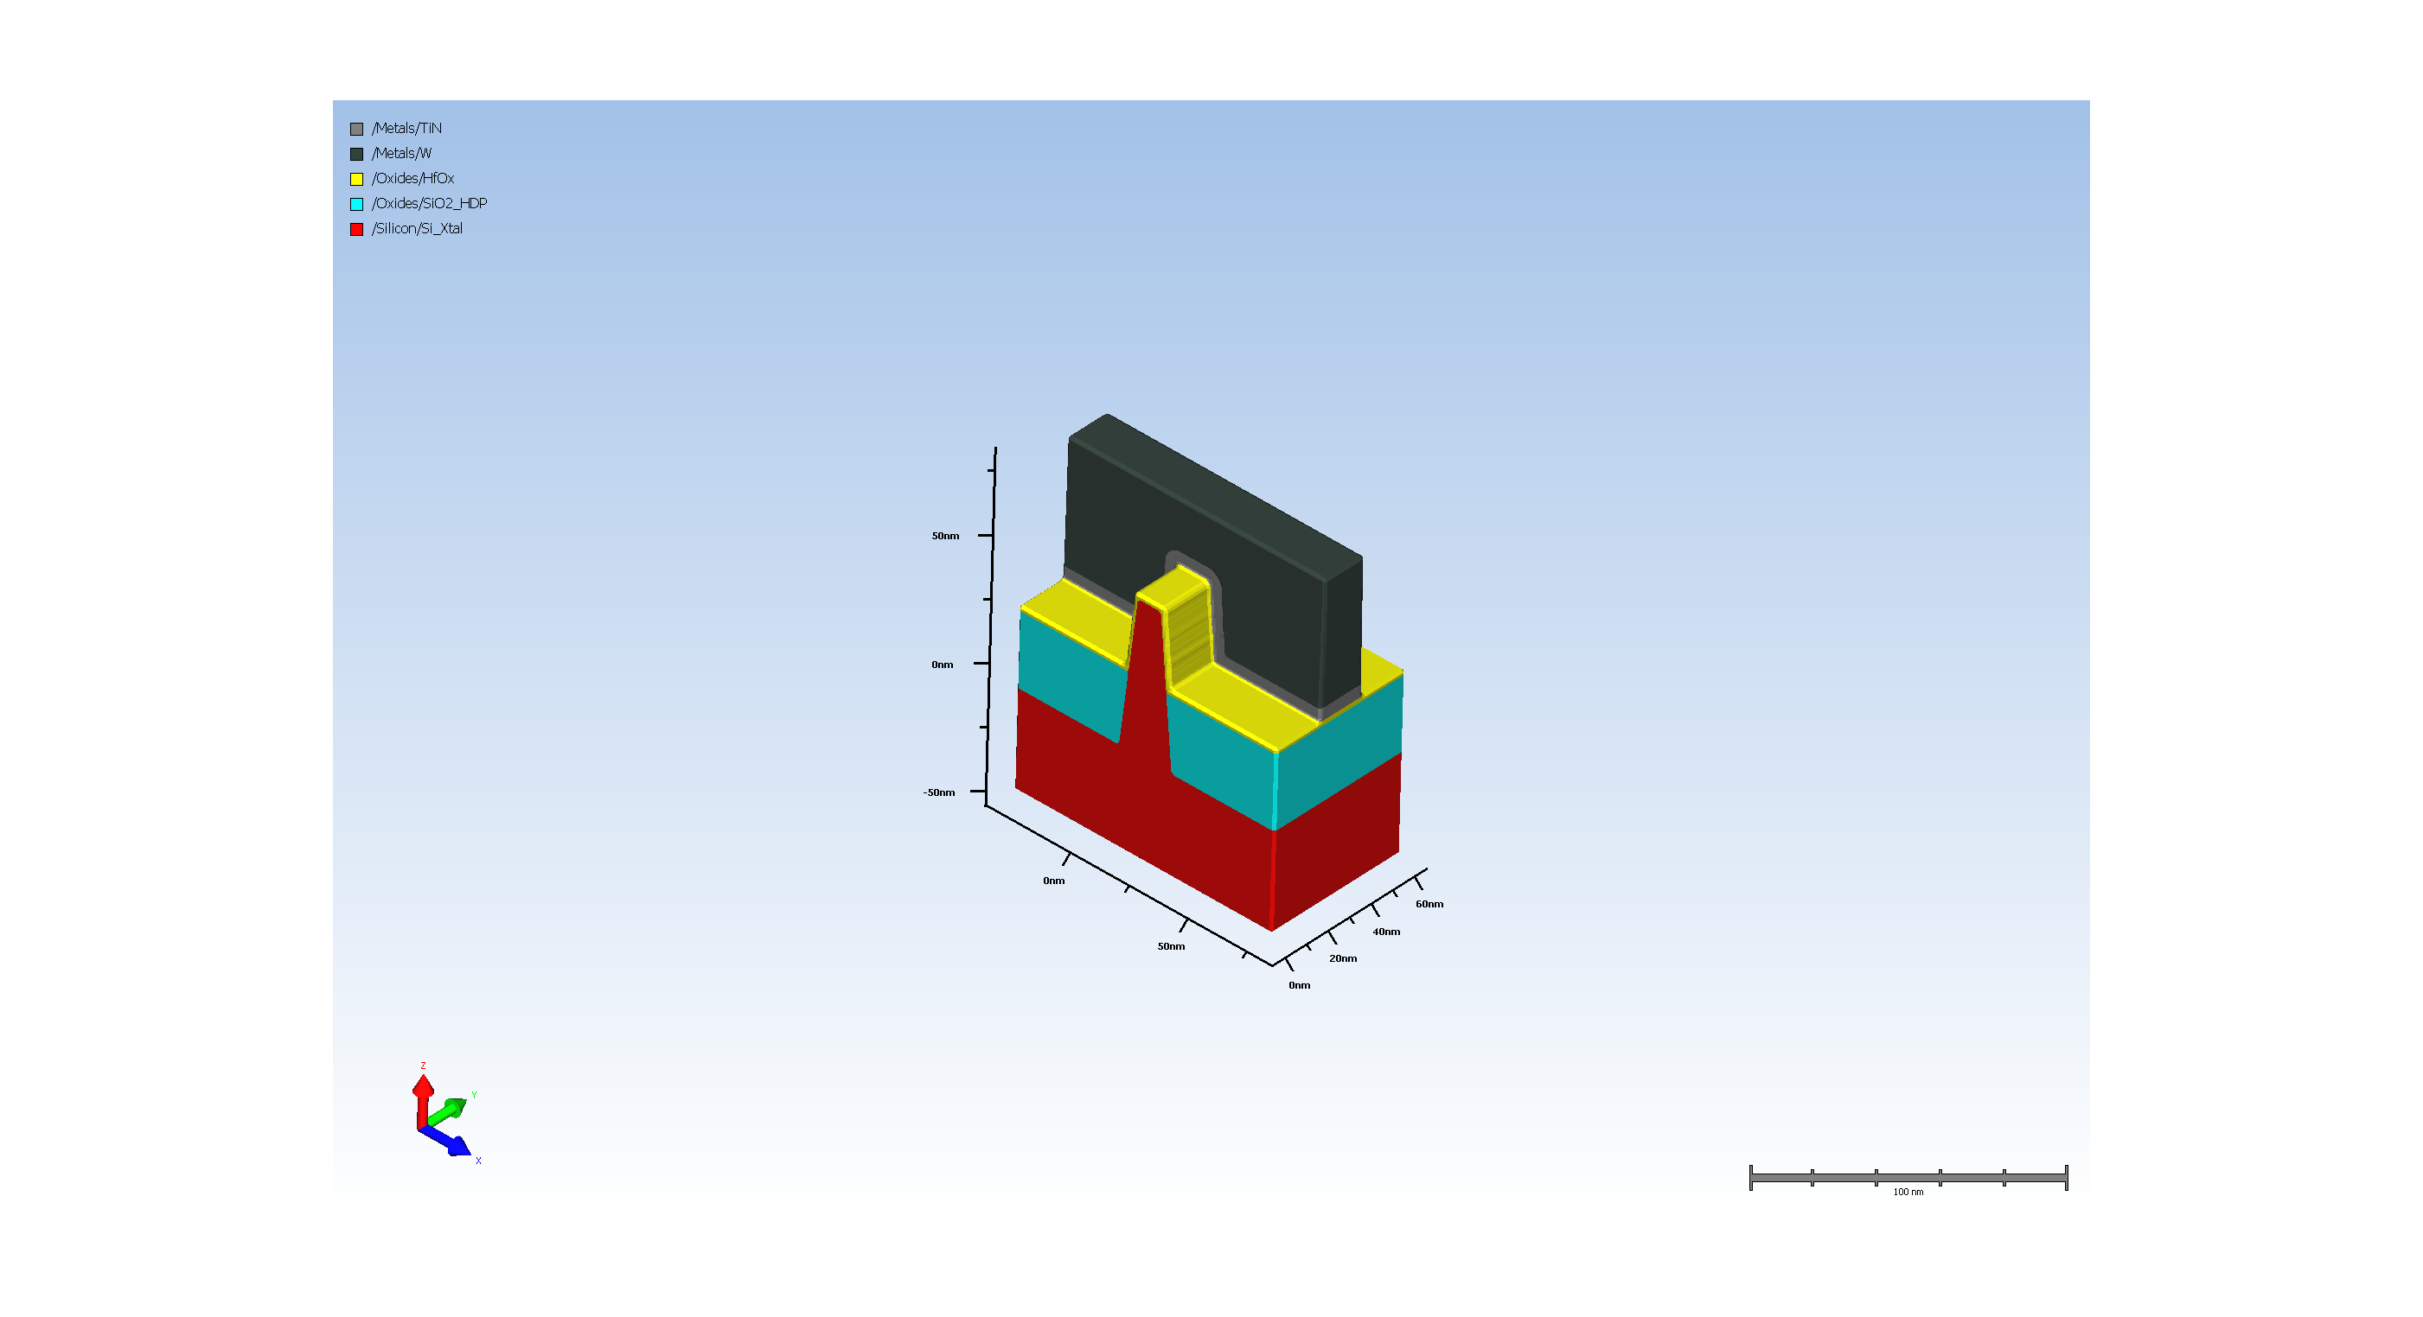
4.7. Remove resist

Slide 18
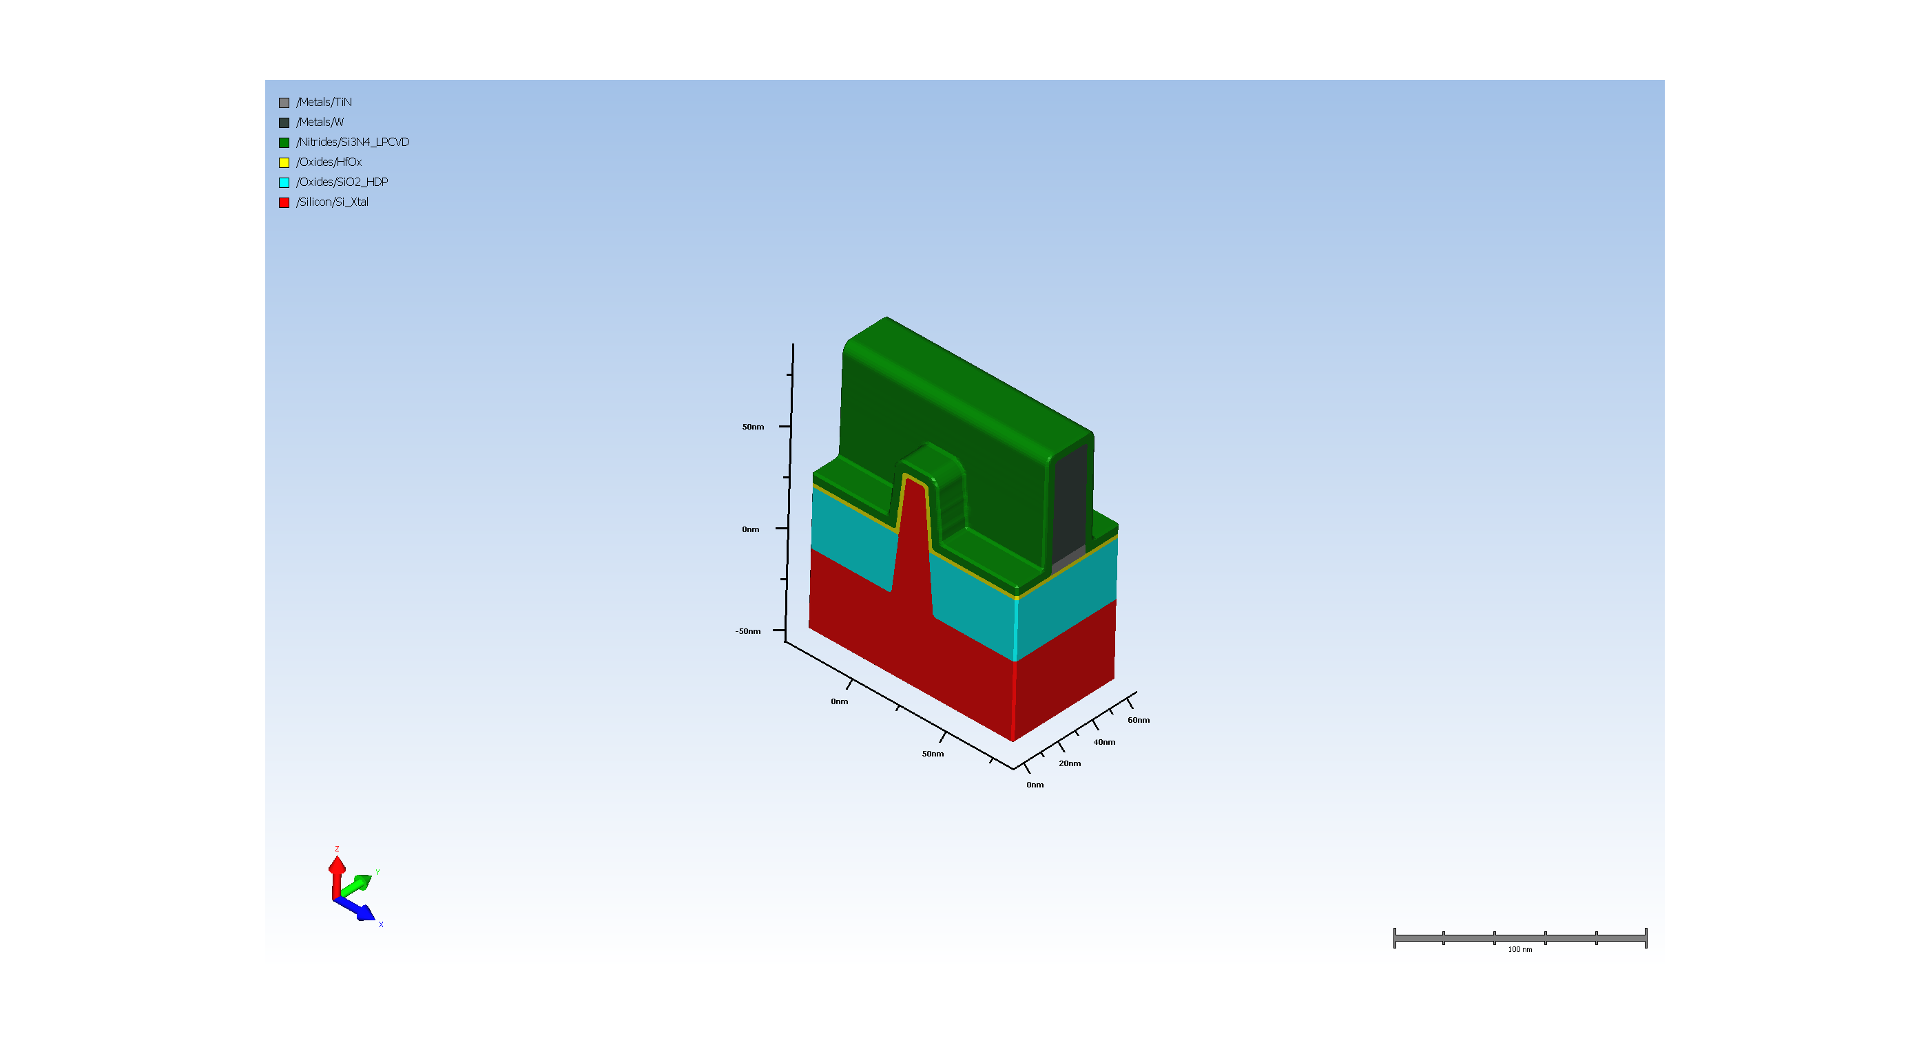
5.1. Spacer deposition

Slide 19
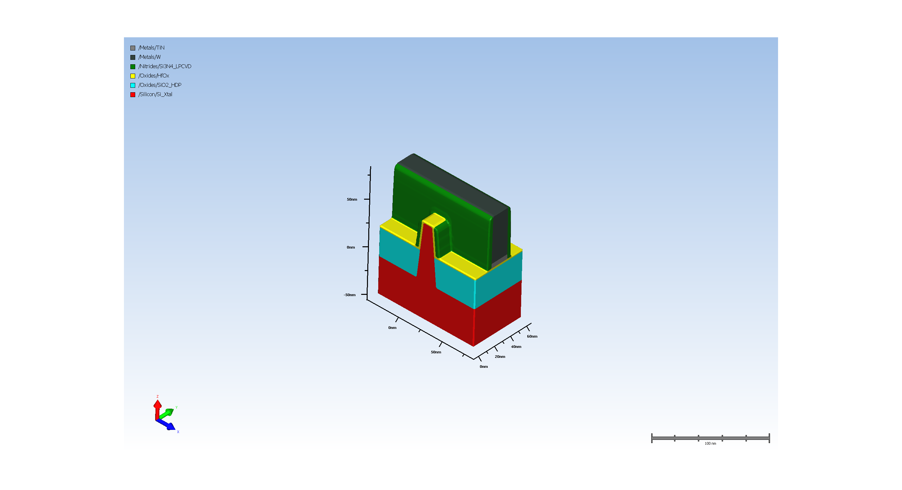
5.2. spacer Etch

Slide 20
A-1.2. Cal_width_spacer
Metrology results:
CD measurement at (54.999999999999986, 0.0, 54.999999999999986, 37.99999999999999):
cd_width = 5.023438

Slide 21
A-2.2. Cal_inflection_spacer
Metrology results:
CD measurement at (54.999999999999986, 0.0, 54.999999999999986, 37.99999999999999):
cd_inflection = 4.746361

Slide 22
A-3.2. Cal_thickness_spacer
Metrology results:
Film thickness measurement for ('/Nitrides/Si3N4_LPCVD',) at (55.000000,19.000000):
thickness_spacer = 53.821739

