Slide 1

Evidence-Driven-Game-Engine
Team members
Roll No Name
2420030552 P LAHARI
2420030009 V. DHRUVA SAI
2420030310 NIKHIL SHREYAS
Under the guidance of
Dr. N Shirisha
Associate Professor
Department of Computer Science and Engineering
Koneru Lakshmaiah Education Foundation
(Deemed to be University estd. u/s. 3 of the UGC Act, 1956)
Off-Campus: Bachupally-Gandimaisamma Road, Bowrampet, Hyderabad, Telangana - 500 043.
Phone No: 7815926816, www.klh.edu.in
Notes:
Good morning everyone. Today we are presenting our project EDGE, or Evidence-Driven Game Engine.
EDGE is an AI-powered cricket intelligence platform that converts large amounts of cricket data into simple and useful insights.
Our team consists of Dhruva Sai, Nikhil Shreyas, and P Lahari, under the guidance of Dr. N. Shirisha.

Slide 2

Evidence-Driven-Game-Engine
Review-2
Team Members
P LAHARI | 2420030552
NIKHIL SHREYAS | 2420030310
DHRUVA SAI | 2420030009
Notes:
This is our first project review for EDGE.
Our main aim is to collect, process, and analyse cricket data and provide meaningful insights through a single platform.
In this review, we will cover our project background, literature survey, objectives, problem gap, innovation, challenges, and future work.

Slide 3
ABSTRACT
Cricket generates enormous ball-by-ball data, but most of it stays locked in raw scorecards, leaving deeper insight largely unexplored.
EDGE — Evidence-Driven Game Engine turns this raw data into simple, actionable insights through an AI-powered cricket intelligence platform.
Built on 800,000+ deliveries, 5,000+ player profiles, and 4,500+ matches spanning multiple formats and years.
AI Match Situation Advisor and Bowling Change Recommender deliver tactical, decision-support insights without requiring data expertise.
Supported by the Live Match Centre, ICC Rankings, IPL Franchise Intelligence Hub, and a chase win-probability simulator.
A structured, repeatable data pipeline keeps information current, letting new seasons be added seamlessly as the platform grows.
An interactive interface with AI-generated player biographies and leaderboard visualizations lets fans and analysts explore player careers in more depth.
Future enhancements include real-time ball-by-ball ingestion, advanced predictive analytics, and dedicated player-performance prediction models.
Notes:
Cricket produces a huge amount of data from every ball, run, wicket, and player action. However, most of this data is available only in raw scorecards, making it difficult to get useful insights quickly.
Our project EDGE — Evidence-Driven Game Engine solves this by converting detailed ball-by-ball data into simple and actionable insights.
EDGE uses more than 800,000 deliveries, 5,000 player profiles, and 4,500 matches from different formats and years.
It provides AI features like the Match Situation Advisor and Bowling Change Recommender, along with tools such as the Live Match Centre, ICC Rankings, IPL Franchise Intelligence Hub, and chase win-probability simulator.
Behind these features, a structured data pipeline keeps the cricket data organised and allows new seasons to be added easily.
Overall, EDGE combines historical cricket data, analytics, visualizations, and AI to make advanced cricket analysis easier for fans, analysts, and franchises.

Slide 4
INTRODUCTION
Background
Cricket produces a huge amount of structured and unstructured data every match, but this has traditionally been used only for scorecards and basic leaderboards, leaving most valuable insight unexplored. Growth in fantasy sports, franchise scouting, and fan engagement is driving demand for simple, accessible analytics.
Project Goal
"EDGE — Evidence-Driven Game Engine" converts ball-by-ball data into actionable insight through a data pipeline and web app that collects, processes, and analyses large-scale cricket data, calculates key statistics, shows live match information, and uses generative AI for understandable tactical recommendations — without requiring users to have data or cricket expertise.
Implementation
PostgreSQL with Prisma ORM stores structured cricket data, while a Python-based ETL pipeline extracts, cleans, transforms, and loads Cricsheet JSON files and career statistics. Live information comes from CricAPI and RapidAPI, and Google Gemini with Anthropic Claude provide AI-based match analysis and recommendations.
Motivation
Fans, fantasy users, and analysts rely on scattered sources — scorecards, stats, rankings, news — that rarely combine historical data, live match state, and AI reasoning in one place. Manually analysing thousands of ball-by-ball records is slow and needs domain expertise; EDGE reduces this complexity through one interactive platform.
Notes:
Cricket generates a large amount of data such as runs, wickets, player performances, and match situations.
Traditionally, this data is mainly used for scorecards and basic statistics, while many useful insights remain unexplored.
Our goal is to convert this detailed data into meaningful and actionable insights using a data pipeline, web application, and generative AI.
EDGE brings historical data, live information, analytics, and AI together in one platform.

Slide 5
OBJECTIVES
• Develop EDGE as an AI-powered cricket intelligence platform that transforms raw ball-by-ball data into meaningful and actionable insights.
• Integrate historical and live cricket data from multiple sources, covering matches, players, teams, and different cricket formats.
• Build a structured ETL pipeline to collect, clean, transform, validate, and efficiently store large-scale cricket datasets.
• Analyse ball-by-ball match data to identify player performance, team trends, match patterns, and important match-state features.
• Develop AI-powered decision support through Match Situation Advisor and Bowling Change Recommender for contextual tactical insights.
• Provide real-time cricket intelligence by combining live match conditions with historical data and win-probability analysis.
• Deliver an interactive platform with Live Match Centre, rankings, player profiles, franchise insights, visualizations, and AI-generated explanations.
• Create a scalable foundation that can support new seasons, leagues, formats, real-time ingestion, and advanced predictive analytics.

Slide 6
Literature Survey
Authors | Title of the Paper | Link for reference | Drawbacks | Future work
Ashish V Shenoy, Arjun Singhvi, Shruthi Racha, Srinivas Tunuguntla | Prediction of the outcome of a Twenty-20 Cricket Match : A Machine Learning Approach | https://arxiv.org/abs/2209.06346 | Limitation: Focuses mainly on pre-match information rather than continuously changing match state. | Future: Incorporate ball-by-ball/live match features for dynamic prediction.
S. Chakraborty et al. (2024) | Cricket Data Analytics: Forecasting T20 Match Winners Through Machine Learning | https://doi.org/10.1177/17479541221119738 | Limitation: Primarily predicts before the match begins; limited real-time match-state reasoning. | Future: Extend prediction using live ball-by-ball features and dynamic match conditions
Pussella et al. (2023) | In-game Winner Prediction and Winning Strategy Generation in Cricket: A Machine Learning Approach | https://ieeexplore.ieee.org/document/10705216/ | Limitation: Dataset is limited to IPL matches from 2008–2020. | Future: Extend across formats, leagues and more recent matches; incorporate richer contextual features.
Notes:
We studied existing research on cricket prediction and strategy generation.
Some studies mainly focus on pre-match prediction, while others have limited real-time match analysis.
We also found research on in-game prediction, but one study was limited mainly to IPL matches from 2008 to 2020.
From this, we identified a gap in combining ball-by-ball data, live match situations, analytics, and AI-based reasoning in one platform.
This research gap forms the basis of our EDGE project.

Slide 7
Authors | Title of the Paper | Link for reference | Drawbacks | Future work
K. Dhinakaran, S. Anbuchelian | Enhanced Cricket Match Prediction Using Kernel Methods for Feature Extraction and Back-Propagation Neural Networks | https://www.nature.com/articles/s41598-026-36555-6 | Limitation: Validated only on ODI matches using six match-state features. | Future: Extend the framework to T20/IPL with added contextual features like pitch and weather.
Jhansi Rani P., Apurva Kulkarni, Aditya V. Kamath, Aadith Menon, Prajwal Dhatwalia, Rishabh D | Prediction of Player Price in IPL Auction Using Machine Learning Regression Algorithms | https://ieeexplore.ieee.org/document/9198668/ | Limitation: Price predicted from past stats only, ignoring current form or bidding demand. | Future: Add real-time form and demand-based features to the pricing model.
Gaurav Malhotra | A Comprehensive Approach to Predict Auction Prices and Economic Value Creation of Cricketers in the IPL | https://journals.sagepub.com/doi/10.3233/JSA-200580 | Limitation: Uses linear regression, limiting capture of non-linear price-performance relationships. | Future: Apply advanced ML/ensemble models with continuously updated in-season data.

Slide 8
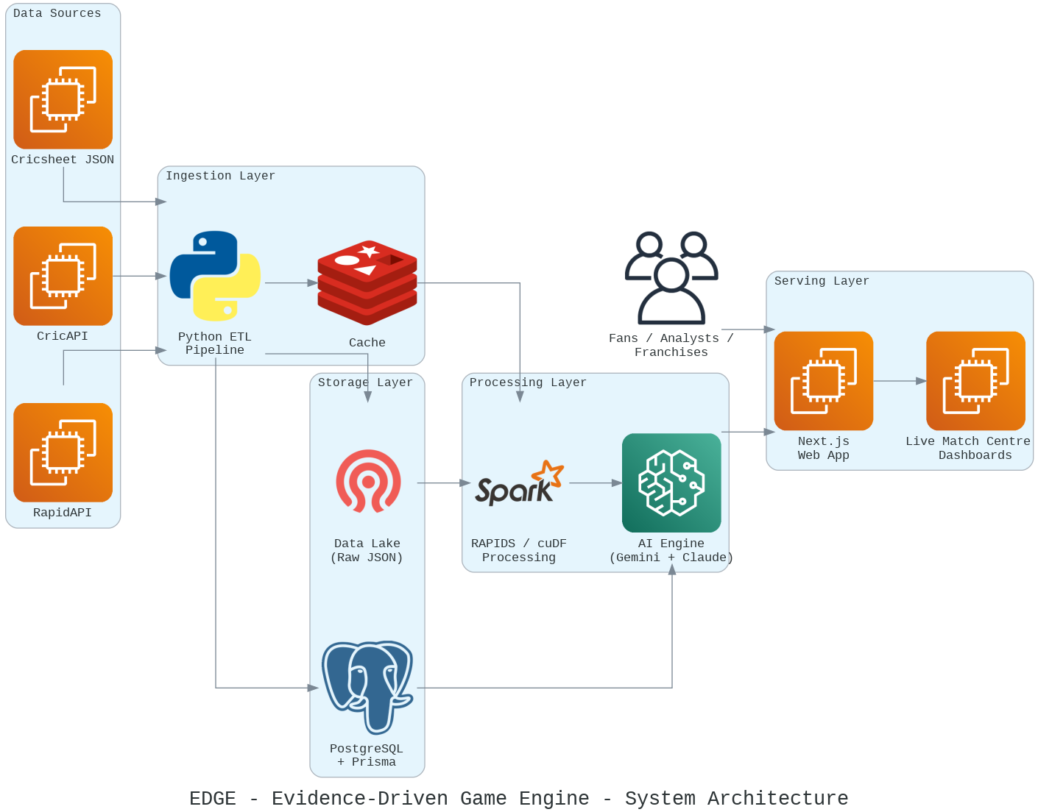
System Architecture

Slide 9
System Architecture
Data Sources
Three external feeds bring cricket data in: Cricsheet JSON (historical ball-by-ball match files), CricAPI, and RapidAPI (live match data). These are where all the raw information originates.
Ingestion Layer
All three sources feed into the Python ETL Pipeline, which extracts, cleans, and transforms the raw data. From there it passes through a Cache, so frequently requested data (like live scores) can be served quickly without hitting the sources or database every time.
Storage Layer
The pipeline writes data into two places:
Data Lake (Raw JSON) — stores the original, unprocessed ball-by-ball files for historical/archival purposes.
PostgreSQL + Prisma — stores the cleaned, structured data (matches, players, stats) that the app actually queries.
Processing Layer
Both the Data Lake and PostgreSQL feed into RAPIDS/cuDF Processing, which crunches the large datasets quickly (GPU-accelerated). The processed output then goes to the AI Engine (Gemini + Claude), which generates the tactical insights — match situation advice, bowling change recommendations, and so on.
Serving Layer
The AI Engine's output reaches the Next.js Web App, which powers the Live Match Centre and dashboards that users actually see.
Users
Fans, analysts, and franchises interact with the Web App on the front end — they're the ones consuming everything the pipeline behind them produced.

