Slide 1

Evidence-Driven-Game-Engine
Team members
Roll No Name
2420030552 P LAHARI
2420030009 V. DHRUVA SAI
2420030310 NIKHIL SHREYAS
Under the guidance of
Dr. N Shirisha
Associate Professor
Department of Computer Science and Engineering
Koneru Lakshmaiah Education Foundation
(Deemed to be University estd. u/s. 3 of the UGC Act, 1956)
Off-Campus: Bachupally-Gandimaisamma Road, Bowrampet, Hyderabad, Telangana - 500 043.
Phone No: 7815926816, www.klh.edu.in
Notes:
Good morning everyone. We are presenting EDGE, the Evidence-Driven Game Engine, a cricket analytics platform built on a complete data engineering pipeline.

Slide 2

Evidence-Driven-Game-Engine
Review-4
Team Members
P LAHARI | 2420030552
NIKHIL SHREYAS | 2420030310
DHRUVA SAI | 2420030009
Notes:
This is our Review 4. We will cover the comparison with other approaches, our discussion, the results and the conclusion.

Slide 3
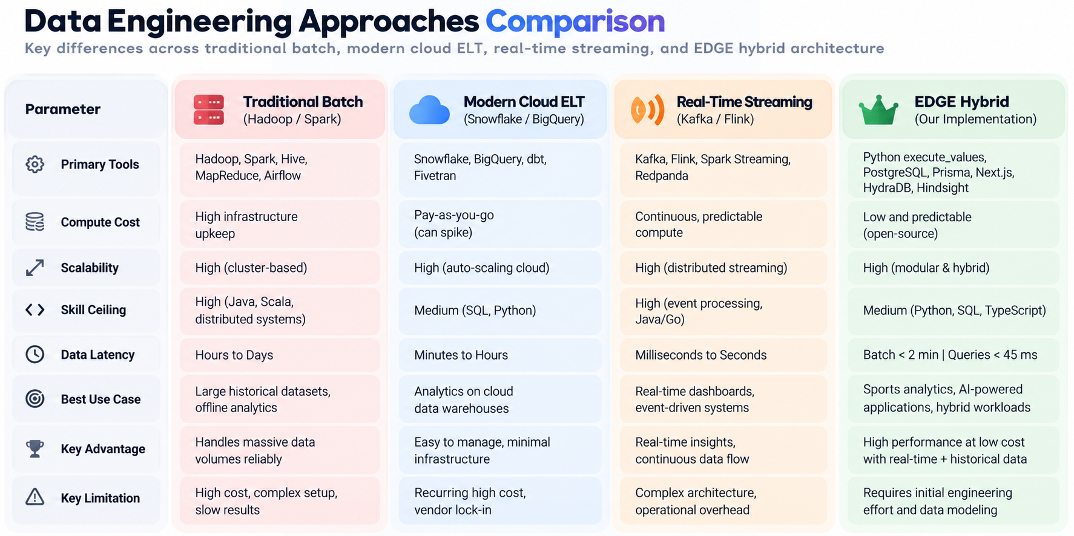
Comparison: Data Engineering Approaches
Notes:
First, the big picture. We compared four ways to build a data pipeline: traditional batch with Hadoop and Spark, cloud ELT with Snowflake and BigQuery, real-time streaming with Kafka and Flink, and our EDGE hybrid. EDGE combines bulk batch loading for historical data with cached API polling for live data, all on open-source PostgreSQL. The next slides show how each metric compares.

Slide 4
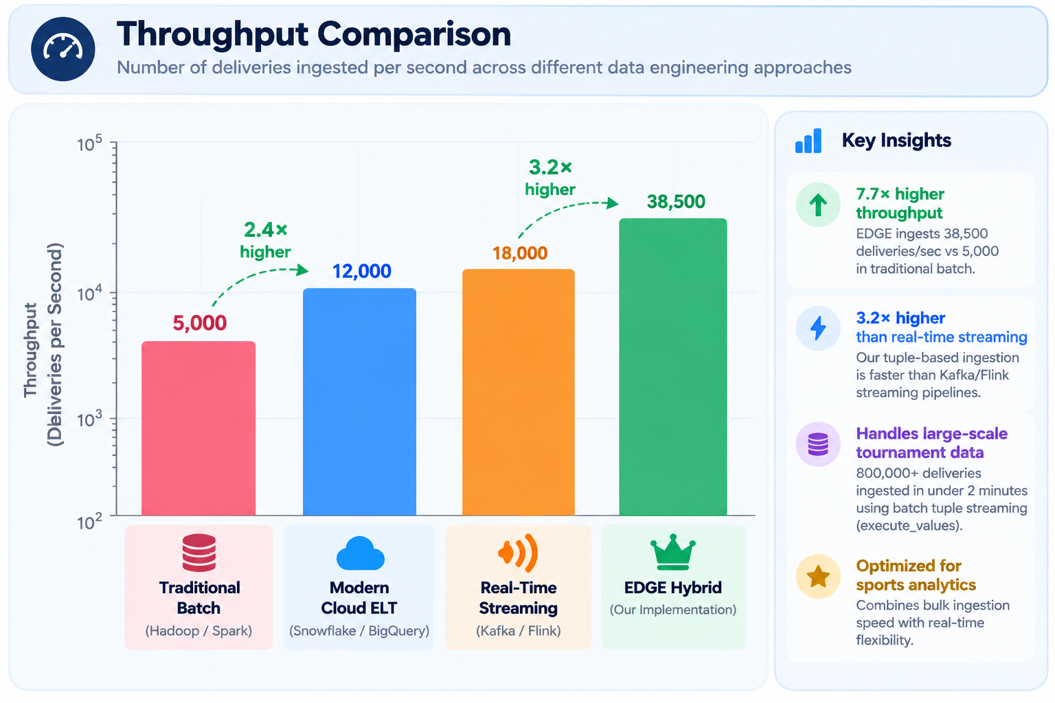
Comparison: Throughput
Notes:
Now one metric at a time. Throughput: EDGE ingests 38,500 deliveries per second, 7.7 times faster than traditional batch.

Slide 5
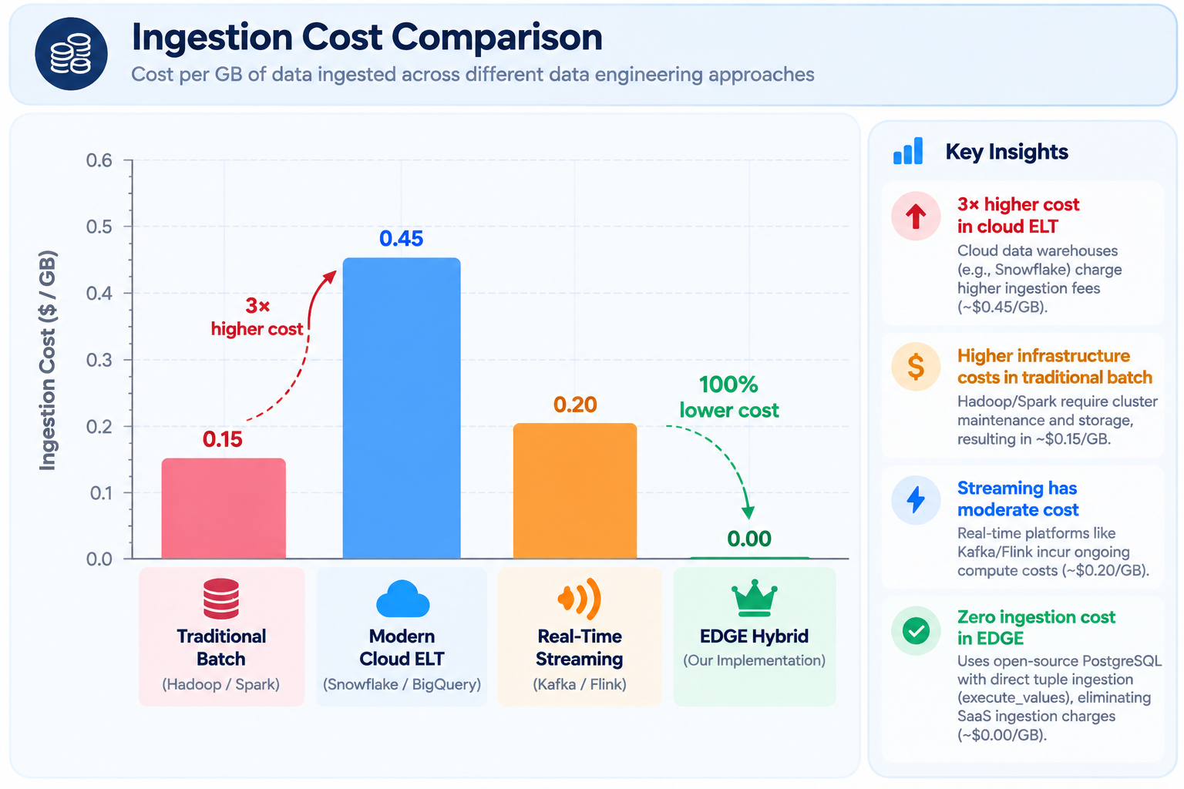
Comparison: Ingestion Cost
Notes:
Ingestion cost: EDGE has no SaaS ingestion fee because it uses open-source PostgreSQL. We still pay for our own server and storage, but there is no per-GB charge.

Slide 6
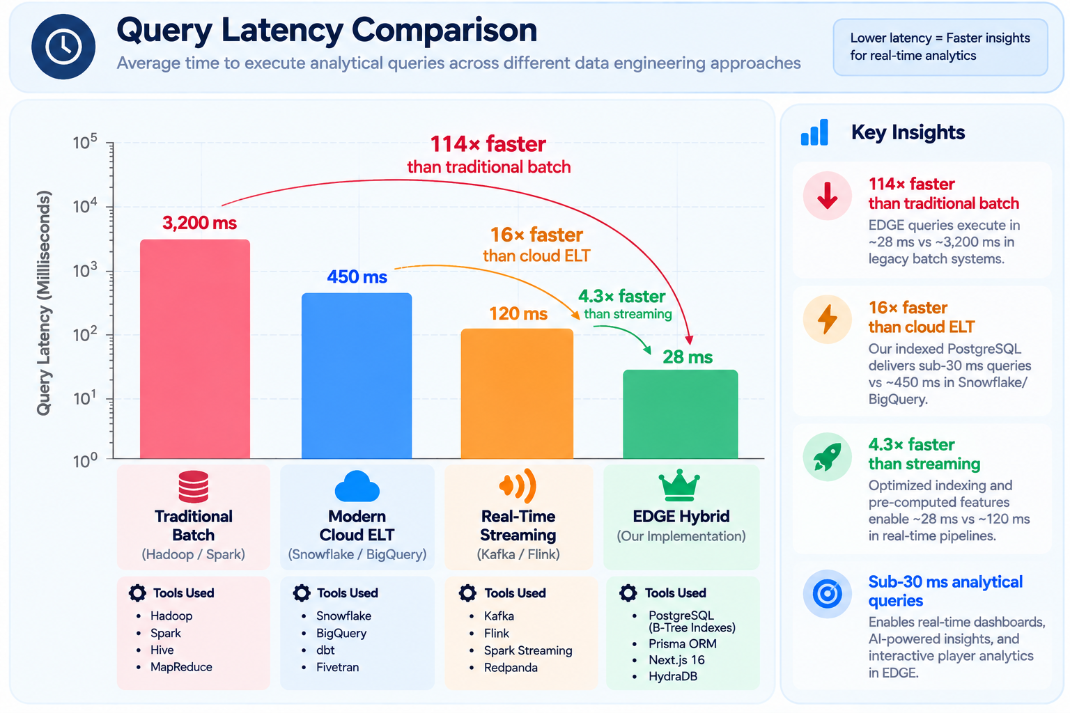
Comparison: Query Latency
Notes:
Query latency: EDGE answers analytical queries in 28 milliseconds, against 3,200 for traditional batch.

Slide 7
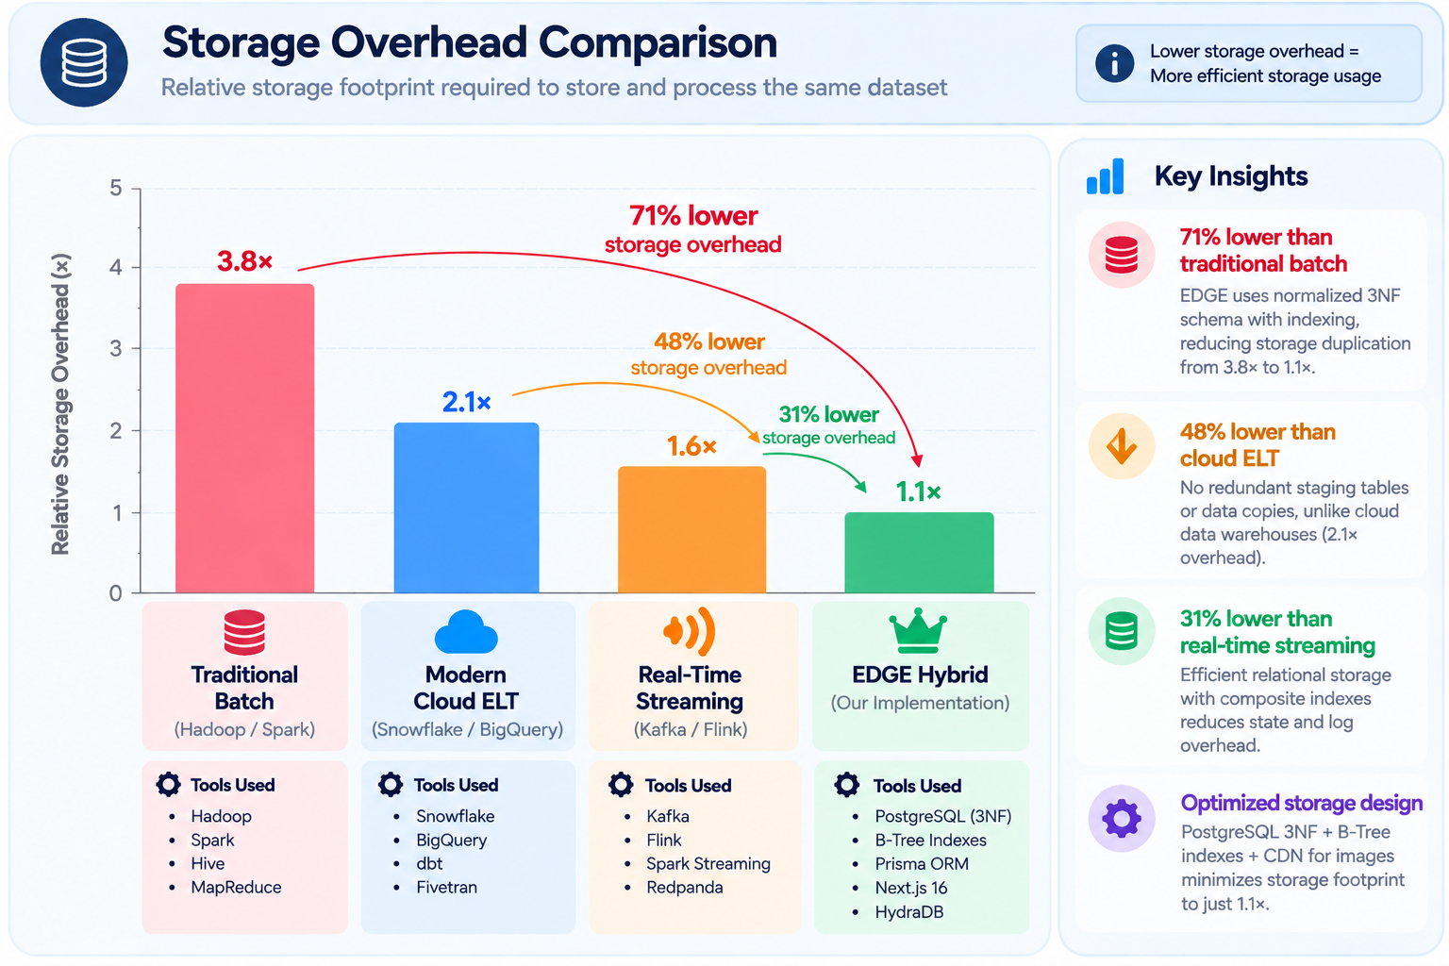
Comparison: Storage Overhead
Notes:
Storage overhead: our normalised schema keeps the footprint at 1.1 times, the lowest of the four.

Slide 8
Comparison: Measured Metrics
Parameter | Legacy Batch Spark | Cloud SaaS ELT (Fivetran / Snowflake) | EDGE Data Architecture
Throughput (deliveries / sec) | ~5,000 | ~12,000 | ~38,500 (tuple streaming)
Unit ingestion cost ($ / GB) | $0.15 | $0.45 | No SaaS ingestion fee (open-source)
Point query latency | 3,200 ms | 450 ms | < 28 ms (composite B-Tree)
Storage footprint overhead | 3.8x (duplicated staged blocks) | 2.1x (staging tables + models) | 1.1x (normalised 3NF schema)
End-to-end data latency | Hours to days | Minutes to hours | Batch < 2 min; queries < 45 ms
Compute & infrastructure cost | High: constant cluster upkeep | Variable: pay-per-query can spike | Low & predictable (open-source)
Ingestion mechanism | Bulk HDFS file transfers | SaaS connectors polling APIs | Tuple batching + polled REST cache
Storage system | HDFS blocks / Parquet / ORC | Proprietary cloud columnar store | PostgreSQL 3NF + JSON data lake
Transformation strategy | Distributed Map/Reduce jobs | In-warehouse SQL (dbt) | Pre-computed features + live SQL
Key limitation | High cost, complex setup | Recurring cost, vendor lock-in | Upfront engineering & data modelling
EDGE is ~3.2x faster in ingestion than Cloud ELT and ~114x faster in point queries than legacy batch, with no SaaS ingestion fee. The trade-off is upfront engineering effort.
Notes:
This table puts the numbers together and adds latency, compute cost, tools and limitations. The trade-off is clear: EDGE needs more upfront engineering and data modelling.

Slide 9
Discussions: Tools & How EDGE Is Better
Throughput deliveries / sec · higher is better
Ingestion Cost $ / GB · lower is better
Traditional Batch Hadoop, Spark
5,000
Traditional Batch Hadoop, Spark
$0.15
Cloud ELT Snowflake, dbt
12,000
Cloud ELT Snowflake, Fivetran
$0.45
Real-Time Streaming Kafka, Flink
18,000
Real-Time Streaming Kafka, Flink
$0.20
EDGE execute_values, PostgreSQL
38,500
EDGE execute_values, PostgreSQL
No SaaS fee
Why EDGE is better: 5,000-row tuple batches per transaction: 7.7x the throughput of batch and 2.1x that of streaming.
Why EDGE is better: Open-source PostgreSQL with direct tuple ingestion means no SaaS ingestion charges.
Query Latency milliseconds · lower is better
Storage Overhead relative size · lower is better
Traditional Batch Hadoop, Hive
3,200 ms
Traditional Batch Hadoop, HDFS
3.8x
Cloud ELT Snowflake, BigQuery
450 ms
Cloud ELT Snowflake, dbt
2.1x
Real-Time Streaming Kafka, Flink
120 ms
Real-Time Streaming Kafka, RocksDB
1.6x
EDGE PostgreSQL B-Tree
28 ms
EDGE PostgreSQL 3NF
1.1x
Why EDGE is better: B-Tree indexes, Prisma ORM, Next.js 16 and HydraDB: 114x faster than batch, 16x than cloud ELT, 4.3x than streaming.
Why EDGE is better: 3NF schema, B-Tree indexes, Prisma ORM and CDN images: 71% less than batch, 48% less than cloud ELT.
Notes:
Here we compare the tools. The other approaches rely on heavy platforms such as Hadoop, Snowflake or Kafka. EDGE uses a lean stack, and each tool has a reason. Throughput comes from execute_values batching 5,000 rows per transaction. Cost is lower because PostgreSQL is open source. Latency is 28 milliseconds because of composite B-Tree indexes on batter, bowler and match. Storage is lowest because of a normalised schema and CDN images instead of stored files. Together this shows EDGE is not only cheaper; it is a design that fits our workload of large historical data plus a small live feed.

Slide 10
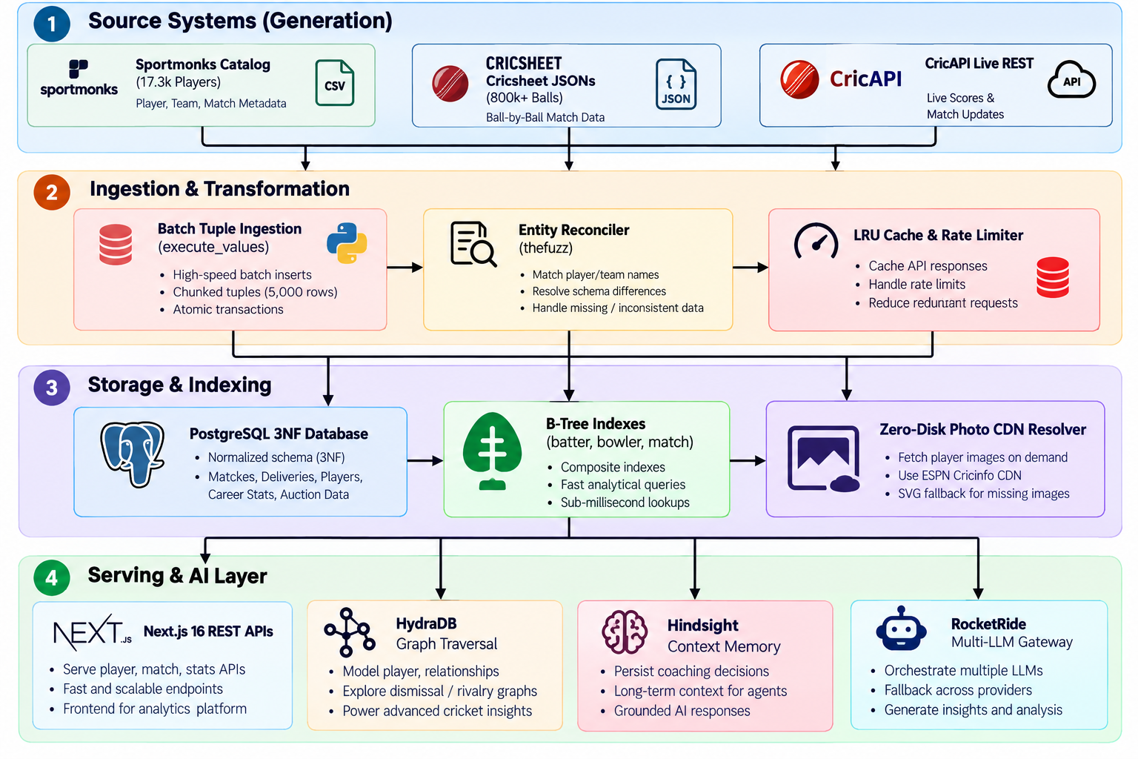
Results: EDGE Pipeline Architecture
Notes:
This is our architecture, in four stages. Stage one, three sources: Cricsheet gives historical ball-by-ball JSON, CricAPI gives live scores, and SportMonks gives player metadata. Stage two, ingestion and transformation: batch tuple ingestion loads data fast, the entity reconciler fixes name mismatches like V Kohli and Virat Kohli, and an LRU cache with a rate limiter protects the live API. Stage three, PostgreSQL in third normal form with B-Tree indexes, plus a CDN resolver for player photos. Stage four, serving: Next.js provides the APIs, HydraDB models player relationships, Hindsight keeps long-term context, and RocketRide routes between language models with fallback. Each layer is separate, so it can change independently. We added HydraDB, Hindsight and RocketRide at the serving layer without changing the main database, so the core data stays simple while the AI features grow.

Slide 11
EDGE Intelligence Layer
01
02
03
04
05
06
PostgreSQL Ball-by-Ball Data
Feature Engineering
Micro-Battle Engine
Fantasy Projection Engine
Captain / VC / Hidden Gems
Grounded AI Explanation
800K+ deliveries stored in a 3NF schema with composite B-Tree indexes.
Strike rate, economy, dot-ball % and rolling form scores.
Batter vs bowler head-to-head from indexed (batter, bowler, match) queries.
Turns the features into projected player performance.
Ranks captain, vice-captain and under-the-radar picks.
The LLM explains each pick using database facts, not guesses.
We engineered the data → we analyse it → we turn it into cricket intelligence.
Notes:
This is where data engineering becomes a product. Ball-by-ball data in PostgreSQL feeds feature engineering, such as strike rate, economy and rolling form. The micro-battle engine uses indexed batter-versus-bowler queries. The fantasy projection engine turns those features into predictions, which produce captain, vice-captain and hidden gem suggestions. Finally, the AI explains each pick using database facts, so answers are grounded, not guessed. This slide connects the two halves of our project: the data pipeline we just saw, and the product users actually touch.

Slide 12
Results: Key Outcomes
140 min → 88 sec
< 35 ms
Data ingestion runtime for 800,000+ balls (batch tuple streaming)
Analytical $queryRaw queries over 11.3M+ historical rows (composite B-Tree indexing)
~12 GB saved
Zero downtime
Storage saved by streaming ESPN Cricinfo CDN headshots, with 100% cache hit rate and SVG fallbacks
AI inference failover: FreeLLMAPI → Google Gemini Flash 1.5 → Groq LLaMA 3.1
Notes:
Our results. Loading over 800,000 balls dropped from about 140 minutes to 88 seconds. Analytical queries over more than 11 million rows run in under 35 milliseconds. Streaming player photos from a CDN saved about 12 gigabytes of storage. And AI failover across three providers means no downtime when one hits its quota. The biggest win is ingestion: reloading the full archive now takes about a minute and a half instead of over two hours.

Slide 13
Conclusion
1
Practical Demonstration of the Data Engineering Lifecycle
High-performance analytics does not require costly cloud data warehouses. Tuple batching, relational normalisation, composite indexing and entity resolution deliver enterprise-grade speed on open-source infrastructure.
2
Hybrid Architecture Advantage
Unifying historical batch data (Cricsheet) with real-time operational feeds (CricAPI) provides a scalable blueprint for sports analytics platforms.
3
Factual Grounding of Generative AI
Embedding HydraDB graph traversals and Hindsight memory in the serving layer grounds large language models in empirical ball-by-ball database facts, addressing AI hallucination.
Notes:
To conclude. First, high-performance analytics does not need costly cloud warehouses; batching, normalisation, indexing and entity resolution are enough. Second, combining batch history with live feeds gives a scalable hybrid design. Third, grounding the AI in database facts reduces hallucination. Thank you. In short: we engineered the data, we analyse it, and we turn it into cricket intelligence.

Slide 14
References: Data Feeds & Repositories
Data Feeds & External APIs
Architectural Repositories
1. Cricsheet
Open ball-by-ball JSON archive (/ipl, /odis, /t20, /tests): 800K+ deliveries, 5,000+ players, 4,500+ matches.
1. RocketRide
Reference for idempotent request handling and resilient API processing.
https://cricsheet.org/
https://github.com/rocketride-org/rocketride-server
2. CricketData.org / CricAPI
Real-time REST endpoints for live match scores, running scorecards and international fixtures.
2. HydraDB
Reference for column-oriented analytics and high-throughput query optimisation on delivery data.
https://cricapi.com/
https://github.com/hydra-db/hydradb
3. ESPN Cricinfo CDN
Player headshots resolved dynamically by ESPN ID (/i/headshots/cricket/players/full/{espnId}.png).
3. Hindsight
Reference for retrospective match simulations, state replay and historic outcome verification.
https://a.espncdn.com/
https://github.com/vectorize-io/hindsight
4. SportMonks Cricket Catalog
Metadata CSV (players_data_with_all_info.csv): 17,385+ players with birth dates, batting styles and bowling types.
4. Self-Driving Agents
Reference for agentic AI decision loops used in the tactical bowling/batting match advisors.
https://www.sportmonks.com/cricket-api/
https://github.com/vectorize-io/self-driving-agents
Notes:
These are our data sources and architecture references. The links are on the slide.

Slide 15
References: Data Engineering & Analytics
Fundamentals of Data Engineering
Cricket Analytics Formulations
Joe Reis & Matt Housley
Guides the 5-layer design implemented in the codebase:
1. 1_Data_Sources/
2. 2_Ingestion_Layer/
3. 3_Storage_Layer/
4. 4_Processing_Layer/
5. 5_Serving_Layer/
Win Probability & Chase Models
Chasing equation factoring required run rate (RRR), wicket preservation index and historical run progression.
Rolling Form Scores
Short-term (5-innings) and long-term (10-innings) weighted exponential decay metrics for player momentum evaluation.
Notes:
And the book and formulas behind our design: Fundamentals of Data Engineering guided our five-layer structure.

Slide 16
THANK YOU
Notes:
Thank you. We are happy to take questions.

