Slide 1
Real-time Visualization of Analyzed Industrial Communication Network Traffic
Xiaoru Li, Klevia Ulqinaku, Mario Alberto Gonzalez Ordiano, Philipp Mergenthaler
Advisor: Ankush Meshram

Slide 2
Background
Industrial Network Security aims to understand the traffic in
industrial production systems
Analysis of the traffic to find anomalies
Real-time visualization to help the user understand
  Communication behavior
  Changes in the communication
Incidents can be detected visually
Overview
Back-end
Front-end
Demo
Evaluation
Conclusion

Slide 3
Requirements
24 Functional Requirements
  User access control, security roles
  Three different diagram types
  Brushing
  Data filter
12 Non-Functional Requirements
  extensibility
Overview
Back-end
Front-end
Demo
Evaluation
Conclusion
17.04.2019

Slide 4
The Workflow
Network traffic is recorded
Traffic data is analyzed (dissected)
Data is fed to a streaming platform (Kafka)
A visualization tool displays data and analysis results
Network
Dissectors
raw data
Streaming
platform
Visualization
notifications
Overview
Back-end
Front-end
Demo
Evaluation
Conclusion
17.04.2019

Slide 5
Architecture and Design
Client-Server Architecture
Front-End:
  Flux pattern
  Observer pattern
Back-End:
  Mediator pattern
  Strategy pattern
Overview
Back-end
Front-end
Demo
Evaluation
Conclusion
17.04.2019

Slide 6
Back-End Design
Network
data
Kafka
Front-End
MongoConsumer
MongoDB
MongoMediator
Hub
Tomcat
DataProcessor
Our components
Third Party comp.
Front-End
Overview
Back-end
Front-end
Demo
Evaluation
Conclusion
17.04.2019

Slide 7
Back-End Design
Streaming
Platform
Network
data
Kafka
Front-End
MongoConsumer
MongoDB
MongoMediator
Hub
Tomcat
DataProcessor
Our components
Third Party comp.
Front-End
Overview
Back-end
Front-end
Demo
Evaluation
Conclusion
17.04.2019

Slide 8
Back-End Design
Network
data
Kafka
Front-End
Database
MongoConsumer
MongoDB
MongoMediator
Hub
Tomcat
DataProcessor
Our components
Third Party comp.
Front-End
Overview
Back-end
Front-end
Demo
Evaluation
Conclusion
17.04.2019

Slide 9
Back-End Design
Network
data
Kafka
Imports data
Front-End
MongoConsumer
MongoDB
MongoMediator
Hub
Tomcat
DataProcessor
Our components
Third Party comp.
Front-End
Overview
Back-end
Front-end
Demo
Evaluation
Conclusion
17.04.2019

Slide 10
Back-End Design
Network
data
Kafka
Encapsulates
Database
access
Front-End
MongoConsumer
MongoDB
MongoMediator
Hub
Tomcat
DataProcessor
Our components
Third Party comp.
Front-End
Overview
Back-end
Front-end
Demo
Evaluation
Conclusion
17.04.2019

Slide 11
Back-End Design
Network
data
Kafka
Front-End
MongoConsumer
MongoDB
MongoMediator
Hub
Tomcat
Computes
data
aggregations
DataProcessor
Our components
Third Party comp.
Front-End
Overview
Back-end
Front-end
Demo
Evaluation
Conclusion
17.04.2019

Slide 12
Back-End Design
Network
data
Kafka
Manages
communication
with Front-end
Front-End
MongoConsumer
MongoDB
MongoMediator
Hub
Tomcat
DataProcessor
Our components
Third Party comp.
Front-End
Overview
Back-end
Front-end
Demo
Evaluation
Conclusion
17.04.2019

Slide 13
Back-End Design
Network
data
Kafka
Web- and
Application server
Front-End
MongoConsumer
MongoDB
MongoMediator
Hub
Tomcat
DataProcessor
Our components
Third Party comp.
Front-End
Overview
Back-end
Front-end
Demo
Evaluation
Conclusion
17.04.2019

Slide 14
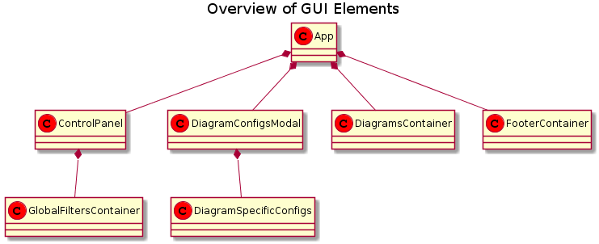
Front-End Design
Overview
Back-end
Front-end
Demo
Evaluation
Conclusion
17.04.2019

Slide 15
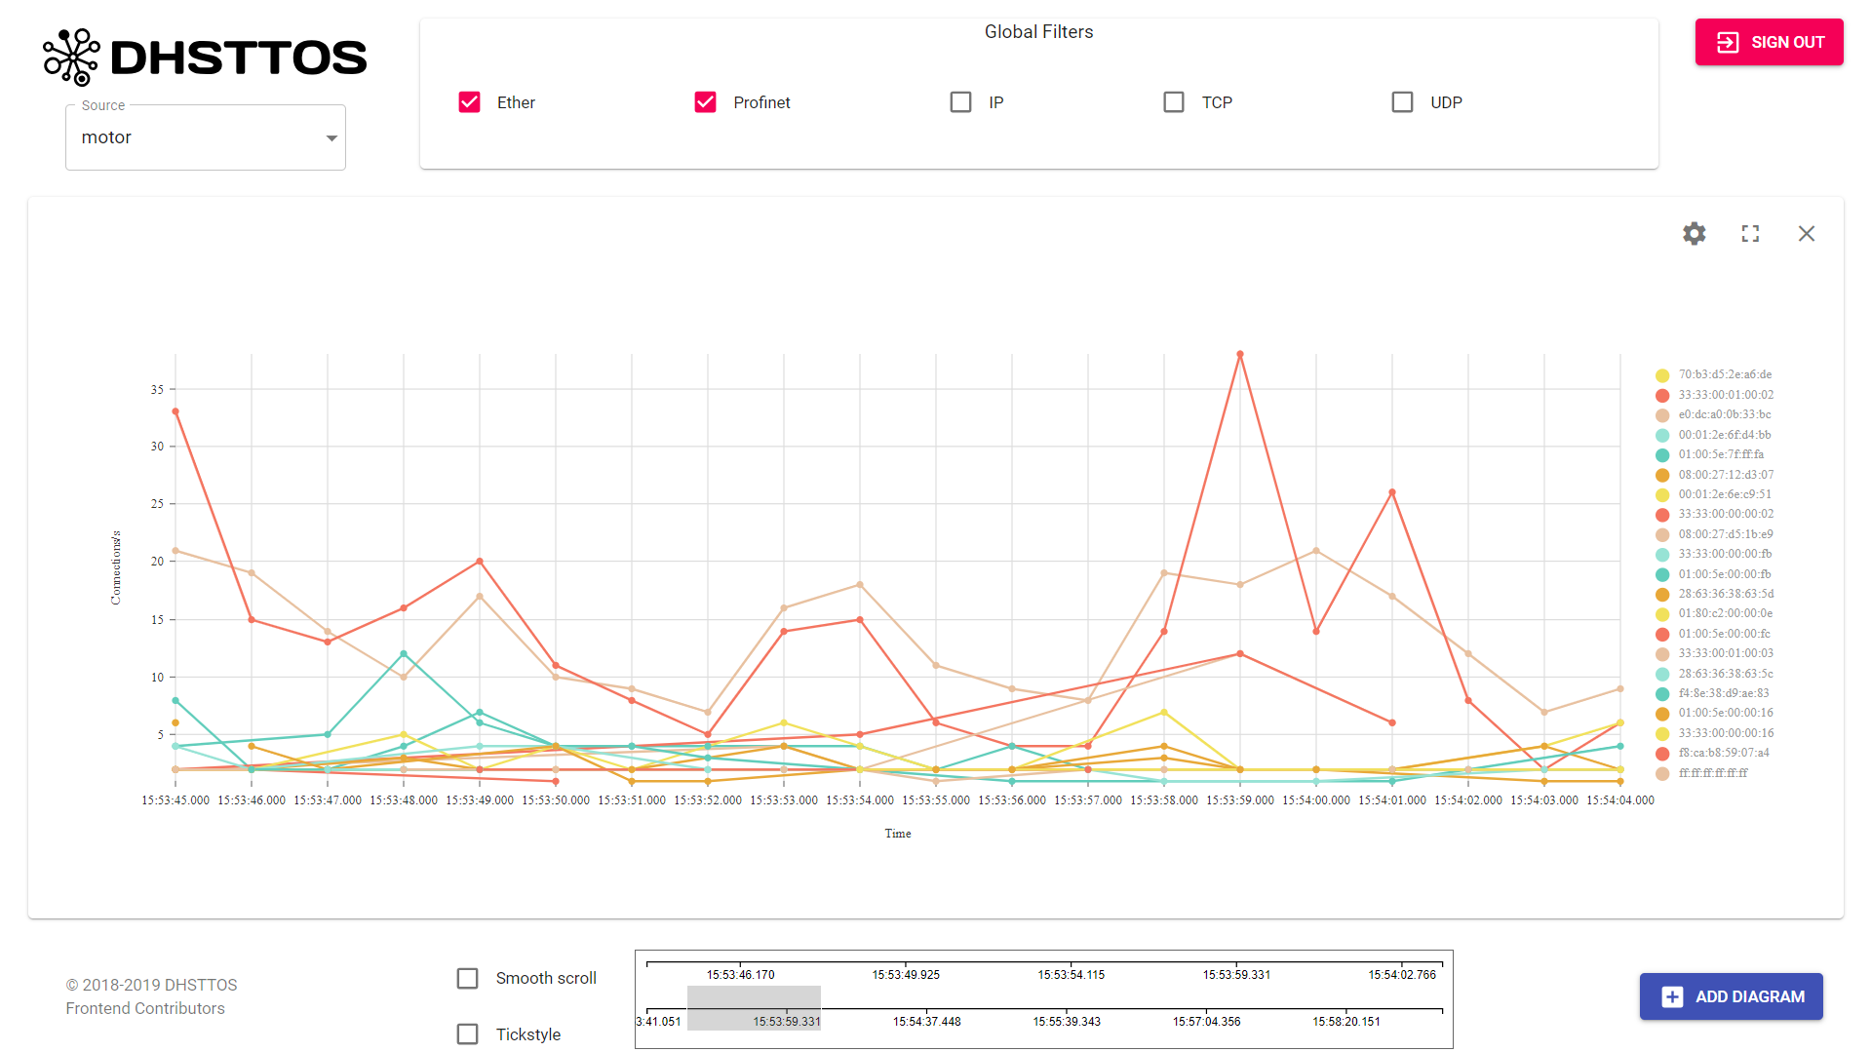
Front-End Design
Front-End Design
Control Panel
Diagrams Container
Footer Container
Overview
Back-end
Front-end
Demo
Evaluation
Conclusion
17.04.2019

Slide 16
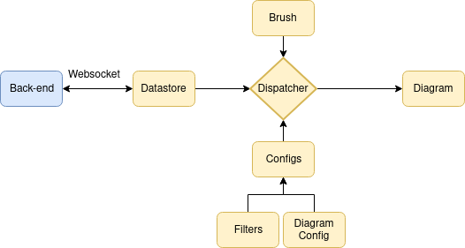
Front-End Data Flow
Overview
Back-end
Front-end
Demo
Evaluation
Conclusion
17.04.2019

Slide 17




Front-End Components
Written in Javascript
Additional third party components (open source):
  React library
  D3 graphics library
  nivo diagram components
  MobX state management
Overview
Back-end
Front-end
Demo
Evaluation
Conclusion
17.04.2019

Slide 18










Development Tools Used
Back-end development:
  Eclipse
  Maven
  Junit
Front-end development:
  Visual Studio Code
  Parcel.js
  Netlify (CD)
Common tools:
  Git
  GitHub
  Slack
  Latex
Overview
Back-end
Front-end
Demo
Evaluation
Conclusion
17.04.2019

Slide 19

Implementation
User access control
Data source selection
Multiple diagram types
Brushing
Modular structure
19 of 24 functional requirements
Node-link diagram (partial)
Filtering (partial)
Data selection
Display notifications
Overview
Back-end
Front-end
Demo
Evaluation
Conclusion
17.04.2019

Slide 20
Unexpected Difficulties and Challenges
Only four team members
Larger Scope than expected
Many different technologies
  Javascript and the libraries make use of multiple programming paradigms
  Complexity of D3
  Nivo components have inconsistent features
  MongoDB idiosyncracies
Overview
Back-end
Front-end
Demo
Evaluation
Conclusion
17.04.2019

Slide 21
Lessons Learned
Design more thoroughly
  Especially data structures and protocolls
Plan and schedule more strictly
Evaluate third party components more thoroughly
Waterfall model didn‘t work.
Overview
Back-end
Front-end
Demo
Evaluation
Conclusion
17.04.2019

Slide 22
Best Practices
Overall design was viable
Good commit practices
Frequent team communication
Flexibility
Learning from each other
Overview
Back-end
Front-end
Demo
Evaluation
Conclusion
17.04.2019

Slide 23
Conclusion
We produced a working system
Usable as a good and extensible base for future work
Underestimated the amount of work required
Gained experience with teamwork
Gained understanding of technologies
Overview
Back-end
Front-end
Demo
Evaluation
Conclusion
17.04.2019

