Slide 1
Real-time Visualization of Analyzed Industrial Communication Network Traffic
Notes:
Welcome, etc.
We are gonna go over the design of the whole system and talk about largely about the connection between the components.
The app design is essentially a mvc modeled app.
The sys. Is separated in 2, front- and back-end
Questions will be referred to the appropriate person. If I cannot answer them.

Slide 2
The Background
Industrial Network Security – want to understand the traffic
Analysis of the traffic
Real-time visualization to help the user understand
Incidents can be detected visually

Slide 3
The System
Network traffic is recorded
Traffic data is analyzed (dissected)
Data is fed to a streaming platform (Kafka)
A visualization tool displays data and analysis results

Slide 4

The System
Network traffic is recorded
Traffic data is analyzed (dissected)
Data is fed to a streaming platform (Kafka)
A visualization tool displays data and analysis results

Slide 5
Requirements
Functional Requirements
  200, 500, 900, filter
  12 Non-Functional Requirements
  15 Testcases

Slide 6
Architecture & Design
Client-Server Architecture
Back-End:
  Mediator pattern
  Strategy pattern
Front-End:
  Model-View-Controller
  Observer

Slide 7
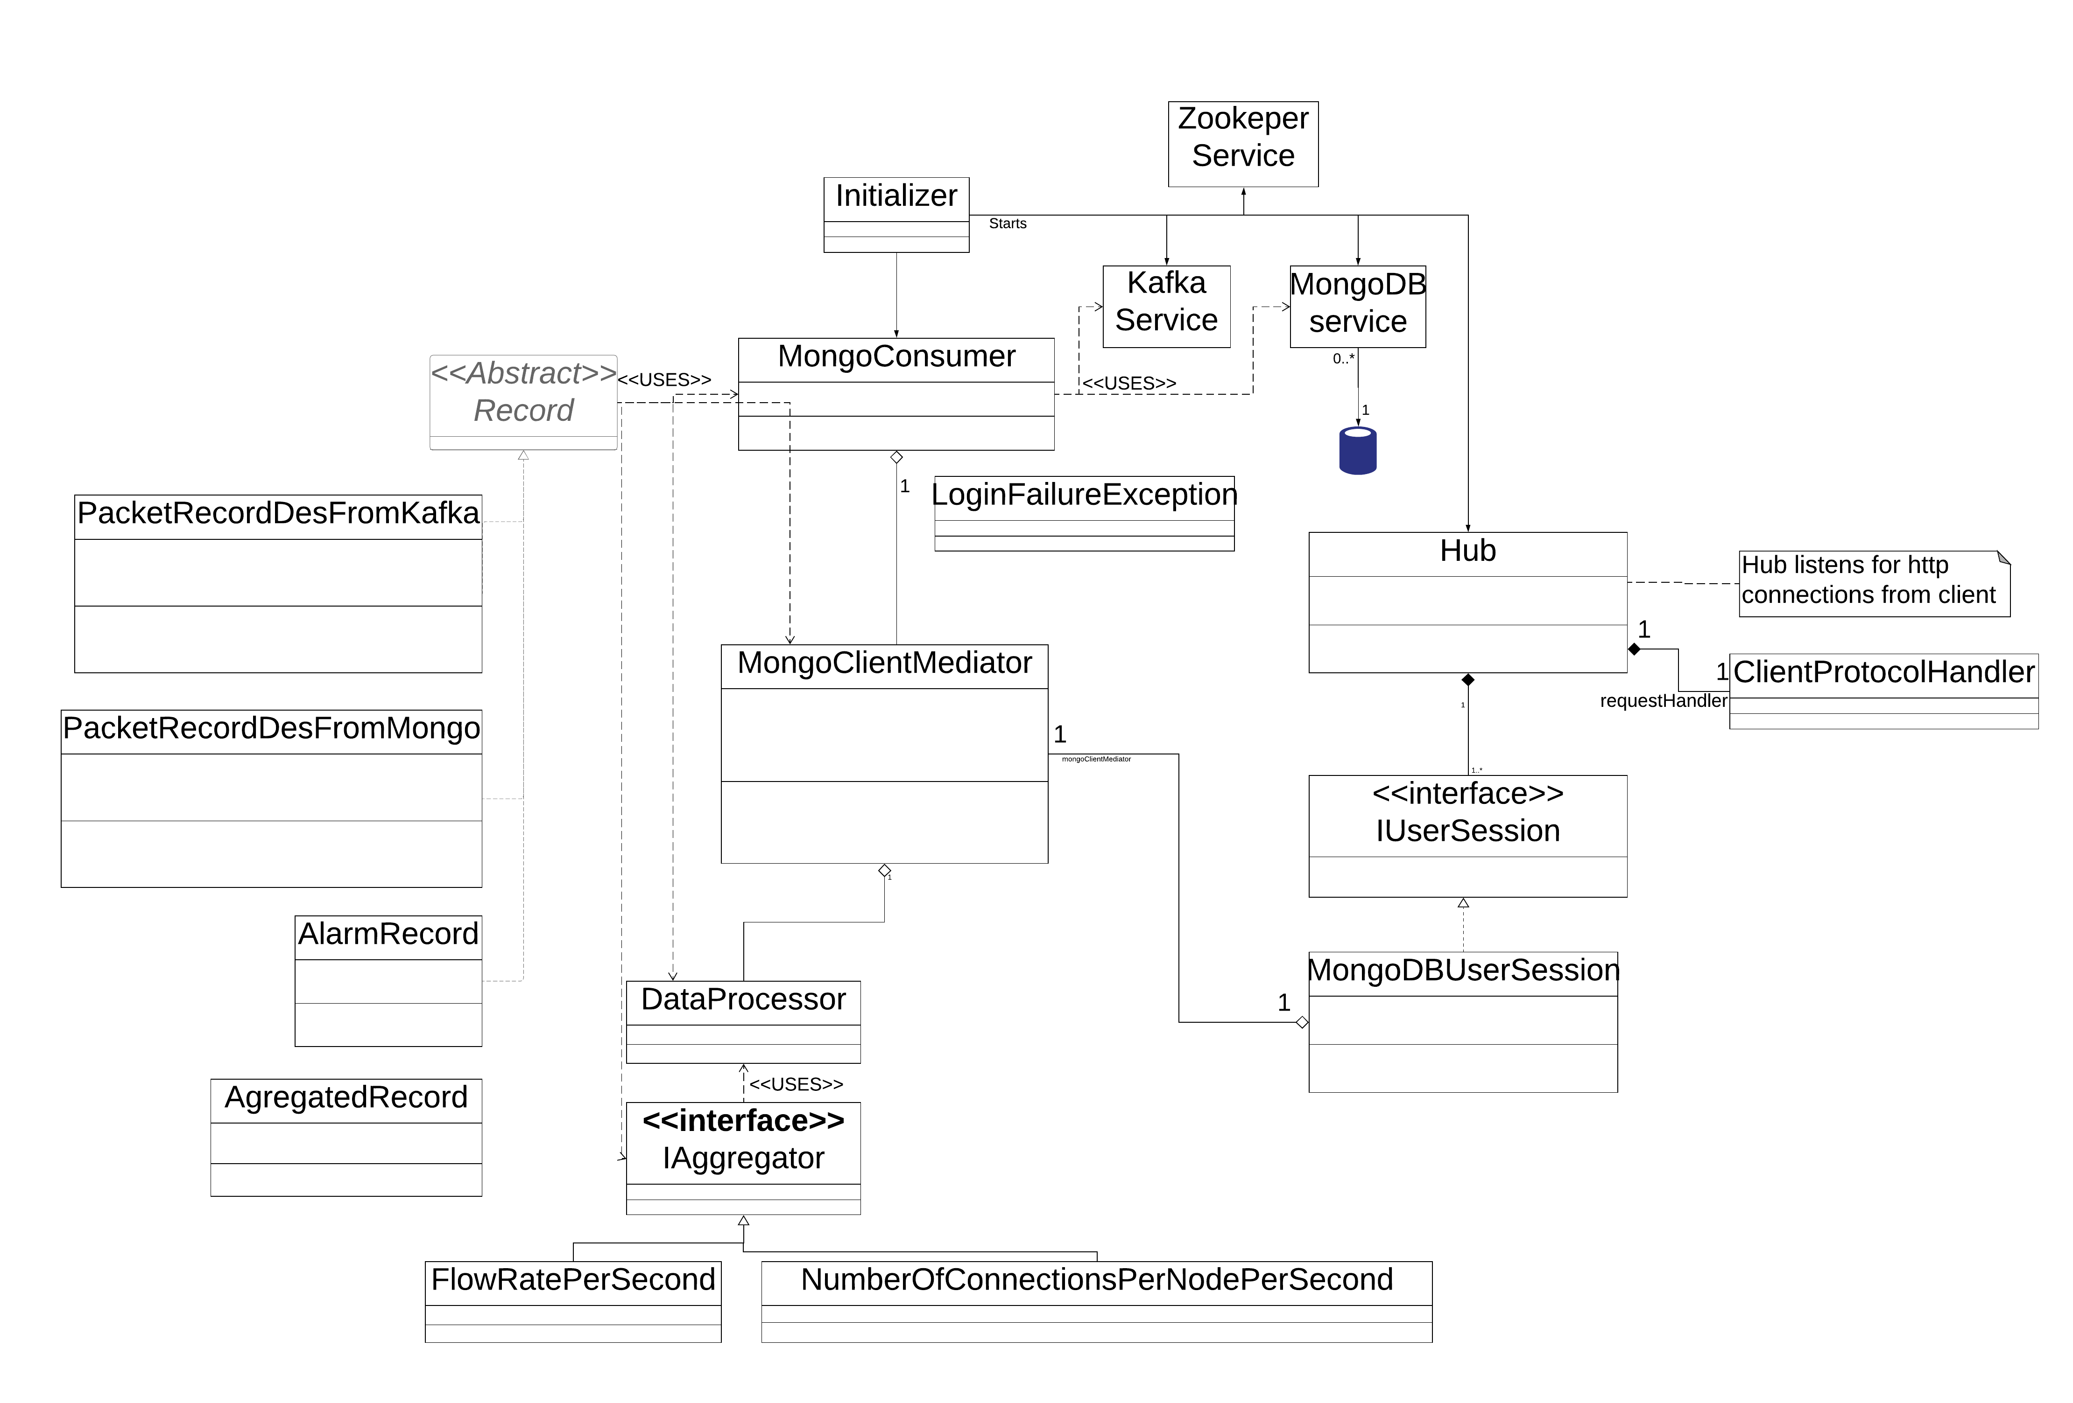
Back-end Design

Slide 8
Back-end components
Written in Java and using open source components
Kafka streaming server
MongoDB for both archived and
real-time data
Network hub realized as servlet running in Apache Tomcat
A Mediator component for the database accesses

Slide 9
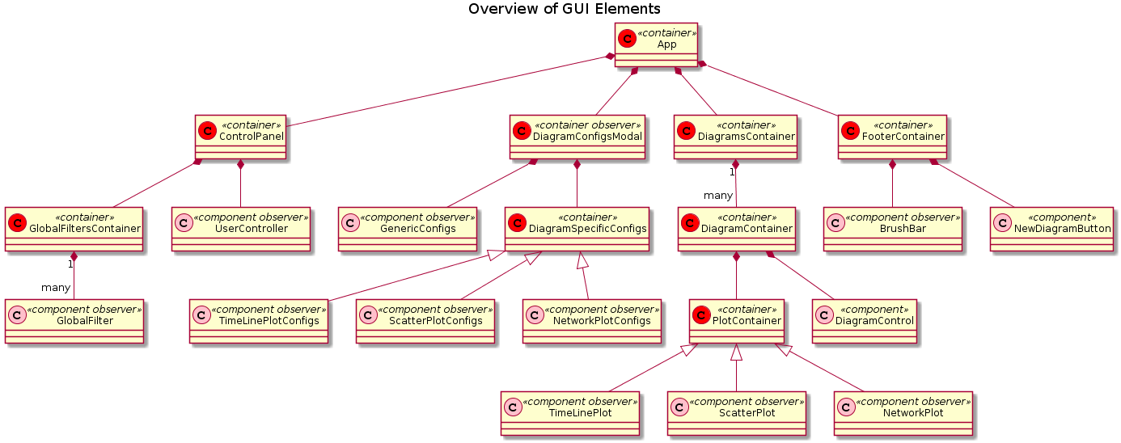
Front-end Design

Slide 10
Front-End Components
Written in Javascript
React library
D3 graphics library
nivo diagram components
MobX state management
All of the above are open source

Slide 11
Implementation
Tools for Back-end development:
  Eclipse
  Maven
  Junit
Tools for Front-end development:
  Visual Studio Code
  Netlify (CD)
Github
Latex

Slide 12
Implementation Summary
What‘s there, what‘s missing

Slide 13
Unexpected Difficulties
Javascript and its libraries are more functional oriented than OO
Complexity of D3
Nivo components have inconsistent features
MongoDB idiosyncracies
Notes:
Setup and manage a server for testing

Slide 14
Challenges
Only four team members
Many different technologies:
  Java, Javascript
  Kafka
  MongoDB
  React framework
  D3 graphics library
  Nivo graphics library

Slide 15
XXXXX Requirements fulfilled
„Must“ requirements:
  16 of 20 implemented
  1 dropped
„Should“ requirements
  3 of 4 implemented

Slide 16
Lessons Learned
Design more thoroughly
  Especially data structures
Plan and schedule more strictly
Waterfall model didn‘t work well
Notes:
re. design deficits: e.g.
- we hadn‘t settled on specific libraries/codeblocks to use
- lack of knowledge about javascript+React required network code to be switched from oo paradigm to more of a functional paradigm
Design was incomplete, imprecise →
More coordination/communication required → delays
Rework needed→ delays

Slide 17
Conclusion
We produced a partially working system
Usable as base for future work and extensions
Gathered experience with teamwork

