Slide 1

RCNN
Author: QChen
Date: Apr 11 2019
汇报人：第PPT

Slide 2
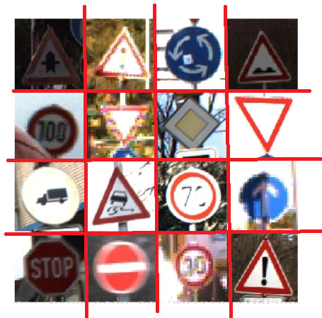
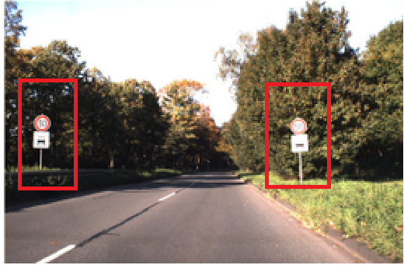
R-CNN
Object Detection Model
Object Recongnition
Object Detection

Slide 3
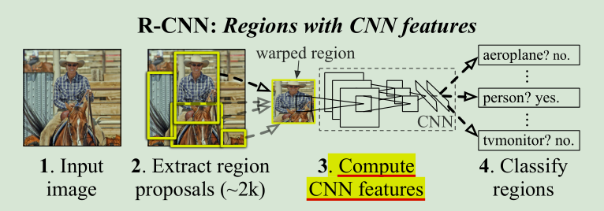
R-CNN
Object Detection Model
Rich feature hierarchies for accurate object detection and semantic segmentation

Slide 4
R-CNN
Sliding Window Approach
Five Convolutional Layer
Very Large Fields and Strides
2. Labeled Data is Scarce
supervised pre-training on a large auxiliary dataset (ILSVRC), followed by domain-specific fine-tuning on a small dataset (PASCAL)

Slide 5
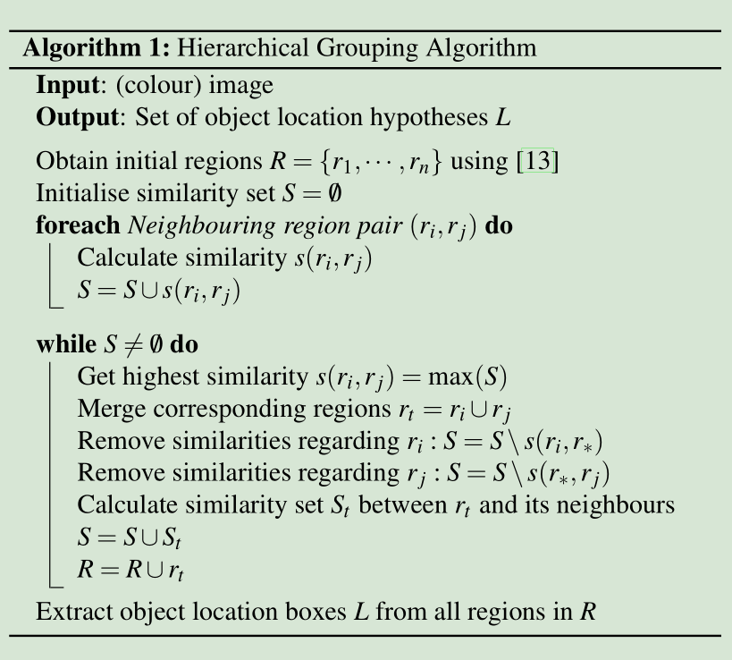
R-CNN
Sliding Window Approach
Region Proposal: Selective Search(1-2k)
objectness, category-independent object proposal, Constrained Parametric Min-cut
Efficient Graph-Based Image Segmentation
Image → graph
Minimun Spanning Tree
Selective Search for Object Recognition

Slide 6
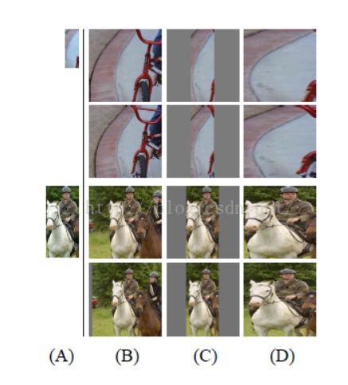
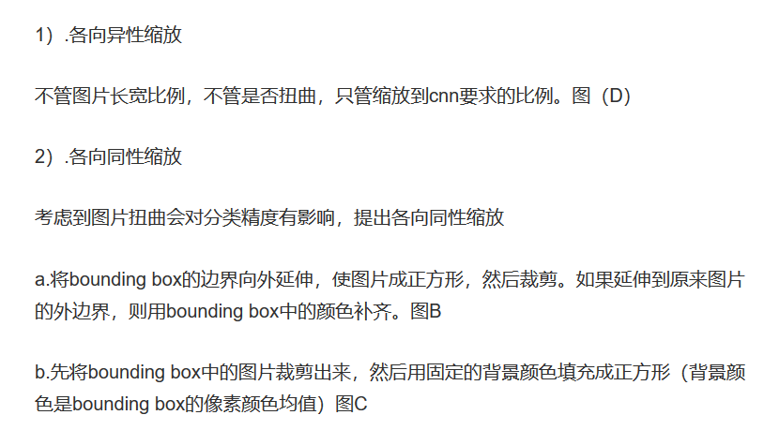
R-CNN
2. Compute CNN features
Extract fixed length feature vectors → AlexNet
(2) Determine Examples
(1) Affine Image Wrapping
IoU
Positive Example: IoU >= 0.5, 32
Negative Example: IoU < 0.5, 96

Slide 7
R-CNN
3. Region Classification
20 !!!
SVM ---------> VOL:20 + 1
IoU threshold 0.3
Positive Example: the ground-truth bounding boxes for each class
Negative Example: IoU < 0.3
In Appendix B we discuss why the positive and negative examples are defined differently in fine-tuning versus SVM training.

Slide 8
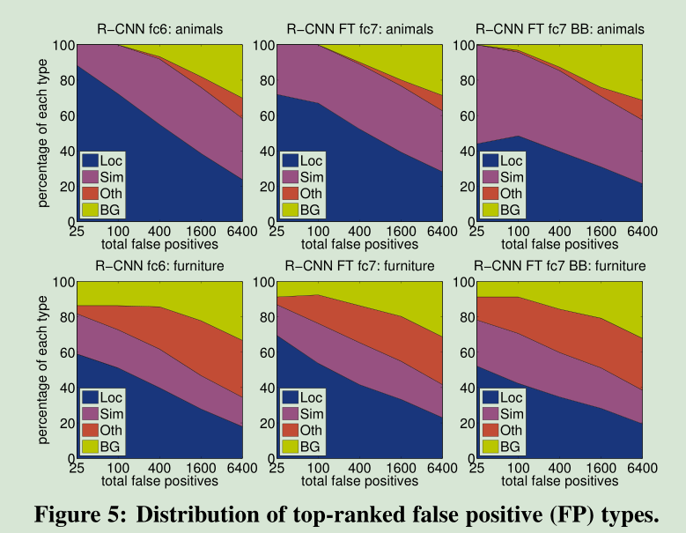
R-CNN
4. Detection error analysis
Loc—poor localization (a detection with an IoU overlap with the correct class between 0.1 and 0.5, or a duplicate);
Sim—confusion with a similar category;
Oth—confusion with a dissimilar object category;
BG—a FP that fired on background

Slide 9
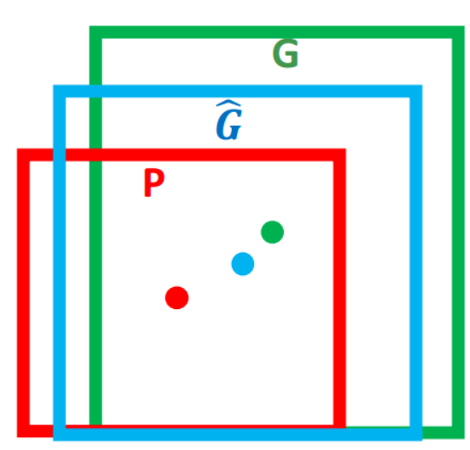
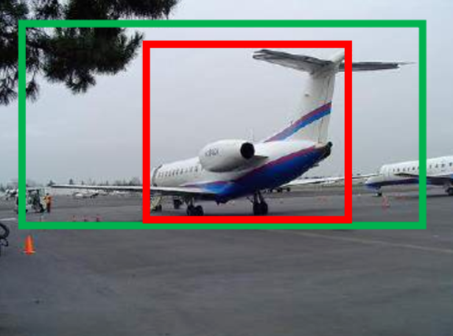

R-CNN
5. Bounding-Box Regression: Loaction
https://blog.csdn.net/qq_33254870/article/details/88877139
https://blog.csdn.net/qq_33254870/article/details/88887250

Slide 10
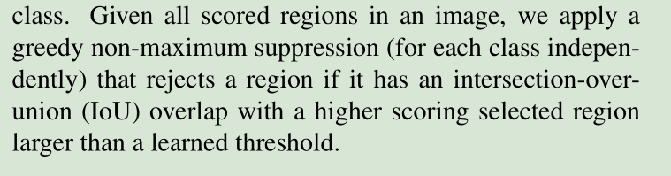
R-CNN
Further Discuss
1. How to train ?
Supervised pre-training
Domain-specific fine-tuning
Object category classifiers
2. How to test?

Slide 11
R-CNN
Advantages
1. DL Extract More Expressive Features
2. Region Proposal, Rather then Sliding Window
3. Bounding-Box Regression Improve Accuracy
Disadvantages
1. Region Repeat Compute
2. Not end-to-end Model: SS

