Slide 1
Review Dynamic CNN
Author: QChen
Date: June 19 2019
汇报人：第PPT

Slide 2
Dynamic CNN
Dynamic Deep Neural Networks
Dynamic Multi-path Neural Network
DYNAMIC NEURAL NETWORK CHANNEL EXECUTION FOR EFFICIENT TRAINING

Slide 3
Dynamic CNN
深度神经网络压缩与加速综述
1）参数剪枝
2）参数共享
3）低秩分解
4）紧性卷积核的设计
5）知识蒸馏

Slide 4
Dynamic CNN
不依赖于训练数据和反向传播，直接构建并排序权重的显著性矩阵，删除不显著冗余的节点，由于不依赖于训练数据及后向传播计算梯度信息，因此该网络剪枝过程较为快速。

Slide 5
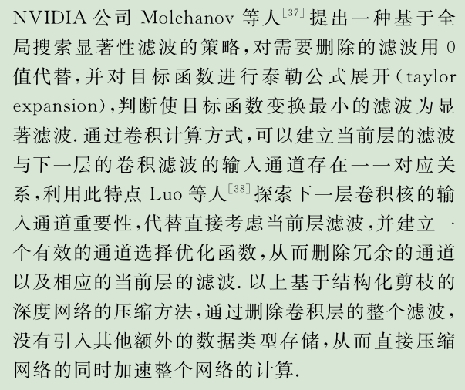
Dynamic CNN

Slide 6
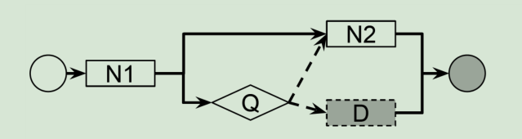
Dynamic CNN
Dynamic Deep Neural Networks
Optimizing Accuracy-Efficiency Trade-offs by Selective Execution
only a subset of neurons are executed
Notes:
与剪枝区别就是：这个 依赖于输入 决定是否执行节点，即选择性执行。
剪枝方法不依赖与输入，直接执行所有节点。
The proposed framework uses Q-learning to learn the parameters of control nodes that influence the computational path

Slide 7
Dynamic CNN
Dynamic Deep Neural Networks
(1) the decisions on selective execution are part of the network inference and are learned end to end together with the rest of the network, as opposed to hand-designed or separately learned
(2) DDNNs allow more flexible network architectures and execution sequences including parallel paths, as opposed to architectures with less variance
(3) our DDNNs directly optimize arbitrary efficiency metric that is defined by the user
(4) our method optimizes metrics such as the F-score that does not decompose over individual examples
Notes:
（3）其他方法鼓励稀疏激活
Attention models: However, hard attention models differ from D 2 NNs because hard attention models have typically involved only one attention module whereas DDNNs can have multiple attention (controller) modules

Slide 8
Dynamic CNN
Dynamic Deep Neural Networks
1. How to design controller?
2. How to train or learn?
Notes:
We call a function node a control node if its outgoing edges are control edges.
We call a function node a regular node if its outgoing edges are data edges.

Slide 9
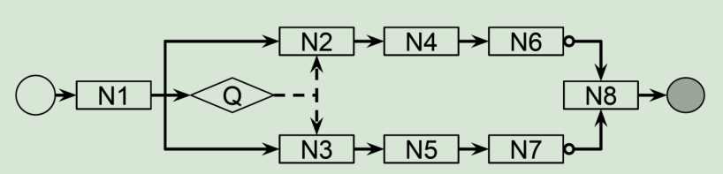
Dynamic CNN
Dynamic Deep Neural Networks
control nodes can cause the computation of some nodes to be skipped
a program with conditional statements
Notes:
control nodes: Q
The control edge with the highest score is “activated”
the node Q controls N2 and N3. Either N2 or N3 will execute depending on which has the higher control score

Slide 10

Dynamic CNN
Dynamic Deep Neural Networks
A DDNN is trained end to end.
That is, regular modules and control modules are jointly trained to
optimize both accuracy and efficiency.
The output of the network cannot be expressed as a differentiable function of all trainable parameters
control nodes outputs discretized into control decisions
-- reinforcement learning
Notes:
r is a user-defined reward, a is an action, s is the input to control node, and Q is computed by the control node.
we pick the action with the largest Q

Slide 11
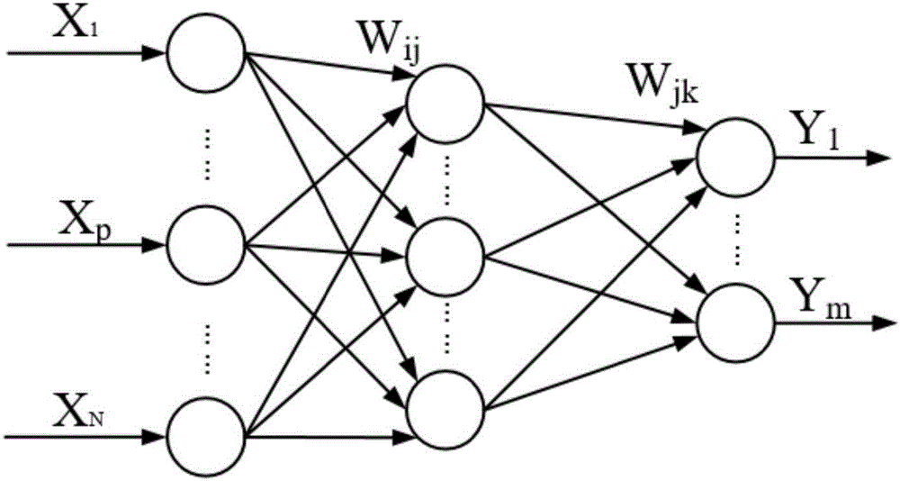
Dynamic CNN
Dynamic Deep Neural Networks

Slide 12
Dynamic CNN
Dynamic Multi-path Neural Network
There exists different emphasis on extracting feature among different channels and layers.
M. D. Zeiler and R. Fergus. Visualizing and understanding convolutional networks.
In European conference on computer vision, pages 818–833. Springer, 2014.

Slide 13
Dynamic CNN
Dynamic Multi-path Neural Network
we propose a novel method called Dynamic Multi-path Neural Network (DMNN), which provides more path selection choices in terms of network width and depth during inference.
Reconfiguring the inference path according to the input sample adaptively to meet a better accuracy-efficiency trade-off
Notes:
不同于以往模型压缩的方法在于：
以前的方法是在训练之后进行处理，而DMNN训练过程中进行channel选择。

Slide 14
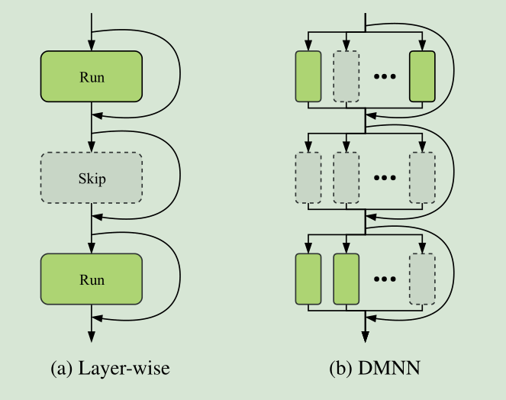
Dynamic CNN
Dynamic Multi-path Neural Network
Notes:
目前的方法：只能修改深度
这样做的缺点：
1）跳过的层中某些通道是有用的
2）剩余层的某些通道的信息可能是冗余的

Slide 15
Dynamic CNN
Dynamic Multi-path Neural Network
1. How to design controller?
We also carefully design the gate controller to take both
previous state information and object category into consideration
2. How to train or learn?

Slide 16
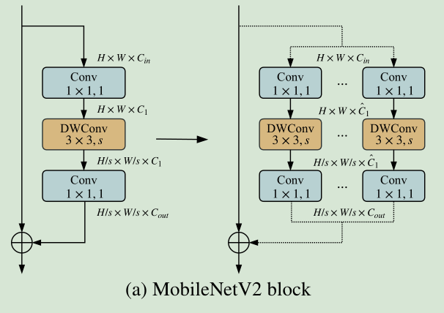
Dynamic CNN
Dynamic Multi-path Neural Network
Notes:
为什么要分block ?
因为一个channel对应一个controller会增加计算复杂度。
each sub-block has its switch to decide whether to execute or not,
resulting to a dynamic inference path for different samples

Slide 17
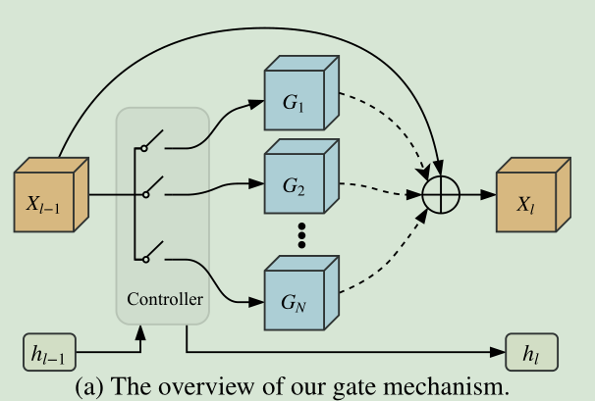
Dynamic CNN
Dynamic Multi-path Neural Network
Notes:
做 Identity connection 的目的是保持下一层channel至少和上一次相等

Slide 18
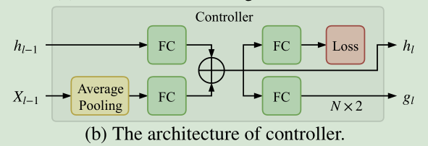
Dynamic CNN
Dynamic Multi-path Neural Network
Notes:
Spatial and previous state information（$h_{l−1}$） embedding

Slide 19

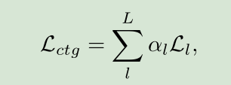
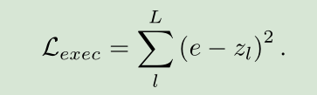

Dynamic CNN
Dynamic Multi-path Neural Network
Controller Loss
The total execution rate loss
The FLOPs loss
Notes:
Spatial and previous state information（$h_{l−1}$） embedding

Slide 20
Dynamic CNN
DYNAMIC NEURAL NETWORK CHANNEL EXECUTION
we propose a novel method which reduces the memory footprint and number of computing operations required for training and inference.
At each training step, we select only a subset of highly salient channels to execute according to the combinatorial upper confidence bound algorithm
Notes:
在训练过程中进行 通道剪枝 程序
与剪枝的区别在于：用强化学习的方法将反向传播融入到模型中进行选择性执行
与前两篇论文区别在于：不需要控制节点

Slide 21
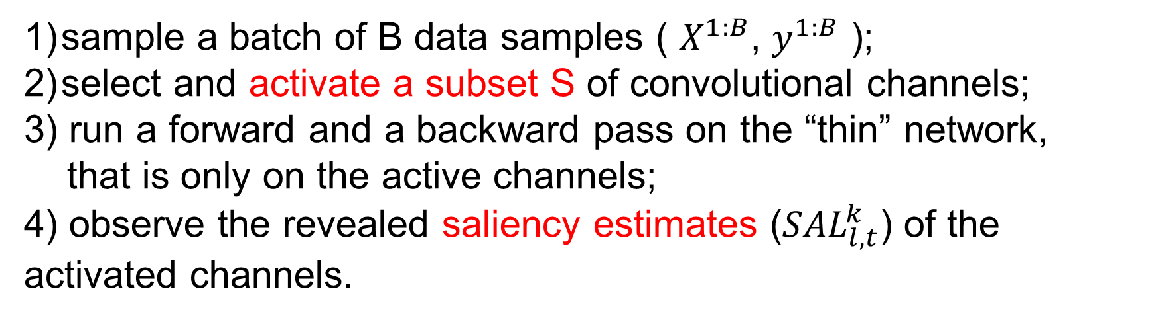
Dynamic CNN
DYNAMIC NEURAL NETWORK CHANNEL EXECUTION
In each training step t
sample a batch of B data samples ( $X^{1:B}$, $y^{1:B}$ );
select and activate a subset S of convolutional channels;
3) run a forward and a backward pass on the “thin” network,
that is only on the active channels;
4) observe the revealed saliency estimates (${SAL}_{l, t}^{k}$) of the activated channels.

Slide 22



Dynamic CNN
DYNAMIC NEURAL NETWORK CHANNEL EXECUTION
The saliency metric approximates the change in loss incurred
from removing a particular channel
$${ \hat{u}}_{l}^{k}$$
an empirical channel saliency mean
the number of times each channel has been activated
in all training steps so far
$$T_{l}^{k}$$
Notes:
经验的channel显著性均值${ \hat{u}}_{l}^{k}$
channel被激活次数 $T_{l}^{k}$
初始值由显著性指标计算得来

Slide 23
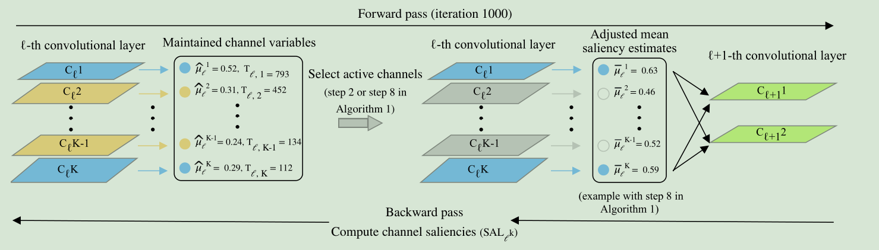
Dynamic CNN
DYNAMIC NEURAL NETWORK CHANNEL EXECUTION
Notes:
经验的channel显著性均值${ \hat{u}}_{l}^{k}$
channel被激活次数 $T_{l}^{k}$

Slide 24
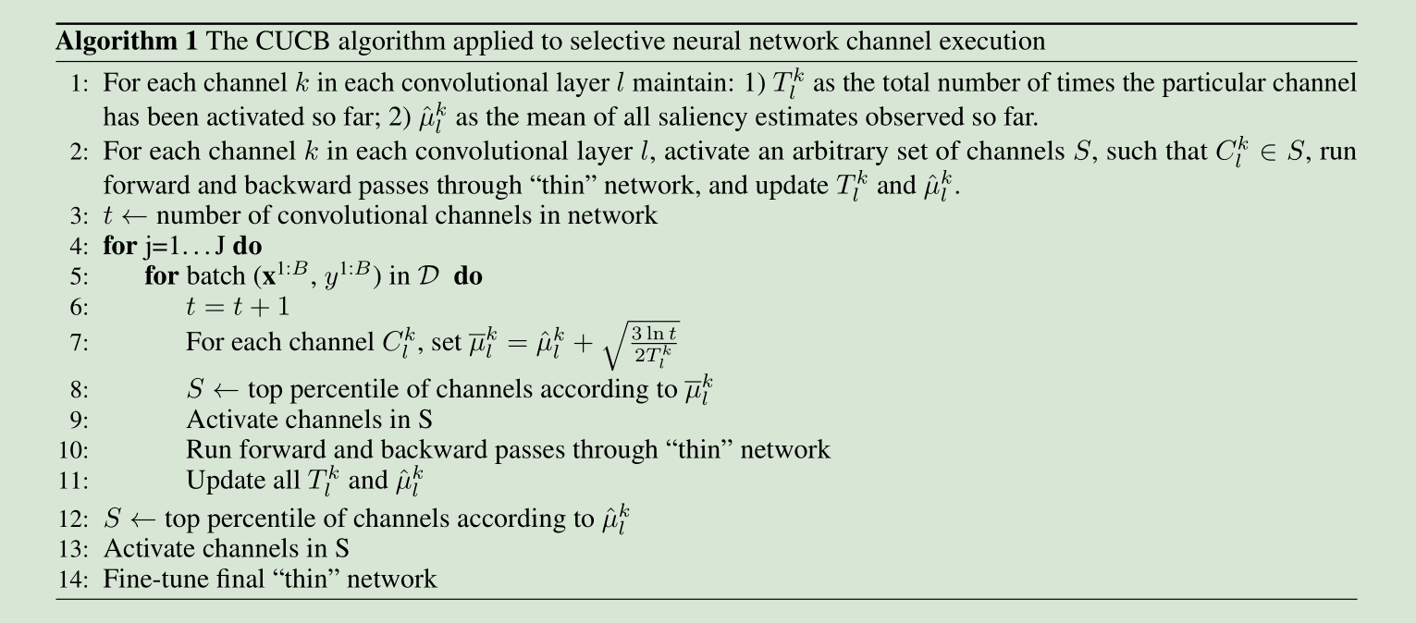
Dynamic CNN
DYNAMIC NEURAL NETWORK CHANNEL EXECUTION

Slide 25
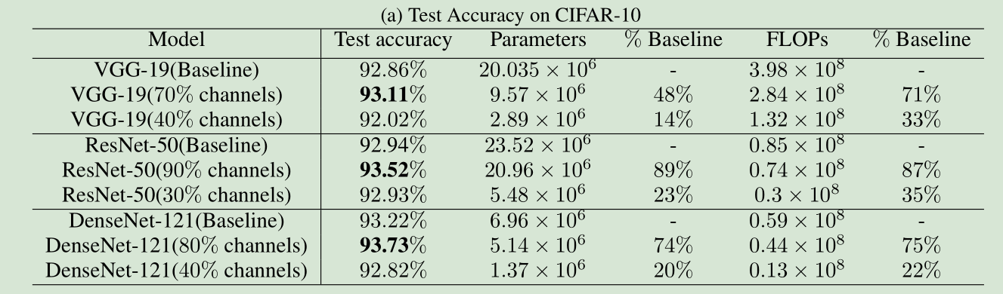
Dynamic CNN
DYNAMIC NEURAL NETWORK CHANNEL EXECUTION

Slide 26
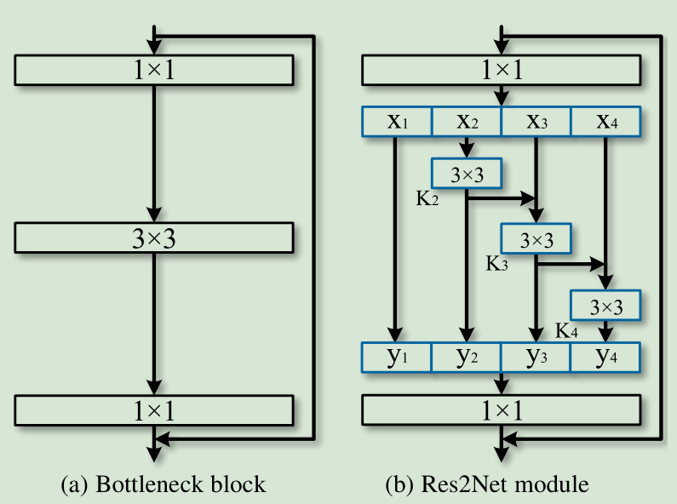
Dynamic CNN

Slide 27
Dynamic CNN
Hard Attention or Soft Attention？
Hard attention models only process the salient parts and discard others
(e.g. processing only a subset of image subwindows);
In contrast, soft attention models process all parts but up-weight the salient parts.

